Slide 1


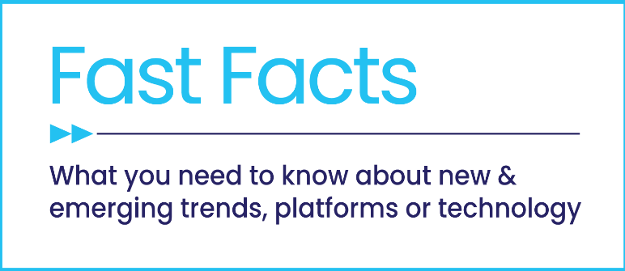

Staying Current on Streaming
The Latest on Connected TV Consumer Behaviors
June 2026

Slide 2




Four Key Consumer Behaviors on Streaming
1
2
Today’s streaming landscape gives consumers the flexibility to prioritize
their favorite content across services, supporting more intentional viewing
Streaming long-form content via shared, engaging experiences sparks passion, fuels conversation and fandom, and builds connection, loyalty and belonging
3
4
Streaming continues to shift towards
ad-supported models, driven by growing demand for value and affordability,
fueling rapid FAST growth
From targeting to interactivity to AI,
CTV is making ads more relevant,
more engaging and more effective
at driving consumer response
This information is exclusively provided to VAB members and qualified marketers.
PAGE 2

Slide 3

1
Today’s streaming landscape gives consumers the flexibility to prioritize their favorite content across services, supporting more intentional viewing

Slide 4
Audiences have 300+ standalone streaming services to choose from, even as recent consolidation has begun to slightly streamline the landscape
Source: Philo / Parks Associates, Unified Streaming: Unlocking Next-Gen Advertising.
This information is exclusively provided to VAB members and qualified marketers.
PAGE 4

Slide 5
Consumers are blending streaming and live TV into their viewing habits, with more than four in 10 audiences watching a steady mix of both
How Streamers Are Watching TV
41%
of streamers watch
a mix of streaming and live TV
41%
of streamers watch only streaming apps (i.e., Netflix, Prime Video)
18%
of streamers watch mostly streaming apps
Source: tvScientific, 2026 Consumer Trends Report. VAB analysis of tvScientific data based on universe of streamers.
This information is exclusively provided to VAB members and qualified marketers.
PAGE 5

Slide 6



Households subscribe to multiple streaming services, curating viewing across a selection each month to prioritize favorite content year-round
5.3
Average number of streaming services U.S. internet households subscribe to
2.8
Number of streaming apps Americans access per month*
Source: Philo / Parks Associates, Unified Streaming: Unlocking Next-Gen Advertising. *TVision, State of Streaming, February 2026.
This information is exclusively provided to VAB members and qualified marketers.
PAGE 6

Slide 7

The flexibility and control offered contribute to a strong streaming experience that is valued by almost all viewers
9 in 10
Viewers Are Satisfied With Their Streaming Experience
Source: FreeWheel, Voice of the Viewer: How Ad Experiences Impact Streaming for U.S. Viewers, 2026.
This information is exclusively provided to VAB members and qualified marketers.
PAGE 7

Slide 8



Content choice, convenience and consumer-friendly pricing are central to streaming’s appeal, shaping how viewers engage across services
Source: FreeWheel, Voice of the Viewer: How Ad Experiences Impact Streaming for U.S. Viewers, 2026.
This information is exclusively provided to VAB members and qualified marketers.
PAGE 8

Slide 9
The enjoyment of streaming extends beyond content itself, with long-form viewing shaped by bigger screens, comfort and shared experiences
51%
45%
42%
are streaming on a television or bigger screen
enjoy creating a comfortable environment when streaming
watch streaming content with family, friends or a partner
Source: Tubi, The Stream 2026: When Intention Becomes Attention, March 2026. Based on survey conducted by The Harris Poll of 2,500 respondents ages 18+ that stream video at least one hour a week and live in the United States.
This information is exclusively provided to VAB members and qualified marketers.
PAGE 9

Slide 10
2
Streaming long-form content via shared, engaging experiences sparks passion, fuels conversation and fandom, and builds connection, loyalty and belonging

Slide 11




Immersive, long-form video content creates stronger fandoms among all adults than even music or sports
Top Fandoms
% of respondents
Movies
TV Shows
Music
Sports Teams
44%
38%
34%
30%
Source: Tubi, The Stream 2026: When Intention Becomes Attention, March 2026. Based on survey conducted by The Harris Poll of 2,500 respondents ages 18+ that stream video at least one hour a week and live in the United States.
This information is exclusively provided to VAB members and qualified marketers.
PAGE 11

Slide 12

TV and movies capture deeper attention, creating streaming experiences where audiences are especially engaged
90%
of viewers say they are highly engaged while streaming TV and movies
Source: Tubi, The Stream 2026: When Intention Becomes Attention, March 2026. Based on survey conducted by The Harris Poll of 2,500 respondents ages 18+ that stream video at least one hour a week and live in the United States.
This information is exclusively provided to VAB members and qualified marketers.
PAGE 12

Slide 13


Long-form streaming content ignites widespread passion among adults of all ages, with especially strong enthusiasm across key demographics
“I love streaming TV shows”
% of streamers who agree
A18+
A18-24
A25-34
81%
82%
84%
A35-44
A45-54
A55+
84%
84%
76%
Source: VAB analysis of MRI-Simmons March 2026 Cord Evolution Study. Base = A18+ who have used any streaming service in the past 12 months.
This information is exclusively provided to VAB members and qualified marketers.
PAGE 13

Slide 14
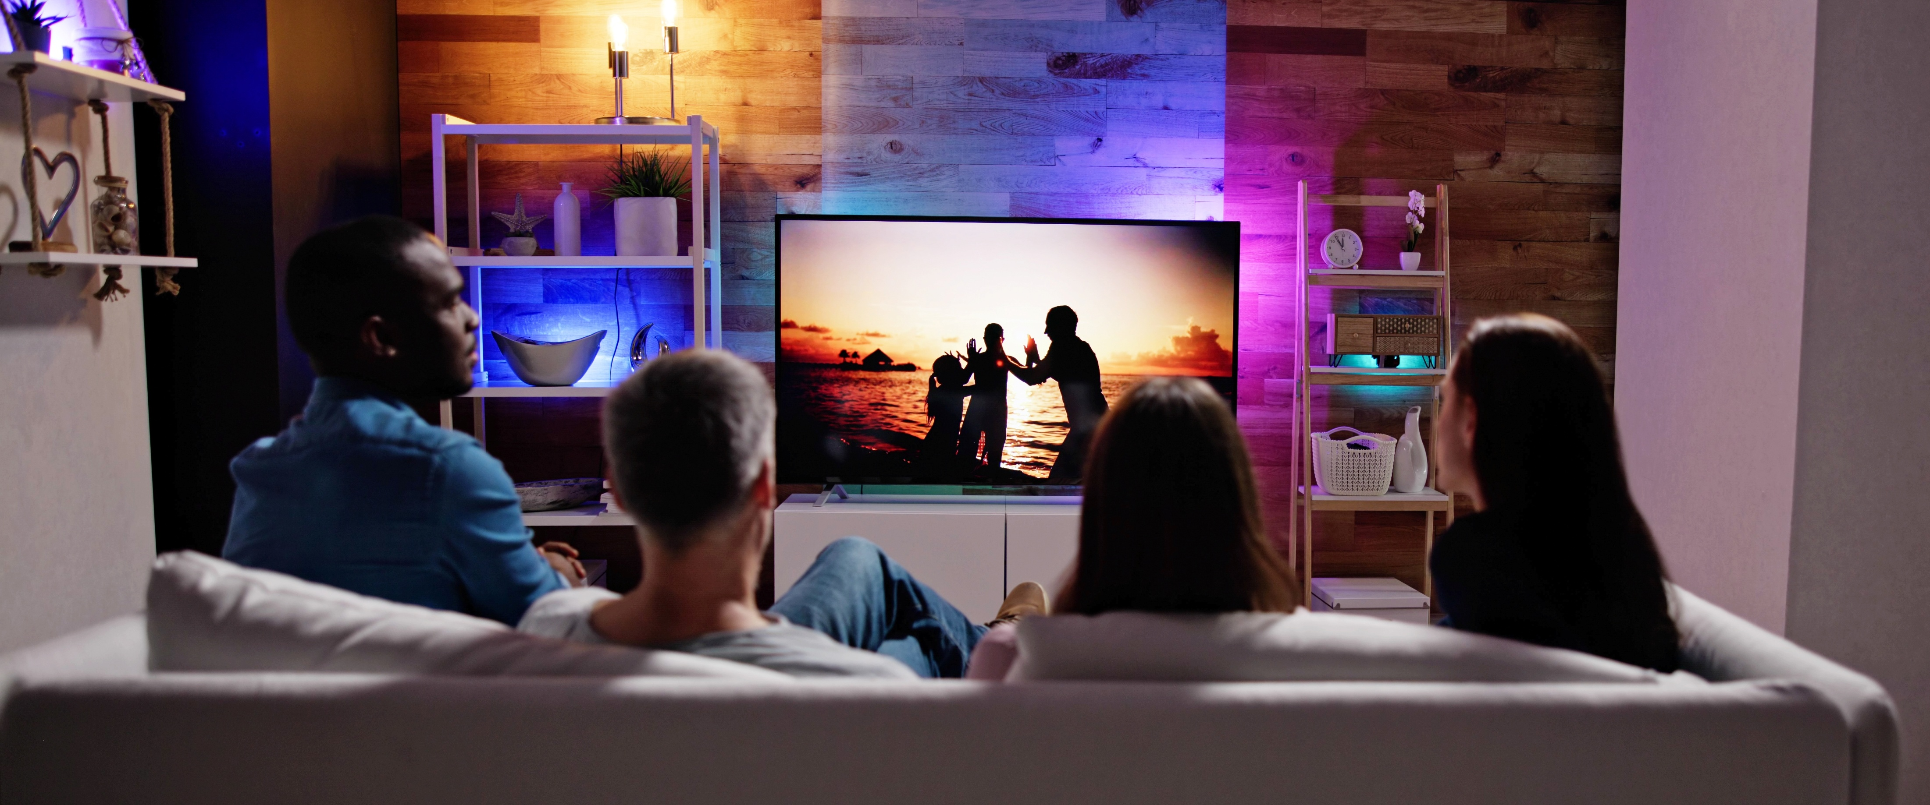
Time spent streaming is time well spent, bringing loved ones closer through shared moments of quality connection
% of Streaming Adults Who…
75%
52%
agree members of their household use streaming together as a form of quality time
(+4% YoY)
are watching with other people they don’t live with, like going to a friend’s house
(+15% YoY)
Source: Tubi, The Stream 2026: When Intention Becomes Attention, March 2026. Based on survey conducted by The Harris Poll of 2,500 respondents ages 18+ that stream video at least one hour a week and live in the United States.Download ‘Rising Tides: 26 Streaming Insights That Are Impacting Marketing Plans in 2026’ for streaming trends.
This information is exclusively provided to VAB members and qualified marketers.
PAGE 14

Slide 15
The long-form video content that people love watching together becomes social currency, fueling what they share online and talk about with friends
% of streamers who agree with the following statements
Source: VAB analysis of MRI-Simmons March 2026 Cord Evolution Study. Base = A18+ who have used any streaming service in the past 12 months.
This information is exclusively provided to VAB members and qualified marketers.
PAGE 15

Slide 16

Connection builds loyalty, with audiences sticking with platforms that consistently show up for the content and communities they care about
74%
of viewers are loyal to streaming services that support their fandoms
Source: Tubi, The Stream 2026: When Intention Becomes Attention, March 2026. Based on survey conducted by The Harris Poll of 2,500 respondents ages 18+ that stream video at least one hour a week and live in the United States.
This information is exclusively provided to VAB members and qualified marketers.
PAGE 16

Slide 17

That sense of community deepens when discovery feels personal, with audiences feeling seen as platforms help them find new fandoms
68%
say they feel seen when a streaming service helps them find their newest fandom and niche
73%
report that streaming services make them feel seen when they suggest ‘new-to-me’ content from genres or creators I already love
Source: Tubi, The Stream 2026: When Intention Becomes Attention, March 2026. Based on survey conducted by The Harris Poll of 2,500 respondents ages 18+ that stream video at least one hour a week and live in the United States.
This information is exclusively provided to VAB members and qualified marketers.
PAGE 17

Slide 18
3
Streaming continues to shift towards ad-supported models, driven by growing demand for value and affordability, fueling rapid FAST growth

Slide 19
Viewers are gravitating toward ad-supported streaming, favoring access and variety as it becomes a central part of how they watch and engage
Change in Streaming Time by App Type: Q4 ‘25 vs. Q4 ‘24
All Streaming
Ad-Supported Streaming
Ad-Free Streaming
+7%
+24%
-26%
Source: Samsung Ads, State of CTV 2026. Samsung Proprietary ACR – Includes Active TVs in the quarter. Streaming is viewership in Smart Hub (including Samsung TV Plus) with a minimum of 1 minute of consecutive app viewership. AVOD includes all ad-supported streaming minutes and SVOD includes all ad-free streaming minutes inclusive of hybrid apps that offer both ad-supported and ad-free tiers.
This information is exclusively provided to VAB members and qualified marketers.
PAGE 19

Slide 20
Ad-supported viewing is a common part of the experience for many, with most paid subscribers using services with some level of ads
Do the services you subscribe to, or have access to, have ads?
% of paid streaming subscriber respondents
89% of viewers use services with ads
Source: FreeWheel, Voice of the Viewer: How Ad Experiences Impact Streaming for U.S. Viewers, 2026. FreeWheel survey conducted by Dynata, n= 800. Base: U.S. Adults 18+ who have watched video content (excluding social media) in the past 3 months and subscribe to/have access to paid streaming or FAST in their household.
This information is exclusively provided to VAB members and qualified marketers.
PAGE 20

Slide 21
Ad-supported streaming combines value with a balanced viewing experience, where natural breaks create a comfortable pace for audiences
61%
41%
40%
of AVOD subscribers selected a plan with ads when they signed up for the service
cite the cost savings in exchange for ads as a benefit
say they like having a break during content
Source: FreeWheel, Voice of the Viewer: How Ad Experiences Impact Streaming for U.S. Viewers, 2026.
This information is exclusively provided to VAB members and qualified marketers.
PAGE 21

Slide 22
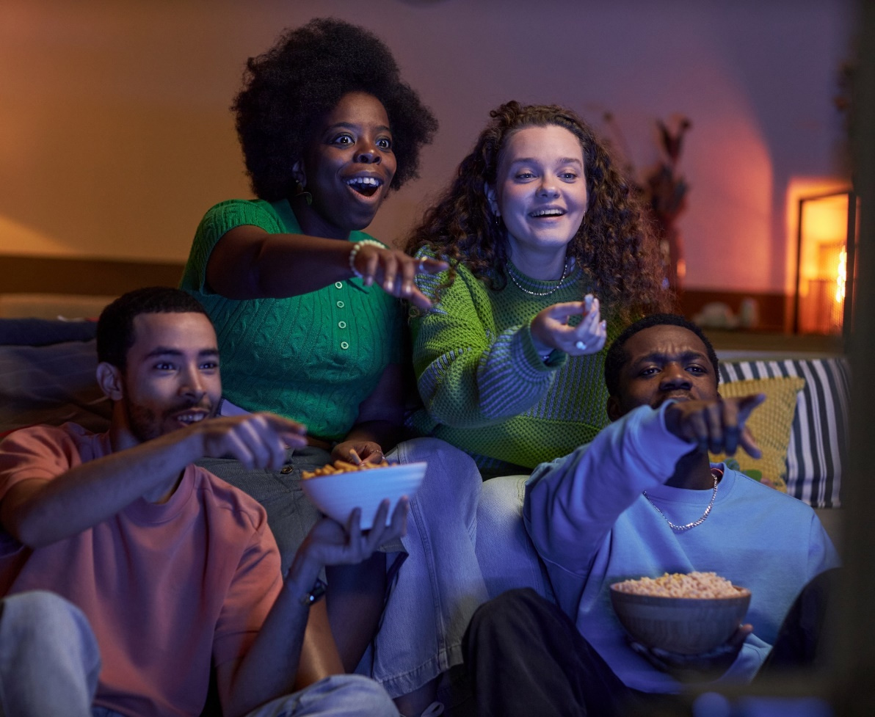
To balance rising costs, viewers are prioritizing value, increasingly choosing free, ad-supported services as a flexible way to keep watching
‘I prefer streaming free video content with ads / commercials instead of paying for a subscription without ads / commercials’
% of video streamers that agree
Source: VAB analysis of MRI-Simmons March 2025 & March 2026 Cord Evolution Study, A18+. ‘I prefer streaming free video content with ads/commercials instead of paying for a subscription without ads/commercials’ (strongly / somewhat agree). Base = ‘Streamed in the past 12 months’. Download ‘Rising Tides: 26 Streaming Insights That Are Impacting Marketing Plans in 2026’ for streaming trends.
This information is exclusively provided to VAB members and qualified marketers.
PAGE 22

Slide 23
FAST channels and households have quickly scaled in tandem, highlighting strong growth in audience adoption and available content
Total U.S. FAST Channels
Estimated Active U.S. FAST Households
In Millions
4X
vs. 2020
2.5x
vs. 2020
Source: Luminate Intelligence, The State of FAST, 2026. FASTMaster Intelligence Estimates.
This information is exclusively provided to VAB members and qualified marketers.
PAGE 23

Slide 24
FAST is watched across all groups, but engagement builds with age, peaking among older adults who spend the most time with these channels
Source: Luminate Intelligence, The State of FAST, 2026. Reach3 Insights, FASTMaster Q4 2025 Study (n=1,956 adults 18-64 using at least one FAST service at least weekly).
This information is exclusively provided to VAB members and qualified marketers.
PAGE 24

Slide 25
FAST channel growth is being fueled by unscripted content like reality, lifestyle and game shows, meeting demand for easy, always-on viewing
Source: Luminate Intelligence, The State of FAST, 2026. Reach3 Insights, FASTMaster Intelligence Analysis. Note: Channel had to be available on at least one tracked service in each year; Tracked services include LG Channels (2024-26), Peacock (2022-26), Prime Video / Freevee (2022-2026), Roku Channel (2020-26), Samsung TV Plus (2020-26), Tubi (2022-26), Vizio WatchFree+ (2022-26), Xumo (2020-26).
This information is exclusively provided to VAB members and qualified marketers.
PAGE 25

Slide 26
4
From targeting to interactivity to AI, CTV is making ads more relevant, more engaging and more effective
at driving consumer response

Slide 27
Smarter CTV targeting is improving the ad experience, making ads feel less intrusive and more relevant while driving stronger engagement
Consumer Sentiment Towards Targeted CTV Ads vs. Untargeted Ads
64%
+23%
less likelihood of feeling overwhelmed by ads
+20%
higher likelihood to interact with a CTV ad
of users find targeted CTV ads to be acceptable
+13%
higher likelihood of being interested in finding out more
Source: LG Ad Solutions / MediaScience, The Art & Science of The CTV-First Era – Part 2: Consumer Experience, 2026.
This information is exclusively provided to VAB members and qualified marketers.
PAGE 27

Slide 28

Interactive CTV ads turn viewers into participants, doubling engagement and significantly boosting brand recall
Interactive Ads Drive Deeper Engagement
2X
Higher engagement than
non-interactive ads
+138%
Higher unaided recall than non-interactive ads
Source: LG Ad Solutions / MediaScience, The Art & Science of The CTV-First Era – Part 2: Consumer Experience, 2026.
This information is exclusively provided to VAB members and qualified marketers.
PAGE 28

Slide 29
Viewers of long-form streaming content have an appetite for interactive TV and are likely to take action to learn more or make a purchase
Source: Philo / Parks Associates, Unified Streaming: Unlocking Next-Gen Advertising. Based on vMVPD subscribers. *% likely to take action (Based on rating 5-7 on a 7-pt. scale).
This information is exclusively provided to VAB members and qualified marketers.
PAGE 29

Slide 30

Building on a demand for relevance, viewers are increasingly receptive to AI in streaming, especially when it helps shape the ads they see
66%
Say they are open to AI deciding which ads are shown during the content
50%
Say they are open to AI being used to create the ads they see during the content
Source: FreeWheel, Voice of the Viewer: How Ad Experiences Impact Streaming for U.S. Viewers, 2026.
This information is exclusively provided to VAB members and qualified marketers.
PAGE 30

Slide 31
Viewers see clear value in AI, especially features that enhance discovery, deepen engagement and deliver more relevant ads
Source: Philo / Parks Associates, Unified Streaming: Unlocking Next-Gen Advertising. Based on vMVPD subscribers. *% rating feature appealing (Based on rating 5-7 on a 7-pt. scale).
This information is exclusively provided to VAB members and qualified marketers.
PAGE 31

Slide 32


The modern viewing experience is increasingly curated, with audiences mixing streaming services and live TV to maximize choice, value and enjoyment
Streaming has become more intentional and immersive through long-form content, centered on the big screen, shared viewing and high engagement that drives deeper connection and cultural conversation
Ad-supported streaming is now foundational, with near-universal adoption and growing preference for value-driven, flexible viewing experiences
Innovation is elevating the ad experience, as targeting, interactivity and AI make ads more relevant, engaging and effective within a Premium Video environment
Key Marketer Takeaways
This information is exclusively provided to VAB members and qualified marketers.
PAGE 32

Slide 33
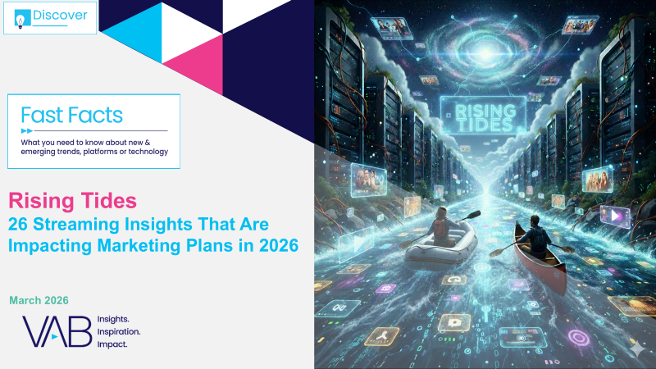
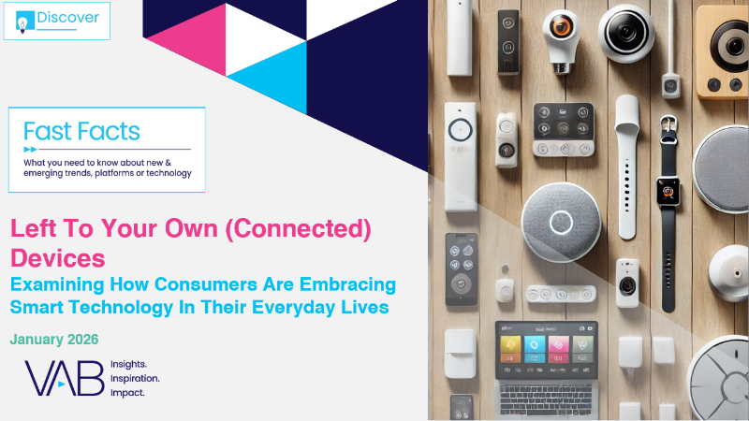
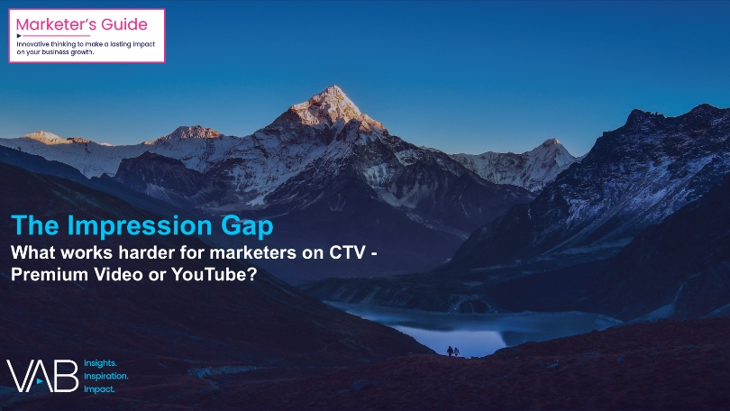
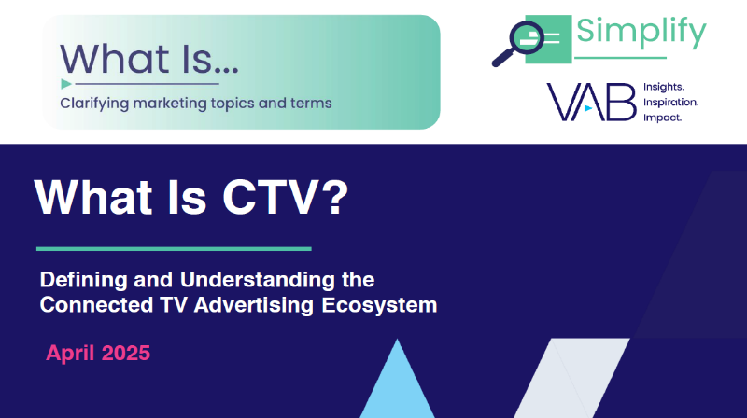
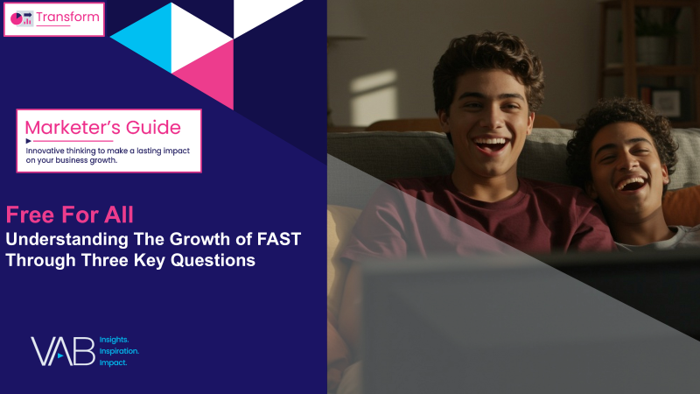
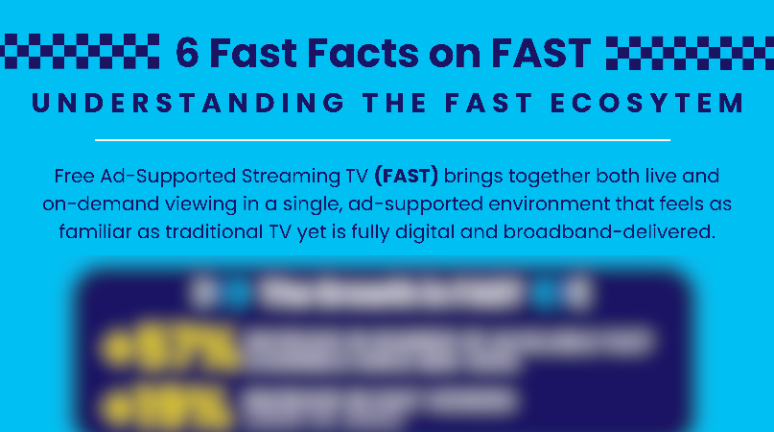

Creators
Jason Wiese
Leah Pujalte
EVP, Strategic Insights & Measurement
jasonw@thevab.com
VP, Audience & Behavioral Insights
leahm@thevab.com
Rising Tides
26 Streaming Insights That Are Impacting Marketing Plans in 2026
Left To Your Own (Connected) Devices Examining How Consumers Are Embracing Smart Technology In Their Everyday Lives – Jan ‘26
Discover more
Looking for more data, insights and takeaways? Check out this related VAB content
Visit our Streaming Video Resources Hub
for the latest consumption stats, trends and advertising opportunities.
The Impression Gap
What works harder for marketers on CTV – Premium Video or YouTube?
What Is Connected TV?
Defining and Understanding the Connected TV Advertising Ecosystem
Free for All
Understanding the Growth of FAST Through Three Key Questions
6 Fast Facts on FAST
Understanding the FAST Ecosystem
(Infographic)
VAB Members, brand marketers and agencies get free and immediate access to VAB’s content library. Get access at theVAB.com
This information is exclusively provided to VAB members and qualified marketers.
PAGE 33

Slide 34


About VAB
VAB plays a dual role in the video advertising industry. We are leading the change to bring about a more innovative and transparent marketplace. We also provide the insights and thought leadership that enables marketers to develop business-driving marketing strategies.
Drawing on our marketing expertise, we simplify the complexities in our industry and discover new insights that transform the way marketers look at their media strategy.
We are committed to your business growth and proud to offer VAB members, brand marketers and agencies complimentary access to our continuously-growing Insights library. Get immediate access at theVAB.com.
This information is exclusively provided to VAB members and qualified marketers.
PAGE 34

