Slide 1



2024 – 4th Quarter

Slide 2


About VAB
VAB plays a dual role in the video advertising industry. We are leading the change to bring about a more innovative and transparent marketplace. We also provide the insights and thought leadership that enables marketers to develop business-driving marketing strategies.
Drawing on our marketing expertise, we simplify the complexities in our industry and discover new insights that transform the way marketers look at their media strategy.
We are committed to your business growth and proud to offer VAB members, brand marketers and agencies complimentary access to our continuously-growing Insights library. Get immediate access at theVAB.com.
This information is exclusively provided to VAB members and qualified marketers.
PAGE 2

Slide 3
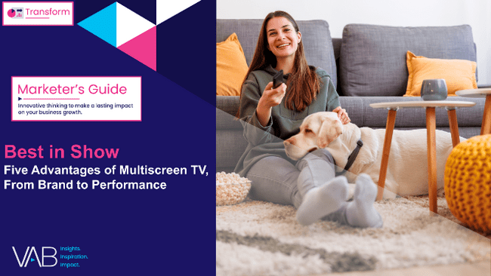





Generating brand interest: Multiscreen TV drive more search queries than a mobile-first campaign strategy
Click here for the full report
Search Intent
Based on Order of Exposure within Full Media Mix
Source: Spectrum Reach and Magna, Ad Mix Synergy, 2022. Note: Order of Exposure within full media mix, delta (exposed – control) frequency exposure =3. Q: How likely are you to search for information about the following brands of [brand]?
↑ indicates statistical significance between exposed and control groups at >=90% confidence level. Sample sizes: Linear TV Only (control n=222; exposed n=222); CTV Only (control n=217; exposed n=217); Mobile Only (control n=256; exposed n=256); Linear + CTV (control n=247); exposed n=247); Linear + Mobile (control n=212; exposed n=212); CTV + Mobile (control n=260); exposed n=260); Linear TV + CTV + Mobile (control n=270); exposed n=270).
This information is exclusively provided to VAB members and qualified marketers.
PAGE 3

Slide 4
Trust in media: Consumers trust multiscreen TV the most and are four times more likely to trust TV over social media
Click here for the full report
TV is the #1 trusted media platform among adults, and they are…
“Trust is very for brand marketing. It’s the driver for purchasing behavior for most consumers. A lot of the time, trust is going to play a different role in the relationships consumers have with brands.” important
4x
over 4x more likely to trust TV
vs. social media
- Matt Prince, Head of PR, Taco Bell
Taco Bell’s Matt Prince on how trust ties brands to new consumers, WARC, 9/24/24
Source: VAB analysis of MRI-Simmons Spring 2024 USA Study, A18+. Q: What is the media you trust the most? (pick one: TV, radio, podcasts, mobile internet, internet on computer, social media, magazines, newspapers).
This information is exclusively provided to VAB members and qualified marketers.
PAGE 4

Slide 5


Igniting customer action: DTC brands achieve significant lifts in website traffic from their first multiscreen TV campaign launch
Click here for the full report
83 ‘Direct-to-Consumer’ Brands Analysis: Average Monthly Website Unique Visitors
Monthly Website Unique Visitors (000) Comparison
based over a four-year time period: Apr ‘20 – Apr ‘24
+50%
+28%
+1.1MM
monthly uniques
+619K
monthly uniques
vs. six months average prior to TV launch
vs. six months average prior to TV launch
(monthly average)
(TV launch – April 2024)
Source: VAB analysis of Comscore mediametrix multiplatform media trend data, P18+. April 2020 – April 2024 (calendar months), figures are based on monthly averages for the 83 brands analyzed. VAB analysis of Nielsen Ad Intel, TV activity based on reported spending across national cable TV, national broadcast TV, Spanish language broadcast TV, Spanish language cable TV, spot TV, syndication TV. ‘When On TV’ represents the monthly average for brands in months where they spent in TV as measured through Nielsen Ad Intel between January 2021 – April 2024 (calendar months), across the 83 brands analyzed. Note: Direct-to-Consumer is defined by the company’s ability to sell their product directly to end customers without third-party retailers, wholesalers or other middlemen.
This information is exclusively provided to VAB members and qualified marketers.
PAGE 5

Slide 6
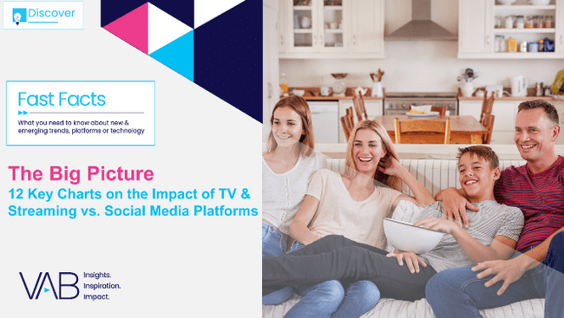


Time spent with content: People across all ages spend more much time with TV & streaming than with non-premium video
Click here for the full report
Hours per week spent watching TV Shows & Movies vs. Non-Premium Videos
Among weekly non-premium video content viewers
Source: Hub Entertainment Research, Video Redefined, January 2024. Based on survey of 1,900 consumers, ages 13-74. P13-24 respondents = 620 (unweighted); P25-34 respondents = 285 (unweighted); P35+ respondents = 995 (unweighted). Data collected December 2023. ‘Non-premium video’ includes short-form or user-generated video on YouTube, influencer video content, etc.
This information is exclusively provided to VAB members and qualified marketers.
PAGE 6

Slide 7
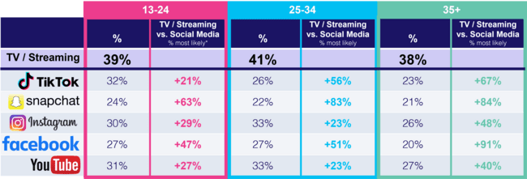
Emotional connection: Stronger bonds are formed with TV & streaming characters than social media influencers
Click here for the full report
% of platform users who ‘feel personally connected to a character/personality’ on the following platforms
*How to read: P13-24 are 21% more likely to feel personally connected to a character/personality from TV or streaming content vs. TikTok content
Source: VAB custom research fielded by Hub Entertainment Research as part of the 2023 Video Redefined report. Data sourced from Hub’s survey of 1,900 consumers, ages 13-74. P13-24 respondents = 620 (unweighted). P25-34 respondents = 285 (unweighted). P35+ respondents = 995 (unweighted). Data collected December 2023. Q1: Which of the following statements apply to you when you watch videos, shows or movies on the following platforms? Based on users of the platform.
This information is exclusively provided to VAB members and qualified marketers.
PAGE 7

Slide 8

New Multiscreen TV Advertisers: Brands of all investment levels are launching their first ever multiscreen TV campaign
Click here for the full report
1H ’24 New National TV Advertisers by Spend Segment
% of brands within spend buckets
Download our latest ‘Welcome to TV’ report to see all the advertisers that fall into each spending segment
Source: VAB analysis of Nielsen Ad Intel data as of 9/16/24, 1/1/24-6/30/24. TV spend includes national cable TV, broadcast TV, Spanish language cable TV, Spanish language broadcast TV. Brands reflect those with national TV spend over $50K.
This information is exclusively provided to VAB members and qualified marketers.
PAGE 8

Slide 9



Time spent on social: Gen Z has significantly cut down on how much time they spend on major social media platforms
Click here for the full report
-25%
A18-24 YoY Total Time Spent
on Social Networking Apps
(Snapchat, Facebook, TikTok, X, Instagram)
May - July ‘23 vs. May - July ’24
Source: VAB analysis of Comscore Media Metrix multiplatform media trend data (includes mobile, desktop). Based on A18-24 total minutes spent during a three-month period YoY (May – July ‘23 vs. May – July ’24) across Snapchat, Facebook, TikTok, X and Instagram.
Among P13-17, YoY time spent was down -18% across Snapchat, Facebook, TikTok, X and Instagram (desktop only, excludes mobile).
This information is exclusively provided to VAB members and qualified marketers.
PAGE 9

Slide 10
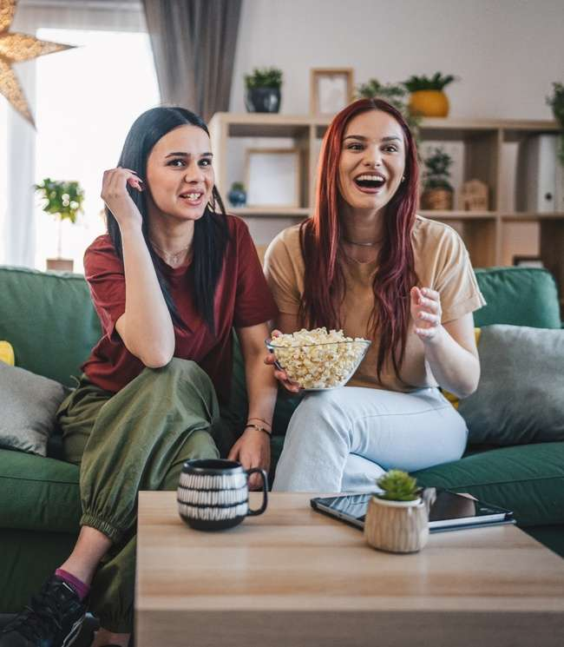


Passion for long-form: Professionally produced, Multiscreen TV content is a common bond among most of Gen Z
Click here for the full report
Gen Z’s Passion for Premium Video Across Screens
Streaming
Linear TV
75%
72%
say that they
‘love streaming TV shows’
say that they
‘just love watching TV’
Source: VAB analysis of MRI-Simmons August 2024 Cord Evolution, Study/ Based on A18-24 respondents, ‘any agree.’
This information is exclusively provided to VAB members and qualified marketers.
PAGE 10

Slide 11

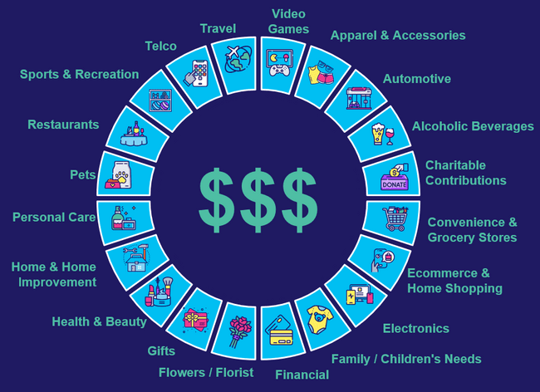
Value of the cinema audience: The average movie goer spends much more on products and services than non-moviegoers
Click here for the full report
19 Categories: Aggregated Annual Expenditure Per Person
(% difference vs. Non-Moviegoers)
Demo | Non-Moviegoers | Moviegoers | ‘Frequent’ Moviegoers
A18+ | $16,241 | $19,233 | $19,677
A18-34 | $15,691 | $17,843 | $18,314
Affluent HHI $100K+ | $20,190 | $22,421 | $22,907
(+18% higher)
(+21% higher)
(+14% higher)
(+17% higher)
(+11% higher)
(+13% higher)
Source: VAB analysis of MRI-Simmons Spring 2024 Doublebase Study, A18+. ‘Non-Moviegoer’ = Has not gone to the movies in the last 12 months; ‘Moviegoer’ = Attended a movie in the last 12 months; ‘Frequent Moviegoer’ = Attend a movie at least once a month.
This information is exclusively provided to VAB members and qualified marketers.
PAGE 11

Slide 12

Scale of cybercrime: The global cost of cybercrime is projected to increase by 50% from 2024 to 2028 to almost $14 trillion
Click here for the full report
Estimated Cost of Cybercrime Globally
$ in Trillions
Greater than the GDP of Germany & Japan combined
Source: Statista, Quantifying the Cost of Ad Fraud: 2023-2028, 9/26/2023. 2024 GDP by country estimates based on International Monetary Fund, World Economic Outlook, April 2024.
This information is exclusively provided to VAB members and qualified marketers.
PAGE 12

Slide 13


TV Upfronts week: See a historical view of the calendar over the last three years so you can start planning for 2025
Click here for the full report
Bonus Slide!
This information is exclusively provided to VAB members and qualified marketers.
PAGE 13

Slide 14



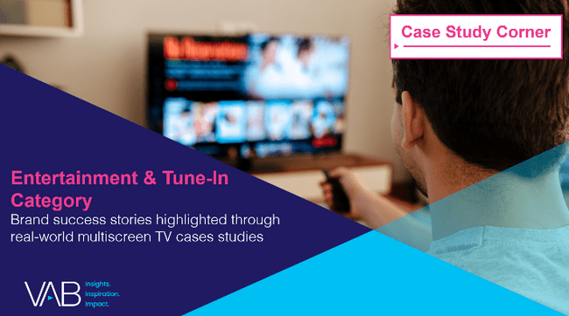








Interested in real-word case studies on successes in multiscreen TV?
Discover VAB’s extensive collection of 12 category case study compilations
Automotive
B2B
Consumer Packaged Goods (CPG)
Entertainment & Tune-In
Financial Services & Insurance
Health, Wellness & Beauty
Home
Pharmaceuticals
Restaurants
Retail
Tech & Telco
Travel
This information is exclusively provided to VAB members and qualified marketers.
PAGE 14

Slide 15




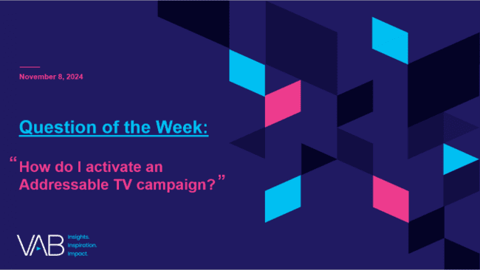
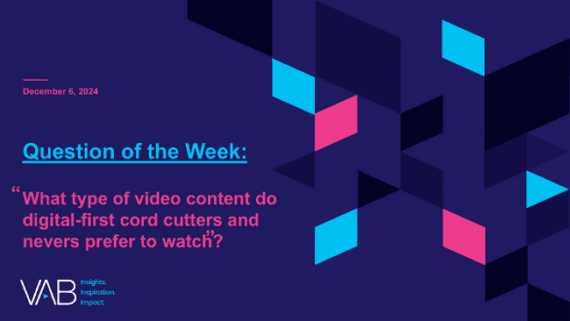
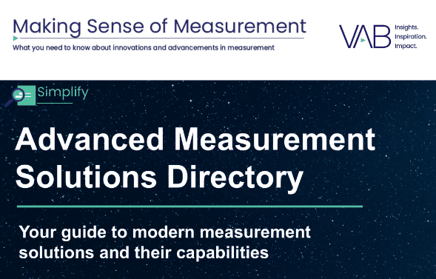
4Q 2024 Insights & Measurement Content Releases
Jason Wiese
Benjamin Vandegrift
SVP, Director of Strategic Insights
jasonw@thevab.com
VP, Measurement Solutions & Innovations benv@thevab.com
Kailyn Hartmann
Leah Montner-Dixon
VP, Advanced Analytics & Intelligence
kailynh@thevab.com
Director, Audience & Behavioral Insights
leahm@thevab.com
Reed Kiely
Karolina Guillen
Director, Data Insights & Trends
reedk@thevab.com
Associate Director, Insights, Strategy & Analytics karolinag@thevab.com
Kaileen Cain
Senior Insights Analyst
kaileenc@thevab.com
Discover more
Looking for more data, insights and takeaways? Check out this related VAB content
VAB Members, brand marketers and agencies get free and immediate access to VAB’s content library. Get access at theVAB.com
This information is exclusively provided to VAB members and qualified marketers.
PAGE 15

