Slide 1

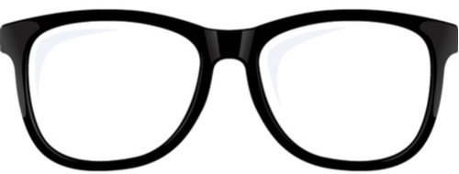

2023 – 4th Quarter

Slide 2


About VAB
VAB plays a dual role in the video advertising industry. We are leading the change to bring about a more innovative and transparent marketplace. We also provide the insights and thought leadership that enables marketers to develop business-driving marketing strategies.
Drawing on our marketing expertise, we simplify the complexities in our industry and discover new insights that transform the way marketers look at their media strategy.
We are committed to your business growth and proud to offer VAB members, brand marketers and agencies complimentary access to our continuously-growing Insights library. Get immediate access at theVAB.com.
This information is exclusively provided to VAB members and qualified marketers.
PAGE 2

Slide 3
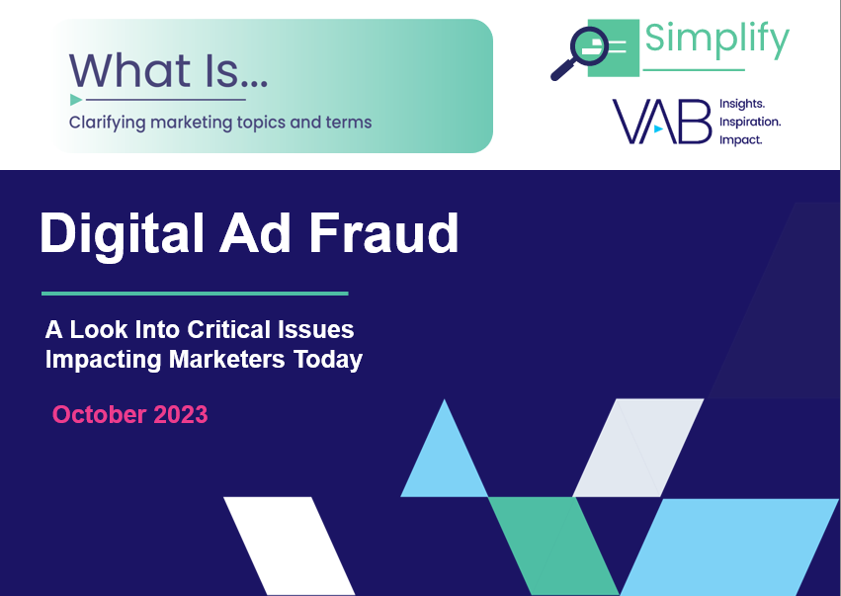
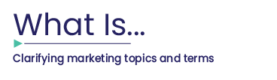
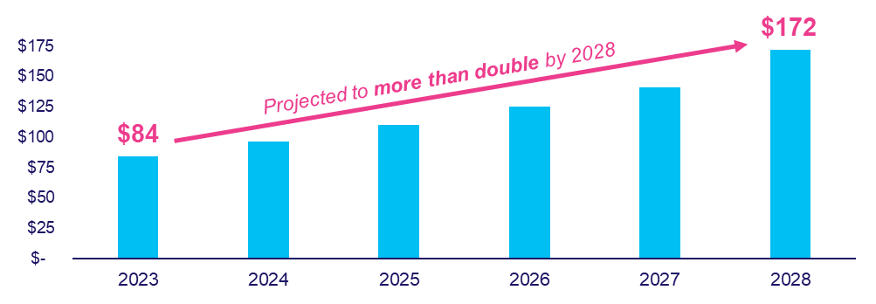
Cost of digital ad fraud: The estimated global cost is projected to more than double by 2028 to $172 Billion
Click here for the full report
Estimated Global Cost of Digital Ad Fraud
$ in Billions
Source: Juniper Research, Quantifying the Cost of Ad Fraud: 2023-2028, 9/26/2023.
This information is exclusively provided to VAB members and qualified marketers.
PAGE 3

Slide 4
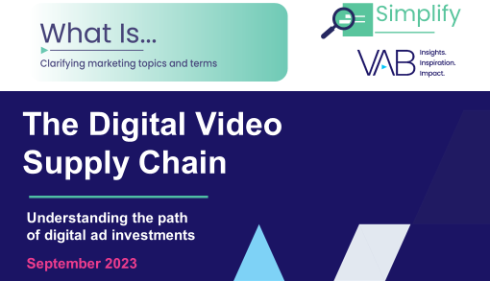
Opaqueness of the digital supply chain: Only about half of an advertiser’s investment via programmatic goes towards ads
Click here for the full report
Digital Supply Chain Advertising Investment Allocation
Agency fee
Technology Fee (Demand Side)
Technology Fee (Supply Side)
Unknown
SSP
DSP
fee
“missing” spend
Only half of spend goes to publisher
Source: ISBA, May 2020 via Augustine Fou in Forbes, In Digital, ‘Wanamaker’s 50%’ Is Known. It’s Also Worse Than That, 12/19/20.
This information is exclusively provided to VAB members and qualified marketers.
PAGE 4

Slide 5



Consumers are concerned about misinformation: Many people report seeing false or misleading information online regularly
Click here for the full report
% of U.S. respondents who have seen false or misleading information on the following topics online in the last week
65%
of respondents are concerned about what is real and what is fake on the internet when it comes to news
Source: Reuters Institute, Digital News Report 2023. Based on global research conducted by YouGov, end of January – beginning of February 2023. Reflects respondents from North America.
This information is exclusively provided to VAB members and qualified marketers.
PAGE 5

Slide 6



The value of local TV news: A platform viewed as trustworthy that provides useful information and creates a positive impact
Click here for the full report
83%
77%
72%
Find local news coverage on TV to be
most trustworthy
Feel local news provides people with important info about their community
& critical national news
Agree local news helps enact positive change
in their local community
Source: Spectrum News / Morning Consult study via Charter Communications press release, Spectrum News/Morning Consult Poll Finds 83% of Americans Trust Local News, 8/25/2022.
This information is exclusively provided to VAB members and qualified marketers.
PAGE 6

Slide 7

Women’s sports is a growth engine for TV: Live viewership has grown significantly, with females outpacing male demographics
Click here for the full report
Total time spent viewing women’s live sporting events
in millions of minutes
+32%
2022 vs. 2018
Female % Change: +39%
Male % Change: +28%
16,741
12,696
Source: VAB analysis of Nielsen NPower R&F Program Report, 2018 & 2022, Total Day, Live+SD, males 2+, females 2+, persons 2+. Ad-supported national cable TV & broadcast TV, includes Spanish language networks; excludes regional sports networks, local broadcast airings and digital airings of sports through MVPD / network TV apps. Reflects live sporting events only.
This information is exclusively provided to VAB members and qualified marketers.
PAGE 7

Slide 8
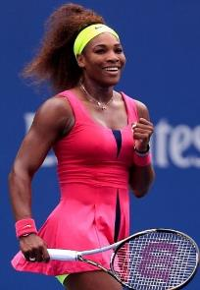
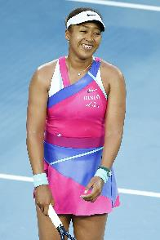
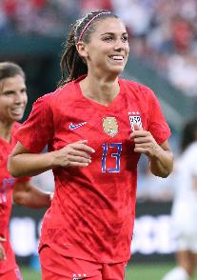
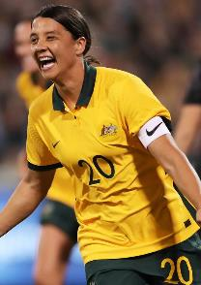



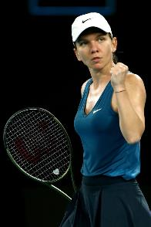
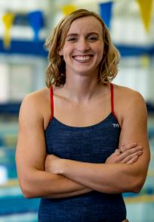
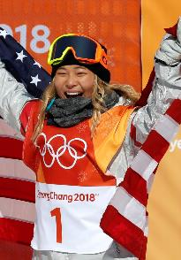
Female athletes are highly marketable: Increased exposure has turned many into mainstream stars and personalities
Click here for the full report
Top 10 marketable female athletes
#1
#2
#3
#4
#5
Serena Williams
#2 Overall
Naomi Osaka
#6 Overall
Alex Morgan
#8 Overall
Sam Kerr
#9 Overall
Simone Biles
#11 Overall
#6
#7
#8
#9
#10
Emma Raducanu
#12 Overall
Alexia Putellas
#13 Overall
Simona Halep
#15 Overall
Katie Ledecky
#21 Overall
Chloe Kim
#22 Overall
Source: SportsProMedia, The Most Marketable Athletes of 2022, 2023. Marketability is scaled on their brand strength, audience and reach, and economics. *Top marketable athletes ranking is based on SportsPro and Northstar’s ‘Marketability Score’, which is made up of 3 components that are added together to generate an overall score: brand strength, audience & reach, economics. Athletes considered were active during the evaluation period (12/1/21-7/31/22) in one of the 24 sports analyzed.
This information is exclusively provided to VAB members and qualified marketers.
PAGE 8

Slide 9


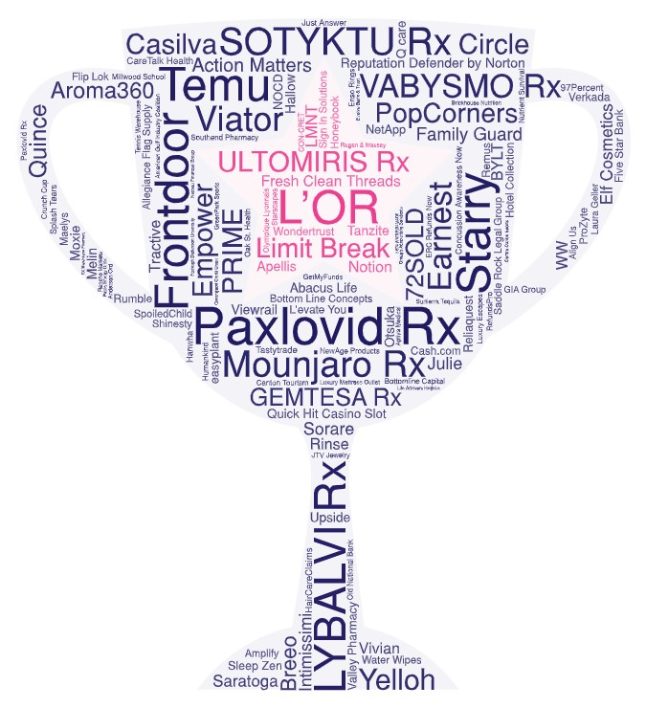




1H ‘23 new TV advertisers: Despite continued uncertainty, more dollars were invested by new advertisers than in prior years
Click here for the full report
New National TV Advertisers
1H 2019 – 1H 2023
Year | # of New Advertisers | # of Categories | New TV $$$ (MM)
1H ‘19 | 49 | 23 | $283.9
1H ‘20 | 110 | 59 | $459.3
1H ‘21 | 162 | 52 | $465.4
1H ‘22 | 136 | 47 | $416.2
1H ‘23 | 127 | 46 | $475.4
Source: VAB analysis of Nielsen Ad Intel data as of 8/16/23, 1/1/23-6/30/23. Prior years based on VAB analysis of Nielsen Ad Intel Data from the following periods: 1/1/2019-6/30/2019, 1/1/2020-6/30/2020, 1/1/2021-6/30/2021, 1/1/2022-6/30/2022. TV spend includes national cable TV, broadcast TV, Spanish language cable TV, Spanish language broadcast TV. Brands reflect those with national TV spend over $100K.
This information is exclusively provided to VAB members and qualified marketers.
PAGE 9

Slide 10



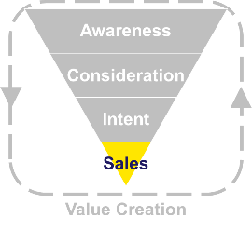


TV strengthens ‘share of market’: Microsoft Teams utilized TV to increase their SOV and take share from a major competitor
Click here for the full report
10-Month COVID Time Period vs. Previous 10-Months
May ’19 - Feb ‘20
Mar ’20 - Dec ‘20
% Change
Total U.S. TV Spend
$20.0 MM
$152.4 MM
+661%
Avg. Monthly Unique Visitors
11.8 MM
32.3 MM
+173%
Time Period Cume Total Hours Spent
68.5 MM
379.1 MM
+453%
May ’19 - Feb ‘20
Mar ’20 - Dec ‘20
% Change
Total U.S. TV Spend
N/A
$0.5 MM
---
Avg. Monthly Unique Visitors
5.1 MM
4.9 MM
-6%
Time Period Cume Total Hours Spent
101.1 MM
49.3 MM
-51%
Source: VAB analysis of Nielsen AdIntel, calendar months of May 2019 - December 2020. TV spend includes cable TV, broadcast TV, Spanish language cable TV, Spanish language broadcast TV, spot TV, and syndicated TV. U.S. TV spend only. VAB analysis of Comscore mediametrix multiplatform media trend data, total audience (Desktop P2+, Mobile 18+), May ‘19 – Dec ‘20 (calendar months)
This information is exclusively provided to VAB members and qualified marketers.
PAGE 10

Slide 11

The excitement of cinema: ‘Barbenheimer’ created the most interest for any premium video content during the summer
Click here for the full report
Cinema, TV & Streaming Content: Google Trends Index*
reflects a selection of top movies, linear TV and streaming programs
Barbie:
7/22 Max: 100
Oppenheimer
7/22 Max: 55
The Summer I Turned Pretty
7/14 Max: 10
Sweet Magnolias
7/23: Max: 4
The Bear
6/25 Max: 9
The Witcher
7/3 Max: 5
Suits
7/9 Max: 5
Justified: City Primeval
7/19 Max: 4
Ahsoka
8/23 Max: 11
One Piece
8/31 Max: 13
Yellowstone
6/18 Max: 6
Hijack
8/2 Max: 2
Source: VAB analysis of Google Trends, United States only, All Categories, Web Search, 06/01/23-08/30/23. *Google Search Index represents search interest relative to the highest point on the chart for the given region and time period, a value of 100 is the peak popularity for the term, a value of 50 means that the term is half as popular.
This information is exclusively provided to VAB members and qualified marketers.
PAGE 11

Slide 12
















Reaching diverse audiences: Cinema has a higher composition of diverse segments than popular digital video platforms
Click here for the full report
Diverse Audience Composition % by Platform
Cinema
(Formerly Twitter)
Source: For cinema - VAB analysis of Comscore Post-Trak reported box office demographics for the opening weekend of theatrical releases in August 2023. For digital video platforms - VAB analysis of MRI-Simmons Cord Evolution Study, August 2023; P18+. Audience % based on Monthly Users / Viewers of each platform – ‘Streaming Services used in the last 30 days’ and ‘Social media, photo or video-sharing services visited or used in the last 30 days.’ Composition % represents diverse respondents (excludes non-Hispanic White).
This information is exclusively provided to VAB members and qualified marketers.
PAGE 12

Slide 13


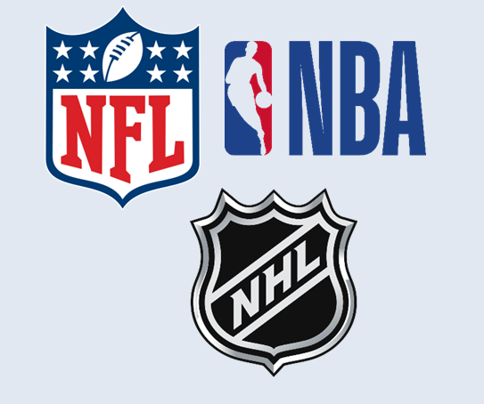
Sizing the ad fraud marketplace: How much ad fraud exists in the digital supply chain annually?
Bonus Slide!
Click here to watch the full presentation
Digital Ad Fraud:
Annual Cost in North America
Three Major League Sports: Combined Annual Revenue
VAB was a proud sponsor of AWNY 2023!
Click here to watch the insightful, industry-shaping conversations designed to transform the way you think about your marketing strategies.
$35B
$34.6B
Source: Juniper Research, Quantifying the Cost of Ad Fraud: 2023-2028, 9/26/2023. NFL – Statista, 2022, 9/5/23 ($18.6B total revenue); NBA - Statista, 2021-2022, 9/7/23 ($10.02B total revenue); NHL – Statista, 2022, 9/14/23 ($5.93B total revenue).
This information is exclusively provided to VAB members and qualified marketers.
PAGE 13

Slide 14
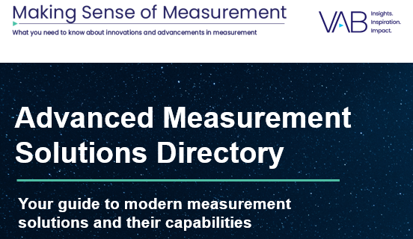

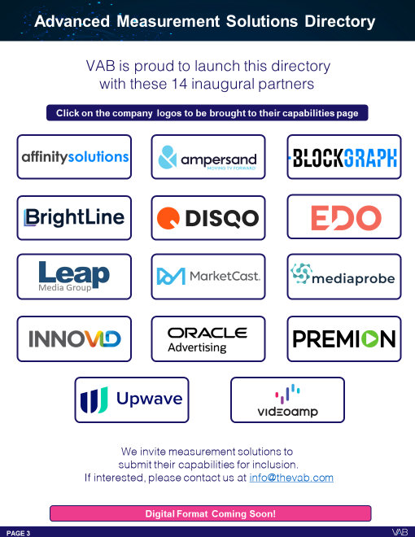
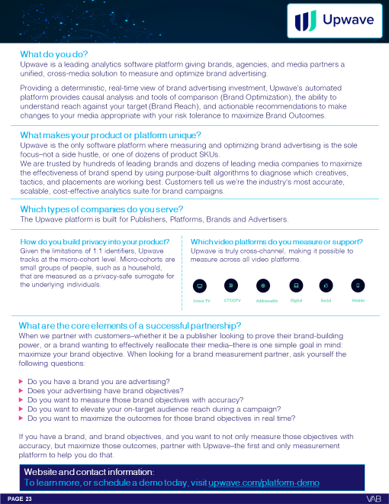
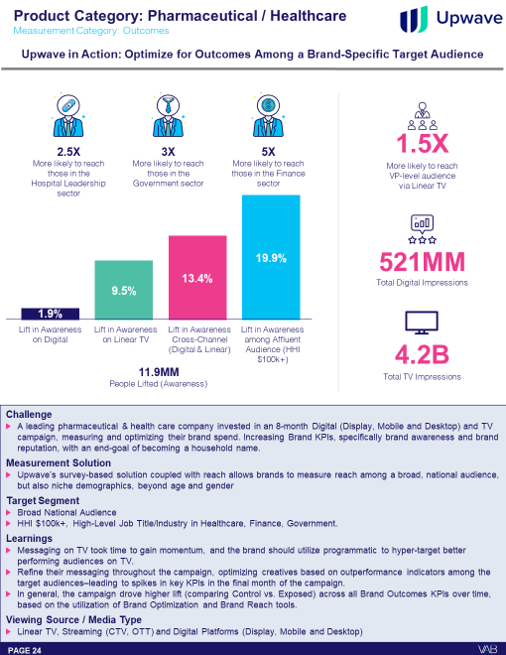
Additionally, this quarter we launched the first edition of our Advanced Measurement Solutions Directory
Click here for the full report
VAB is proud to launch this directory with 14 inaugural measurement solutions partners
The Advanced Measurement Solutions Directory serves as a reference guide to simplify and provide clarity in measurement solutions so that you can keep informed.
Developed in partnership with the solutions themselves, the directory is a compilation of the topline capabilities and several applicable case studies.
We expect this directory to grow and welcome all measurement companies that would like to contribute.
Directory preview
Example of measurement solution & their capabilities
This information is exclusively provided to VAB members and qualified marketers.
PAGE 14

Slide 15



Jason Wiese
Benjamin Vandegrift
SVP, Director of Strategic Insights
jasonw@thevab.com
VP, Measurement Solutions & Innovations
benjaminv@thevab.com
Reed Kiely
Leah Montner-Dixon
Director, Data Insights & Trends
reedk@thevab.com
Director, Audience & Behavioral Insights
leahm@thevab.com
Karolina Guillen
Insights Manager
karolinag@thevab.com
Discover more
Looking for more data, insights and takeaways? Check out this related VAB content
We are committed to providing marketers with the data and insights they need to develop thoughtful, inclusive campaigns & strategies. To find out more on the unique media consumption behaviors and cultural trends of diverse consumers, visit the VAB’s DEIB Marketing Resources Center.
VAB Members, brand marketers and agencies get free and immediate access to VAB’s content library. Get access at theVAB.com
This information is exclusively provided to VAB members and qualified marketers. Further distribution is prohibited.
PAGE 15

