Slide 1



2022 – 4th Quarter

Slide 2



About VAB
VAB is an insights-driven organization that inspires marketers to reimagine their media strategies resulting in fully informed decisions.
Drawing on our marketing expertise, we simplify the complexities in our industry and discover new insights that transform the way marketers look at their media strategy.
We are committed to your business growth and proud to offer VAB members, brand marketers and agencies complimentary access to our continuously-growing Insights library. Get immediate access at theVAB.com.
Curious to learn more about VAB? Check out this quick video to see what we do and how we can help you develop business-driving marketing strategies.
This information is exclusively provided to VAB members and qualified marketers. Further distribution is prohibited.
PAGE 2

Slide 3




Consumers will spend over $1K on average this holiday season: Despite inflation being a major concern, consumers plan to make purchases across a range of holiday-related categories
Click here for the full report
Average Consumer Holiday % Share of Spend*
By Product Segment
Other holiday purchases for themselves or their families
$1,041
Non-gift holiday purchases (i.e., food and decorations)
Gifts for family, friends & co-workers
Spend on the holiday season by the average adult
Source: Samba TV, 2022 Holiday Report. Based on HarrisX online survey of 2,505 U.S. adults, fielded 8/29/22 – 9/1/22. *VAB analysis of National Retail Federation, Holiday 2021 by the Numbers, December 2021.
This information is exclusively provided to VAB members and qualified marketers. Further distribution is prohibited.
PAGE 3

Slide 4


Hispanics driving holiday spending: Due to their fervent holiday spirit, Hispanic consumers are planning to spend one-third more than the average adult on holiday shopping this year
Click here for the full report
Click here to learn about the 6 reasons why Hispanics will be driving brand growth during the holidays
Holiday Shopping Spend in 2022 vs. 2021
% of U.S. Adults
+34%
Spend on the holiday season
by Hispanic adults vs.
the average adult
$1,392 vs. $1,041
(+$351)
Source: Samba TV, 2022 Holiday Report. Based on HarrisX online survey of 2,505 U.S. adults, fielded 8/29/22 – 9/1/22.
This information is exclusively provided to VAB members and qualified marketers. Further distribution is prohibited.
PAGE 4

Slide 5
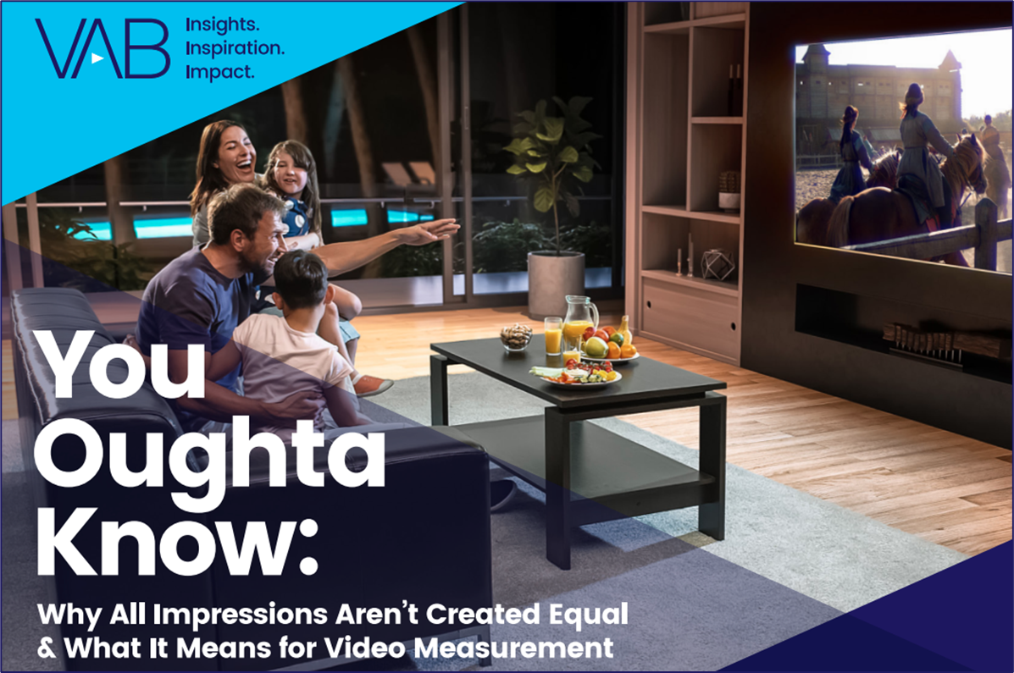


Measuring attention across platforms: The average :30 TV ad generates the same amount of attention as 1.5 YouTube Ads, 4.5 Facebook in-feed ads or 40 desktop display ads
Click here for the full report
NO SKIP
BUMPER
STORIES
INFEED
INFEED
TV
YOUTUBE
SOCIAL MEDIA
DIGITAL DISPLAY
Source: Ebiquity, with Lumen, TVision and Dan White – The Challenge of Attention, June 2021.
This information is exclusively provided to VAB members and qualified marketers. Further distribution is prohibited.
PAGE 5

Slide 6



Multiscreen TV generates the greatest sales impact: TV across all devices outperforms even the best ROI seen with other online video platforms
Click here for the full report
Bonus Slide!
Sales impact across media platforms
 | TV | Desktop | Mobile
Television | 144 | 153 | 161
Facebook | --- | 118 | 121
YouTube | --- | 116 | 137
How to read above chart: An exposure to an ad on Television drove 44% more sales than not seeing the ad at all
Source: Karen Nelson-Field – Amplified Intelligence – “Not All Reach is Equal: An Investigation into Cross Platform Advertising Effectiveness,” ThinkTV Australia, 2019. Short-Term Advertising Strength (STAS) is calculated by determining the proportion of category buyers who bought a specific brand having not been exposed to that brand’s advertising and comparing this to the proportion of category buyers who were exposed to advertising and went on to buy the brand. STAS is built to capture short term effects, capturing impact up to a month after exposure. A STAS score of 100 indicates no advertising impact in that those who were exposed to the advertising were just as likely to purchase as those who were not. A score above 100 indicates that the advertising had an impact on sales. Indices based on % who were exposed to an ad that purchased a product divided by % who were not exposed to an ad that purchased a product.
This information is exclusively provided to VAB members and qualified marketers. Further distribution is prohibited.
PAGE 6

Slide 7


1H ’22 new TV advertisers: Categories that serve ‘everyday’ needs like pharma, insurance and financial services have taken on a renewed importance among consumers
Click here for the full report
1H ‘22 New National TV Advertisers: Top 15 Categories Ranked by Total Spend
Rank | Category | # of Brands | % of total brands | Category $$$ (000) | % of total spend
1 | Pharmaceutical | 13 | 10% | $182,272.1 | 44%
2 | Insurance | 7 | 5% | $38,940.4 | 9%
3 | Communications | 2 | 2% | $26,963.7 | 7%
4 | Professional Services | 5 | 4% | $24,559.0 | 6%
5 | Financial Services | 10 | 8% | $21,518.5 | 5%
6 | Insecticides | 1 | 1% | $15,638.5 | 4%
7 | Apparel | 6 | 5% | $12,908.2 | 3%
8 | Alcohol Beverages | 4 | 3% | $12,301.9 | 3%
9 | Beverages | 1 | 1% | $11,900.3 | 3%
10 | Streaming Services | 1 | 1% | $9,221.7 | 2%
11 | Automotive | 2 | 2% | $7,638.0 | 2%
12 | Pet Care | 4 | 3% | $7,027.5 | 2%
13 | Medical Devices | 3 | 2% | $4,467.2 | 1%
14 | Vitamins & Supplements | 3 | 2% | $4,430.3 | 1%
15 | Entertainment | 2 | 2% | $3,586.3 | 1%
16 | Other Categories (32) | 69 | 52% | $30,740.6 | 7%
 | Grand Total | 133 |  | $414,114.2
=categories highlighted align within at least one of the ‘functional’ categories (healthcare / pharma, insurance, financial services, professional services, apparel & accessories, fitness & wellness and ‘lifestyle’ brands that incorporate alcohol beverages, food and travel)
Source: VAB analysis of Nielsen Ad Intel data, 1/1/22-6/30/22. TV spend includes national cable TV, broadcast TV, Spanish language cable TV, Spanish language broadcast TV. Brands reflect those with national TV spend over $100K.
This information is exclusively provided to VAB members and qualified marketers. Further distribution is prohibited.
PAGE 7

Slide 8
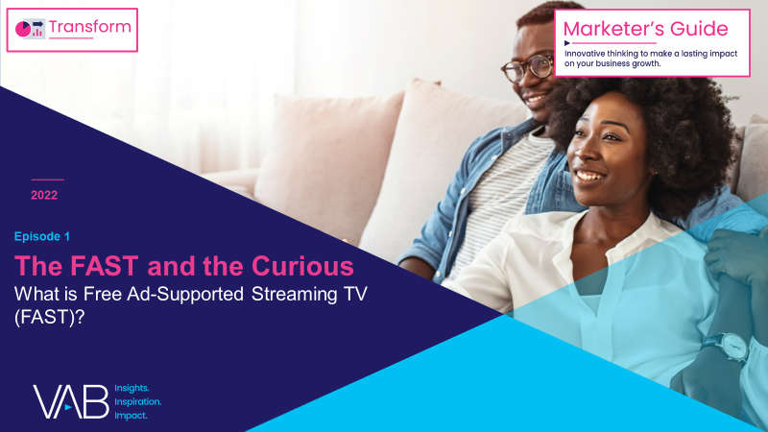
The FAST experience: With many on-demand and paid video services available, FAST presents a ‘frictionless’ viewing experience at no cost with no sign up needed
Click here for the full report
Free Ad-supported Streaming TV
SVOD
AVOD
FAST
vMVPD
Linear TV
MVPD VOD
TV Everywhere
Option to stream either live linear channels or on-demand content
Option to
stream either
live feeds of linear channels or on-demand content
Watch live or time-shifted content through an MVPD or antenna
Option to
stream either
live feeds of linear channels or on-demand content
Viewing Experience
On-Demand vs. Live Scheduled Programming
Stream content on-demand
on viewer’s schedule
Stream content on-demand
on viewer’s schedule
Watch content on-demand on viewer’s schedule through an MVPD
Ad Experience
Ad-Free vs. Ad-supported
Ad-supported
(‘limited ad’ options also available)
Ad-free
Ad-supported
Ad-supported
Ad-supported
Ad-supported
Ad-supported
Some services are free &
ad-supported, while others are offered as part of a SVOD / AVOD hybrid service at a lower cost with limited ads
Paid MVPD subscription or free channels through
Over-the-Air (OTA) access
Free to watch in exchange for viewing ads
(Log-ins are available but
not necessary)
Business Model
Paid vs. Free
Paid monthly or annual subscription
Paid monthly or annual subscription
Paid MVPD subscription
Paid MVPD subscription
MVPD (Multichannel Video Programming Distributor) reflects a cable, telco, or satellite provider.
This information is exclusively provided to VAB members and qualified marketers. Further distribution is prohibited.
PAGE 8

Slide 9
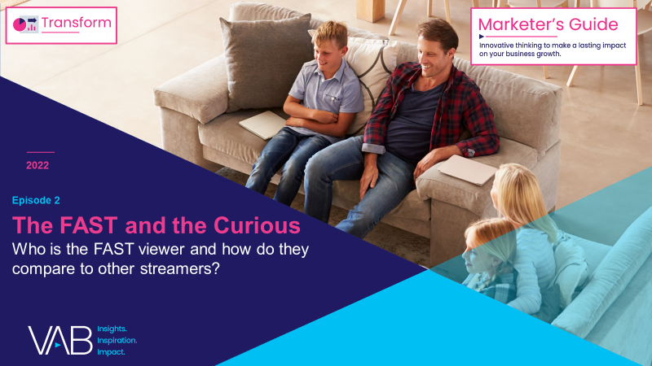
The growth of FAST: With the largest year-over-year growth
of all streaming platforms, 4 out of 10 adult streamers are now watching FAST services
Click here for the full report
% of U.S. adult 18+ streamers that watch the following types of streaming services
+8%
YoY
+20%
YoY
+41%
YoY
Source: VAB analysis of MRI-Simmons August 2022 Cord Evolution Study, A18+. Base = streamed in the past 12 months. SVOD Viewers (72% of A18+ population / 83% of A18+ streaming population) = used any of the following streaming services in the past 30 days: Apple TV+, Discovery+, Disney+, HBO Max (commercial free), Hulu (commercial free), Netflix, Paramount+ (commercial free), Amazon Prime Video. AVOD Viewers (38% of A18+ population / 44% of A18+ streaming population) = used any of the following streaming services in the past 30 days: Hulu (limited commercial), Paramount+ (limited commercial), Peacock (limited commercial), HBO Max (limited commercial), Crackle, Vudu, Discovery+ (limited commercial). FAST (36% of A18+ population / 41% of A18+ streaming population) = used any of the following streaming services in the past 30 days: Peacock (free service w/ limited commercials), Roku Channel, Tubi TV, Freevee (formerly IMDb TV), Pluto, Samsung TV Plus, Xumo, Local Now.
This information is exclusively provided to VAB members and qualified marketers. Further distribution is prohibited.
PAGE 9

Slide 10
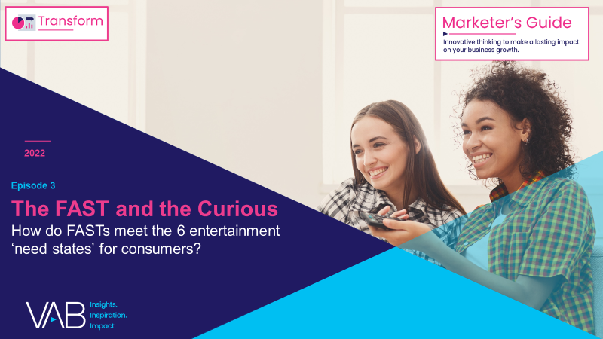
One of six entertainment ‘need states’ that FAST meets: The way FAST viewers make decisions is often based on efficiency, so they seek out brands that make their lives run smoother
Click here for the full report
Click here to learn about how FASTs meet the 6 entertainment ‘need states’ for consumers
Keep It Simple
(desire for convenience)
% of FAST viewers who agree with the following statements
Automotive
Travel
Food
82% say when buying a vehicle, how well
it meets their needs matters more than whether it's foreign or domestic
82% would rather book a trip over the Internet than meet with a travel agent
76% are always on the lookout for quick and ‘easy to prepare’ meal options
Mobile Apps
Online Shopping
Consumer Tech
69% say apps have made their life so much more convenient
63% are more likely to purchase a product online than in a store
33% say ‘smart’ home devices / appliances have become an important part of their life
Source: VAB analysis of MRI-Simmons August 2022 Cord Evolution Study, A18+. Base = streamed in the past 12 months. FAST Viewers (41% of A18+ streaming population) = used any of the following streaming services in the past 30 days: Peacock (free service w/ limited commercials), Roku Channel, Tubi TV, Freevee (formerly IMDb TV), Pluto, Samsung TV Plus, Xumo, Local Now. Reflects respondents who answered ‘somewhat agree’ or ‘strongly agree’.
This information is exclusively provided to VAB members and qualified marketers. Further distribution is prohibited.
PAGE 10

Slide 11

FAST expansion: More channels means more opportunities for marketers as services continue to grow and additional content agreements are formed
Click here for the full report
Total number of FAST channels in the U.S.*
(Exclusive to & Shared Across Services)
+58%
vs. June ‘20
YoY FAST audience increased
+73%
From July 2020 to August 2022
Source: VAB analysis of MRI-Simmons Cord Evolution Study, July 2020 vs. August 2022, A18+. Base = streamed in the past 12 months. FAST Viewers (41% of A18+ streaming population) = used any of the following streaming services in the past 30 days: Peacock (free service w/ limited commercials), Roku Channel, Tubi TV, Freevee (formerly IMDb TV), Pluto, Samsung TV Plus, Xumo, Local Now. *VIP+ Variety Intelligence Platform, Life in the FAST Lane, July 2022. VIP+ analysis includes DistroTV, Freevee, Haystack News, LG Channels+, Local Now, News by Fire TV, Peacock, Plex, Pluto, Prime Video Channels, Redbox, Roku Channel, Samsung TV Plus, Sling Free, Sports.TV, STIRR, Tubi, Very Lcoal, ViX, Vizio WatchFree+, Xumo.
This information is exclusively provided to VAB members and qualified marketers. Further distribution is prohibited.
PAGE 11

Slide 12

Build presence among diverse audiences on video platforms: Multicultural segments are more likely to watch professionally-produced, long-form TV programming across devices
Click here for the full report
Click here to learn about the
7 ways brands can successfully engage diverse audiences
% of weekly time spent watching TV Shows
Share of Time | Live / DVR / VOD on TV | Live TV Streaming / Streaming on TV | TV Total | VOD / Downloaded on Other Devices | Live TV Streaming / Streaming on Other Devices | Other Devices Total
Black / African American | 39% | 28% | 67% | 12% | 21% | 33%
Hispanic | 32% | 35% | 67% | 10% | 21% | 31%
American Indian / Alaska Native | 38% | 34% | 72% | 11% | 19% | 30%
Asian | 32% | 33% | 65% | 9% | 23% | 32%
Other | 30% | 35% | 65% | 16% | 20% | 36%
Non-Hispanic White | 44% | 31% | 75% | 11% | 16% | 27%
Source: VAB analysis of MRI-Simmons August 2022 Cord Evolution Study, A18+. Q40b: Ways Watching TV Shows - Time Spent In Typical Week: Volume (% of Time Spent). Live on TV: Live, when it is broadcast, on a TV set; DVR on TV: DVR, on a TV set; VOD on TV: TV provider's Video On-Demand service on a TV; Live TV Streaming on TV: Streaming live, at the same time it airs on TV, on a TV; Streaming on TV: Streaming, on my schedule, on a TV set; VOD on other devices: TV provider's Video On-Demand service on any other device; Streaming on other devices: Streaming, on my schedule, on any other device; Live TV Streaming on other devices: Streaming live, at the same time it airs on TV, on any other device; Streaming on other devices: Streaming, on my schedule, on any other device; Downloaded content on any device: Watching downloaded content on any device. Note: %s may not add to 100% due to rounding.
This information is exclusively provided to VAB members and qualified marketers. Further distribution is prohibited.
PAGE 12

Slide 13


Inclusivity resonates with all audiences: Expand messaging beyond individual segments to create deeper connections across audiences by engaging ‘allies’ and ‘advocates’ as well
Click here for the full report
Click here to learn about the
6 strategies for developing inclusive campaigns that drive outcomes
5.3%
% of the U.S. A18+ population
that identifies as LGBTQ+
% of A18+ who agree with the following statements*
61%
‘I believe brands should support the LGBTQ community all year, not just during gay pride month’
60%
‘Today, I think most companies / brands should support the LGBTQ community’
% of that are supportive of the LGBTQ community*
68%
(A18+)
80%
(A18-24)
72%
(A25-44)
46%
‘I am more likely to purchase a product / service from a company / brand that supports the LGBTQ community’
64%
(A45-64)
59%
(A65+)
Source: VAB analysis of MRI-Simmons Winter 2022 Study. LGBTQ represents A18+ that identify as LGBTQ. *MRI-Simmons, LGBTQ and Gender Identity Study, October 2021. Based on respondents who ‘strongly agree’ or ‘somewhat agree.’
This information is exclusively provided to VAB members and qualified marketers. Further distribution is prohibited.
PAGE 13

Slide 14
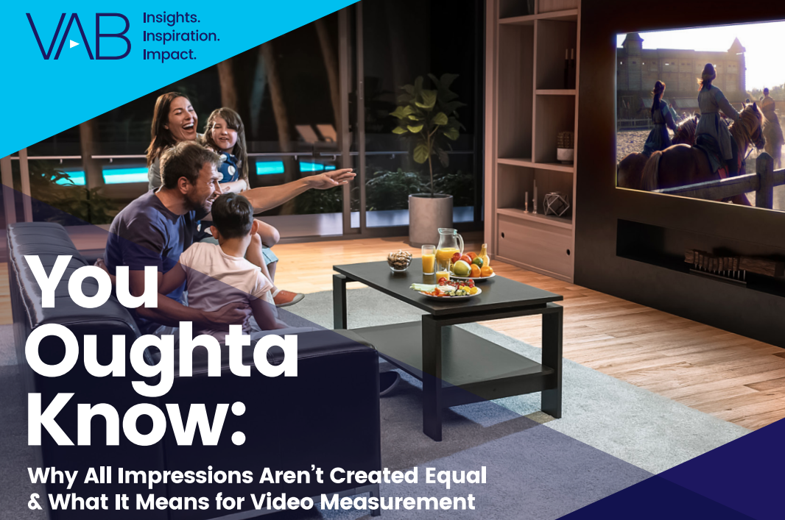

Jason Wiese
Reed Kiely
SVP, Director of Strategic Insights
jasonw@thevab.com
Associate Insights Director
reedk@thevab.com
Leah Montner-Dixon
Karolina Guillen
Associate Insights Director
leahm@thevab.com
Insights Manager
karolinag@thevab.com
Discover more
Looking for more data, insights and takeaways? Check out this related VAB content
We are committed to providing marketers with the data and insights they need to develop thoughtful, inclusive campaigns & strategies. To find out more on the unique media consumption behaviors and cultural trends of multicultural consumers, visit the VAB’s Multicultural Marketing Resource Center.
VAB Members, brand marketers and agencies get free and immediate access to VAB’s content library. Get access at theVAB.com
This information is exclusively provided to VAB members and qualified marketers. Further distribution is prohibited.
PAGE 14

