Slide 1



2022 – 3rd Quarter

Slide 2



About VAB
VAB is an insights-driven organization that inspires marketers to reimagine their media strategies resulting in fully informed decisions.
Drawing on our marketing expertise, we simplify the complexities in our industry and discover new insights that transform the way marketers look at their media strategy.
We are committed to your business growth and proud to offer VAB members, brand marketers and agencies complimentary access to our continuously-growing Insights library. Get immediate access at theVAB.com.
Curious to learn more about VAB? Check out this quick video to see what we do and how we can help you develop business-driving marketing strategies.
This information is exclusively provided to VAB members and qualified marketers. Further distribution is prohibited.
PAGE 2

Slide 3
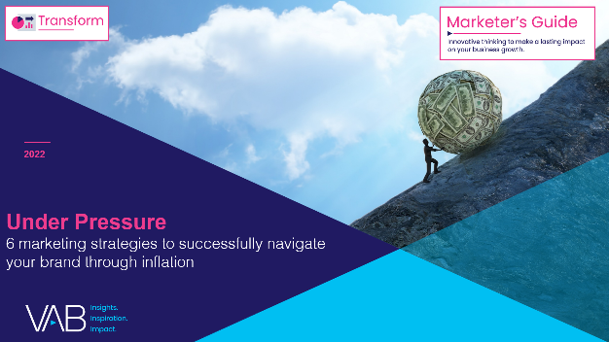


Rethink creative with a focus on empathy: To compete for a shrinking share of wallet, savvy marketers understand they need to rethink their messaging during inflationary times
Click here for the full report
Click the icon above to learn about the other 5 marketing strategies to navigate your brand through inflation
My (company / main client’s) company will have to rethink our messaging in order
to compete for a share of consumers’ smaller discretionary spending
% of respondents who agree
50% Agree
17% Disagree
Source: Advertiser Perceptions, Monthly Omnibus, April 2022.
This information is exclusively provided to VAB members and qualified marketers. Further distribution is prohibited.
PAGE 3

Slide 4




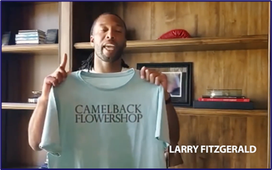


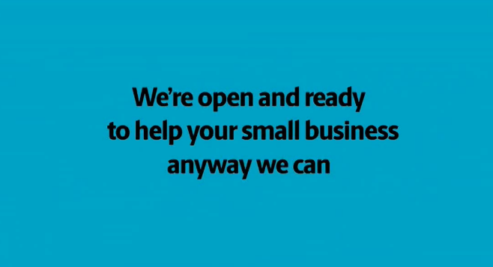
Applying lessons from Covid to Inflation: Marketers who
evolved their messaging to foster a greater connection with their community during Covid experienced new customer growth
Click here for the full report
Click the icon above to learn about the other 5 marketing strategies to navigate your brand through inflation
Digital Platform: Unique Visitors (000)
3-Month Average YoY:
Apr – Jun ’19 vs. Apr – Jun ’20
+99%
(+1.2 MM)
+79%
(+1.2 MM)
+57%
(+3.4 MM)
+23%
(+6.2 MM)
Source: VAB analysis of Comscore mediametrix multiplatform (website + mobile) media trend data, P18+. Three-month average: April – June 2019 vs. April – June 2020 (calendar months).
This information is exclusively provided to VAB members and qualified marketers. Further distribution is prohibited.
PAGE 4

Slide 5
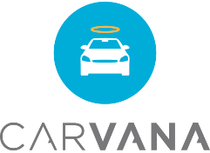
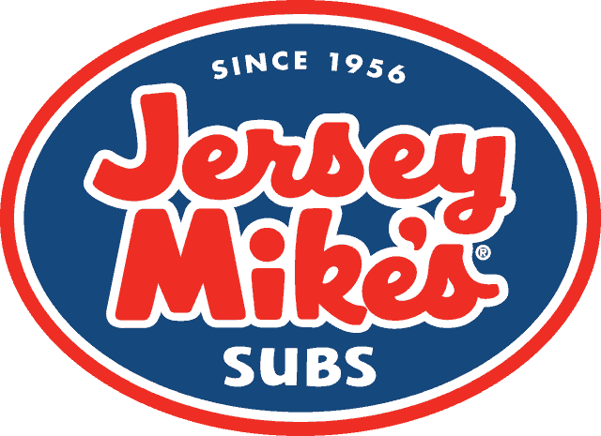



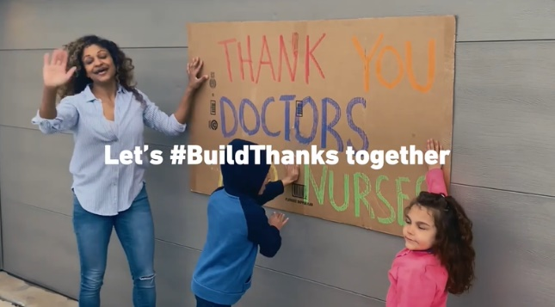
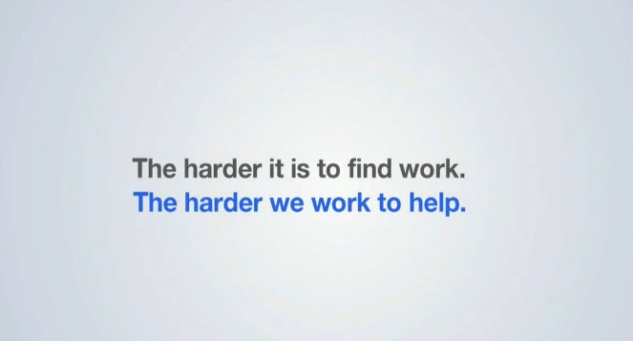
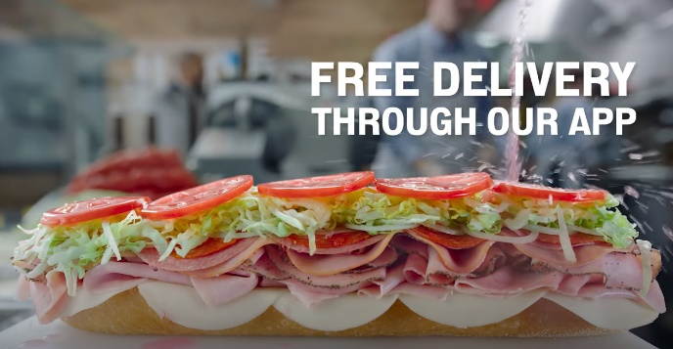
Applying lessons from Covid to Inflation: Many marketers who offered reassurance, hope and practical help through their creative experienced increased interest and trial during Covid
Click here for the full report
Click the icon above to learn about the other 5 marketing strategies to navigate your brand through inflation
Digital Platform: Unique Visitors (000)
3-Month Average YoY:
Apr – Jun ’19 vs. Apr – Jun ’20
+35%
(+1.0 MM)
+26%
(+10.2 MM)
+15%
(+5.0 MM)
+57%
(+1.0 MM)
Source: VAB analysis of Comscore mediametrix multiplatform (website + mobile) media trend data, P18+. Three-month average: April – June 2019 vs. April – June 2020 (calendar months).
This information is exclusively provided to VAB members and qualified marketers. Further distribution is prohibited.
PAGE 5

Slide 6









The value of engaging ‘Sophisticates’ at the cinema: Influential Adult 25-44 frequent movie goers highly value exceptional experiences and are willing to pay extra for them
Click here for the full report
% of Adult 25-44 Frequent Movie Goers who say…
73%
64%
53%
‘for me, going out to eat is all about the ‘experience’’
(109 index vs. total adults 25-44)
‘it’s worth it to me to pay more for
high quality hotel accommodations’
(108 index vs. total adults 25-44)
‘I would pay extra for a product that is consistent with the image I want to convey’
(123 index vs. total adults 25-44)
52%
42%
38%
‘I’m willing to spend more for a quality bottle of wine’
(111 index vs. total adults 25-44)
‘I’m willing to pay more for a flight in order to travel on my favorite airline’
(118 index vs. total adults 25-44)
‘I take vacation experiences that help differentiate me from my friends’
(129 index vs. total adults 25-44)
Source: VAB analysis of MRI-Simmons 2021 Fall Doublebase Study, Base: P25-44.
This information is exclusively provided to VAB members and qualified marketers. Further distribution is prohibited.
PAGE 6

Slide 7






One of 18 case studies on measurement innovation: An auto insurance brand partnered with AudienceXpress to reach
in-market customers and drive them through the sales funnel
Click here for the full report
Category:
Insurance
Incremental Lift /
Website Traffic
Campaign Results Overview
Challenge
An insurance company sought to heighten its brand awareness in order to increase sales leads and drive incremental lift in policies written
Measurement Innovation
Using AudienceXpress, the insurance company was able to measure the success of their campaign against multiple KPIs across key audience segments
Target Segments
A25-64
HHI $100k+
In market for auto insurance
Learnings
Through the analysis the brand was able to determine how each audience segment progressed through the sales funnel, with HHI$100k+ having the highest likelihood to convert leads to policies written
In addition to driving new customers, the campaign provided the brand with a directional roadmap that informed current and future media investments across various media channels
Company / Viewing Source / Media Type
AudienceXpress / Comcast Viewership Data / CTV
+73%
+11%
Total incremental lift in leads
Total Increase in policies written
Source: AudienceXpress, Insurance Case study. Campaign time period: July 8 – October 24, 2021.
This information is exclusively provided to VAB members and qualified marketers. Further distribution is prohibited.
PAGE 7

Slide 8
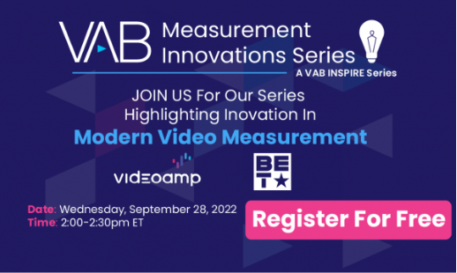



One of 18 case studies on measurement innovation: BET leveraged VideoAmp’s viewing behavior data to highlight the value of the BET Award’s audience for advertisers
Click here for the full report
Category:
Entertainment
Tune - in
Challenge
BET wanted to highlight the value of the BET Awards audience by identifying and measuring advanced audience segments
Measurement Innovation
VideoAmp’s second by second viewership data allowed BET to go beyond providing standard audience metrics to their advertisers. This enabled BET to identify and measure advanced audience segments. Proving the effectiveness of the BET Awards to reach and engage with high value audiences
Target Segment
Targeting included P18-49, and advanced audience segments: BET Change Makers and BET Cultural Innovators
Learnings
Advanced Audience AA viewing for the BET Awards was more than 2.5x higher than the network’s prime audience
BET has strong engagement with its advanced audiences, as well as viewers with high propensity to be trendsetters and ad-receptive
BET Awards had the highest engagement of the night across all linear programming during its airtime
Company / Viewing Source / Media Type
VideoAmp / VideoAmp Platform / Linear
Campaign Results Overview
And check out our webinar series
on Modern Video Measurement
to hear from our partner, VideoAmp!
39
%
YOY growth in households with
P18-49 impressions by the BET Awards
+
500K
BET Change Makers and BET Cultural Innovators reached by the BET Awards
10
x
Higher total minutes viewed on average than
the average of all programs across TV
Source: VideoAmp, Case study: BET Awards 2022
Advanced Audience Definitions:
BET Change Makers Age 18+ • Male / Female • African American Viewers who are influencers around Social Responsibilities
BET Cultural Innovators Age 18+ • Male / Female • African American Viewers who consider themselves to be trendsetters for all cultures
This information is exclusively provided to VAB members and qualified marketers. Further distribution is prohibited.
PAGE 8

Slide 9

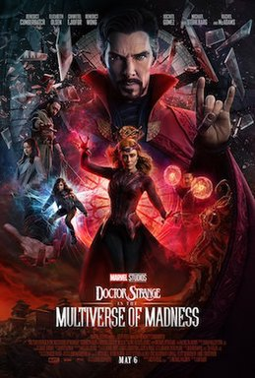

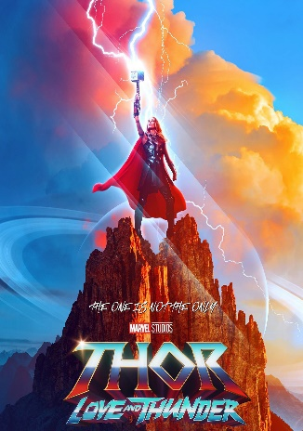



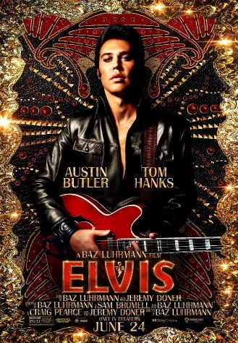





The summer scale of cinema: More adults attended the opening weekend of new movie releases than participated in other summer activities like going to baseball games, bars or beaches
Click here for the full report
Cinema: Estimated 3-Day Opening Weekend Adult 18+ Admissions
13.5 MM
10.8 MM
10 MM+
9.1 MM*
8.4 MM*
4 MM+
2.4 MM
1.4 MM
Other ‘Out-of-Home’ Activities by Comparison (Adult 18+)
Went to an MLB regular season or playoff game in last 12 months: 7.3 MM
Went to a bar / club
in last week: 5.8 MM
Went to the beach
in last week: 5.8 MM
Went to a concert / live music
in last week: 942K
Source: Screendollars Newsletter, based on data from EntTelligence. * Top Gun: Maverick’s estimated 4-day opening weekend over Memorial Day weekend – 11.4 MM; Minions: The Rise of Gru’s estimated 4-day opening weekend over July 4th weekend – 9.7 MM. ‘Other activities’ based on MRI-Simmons Fall 2021 Doublebase USA study, P18+, ‘concert / live music’ includes country, rock, classical, or other.
This information is exclusively provided to VAB members and qualified marketers. Further distribution is prohibited.
PAGE 9

Slide 10







Reaching the ‘Elusives’ and ‘Sophisticates’ at the movies: Between blockbusters and specialty films, there was something for every key audience at the local cineplex this summer
Click here for the full report
‘Elusives’
(young, diverse, ‘cordless’)
‘Sophisticates’
(influential, cultured, adults 25-44)
% of P18-34 opening weekend attendance
% of P25+ opening weekend attendance
The Black Phone
Lightyear
Doctor Strange:
MoM
Thor: Love
and Thunder
Top Gun
Mrs. Harris Goes to Paris
Elvis
Nope
64%
61%
61%
53%
87%
87%
80%
63%
Click here to download “Capturing the ‘Elusives’ at the Cinema”
to learn about the opportunities to reach this audience
Click here to download “Engaging the ‘Sophisticates’ at the Cinema”
to learn about the opportunities to reach this audience
Source: 2022 Comscore Post-Trak reported box office demographics for opening weekend of above movies, with supplemental data from deadline.com.
This information is exclusively provided to VAB members and qualified marketers. Further distribution is prohibited.
PAGE 10

Slide 11
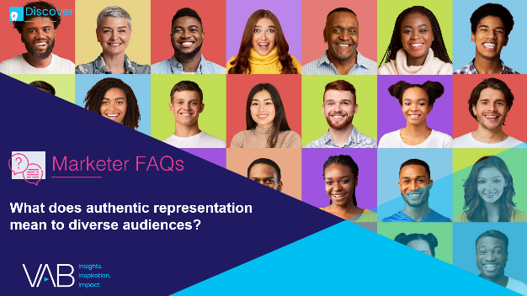

Highlighting Black representation: Cultural and ethnic heritage
is important to Black adults, so authentic characters and storylines that reflect this resonate well with this audience
Click here for the full report
83%
“Across streaming, cable and broadcast platforms, viewership among adults age[s]
18 to 49 peaked in many cases when a show had a majority-minority cast.
People basically want to see the TV shows that look like America, that have characters they can relate to and have experiences that resonate with them.”
of Black adults believe that their cultural & ethnic heritage is an important part of who they are
Represents the highest percentage among ethnicity groups*
Darnell Hunt
Dean of the Social Sciences at UCLA
Source: VAB analysis of MRI-Simmons USA Study, Fall 2021; Black P18+. ‘My cultural / ethnic heritage is an important part of who I am (any agree)’. *% of P18+ respondents that agree with this statement: Asian - 82%, Hispanic – 78%, American Indian or Alaska Native - 75%, NH White – 52%. For more information, download: How does on-screen representation deepen engagement with Black consumers and drive business impact for brands?
This information is exclusively provided to VAB members and qualified marketers. Further distribution is prohibited.
PAGE 11

Slide 12
Highlighting Asian representation: Programs showcasing important issues and stories relevant to their community are appreciated by Asian audiences for the opportunities they create
Click here for the full report
59%
“Being Asian American, there is this truth serum that we all have, I take a lot of pride in being able to say that I’m Asian and talking about it. Talking about it will normalize casting more Asians and giving them those opportunities, then that means a lot.”
of Asian respondents agree that ‘having shows that highlight issues / stories that are important to racially diverse communities available on a streaming service makes it more valuable to me’
Olivia Munn
Actress & Advocate for Stop Asian Hate
Source: VAB analysis of MRI-Simmons Cord Evolution Study, March 2022; Asian P18+. % of P18+ respondents that agree with this statement: Black - 66%, Hispanic – 59%, American Indian or Alaska Native - 51%, NH White – 43%; USC
Annenberg Media, “Olivia Munn discusses Asian heritage and representation with USC Price”, 9/8/20. For more information, download: How does on-screen representation deepen engagement with Black consumers and drive business impact for brands?
This information is exclusively provided to VAB members and qualified marketers. Further distribution is prohibited.
PAGE 12

Slide 13


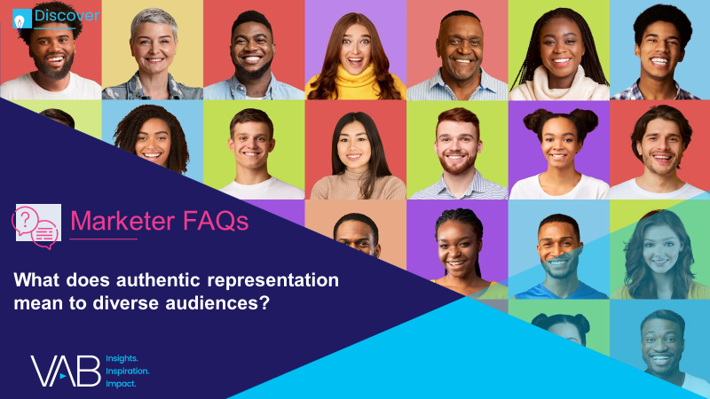



Jason Wiese
Benjamin Vandegrift
SVP, Director of Strategic Insights
jasonw@thevab.com
VP, Measurement Solutions
benjaminv@thevab.com
Leah Montner-Dixon
Reed Kiely
Associate Insights Director
leahm@thevab.com
Associate Insights Director
reedk@thevab.com
Karolina Guillen
Insights Manager
karolinag@thevab.com
Discover more
Looking for more data, insights and takeaways? Check out this related VAB content
We are committed to providing marketers with the data and insights they need to develop thoughtful, inclusive campaigns & strategies. To find out more on the unique media consumption behaviors and cultural trends of multicultural consumers, visit the VAB’s Multicultural Marketing Resource Center.
VAB Members, brand marketers and agencies get free and immediate access to VAB’s content library. Get access at theVAB.com
This information is exclusively provided to VAB members and qualified marketers. Further distribution is prohibited.
PAGE 13

