Slide 1



2024 – 3rd Quarter

Slide 2


About VAB
VAB plays a dual role in the video advertising industry. We are leading the change to bring about a more innovative and transparent marketplace. We also provide the insights and thought leadership that enables marketers to develop business-driving marketing strategies.
Drawing on our marketing expertise, we simplify the complexities in our industry and discover new insights that transform the way marketers look at their media strategy.
We are committed to your business growth and proud to offer VAB members, brand marketers and agencies complimentary access to our continuously-growing Insights library. Get immediate access at theVAB.com.
This information is exclusively provided to VAB members and qualified marketers.
PAGE 2

Slide 3



Igniting customer action: TV campaign launches for first-time advertisers spark an immediate influx of website visitors
Click here for the full report
‘Pre-TV Launch: Measured Website Traffic’ Brands Analysis: Average Monthly Website Unique Visitors
Monthly Website Unique Visitors (000) Comparison
based over a four-year time period: Apr ‘20 – Apr ‘24
TV launch month vs.
six months average prior to TV launch
+12%
+326K monthly uniques
(monthly average)
Source: VAB analysis of Comscore mediametrix multiplatform media trend data, P18+. April 2020 – April 2024 (calendar months), figures are based on monthly averages for the 173 brands analyzed. VAB analysis of Nielsen Ad Intel, TV launch month is based on the first activity reported across national cable TV, national broadcast TV, Spanish language broadcast TV, Spanish language cable TV, spot TV or syndication TV. January 2021 – December 2023 (calendar months).
This information is exclusively provided to VAB members and qualified marketers.
PAGE 3

Slide 4

Piquing consumer interest: Online search peaked immediately for Truff when they launched their first TV campaign
Click here for the full report
Weekly Google Trends Index – Truff
Six Months Pre-TV Campaign vs. Post-TV Campaign Launch (Weeks of 4/3/22 – 10/16/22)
“It’s important for us to find different channels to build brand awareness in a mass way…TV allows for us to get on the radar of those who may have not been familiar with our digital presence, especially as it gives us access to several different audiences and demographics.”
Nick Guillen
Co-Founder and Co-CEO, Truff
(Ad Age, 9/30/22)
TV Launch: 10/3/22
Source: VAB analysis of Google Trends, United States only, All Categories, Web Search, Weeks of 4/3/22 – 10/16/22. Google Search Index represents search interest relative to the highest point on the chart for the given region and time period, a value of 100 is the peak popularity for the term, a value of 50 means that the term is half as popular. VAB analysis of Nielsen Ad Intel, TV spend includes national cable TV, broadcast TV, Spanish language cable TV, Spanish language broadcast TV, January 2021 – December 2023 (calendar months); Note: Light blue line marks the first day of TV spending for each brand.
This information is exclusively provided to VAB members and qualified marketers.
PAGE 4

Slide 5
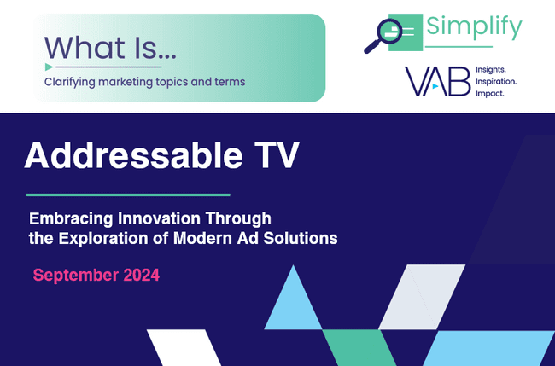




Key stats on Addressable TV: Advertisers are very satisfied with addressable TV and plan to invest more in it next year
Click here for the full report
85
%
40
%
50
%
of advertisers say they are satisfied or very satisfied with addressable TV
of advertisers plan to
increase their spend on addressable TV in 2024
of advertisers that aren’t
using addressable TV plan
to start using it next year
Source: GoAddressable, ‘Addressable TV On the Rise: Increased Understanding Drives Further Adoption’, November 2023
This information is exclusively provided to VAB members and qualified marketers.
PAGE 5

Slide 6








Inspiring action among Black consumers: TV and streaming is more likely to influence where they ‘dine out’ than social media
Click here for the full report
% of Black consumers who have eaten at a restaurant or purchased a cookbook seen in the following platforms
TV / Streaming vs. Social Media*
% more likely
20%
16%
+25%
16%
+24%
VS.
of Black consumers say they have
‘eaten at a restaurant because a
chef / owner / author was featured’
in TV or streaming content
15%
+32%
17%
+17%
16%
+25%
*How to read: Black consumers are 25% more likely to have eaten in a restaurant featured in TV or streaming content vs. TikTok content
Source: VAB custom research fielded by Hub Entertainment Research as part of the 2023 Video Redefined report. Data sourced from Hub’s survey of 1,900 consumers, ages 13-74. Black respondents = 228 (unweighted). Data collected December 2023. Q3: Which of the following actions have you taken as a result of watching something on the following platforms?
This information is exclusively provided to VAB members and qualified marketers.
PAGE 6

Slide 7







Summer cinema successes: The positive vibes of new theatrical releases consistently drove overperformance at the box office
Click here for the full report
Final Domestic Box Office Projection (week of release) vs. Opening Weekend Box Office
$ in MM
Deadpool & Wolverine
Inside Out 2
Long Legs
Twisters
+54%
Opening Weekend vs. 6/12 projection
+28%
Opening Weekend vs. 7/10 projection
+20%
Opening Weekend vs. 7/17 projection
+11%
Opening Weekend vs. 7/24 projection
$15 - $20 MM
$180- $200 MM
$85 - $115 MM
$60 - $75 MM
(as of 6/12)
(6/14-6/16)
(as of 7/10)
(7/12-7/14)
(as of 7/17)
(7/19-7/21)
(as of 7/24)
(7/26-7/28)
Source: Projections based on Box Office Pro, ‘‘Weekend Preview’ - 6/12/24, 7/10/24, 7/17/24 & 7/24/24. Chart projections reflect a median of projection range (Inside Out 2’s 6/12 projection was $85-115MM, with a median of $100MM; Long Legs 7/10 projection was $15-20MM, with a median of $17.5MM; Twisters 7/17 projection was $60-75MM, with a median of $67.5MM; Deadpool & Wolverine’s 7/3 projection was $180-200MM, with a media of $90MM). Opening Weekend $$$ based on finalized opening weekend box office per boxofficemojo.com.
This information is exclusively provided to VAB members and qualified marketers.
PAGE 7

Slide 8

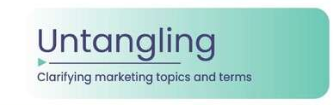

Daily data creation: The amount of data generated every day is a sign of how important privacy and security should be in life
Click here for the full report
337
Million Terabytes
of data is created daily
Which is equal to
135 Billion
HD streaming movies
worth of data created daily*
Source: Edge Delta, ‘Breaking Down The Numbers: How Much Data Does The World Create Daily in 2024?’, March 2024. *Calculated from an average HD streaming movie size of 2.5GB from Tachus, ‘How Much Data Is Used When Streaming TV?’, February 2024.
This information is exclusively provided to VAB members and qualified marketers.
PAGE 8

Slide 9

Data privacy legislation growth: Across the U.S., state laws on data privacy have increased significantly over the last two years
Click here for the full report
% of Total U.S. HH Population in States That Have Signed Laws on Data Privacy
This patchwork of regulations makes measurement, and abiding by all the separate state laws, more challenging for brands.
# of states:
1
3
5
12
19
Source: IAPP, ‘US State Privacy Legislation Tracker 2024’, as of 7/8/24. *Nielsen Universe Estimates, January 1, 2024, Total U.S. HHs.
This information is exclusively provided to VAB members and qualified marketers.
PAGE 9

Slide 10

Shifting towards CTV: Marketers are increasing CTV investment as data privacy legislation and ‘signal loss’ grows
Click here for the full report
% of US ad buyers who plan on increasing spending in 2024
due to legislation and signal loss, by channel
Signal Loss
The diminishing availability of data points directly tied to campaigns or individual users that allow marketers to acquire, measure and retarget customers.
Source: eMarketer, ‘Make Sense of TV Ad Measurement in 2024: What You Need to Know,’ February 2024.
This information is exclusively provided to VAB members and qualified marketers.
PAGE 10

Slide 11
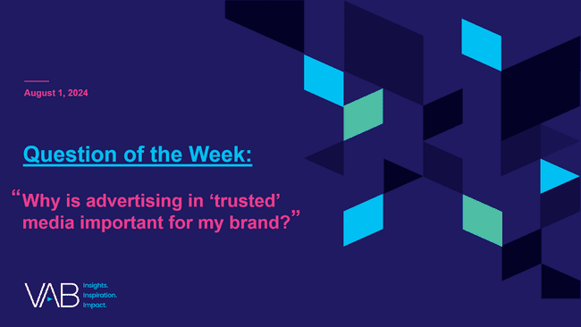
Trust by media platform: Multiscreen TV is the most trusted source for local, financial, political and science news
Click here for the full report
% who trust the following sources by news topic
A18+ (ranked by top five sources for each)
Local News
Financial News
Political News
Science News
Source
%
Source
%
Source
%
Source
%
TV / Streaming
44%
TV / Streaming
39%
TV / Streaming
38%
TV / Streaming
34%
News websites / apps
33%
News websites / apps
33%
News websites / apps
33%
News websites / apps
32%
Family or friends
29%
Family or friends
29%
Newspapers / Magazines
(print or digital)
28%
Federal or organizational websites
(.gov/.org)
30%
Newspapers / Magazines
(print or digital)
29%
Newspapers / Magazines
(print or digital)
27%
Federal or organizational websites
(.gov, .org)
26%
Newspapers / Magazines
(print or digital)
26%
Social media
26%
Federal or organizational websites
(.gov/.org)
25%
Family or friends
25%
Family or friends
24%
Source: VAB analysis of MRI-Simmons Q1 2024 Trending Topics Study, A18+. Reflects respondents who said they trust the following as a source for financial news, science news, political news or local news. Sources: TV/streaming news, news websites/apps, newspapers/magazines (print or digital), social media, radio, documentaries/informational programs, federal or organizational websites (.gov/.org), podcasts, postcards/direct mail, family or friends, other, I don’t look for this information.
This information is exclusively provided to VAB members and qualified marketers.
PAGE 11

Slide 12
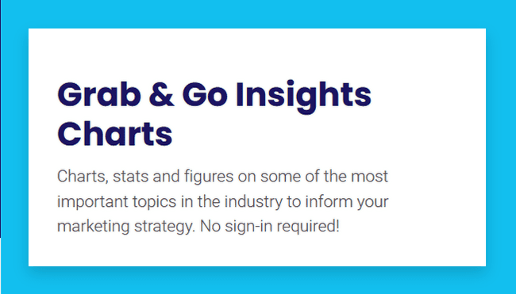
Need a quick chart? Visit our new Grab & Go page for one-off insights slides created for easy insertion into presentations
New Feature!
Click here for the full report
Charts, stats and figures on some of the most important topics in the industry. No sign-in required!
National TV Equivalized Ad IMPs by Program Genre
P2+
Jul ’18 – Jun ‘19
Jul ’23 – Jun ‘24
Grab & Go’s
(easy-to-download charts)
Media Trends
Economic Trends
Premium Video & Quality
Streaming
Transparency, Brand Safety & Ad Fraud
Ad Innovations
Demographic Trends
Life stage Insights
Local
Sports
Total Day
Prime
Source: VAB analysis of Nielsen Ad Intel, as of 8/8/24. National TV: broadcast & cable TV including Spanish-Language TV networks, excludes PSAs and promos. 7/1/18 – 6/30/19; 7/1/23 – 6/30/24. Nielsen program genres were rolled up into four groups. Entertainment - comedy, drama, film, kids, music, specials, variety / game shows; news – news, news documentaries, political; sports – live events, commentary shows, anthologies; other – instructional, devotional, varied format, unclassified.
This information is exclusively provided to VAB members and qualified marketers.
PAGE 12

Slide 13
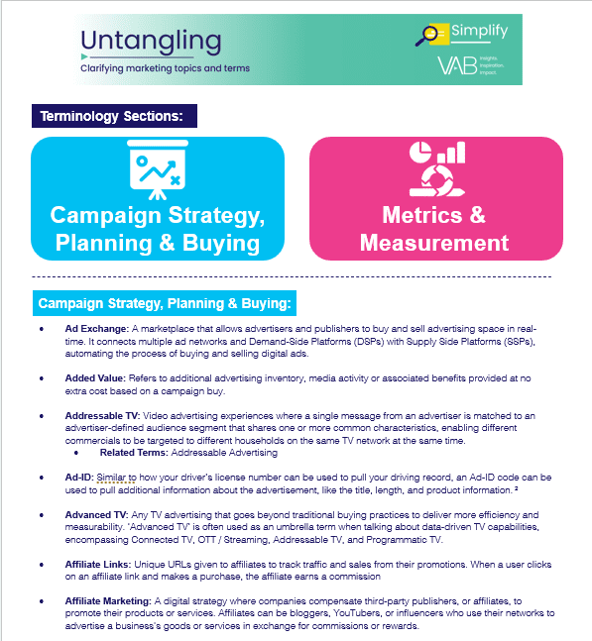
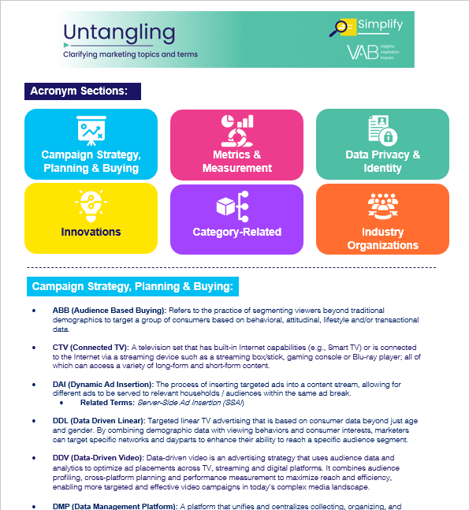
Confused about marketing terminology and acronyms?: Download two
of our most popular ‘Untangling’ reports to simplify the complex!
Bonus Slide!
Untangling Marketing Terminology
Untangling Marketing Acronyms
Click to download the full 16-page piece
Click to download the full 15-page piece
This information is exclusively provided to VAB members and qualified marketers.
PAGE 13

Slide 14




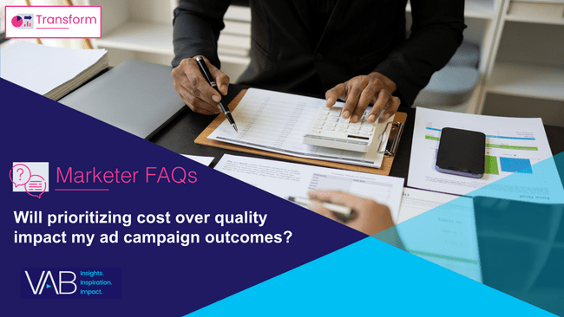
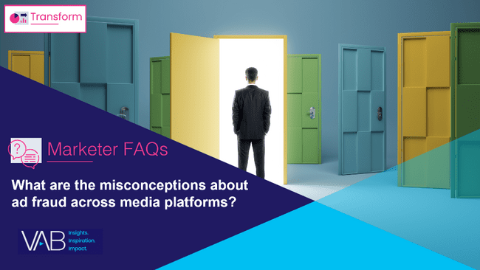
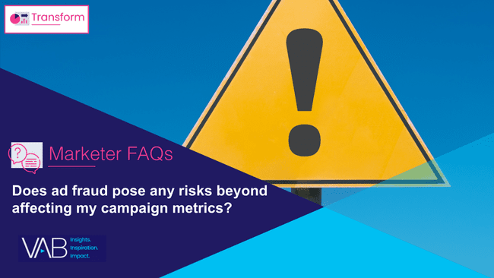


Marketer FAQs: Learn more about ad fraud, brand safety and transparency based on insights from our custom study
Click here for the full report
This information is exclusively provided to VAB members and qualified marketers.
PAGE 14

Slide 15





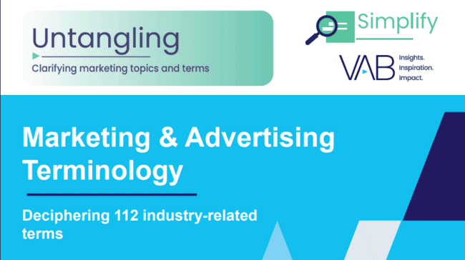
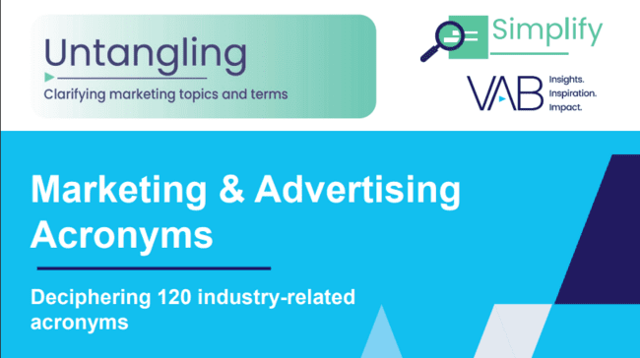


3Q 2024 Insights & Measurement Content Releases
Jason Wiese
Benjamin Vandegrift
SVP, Director of Strategic Insights
jasonw@thevab.com
VP, Measurement Solutions & Innovations benv@thevab.com
Kailyn Hartmann
Leah Montner-Dixon
VP, Advanced Analytics & Intelligence
kailynh@thevab.com
Director, Audience & Behavioral Insights
leahm@thevab.com
Reed Kiely
Karolina Guillen
Director, Data Insights & Trends
reedk@thevab.com
Associate Director, Insights, Strategy & Analytics karolinag@thevab.com
Kaileen Cain
Senior Insights Analyst
kaileenc@thevab.com
Discover more
Looking for more data, insights and takeaways? Check out this related VAB content
VAB Members, brand marketers and agencies get free and immediate access to VAB’s content library. Get access at theVAB.com
This information is exclusively provided to VAB members and qualified marketers.
PAGE 15

