Slide 1



2023 – 3rd Quarter

Slide 2


About VAB
VAB plays a dual role in the video advertising industry. We are leading the change to bring about a more innovative and transparent marketplace. We also provide the insights and thought leadership that enables marketers to develop business-driving marketing strategies.
Drawing on our marketing expertise, we simplify the complexities in our industry and discover new insights that transform the way marketers look at their media strategy.
We are committed to your business growth and proud to offer VAB members, brand marketers and agencies complimentary access to our continuously-growing Insights library. Get immediate access at theVAB.com.
This information is exclusively provided to VAB members and qualified marketers.
PAGE 2

Slide 3
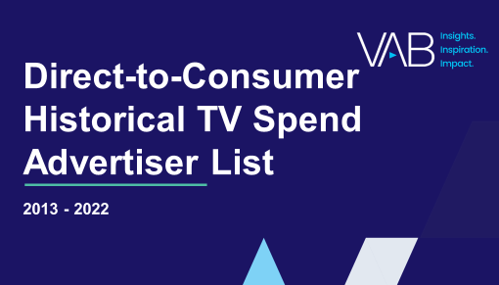


Direct-to-Consumer national TV advertisers: More data-driven, digital-native brands continue to launch new TV campaigns
Click here for the full advertiser list
Direct-to-Consumer (DTC) Brands U.S. Total TV Spend
in millions
+37%
vs. 2020
# of Brands:
62
110
175
327
423
Member’s Only exclusive, download the report to get the full list of advertisers
Source: VAB analysis of Nielsen Ad Intel, 2013-2022 Calendar Years, 6 TV Sources (National broadcast TV, national cable TV, Spanish-Language broadcast TV, Spanish-Language cable TV, Spot TV & Syndication TV). Direct to Consumer – a company that sells their product or service online directly to end customers without involving third-party retailers, wholesalers or other parts of the traditional consumer supply chain.*Number of DTC brands active on U.S. TV each year.
This information is exclusively provided to VAB members and qualified marketers.
PAGE 3

Slide 4


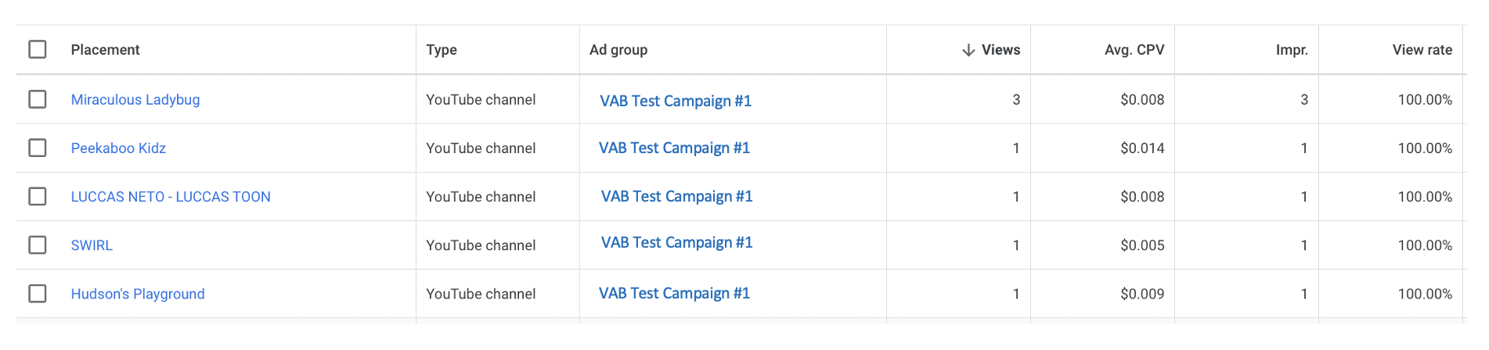
VAB investigates: Did YouTube allow for targeted campaigns to be served on “Made for Kids” channels?
Click here for the full report
The VAB created a YouTube channel with neutral, brand safe content
and executed a campaign to conduct our experiment
5 examples of placements on “Made for Kid’s” channels
being served behaviorally targeted ads
One of the channels included is “Peekaboo Kidz”, which describes itself as “Specially designed for kids as they explore the World of Kids Educational Videos”
Link
Link
Link
Link
Link
*763 total campaign placements
This information is exclusively provided to VAB members and qualified marketers.
PAGE 4

Slide 5




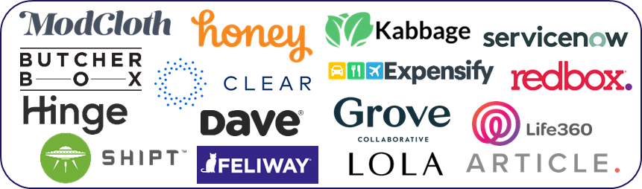

No budget is too small for TV: Brands across all investment levels see significant lifts in website traffic after their TV launch
Click here for the full report
36 ‘Emerging’ Direct-to-Consumer (DTC) Brands*
Average Monthly Website Unique Visitors (000)
Based Over a Four-Year Time Period: Jan ‘16 – Jan ‘20
$500K - $2MM TV Spend: 12 Brands Analysis
$2MM - $10MM TV Spend: 16 Brands Analysis
$10MM+ TV Spend: 8 Brands Analysis
+205%
(+5.3MM)
+126%
(+3.3MM)
+18%
(+376K)
+34%
(+693K)
+31%
(+338K)
+22%
(+236K)
(monthly average)
(TV launch – Jan ‘20)
(monthly average)
(TV launch – Jan ‘20)
(monthly average)
(TV launch – Jan ‘20)
(% & MM) vs. monthly average prior to TV launch
(% & MM) vs. monthly average prior to TV launch
(% & MM) vs. monthly average prior to TV launch
Source: VAB analysis of Nielsen Ad Intel data, TV spend (national cable TV, national broadcast TV, Spanish language broadcast TV, Spanish language cable TV, spot TV, syndication TV), Feb ‘18 – Jan ‘20 (calendar months). VAB analysis of Comscore mediametrix multiplatform media trend data, total audience (Desktop P2+, Mobile 18+), Jan ‘16 – Jan ‘20 (calendar months). ‘Prior to TV Launch’ reflects the average monthly unique visitors based on when each brand’s website began being measured by Comscore, or starting from January 2016 if measurement began before that month. *Reflects the 36 brands that are measured in Comscore and had reported monthly unique visitors in at least one month prior to their campaign launch.
This information is exclusively provided to VAB members and qualified marketers.
PAGE 5

Slide 6


Shoppable TV drives recall among young adults: Younger audiences are more likely to remember seeing interactive ads
Click here for the full report
% of A16+ who recall seeing different types of interactive ad formats when watching TV
% of total respondents
Source: VAB custom research fielded by Hub Entertainment Research as part of the 2023 Monetization of Video report. Data sourced from Hub’s survey of 1,602 TV consumers, ages 16-74 who meet the following criteria: watch at least one hour of TV / week, have broadband access. Data collected June 2023. Q2: Which of the following types of ad formats do you recall seeing when watching TV (including: TV and streaming)?
This information is exclusively provided to VAB members and qualified marketers.
PAGE 6

Slide 7











TV motivates young adults to act: Campaigns for younger-skewing brands drive engagement and online conversion
Click here for the full report
Sampling of Younger-Skewing Disruptor Brands
Monthly Website Unique Visitors (000) Comparison
Based Over a Four-Year Time Period: Jan ‘16 – Jan ‘20
Based Over a Four-Year Time Period: Mar ‘16 – Feb ’19
Brand | Monthly Average: Prior to TV Launch | Monthly Average: TV Launch – Jan ‘20 | # Diff | % Diff
 | 5,467 | 22,020 | +16,553 | +303%
 | 2,920 | 3,923 | +1,003 | +34%
 | 765 | 1,662 | +897 | +117%
 | 549 | 1,081 | +532 | +97%
 | 286 | 474 | +188 | +66%
Brand | Monthly Average: Prior to TV Launch | Monthly Average: TV Launch – Feb ‘19 | # Diff | % Diff
 | 2,471 | 10,549 | +8,078 | +327%
 | 5,978 | 13,812 | +7,833 | +131%
 | 1,309 | 1,630 | +321 | +25%
 | 1,584 | 3,008 | +1,424 | +90%
 | 254 | 1,324 | +1,070 | +422%
Source: Direct Effect - VAB analysis of Nielsen Ad Intel data, TV spend (national cable TV, national broadcast TV, Spanish language broadcast TV, Spanish language cable TV, spot TV, syndication TV), Feb ‘18 – Jan ‘20 (calendar months). VAB analysis of Comscore mediametrix multiplatform media trend data, total audience (Desktop P2+, Mobile 18+), Jan ‘16 – Jan ‘20 (calendar months). ‘Prior to TV Launch’ reflects the average monthly unique visitors based on when each brand’s website began being measured by Comscore, or starting from January 2016 if measurement began before that month. Direct Outcomes - Source: VAB analysis of Nielsen Ad Intel data, TV spend (national cable TV, national broadcast TV, Spanish language broadcast TV, Spanish language cable TV, spot TV, syndication TV), March ‘15 – February ‘19 (calendar months). VAB analysis of Comscore mediametrix multiplatform media trend data, total audience (Desktop P2+, Mobile 18+), March ’15 – February ’19 (calendar months). ‘Prior to TV Launch’ reflects the average monthly unique visitors based on when each brand’s website began being measured by Comscore, or starting from March 2015 if measurement began before that month.
This information is exclusively provided to VAB members and qualified marketers.
PAGE 7

Slide 8

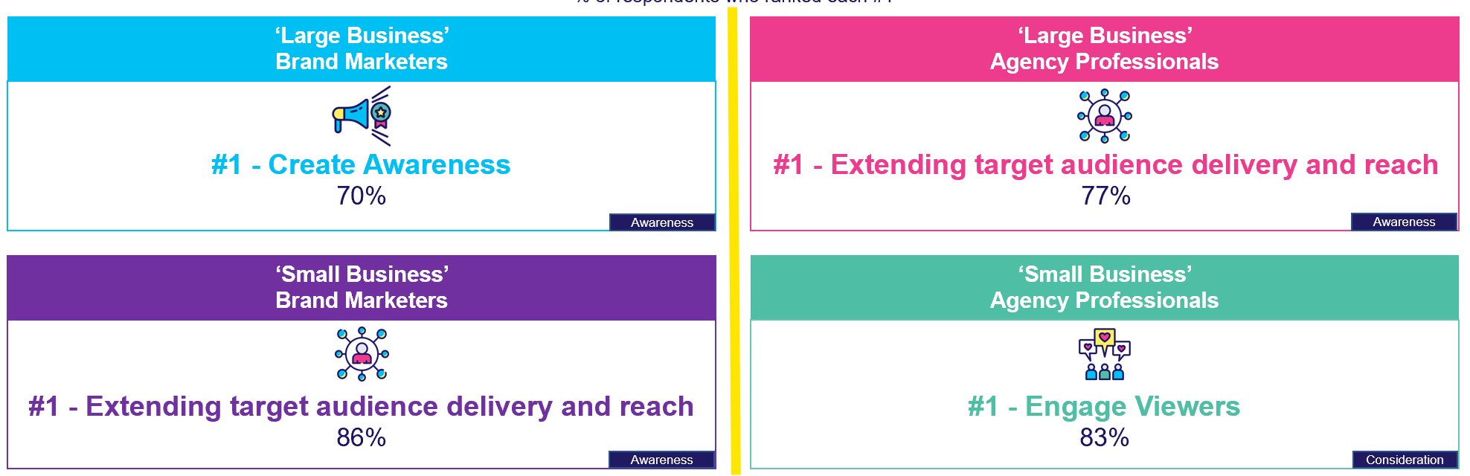
Audience-based TV buying drives KPIs: Brands are using ABB to increase target audience reach and engage new customers
Click here for the full report
% of respondents who believe audience-based TV buying can impact each of the following KPIs
% of respondents who ranked each #1
VAB / Spectrum Reach / Advertiser Perceptions ‘Audience-Based Buying Survey,’ February 2023, fielded January 11 – 27, 2023 (n=210). Survey base: Advertising decision-makers who are involved in buying or planning digital video, cable / broadcast TV, or advanced TV. ‘Large’ Brand Marketers = business with annual total ad spend of $5MM+, ‘Small’ Brand Marketers = business with annual total ad spend of $10K - $5MM, ‘Large Business’ Agency Pros = client with annual total ad spend of $5MM+, ‘Small Business’ Agency Pros = client with annual total ad spend of $10K - $5MM. Q150. To what extent do you believe audience-based buying of TV advertising can impact each of the following KPIs? (extremely impactful / very impactful). Base = Total Respondents.
This information is exclusively provided to VAB members and qualified marketers.
PAGE 8

Slide 9

Another silver lining for FAST: Adults 65+ are turning to FAST services to expand the amount of content they have access to
Click here for the full report
Which of the following are reasons for why you have watched / signed up for a free ad-supported streaming TV service?
% of total respondents (rank 1-3)
A25-34
A55-64
A65-74
#1 - A specific TV program or movie I wanted to see
36%
#1 - A specific TV program or movie I wanted to see
50%
#1 - Ability to access free content I want to see in exchange for watching ads
48%
#2 - Ability to access free content I want to see in exchange for watching ads
34%
#2 - Ability to access free content I want to see in exchange for watching ads
47%
#2 - Easy access to a large library of 'classic' programming at any time
48%
#3 - Wide variety of content offered which complements my other video subscriptions
33%
#3 - Easy access to a large library of 'classic' programming at any time
45%
#3 - A specific TV program or movie I wanted to see
47%
Source: VAB custom research fielded by Hub Entertainment Research as part of the 2023 Evolution of Video Branding report. Data sourced from Hub’s survey of 2,400 TV consumers, ages 16-74 who meet the following criteria: watch at least one hour of TV / week, have broadband access. Data collected early February 2023. Q2: Which of the following are reasons for why you have watched / signed up for a free ad-supported streaming TV service?
This information is exclusively provided to VAB members and qualified marketers.
PAGE 9

Slide 10

Adults 65+ discretionary spending advantage: HH net worth growth for older adults is outpacing younger demographics
Click here for the full report
Household Net Worth by Demo
2017 vs. 2023
+80%
+50%
+7%
Source: VAB analysis of MRI-Simmons USA Study, Spring 2017 & Spring 2023. According to the U.S. Census Bureau, ‘net worth’ is the value of assets owned (cash in bank accounts, investments, retirement accounts, etc. as well as the value of any owned property) minus any liabilities owed (debt, including student loans, credit cards, mortgage, etc.).
This information is exclusively provided to VAB members and qualified marketers.
PAGE 10

Slide 11
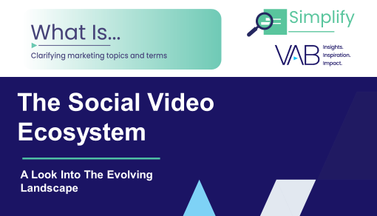

Social video ad growth: Spend has more than tripled since 2019 and will soon represent a $40 billion marketplace
Click here for the full report
U.S. Social Video Ad Spending
$ in Billions
Source: eMarketer, ‘Social Video Ad Spending Forecast 2023,’ 1/24/23. Note: excludes spending by marketers that goes toward developing or maintaining organic social video content; excludes YouTube; includes paid video advertising appearing within social networks, social network games and social network apps. Ad Spend Forecast based of October 2022 data. Note: YouTube advertising revenues, from eMarketer: 2019 - $3.4B, 2020 - $4.5B, 2021 - $6.5B, 2022 - $6.9B, 2023 - $7.4B, 2024 - $8.5B
This information is exclusively provided to VAB members and qualified marketers.
PAGE 11

Slide 12
















Measuring outcomes: Three key components lead to insights and optimization opportunities for cross-platform measurement
Click here for the full report
1
2
3
Insights & Optimization Opportunities
Ad Data
Outcomes Data
Identity Resolution
Surveys
Aggregated
Online Behavior
Individual
Level
Household
Level
Privacy
Compliant
Outcomes Over Time
Target Audience Insights
Cross Platform
Outcomes
Impression
Data
Cross Platform Ad Exposure
Web Tags
Sales
Leverage impression-based ad exposure data that reflects when and where your ads ran across the video ecosystem
Collect full funnel outcomes data during your ad campaign to capture a full picture look at the customer journey
Match ad data & outcomes data in a privacy compliant manner via an identity resolution at a HH or individual level
Outcome solutions rooted in identity enable true cross platform measurement of outcomes and supports the ability to layer in valuable audience information
This information is exclusively provided to VAB members and qualified marketers.
PAGE 12

Slide 13




What’s next in measurement? The future of TV measurement will likely be dependent on both big data and panels, with panels acting as a complement to modern measurement
Bonus Slide!
Click here for the full report
Measurement Panel
Calibration Panel
Validation Panel
Overview
Overview
Overview
Viewing habits, behaviors and demographic info are collected from a small group of people to represent a larger group
Used along with another data asset (such as big data) and is used to understand where the gaps or biases are within that dataset
Used to show mathematically that you’re solving for the gaps in the measurement (such as representation or bias)
Benefits
Benefits
Benefits
When stable, panels can be used to provide a common view of the TV landscape
Can provide a path to demographic, geographic and television household type representation in TV measurement
Can be used to prove that relevant changes/adjustments have been made to solve bias issues
Challenges
Challenges
Challenges
Can lack in representation of certain television household types such as OTA
If there are issues with the panel, those biases can be passed into the dataset they are meant to benefit
Requires a well-trained Machine Learning Model
This information is exclusively provided to VAB members and qualified marketers.
PAGE 13

Slide 14

Jason Wiese
Benjamin Vandegrift
SVP, Director of Strategic Insights
jasonw@thevab.com
VP, Measurement Solutions & Innovations
benjaminv@thevab.com
Reed Kiely
Leah Montner-Dixon
Director, Data Insights & Trends
reedk@thevab.com
Director, Audience & Behavioral Insights
leahm@thevab.com
Karolina Guillen
Insights Manager
karolinag@thevab.com
Discover more
Looking for more data, insights and takeaways? Check out this related VAB content
We are committed to providing marketers with the data and insights they need to develop thoughtful, inclusive campaigns & strategies. To find out more on the unique media consumption behaviors and cultural trends of diverse consumers, visit the VAB’s DEIB Marketing Resources Center.
VAB Members, brand marketers and agencies get free and immediate access to VAB’s content library. Get access at theVAB.com
This information is exclusively provided to VAB members and qualified marketers.
PAGE 14

