Slide 1



2021 – 3rd Quarter

Slide 2

About VAB
VAB is an insights-driven organization that inspires marketers to reimagine their media strategies resulting in fully informed decisions.
Drawing on our marketing expertise, we simplify the complexities in our industry and discover new insights that transform the way marketers look at their media strategy.
Simplify
We save you time by bringing you the latest data & actionable takeaways you can use to inform your marketing plans.
Discover
We keep you one step ahead with the latest thinking so you can create innovative, forward-looking strategies.
Transform
We help you build your brand by focusing on core marketing principles that will help drive tangible business outcomes.
We are committed to your business growth and proud to offer VAB members, brand marketers and agencies complimentary access to our continuously-growing Insights library. Get immediate access at theVAB.com.
This information is exclusively provided to VAB members and qualified marketers. Further distribution is prohibited.
PAGE 2

Slide 3







Solutions to the crumbling cookie: The anticipated phase-out is driving marketers to reallocate budgets to channels without third-party cookies like streaming platforms and connected TV
Click here for the full report
Because of major browsers phasing out third-party cookies…
Click below to untangle the
terminology within data, privacy & identity
36%
33%
32%
My company/main client will reallocate spend to other channels without third-party cookies
My company/client will build an effective identity solution
My company/main client will develop a more sophisticated tech stack
Source: Xandr, 2020 Ad Relevance Report
This information is exclusively provided to VAB members and qualified marketers. Further distribution is prohibited.
PAGE 3

Slide 4





A total audience buying approach engages best prospects:
TV exposure to adult 50+ viewers resulted in the influx of new consumers through the ‘digital storefronts’ of 30 DTC brands
Click here for the full report
Unique Website Visitors: 30 Brand Average
1Q ‘17*
(Monthly Avg)
1Q ‘21
(Monthly Avg)
1Q ‘21 vs. 1Q ‘17
(Monthly Avg)
Median Age
30 Brand Avg
43.2
49.9
+6.7
years
Total U.S. Internet Avg
44.3
45.2
+0.9
years
P50+ Comp %
30 Brand Avg
37.6%
51.7%
+14.1%
percentage points
Total U.S. Internet Avg
39.7%
42.2%
+2.5
percentage points
Source: VAB analysis of Comscore mediametrix multiplatform media trend data, P18+. 1Q ’17: January – March ‘17, 1Q ‘21: January – March ‘21 (calendar months), monthly average within each quarter, P50+ comp% is based on monthly unique visitors; figures are based on monthly averages for each 3-month time period across the 30 brands analyzed. *1Q ‘17 (Jan-Mar ‘ 17) is reflective of the first 3-month measurement period available and is inclusive of a few brands that were first measured after this time period, based on their first 3-month measurement period. Note: Comscore did not begin measuring ‘median age’ as a reported metric until February ‘17, therefore the first time period reflects Feb-Apr ‘17.
This information is exclusively provided to VAB members and qualified marketers. Further distribution is prohibited.
PAGE 4

Slide 5
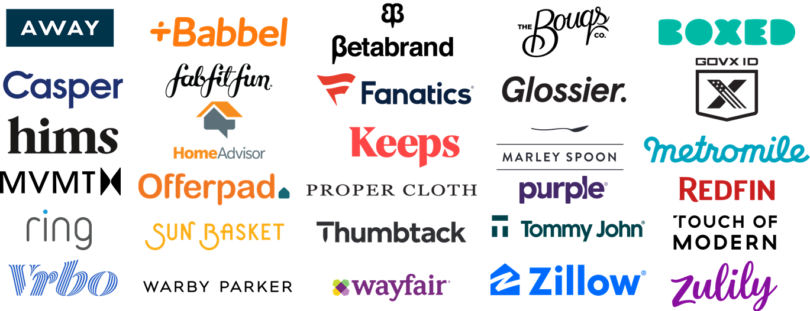



Driving business outcomes through total audience-based buying:
The TV investment strategies of 30 DTC brands analyzed led to exponential growth in consumer action and digital engagement
Click here for the full report
Key Website Metrics: 30 Brand Average
Jan-Mar ‘21 vs. Jan-Mar ’17: Three-Month Avg Comparison
Unique Visitors (000)
Total Visits (000)
Total Minutes (MM)
# Difference
+3,156
+22,184
+95
% Difference
+63%
+135%
+89%
Total U.S. Internet Avg
% Difference
+10%
+26%
+34%
Source: VAB analysis of Comscore mediametrix multiplatform media trend data, P18+. January – March ’17, January – March ‘21 (calendar months), figures are based on averages across the 30 brands analyzed. *Jan-Mar ’17 is reflective of the first 3-month measurement period and is inclusive of brands that were not Comscore measured until later into 2017.
This information is exclusively provided to VAB members and qualified marketers. Further distribution is prohibited.
PAGE 5

Slide 6

What would encourage brand marketers to increase their investment in audience-based TV buying? Development of enhanced performance metrics, as well as more education and training
Click here for the full report
Which of the following would encourage you to increase your investment in audience-based TV buying?
% of brand marketer respondents that ranked the following statement 1-3
48%
43%
41%
39%
33%
Development of better performance metrics solutions
Having a better understanding of benefits and how it works
Unified measurement across media platforms
Incentives provided by media companies
Introduction of a new advanced solution or offering in the market
vs. 26% among ‘agency pros’
Source: VAB / Advertiser Perceptions ‘Audience-Based Buying Survey,’ March 23 – 31, 2021. Survey base: Advertising decision-makers who are involved in buying or planning digital video, cable / broadcast TV, or advanced TV (n=211). Brand Marketers = respondents who work for a company selling products or services to consumers (B2C) or businesses (B2B), ‘Small Business’ Brand Marketers = business with annual total ad spend of $10K - $5MM. Q130. Which of the following would encourage you to increase your investment in audience-based TV buying?
This information is exclusively provided to VAB members and qualified marketers. Further distribution is prohibited.
PAGE 6

Slide 7



Greater education on audience-based buying leads to higher satisfaction: Marketers that are formally trained are more likely to see successes from their ABB TV campaigns
Click here for the full report
% of respondents who are satisfied with the following aspects of the audience-based TV buying process
Formal Company Training
Informal In-house Training
No Training
Ability to Deliver Outcomes
Media Measurement
72% / 55% / 40%
72% / 55% / 23%
Source VAB / Advertiser Perceptions ‘Audience-Based Buying Survey,’ March 23 – 31, 2021. Survey base: Advertising decision-makers who are involved in buying or planning digital video, cable / broadcast TV, or advanced TV (n=211). Q103. How satisfied are you with the following aspects of the audience-based buying process in TV advertising? (very satisfied / satisfied). Base = Respondents who say audience-based buying is a ‘key part’ / ‘small part’ of their TV strategy or are currently testing audience-based buying and determining its role. ‘Formal Company Training’ = formal internal training program offered by your company; ‘Informal In-house Training’ = informal internal training provided by a colleague.
This information is exclusively provided to VAB members and qualified marketers. Further distribution is prohibited.
PAGE 7

Slide 8





Embracing innovative buying strategies through ‘test and learns’: Marketers are learning that ABB TV campaigns can deliver greater ROI and quantifiable business outcomes against their objective
Click here for the full report
Top Benefits of Audience-Based Buying in TV Advertising
% of marketers ‘currently testing ABB TV’ that ranked each between #1-3 in priority
Better Return on Investment (ROI)
Execute Against Objectives With A Smaller Initial Investment
Ability to Deliver Outcomes
Increased Ad Relevance for Consumers
44%
30%
28%
28%
122 index
149 index
107 index
How to read the indices: example - marketers ‘currently testing ABB TV’ are 22% more likely then all other respondents to rank ‘Better Return on Investment (ROI)’ in their top 3 benefits of audience-based buying in TV.
Source: VAB / Advertiser Perceptions ‘Audience-Based Buying Survey,’ March 23 – 31, 2021. Base: Marketers who are “currently testing audience-based buying and determining its role in our TV strategies.” Q110. Rank up to 3 factors that you believe are the top benefits of audience-based buying in TV advertising (rank 1-3). Top 4 on percentage are reflected. Index calculated against survey respondents who are not currently testing audience-based TV buying (n=168).
This information is exclusively provided to VAB members and qualified marketers. Further distribution is prohibited.
PAGE 8

Slide 9
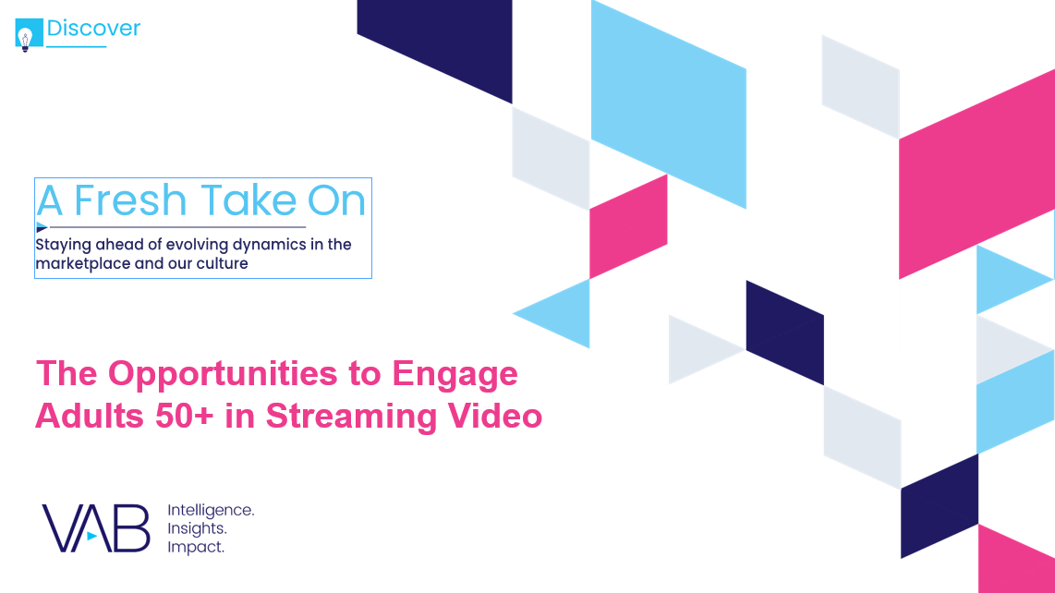
Ad opportunity in streaming for older consumers: On average, adults 50+ spend nine hours with video streaming per week, over five of which are through services with at least a limited ad load
Click here for the full report
Average % of time spent with streaming in a typical week by platform
A50+
On average, adults 50+ spend nearly
38% of their time streaming on subscription services without ads in a typical week
On average, adults 50+ spend
62% of their time streaming on services with ads in a typical week
Source: VAB analysis of MRI-Simmons Cord Evolution Study, April 2021. Percentage breakout represents average time spent in a typical week with various sources used to watch content. Average hours represents ‘hours of time-shifted streaming in typical week’ and ‘hours of live streaming in typical week’. ‘Paid Subscription Streaming w/out Ads’ includes pure paid subscription services (e.g., Netflix, Prime Video, HBO Max, Commercial-free Hulu, etc). ‘Streaming Services w/ Ads (Paid/Free)’ includes Paid Subscription Streaming w/ Ads (e.g., versions of Hulu, Discovery+, Peacock, etc. with ads/commercials), Free Streaming services (e.g., Pluto TV, YouTube, Tubi, etc.), Streaming Cable TV network apps (e.g., A&E app, Bravo app, E! app, etc.) and Streaming Broadcast TV network apps (e.g., ABC app, NBC app, CBS app, FOX app, etc.).
This information is exclusively provided to VAB members and qualified marketers. Further distribution is prohibited.
PAGE 9

Slide 10
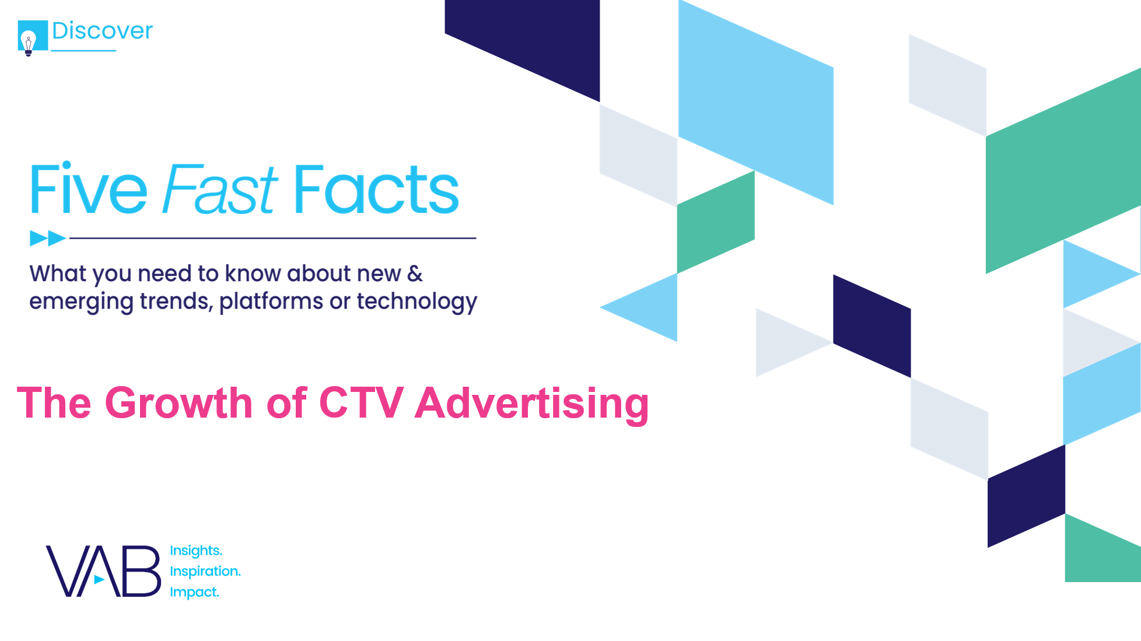
The growth of CTV advertising: Marketers are flocking to the platform as two-thirds began shifting some of their media investment into connected TV within the last three years
Click here for the full report
Connected TV: Annual Advertising Spend
Two-thirds of marketers began shifting their media investment to connected TV within the last three years
24%
41%
11%
24%
> One year ago
1-3 years ago
< 3 years ago
Have not started shifting strategy
Source: eMarketer’s Connected TV Ad Spending in the U.S., June 2020 & March 2021. Innovid: The State of CTV Advertising, May 2021.
This information is exclusively provided to VAB members and qualified marketers. Further distribution is prohibited.
PAGE 10

Slide 11
Bartering data for a better experience: Marketers searching for consumer data should consider CTV as over two-thirds of viewers are willing to share their information for improved personalization
Click here for the full report
What type of data are you comfortable sharing with brands to improve your CTV ad experience?
Source: Integral Ad Science, Press Play: CTV & Ads, October 2020; Valassis, Connected TV Isn’t Just Cool, It Really Works, March 2021
This information is exclusively provided to VAB members and qualified marketers. Further distribution is prohibited.
PAGE 11

Slide 12
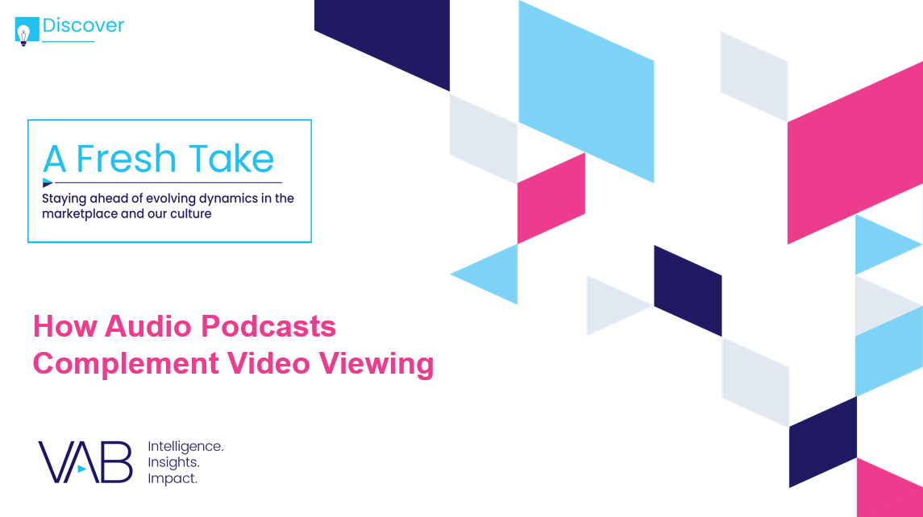
Audio podcasts complement video viewing: While TV drives outcomes throughout the entire funnel, adding podcasts to the media mix can build consideration and purchase intent
Click here for the full report
Media Types Best at Delivering Campaign Objectives
% of advertisers
Upper Funnel
Mid Funnel
Lower Funnel
Source: VAB analysis of Advertiser Perceptions’ Podcast Advertising Market Report, 2020.
This information is exclusively provided to VAB members and qualified marketers. Further distribution is prohibited.
PAGE 12

Slide 13

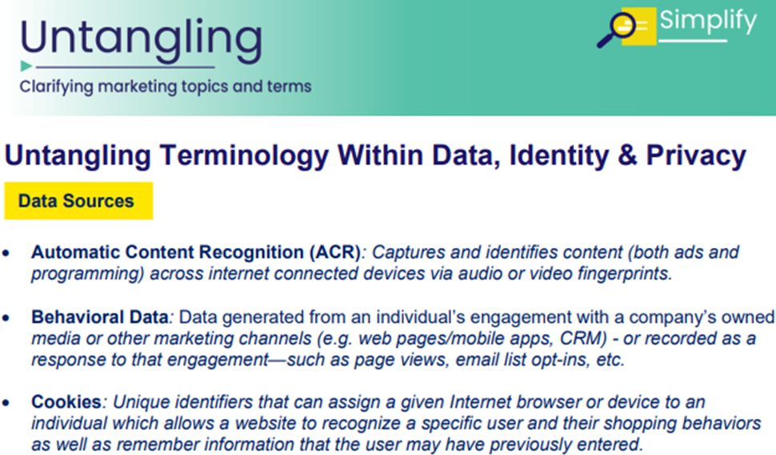
Leah Montner-Dixon
Reed Kiely
Associate Insights Director
leahm@thevab.com
Associate Insights Director
reedk@thevab.com
Karolina Guillen
Insights Manager
karolinag@thevab.com
Discover more
Looking for more data, insights and takeaways? Check out this related VAB content
VAB Members, brand marketers and agencies get free and immediate access to VAB’s content library. Get access at theVAB.com
This information is exclusively provided to VAB members and qualified marketers. Further distribution is prohibited.
PAGE 13

