Slide 1



2024 – 2nd Quarter

Slide 2


About VAB
VAB plays a dual role in the video advertising industry. We are leading the change to bring about a more innovative and transparent marketplace. We also provide the insights and thought leadership that enables marketers to develop business-driving marketing strategies.
Drawing on our marketing expertise, we simplify the complexities in our industry and discover new insights that transform the way marketers look at their media strategy.
We are committed to your business growth and proud to offer VAB members, brand marketers and agencies complimentary access to our continuously-growing Insights library. Get immediate access at theVAB.com.
This information is exclusively provided to VAB members and qualified marketers.
PAGE 2

Slide 3





Gen Z prefers long-form video: While P16-34 enjoy social videos, over two-thirds spend more time with long-form content
Click here for the full report
How much do you agree or disagree with the following statements regarding short-form content?
% P16-24 / P25-34 respondents
65% / 75%
‘I spend more time watching professionally
produced long-form programming through streaming and TV than short-form video content
on social media platforms’
66% / 71%
‘Watching professionally produced, long-form programming through streaming and TV is
more engaging to me than short-form,
user-generated videos on social media platforms’
of P16-24 agree that…
of P25-34 agree that…
of P16-24 agree that…
of P25-34 agree that…
Source: VAB custom research fielded by Hub Entertainment Research as part of the 2023 Evolution of Video Branding report. Data sourced from Hub’s survey of 2,400 TV consumers, ages 16-24 & P25-34 who meet the following criteria: watch at least one hour of TV / week, have broadband access. U.S. census balanced. Data collected early February 2023. Q: How much do you agree with the following statements?
This information is exclusively provided to VAB members and qualified marketers.
PAGE 3

Slide 4
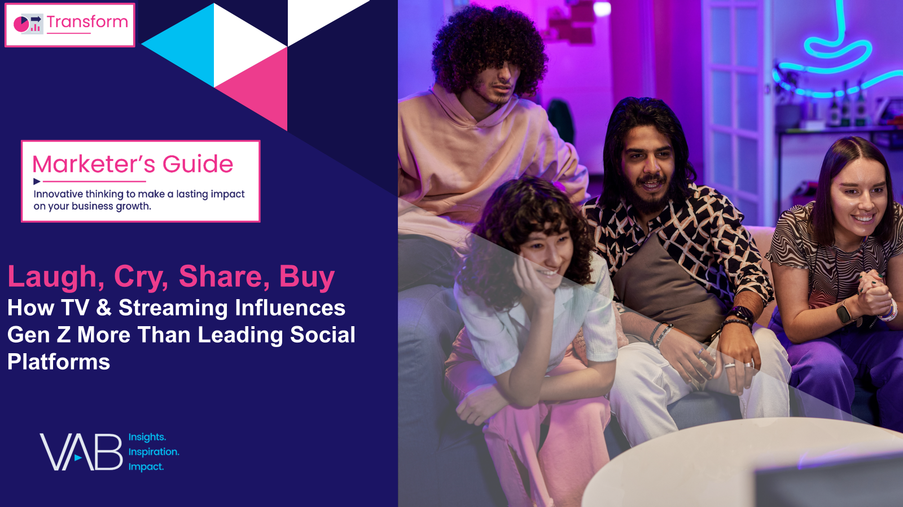






All the Feels: Gen Z builds more meaningful connections with characters and people from TV and streaming than social media
Click here for the full report
% of P13-24 who feel personally connected to a character / personality from content on the following platforms
TV / Streaming vs. Social Media*
% more likely
34%
+35%
25%
15%
+125%
of Gen Z say they
‘feel personally connected to a character / personality’
from TV or streaming content
VS.
21%
+61%
16%
+117%
+26%
27%
*How to read: P13-24 are 35% more likely to feel personally connected to a character / personality from TV or streaming content vs. TikTok content
Source: VAB custom research fielded by Hub Entertainment Research as part of the 2023 Video Redefined report. Data sourced from Hub’s survey of 1,900 consumers, ages 13-74. P13-24 respondents = 620 (unweighted). Data collected December 2023. Q1: Which of the following statements apply to you when you watch videos, shows or movies on the following platforms?
This information is exclusively provided to VAB members and qualified marketers.
PAGE 4

Slide 5






Inspiring action among Hispanics: TV and streaming is more likely to influence tech product purchases than social media
Click here for the full report
% of Hispanics who have purchased a tech product that has been shown / featured on the following platforms
TV / Streaming vs. Social Media*
% more likely
18%
14%
+26%
12%
+51%
of Hispanics say they have
‘purchased a tech product that has been shown / featured’
in TV or streaming content
VS.
13%
+30%
16%
+12%
16%
+10%
*How to read: Hispanics are 26% more likely to purchase a tech product that has been shown / featured in TV or streaming content vs. TikTok content
Source: VAB custom research fielded by Hub Entertainment Research as part of the 2023 Video Redefined report. Data sourced from Hub’s survey of 1,900 consumers, ages 13-74. Hispanic respondents = 325 (unweighted). Data collected December 2023. Q3: Which of the following actions have you taken as a result of watching something on the following platforms?
This information is exclusively provided to VAB members and qualified marketers.
PAGE 5

Slide 6
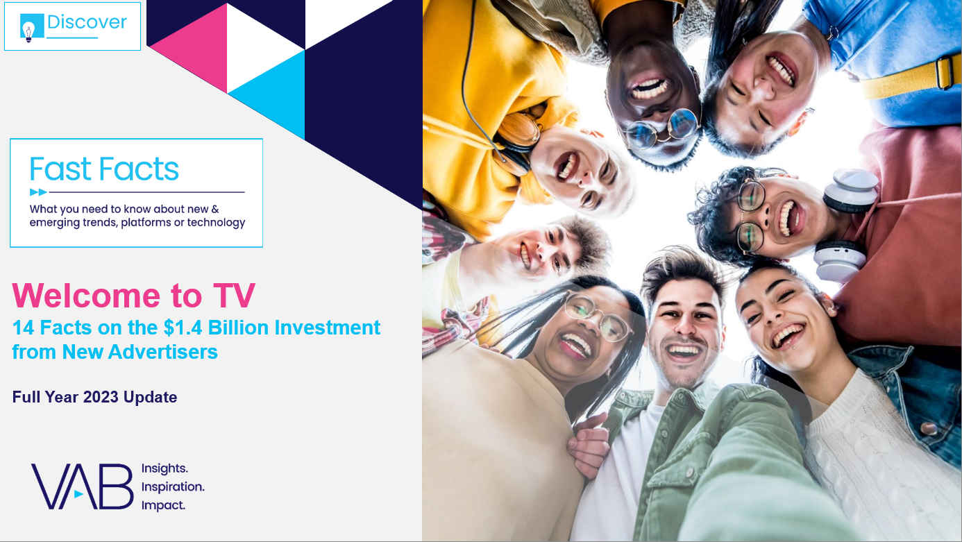


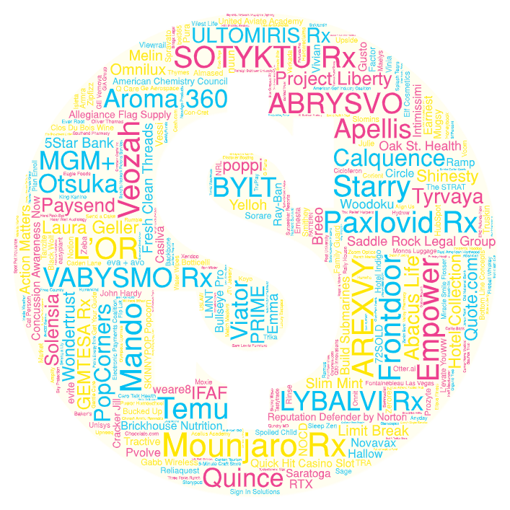





2023 new TV advertisers: Despite economic uncertainty, more dollars were invested by new advertisers than in prior years
During the full year of 2023, 313 advertisers across 56 categories invested over $1.36 billion in national TV for the first time
Click here for the full report
New
TV Advertisers
New National TV Advertisers
2019 – 2023
Year | # of New Advertisers | # of Categories | New TV $$$
2019 | 114 | 61 | $840MM
2020 | 283 | 95 | $1.28B
2021 | 315 | 74 | $1.32B
2022 | 303 | 71 | $1.33B
2023 | 313 | 56 | $1.36B
For a full list of the 313 brands with spend click here
Source: VAB analysis of Nielsen Ad Intel data as of 2/7/24, 1/1/23-12/31/23. Prior years based on VAB analysis of Nielsen Ad Intel Data from the following periods: 1/1/2019-12/31/2019, 1/1/2020-12/31/2020, 1/1/2021-12/31/2021, 1/1/2022-12/31/2022. TV spend includes national cable TV, broadcast TV, Spanish language cable TV, Spanish language broadcast TV. Brands reflect those with national TV spend over $100K.
This information is exclusively provided to VAB members and qualified marketers.
PAGE 6

Slide 7




An inconvenient truth: More than two out of three marketers & agencies prioritize cost over brand safety in their ad campaigns
Click here for the full report
% of respondents who are prioritizing brand safety over lower CPMs
Brand Marketers
Agency Professionals
32%
27%
Brands and agencies have different reasons to push for lower costs including cost suppression tied to compensation or KPI directives
Source: VAB / Advertiser Perceptions ‘Marketer Sentiment on Ad Fraud’ Survey, November 2023. Survey base: Marketer and agency contacts from the Advertiser Perceptions ‘Senior Marketer’ and ‘Streaming Video’ online communities. Q6. What solutions [is your company/are your clients] using to prevent digital ad fraud? Base = Total Respondents.
This information is exclusively provided to VAB members and qualified marketers.
PAGE 7

Slide 8
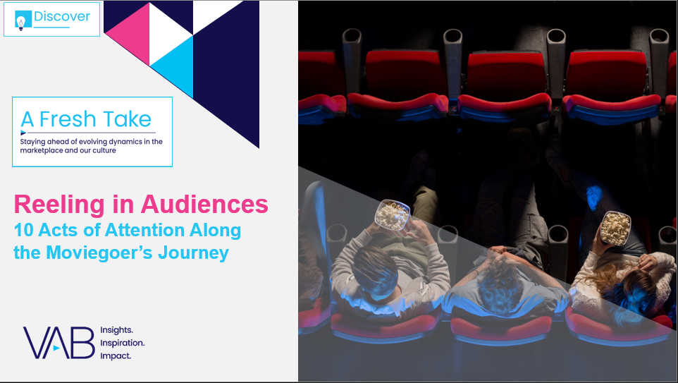

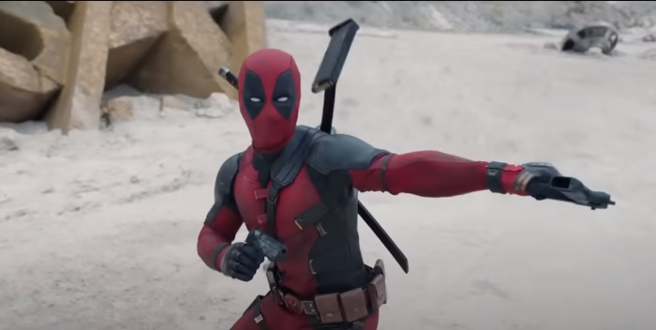
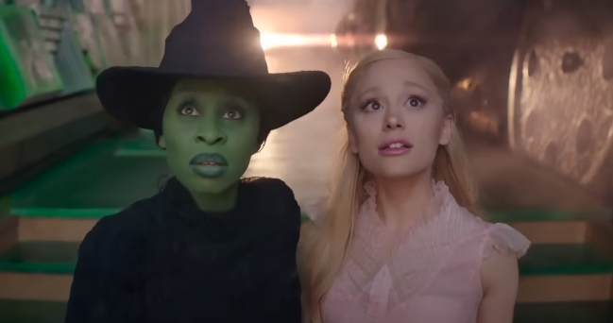

Consumer interest in cinema: Upcoming theatrical releases were the two most engaging ads in this year’s Super Bowl
Click here for the full report
2024 Superbowl Ads
Ranked by Engagement Index
“Deadpool & Wolverine”
(Walt Disney Studios)
“Wicked: Part One”
(Universal Pictures)
“Twisters”
(Universal Pictures)
#1
~6 months from release
#2
10 months from release
#6
~6 months from release
23.4x
more engagement
as the median-performing Super Bowl LVIII ad airing
21.1x
more engagement
as the median-performing Super Bowl LVIII ad airing
16.9x
more engagement
as the median-performing Super Bowl LVIII ad airing
*Note: Each Super Bowl ad performance is indexed to the median-performing in-game spot (the median airing is scored at 100). Engagement is based online activity like search and website visits after airing.
Source: EDO, ‘Super Bowl LVIII Ad Rankings’, February 2024. Rank #3 was ‘Volkswagen – An American Love Story’ (1,694 index), Rank #4 was ‘Poppi – The Future of Soda is Now’ (1,661 index), Rank #5 was ‘Temu Billionaire’ (1,443 index). Click imagery above to watch commercial.
This information is exclusively provided to VAB members and qualified marketers.
PAGE 8

Slide 9








Device ownership: HHs have more TVs than any other device, which creates more opportunities for brands on a big screen
Click here for the full report
Households: Average Number of Devices Owned
2.4
2.2
2.0
1.8
TV
Smartphone
Smart Speaker
Laptop
1.7
1.7
1.3
Tablet
Game Console
Desktop Computer
Source: VAB analysis of ARF DASH study, full year 2023. Based on survey of 10,000 A18+. Q4: How many of the following devices do you and the members of your household own and have used in the past 6 months? Based on household weighting.
This information is exclusively provided to VAB members and qualified marketers.
PAGE 9

Slide 10

Growth of ad-supported streaming: A majority of new streaming subscriptions are now for an ad-supported tier
Click here for the full report
Select SVOD Gross Adds
Ad-Free vs. Ad-Supported
Source: Antenna. U.S. only. Excludes free tiers, MVPD + Telco Distribution, and select Bundles. Services include AMC+, Apple TV+, BET+, Discovery+, Disney+, Hulu, Max, Netflix, Paramount+, Peacock and Starz. AMC+ does not include Direct distribution.
This information is exclusively provided to VAB members and qualified marketers.
PAGE 10

Slide 11
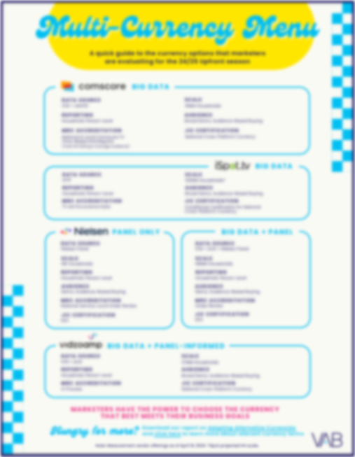

Snackable Insights: Download two of VAB’s most popular infographics for quick insights on video consumption and the latest on currency!
The Story of Us:
How Americans Spend Their Leisure Time
Multi-Currency Menu:
Quick Guide on Currency Options
Download to get the full picture!
Download to learn more!
This information is exclusively provided to VAB members and qualified marketers.
PAGE 11

Slide 12
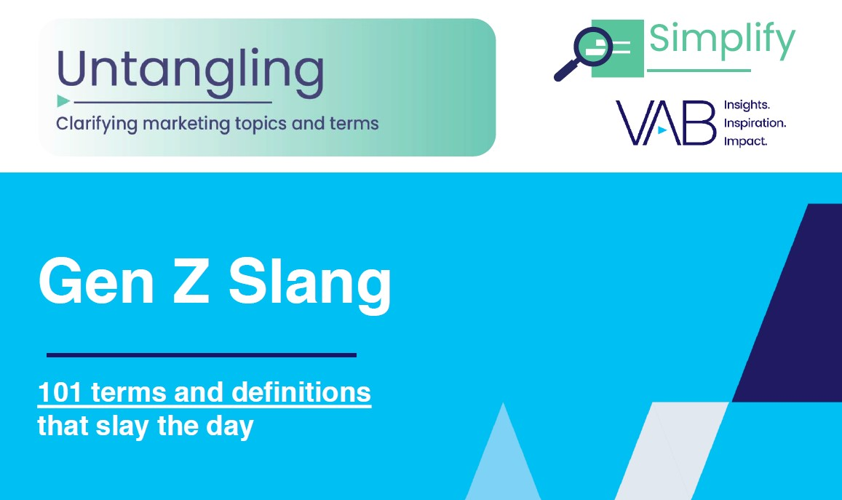







Gen Z Glossary: 101 terms to decoding Gen Z, helping brands understand and connect with young audiences
Bonus Slide!
Click here for the full report
Sampling of Gen Z Terms Included
Basic: Someone who likes and prefers mainstream products, music, fashion and trends
FRFR: For Real For Real, to emphasize the truth in a statement
Hits Different: Something that has a profound impact on you
Cap: Not the truth, a lie
Eras: A stage of life that you are in (I'm in my fitness era!)
Main Character: A type of energy someone gives off, thinking they are the main character in their own story
Flavortown: Guy Fieri slang term, it is a state of mind where food and fun meet in harmony
Understood the Assignment: Someone who is giving 100% in whatever they are doing
Download ‘Untangling Gen Z Slang’ for the full list of 101 terms!
This information is exclusively provided to VAB members and qualified marketers.
PAGE 12

Slide 13
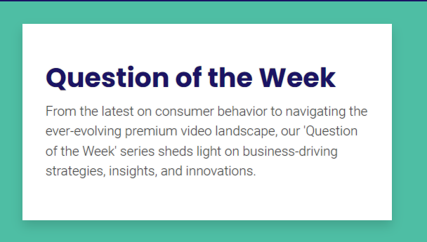
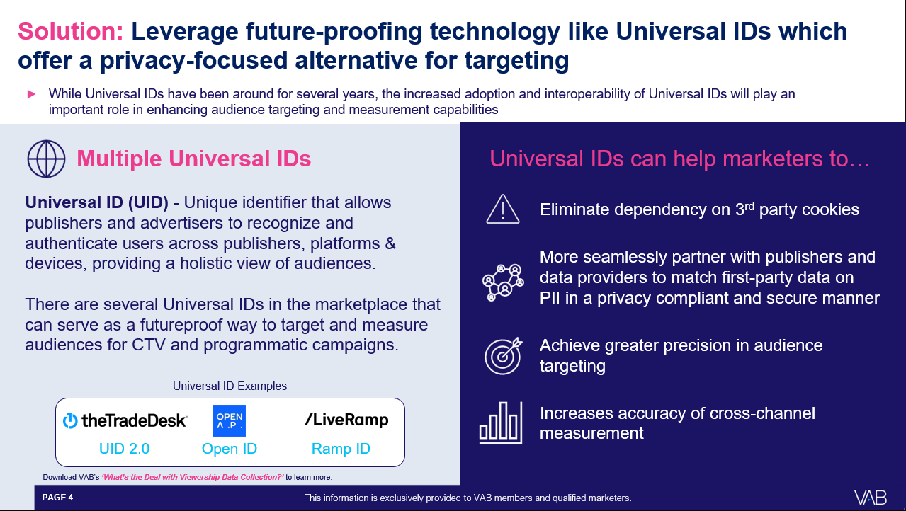
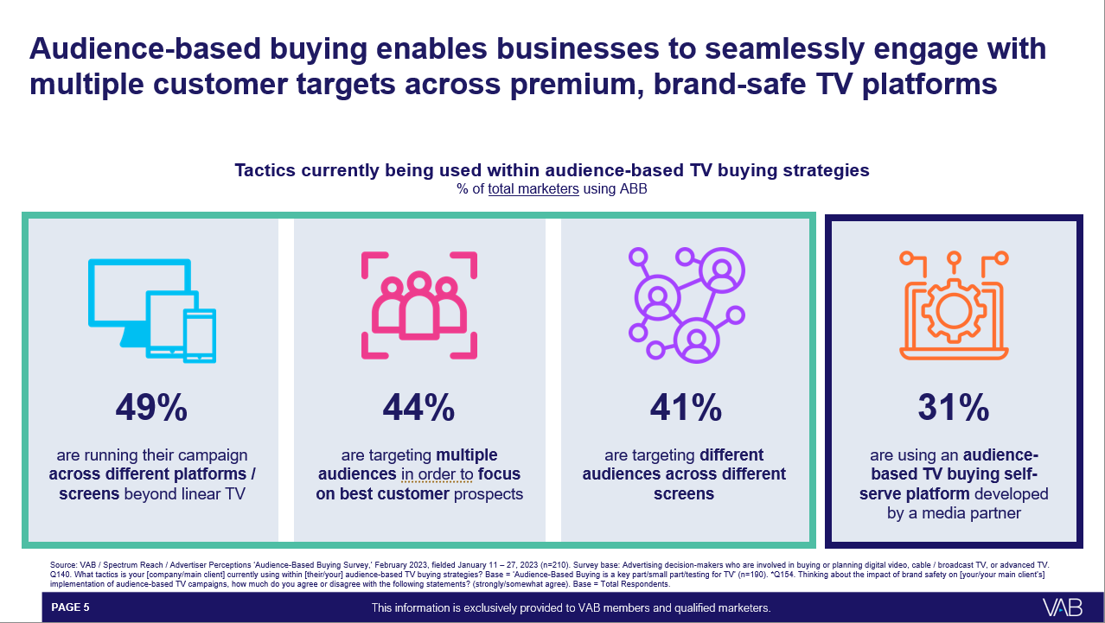
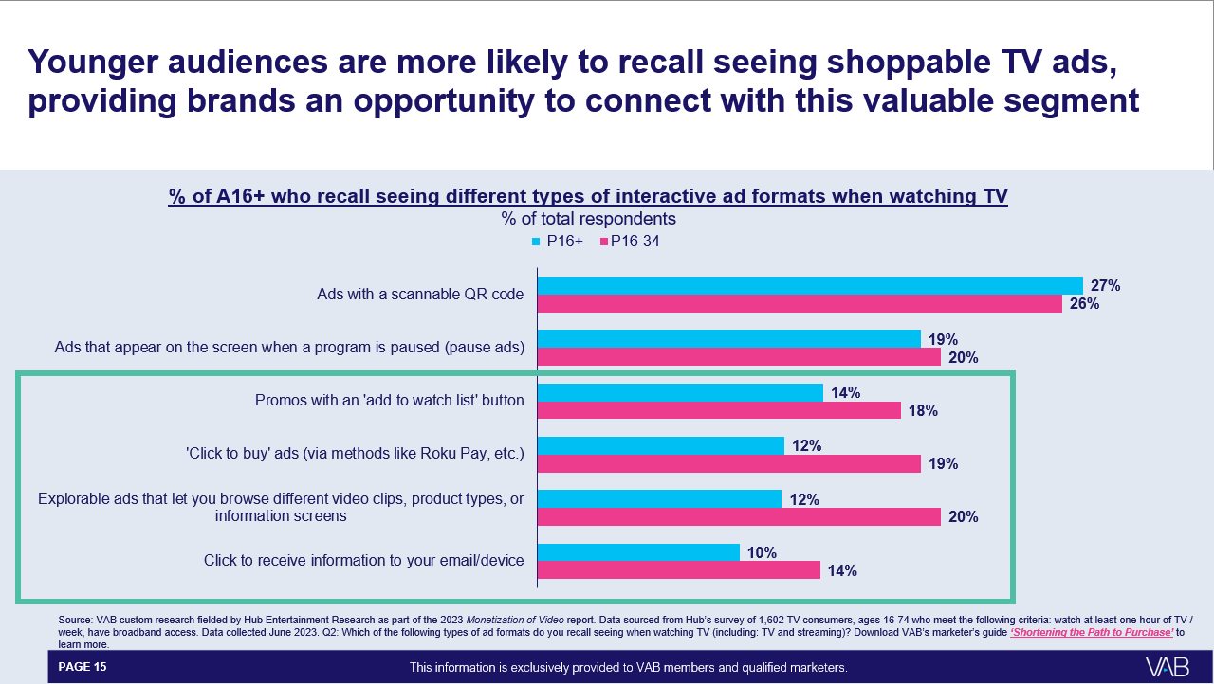
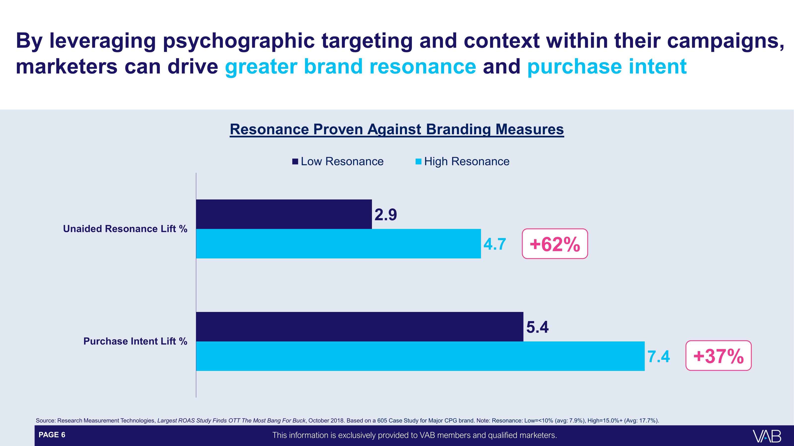
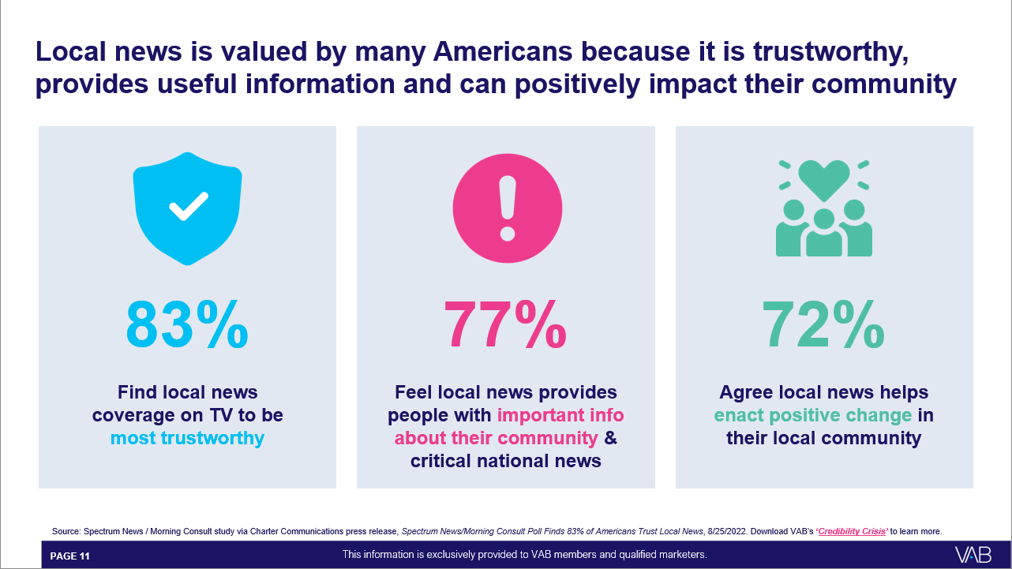
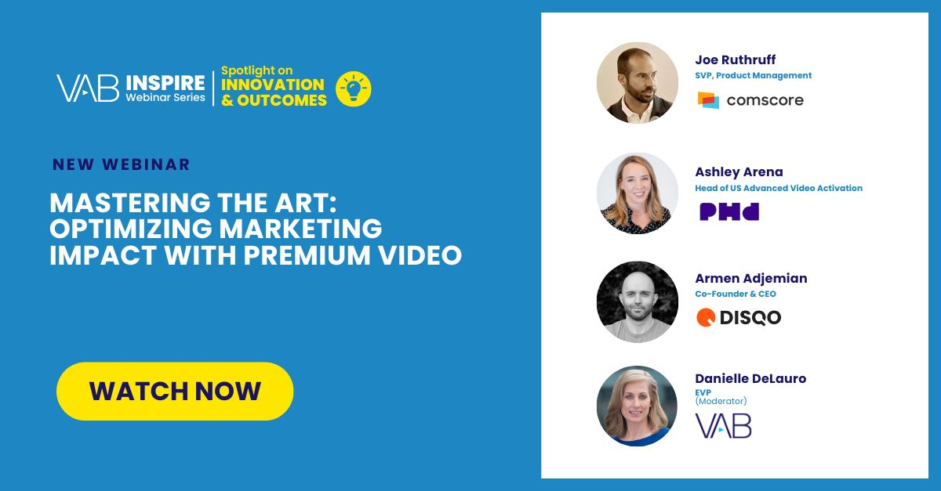
Your Questions, Answered: Stay up-to-date on relevant industry topics through our new Question of the Week series
New Feature!
Click here for the hub
Have a question you want us to answer? We’re always fielding them! Click here to reach out to us.
‘Despite Google’s recent delay,
how do I reduce my dependency on third-party cookies?’
‘As a small business owner, how
can I effectively advertise on TV?’
‘How can I be more innovative
with my TV campaign?’
Click to download
Click to download
Click to download
‘How can I optimize my local video campaigns across screens to extend reach, drive site visits and increase sales?’
‘Are ads with creative that run in contextually relevant content more effective?’
‘During this election year, how can I get the most impact from my local ad campaign?’
Click to download
Click to download
Click to watch
Note: the above reflects a sampling of slides from each ‘Question of the Week’ content piece
This information is exclusively provided to VAB members and qualified marketers.
PAGE 13

Slide 14


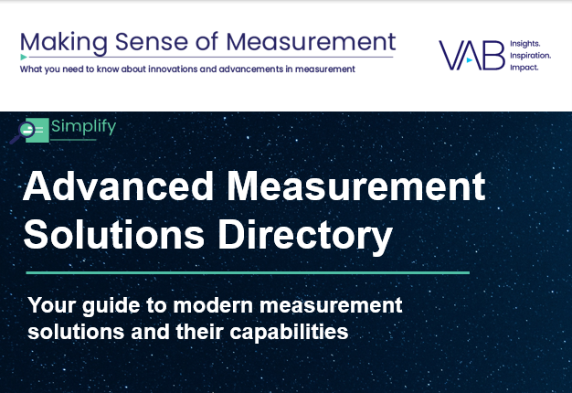

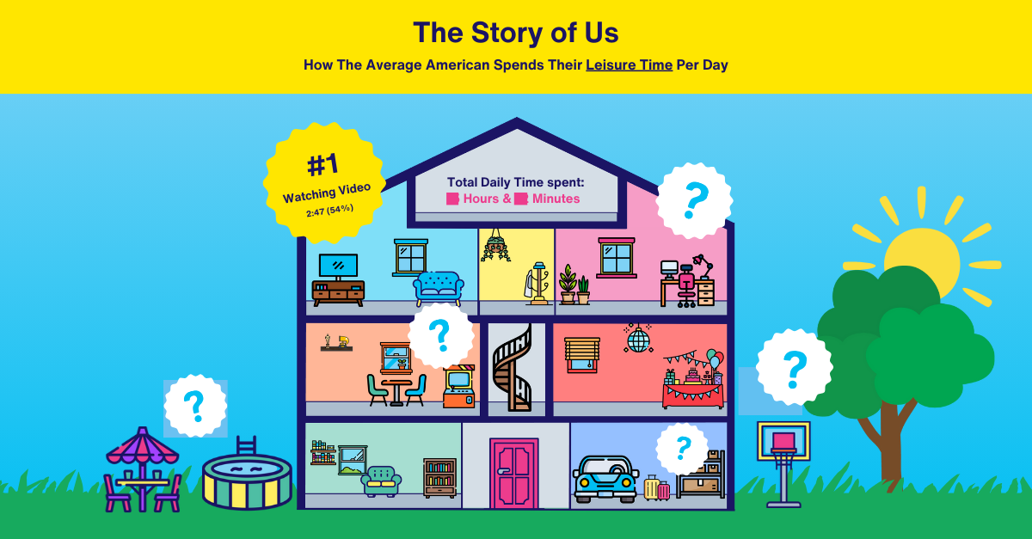

2Q 2024 Insights & Measurement Content Releases
Jason Wiese
Ben Vandegrift
SVP, Director of Strategic Insights
jasonw@thevab.com
VP, Measurement Solutions & Innovations benjaminv@thevab.com
Kailyn Hartmann
Leah Montner-Dixon
VP, Advanced Analytics & Intelligence
kailynh@thevab.com
Director, Audience & Behavioral Insights
leahm@thevab.com
Reed Kiely
Karolina Guillen
Director, Data Insights & Trends
reedk@thevab.com
Associate Director, Insights, Strategy & Analytics karolinag@thevab.com
Kaileen Cain
Insights Analyst
kaileenc@thevab.com
Discover more
Looking for more data, insights and takeaways? Check out this related VAB content
VAB Members, brand marketers and agencies get free and immediate access to VAB’s content library. Get access at theVAB.com
This information is exclusively provided to VAB members and qualified marketers. Further distribution is prohibited.
PAGE 14

