Slide 1



2023 – 2nd Quarter

Slide 2


About VAB
VAB is an insights-driven organization that inspires marketers to reimagine their media strategies resulting in fully informed decisions.
Drawing on our marketing expertise, we simplify the complexities in our industry and discover new insights that transform the way marketers look at their media strategy.
We are committed to your business growth and proud to offer VAB members, brand marketers and agencies complimentary access to our continuously-growing Insights library. Get immediate access at theVAB.com.
Curious to learn more about VAB? Check out this quick video to see what we do and how we can help you develop business-driving marketing strategies.
This information is exclusively provided to VAB members and qualified marketers. Further distribution is prohibited.
PAGE 2

Slide 3








TV’s economic resilience: Despite uncertainty, more dollars were invested by new advertisers in 2022 than prior years
Click here for the full report
New National TV Advertisers
2019 - 2022
Year | # of New Advertisers | # of Categories | New TV $$$ (MM)
2019 | 114 | 61 | $843.4
2020 | 283 | 95 | $1,279.1
2021 | 315 | 74 | $1,320.2
2022 | 303 | 71 | $1,331.6
For a full list of the 303 brands with spend, download the report here
Source: VAB analysis of Nielsen Ad Intel data as of 2/16/23, 1/1/22-12/31/22. Prior years based on VAB analysis of Nielsen Ad Intel Data from the following periods: 1/1/2019-12/31/2019, 1/1/2020-12/31/2020, 1/1/2021-12/31/2021. TV spend includes national cable TV, broadcast TV, Spanish language cable TV, Spanish language broadcast TV. Brands reflect those with national TV spend over $100K.
This information is exclusively provided to VAB members and qualified marketers. Further distribution is prohibited.
PAGE 3

Slide 4



TV buying strategies in a challenging economy: Most marketers are increasing their audience-based buying investment to achieve their main campaign priorities throughout the funnel
Click here for the full report
Impact of uncertain economic conditions on ABB vs.
traditional demographic-based buying
% of respondents
How uncertain economic conditions have impacted audience-based buying strategies*
% of respondents impacted by current economic conditions
Increasing investment in ABB TV to target best customer prospects more precisely while eliminating ‘wasted’ impressions
Increasing investment in ABB TV to drive upper-funnel outcomes like brand awareness and consideration
Increasing investment in ABB TV to drive lower-funnel outcomes like sales
Source: VAB / Spectrum Reach / Advertiser Perceptions ‘Audience-Based Buying Survey,’ February 2023, fielded January 11 – 27, 2023 (n=210). Survey base: Advertising decision-makers who are involved in buying or planning digital video, cable / broadcast TV, or advanced TV.
Q59. To what extent have current economic conditions (rising inflation, recession concerns) impacted [your/your main client’s] TV campaign investment allocation between audience-based buying and traditional demographic-based buying? Base = ‘Audience-Based Buying is a Key Part/Small Part/Testing Phase’ (n=190). *Q59b. You mentioned that the current economic conditions have had at least some impact on [your/your main client’s] TV campaign investment towards audience-based buying. How have these conditions changed [your/your main client’s] audience-based buying strategies? Base = ‘Economic Conditions have had an Impact’ (n=183).
This information is exclusively provided to VAB members and qualified marketers. Further distribution is prohibited.
PAGE 4

Slide 5

Reach & time spent by media: The TV set is the leading device for engagement among all adults
Click here for the full report
P18-34, P18-49 & P25-54 demos available in the full report
= video devices / platforms
Source: VAB analysis of data from the Nielsen Audience Insights Data Tables, Q3 2022, time spent and percentage of users among U.S. population, P18+. TV-Connected Device = devices connected to the TV that are used to stream content such as Apple TV, Roku, Google Chromecast, Amazon Fire TV, Smartphone, Computer/Laptops, etc. (inclusive of smart TV app usage). Internet on a computer is inclusive of ‘social networking on a computer. App/Web on a smartphone is inclusive on ‘streaming audio’ and ‘social networking’ on a smartphone. App/Web on a tablet is inclusive of ‘streaming audio’ and ‘social networking’ on a tablet. Video on a computer is excluded due to unavailable reach percentage data.
This information is exclusively provided to VAB members and qualified marketers. Further distribution is prohibited.
PAGE 5

Slide 6

Streaming ad opportunity: Nine out of ten streamers watch content with ads, with half watching only ad-supported services
Click here for the full report
What Are Streamers Watching?
86% of streamers watch
ad-supported streaming content
Source: Magnite Research, Streaming Continues To Surge- An In-Depth Look at How Ads Are Powering Streaming Growth, 2023.
This information is exclusively provided to VAB members and qualified marketers. Further distribution is prohibited.
PAGE 6

Slide 7
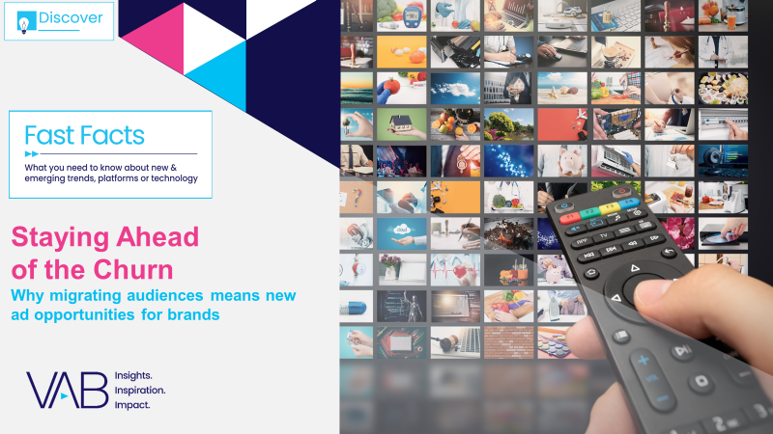
Audience migration in streaming: Wider viewer adoption of FAST has fostered a shift from subscription services among highly desirable audiences for brands
Click here for the full report
SVOD & FAST Services: Total Aggregated Minutes (YoY Difference)
February 2023 vs. February 2022
P18+
P18-34
HHI $75K+
SVOD
FAST
SVOD
FAST
SVOD
FAST
-2%
YOY
+39%YOY
+25%YOY
+70%YOY
-6%
YOY
+22%
YOY
Source: VAB analysis of Comscore mediametrix multiplatform, Mediatrend data, P18+, P18-34 and households with $75K+ income. February 2023 vs. February 2022. Based on total cume minutes across five measured platforms for both SVOD and FAST. SVOD includes Amazon Prime Video, Apple+, DAZN, Netflix and STARZ. FAST includes Tubi, Freevee, Vudu, Xumo and Crackle.
This information is exclusively provided to VAB members and qualified marketers. Further distribution is prohibited.
PAGE 7

Slide 8

Streaming advertising in linear TV: Services have tripled their TV investment but have also shifted more towards promoting specific programs to aid viewers’ content discovery
Click here for the full report
Streaming Categories: Annual TV Ad Spend
$ in MM
$2,540
$2,313
$1,369
$762
$839
Source: VAB analysis of Nielsen AdIntel, CY 2018-2022, TV spend includes cable TV, broadcast TV, Spanish language cable TV, Spanish language broadcast TV, spot TV, and syndicated TV. U.S. TV spend only, excludes promos. Streaming Categories include: Streaming Channel, Streaming Player, Streaming Program and Streaming Services-Video.
This information is exclusively provided to VAB members and qualified marketers. Further distribution is prohibited.
PAGE 8

Slide 9
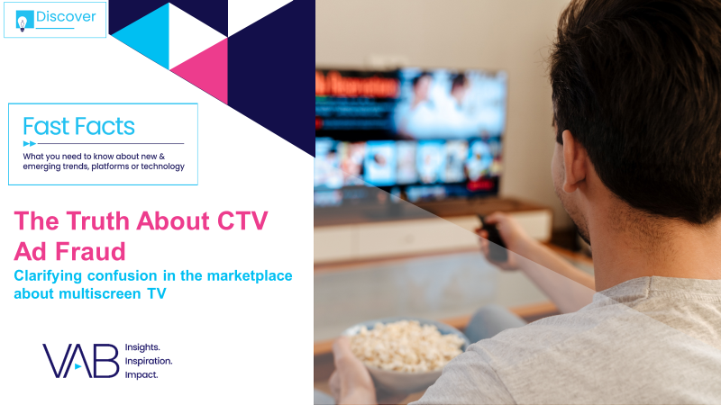
Platforms most at risk of ad fraud: Like consumers, marketers trust the premium environment of CTV and view it as less vulnerable to fraud than many other digital platforms
Click here for the full report
Which media types will be most vulnerable to ad fraud in the next 12 months?
% of respondents
= ‘non-CTV’ digital
= CTV
Source: Integral Ad Science (IAS), The 2023 Industry Pulse Report, December 2022. Based on October 2022 IAS / YouGov survey of U.S. digital media experts who use programmatic advertising (n=356). Q. Which of the following media types will be most vulnerable to ad fraud in the next 12 months? (select up to three).
This information is exclusively provided to VAB members and qualified marketers. Further distribution is prohibited.
PAGE 9

Slide 10
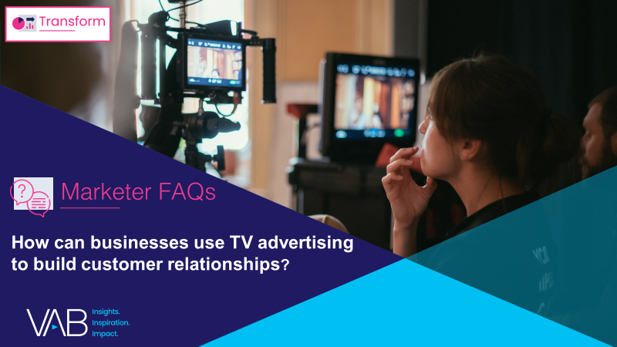




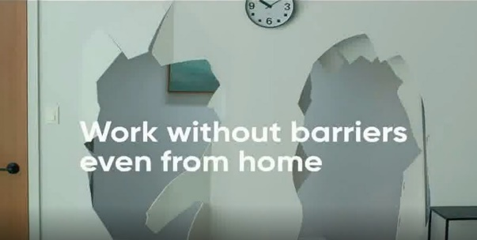

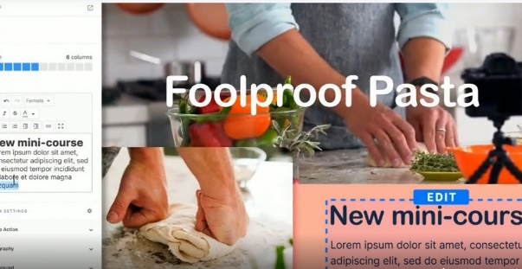
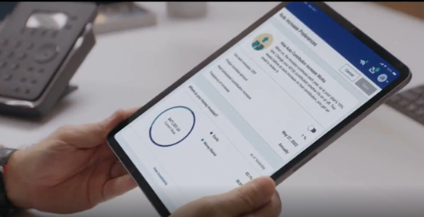





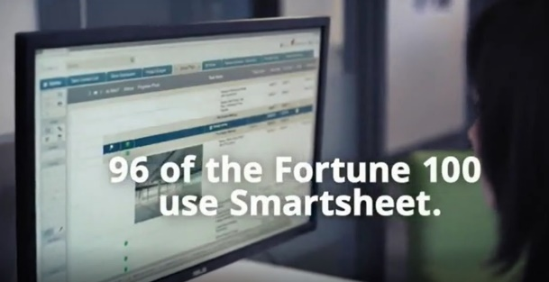
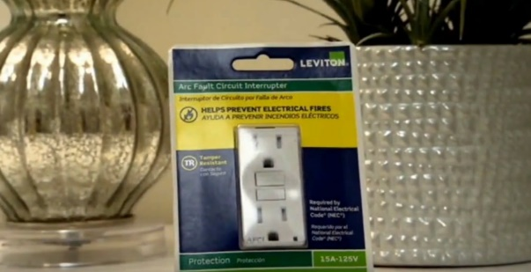
Ad creative strategies that drive results: Video ads featuring lighthearted moments and visual branding tend to achieve
the highest viewer attention and awareness
Click here for the full report
Lighthearted, funny and relatable moments
Visual branding with a focus on products services
‘Experience Without Barriers’
(TV Spot first aired: 3/30/20)
‘Get Out Of Your Own Way With Kim: What People Want’
(TV Spot first aired: 9/29/20)
‘Every Business Needs a Website’
(TV Spot first aired: 9/20/20)
'Making 401(k) Simple’
(TV Spot first aired: 7/30/21)
159
Ad Attention Index
155
Ad Attention Index
160
Ad Attention Index
154
Ad Attention Index
Super Bowl 2019 TV Spot, 'Expensify This' Featuring 2 Chainz, Adam Scott
(TV Spot first aired: 2/3/19)
‘Make it Easier’
(TV Spot first aired: 10/26/19)
‘96 of 100’
(TV Spot first aired: 10/9/18)
'Protect Your Home' Featuring Danny Lipford
(TV Spot first aired: 10/11/20)
152
Ad Attention Index
132
Ad Attention Index
141
Ad Attention Index
132
Ad Attention Index
How to read: ‘Experience Without Barriers’ (159 index) had 59% less interruptions than other ads in the context of the media placement with a 100 score being average.
Source: Creative from iSpot.tv, time period of airing 4/1/18 – 4/30/22, note: each creative execution had to launch before 4/30/22 so some may still be actively airing on TV. Ad Attention Index within iSpot.tv’s Attention Analytics. Index scale is 0-200 with a 100 index seeing ad performance as expected. Click above images to watch TV spots. Note: Ad interruptions = when viewers are changing channels, fast forwarding, turning off the TV or otherwise interrupting an ad.
This information is exclusively provided to VAB members and qualified marketers. Further distribution is prohibited.
PAGE 10

Slide 11
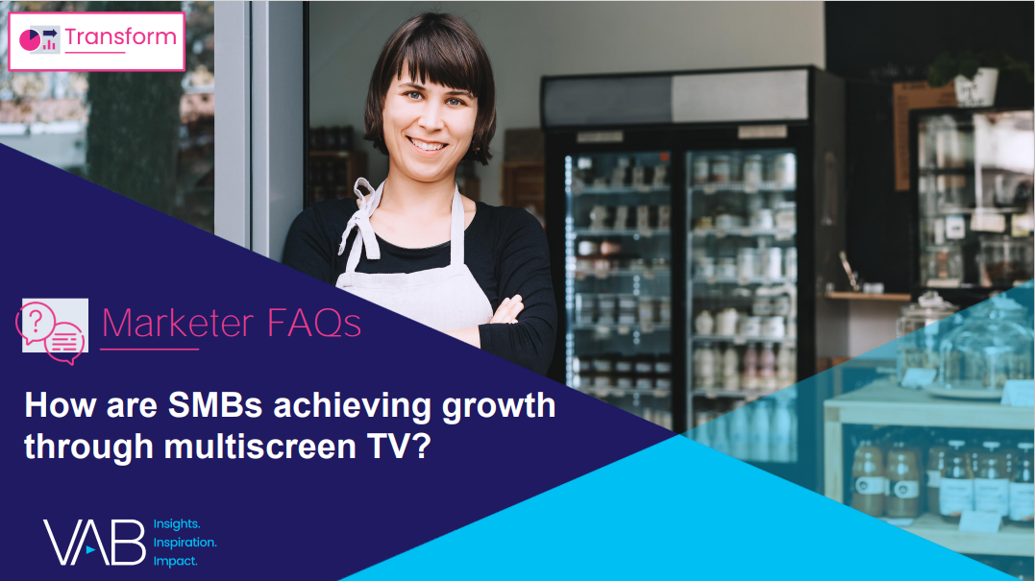



Building website traffic for SMBs: TV advertising delivers thousands of new customers monthly for small and medium-sized brands
Click here for the full report
Unmeasured B2B Brands: Monthly Website Unique Visitors (000) Comparison
Based Over a Four-Year Time Period: Apr ‘18 – Apr ‘22
Brand | B2B Category | Three-Month Average: Prior to TV Launch | Monthly Average: ‘When On TV’
 | Commercial Real Estate | N/A | 25
 | Banking/Finance | N/A | 35
 | Manufacturing | N/A | 75
 | Software | N/A | 166
Source: VAB analysis of Comscore mediametrix multiplatform media trend data, P18+. April 2018 – April 2022 (calendar months), figures are based on monthly averages for the 25 brands analyzed.
This information is exclusively provided to VAB members and qualified marketers. Further distribution is prohibited.
PAGE 11

Slide 12
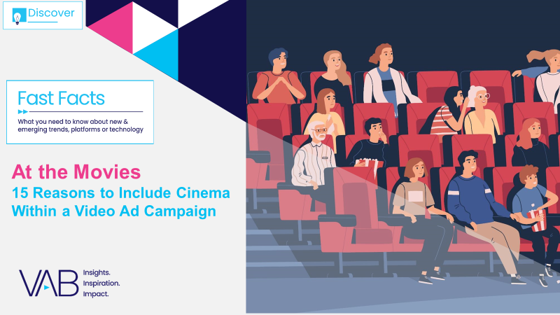






Affordable entertainment at the cinema: The cost of a movie ticket is much more affordable than other popular local activities
Click here for the full report
Entertainment Costs Across Different Market Sizes
Activity
New York City
(County ‘A’)
Cleveland, OH
(County ‘B’)
Des Moines, IA
(County ‘C’)
Bakersfield, CA
(County ‘D’)
Movie Tickets
From Fandango
1 Adult Ticket
$19.65
$10.25
$11.24
$13.75
Regal E-Walk
Capitol Theatre
Flix Brewhouse
Maya Bakersfield 16 & MPX
Bowling
1 lane for 2 hours (Group of 6)
Price Per Person
$41.43
$20.16
$13.50
$26.00
Bowlero
The Corner Alley
Air Lanes
Bowlero
Mini Golf
2 rounds of mini golf (estimated 50 – 90 mins)
Price Per Person
$43.98
$25.98
$30.00
$20.00
Shipwrecked
Swing n Things
Slideway Center
Golf N’ Stuff
Archery
Price Per Person
$40.00
$60.00
$20.00
$30.00
Gotham Archery
Crooked River Archers
Archery Field & Sports
Brainy Actz
Axe Throwing
Price Per Person for 2 hours
$42.00
$28.99
$40.00
$30.00
Bury the Hatchet
Class Axe
Ironside Axe Club
Brainy Actz
Laser Tag
Price Per Person for 2 hours
$39.99
$22.50
$32.00
$20.00
Area 53 NYC
Area 51 Laser Tag
Spare Time Entertainment
The BLVD!
Source: VAB analysis of pricing available on the specific venues’ websites for the cost of activities based on the appropriate location as of 3/24 *Location in Boise, ID. Markets were selected from ABCD counties as categorized by Nielsen based on U.S. Census Bureau population data and metro areas.
This information is exclusively provided to VAB members and qualified marketers. Further distribution is prohibited.
PAGE 12

Slide 13


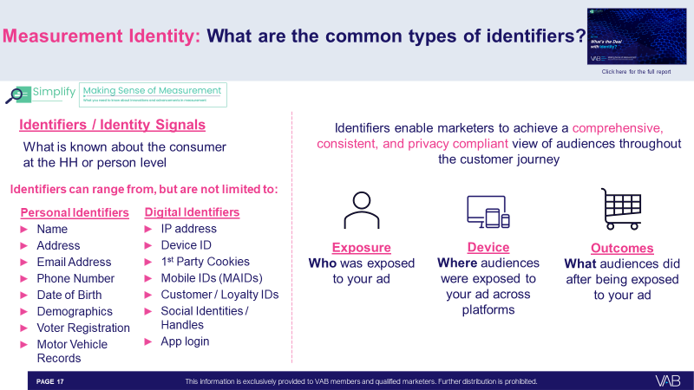
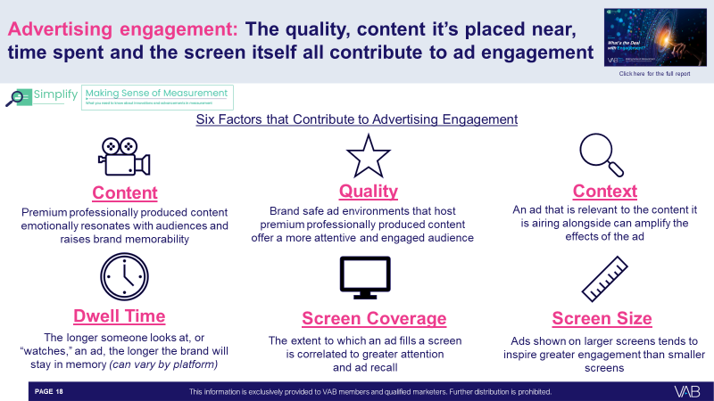
What’s the Deal with…: This series provides marketers with clear, concise and straightforward answers to the most asked questions about measurement
Bonus Slide!
Click here for more Measurement Education Resources
What’s the Deal with Identity?
What’s the Deal with Engagement?
In this piece, you’ll learn common types of identifiers, how privacy should be factored into identity solutions, data clean rooms and the roles they play in measurement, questions to ask your advertising partners when it comes to identity and more.
This quick read will tell you what ad engagement is, which factors increase it, how it is measured and what new innovative metrics are now available to marketers to help quantify engagement.
Click the screenshots above to download each report
This information is exclusively provided to VAB members and qualified marketers. Further distribution is prohibited.
PAGE 13

Slide 14
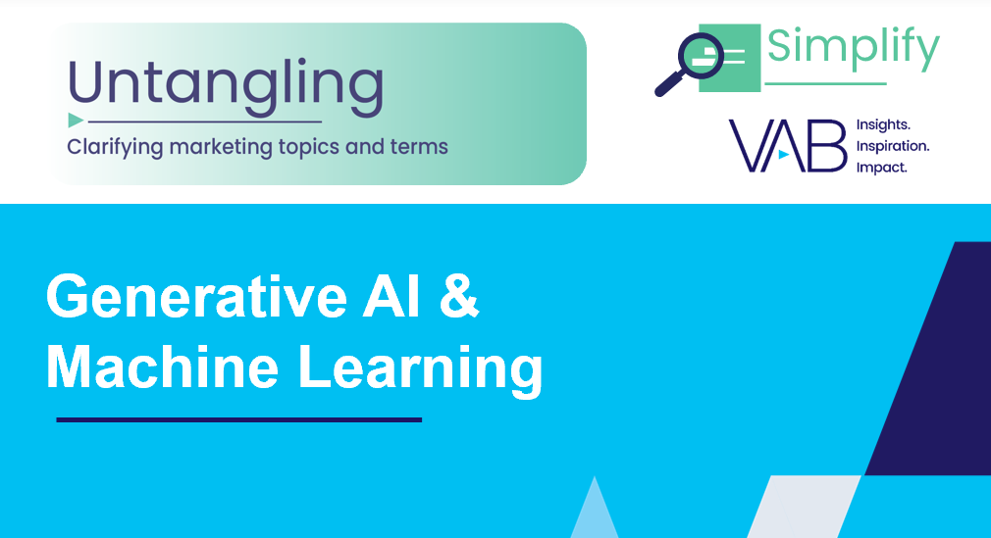
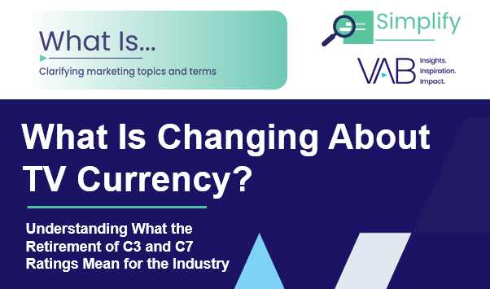
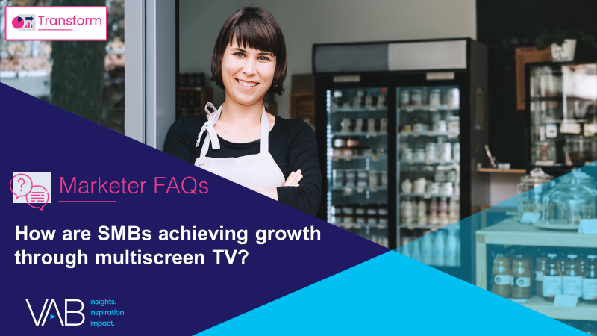


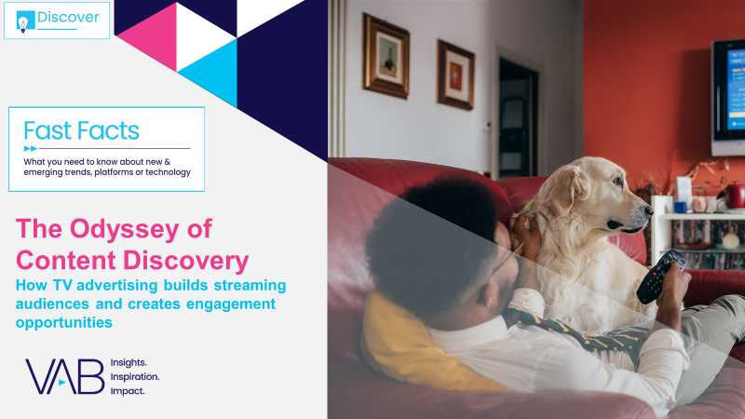






Jason Wiese
Reed Kiely
SVP, Director of Strategic Insights
jasonw@thevab.com
Associate Insights Director
reedk@thevab.com
Click here to download this 8-page glossary
Leah Montner-Dixon
Karolina Guillen
Associate Insights Director
leahm@thevab.com
Insights Manager
karolinag@thevab.com
Discover more
Looking for more data, insights and takeaways? Check out this related VAB content
As upfront negotiations continue, marketers are making important decisions about their video investment strategy.
We’re here to help.
Visit our Upfront Planning Resource Center
for a curated a list of resources filled with the data, analysis and insights needed to make informed investment decisions.
VAB Members, brand marketers and agencies get free and immediate access to VAB’s content library. Get access at theVAB.com
This information is exclusively provided to VAB members and qualified marketers. Further distribution is prohibited.
PAGE 14

