Slide 1



2021 – 2nd Quarter

Slide 2

About VAB
VAB is an insights-driven organization that inspires marketers to reimagine their media strategies resulting in fully informed decisions.
Drawing on our marketing expertise, we simplify the complexities in our industry and discover new insights that transform the way marketers look at their media strategy.
Simplify
We save you time by bringing you the latest data & actionable takeaways you can use to inform your marketing plans.
Discover
We keep you one step ahead with the latest thinking so you can create innovative, forward-looking strategies.
Transform
We help you build your brand by focusing on core marketing principles that will help drive tangible business outcomes.
We are committed to your business growth and proud to offer VAB members, brand marketers and agencies complimentary access to our continuously-growing Insights library. Get immediate access at theVAB.com.
This information is exclusively provided to VAB members and qualified marketers. Further distribution is prohibited.
PAGE 2

Slide 3




Evolving Buying Strategies During COVID-19: The economic effects of the pandemic led to greater ROI accountability and openness to new solutions, spurring the growth of audience-based TV buying
Click here for the full report
% of respondents that agree with the following statements
87%
86%
56%
“With the economic downturn and increased scrutiny on ROI and budgets since COVID, there has been more pressure to prove the effectiveness of our video campaigns”
“Since COVID, my company / client has been more open to new ways to plan, buy and measure the efficiency and effectiveness of our TV campaigns”
“COVID-19 has had a moderate to major impact on my TV campaign investment allocation between audience-based buying and traditional demographic-based buying”
Source VAB / Advertiser Perceptions ‘Audience-Based Buying Survey,’ March 23 – 31, 2021. Survey base: Advertising decision-makers who are involved in buying or planning digital video, cable / broadcast TV, or advanced TV (n=211). Q20. With the economic downturn and increased scrutiny on ROI (return on investment) / budgets since COVID, there has been more pressure to prove the effectiveness of our video campaign (strongly/somewhat agree). Q21. Since COVID, [my company / main client] has been more open to new ways to plan, buy and measure the efficient\cy and effectiveness of our TV campaigns (strongly/somewhat agree). Q59. To what extent did COVID-19 impact your TV campaign investment allocation between audience-based buying and traditional demographic/content-based buying? Base: Total Respondents.
This information is exclusively provided to VAB members and qualified marketers. Further distribution is prohibited.
PAGE 3

Slide 4



Driving Campaign Success: Audience-based TV buying makes a marketer’s job easier by increasing the ability of their media to deliver on brand objectives
Click here for the full report
% of respondents that agree with the following statements
89%
86%
79%
“Implementation of audience-based buying has increased the ability to meet campaign objectives”
“Overall, I am satisfied with campaign results from our audience-based buying initiatives”
“Implementing audience-based buying has made my job easier”
Source: VAB / Advertiser Perceptions ‘Audience-Based Buying Survey,’ fielded March 23 – 31, 2021. Survey base: Advertising decision-makers who are involved in buying or planning digital video, cable / broadcast TV, or advanced TV (n=211). Q135. How much do you agree or disagree with the following statements around your experiences with TV audience-based buying? (strongly/somewhat agree). Base = Respondents who say audience-based buying is a ‘key part’ / ‘small part’ of their TV strategy (n=151).
This information is exclusively provided to VAB members and qualified marketers. Further distribution is prohibited.
PAGE 4
This information is exclusively provided to VAB members and qualified marketers. Further distribution is prohibited.

Slide 5




Upending The Way Media Is Bought: With their openness to innovate, brands and agencies are welcoming the industry-wide shift towards audience-based TV buying
Click here for the full report
% of respondents that agree with the following statements
“I am comfortable with moving from traditional, GRP-driven TV buying to an audience-based TV buying approach”
83% / 91% / 83% / 71%
“Over the next three years, I believe the industry will significantly shift from traditional TV buying (GRPs) to an audience-based TV buying approach”
90% / 94% / 85% / 89%
'Large' Brand Marketers
'Small' Brand Marketers
'Large Business' Agency Pros
'Small Business' Agency Pros
Source: VAB / Advertiser Perceptions ‘Audience-Based Buying Survey,’ March 23 – 31, 2021. ‘Large’ Brand Marketers = business with annual total ad spend of $5MM+, ‘Small’ Brand Marketers = business with annual total ad spend of $10K - $5MM, ‘Large Business’ Agency Pros = client with annual total ad spend of $5MM+, ‘Small Business’ Agency Pros = client with annual total ad spend of $10K - $5MM. Pros = Professionals. Q170. How much do you agree or disagree with the following statements? (strongly/somewhat agree).
This information is exclusively provided to VAB members and qualified marketers. Further distribution is prohibited.
PAGE 5
This information is exclusively provided to VAB members and qualified marketers. Further distribution is prohibited.

Slide 6
Positive Momentum for Data-Driven TV: Many brands and agencies are shifting from traditional demo-based TV buying to audience-based buying to some degree
Click here for the full report
Which of the following best describes your (company’s/main client’s) current approach to audience-based buying for TV advertising?
‘Testing ABB and determining it’s role in our TV strategies’
‘Any Degree’
‘ABB is a key part
of our TV Strategy’
‘ABB is a small part
of our TV strategy’
‘Not currently using ABB for TV’
'Large' Brand Marketers
37%
41%
16%
6%
94%
'Small' Brand Marketers
37%
37%
26%
0%
100%
'Large Business' Agency Pros
30%
39%
18%
13%
87%
'Small Business' Agency Pros
26%
34%
29%
11%
89%
Source: VAB / Advertiser Perceptions ‘Audience-Based Buying Survey,’ March 23 – 31, 2021. ‘Large’ Brand Marketers = business with annual total ad spend of $5MM+, ‘Small’ Brand Marketers = business with annual total ad spend of $10K - $5MM, ‘Large Business’ Agency Pros = client with annual total ad spend of $5MM+, ‘Small Business’ Agency Pros = client with annual total ad spend of $10K - $5MM. Q70. Which of the following best describes your (company’s/main client’s) current approach to audience-based buying for TV advertising?
This information is exclusively provided to VAB members and qualified marketers. Further distribution is prohibited.
PAGE 6
This information is exclusively provided to VAB members and qualified marketers. Further distribution is prohibited.

Slide 7



One of 23 Case Studies on Audience-Based TV Buying: A QSR brand saw lifts in foot traffic among all exposure groups, especially target households, through a data-driven linear TV campaign
Click here for the full report
% Lift in Restaurant Visitation
Challenge
A QSR brand wanted to drive foot traffic to restaurant locations during a limited-time promotion
Solution
Using NBCU’s AdSmart audience targeting solution, the brand ran a national TV campaign across the NBCU portfolio to reach their custom target. Data Plus Math was utilized to measure the incremental impact of the campaign on driving foot traffic to the brand’s locations.
Target Segment
Custom LiveRamp look-alike target modeled from the brand’s 1st-party database of mobile app users
Results
By implementing a targeted data-driven TV campaign, overall restaurant visitations increased +4.5% with a +5% increase among in-target HHs
Company / Platform
NBCU’s AdSmart solution / Data-driven linear
+4.5%
+5%
+4.5%
Overall
In-Target
Non-Target
(Total HHs Exposed to AdSmart Campaign vs.
Total HHs Exposed to Non-AdSmart Campaign)
(Target HHs Exposed to AdSmart Campaign vs.
Target HHs exposed to non-AdSmart campaign,
the non-target lift indicates a strong halo effect)
AdSmart Exposure Among Target HHs Drove Higher Restaurant Visitation, Validating The Targeting
+18%
Higher In-Target Restaurant Visitation vs. Overall
+22%
Higher In-Target Restaurant Visitation vs. Non-Target
Source: NBCU, AdSmart + QSR Case Study.
This information is exclusively provided to VAB members and qualified marketers. Further distribution is prohibited.
PAGE 7

Slide 8
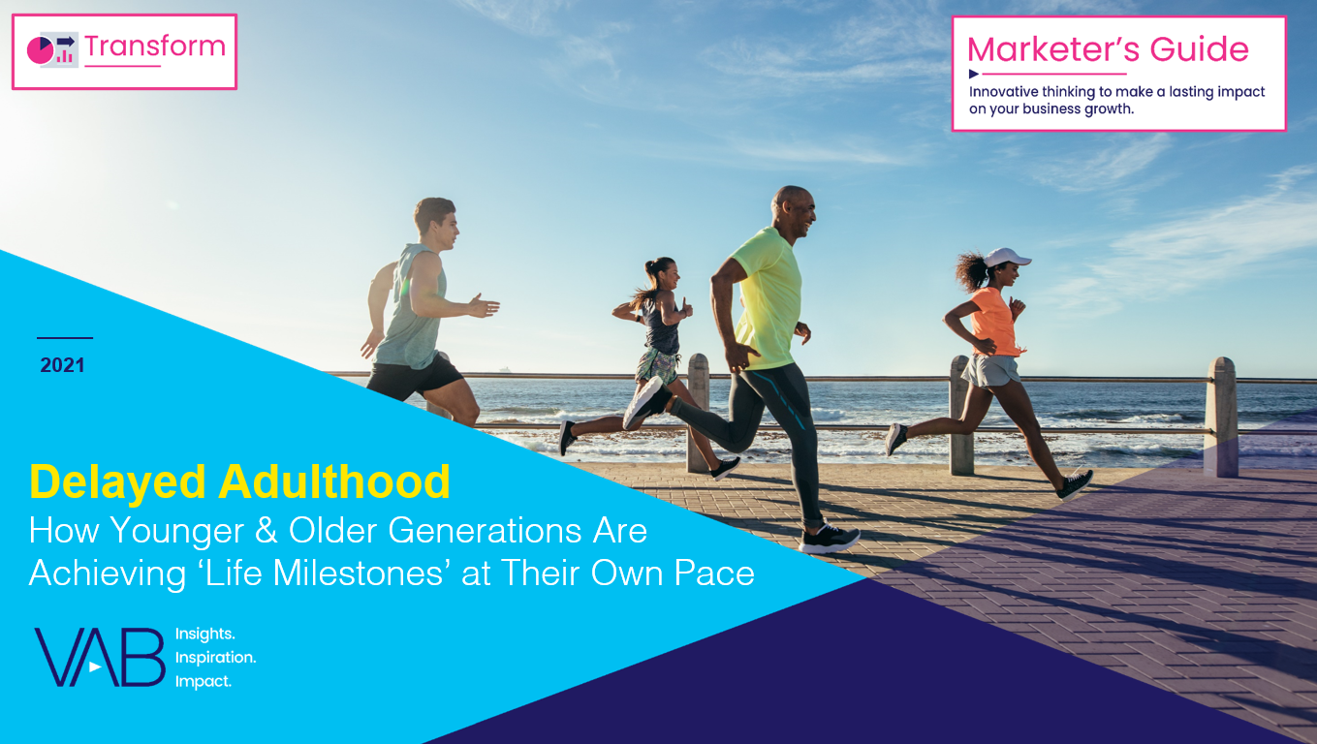




Delayed Adulthood: Only half as many adults 25-34 achieved all four common ‘life milestones’ in 2016 as they did in 1975
Click here for the full report
Four Common Milestones of Adulthood Achieved
% of A25-34
Four Common Milestones
= 1975
= 2016
Employed
Live Independently
-47%
vs 1975
Married
Has Children
Live Independently + Employed + Married + Has Children
Source: U.S. Census Bureau, The Changing Economics and Demographics of Young Adulthood: 1975 – 2016, April 2017. Data based on 1975 and 2016 Current Population Survey Annual Social and Economic Supplement. Figure 5. Four Common Milestones of Adulthood – Getting Married, Having Children, Working, and Living Independently. Q: What are the most common combinations that young adults have completed?
This information is exclusively provided to VAB members and qualified marketers. Further distribution is prohibited.
PAGE 8

Slide 9


















2020 New TV Advertisers: In a pandemic, $400MM more in ‘new advertiser’ spending flowed into the national TV marketplace from more brands, and across more categories, compared to the prior year
Click here for the full report
New National TV Advertisers
2019 vs. 2020 Comparison
Sampling of 2020 New
Nat’l TV Advertisers
Year | # of Brands | # of Categories | New TV $$$ (MM)
2019 | 114 | 61 | $843.4
2020 | 283 | 95 | $1,279.1
# YoY Diff | +169 | +34 | +$435.7
% YoY Diff | +148% | +56% | +52%
For a full list of the 283 brands with spend click here
Source: VAB analysis of Nielsen Ad Intel data, 1/1/20-12/3120. TV spend includes national cable TV, broadcast TV, Spanish language cable TV, Spanish language broadcast TV. Brands reflect those with national TV spend over $100K. MM = millions. DTC brands are included within the total brand count.
This information is exclusively provided to VAB members and qualified marketers. Further distribution is prohibited.
PAGE 9

Slide 10
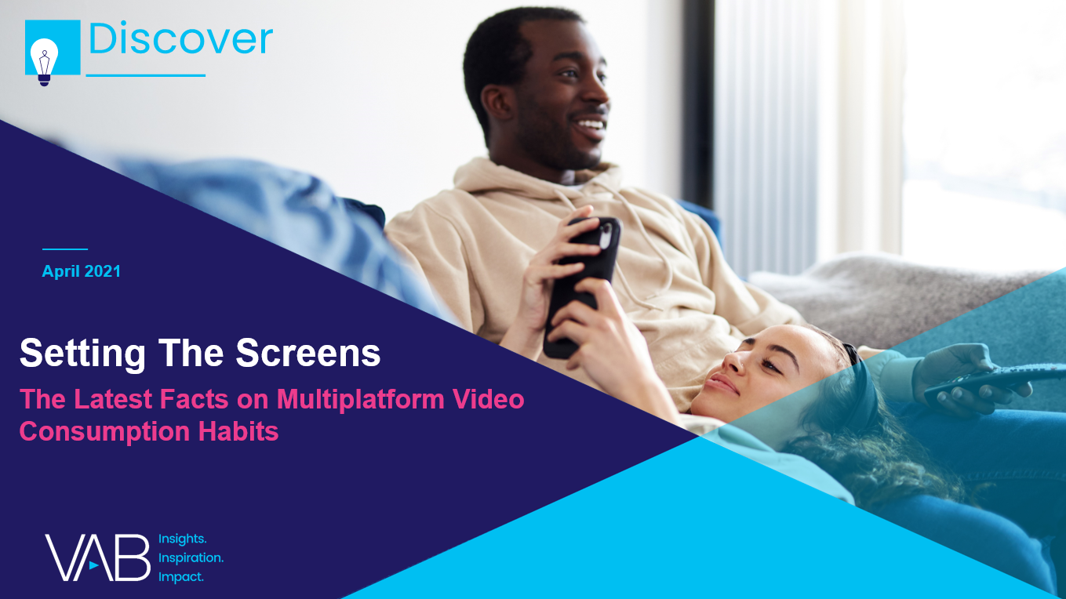


Ad Opportunity In Streaming: Ad-supported services collectively account for over one-third of all video streaming time, providing brands greater opportunities for incremental cross-platform reach
Click here for the full report
Share of Streaming by Platform Type
Among Streaming Capable Homes
AVOD / Linear TV Streaming
SVOD / Other Streaming
K2-11: 35%
T12-17: 32%
P18-34: 29%
P35-54: 32%
P55+: 40%
Jan ‘20
Jan ‘21
*As of December 2020, streaming accounted for 23% of total TV usage among streaming capable homes (vs. 21% in Dec ‘19)
Source: Nielsen Streaming Meter Homes, January 2020 & January 2021, P2+, Total Day. Linear TV streaming reflects TVE / network / cable provider apps. ‘Other Streaming’ primarily reflects SVOD platforms and includes social, gaming and other uncategorized platforms.
This information is exclusively provided to VAB members and qualified marketers. Further distribution is prohibited.
PAGE 10

Slide 11
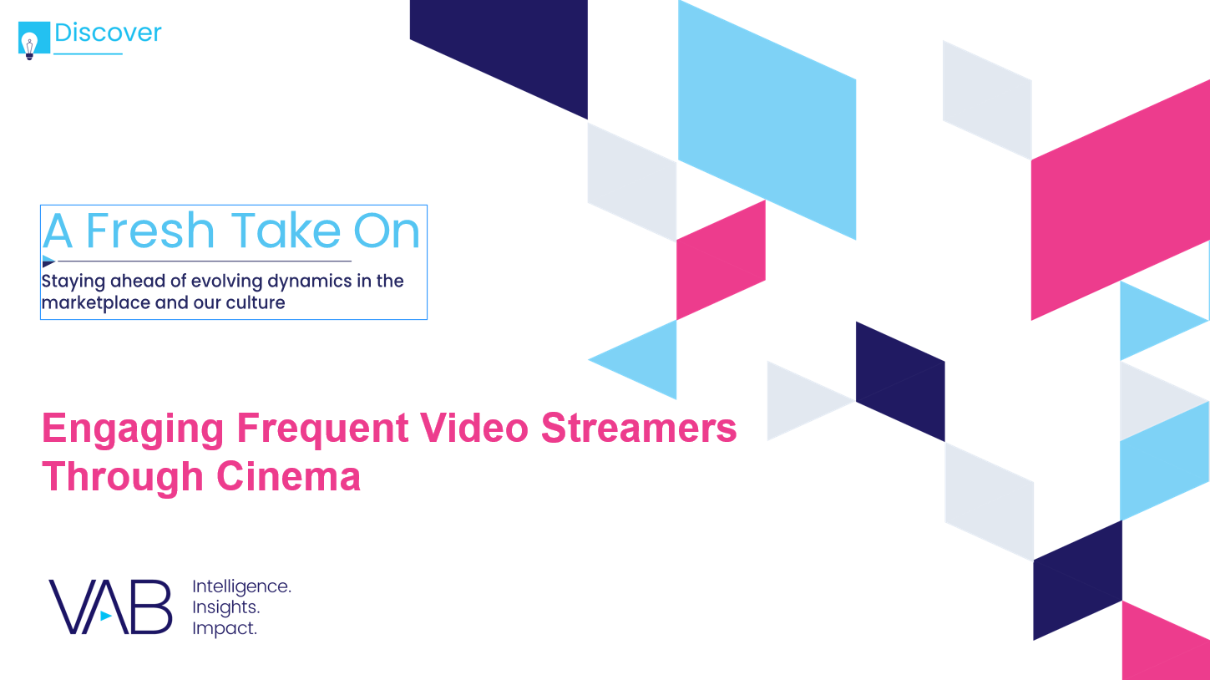
Engaging Streamers At The Cinema: Frequent video streamers are more likely than the average adult, and even occasional streamers, to be habitual movie goers
Click here for the full report
Pre-Pandemic Movie Attendance: Video Streamers vs. Adults 18+
‘Frequent’ / ‘Occasional’ Video Streamers
Once a Week or More
2+ Times a Month
At Least Once a Month
19%
of frequent video streamers went to the movies at least once a month pre-pandemic
‘Frequent’
Video Streamers:
vs. A18+
+17%
More likely
+23%
More likely
+23%
More likely
‘Occasional’
Video Streamers:
vs. A18+
-11%
less likely
-5%
less likely
+7%
more likely
16%
of occasional video streamers went to the movies at least once a month pre-pandemic
How to read: ‘Frequent’ video streamers are 17% more likely than the average adult to go to the movies at least once a week.
Source: MRI-Simmons, GfK MRI Spring 2020, fielded March 2019 - May 2020, Base: P18+, ‘frequent’ video streamer (14% of streamers) – video streaming 10+ hours weekly,‘ occasional’ video streamer (28% of streamers) – video streaming 5-9 hours weekly. Streaming services include: AppleTV+, Amazon Prime Video, Disney+, Hulu or Netflix. Frequency = # of times attended a movie in the last 90 days. Roku, ‘The Future of Movies: How Theaters & Studios Can Thrive in the Streaming Era,’ 2020
This information is exclusively provided to VAB members and qualified marketers. Further distribution is prohibited.
PAGE 11

Slide 12
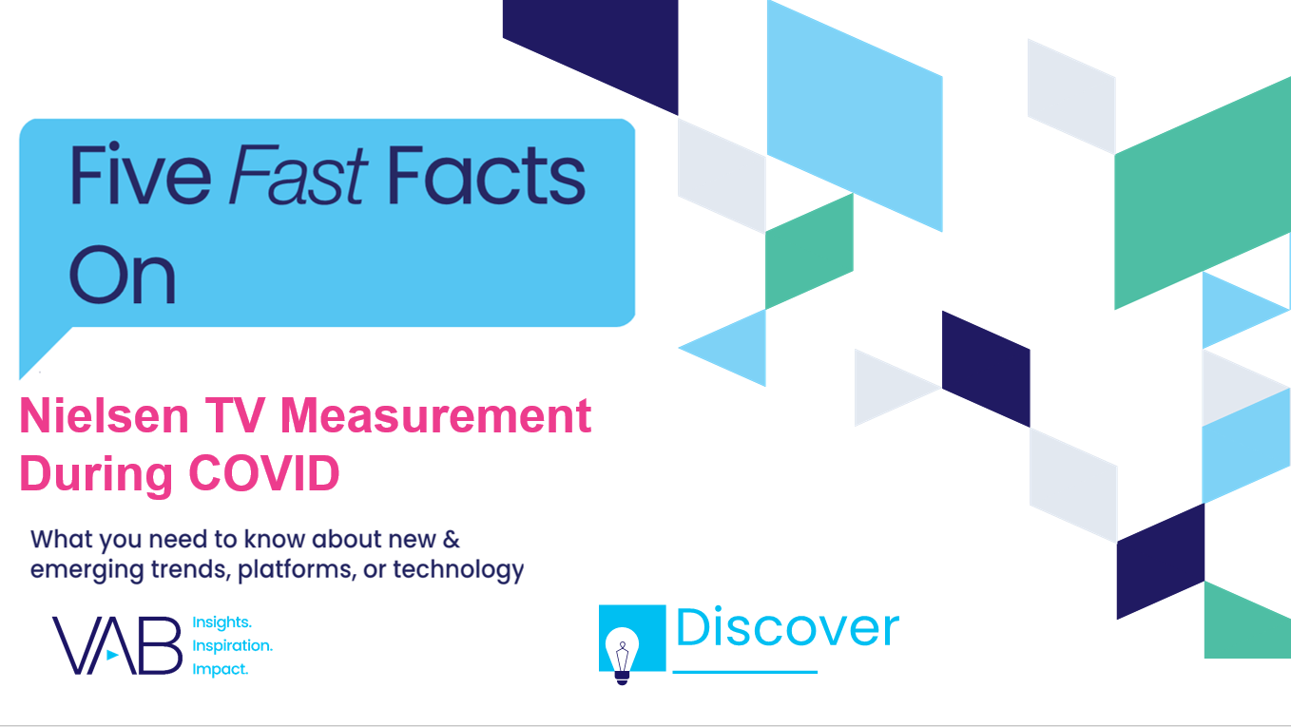
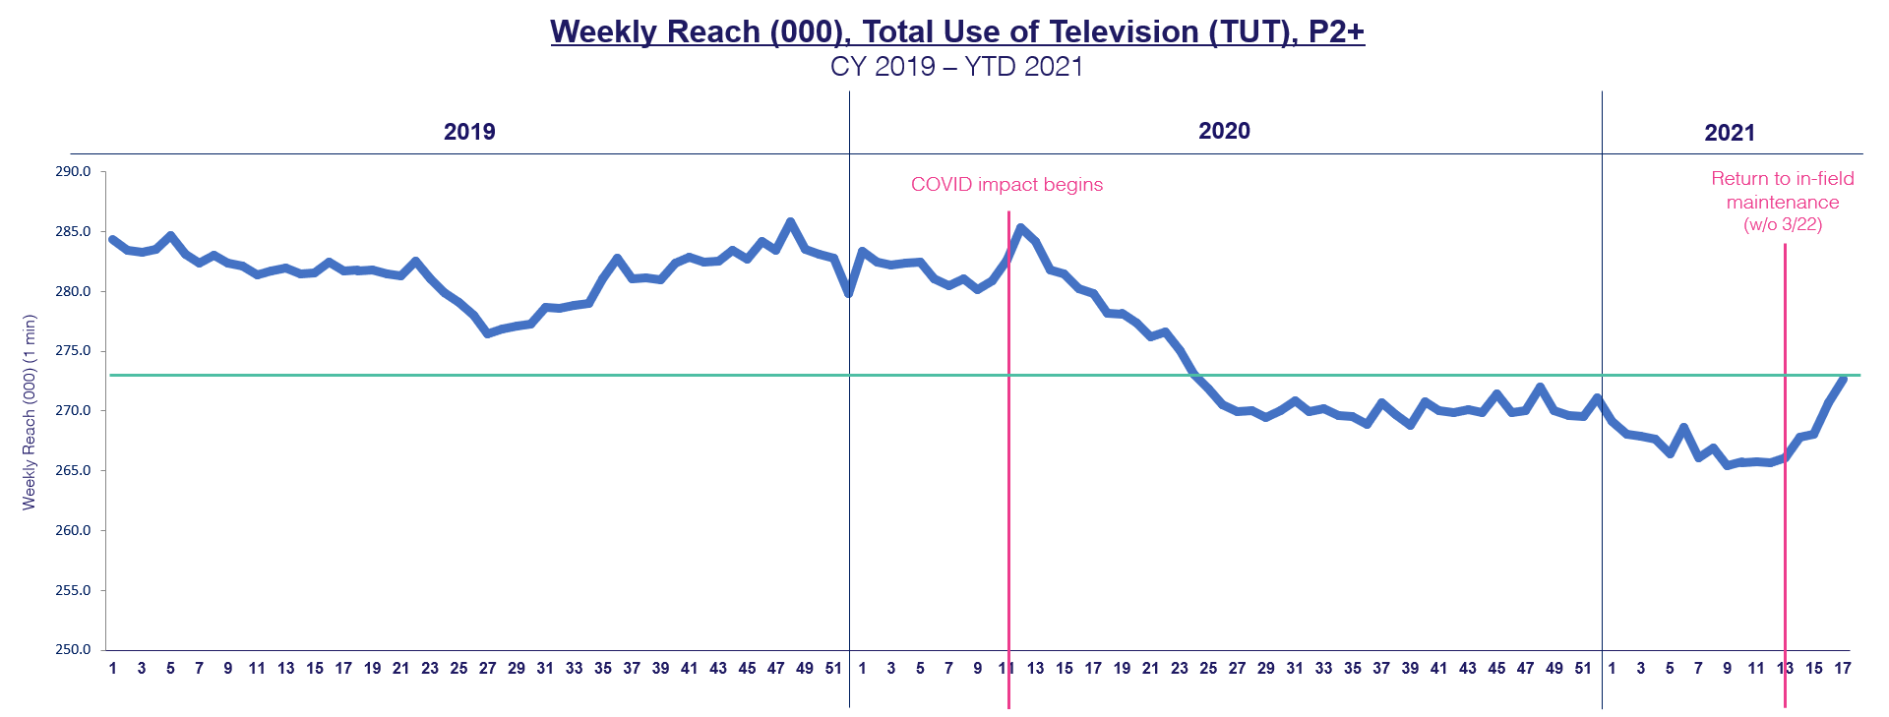
Nielsen Sample Update: When Nielsen returned to in-home panel maintenance, ‘Total Use of Television’ began to immediately recover - achieving its highest level in 10 months after just five weeks
Click here for the full report
Nielsen announced that they would return to in-home service w/o March 22nd with 9,400 homes within the existing sample identified as priorities requiring maintenance (projected completion date: end of May).
The recent TUT growth reflected
in the chart occurred within the context of work being completed on only half of the 9,400 homes requiring in-person maintenance.
As of w/o 4/22
4,681 HHs completed work (50%)
3,625: maintenance performed
582: temporarily removed
474: removed from sample
w/o 4/19
w/o 6/8
Source: Nielsen R&F Time Period Report, Live+7, Total Day, P2+. Viewing Source: Total Use of Television. Time period: w/o 12/31/18 – w/o 4/19/21. The numbers on the horizontal axis represent the week # of the appropriate calendar year.
This information is exclusively provided to VAB members and qualified marketers. Further distribution is prohibited.
PAGE 12

Slide 13

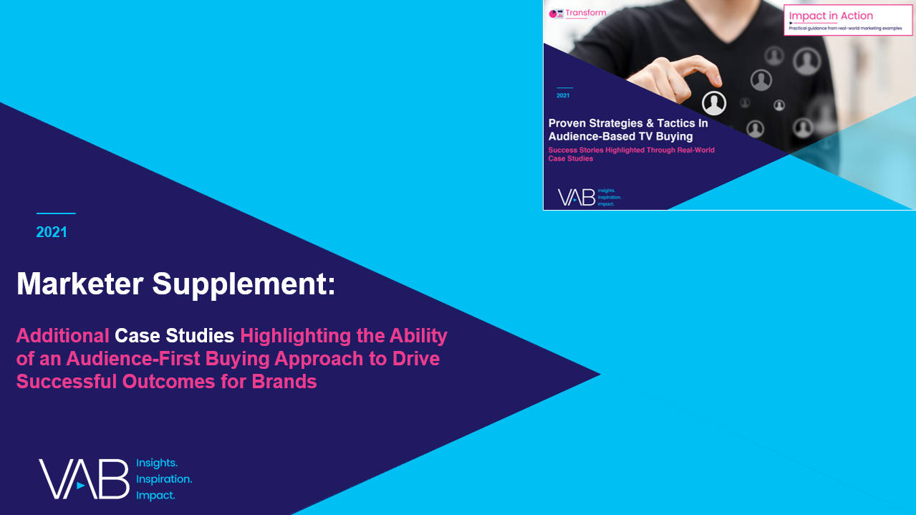
Leah Montner-Dixon
Reed Kiely
Karolina Guillen
Insights Manager
leahm@thevab.com
Insights Manager
reedk@thevab.com
Senior Insights Analyst
karolinag@thevab.com
Discover more
Looking for more data, insights and takeaways? Check out this related VAB content
VAB Members, brand marketers and agencies get free and immediate access to VAB’s content library. Get access at theVAB.com
This information is exclusively provided to VAB members and qualified marketers. Further distribution is prohibited.
PAGE 13

