Slide 1



2025 – 1st Quarter

Slide 2


About VAB
VAB plays a dual role in the video advertising industry. We are leading the change to bring about a more innovative and transparent marketplace. We also provide the insights and thought leadership that enables marketers to develop business-driving marketing strategies.
Drawing on our marketing expertise, we simplify the complexities in our industry and discover new insights that transform the way marketers look at their media strategy.
We are committed to your business growth and proud to offer VAB members, brand marketers and agencies complimentary access to our continuously-growing Insights library. Get immediate access at theVAB.com.
This information is exclusively provided to VAB members and qualified marketers.
PAGE 2

Slide 3
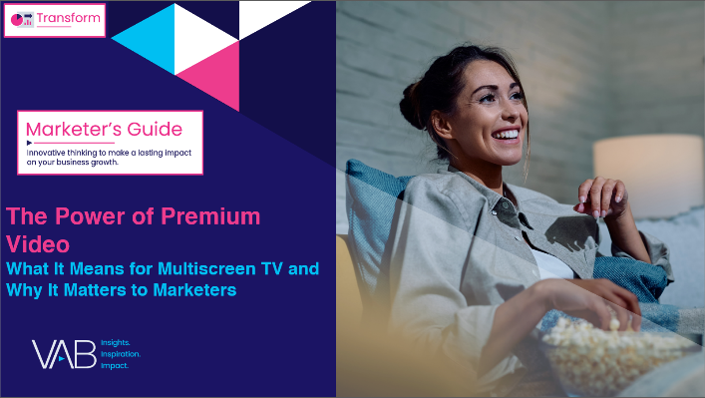


Premium environments boost results: Ads in high quality content are more likely to drive brand salience and action
Click here for the full report
Premium Environments Compared to Non-Premium
% of U.S. respondents who agree
Source: NBCUniversal and FreeWheel, Prescribing Premium: What a high-quality viewing experience means for consumers and why advertisers should take advantage of it, September 2024. Reflects U.S. respondents only. Note: Premium content in the study was publisher created episodic content with 100% of the ads viewable. Non-premium content was individual created short form content with 50% of the ads viewable. All content was delivered on a TV screen.
This information is exclusively provided to VAB members and qualified marketers.
PAGE 3

Slide 4
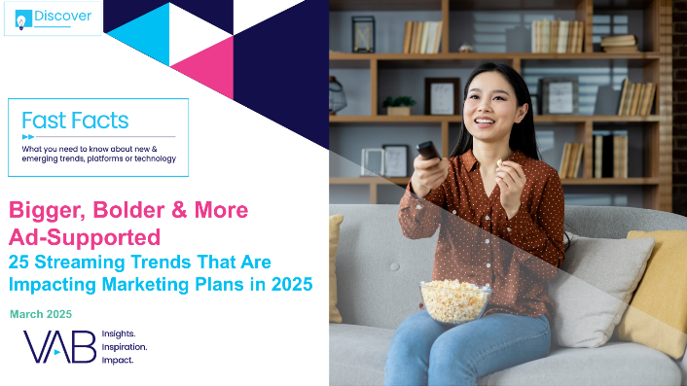


Ad-supported streaming growth: Through organic growth and the launch of new ad tiers, over 90% of streamers now see ads
Click here for the full report
% of streamers who used at least one ad-supported streaming service
Last 30 Days
Source: VAB analysis of MRI-Simmons November 2022 & November 2024 Cord Evolution Study, A18+. Base = ‘streamed in the past 12 months’. November ’22: reflects % of streamers who have used any ad-supported streaming service in the past 30 days. November ’24: reflects % of streamers who have used any ad-supported streaming services in the past 30 days.
This information is exclusively provided to VAB members and qualified marketers.
PAGE 4

Slide 5
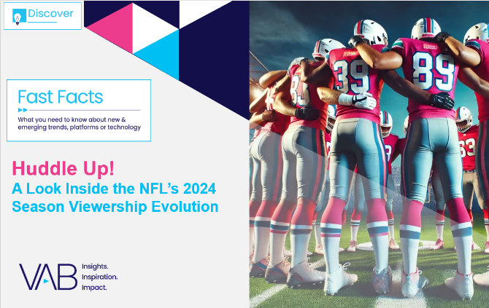
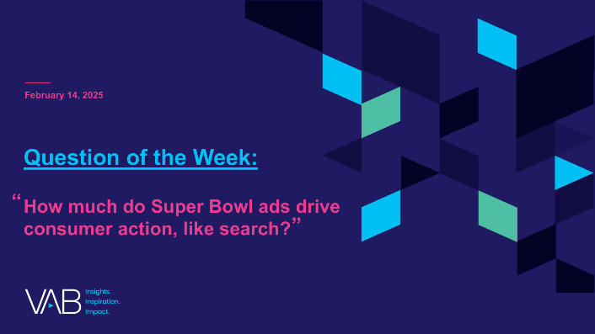
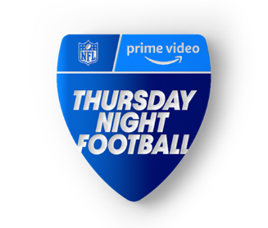
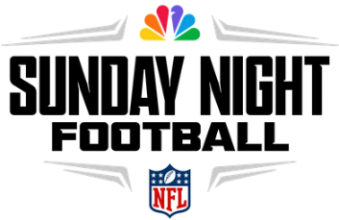

NFL matchups matter: Divisional games, which also tend to be more competitive, significantly increase NFL viewership
Click here for the full report
P2+ Reach
2024 Season
(based on 12-game comparable analysis)
Amazon’s TNF had a definitive advantage with nine divisional games within the 12-game comparable analysis
(9 Divisional Games)
(1 Divisional Game)
(2 Divisional Games)
Divisional
Game Average
23.7M
Divisional
Game Average
39.1M
Divisional
Game Average
36.9M
Non – Divisional
Game Average
20.6M
Non – Divisional
Game Average
35.6M
Non – Divisional
Game Average
35.0M
3.1M Difference
3.5M Difference
1.9M Difference
Divisional
Game Variance
+15%
Divisional
Game Variance
+10%
Divisional
Game Variance
+6%
An average +10% lift in viewership for divisional games vs. non-divisional match ups across the three events
Source: VAB analysis of Nielsen R&F Program Report, Sunday Night Football (Universo & Telemundo), Monday Night Football (ESPN Deportes) and Thursday Night Football (Amazon Spanish), excludes pre- & post-game shows, Live+SD, P2+, Panel data. Universo and ESPN Deportes linear TV audience only and does not include audiences gained from their digital / app streaming. The 12 comparable games reflect all weeks that have standalone NFL night game broadcasts across NFL weeks: 2-11 & 14-15 (excludes Thanksgiving weekend). Note: MNF week 7 includes exclusive game streamed on ESPN+; Telemundo simulcast included for NFL week 8.The average margin of victory for divisional matchups was 7.7 vs. 11.3 for non-divisional matchups with the analysis (almost a 4-point differential).
This information is exclusively provided to VAB members and qualified marketers.
PAGE 5

Slide 6
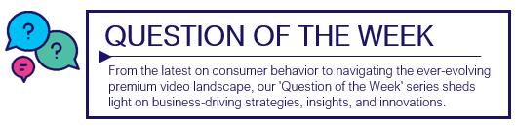

Young brands in the Super Bowl: Branded search for Liquid Death increased ten-fold after their ad aired in the big game
Click here for the full report
Download to see search results for all 15 brands analyzed
10x
Weekly Google Trends Index – Liquid Death
12-month trend leading up to Superbowl LIX (Weeks of 2/4/2024 – 2/9/2025)
vs. prior week
Super Bowl
(100 index)
“While we have a massive audience of loyal fans,
the Super Bowl is a great opportunity to introduce ourselves to new people and educate everyone about our entire line of healthy beverages.”
Andy Pearson
VP of Creative, Liquid Death
(Muse by Clios, 2/9/25)
Second Highest Week
(17 index)
Week Before Super Bowl
(10 index)
“[There is] no cheaper way to reach over
100 million unique people who want to pay attention to the commercials.”
Mike Cessario
CEO, Liquid Death
(Adweek, 2/9/25)
Source: VAB analysis of Google Trends, United States only, All Categories, Web Search, Weeks of 2/4/24 – 2/9/25. Google Search Index represents search interest relative to the highest point on the chart for the given region and time period, a value of 100 is the peak popularity for the term, a value of 50 means that the term is half as popular. Note: Light blue line marks the date of Super Bowl LIX. Click here to view Liquid Death’s Super Bowl commercial (via iSpot.tv).
This information is exclusively provided to VAB members and qualified marketers.
PAGE 6

Slide 7
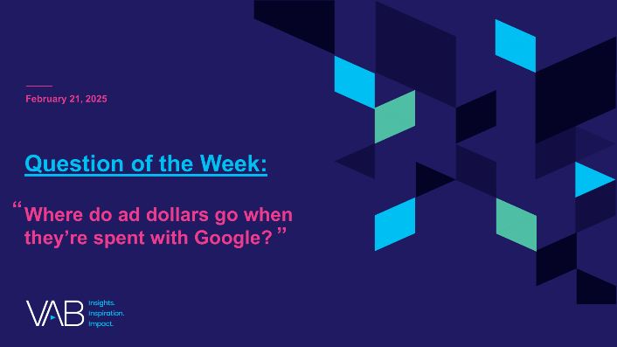




Understanding Alphabet’s ad revenue: Spending on undefined platforms through Google equals the global ad spend in print
Click here for the full report
Estimated Global Advertising Revenues by Media
2024
Print
Google Network & ‘Other’
Outdoor
Radio
$43.7
Billion
$43.6
Billion
$36.2
Billion
$29.3
Billion
Download to understand where ad dollars go when they’re spent with Google
Source: Alphabet SEC company 10-K filings via SEC Edgar Search, for fiscal year ended 12/31/24. ‘Google Network’ includes revenues generated on Google Network properties participating in AdMob, AdSense, and Google Ad Manager. Reflects gross revenue which includes the dollars that Google pays in traffic acquisition costs (TAC) to partner sites. Totaled numbers may equal not total due to rounding. Adalytics Research LLC, ‘Does A Lack of Transparency Create Brand Safety Concerns For Search Advertisers?’ report, November 2023, for more methodological details see page 6, for ‘Other’ methodology see page 7. S&P Global Market Intelligence Kagan, Global Advertising Expenditure Forecasts, December 2024.
This information is exclusively provided to VAB members and qualified marketers.
PAGE 7

Slide 8
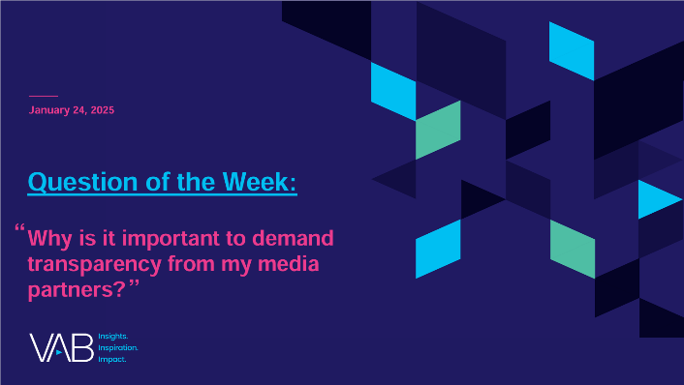
Top concerns for marketers: Lack of transparency can lead to brand safety issues like ad fraud and questionable placements
Click here for the full report
% of respondents who are concerned about the following
For Their Business / Client’s Businesses
Click fraud*
Lack of transparency on campaign details and placements
Unknowingly appearing on websites with objectionable, offensive content
Unknowingly appearing on websites that deliberately serve disinformation / misinformation
Targeted/tracked ads running alongside children's content
Unknowingly appearing on 'Made for Advertising' (MFA) websites
Source: VAB / Advertiser Perceptions ‘Marketer Sentiment on Ad Fraud’ Survey, November 2023. Survey base: Marketer and agency contacts from the Advertiser Perceptions ‘Senior Marketer’ and ‘Streaming Video’ online communities.
Q3A. What are your top 3 concerns surrounding digital ad fraud regarding [your business/your clients' businesses]? Base = Total Respondents. *‘Click fraud’ refers to bots, click farms, etc. that generate fake clicks on an ad or website.
This information is exclusively provided to VAB members and qualified marketers.
PAGE 8

Slide 9
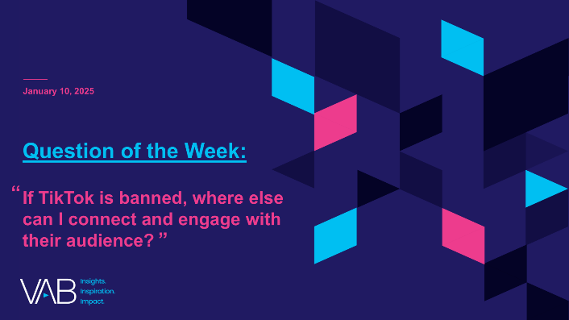


Where else can I engage with TikTok’s audience?: Multiscreen TV creates greater emotional bonds with Gen Z
Click here for the full report
% of platform users who ‘feel personally connected to a character / personality’ on the following platforms
 | Gen Z | Hispanic | Black
TV / Streaming | 34% | 34% | 31%
TikTok | 25% | 21% | 15%
TV / Streaming vs. TikTok % more likely | +35% | +62% | +117%
*How to read: P13-24 are 21% more likely to feel personally connected to a character / personality from TV or streaming content vs. TikTok content
Source: VAB custom research fielded by Hub Entertainment Research as part of the 2023 Video Redefined report. Data sourced from Hub’s survey of 1,900 consumers, ages 13-74. Gen Z (P13-24) respondents = 620 (unweighted). Hispanic respondents = 325 (unweighted). Black respondents = 228 (unweighted). Data collected December 2023. Q1: Which of the following statements apply to you when you watch videos, shows or movies on the following platforms? Based on users of the platform.
This information is exclusively provided to VAB members and qualified marketers.
PAGE 9

Slide 10
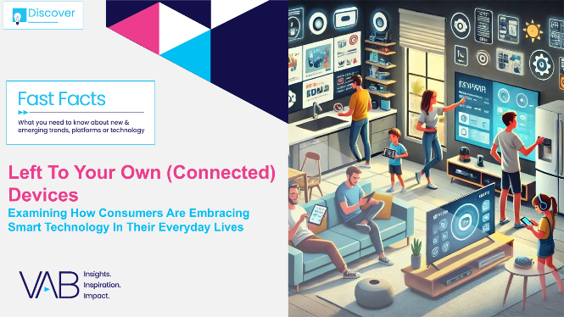


Connected car penetration: Most vehicles are now connected and nearly half of adults would pay for in-vehicle entertainment
Click here for the full report
Download to see insights on 15 other connected devices
U.S. Connected Car Drivers
In millions
Monthly automotive subscription features
U.S. adults are willing to pay for*
% of respondents
66%
45%
In-vehicle Wi-Fi / Connectivity Packages
(Allows passengers to always connect to the internet from the car)
In-Vehicle
Entertainment
(Streaming services, movies,
games packages)
% of licensed drivers who drive connected cars
58%
62%
66%
69%
71%
Source: EMARKETER Forecast, September 2024. Note: ages 14+; licensed drivers who have driven a connected car and accessed its internet-enabled features at least once during the calendar year. *KPMG, KPMG American Perspectives Survey, May 30, 2024. Note: ages 18+. Reflects respondents who would be ‘very likely’ or ‘somewhat’ likely to pay for monthly automotive subscription features.
This information is exclusively provided to VAB members and qualified marketers.
PAGE 10

Slide 11

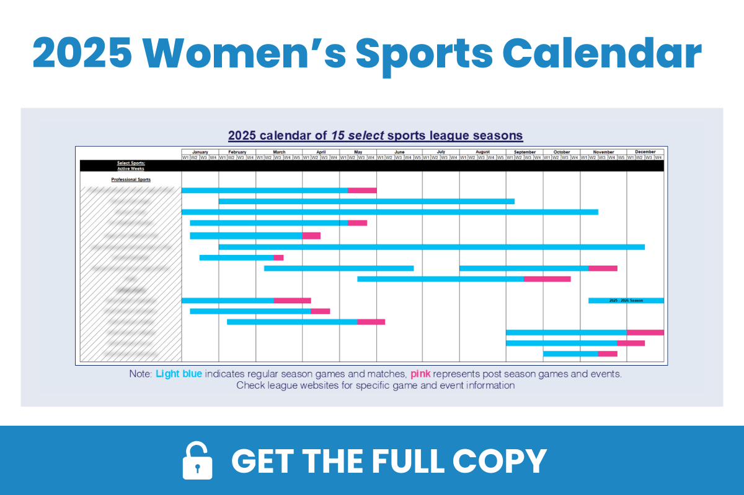
Women’s sports calendar: Find out where you can engage with highly attentive, growing audiences throughout the year
Click here for the full report
185MM
60MM
Adults 18+ are interested
in women’s sports*
Adults 18+ are more interested in women’s sports
than last year**
108MM
67%
Fans wish there was more media coverage of
women’s sports***
of women sports fans make it a point to support brands that invest in women’s sports***
Source: VAB analysis of 2024 Fall MRI-Simmons USA Study, A18+. *Reflects respondents who are ‘very interested’, ‘somewhat interested’ or ‘a little bit interested’ in the following women’s sports: Mexican Women’s National Soccer Team, National Women’s Soccer League, Women’s National Soccer Team, WNBA, LPGA, Women’s Tennis, Figure Skating, Summer Olympics and Winter Olympics. **VAB analysis of MRI-Simmons 2024 Q4 Trending Topics Study, A18+. ***SBJ, Horizon Sports & Experiences releases study on women's sports growth, 2/4/2024.
This information is exclusively provided to VAB members and qualified marketers.
PAGE 11

Slide 12
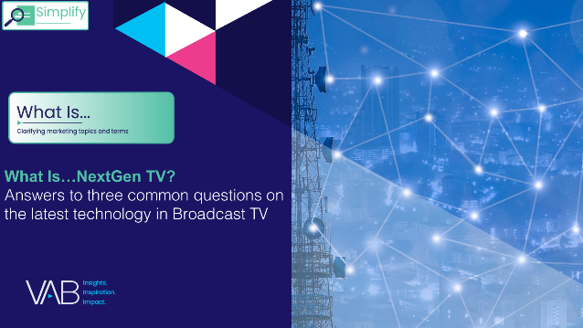
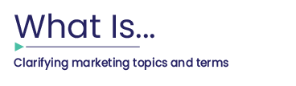
NextGen TV: Only 3% of TVs in the U.S. are NextGen-capable, with penetration projected to still be below 10% by 2028
Click here for the full report
Estimated Number of NextGen-Capable TVs in the U.S.
2023
2024
2025
2026
2027
2028
11MM
27MM
31MM
34MM
3.8MM
5.5MM
% of total U.S. TV Installed Base*
1%
1.5%
3%
7%
8%
9%
Source: TV New Check, ATSC Touts 3.0 Progress Despite Spectrum Challenges, 6/20/24. *S&P Global Market Intelligence Kagan estimates; industry data.
This information is exclusively provided to VAB members and qualified marketers.
PAGE 12

Slide 13
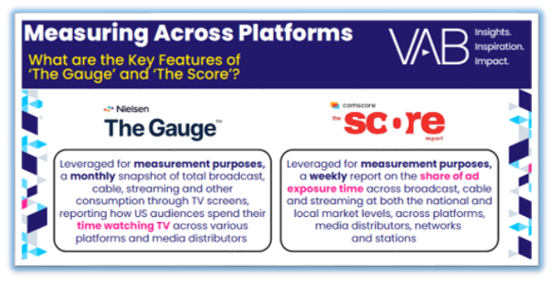
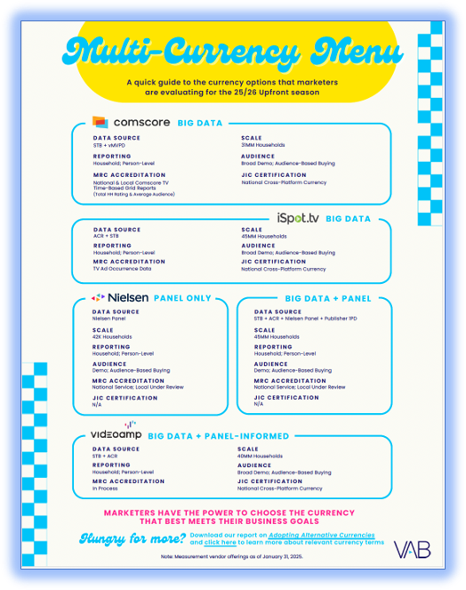
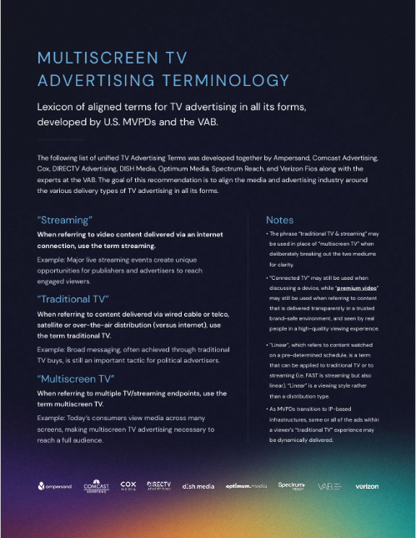
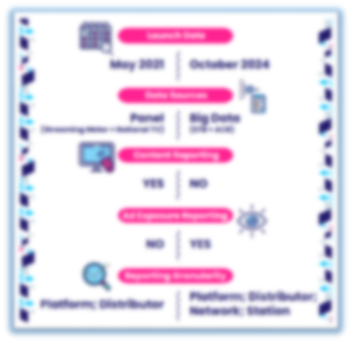
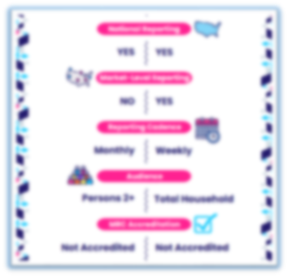
Essential one-sheeters: VAB helps to simplify measurement platforms, currency offerings and multiscreen TV terminology. Download Now!
Bonus Slide!
Download to learn more about the key features between ‘The Gauge’ & ‘The Score’!
Download for an updated look at currency solutions!
Download for key multiscreen TV ad terms!
This information is exclusively provided to VAB members and qualified marketers.
PAGE 13

Slide 14
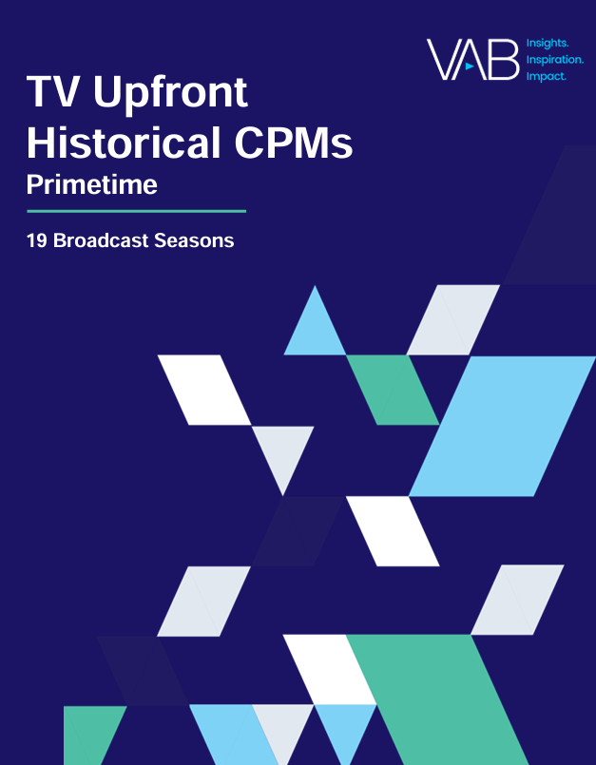
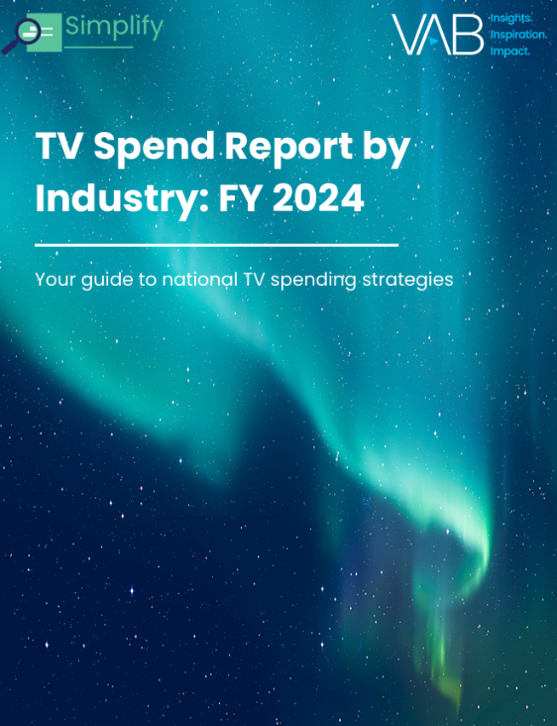
Member only resources: Access exclusive content including historical TV upfront CPMs and TV spend by industry, only for VAB members
Member Exclusives
VAB Member Exclusive
VAB Member Exclusive
If you're interested
in becoming a VAB member, click here
for more information
Download to see TV Upfront TV Historical CPMs!
Download for TV spend insights by industry!
This information is exclusively provided to VAB members and qualified marketers.
PAGE 14

Slide 15


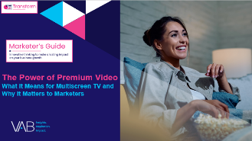
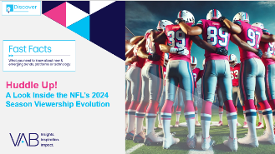
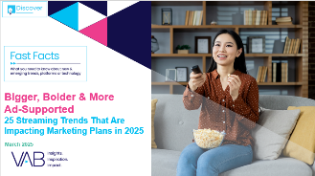
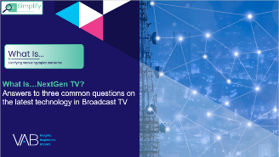

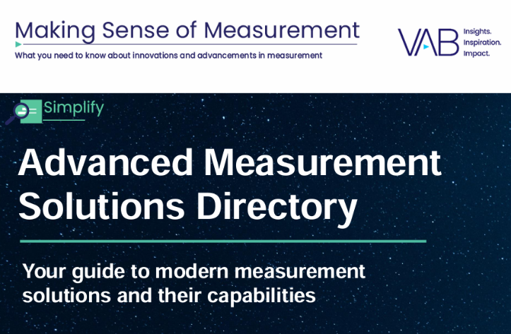
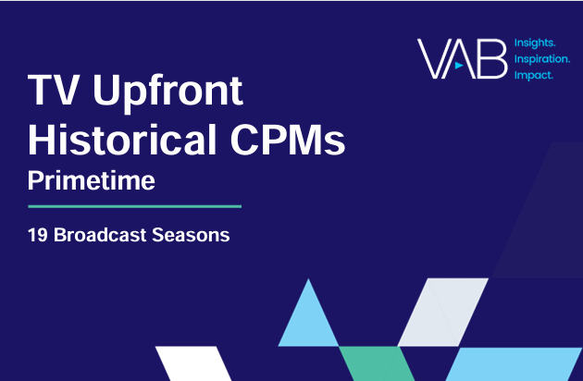
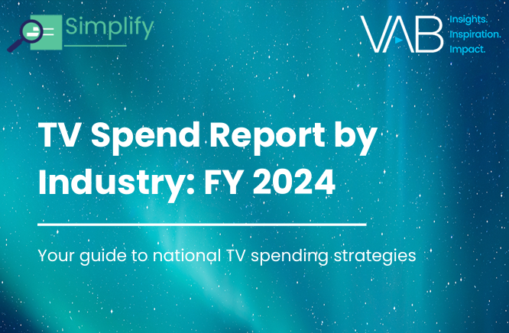
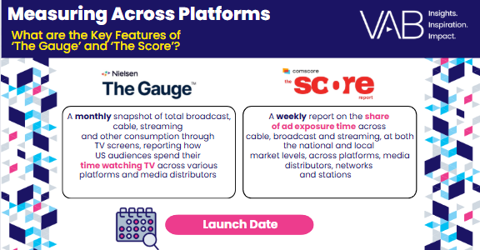

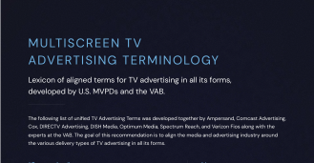
1Q 2025 Insights & Measurement Content Releases
Jason Wiese
Benjamin Vandegrift
SVP, Director of Strategic Insights
jasonw@thevab.com
VP, Measurement Solutions & Innovations benv@thevab.com
Kailyn Hartmann
Leah Montner-Dixon
VP, Advanced Analytics & Intelligence
kailynh@thevab.com
Director, Audience & Behavioral Insights
leahm@thevab.com
Reed Kiely
Karolina Guillen
Director, Data Insights & Trends
reedk@thevab.com
Associate Director, Insights, Strategy & Analytics karolinag@thevab.com
Kaileen Cain
Senior Insights Analyst
kaileenc@thevab.com
Discover more
Looking for more data, insights and takeaways? Check out this related VAB content
VAB Members, brand marketers and agencies get free and immediate access to VAB’s content library. Get access at theVAB.com
This information is exclusively provided to VAB members and qualified marketers.
PAGE 15

