Slide 1



2024 – 1st Quarter

Slide 2


About VAB
VAB plays a dual role in the video advertising industry. We are leading the change to bring about a more innovative and transparent marketplace. We also provide the insights and thought leadership that enables marketers to develop business-driving marketing strategies.
Drawing on our marketing expertise, we simplify the complexities in our industry and discover new insights that transform the way marketers look at their media strategy.
We are committed to your business growth and proud to offer VAB members, brand marketers and agencies complimentary access to our continuously-growing Insights library. Get immediate access at theVAB.com.
This information is exclusively provided to VAB members and qualified marketers.
PAGE 2

Slide 3







Prioritize quality: Marketers have a standard for what constitutes premium media partners within their video campaigns
Click here for the full report
How important are the following factors when buying premium video inventory?
% of buyers who responded important / very important
91%
89%
85%
81%
Brand Safety
High Production Quality
Publisher
of Content
Demand
for Content
Source: Comcast Advertising, What is Premium Video: Redefining what it Means to be Premium in Advertising, November 2023.
This information is exclusively provided to VAB members and qualified marketers.
PAGE 3

Slide 4
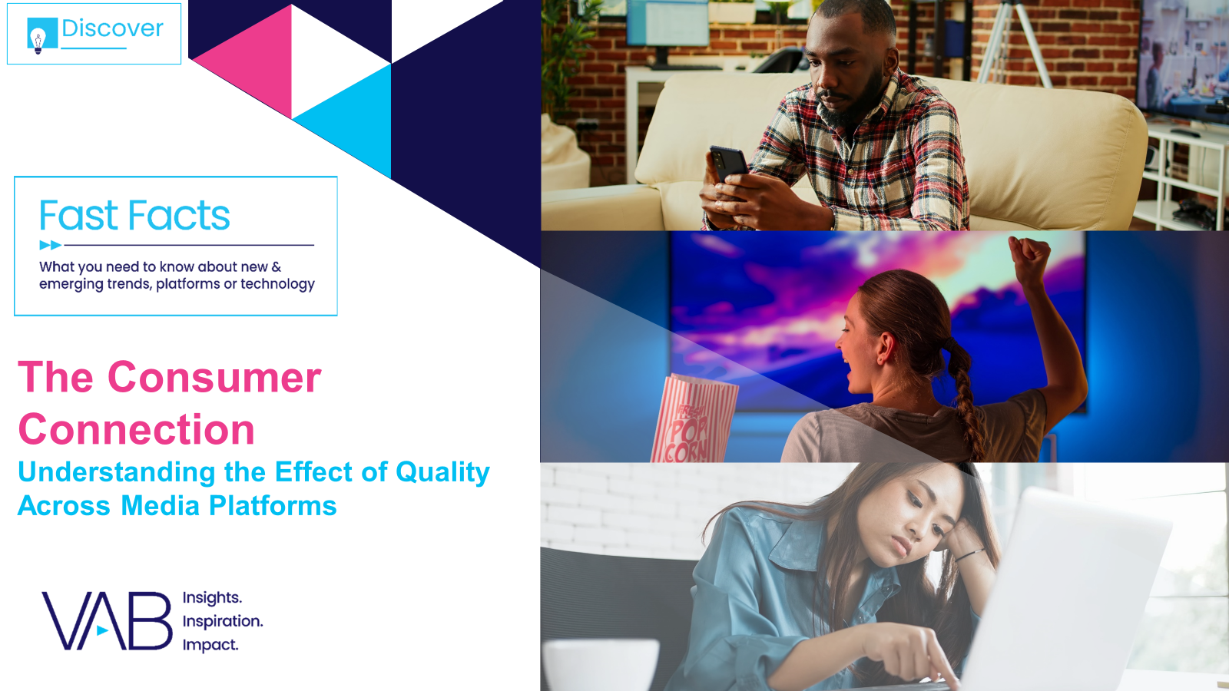


A ‘premium’ halo effect: High-quality video content shapes
a more positive perception of advertisers vs. digital platforms
Click here for the full report
‘Signaling strength’ by channel
Media signaling:
The perceived cost and scale
of an advertising channel that
can enhance brand attributes
in the eyes of the consumer.
Signaling determines a platform’s ability to strengthen brand perception in terms of its financial footing, popularity and degree to which it could be trusted.
How to read: 46% of respondents believe TV advertising enhances a brand’s attributes
Source: WARC, Why media quality will take centre stage in 2024, 1/22/24.
This information is exclusively provided to VAB members and qualified marketers.
PAGE 4

Slide 5



Demand transparency: Ad placements appearing alongside misinformation can have a drastic negative impact on brands
Click here for the full report
73%
65%
of consumers agree that they would feel unfavorably towards brands that have been associated with misinformation*
of consumers say that they are
likely to stop buying from a brand that advertises next to misinformation**
Source: Integral Ad Science, Advertising in the Age of Misinformation, 2022. Based on survey of 1,189 U.S. adults in July 2022. *Reflects respondents who answered ‘agree’ or ‘strongly agree’. **Reflects respondents who answered ‘likely’ or ‘very likely’. Download VAB’s report ‘The Credibility Crisis’ to learn more.
This information is exclusively provided to VAB members and qualified marketers.
PAGE 5

Slide 6
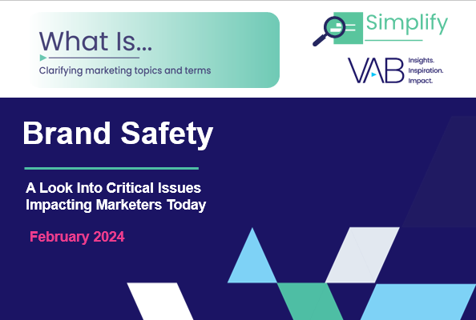
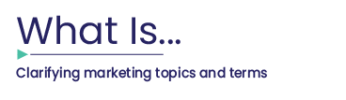
Consumer outlook on brand safety: Many people will stop buying a brand if they see its ads next to objectionable content
Click here for the full report
90
82
67
^{nearly}
%
%
%
of consumers would be
likely to stop using the
brand if they viewed the brand’s digital advertising beside false, objectionable
or inflammatory content
of consumers say it is important that a brand’s
ads appear on content
that is safe, accurate
and trustworthy
of consumers feel that
brands bear responsibility for ensuring their ads run beside content that is safe
Source: DoubleVerify & Harris Poll, Consumers Reject Brands That Advertise on ‘Fake News’ and Objectionable Content Online, June 2019
This information is exclusively provided to VAB members and qualified marketers.
PAGE 6

Slide 7

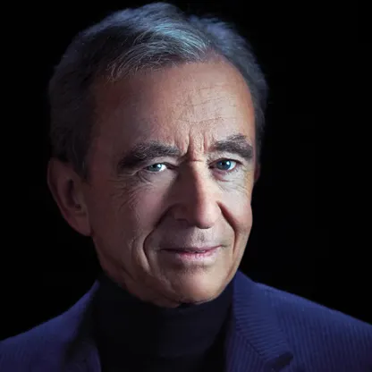
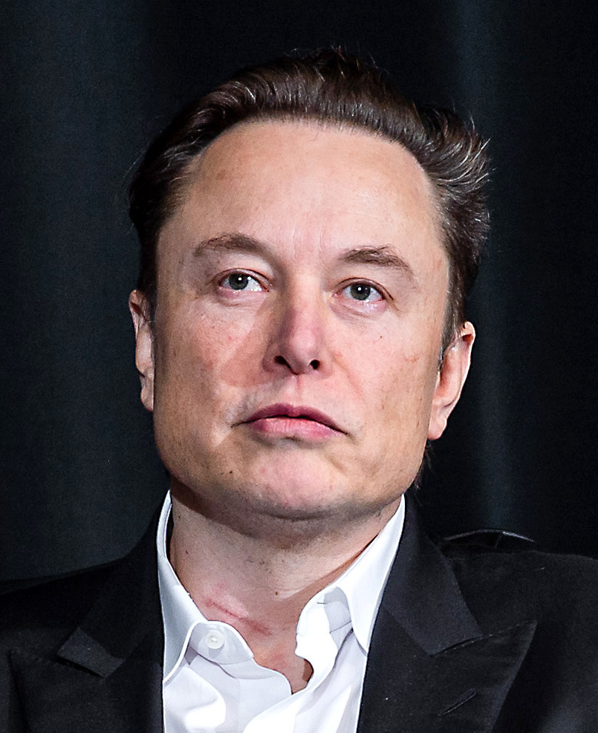
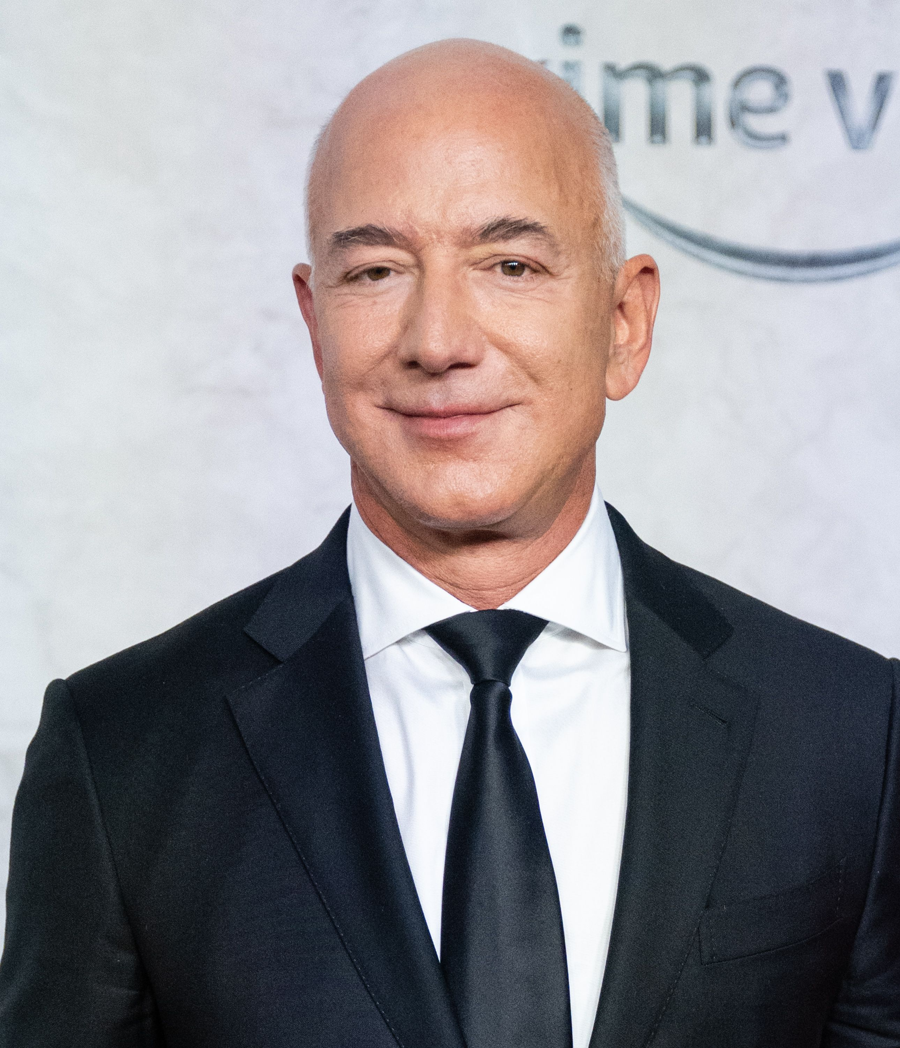
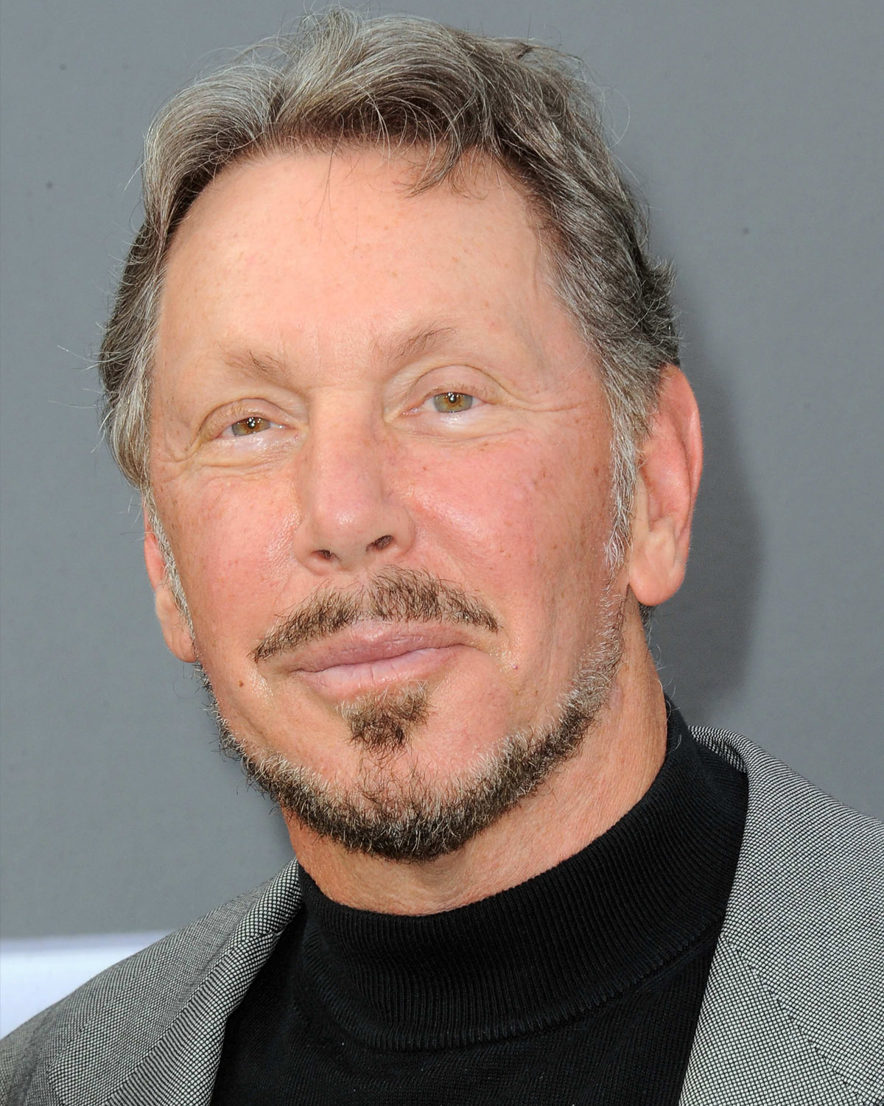
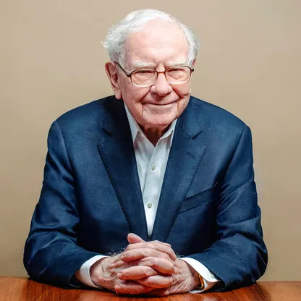
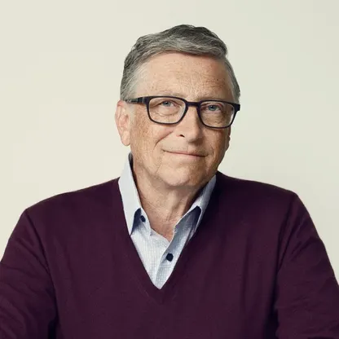
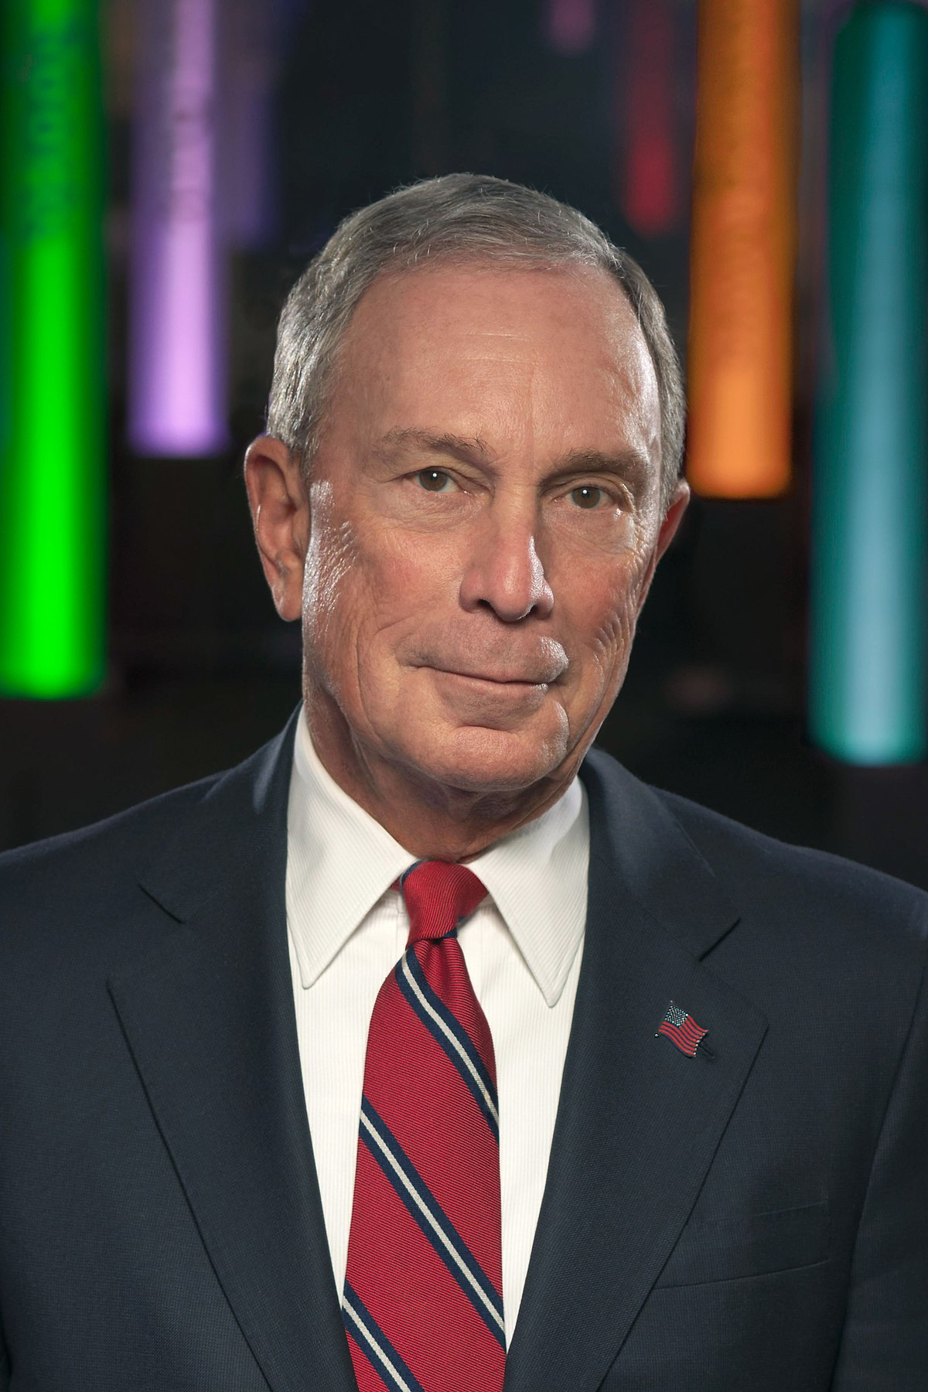
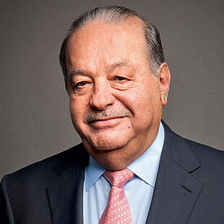

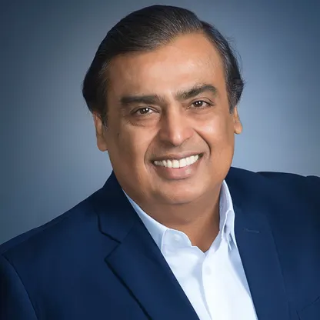

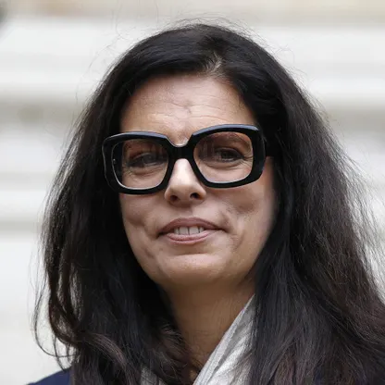
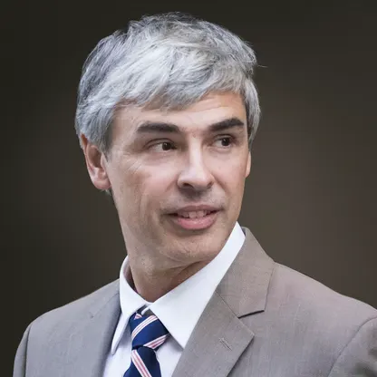
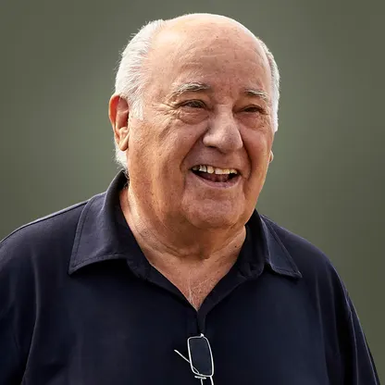
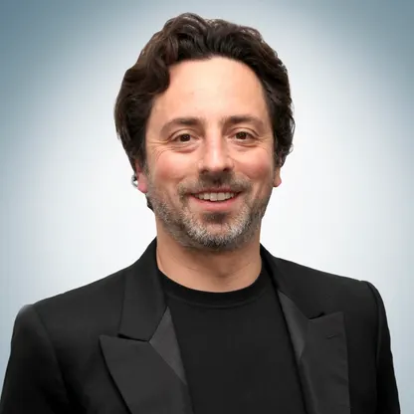

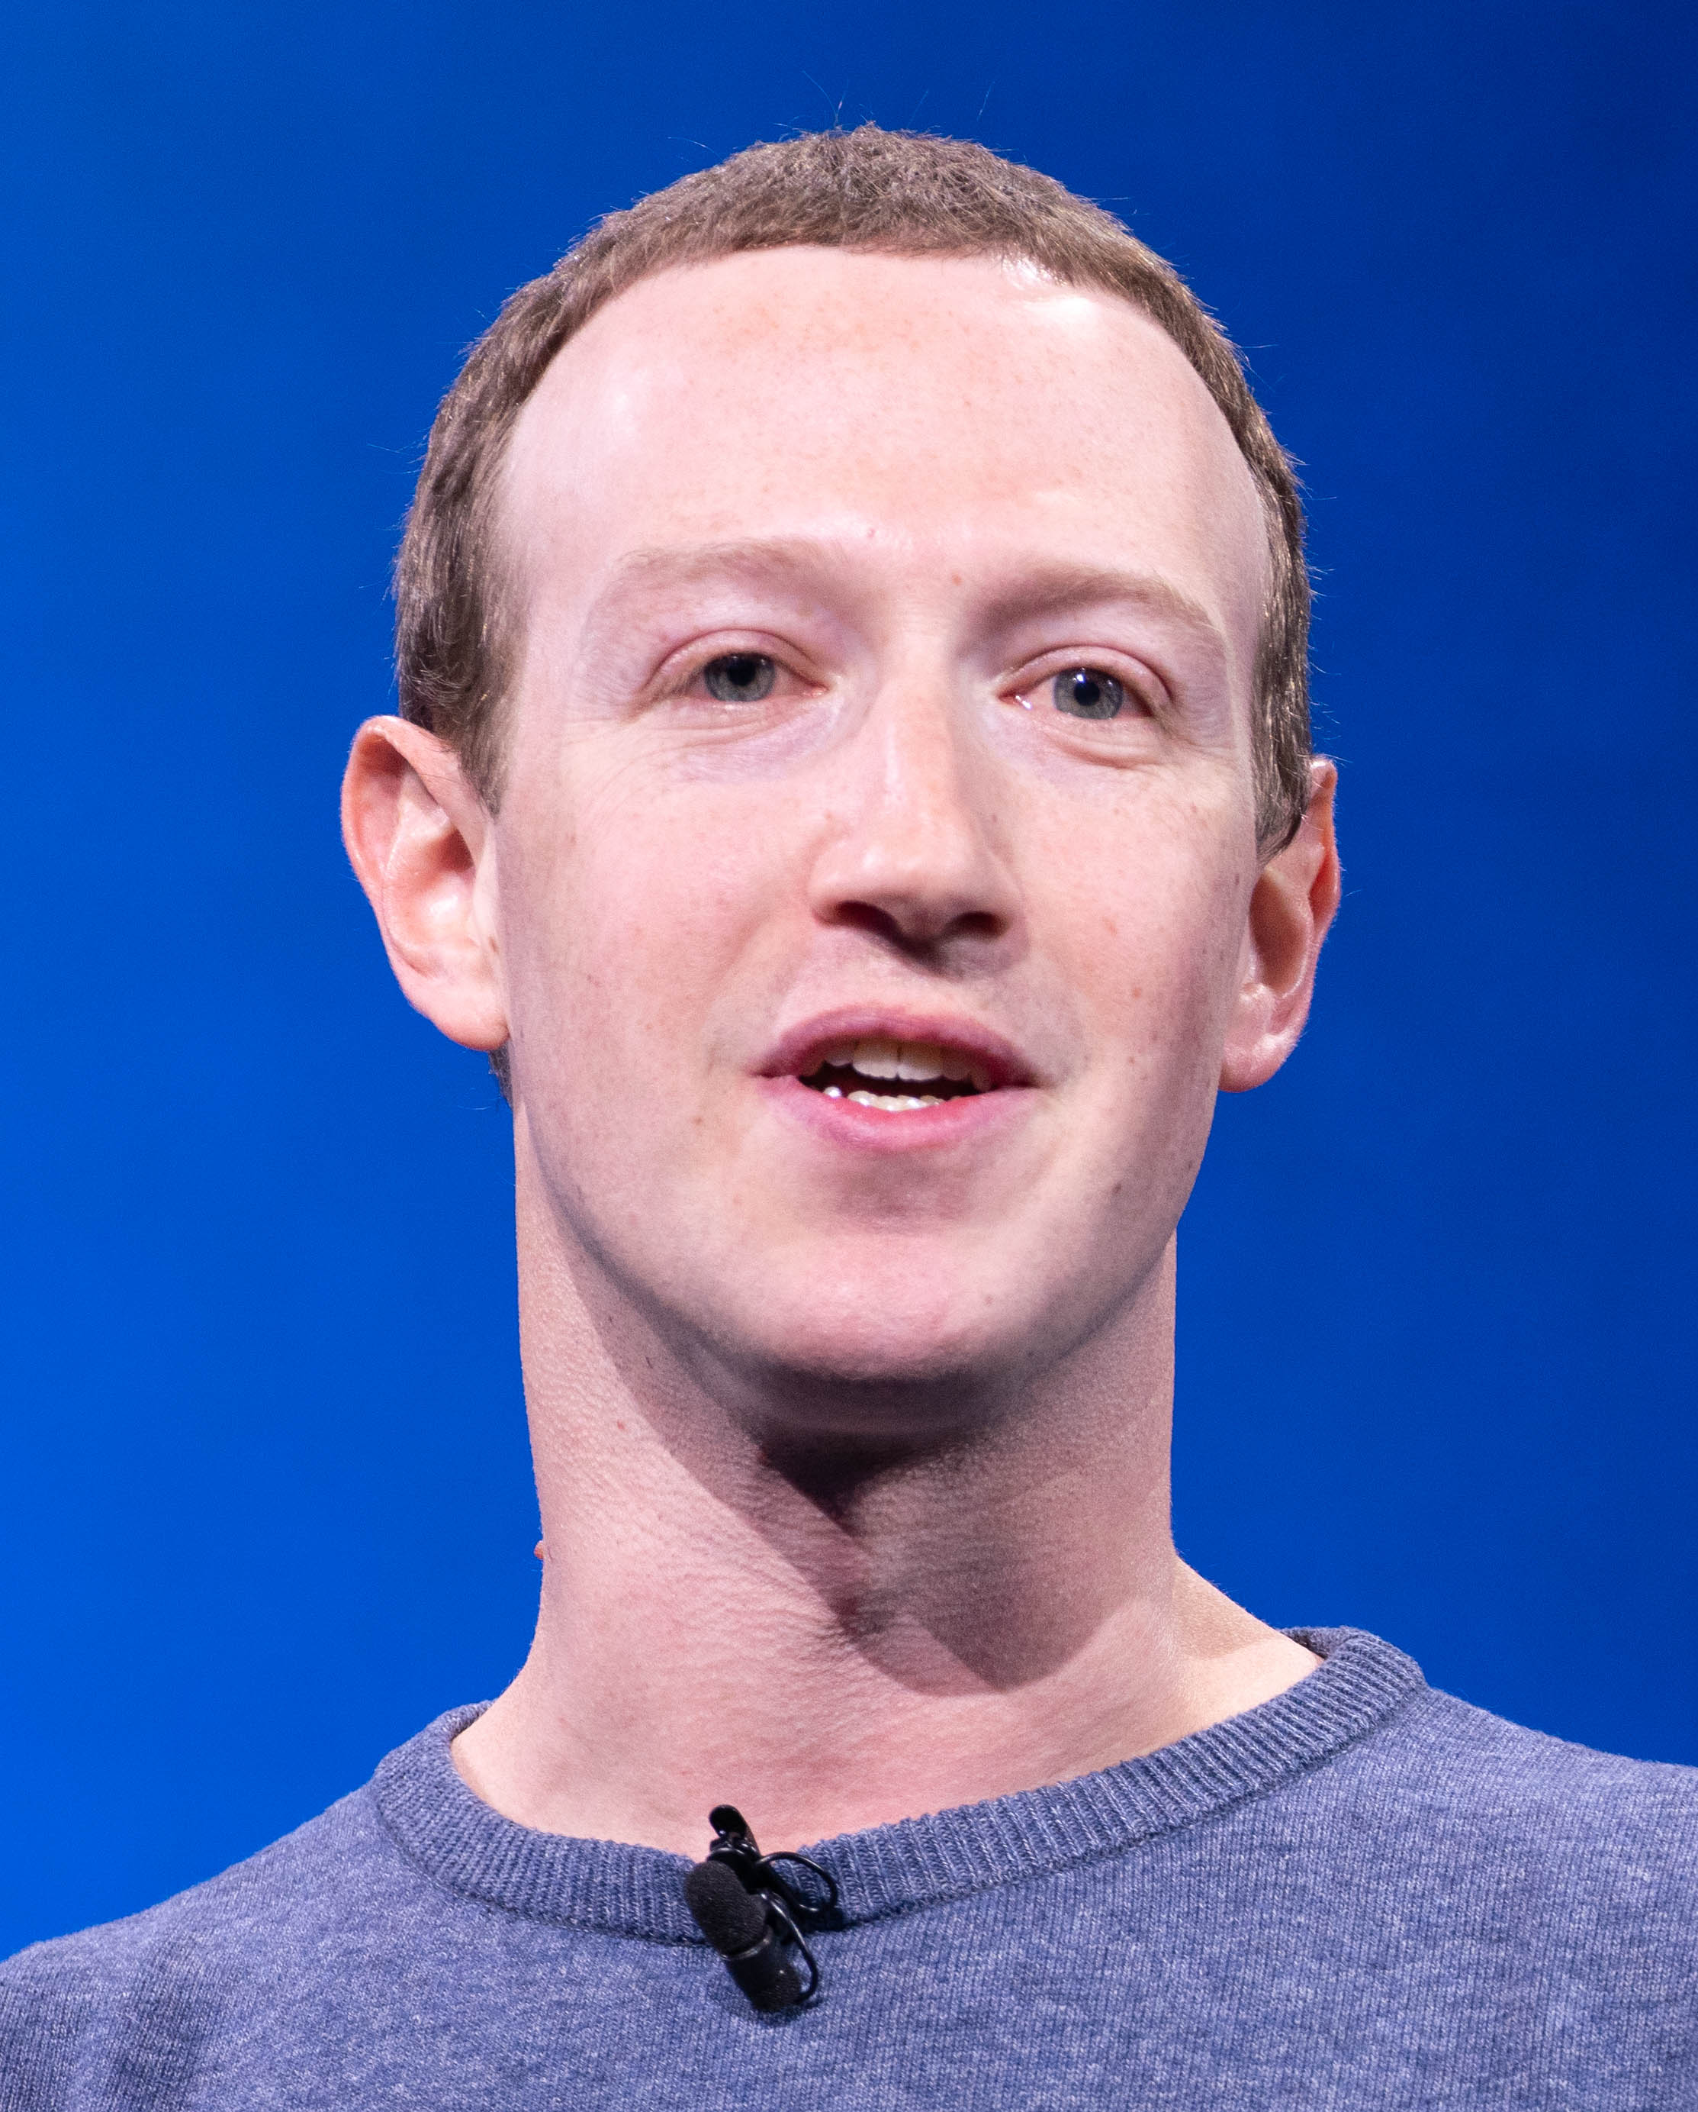
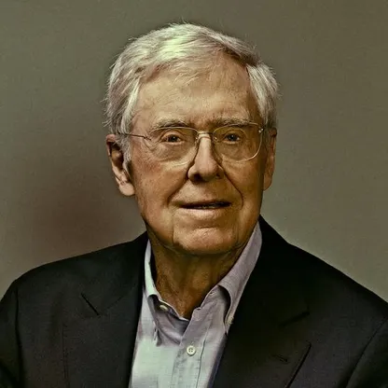
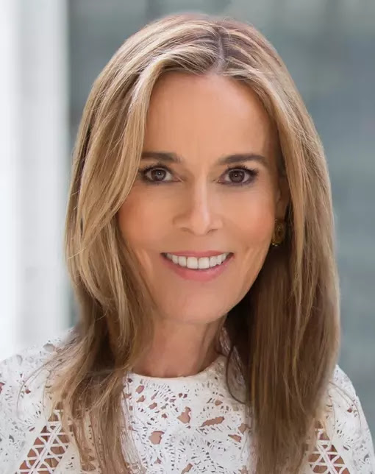
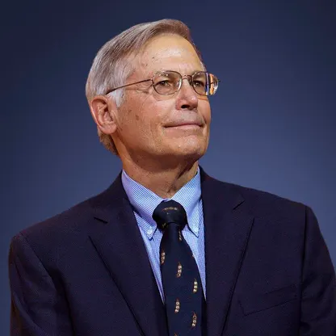
Understanding the scale of fraud: If global digital ad fraud was a human, it would be the ninth richest person in the world
Click here for the full report
Net Worth of the Wealthiest People in the World vs. Global Cost of Digital Ad Fraud
in billions
Rank #1
Rank #2
Rank #3
Rank #4
Rank #5
Rank #6
Rank #7
Rank #8
Rank #9
Rank #10
Bernard Arnault & family
$211B
Elon Musk
$180B
Jeff Bezos
$114B
Larry Ellison
$107B
Warren Buffett
$106B
Bill Gates
$104B
Michael Bloomberg
$95B
Carlos Slim Helú & family
$93B
Ad Fraud*
$84B
Mukesh Ambani
$83B
Rank #11
Rank #12
Rank #13
Rank #14
Rank #15
Rank #16
Rank #17
Rank #18t
Rank #18t
Rank #20
Steve Ballmer
$81B
Françoise Bettencourt Meyers & family
$81B
Larry Page
$79B
Amancio Ortega
$77B
Sergey Brin
$76B
Zhong Shanshan
$68B
Mark Zuckerberg
$64B
Charles Koch
$59B
Julia Koch
$59B
Jim Walton
$59B
Source: Forbes, The 25 Richest People In The World 2023, 4/4/2023. *Juniper Research, Quantifying the Cost of Ad Fraud: 2023-2028, 9/26/2023. *Includes Elon Musk (X/Twitter), Jeff Bezos (Amazon), Bill Gates & Steve Ballmer (Microsoft), Larry Page & Sergey Brin (Alphabet/Google), Mark Zuckerberg (Meta/Facebook)
This information is exclusively provided to VAB members and qualified marketers.
PAGE 7

Slide 8


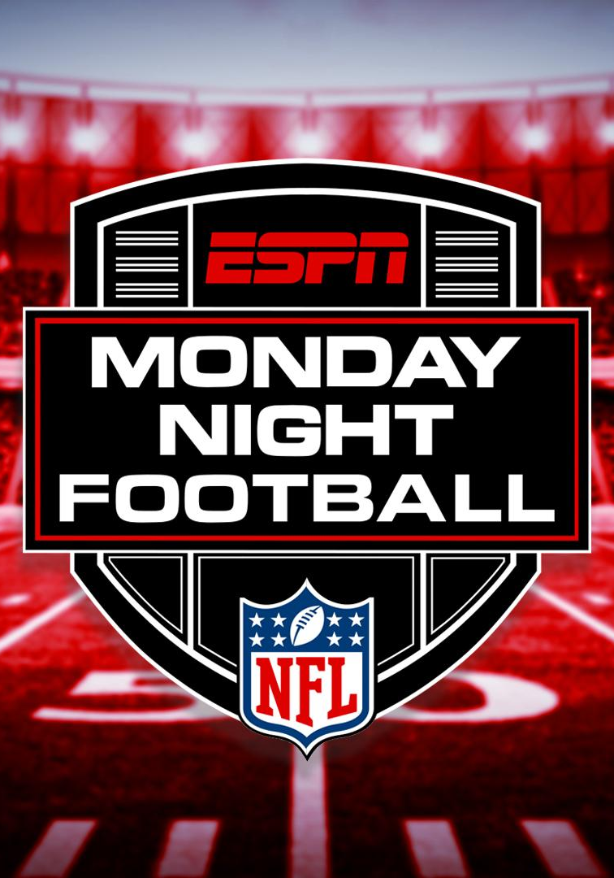



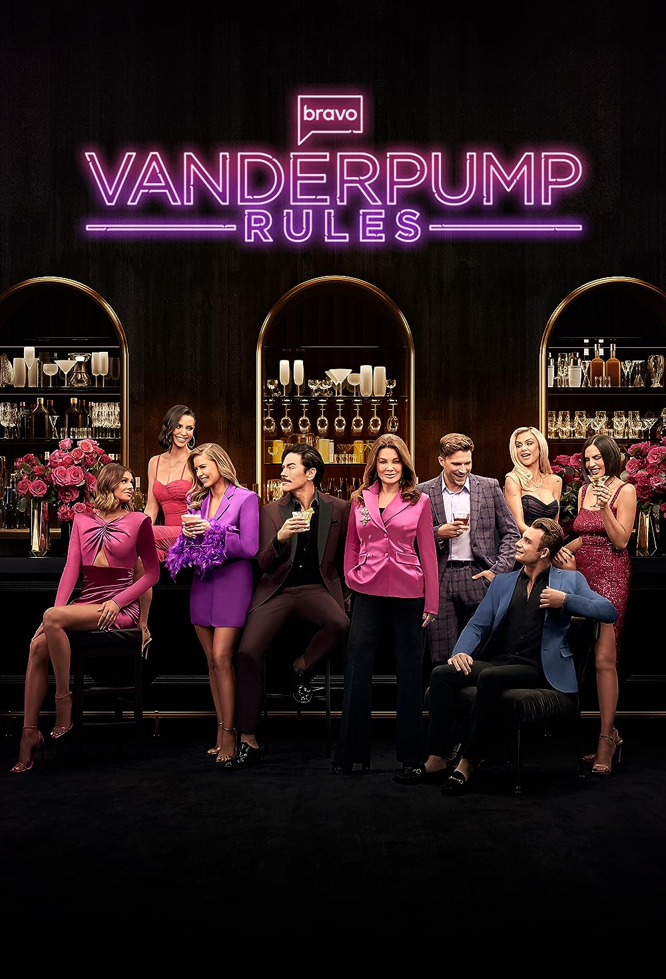




Sizing up fraud: The North American cost of digital ad fraud
is equivalent to the total national & local cable TV ad spend
Click here for the full report
North America Cost of Digital Ad Fraud
U.S. National & Local Cable TV Ad Spend
$35B
$34B
Source: Juniper Research, Quantifying the Cost of Ad Fraud: 2023-2028, 9/26/2023. eMarketer Insider Intelligence, 2022 estimated based on MoffettNathanson analysis of company reports. Based on estimated TV ad spending; national cable ($28.5B total) and local cable ($5.3B total).
This information is exclusively provided to VAB members and qualified marketers.
PAGE 8

Slide 9

Embrace innovation: Marketers seek customizable targeting, creative partnerships & innovative ad formats to drive KPIs
Click here for the full report
The Top Five Factors of Innovation & Creativity in Advertising-Supported Media
Source: The Myers Report / MediaVillage Education Foundation / American Association of Advertising Agencies (4A’s), based on survey of 3,400 agency professionals in July / August 2023.
This information is exclusively provided to VAB members and qualified marketers.
PAGE 9

Slide 10
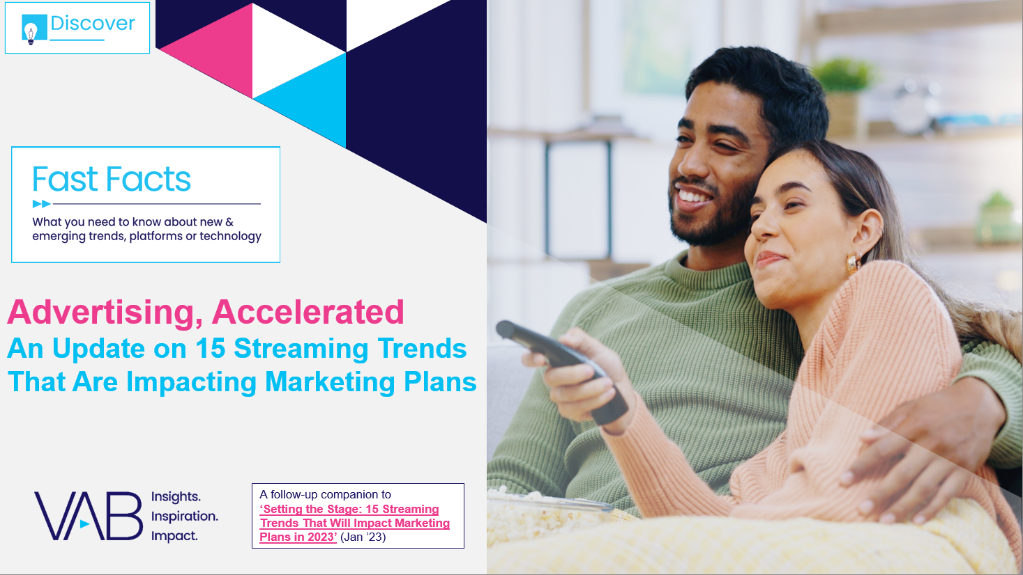
Opportunities in streaming: Ad-supported services now reach eight of ten streamers as platforms and audiences grow
Click here for the full report
% of streamers who use at least one ad-supported streaming service
Source: VAB analysis of MRI-Simmons November 2022 & March 2024 Cord Evolution Study, A18+. Base = ‘streamed in the past 12 months’. November ’22: reflects % of streamers who have used any of the following streaming services in the past 12 months: Crackle, Crunchyroll (limited commercial subscription), Discovery + (limited commercial subscription), Hulu (limited commercial subscription), PARAMOUNT + (LIMITED COMMERCIAL SUBSCRIPTION), Peacock (limited commercial subscription), IMDb TV, Local Now OR PARAMOUNT + (LIMITED COMMERCIAL SUBSCRIPTION), Peacock (limited commercial subscription), Pluto TV, redbox, Roku Channel, Samsung TV Plus, Tubi TV, Vudu, Xumo. March ’24: reflects % of streamers who have used any of the following streaming services in the past 12 months: Crackle, Crunchyroll (free), Tubi, Discovery+ (with ads/commercials), Disney+ (with ads/commercials), Freevee (formerly IMDb TV), Max (with ads/commercials), Hulu (with ads/commercials) NET, LG Channels, Local Now App, Paramount+ (with ads/commercials), Peacock (with ads/commercials), Pluto TV, redbox, Roku Channel, Samsung TV Plus, Vudu)
This information is exclusively provided to VAB members and qualified marketers.
PAGE 10

Slide 11
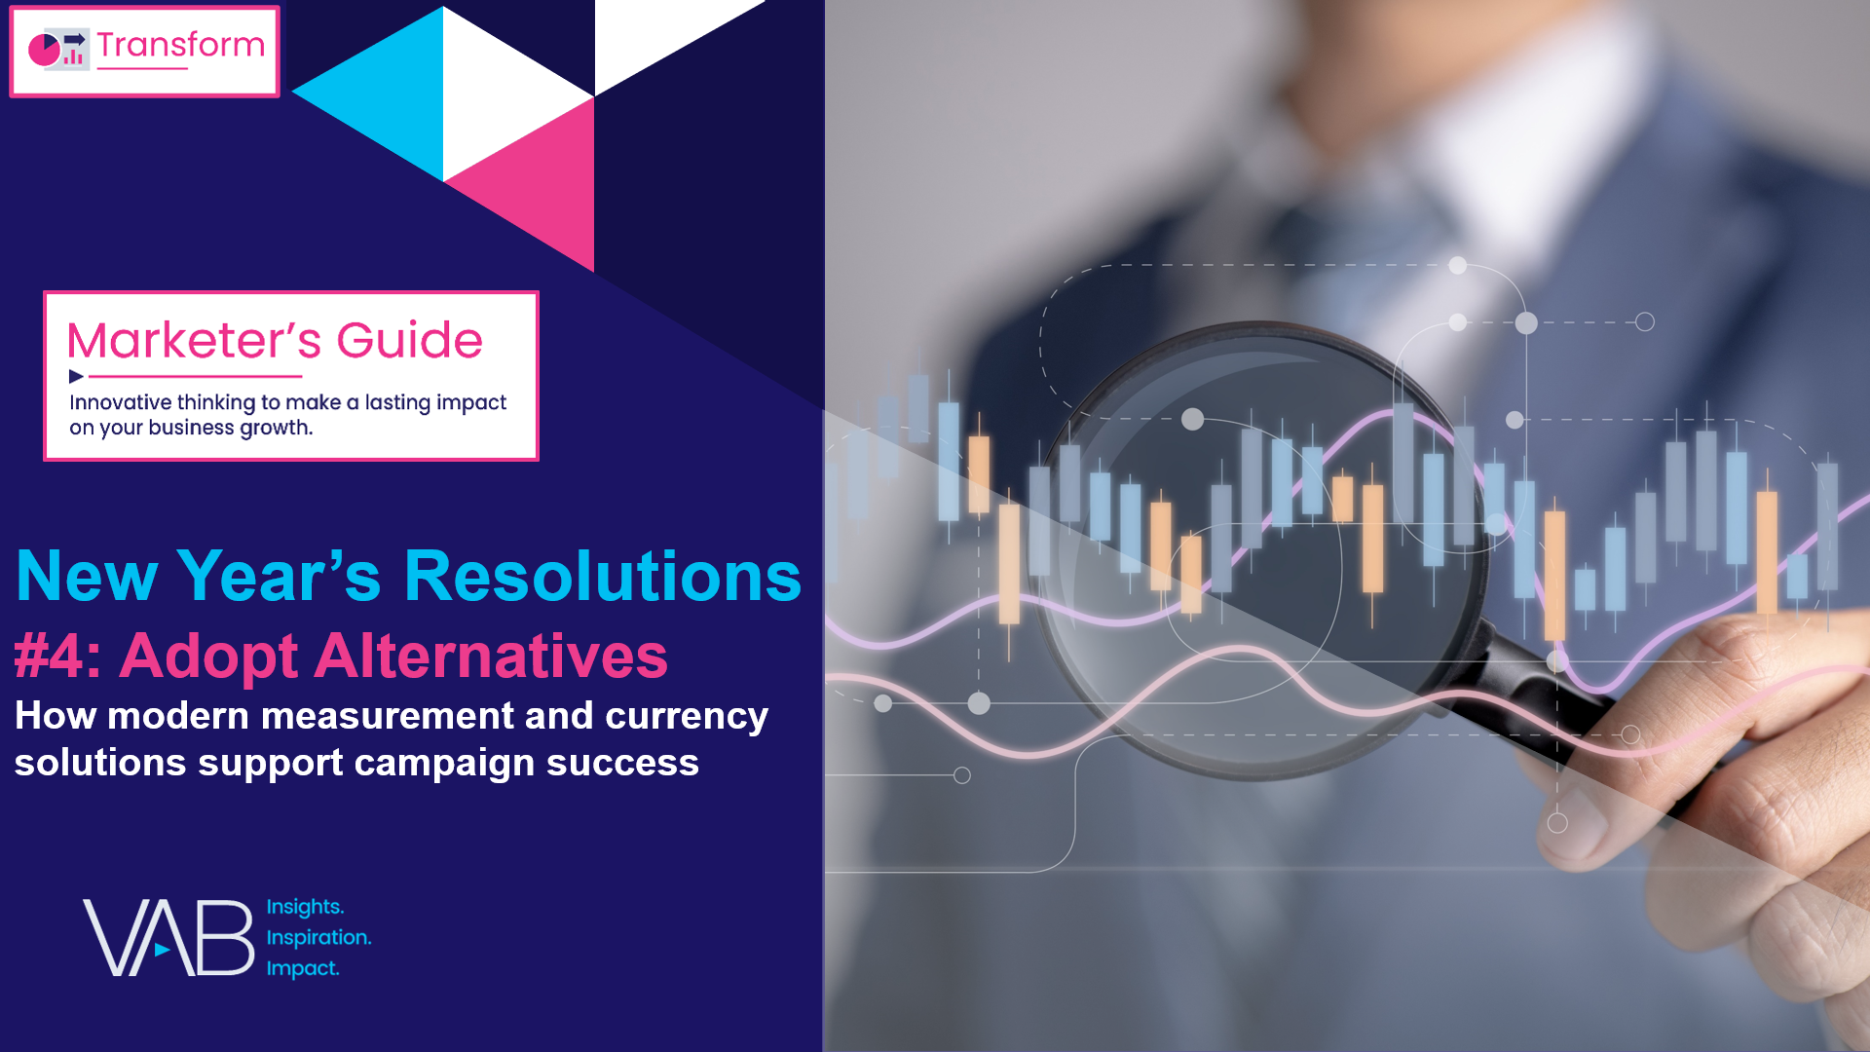
Adopt alternatives: Choosing currencies that best meet their evolving business goals can set up brands for future success
Click here for the full report
‘Currency’ Used for Audience-Based TV Buys
% of respondents using ABB
Alternate ‘Currency’ Used for Audience-Based TV Campaigns*
% of respondents using alternate ‘currency’ sources
Source: VAB / Spectrum Reach / Advertiser Perceptions ‘Audience-Based Buying Survey,’ February 2023, fielded January 11 – 27, 2023 (n=210). Survey base: Advertising decision-makers who are involved in buying or planning digital video, cable / broadcast TV, or advanced TV. Q240. Which of the following best describes how you’re transacting on your audience-based TV buys? Base = Audience-Based Buying is a Key Part/Small Part/Testing Phase (n=190). *Q240b. Which of the following alternate ‘currency’ sources is your [company/main client] using for audience-based TV campaigns? Base = ‘Using Alternate or Nielsen currency for audience-based TV campaigns’ (n=147). Download VAB’s marketer’s guide ‘Unlocking Brand Growth with Audience-Based Buying’ to learn more.
This information is exclusively provided to VAB members and qualified marketers.
PAGE 11

Slide 12
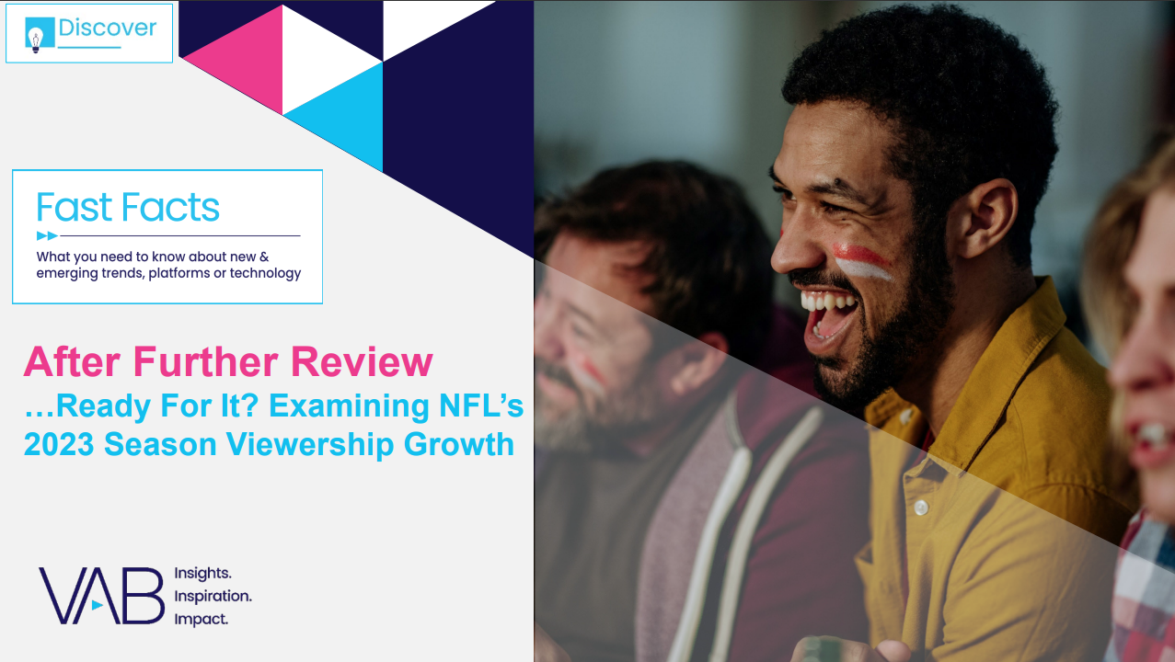

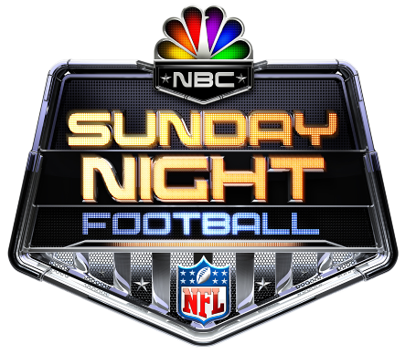

Impact of ‘big data’ inclusion: A modern measurement solution shows viewership lifts over panel-only data for NFL games
Click here for the full report
Impact of Nielsen’s Modern Measurement Solutions vs. ‘Panel Only’ Data
2023 season (based on comparable game analysis)
TNF on Amazon in Spanish /
SNF on Universo & Telemundo /
MNF on ESPN Deportes
+9%
+3%
+2%
+58%
Lift in TNF viewership with the inclusion of Amazon’s
first-party data over panel only data, on average
Lift in SNF viewership with Nielsen’s Big Data measurement over panel only data, on average
Lift in MNF viewership with Nielsen’s Big Data measurement over panel only data, on average
Lift in Spanish-language broadcast viewership with Nielsen’s Big Data measurement over panel only data, on average
Source: VAB analysis of Nielsen Ratings Analysis Program Report, Sunday Night Football (NBC, Universo, Telemundo), Monday Night Football (ESPN, ESPN2, ESPN Deportes, ABC) and Thursday Night Football (Amazon (incl. local broadcast for in-game markets only)), excludes pre- & post-game shows, Live+SD, P18-34, P18-49 & P25-54, Panel data & Big data: TNF (Panel+ Amazon First-Party Data) & SNF/MNF (Panel+ STB/ACR). NBC, Universo, Telemundo, ESPN, ESPN2, ESPN Deportes and ABC reflects linear TV audience only and does not include audiences gained from their digital / app streaming. The 13 comparable games reflect all weeks that have standalone NFL night game broadcasts across NFL weeks: 2-11 & 13-15 (excludes Thanksgiving weekend). NBC Sunday Night Football includes Universo and Telemundo simulcast viewership. ESPN Monday Night Football includes ESPN2 and ESPN Deportes simulcast viewership. Note: ESPN MNF data also includes ABC simulcast data and reflects only ABC for week 14 (12/11/23) due to a staggered doubleheader that night when each game partially overlapped each other. MNF weeks 2, 3 and 14 include two matchups. See appendix for schedule and single game details.
This information is exclusively provided to VAB members and qualified marketers.
PAGE 12

Slide 13
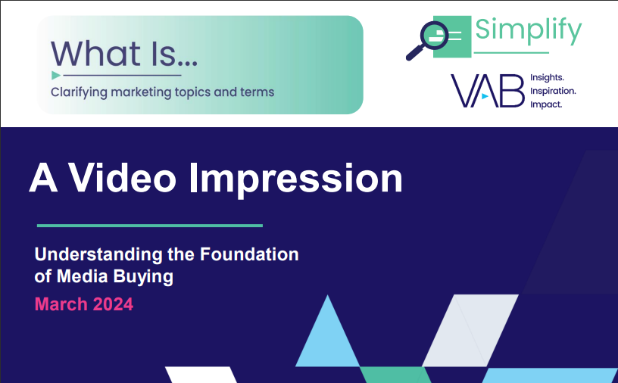




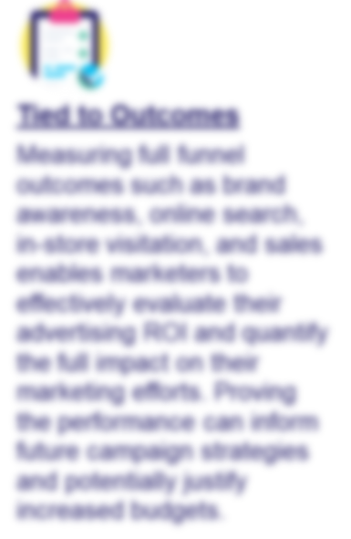
Download What Is A Video Impression to uncover the five values of buying & measuring based on impressions and more
Click here for the full report
Bonus Slide!
The 5 Values of Buying and Measuring Based on Impressions
Increased Granularity
Evolving from traditional GRP-driven buying to impression-based buying gives marketers a more thorough and accurate view of audiences. Shifting from ratings to impressions can lead to increased supply enabling more cost-effective planning, buying and measuring
of video campaigns.
Audience-Based Buying
Audience-Based Buying enables advertisers to effectively target their best customers through data-driven segments (based on behavioral, attitudinal, lifestyle or transactional data), adjust creative messaging, and engage with multiple target audiences across video platforms.
Download the report to access the other 3 values…and much more!
This information is exclusively provided to VAB members and qualified marketers.
PAGE 13

Slide 14






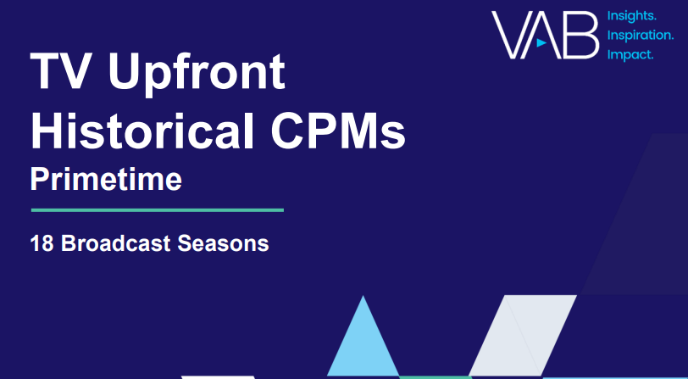

Jason Wiese
Leah Montner-Dixon
SVP, Director of Strategic Insights
jasonw@thevab.com
Director, Audience & Behavioral Insights
leahm@thevab.com
Reed Kiely
Karolina Guillen
Director, Data Insights & Trends
reedk@thevab.com
Associate Director, Insights, Strategy & Analytics
karolinag@thevab.com
Kaileen Cain
Insights Analyst
kaileenc@thevab.com
Discover more
Looking for more data, insights and takeaways? Check out this related VAB content
Visit our Upfront Planning Resources Hub
to get data, insights, takeaways and real-world examples to keep you informed on key upfront topics like convergent TV, cross-platform measurement, audience-first buying strategies
and multicultural marketing.
VAB Member Exclusive
VAB Members, brand marketers and agencies get free and immediate access to VAB’s content library. Get access at theVAB.com
This information is exclusively provided to VAB members and qualified marketers. Further distribution is prohibited.
PAGE 14

