Slide 1



2023 – 1st Quarter

Slide 2


About VAB
VAB is an insights-driven organization that inspires marketers to reimagine their media strategies resulting in fully informed decisions.
Drawing on our marketing expertise, we simplify the complexities in our industry and discover new insights that transform the way marketers look at their media strategy.
We are committed to your business growth and proud to offer VAB members, brand marketers and agencies complimentary access to our continuously-growing Insights library. Get immediate access at theVAB.com.
Curious to learn more about VAB? Check out this quick video to see what we do and how we can help you develop business-driving marketing strategies.
This information is exclusively provided to VAB members and qualified marketers. Further distribution is prohibited.
PAGE 2

Slide 3



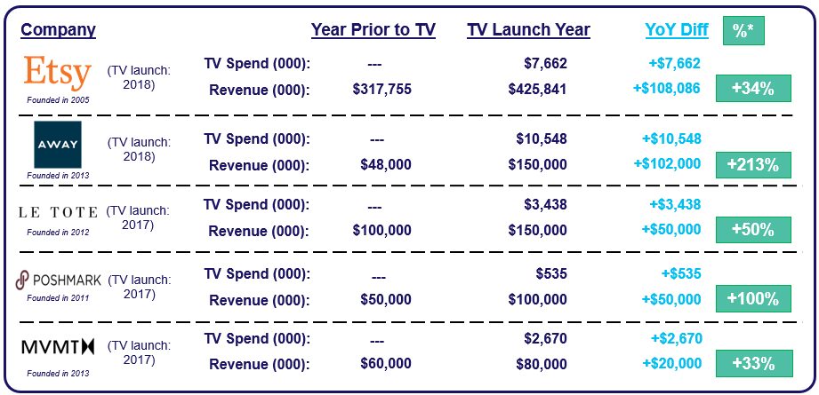
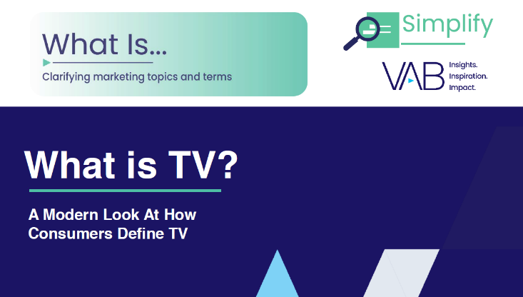

One of 25 ways TV grows brands: TV is the catalyst for short-term business results, igniting revenue growth for brands during the launch year of their first TV campaign
Click here for the full report
Sales: Ignites short-term business performance
Click here to learn about the 24 other ways that TV Grows Brands
Click here to learn about how consumers define TV today
Source: Revenues reflect estimated revenue data from Pivotal Research. TV spend based on VAB analysis of Nielsen Ad Intel data, TV spend (national cable TV, national broadcast TV, Spanish language broadcast TV, Spanish language cable TV, spot TV, syndication TV), CY 2016 & 2017 &TV spend based on VAB analysis of Nielsen Ad Intel data, TV spend (national cable TV, national broadcast TV, Spanish language broadcast TV, Spanish language cable TV, spot TV, syndication TV), CY 2016-2018. Revenues for public companies are based on company filings (10-K) for U.S. revenue via SEC.gov (EDGAR). Revenues for private companies are based on reports/projections/guidance provided publicly by company founders/representatives, or analyst estimates/forecasts, and reported within business/technology news outlets such as Bloomberg, CNBC, Digiday, Forbes, Inc., Recode, TechCrunch, WSJ, etc.. *Revenue increase after launching TV.
This information is exclusively provided to VAB members and qualified marketers. Further distribution is prohibited.
PAGE 3

Slide 4


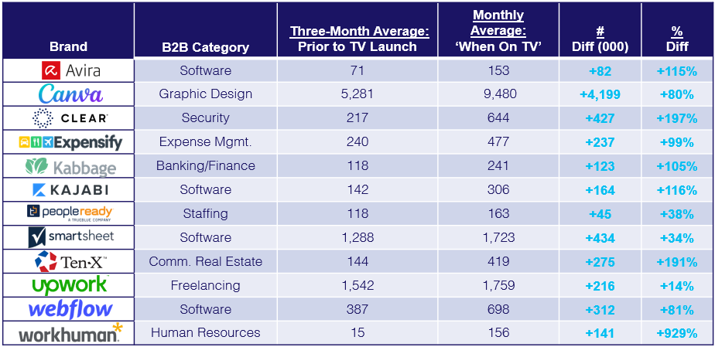
TV delivers outcomes for small & mid-sized businesses: Brands see significant increases in their online traffic when they are on TV, with smaller brands seeing some of the largest increases
Click here for the full report
Sampling of B2B Brands: Monthly Website Unique Visitors (000) Comparison
Based Over a Four-Year Time Period: Apr ‘18 – Apr ‘22
Source: VAB analysis of Comscore mediametrix multiplatform media trend data, P18+. April 2018 – April 2022 (calendar months), figures are based on monthly averages for the 25 brands analyzed. ‘When On TV’ represents the monthly average for brands in months where they spend on national TV as measured through Nielsen AdIntel across the April 2018 – April 2022 (calendar months) time period across the 25 brands analyzed.
This information is exclusively provided to VAB members and qualified marketers. Further distribution is prohibited.
PAGE 4

Slide 5


TV creates a ‘halo effect’ on digital: Brands’ websites see more visitors after their TV campaign launch, even in months when they are not actively on TV
Click here for the full report
25 Business-to-Business (B2B) Brands Analysis
Monthly Website Unique Visitors (000) Comparison
Based Over a Four-Year Time Period: Apr ‘18 – Apr ‘22
+35%
+26%
+305K monthly uniques
+226K monthly uniques
vs. three months average prior to TV launch
vs. three months average prior to TV launch
Monthly Average ‘When On TV’
(monthly average)
(TV launch – April 2022)
(TV launch – April 2022)
Source: VAB analysis of Comscore mediametrix multiplatform media trend data, P18+. April 2018 – April 2022 (calendar months), figures are based on monthly averages for the 25 brands analyzed. ‘When On TV’ represents the monthly average for brands in months where they spend on national TV as measured through Nielsen AdIntel across the April 2018 – April 2022 (calendar months) time period across the 25 brands analyzed. ‘When Not On Air’ represents the monthly average for brands in months where they don’t spend on national TV, after their first month of TV spend, as measured through Nielsen AdIntel across the April 2018 – April 2022 (calendar months) time period across the 25 brands analyzed.
This information is exclusively provided to VAB members and qualified marketers. Further distribution is prohibited.
PAGE 5

Slide 6







The importance of brand-building for B2B categories: Marketers are increasingly using brand marketing to drive key business outcomes across the funnel from awareness to advocacy
Click here for the full report
What Are Your Top Five Brand Marketing Objectives for the Next 12 Months?
% of B2B Marketers
71%
43%
42%
41%
40%
40%
of B2B marketing leaders say brand marketing has
increased in importance
in the last 12 months
Growing brand awareness
and familiarity
Improving creative stand out and creative identity
Strengthening brand
strategy and positioning
Improving
brand experience
(digitally and physically)
Growing
brand loyalty
and advocacy
Source: Transmission, ‘The State of B2B Brand Building 2022’, Base: 500 B2B senior marketing leaders, Question: Summary of Top 5 - “Looking ahead to the next 12 months, what are your top five brand marketing objectives or priorities?”
This information is exclusively provided to VAB members and qualified marketers. Further distribution is prohibited.
PAGE 6

Slide 7

Audience-based TV buying for niche advertisers: B2B brands are using an audience-first approach across a broad mix of programming to reach their best customer prospects
Click here for the full report
25 B2B Brand Average: National TV Networks, Genres and Programs
Based Over a Four-Year Time Period: Apr ‘18 – Apr ‘22
21
28
464
Avg #
of TV Networks
Avg #
of Genres*
Avg #
of Programs
To reach targeted stakeholders, B2B brands are advertising across a mix of sports, lifestyle and entertainment networks in addition to business and news programming.
Source: VAB analysis of Nielsen AdIntel, 04/01/18-04/30/22, National TV includes cable TV, broadcast TV, Spanish language cable TV and Spanish language broadcast TV across 25 brands included in analysis. *Number of Genres includes sub-genres, e.g., ‘Sports Event: NFL Football / Regular Season.’ The total count for the 25 brands reflects an unduplicated count across national TV networks, genres and programs.
This information is exclusively provided to VAB members and qualified marketers. Further distribution is prohibited.
PAGE 7

Slide 8

TV engages best prospects for advertisers with niche targets: B2B TV campaigns drove double-digit increases in potential new customers to brands’ digital platforms
Click here for the full report
25 B2B Brands Analysis: Average Monthly Website Unique Visitors
Monthly Website Unique Visitors (000) Comparison
Based Over a Four-Year Time Period: Apr ‘18 – Apr ‘22
+35%
+15%
(monthly average)
(TV launch – April 2022)
Source: VAB analysis of Comscore mediametrix multiplatform media trend data, P18+. April 2018 – April 2022 (calendar months), figures are based on monthly averages for the 25 brands analyzed. ‘When On TV’ represents the monthly average for brands in months where they spend on national TV as measured through Nielsen AdIntel across the April 2018 – April 2022 (calendar months) time period across the 25 brands analyzed. During this four-year analysis, the average B2B advertiser was on TV for 12 months. Average Monthly Visitors (000) – 3 Months Prior to TV Launch: 859; TV Launch Month: 986; ‘When On TV’: 1,164.
This information is exclusively provided to VAB members and qualified marketers. Further distribution is prohibited.
PAGE 8

Slide 9

Branding is even more important for business purchases: This is driven by the need to build ‘top-of-mind’ awareness and gain buy-in from multiple stakeholders & decision makers
Click here for the full report
% of Purchase Decisions Driven by ‘Brand’
Source: Lippincott, ‘B2B Brands in the Human Era’, November 2019. Analysis and survey based on tablet purchasers which is a product category with both business & consumer buyers. Business purchase decisions: 39% driven by brand, 34% driven by features, 27% driven by price; Consumer purchase decisions: 39% driven by price, 34% driven by features, 27% driven by brand.
This information is exclusively provided to VAB members and qualified marketers. Further distribution is prohibited.
PAGE 9

Slide 10



Ad-supported streaming at scale: Most streamers across all ages, are now watching at least one ad-based streaming service
Click here for the full report
% of streamers who use at least one ad-supported streaming service
Source: VAB analysis of MRI-Simmons November 2020 & November 2022 Cord Evolution Study, A18+. Base = ‘streamed in the past 12 months’. November ’22: reflects % of streamers who have used any of the following streaming services in the past 12 months: Crackle, Crunchyroll (Limited Commercial Subscription), Discovery + (Limited Commercial Subscription), Freevee (Formerly IMDB TV), HBO Max (Limited Commercial Subscription), Hulu (Limited Commercial Subscription), LG Channels, Local Now, Newsy, Paramount + Essential (Limited Commercial Subscription), Peacock Free (Free Service W/Limited Commercial), Peacock Premium (Limited Commercial Subscription), Pluto TV, Redbox., Roku Channel, Samsung TV Plus, Tubi TV, Vudu or Xumo. November ’20: reflects % of streamers who have used any of the following streaming services in the past 12 months: Hulu (Limited Commercial Subscription), Freevee (Formerly IMDB TV), Local Now, Pluto TV, Redbox., Roku Channel, Samsung TV Plus, Sony Crackle, Tubi TV, Vudu or Xumo.
This information is exclusively provided to VAB members and qualified marketers. Further distribution is prohibited.
PAGE 10

Slide 11
The fastest growing streaming platform: FAST services are now being watched by over half of all adult streamers
Click here for the full report
% of U.S. adult 18+ streamers that watch FAST services
(Free Ad-supported Streaming TV) services
+47%
YoY
Source: VAB analysis of MRI-Simmons November 2021 & November 2022 Cord Evolution Study, A18+. Base = ‘streamed in the past 12 months’. November ‘22: FAST = used any of the following streaming services in the past 12 months: Peacock (free service w/ limited commercials), Roku Channel, Tubi TV, Freevee (formerly IMDb TV), Pluto, Samsung TV Plus, Xumo, Local Now. November ‘21: FAST = used any of the following streaming services in the past 12 months: Roku Channel, Tubi TV, Freevee (formerly IMDb TV), Pluto, Samsung TV Plus, Xumo, Local Now.
This information is exclusively provided to VAB members and qualified marketers. Further distribution is prohibited.
PAGE 11

Slide 12
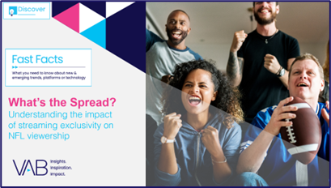




Amazon Thursday Night Football exclusivity: Average audience and weekly reach declined 37% and 49% respectively vs. game that were available across major video platforms in 2021
Click here for the full report
Weekly Averages - NFL Thursday Night Football
2022 vs. 2021 Comparable ‘Thursday Night’ Games
2022 vs. 2021
Audience Differences
2021
2022
Cable TV Net Only
(NFL Network: 4 Games)
Broadcast & Cable TV
(FOX / FOX Deportes / NFL Network: 10 games)
14-Game Average
(broadcast & cable TV or cable TV only)
Amazon Streaming
(15 games includes the two in-market local broadcasts)
Amazon vs.
NFL Network Only
Amazon vs. Broadcast & Cable TV
Amazon vs.
14-Game Average
# Diff
% Diff
# Diff
% Diff
# Diff
% Diff
Average
Audience
(Per Min):
8.5 MM
15.1 MM
13.2 MM
9.6 MM
+1.1 MM
+13%
-5.5 MM
-37%
-3.6 MM
-28%
Reach:
17.5 MM
32.9 MM
28.6 MM
16.9 MM
-0.6 MM
-3%
-16.1 MM
-49%
-11.6 MM
-41%
Source: VAB analysis of Nielsen NPower Powerplay and R&F Program Report, 2021 Season: FOX, FOX Deportes & NFL Network; 2022 Season: Amazon & local broadcast for in-game markets only (excludes pre- & post-game shows), Live+SD, P2+. FOX, FOX Deportes & NFL Network reflects linear TV audience only and does not include audiences gained from their digital / app streaming. 2021 reflects 14 games total (4 NFL Network only games: Weeks 2-4 & 16; 10 games with Fox / Fox Deportes, NFL Network & Amazon: Weeks 5-11 & 13-15). 2021 audience figures excludes Amazon since the platform was not measured by Nielsen in 2021. 2022 reflects 15 games total, streamed by Amazon (Weeks 2-11 & 13-17). *See appendix for schedule and single game details. Analysis reflects only those games played on Thursday Night.
This information is exclusively provided to VAB members and qualified marketers. Further distribution is prohibited.
PAGE 12

Slide 13
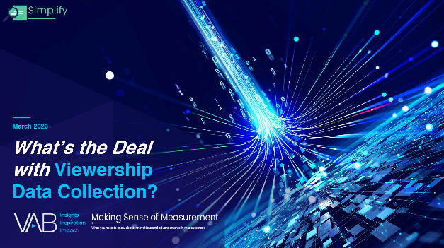





Viewership data collection: What is census level data and what role does it play in measurement?
Click here for the full report
Bonus Slide!
Census Level Data
Role of Census Level Data
Census level data means every viewer in an ad environment universe is counted.
Reduce ad waste
Enable more representative measurement
Identify audiences in a more granular way
Receive greater coverage across people, platforms, and geographies
Attribute response more granularly
(Not to be confused with the US census)
Census level data can help marketers…
People
Who is being measured
Platform / Devices
What is being measured
Geography
Where is being measured
Census level data can allow for a more demographically representative measurement. All audiences should
be counted fairly and accurately.
Enables more accurate measurement of diverse audiences. This creates economic growth opportunities for marketers with audiences that are rapidly growing (and historically have not been fairly counted/measured).
Viewership is across multiple screens, and all screens can and should be counted. Consumers have broadened their definition of TV and will find and follow their favorite premium content across platforms and the devices they use.
Coverage across multiple platforms and devices results in reach extension capabilities.
Census level data can allow for greater flexibility in the geographies measured
Creates opportunities for more precise measurement at the local, regional and national level
This information is exclusively provided to VAB members and qualified marketers. Further distribution is prohibited.
PAGE 13

Slide 14
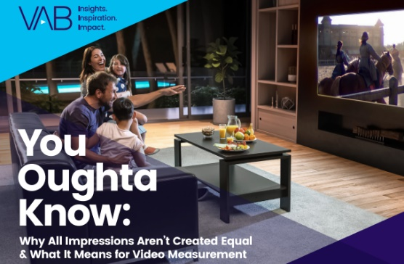
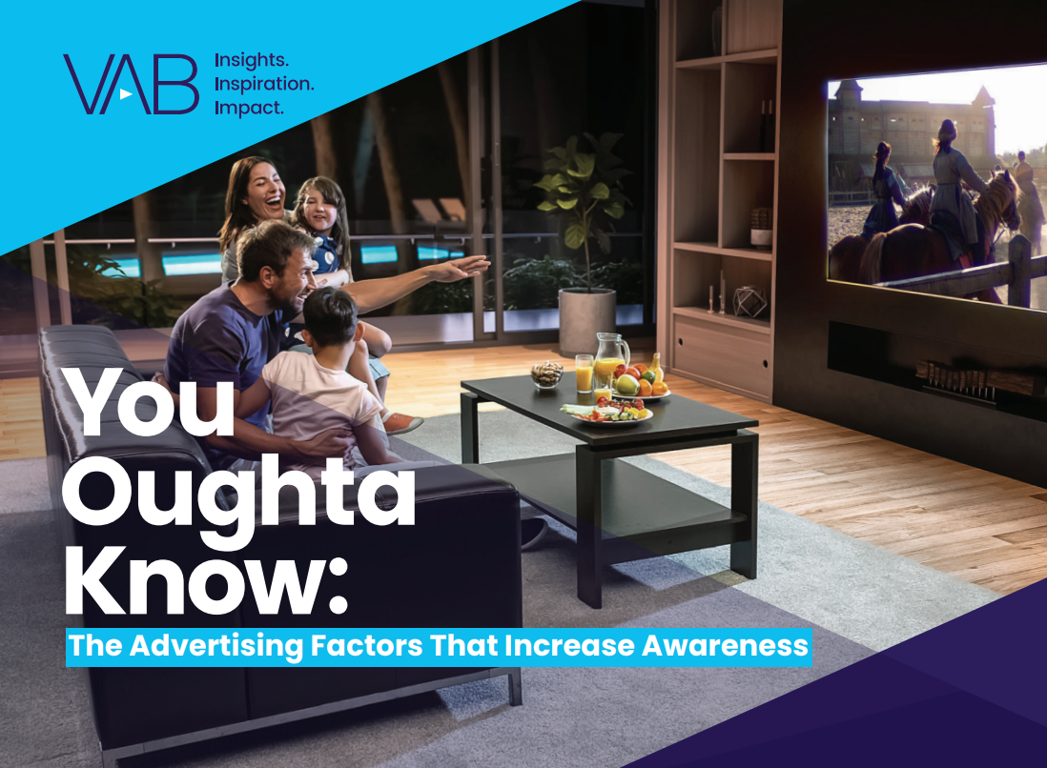
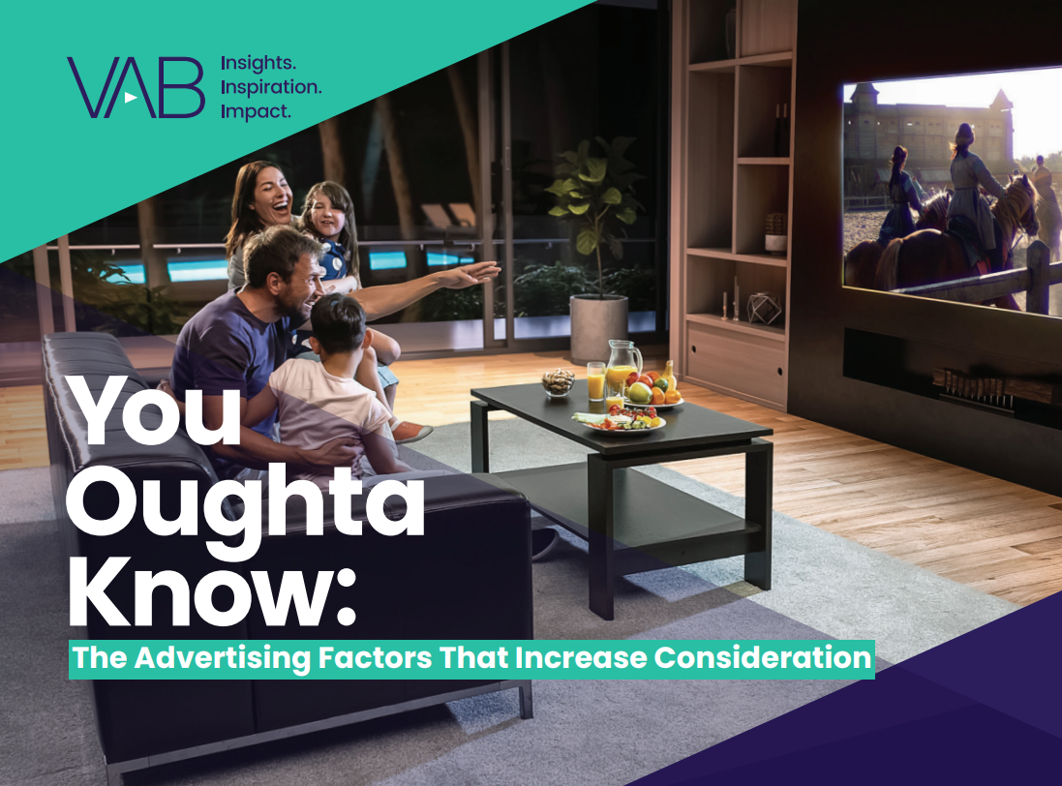
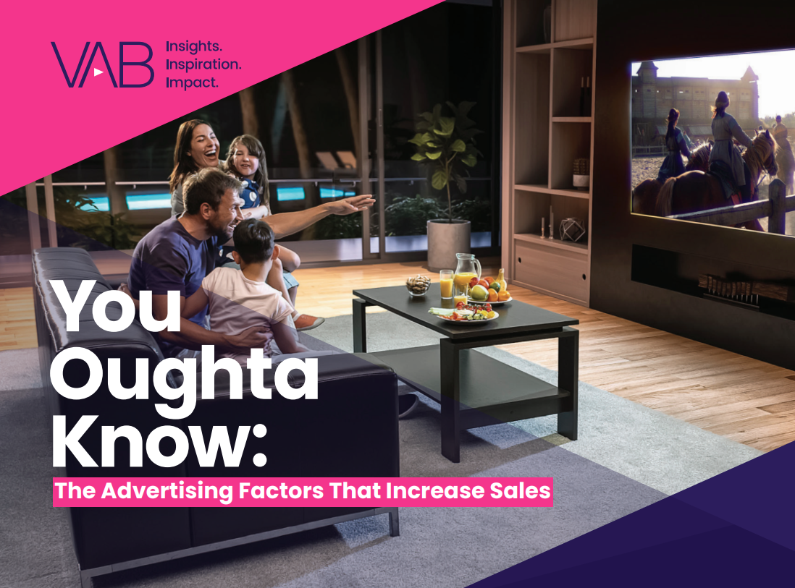
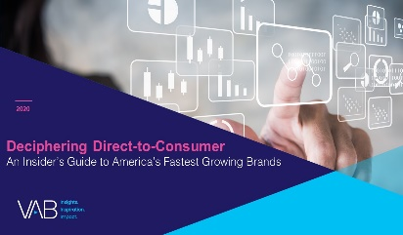
Additionally, we released three excerpts from our popular
‘You Oughta Know’ marketer’s guide that focuses on each
stage of the purchase funnel: awareness, consideration & sales
Click here to download
the Marketer’s Guide, You Oughta Know, to learn more
Awareness
Consideration
Sales
Click above to download each report
This information is exclusively provided to VAB members and qualified marketers. Further distribution is prohibited.
PAGE 14

Slide 15



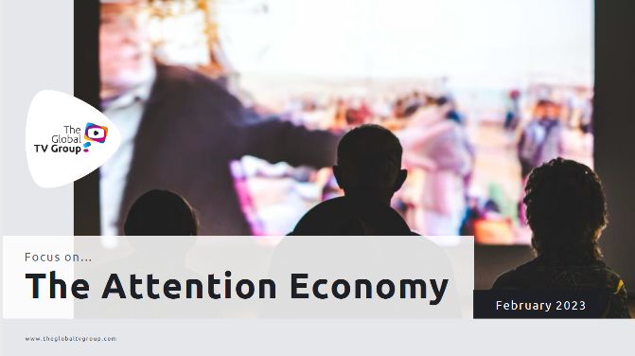



Jason Wiese
Reed Kiely
SVP, Director of Strategic Insights
jasonw@thevab.com
Associate Insights Director
reedk@thevab.com
Leah Montner-Dixon
Karolina Guillen
Associate Insights Director
leahm@thevab.com
Insights Manager
karolinag@thevab.com
Discover more
Looking for more data, insights and takeaways? Check out this related VAB content
Through Upfront season, marketers are making important decisions about their video investment strategy.
We’re here to help.
Visit our Upfront Planning Resource Center
for a curated a list of resources filled with the data, analysis and insights needed to make informed investment decisions.
VAB Members, brand marketers and agencies get free and immediate access to VAB’s content library. Get access at theVAB.com
This information is exclusively provided to VAB members and qualified marketers. Further distribution is prohibited.
PAGE 15

