Slide 1






Today’s Innovations in Measurement
Real-world case studies from industry innovators
4Q 2022 – Fourth Edition

Slide 2

TV Measurement is critically important for marketers,
and often holds the key to business growth.
However, keeping up with the ever-evolving complex ecosystem of innovative platforms, tools, devices and services can be challenging. To help navigate, the VAB, in collaboration with our Measurement Innovation Task Force, has produced Today’s Innovations in Measurement.
The focus of this quarterly series is on case studies - giving you real-world examples of how brands are successfully adding new ways of measuring their video campaigns to optimize and more effectively gauge success.
This information is exclusively provided to VAB members and qualified marketers. Further distribution is prohibited.
PAGE 2

Slide 3

What You’ll Learn
How brands are utilizing innovative, modern measurement approaches to maximize the effectiveness of their campaigns and achieve better outcomes
Be inspired by the insightful analysis and learnings revealed in these 8 real-world examples from across major product categories like Automotive, Retail, and Insurance
Considerations as you evaluate and add new solutions to your measurement plans
This information is exclusively provided to VAB members and qualified marketers. Further distribution is prohibited.
PAGE 3

Slide 4








In this fourth edition of our series, we showcase real-world case studies from eight innovative measurement companies
This information is exclusively provided to VAB members and qualified marketers. Further distribution is prohibited.
PAGE 4
Click the logos to go to each company’s website homepage to learn more about their measurement solutions.

Slide 5







The case studies span over 7 major product categories, from Automotive and QSR to Tune-in and Insurance
Automotive
Retail
Tune-in
QSR
Business to Business
Insurance
Wellness &
Fitness
This information is exclusively provided to VAB members and qualified marketers. Further distribution is prohibited.
PAGE 5

Slide 6
7 Performance Objectives for Marketers:
Most marketers are seeking accurate measurement for one (or more) of the following:
Brand Lift
Advanced Targeting
Frequency Management
Incremental Reach
Website Traffic
Tune-In
Online and Offline Sales
This information is exclusively provided to VAB members and qualified marketers. Further distribution is prohibited.
PAGE 6

Slide 7



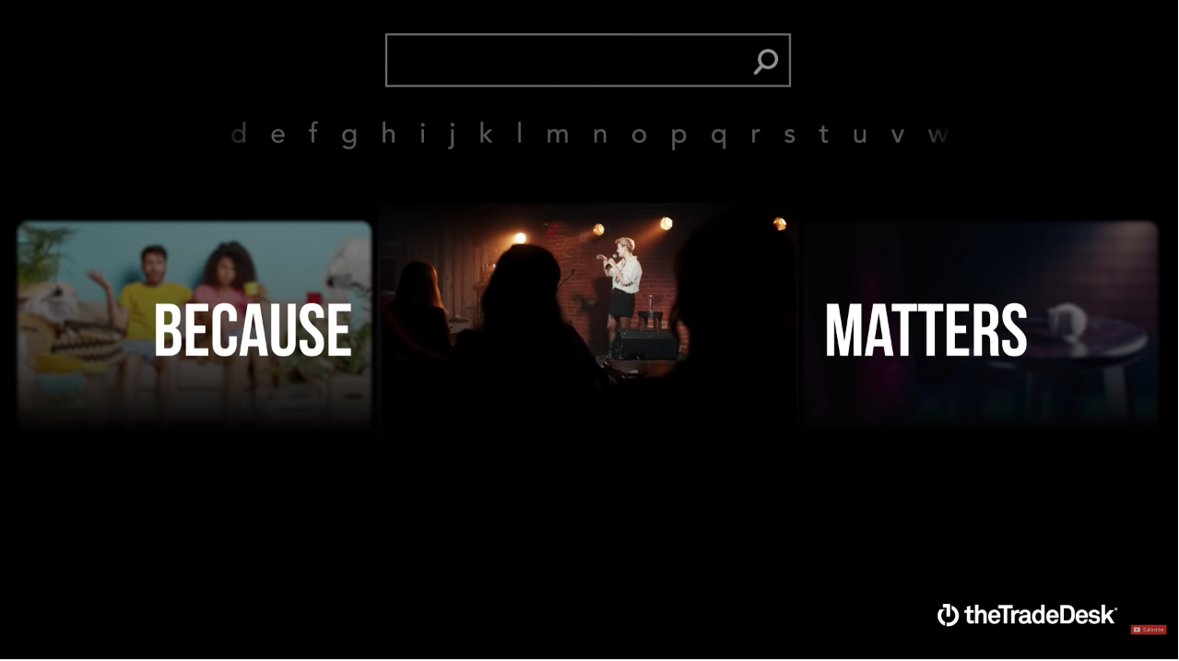
Category:
Business-to-business
The Trade Desk, in partnership with Lucid, sought to better understand how CTV can drive a lift among target audiences
Brand Lift
Challenge
The Trade Desk wanted to go beyond standard Connected TV performance KPIs like reach and frequency to gain a deeper understanding of how they achieved their primary KPI: driving a lift in brand awareness among the target audiences
Measurement Innovation
The Trade Desk used the Lucid integration, a survey-based solution that gives advertisers the ability to set up surveys and view brand lift reports directly within The Trade Desk media buying platform
Lucid tracks campaigns and matches the impression data against campaigns in The Trade Desk platform to identify respondents who have been exposed to the brand’s ads. Respondents are then surveyed, and their responses are measured against the client’s KPIs
Target Segment
Marketing Leaders at Agencies & Brands
Learnings
CTV exposure drove lift across multiple metrics — including brand awareness, which was the team’s primary campaign goal. As a result, the team now approaches media buying with a CTV-first mindset and has also increased media spend on CTV
Company / Viewing Source / Media Type
The Trade Desk / Connected TV, Desktop, & Mobile / Programmatic (on TTD)
Campaign Results
The brand lift study showed CTV exposure drove lift across multiple metrics
+4.6%
+5.7%
+7.1%
Lift in awareness
Lift in ad recall
Lift in favorability
“With our Brand Lift integration, we have greater insight into the campaign’s impact, including lift in awareness, favorability, and ad recall”
-Jeff Kerestes, Digital Marketing Director at The Trade Desk
“What Matters” Campaign
Source: The Trade Desk, case study: The Trade Desk x Lucid, a Cint Group. Campaign time period: Q4 2021
This information is exclusively provided to VAB members and qualified marketers. Further distribution is prohibited.
PAGE 7

Slide 8


Category:
Wellness & Fitness
A wellness & fitness brand partnered with Stirista to target in-market customers on CTV and measure the impact on website visits and sales
Advanced Targeting / Website Traffic / Online Sales
Challenge
A wellness & fitness company wanted to efficiently scale its growth beyond linear TV and traditional direct response digital channels
Measurement Innovation
The brand sought to increase ROAS through audience-based targeting across CTV by using Stirista’s CTV targeting and view-through attribution reports
The brand leveraged Stirista’s Visitor Id Graph (VIG) website identity tool to conduct an audience profile analysis of their purchasers and create “targeting buckets” representing different high-indexing characteristics
Stirista targeted specific households that matched the high-indexing characteristics with CTV, while retargeting website visitors with Display advertising
Stirista’s VIG was also leveraged to source conversion data used for attribution and optimization
Target Segments
Proprietary Stirista modeled prospect segments
People with most stationary & most physical occupations
Gamers
People interested in natural medicine
People interested in sport the advertiser was a major sponsorship of
Learnings
Targeting specific households that matched the high-indexing characteristics with CTV combined with measurement and optimization of campaign, creative, target segment, geography, daypart, and publisher led to significant increases in ROAS for the brand
Stirista's View-Through Attribution reports allowed the brand to match and identify the number of website visitors and purchasers, the cost per purchaser, and the revenue generated and ROAS for the campaign
Company / Viewing Source / Media Type
Stirista / CTV / Programmatic CTV via AdStir DSP
Campaign Results
+67%
Increase in Return on Ad Spend
$4.28
Average Return on Ad Spend
Source: Stirista, Wellness & Fitness Case study. Campaign time period: November 1 2021 – October 4, 2022.
This information is exclusively provided to VAB members and qualified marketers. Further distribution is prohibited.
PAGE 8

Slide 9
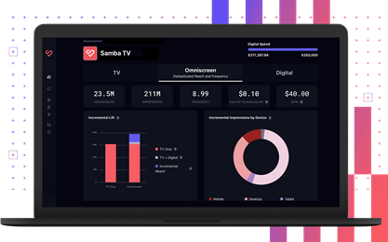
Category:
QSR
A QSR brand partnered with Samba TV to drive incremental reach to their linear TV campaign
Incremental Reach
Challenge
A national QSR brand wanted to reach net-new households and drive incremental reach beyond their linear campaign
Measurement Innovation
A QSR brand utilized Samba TV’s iCPM* product. This TV data and identify graph helped the QSR brand to target deduplicated, incremental audiences
Target Segment
Households unexposed to linear ad campaign
Learnings
The combination of iCPM Audience Insights (an incremental reach-focused dashboard) and real-time optimization capabilities drove incremental reach across streaming, online and mobile video
Samba TV’s iCPM product saved the brand money by identifying and only counting incremental impressions
Company / Viewing Source / Media Type
Samba TV / ACR, Set-top Box / Linear, CTV,
Other Digital
Campaign Results
Reached
Drove
Drove
4.9M
Incremental households
$0.23
Cost Per Incremental Household
10.4M
Incremental impressions
Beyond the advertisers’ 80M linear television reach, resulting in a 6% Incremental Reach Lift
For massive incremental reach efficiencies
Served to brand new households
By activating on iCPM, and only paying for incremental impressions, the QSR brand saved $38k compared to a standard CPM campaign
Source: Samba TV, QSR Case Study. Campaign time period: 2/15/21 - 11/21/21. *iCPM: incremental cost per thousand impressions.
This information is exclusively provided to VAB members and qualified marketers. Further distribution is prohibited.
PAGE 9

Slide 10



Category:
Retail
A major retailer partnered with LiveRamp to drive
and validate ad effectiveness in driving sales
Online and Offline Sales
Challenge
A major MVPD was looking to prove that their addressable TV inventory, across both their set-top-box and streaming inventory, consistently drove sales for a Big Box Retailer
Measurement Innovation
Using Data Plus Math’s sales attribution solution, the major MVPD was able to validate their addressable TV effectiveness on the retailer’s
in-store and online sales
Target Segment
Occasional Shoppers
Learnings
Over the course of a year, the retailer’s TV campaign media produced consistent lift among their target audience over the control in the retailer’s target household sales, both in-store and online
Company / Viewing Source / Media Type
LiveRamp & Data+Math / Linear & Streaming TV / Addressable TV
Campaign Results
+30%
+51%
Sales Lift over four quarters after exposure to the Addressable TV campaigns, on average
Lift in Units Purchased over
four quarters after exposure to
the Addressable TV campaigns,
on average
Source: LiveRamp, retail brand case study. Campaign time period: Feb-March 2021, May-July 2021, August - Sept 2021, and Oct-Dec 2021.
This information is exclusively provided to VAB members and qualified marketers. Further distribution is prohibited.
PAGE 10

Slide 11
Category:
Automotive
An auto brand partnered with DIRECTV to increase reach of its high-value audiences via Addressable TV
Incremental Reach / Advanced Targeting / Frequency Management
Challenge
A domestic auto brand wanted to expand reach of their High Value Audience (HVA)* and improve frequency management
Measurement Innovation
The brand utilized DIRECTV’s Addressable Reach-Frequency Optimization offering to target and reach only the HVA target underexposed to their National media campaign
Target Segment
Custom HVA Target developed using data from Neustar, a Transunion company
Unreached or underexposed to brand’s national campaign from previous quarter
Learnings
The brand was able to see Addressable TV’s impact on:
  Incremental reach of the High Value Audience target, as well as the multicultural subsegments of that audience
  Impression distribution against underexposed audiences
Company / Viewing Source / Media Type
DIRECTV / Set-top Box / Addressable Linear TV + VOD
The addressable campaign increased reach of the brand’s HVA HHs not exposed to the
national campaign from 47% to 85%, including positive lifts across multicultural audiences
HVA HH Reach
% of HHs Reached by National Campaign and National + DIRECTV Addressable
+79% lift
vs. National
+78% lift
vs. National
+47% lift
vs. National
+145% lift
vs. National
Adding Addressable to the advertiser’s overall campaign significantly increased
the share of impressions against the campaign’s lighter exposed HHs
Weekly Frequency
Difference Between National Campaign and National + DIRECTV Addressable
Source: DIRECTV, Automotive Case Study. Campaign time period: Q2 2022. Analysis conducted within DIRECTV footprint.
Case study results are based on individual campaign factors. DIRECTV makes no performance warranties. Data Source: Neustar & DIRECTV Viewership Data. *High Value Audience (HVA) is a custom target built using data from Neustar, a Transunion company, overlaid with viewership data to understand who was unreached or underexposed.
This information is exclusively provided to VAB members and qualified marketers. Further distribution is prohibited.
PAGE 11

Slide 12
Category:
Tune-In
A TV network partnered with Effectv to drive tune-in to a program through linear and addressable TV
Tune-In
Challenge
A TV network sought to promote tune-in to a new season of a broadcast drama
Measurement Innovation
Path-to-purchase contribution analyses
were applied to ad exposure data to measure viewership. This helped to determine conversion rates for each tactic to determine
their contribution to the overall campaign
Target Segment
Linear or Video-on-Demand viewers of past seasons of a broadcast drama
Learnings
Addressable works best in combination with other broad reach tactics such as data-driven linear
Company / Viewing Source / Media Type
Effectv / Linear TV / Linear & Audience Addressable
Campaign Results
Advertising Drove Conversion
+29% campaign lift
Exposed households tuned in at a higher rate
Combined Tactics Drove Results
Audience Addressable
Reached Likely Tuners More Often
1.6X
Higher conversion rate than non-addressable tactics²
Conversion Rates
+29%
Linear
Reached Additional Tuners
Contributed
38%
of total conversions³
Source: Comcast Aggregated Viewership Data combined with Ad Exposure. Analysis of advertiser campaign, 12/27/21-1/11/22. Target based on Comcast Viewership Data. Note: 63% of impressions were delivered via Audience Addressable.
1. Campaign lift: Difference in conversion rate between exposed and unexposed HHs
2. Conversion Rate: Rate of Tune-In, calculated by dividing the total number of Tuned HHs by the total number of Exposed HHs
3. Contribution Percent: Percent of conversion values attributed to the strategy out of total converted HHs using a Markov Chain method
This information is exclusively provided to VAB members and qualified marketers. Further distribution is prohibited.
PAGE 12

Slide 13
Category:
Automotive
An automotive advertiser partnered with Canoe and leveraged their Addressable Linear and VOD platforms to reach 3 specific in-market auto shopper groups across 34MHHs
Advanced Targeting
Challenge
An automotive advertiser sought a customized messaging and campaign approach to target 3 distinct buyer segments. They required the emotive storytelling power of TV, along with its wide-scale reach but also needed to ensure the right creative message was delivered to the intended target audience
Measurement Innovation
A Canoe Addressable campaign was planned across 4 Programming groups on national programmer’s Linear and VOD inventory. The cross-platform TV campaign targeted 3 audience segments across 16 TV Networks
Target Segments
3 unique In-market for auto segments
Learnings
By mining Canoe delivery data, it was determined that, in aggregate, the 14 VOD networks provided greater reach than the 2 Linear network due to the diverse pool of premium content available across the Programmer’s VOD networks
National Linear TV delivered the greatest network-specific reach against the target audiences. Building on that, there were specific VOD networks that performed nearly as well as the primary Linear network
Company / Viewing Source / Media Type
Canoe / AMC, Fox, TelevisaUnivision, WarnerBrothers Discovery Linear Addressable and VOD Addressable inventory / Linear and Cable STB VOD
Campaign Results
Unique Target Reach
by Platform and Programmer
Unique Target Reach
by Network
More Reach
on VOD
+33%
Diversity of Networks Delivers Greater Reach
Source: Canoe, Automotive Case study. Campaign time period: April – September 2022.
This information is exclusively provided to VAB members and qualified marketers. Further distribution is prohibited.
PAGE 13

Slide 14

Category:
Insurance
A national insurance brand partnered with Ampersand to target un- and underexposed households to drive incremental reach and increase lift in leads
Incremental Reach / Advanced Targeting
Challenge
A national insurance advertiser, in partnership with their agency of record, sought to increase its exposure to un- and underexposed* in-segment households in order to drive brand recognition and increase leads
Measurement Innovation
The brand leveraged Ampersand’s AND Platform to identify and eliminate wasted spend in their national buys
Built addressable segment to improve reach and frequency within the target audience**
Target Segment
Target Audience: A25-54 w/ HHI $125k+, and college education
Target Geo: CA, CT, GA, MA, ME, NC, NH, NJ, OR, RI, TX, VT, WA
Learnings
The brand was able to optimize their targeting to more efficiently reach new in-target audiences
The targeted Addressable campaign drove greater engagement and increased leads among exposed households compared to the control group
Company / Viewing Source / Media Type
Ampersand / Set-top Box / Addressable Linear TV, VOD & Streaming
Results
2.4x
Increase in frequency to underexposed audiences with addressable
Addressable incremental reach points generated against the strategic audience
(Equates to 232.6K households reached by Addressable that otherwise would not have been found with just National alone)
16.4
More efficiency reaching target HHs with addressable
(223K HHs would have been unexposed per week
without the utilization of Addressable)
17.3x
16%
Lift in leads for those exposed to addressable campaign vs. control group***
Source: Ampersand, Insurance Case Study. Campaign time period: 5/31/21-6/27/21. *Underexposed audiences are households that were not exposed at the established frequency goal of the advertiser during their national linear advertising campaign. **Addressable campaign targeted households in key markets at a frequency of 4 weekly exposures, compared to national campaign average of 1.7 weekly exposures. ***The control group was made up of the unexposed portion of the client’s target audience.
This information is exclusively provided to VAB members and qualified marketers. Further distribution is prohibited.
PAGE 14

Slide 15
Considerations as you evaluate and add new solutions to your measurement plans
Research multiple measurement providers
Partner with the appropriate provider(s) whose data capabilities align with your objectives / KPIs
Understand the data sets being used, how they are sourced and what the reporting and outputs are
Ensure the accuracy, validity and transparency
of the datasets
Understand the cross-platform capabilities
of the measurement providers under review
Learn if you can optimize your campaigns based on the data outputs
Know if your precise target audience can be properly measured by the data provider
Ask how timely the campaign metrics / results will be reported
This information is exclusively provided to VAB members and qualified marketers. Further distribution is prohibited.
PAGE 15

Slide 16



For an additional 30 case studies and the companion webinars, check out the first 3 releases in this series
Click to download
Today's Innovations
In Measurement – Q1 2022
Case studies from product categories such as automotive, QSR, CPG, pharmaceutical and entertainment
Today's Innovations
In Measurement – Q2 2022
Case studies from product categories such as such as tech, beverages, beauty and healthcare
Today's Innovations
In Measurement – Q3 2022
Category-specific best practices and guidance supported by real-world case studies
View the webinars here
View the webinars here
View the webinar here
This information is exclusively provided to VAB members and qualified marketers. Further distribution is prohibited.
PAGE 16

Slide 17

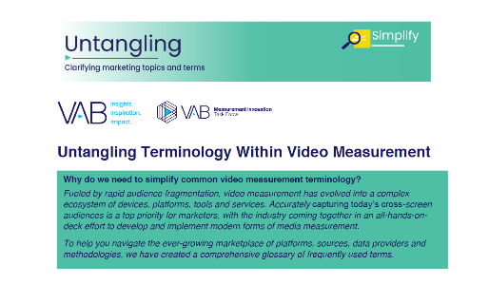
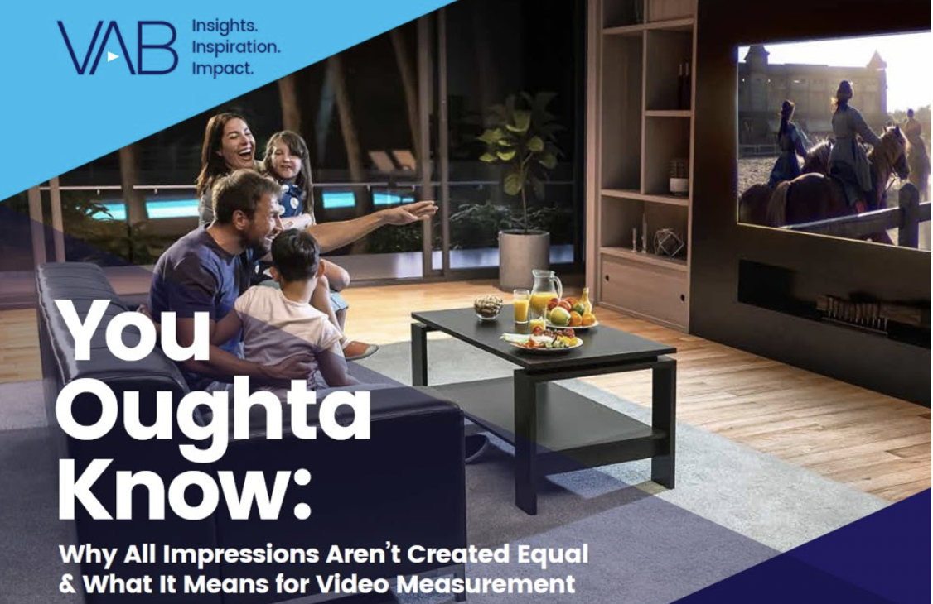
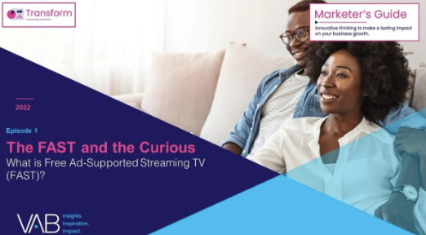


Benjamin Vandegrift
Leah Montner-Dixon
VP, Measurement Solutions
BenjaminV@thevab.com
Associate Insights Director
LeahM@thevab.com
Reed Kiely
Associate Insights Director
ReedK@thevab.com
Discover more
Looking for more data, insights and takeaways? Check out this related VAB content
Untangling Terminology Within Video Measurement
You Oughta Know
Why all impressions aren’t created equal & what it means for video measurement
The FAST and the Curious
What you need to know about Free Ad-Support Streaming TV
The Most Opportune
Time of the Year
Why consumers’ holiday spirit triumphs over academic uncertainty
VAB Members, brand marketers and agencies get free and immediate access to VAB’s content library. Get access at theVAB.com
This information is exclusively provided to VAB members and qualified marketers. Further distribution is prohibited.
PAGE 17

Slide 18


About VAB
VAB is an insights-driven organization that inspires marketers to reimagine their media strategies resulting in fully informed decisions.
Drawing on our marketing expertise, we simplify the complexities in our industry and discover new insights that transform the way marketers look at their media strategy.
We are committed to your business growth and proud to offer VAB members, brand marketers and agencies complimentary access to our continuously-growing Insights library. Get immediate access at theVAB.com.
Curious to learn more about VAB? Check out this quick video to see what we do and how we can help you develop business-driving marketing strategies.
This information is exclusively provided to VAB members and qualified marketers. Further distribution is prohibited.
PAGE 18

