Slide 1






Today’s Innovations in Measurement
Real-world case studies from industry innovators
3Q 2022 – Third Edition

Slide 2

TV Measurement is critically important for marketers,
and often holds the key to business growth.
Keeping up with the ever-evolving complex ecosystem of innovative platforms, tools, devices and services can be challenging. To help navigate, the VAB, in collaboration with
our Measurement Innovation Task Force, has produced Today’s Innovations in Measurement.
The focus of this quarterly series is on case studies - giving you real-world examples of how brands are successfully adding new ways of measuring their video campaigns to optimize and more effectively gauge success.
This information is exclusively provided to VAB members and qualified marketers. Further distribution is prohibited.
PAGE 2

Slide 3



What You’ll Learn…
Measurement
Innovations Series
How brands are utilizing innovative, modern measurement approaches to maximize the effectiveness of their campaigns and achieve better outcomes
Insightful category-specific best practices drawn from18 real-world examples across five major product categories: Healthcare, Automotive, and CPG, Insurance, and Entertainment / Tune-in
Considerations as you evaluate and add new solutions to your measurement plans
This information is exclusively provided to VAB members and qualified marketers. Further distribution is prohibited.
PAGE 3

Slide 4












In this third edition of our series, we showcase real-world case studies from twelve innovative measurement companies
Click the logos to go to each company’s website homepage to learn more about their measurement solutions.
This information is exclusively provided to VAB members and qualified marketers. Further distribution is prohibited.
PAGE 4

Slide 5





The case studies focus on five major product categories
CPG
Pharma / Healthcare
Insurance
Entertainment / Tune - in
Automotive
click on the category above to be taken to the relevant case studies
This information is exclusively provided to VAB members and qualified marketers. Further distribution is prohibited.
PAGE 5

Slide 6
8 Performance Objectives for Marketers:
Most marketers are seeking accurate measurement for one (or more) of the following:
Brand Perception
Targeting Optimization
Frequency Management
Incremental Reach
Maximize Full-Funnel Outcomes
Website Traffic
Accurate Audience Count
Online and Offline Sales
This information is exclusively provided to VAB members and qualified marketers. Further distribution is prohibited.
PAGE 6

Slide 7
Consumer Packaged Goods
Please continue to review CPG case studies and best practices
This information is exclusively provided to VAB members and qualified marketers. Further distribution is prohibited.
PAGE 7

Slide 8

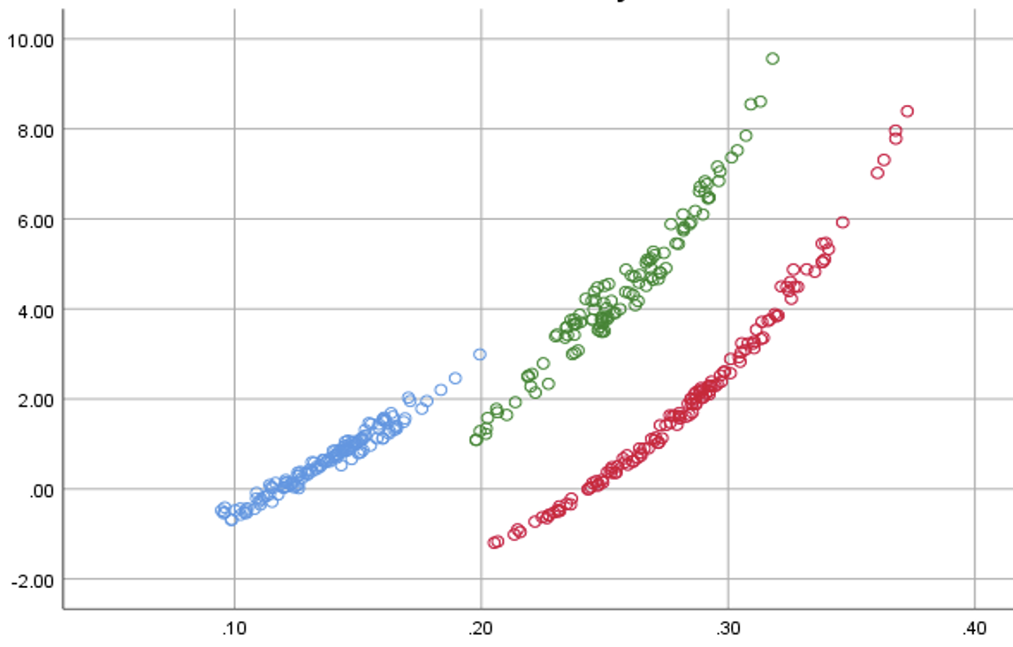
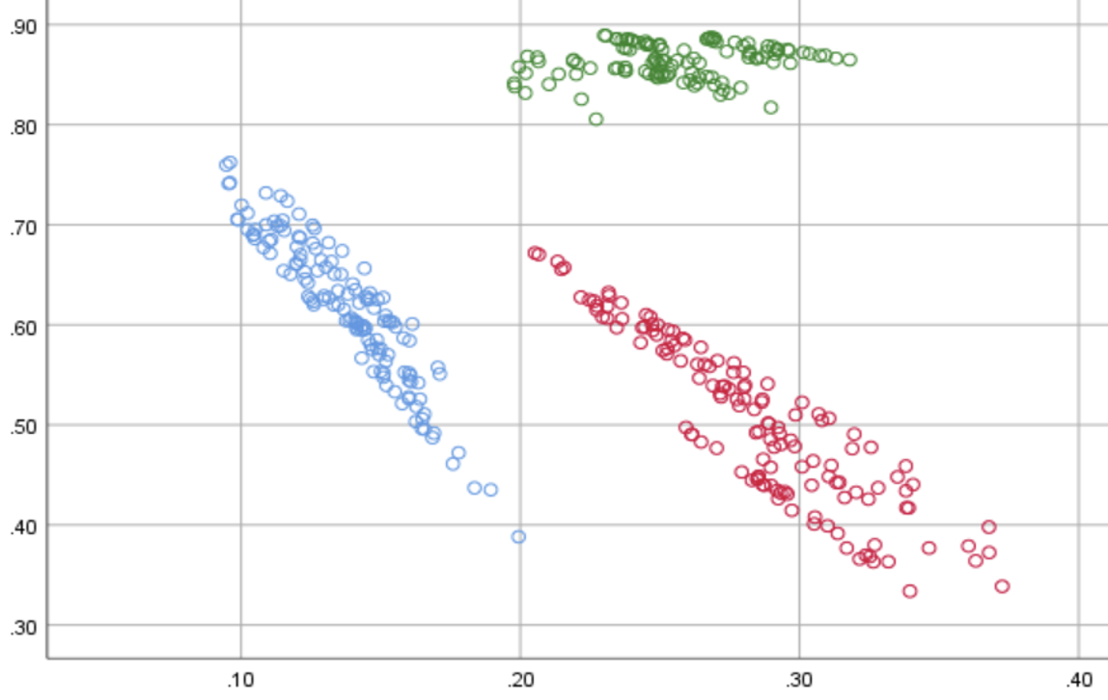

Category:
Consumer Packaged Goods (CPG)
A CPG company utilized EDO’s Behavioral Brand Power (BBP) metric to better evaluate how its own brand health had an impact on its competitors
Brand Perception
Challenge
A CPG brand wanted to know how its brand health impacts its own and competitors’ advertising results
Measurement Innovation
EDO’s Behavioral Brand Power (BBP) is a real-time brand health metric built on proprietary Share of Search (SoS) and Share of Voice (SoV) data
BBP allows a brand to quantify its consumer interest (SoS) relative to its ad visibility in the marketplace (SoV)
Target Segment
P2+
Learnings
A five-year campaign with 237 billion imps illustrated that BBP is a strong measure and tracker of brand health
Higher BBP insulates marketers to price competition and amplifies sensitivity to changes in media weight. Marketers who invest in their advertising generate positive ripple effects for the brand
Company / Viewing Source / Media Type
EDO, Inc. / ACR, Google API / National Linear TV
SoV Elasticity vs. BBP
As BBP increases, a brand’s sensitivity to Share of Voice increases – enabling greater consumer engagement impact from its media investment
Share of Voice (SoV) Elasticity *
CPG Brand A
CPG Brand B
CPG Brand C
BBP Metric
Price Elasticity vs. BBP
As BBP increases, a brand’s sensitivity to price changes decreases – which makes the advertiser more immune to price fluctuations
Price Elasticity *
CPG Brand A
CPG Brand B
CPG Brand C
BBP Metric
Source: EDO, Inc.. Campaign time period: March 2017 to March 2022.
* Price Elasticity is a measure of Share of Revenue’s sensitivity to a change in Price Per Unit
* SoV Elasticity is a measure of Share of Revenue’s sensitivity to a change in Share of Voice
This information is exclusively provided to VAB members and qualified marketers. Further distribution is prohibited.
PAGE 8

Slide 9



Category:
Consumer Packaged Goods (CPG)
A CPG brand worked with LiveRamp to identify
new audiences and increase campaign reach
Incremental Reach
Challenge
A major CPG brand was experiencing diminishing offline sales for HH’s exposed to ads 10+ times. This highlighted a need to reach new HHs and minimize waste
Measurement Innovation
LiveRamp helped the brand identify opportunities to adjust spend and increase campaign reach
This was done by suppressing heavily exposed homes across CTV and OTT. Those impressions were redirected to CTV households with little to no linear exposure to drive incremental reach
Target Segment
All households
Learnings
The CPG brand was able to drive incremental reach with unique HH reach increasing by 176% for the OTT/CTV campaign
Through this analysis, they were able to determine their ROAS and what was driving it – ROAS was 86%, mostly driven by light/med TV HHs that were previously challenging to reach
Company / Platform
LiveRamp, Data Plus Math (D+M) / Linear TV, OTT, Connected TV (CTV)
Campaign Results
More Reach
+176%
increase in unique HH reach
More Efficient
86%
ROAS
Source: LiveRamp, CPG brand case study. Campaign time period: Q1 – Q2 ‘21.
This information is exclusively provided to VAB members and qualified marketers. Further distribution is prohibited.
PAGE 9

Slide 10


Category:
Consumer Packaged Goods (CPG)
A carbonated beverage advertiser utilized 605’s attribution solution to connect sales with viewership
of co-branded integrated programming
Online & Offline Sales
Challenge
A beverage brand sought to understand the impact of
two campaigns – an ad campaign for their carbonated beverage, and a product integration on a sub-brand
Specifically, they wanted to know the impact on 3 KPIs: Purchase Frequency, Conversions, Total Sales
Measurement Innovation
605’s attribution solutions leveraged 605 viewership/tune-in data, third party sales data and the client’s first-party digital data to measure the effectiveness of the brand’s cross-platform campaign compared to a “Matched Control”*
Target Segment
Customers who have previously made a purchase from the beverage brand (carbonated beverage brand target)
Customers who have previously made a purchase of one specific beverage flavor from the beverage brand (sub-brand target)
Learnings
The brand was able to see lifts vs. the ‘matched control’ for each platform individually, allowing them to more effectively allocate spend
The brand was able to see the relative impact on their core KPIs for the ad campaign vs. the product integration allowing for more informed strategy decisions in future
Company / Viewing Source / Media Type
605 / Automated Content Recognition (ACR), Set-Top Box / Linear TV (Large Entertainment Network), Digital (Large Entertainment Network’s digital platform)
CARBONATED BEVERAGE BRAND (ADS) | Index - Transactions |  | Incremental Sales
PLATFORM: | LINEAR |  | DIGITAL |  | ANY (LINEAR + DIGITAL)**
RESULTS: | LIFT vs. control | INDEX | LIFT vs. control | INDEX | LIFT
Purchase Frequency | 22% | 122 | 58% | 122 | 20.9%
Conversions | 22% | 112 | 6% | 73 | 22.0%
Total Sales | 11% | 140 | 3% | 101 | 11.1%
SUB-BRAND (PRODUCT PROGRAM INTEGRATION) | Index - Transactions
PLATFORM: | ANY (LINEAR + DIGITAL)**
LIFT PER EXPOSURE: vs. control | ANY | PREMIER EPISODE | 5+
Purchase Frequency | 34% | 41% | 51%
Conversions | 38% | 37% | 42%
Total Sales | 15% | 30% | 89%
Source: 605, Case study: Campaign for Carbonated Beverage Brand, Sales. Campaign dates: 2/7/2021 – 4/11/2021. *”Matched Control” = match each “exposed” HH to similar unexposed HH. **”Any (Linear + Digital)" is any exposure to the ad on Linear or Digital. A viewer could have seen both, but they were exposed on at least one platform during the campaign period.
This information is exclusively provided to VAB members and qualified marketers. Further distribution is prohibited.
PAGE 10

Slide 11
CPG
Best Practices
Consumer Packaged Goods
Consider non-traditional metrics of success. Share of Search (SoS) and Share of Voice (SoV) are valuable measures of success in the highly competitive CPG category, but might not be the first considered by marketers when measuring their campaigns. They can be used to understand the value of long-term investment in branding, as well as indicate how resistant a brand could be to economic and supply chain changes that may raise the cost of goods.
Manage frequency by suppressing audiences that have been overexposed. This allows a brand to build incremental reach and increase efficiency. This balanced approach of retaining current customers and reaching new ones ensures the sales funnel is never empty.
Leverage 1st and 3rd party data sources to develop more intelligent plans and measure effectiveness. Infusing 1st party customer data with media plans and post - campaign measurement results in more intelligent plans, stronger effectiveness and sharper insights for future product development.
This information is exclusively provided to VAB members and qualified marketers. Further distribution is prohibited.
PAGE 11

Slide 12
Pharma / Healthcare
Please continue to review CPG case studies and best practices
This information is exclusively provided to VAB members and qualified marketers. Further distribution is prohibited.
PAGE 12

Slide 13




Category:
Healthcare
A DTC Health Tech brand partnered with Tatari
to identify optimal ad frequency for streaming campaigns
Frequency Management
Challenge
A Health Tech brand running local streaming campaigns had ad frequency concerns (over-serving ads to the same viewers). It sought to uncover the optimum frequency in order to expand its reach and increase lower-funnel metrics
Measurement Innovation
Tatari analyzed the impact different ad frequencies have on response and conversion rates
Net Funnel Efficiency (response rate x conversion rate), was used to identify the optimal weekly and daily frequency caps that should be put in place to drive lower-funnel impact
Target Segment
Streaming audiences that are incremental to linear TV DMA targets
Learnings
As a result of frequency implementation, the brand was able to increase the reach of it’s campaign by 95%, more effectively distributing impressions with the same budget
From a cost perspective, the brand saw a 65% reduction in Cost Per Website Sign-Up after implementing the above-mentioned caps
Company / Viewing Source / Media Type
Tatari / Streaming Platform / CTV
Overview Of Results for the Campaign
+65%
Reduction in Cost Per Website Sign-Up after implementing frequency caps
+95%
Increase in reach with impressions spread further with frequency caps
Source: Tatari, Case study: DTC Health Tech Case Study. Campaign dates: Q2 2020- Q2 2021.
This information is exclusively provided to VAB members and qualified marketers. Further distribution is prohibited.
PAGE 13

Slide 14

Category:
Healthcare
A healthcare brand worked with Samba TV to quantify the impact of their CTV campaign on 5 KPIs
Brand Perception / Targeting Optimization
Challenge
A major healthcare company sought to understand how their CTV campaign drove brand perception metrics across key audiences, with a focus on brand awareness and action intent
Measurement Innovation
Pairing Samba TV’s ACR viewership measurement with Lucid’s Brand Lift tool allows for deeper insights into campaign impact on awareness and consideration
Using Lucid’s Propensity Matched Control Methodology, Samba TV created an unexposed control group to measure campaign lift among those who were exposed to the advertising
Target Segment
A25+ including light TV-viewing cohorts, parents, African Americans & Hispanics
Learnings
The brand was able to determine campaign impact across 5 key brand perception metrics and compare to benchmarks. They saw lift in 4 out of 5 metrics, including brand awareness, ad recall, and action intent
The analysis revealed which target groups were most responsive, allowing for future target refinement. Key demographic groups (male, 25-54) responded best to the CTV Messaging
Company / Viewing Source / Media Type
Samba TV & Lucid / Pixel Tags / CTV
Control
Exposed
Lift
Significance
Benchmark lift*: 30.2%
Benchmark lift*: 12.1%
Source: Samba TV, Healthcare Case Study. Campaign time period: October 2021 – December 2021. *Benchmarks are provided at a category level from Brand Lift partner Lucid.
This information is exclusively provided to VAB members and qualified marketers. Further distribution is prohibited.
PAGE 14

Slide 15

Category:
Pharmaceuticals / Healthcare
Incremental Reach /
Frequency Management
A pharma & health care company leveraged
Upwave’s Brand Optimization capability to
drive lift across both TV and digital
Challenge
A leading pharmaceutical and health care company wanted to measure reach among both broad and niche audiences utilizing targeting criteria beyond age and gender
Audience Measurement Innovation
The brand utilized Upwave’s Analytics Platform for Brand Advertising, which enabled them to optimize and reallocate across channels and monitor reach, frequency and penetration rate within their specific target audience
Target Segment
HHI $100K+
High-Level Job Title / Industry in Healthcare, Finance, Government
Learnings
Upwave’s Brand Optimization capability revealed that Digital alone was not as effective, running both TV and Digital together helped drive lift
Campaign lifted awareness among 11.9MM people, with the highest lift seem among affluent audiences
Company / Viewing Source / Media Type
Upwave / ACR, Event Tags / Linear TV, Digital (Display, Mobile, Desktop)
11.9MM
People with Lift
in Awareness
521MM
Total Digital Impressions
4.2B
Total TV Impressions
2.5X
More likely to reach those in the Hospital Leadership sector
3X
More likely to
reach those in the Government sector
5X
More likely to
reach those in the Finance sector
1.5X
More likely to
reach VP-level audience via Linear TV
Source: Upwave. Campaign time period: May – December 2021. Comparisons based against a representative control group.
This information is exclusively provided to VAB members and qualified marketers. Further distribution is prohibited.
PAGE 15

Slide 16
Pharma / Healthcare
Best Practices
Pharma / Healthcare
Measure locally to better quantify the impact of your campaign in the ’regulation heavy’ pharma category. With regulations on targeting for healthcare campaigns, local campaigns will allow you to focus on a precise trade area that is not linked to specific patients or households. Ensuring you meet privacy regulations and guidelines.
Partner with measurement providers who understand the restrictions involved in healthcare advertising and can help you build and analyze the impact of customized, privacy compliant targets. This will allow you to understand how different audiences are responding to your campaign and enable you to refine targeting for future campaigns while also meeting privacy guidelines and reaching the audiences that matter most to you.
This information is exclusively provided to VAB members and qualified marketers. Further distribution is prohibited.
PAGE 16

Slide 17
Insurance
Please continue to review CPG case studies and best practices
This information is exclusively provided to VAB members and qualified marketers. Further distribution is prohibited.
PAGE 17

Slide 18




Category:
Insurance
An insurance brand partnered with AudienceXpress to reach customers in market for auto insurance and drive them through the sales funnel.
Incremental Lift / Website Traffic
Challenge
An insurance company sought to increase sales leads and drive incremental lift in policies written by using audience-based targeting across CTV.
Measurement Innovation
Working with AudienceXpress, the insurance company was able to measure the success of its campaign against multiple KPIs across key audience segments.
Target Segments
A25-64
HHI $100k+
In market for auto insurance
Learnings
Through the analysis, the brand was able to determine how each audience segment progressed through the sales funnel, with auto insurance leads doubling over the control group and HHI$100k+ having the highest likelihood to convert leads to policies written.
In addition to driving new customers, the campaign provided the brand with a directional roadmap that informed current and future media investments across various media channels.
Company / Viewing Source / Media Type
AudienceXpress / Comcast Data and Long-Form Video Providers / CTV
Campaign Results
+73%
+11%
Total incremental lift in leads
Total Increase in policies written
Source: AudienceXpress, Insurance Case study. Campaign time period: July 8 – October 24, 2021.
This information is exclusively provided to VAB members and qualified marketers. Further distribution is prohibited.
PAGE 18

Slide 19
Category:
Insurance
Insurance brand Amica used iSpot.tv’s Unified Measurement tool to optimize and justify linear and streaming TV advertising
Incremental Reach / Website Traffic
Challenge
To justify their linear and streaming TV advertising, Amica needed deeper insight into conversion rates, creative performance and reach of their campaign
Measurement Innovation
Using iSpot.tv Unified Measurement, Amica was able to measure
  Deduplicated reach and conversion rates of linear compared to streaming ads
  Granular performance measurement of various ad lengths and creatives
  Reach and conversion rates across individual OTT publishers
Target Segment
Any potential Amica customer
Learnings
The analysis allowed for creative optimization, demonstrating that the :15 streaming ads were more effective at driving conversions
Amica was able to use the analysis to more efficiently allocate between publishers
Amica was able to evaluate performance of its streaming ad linear components, with streaming ads converting at a 6x higher rate
Company / Viewing Source / Media Type
iSpot.tv / Smart TV / Linear TV / Streaming TV
Unified Measurement Publisher and Incremental Reach Example
Source: iSpot.tv, Case study: Amica x iSpot.TV. Campaign time period: Q4 2020.
This information is exclusively provided to VAB members and qualified marketers. Further distribution is prohibited.
PAGE 19

Slide 20


Category:
Insurance
A major insurance advertiser used VIZIO and Inscape data to determine the incremental audience reached via VIZIO Ads and the effectiveness of digital ads in driving new users to its site
Website Traffic
Challenge
An insurance brand wanted to drive traffic to its website for quote requests
Measurement Innovation
Ads were run through VIZIO’s FAST service WatchFree+, as well as the AVOD ad inventory VIZIO Ads has with programming partners
Inscape data was used to determine the brand’s reach within linear environments as well as the incremental audience VIZIO Ads reached through digital media
Web pixel was placed to tie on-site actions back to media exposure across both linear and digital environments
Target Segment
P18+
Learnings
The combination of Linear TV and CTV via VIZIO Ads drove the greatest conversion rate
By adding CTV on top of linear TV, the brand was able to add incremental reach to their campaign
Company / Viewing Source / Media Type
Vizio / VIZIO Ads / Linear and CTV
Campaign Results Overview
+12%
Incremental reach from VIZIO Ads
when combined with linear TV
Conversion Rate by Platform
Cross-Platform Performance
7x
conversion rate of “exposed both” over linear alone
+26%
conversion rate of “exposed both” over VIZIOads alone
Source: Vizio, Case study: Blinded Insurance Site Conversion. Campaign dates: Q2 2021.
This information is exclusively provided to VAB members and qualified marketers. Further distribution is prohibited.
PAGE 20

Slide 21

Insurance
Best Practices
Insurance
Cross-platform measurement strategies increase your ability to connect with the broad insurance customer target. Both linear and CTV are capable of being measured and optimized on their impact of driving conversions such as leads and policies written.
Partner with measurement providers that enable you to measure the effectiveness of multiple campaign component’s ability to drive leads. Look for optimization opportunities across as many campaign elements as possible i.e. creative, spot length, and OTT publisher etc.. This will allow you to increase campaign efficiencies by better understanding what drives your customers to convert, ensuring you leave no potential customers on the table.
This information is exclusively provided to VAB members and qualified marketers. Further distribution is prohibited.
PAGE 21

Slide 22
Entertainment / Tune-in
Please continue to review CPG case studies and best practices
This information is exclusively provided to VAB members and qualified marketers. Further distribution is prohibited.
PAGE 22

Slide 23


Category:
Entertainment / Tune-In
BET leveraged VideoAmp’s viewing behavior data to highlight the value of the BET Award’s Audience for advertisers
Tune - in
Challenge
BET wanted to highlight the value of the BET Awards audience by identifying and measuring advanced audience segments
Measurement Innovation
VideoAmp’s second by second viewership data allowed BET to go beyond providing standard audience metrics to their advertisers. This enabled BET to identify and measure advanced audience segments. Proving the effectiveness of the BET Awards to reach and engage with high value audiences
Target Segment
Targeting included P18-49, and advanced audience segments: BET Change Makers and BET Cultural Innovators
Learnings
Advanced Audience AA viewing for the BET Awards was more than 2.5x higher than the network’s prime audience
BET has strong engagement with its advanced audiences, as well as viewers with high propensity to be trendsetters and ad-receptive
BET Awards had the highest engagement of the night across all linear programming during its airtime
Company / Viewing Source / Media Type
VideoAmp / VideoAmp Platform / Linear
Campaign Results Overview
39
%
YOY growth in households with P18-49 impressions by the BET Awards
+
500K
BET Change Makers and BET Cultural Innovators reached by the BET Awards
10
x
Higher total minutes viewed on average than the average of all programs across TV
Source: VideoAmp, Case study: BET Awards 2022
Advanced Audience Definitions:
BET Change Makers Age 18+ • Male / Female • African American Viewers who are influencers around Social Responsibilities
BET Cultural Innovators Age 18+ • Male / Female • African American Viewers who consider themselves to be trendsetters for all cultures
This information is exclusively provided to VAB members and qualified marketers. Further distribution is prohibited.
PAGE 23

Slide 24
Category:
Entertainment / Tune-In
A major cable network utilized Vizio’s Inscape viewing behavior data to drive tune-in to the premiere of a flagship TV show
Tune - in
Challenge
A network wanted to drive tune-in to the season premiere of a flagship TV show and understand which tactics of its promotion were making the most impact on tune-in
Measurement Innovation
Vizio’s Inscape viewing behavior data determined how viewers engaged with the promotion across the devices targeted and which viewers ultimately tuned into the show
Vizio built a control group of Organic Viewers - those who were not exposed to the campaign to compare and contrast against
Target Segment
Targeting included existing network viewers, a competitive proxy show list, and retargeting of linear promos
Learnings
The analysis allowed the network to prove that those who were exposed to the promotion of the show were 64% likely to have tuned in for it vs. those who weren’t exposed to it
The network was able to determine which tactics had the greatest impact on tune-in, increasing efficiency
of future campaigns
*Household Connect generated the most positive results
Company / Viewing Source / Media Type
Vizio / VIZIO Ads / CTV and SmartCast
Campaign Results Overview
Watched TV Show
Lift vs. Control Group by Tactic
+64%
Higher than control
Source: Vizio, Case study: Season Premier Omnichannel. Campaign dates: Q2 2021. *Household connect allows advertisers to extend their campaigns beyond the TV to millions of additional touchpoints and devices, so viewers will see a complementary ad or call-to-action on their computer, tablet, or mobile device shortly after being presented with an ad on TV
This information is exclusively provided to VAB members and qualified marketers. Further distribution is prohibited.
PAGE 24

Slide 25

Category:
Entertainment / Tune - in
A streaming service partnered with Samba TV
to uncover actionable insights from media tactics
to drive tune-in for a new reality program
Tune - in
Challenge
A streaming service sought to understand the impact of their linear + digital video campaign on tune-in rates for the premiere of one of their reality shows
Measurement Innovation
To show the impact of the campaign on tune-in rate, Samba TV uses their Verified Tune-In Rate Measurement to analyze lift compared to their Synthetic Control Group Methodologies
Target Segment
Reality TV viewers, as well as heavy TV viewers, were selected from Samba TV’s viewership data and were targeted as likely viewers of the streaming services reality show
  Streaming Reality Viewers
  Heavy TV Viewers
  MTV, CBS, Bravo & E! Reality Viewers
Learnings
Through this analysis, the streaming platform learned the impact of its digital ad component, a 63% lift vs. the control
The service was able to determine optimal frequency levels, with peak impact occurring at 5 exposures in TV and >9 exposures in digital
The advertiser was able to glean insights into programming effectiveness, with the greatest impact seen among Streaming Reality viewers – a learning they can apply to future tune-in campaigns
Company / Viewing Source / Media Type
Samba TV / Automated Content Recognition (ACR) & Pixel Tags / Linear TV, CTV, Online Video
Digital Lift
+63%
Average Frequency
2.7
2.5
Source: Samba TV, Entertainment Case Study. Campaign time period: March 2021.
This information is exclusively provided to VAB members and qualified marketers. Further distribution is prohibited.
PAGE 25

Slide 26





Category:
Entertainment / Tune - in
Accurate Audience Count / Audience Duplication
NBC leveraged Conviva’s continuous, census
level measurement to understand de-duplicated
reach for key tentpole events
Challenge
NBC was looking for new measurement solutions to accurately capture their total audience for the Super Bowl and Winter Olympics
Audience Measurement Innovation
NBC leveraged Conviva’s measurement and their HH identifier that allows them to understand de-duplicated reach on streaming by accounting for scenarios like a single
household viewing events across multiple apps
Conviva data is collected directly from the video player and
acts as a publisher’s proprietary first-party data, capturing everything that happens during a video session, including
both content and ad breaks
Viewing Segment
Super Bowl and Winter Olympics Viewers
Learnings
NBC was able to:
  Better understand behaviors of HHs tuning into the events, including how many devices per HH were streaming & what content they were watching
  Get a deduplicated, cross-platform measurement of their audience across streaming & linear*
  Provide advertisers with next-day ad delivery reports
Company / Viewing Source / Media Type
Conviva, iSpot, NBCUniversal / SDK built into Video Player (Stream Sensor) / OTT, CTV, Mobile, Tablet, Desktop, Connected Devices
Leveraging continuous, census-level measurement, NBC measured:
Streaming Audience
10.5MM
Super Bowl Average Streaming Minute Audience
8:25PM
Time of peak viewership during Super Bowl
+279%
Increase in streaming activity during the Olympics opening ceremony
vs. 2018 opening ceremony
Streaming Audience by Device & Composition
78.4%
of Peacock viewing for the Super Bowl occurred on televisions with Roku, Samsung TV and Amazon Fire TV accounting for 68.5% of big screen viewing share
70.1%
of those streaming the Super Bowl came from ‘cord cutters’ or HHs without bundled pay TV service
Source: Conviva, Case study: Conviva Partners with iSpot to provide NBC deduplicated measurement for the Olympics and Super Bowl. Campaign time period: February 2022. *Using iSpot.TV for linear TV data, NBC matched Conviva’s Stream ID with iSpot’s identity to get a deduplicated view of consumption across all platforms.
This information is exclusively provided to VAB members and qualified marketers. Further distribution is prohibited.
PAGE 26

Slide 27

Category:
Entertainment / Tune - in
Comscore helped prove a network garnered higher reach, engagement and incremental viewing in a niche automotive segment
Advanced Audiences /
Audience Duplication
Challenge
Pursuit Channel needed to win business away from their closest TV network competitor by proving their audience garnered superior reach, engagement, and incremental viewing metrics against niche automotive segments
Audience Measurement Innovation
Pursuit leveraged Comscore TV’s national reporting and automotive Advanced Audiences (AA) data to prove their network delivers an incremental audience of outdoor enthusiast viewers who have a higher index
of intent to buy both new and used pickups/SUVs compared to their competitor’s viewers
Target Segment
Total Network Audience (Pursuit vs. Network B)
Audience by Top 3 programs
Mid-sized truck buying intenders**
Learnings
Pursuit Channel won the automotive account away from their competitor because they were able to show their network reaches a continuously engaged audience of more likely auto purchase intenders
Company / Viewing Source / Media Type
Comscore / Set-Top Box / National Linear TV (Pursuit outdoor enthusiast network vs. competitive national network)
Pursuit won an auto account away from competitive Network B by proving:
Audience is more likely to be in-market for new or used pickups and SUVs
Continuous Second-by-Second Engagement Levels
Low audience overlap =
strong opportunities to reach incremental viewers
Top three programs revealed live AA metrics remained consistent throughout entire broadcast of the program, suggesting that viewers stayed engaged during ad spots
For example, the average Live AA
of DeerTech TV show, which airs between
10 - 10:30 am was 14,903 viewers
Lowest AA: 10:00 a.m. (12,864)
Peak AA: 10:25 a.m. (16,003).
14%
overlap duplication with Channel B viewers
283 Index
For intent to buy a new full-size pickup truck
Pursuit
Network B*
261 Index
For intent to buy a used full-size pickup truck
Source: Comscore, Pursuit Channel: Automotive Case Study - Network vs. Network, In A High-stakes Battle To Win The Business. Campaign time period: 5/31/21 – 8/8/21. *Competitive national network to Pursuit Channel. **Includes ‘intent to buy new non-luxury truck and SUV’ segments and ‘intent to buy used non-luxury truck and SUV’ segments. Indices based on national TV HH average.
This information is exclusively provided to VAB members and qualified marketers. Further distribution is prohibited.
PAGE 27

Slide 28
Entertainment / Tune - in
Best Practices
Entertainment / Tune - in
Leverage viewership data to establish test and control / exposed vs. unexposed groups. Those learnings can then be used to accurately evaluate which campaign tactics had the greatest impact on tune-in and refine for future campaigns.
Utilize advanced audience targeting capabilities to reach current fans and prospective viewers. Audiences that are not current fans, but look like they could be based on their viewership habits of similar programs or networks, are a great source for driving new viewers to tune-in.
Second by second viewership data can be used to measure network and program engagement of content and advertisements. Leverage viewership data to illustrate to advertisers that your network/program has strong engagement across platforms and key audiences to capture share and drive revenue.
This information is exclusively provided to VAB members and qualified marketers. Further distribution is prohibited.
PAGE 28

Slide 29
Automotive
Please continue to review CPG case studies and best practices
This information is exclusively provided to VAB members and qualified marketers. Further distribution is prohibited.
PAGE 29

Slide 30
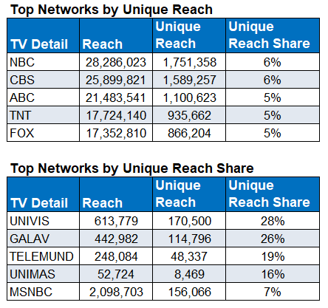
Category:
Automotive
Actionable insights from Samba TV enabled
a major auto marketer to more effectively balance their digital vs. TV strategy
Audience Duplication / Frequency Management
Challenge
A major automotive brand wanted to understand the interplay between their Linear TV and Digital media, seeking insights to increase efficiency & impact
Audience Measurement Innovation
Samba TV’s True Reach and Frequency (TRF) measurement provided insights into how the campaign performed across TV and Digital tactics, ultimately supporting the need for more balanced digital vs. Linear TV media mix going forward
Target Segment
U.S. HHs
Learnings
45% of Digital-delivered HH’s were incremental to the campaign (high unique reach factor)
Digital delivered a CPIR* 1/10th the cost of Linear TV
Within TV, Hispanic Networks delivered a far greater share of unique vs. duplicated audiences
Linear TV vs. Digital frequency required balancing
Company / Viewing Source / Media Type
Samba TV / Automated Content Recognition (ACR) / Linear, CTV, Online Video
Enabled by Samba TV’s True Reach & Frequency Measurement & Dashboards
2.6MM
Digital Only Exposed HHs
17.4
Average Frequency
17.7
TV
4.42
Digital
Source: Samba TV, Automotive Case Study. Campaign time period: February – June 2021. *Cost per incremental reach.
This information is exclusively provided to VAB members and qualified marketers. Further distribution is prohibited.
PAGE 30

Slide 31
Category:
Automotive
An automotive brand utilized 605 to
understand which platforms drove the highest engagement via website visits
Incremental Reach / Accurate Audience Count / Audience Duplication
Challenge
An auto brand wanted to understand which tactics from their cross-platform campaign have an impact on driving consumers to website pages specific to a new car model
Audience Measurement Innovation
To determine causal impact, 605 utilized a “Matched Control” to remove outside influences and biases. This is done by applying machine learning methods to match each “treated” household to unexposed households that compose a “Matched Control” group
Target Segment
Conversion was measured both for any page on the Auto website, and at the page level for five distinct model-related pages
Learnings
The national linear campaign drove a +12% increase in website visitors. On top of this, cross platform targeted ads produced an additional +11% increase, indicating that the campaign is driving even further conversions
Out of all three platforms, OLV drove the highest engagement with +>100% lifts across most pages. Digital delivery increased digital engagement with the brand
Exposed households that converted tended to be younger, highly educated, and earn higher incomes
Company / Viewing Source / Media Type
605 / Automated Content Recognition (ACR), Set-Top Box / Linear TV, Addressable, Addressable VOD, Digital
 | All Reached Households |  |  |  |  | Uniquely Reached Households
Platform | Impressions | Reach | % Reach Overall | % Reach per Platform | Average Frequency | Unique Reach | % Unique Reach | Average Frequency
Full Campaign | 2,832,587 | 660,435 | 16.5% | — | 4.3 | — | — | —
Addressable Linear | 1,247,772 | 422,678 | 10.5% | 22.5% | 3.0 | 360,348 | 85.3% | 2.9
Addressable VOD | 1,226,973 | 250,710 | 6.2% | 6.9% | 4.9 | 188,544 | 75.2% | 4.9
OLV | 357,842 | 49,577 | 1.2% | 14.0% | 7.2 | 49,074 | 99.0% | 7.2
Effect Size
(percentage point difference)
% Visiting Auto Website
Source: 605, Case study: Campaign for Automotive Brand. Campaign time period: 4/5/2021 – 6/13/2021. OLV = online video. Percentage point differences are compared to the matched control group.
This information is exclusively provided to VAB members and qualified marketers. Further distribution is prohibited.
PAGE 31

Slide 32
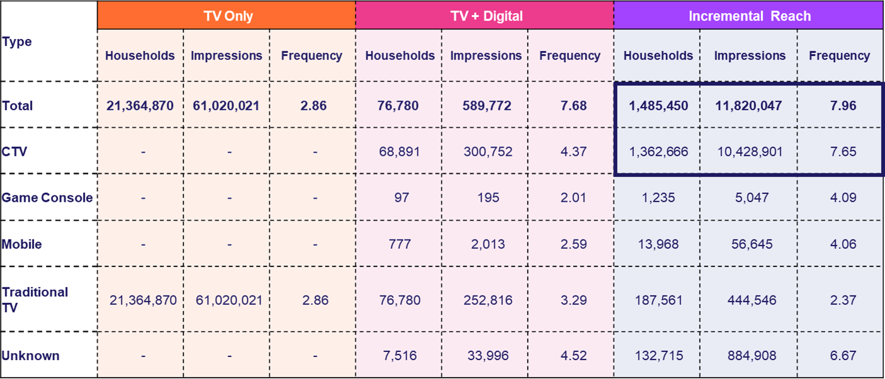
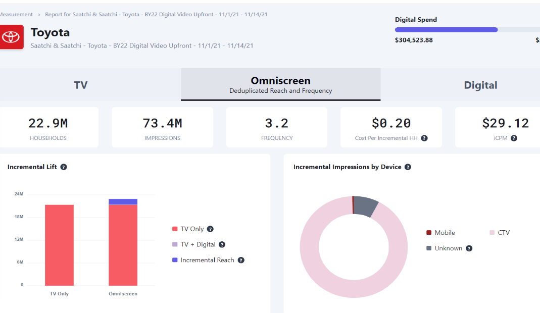

Category:
Automotive
Samba TV provided real-time measurement
to an auto manufacturer so they could optimize incremental reach vs. Linear TV
Incremental Reach /
Frequency Management
Challenge
A major auto manufacturer sought to offset Linear TV over-frequency and maximize incremental reach to avoid oversaturating targeted viewers
Audience Measurement Innovation
Samba ACR data was used to create reach-enhancing audiences for addressable CTV targeting
As the client’s linear TV and CTV campaign rolled out, Samba’s Incremental Reach Measurement Dashboard enabled a real-time view of the incremental delivery of various target audiences
and tactics, enabling dynamic in-campaign target and tactic optimization
Target Segment
Multiple custom unexposed and light-viewing
target cohorts
Learnings
Achieved live and dynamic understanding of unreached (and over-reached) audiences, enabling optimization of media spend/allocation
Campaign delivered 95% incremental impressions
and +6.9% incremental omni-screen reach
Company / Viewing Source / Media Type
Samba TV / Automated Content Recognition (ACR) / Linear, CTV, Online Video
over 90% of CTV measured as incremental to client’s Linear TV campaign
Source: Samba TV, Automotive Case Study. Campaign time period: November 2021.
This information is exclusively provided to VAB members and qualified marketers. Further distribution is prohibited.
PAGE 32

Slide 33

Category:
Automotive E-commerce
iSpot.tv’s user level data enabled DriveTime, an auto e-retailer, to optimize frequency and boost their Return on Ad Spend (ROAS)
Incremental Reach /
Frequency Management
Challenge
In order to maximize ROAS, one of the largest used vehicle retailers in the US, DriveTime needed deeper insight into incremental results at the network level, as well as optimal frequency before diminishing returns
Audience Measurement Innovation
Using iSpot.tv’s Integrated User Level Data (IULD), DriveTime tied linear TV ad exposures to conversion events at the individual device level and tallied
the number of impressions per device
Through a lift analysis using an unexposed control group, iSpot.tv calculated incremental conversion events aligned to frequency of impressions
Spend and conversion rates at the individual network level was also looked at to calculate the Cost Per Incremental Visit (CPIV), also mapped to frequency
Target Segment
Any potential DriveTime customer segment
Learnings
The first linear TV ad impression had the highest incremental response rate at 60% with the incremental response rate diminishing as frequency increases
The rate at which TV ad response decreases as frequency increases was calculated to determine
optimal frequency for each TV network
Company / Viewing Source / Media Type
iSpot.tv / Smart TV / Linear TV
Incremental Response Calculations – Bounce TV Network (w/o 2/14/22) example
The first linear TV ad imp has the highest incremental response rate at 60% (160 index)
Frequency
Response
Baseline
Base
Incremental
Total
Index
Index
Lift
TV Count
0
1
1
160
100
60
7,543
Baseline for Base Freq 3
0
2
2
186
100
86
2,976
0
3
3
205
100
105
1,869
Baseline for Base Freq 1
1
1
2
186
160
26
Response Rate (Indexed)
2,523
1
2
3
205
160
45
1,128
1
3
4
220
160
60
662
2
1
3
205
186
19
1,572
2
2
4
220
186
34
666
2
3
5
233
186
48
436
3
1
4
220
205
15
1,060
3
2
5
233
205
29
398
3
3
6
244
205
39
271
Base Frequency: Impressions delivered through other networks (not Bounce)
Incremental Frequency: Impressions delivered through Bounce
Total Frequency: Sum of the previous two
iSpot IULD Impressions: 135k
Distinct Devices: 40k – 3.5 Avg Frequency
Audience Size: 160k – 25% Reach
Source: iSpot.tv, case study: DriveTime x iSpot.TV. Campaign time period: Q1 2022. Conversion events are driven by website traffic.
This information is exclusively provided to VAB members and qualified marketers. Further distribution is prohibited.
PAGE 33

Slide 34
Automotive
Best Practices
Automotive
Manage frequency and optimize cross platform spend in real-time. When layered with advanced targeting capabilities of in market automotive purchasers, a brand can reach the right audience, in the right place, at the right time, the right number of times throughout the campaign.
Reduce duplicated reach across your campaign by including a diverse set of linear networks. This provides the ability to access unique car buying audiences not found elsewhere.
Leverage website conversion data to better understand your customer’s path to purchase. This will enable a brand to better engage with car buyers from the time they begin researching specific models, to when they’re booking a test a drive, to when they purchase a vehicle.
This information is exclusively provided to VAB members and qualified marketers. Further distribution is prohibited.
PAGE 34

Slide 35




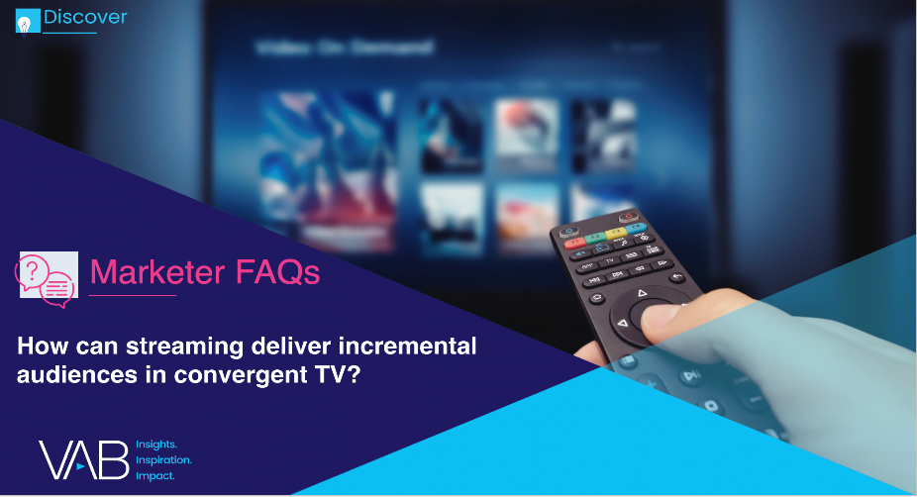

Benjamin Vandegrift
VP, Measurement Solutions
BenjaminV@thevab.com
Discover more
Looking for more data, insights and takeaways? Check out this related VAB content
Today’s Innovations in Measurement 1Q 2022
Real-world case studies from industry innovators
Today’s Innovations in Measurement 2Q 2022
Real world case studies from industry innovators
Stream On
23 Real-World Case Studies Highlighting How Video Streaming Drives Brand Success
Convergent TV Marketer FAQ
How streaming can deliver incremental audiences in convergent TV
VAB Members, brand marketers and agencies get free and immediate access to VAB’s content library. Get access at theVAB.com
This information is exclusively provided to VAB members and qualified marketers. Further distribution is prohibited.
PAGE 35

Slide 36


About VAB
VAB is an insights-driven organization that inspires marketers to reimagine their media strategies resulting in fully informed decisions.
Drawing on our marketing expertise, we simplify the complexities in our industry and discover new insights that transform the way marketers look at their media strategy.
We are committed to your business growth and proud to offer VAB members, brand marketers and agencies complimentary access to our continuously-growing Insights library. Get immediate access at theVAB.com.
Curious to learn more about VAB? Check out this quick video to see what we do and how we can help you develop business-driving marketing strategies.
This information is exclusively provided to VAB members and qualified marketers. Further distribution is prohibited.
PAGE 36

