Slide 1






Today’s Innovations in Measurement
Real-world case studies from industry innovators
2Q 2022 – Second Edition

Slide 2

TV Measurement is critically important for marketers,
and often holds the key to business growth.
However, keeping up with the ever-evolving complex ecosystem of innovative platforms, tools, devices and services can be challenging. To help navigate, the VAB, in collaboration with
our Measurement Innovation Task Force, has produced Today’s Innovations in Measurement.
The focus of this quarterly series is on case studies - giving you real-world examples of how brands are successfully adding new ways of measuring their video campaigns to optimize and more effectively gauge success.
This information is exclusively provided to VAB members and qualified marketers. Further distribution is prohibited.
PAGE 2

Slide 3

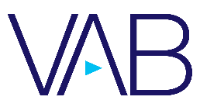

What You’ll Learn…
How brands are utilizing innovative, modern measurement approaches to maximize the effectiveness of their campaigns and achieve better outcomes
Be inspired by the insightful analysis and learnings revealed in these 15 real-world examples from across major product categories like Healthcare, Finance, and CPG
Considerations as you evaluate and add new solutions to your measurement plans
See these case studies brought to life in 30-minute webinars.
Listen to industry leaders as they review their capabilities and case studies, as well as highlight key learnings. You’ll find inspiration and get a "behind the scenes look" at how marketers are igniting brand growth through measurement.
Register Here
Measurement
Innovations Series
If you missed the Q1 edition, you can find it here.
You'll find 13 case studies across product categories like Automotive, CPG, Healthcare and more.
This information is exclusively provided to VAB members and qualified marketers. Further distribution is prohibited.
PAGE 3

Slide 4









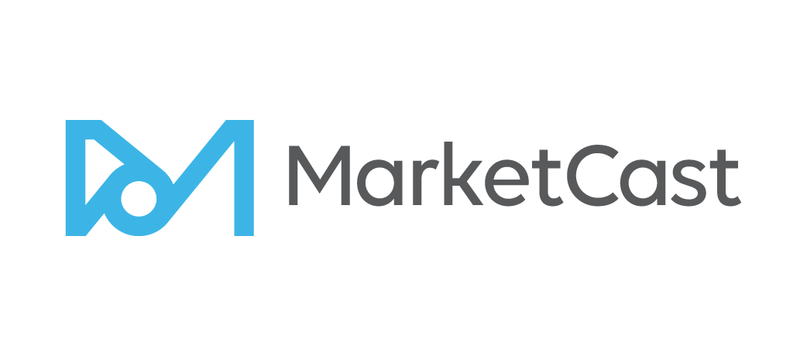

In this second edition of our series, we showcase real-world case studies from eleven innovative measurement companies
Click the logos to go to each company’s website homepage to learn more about their measurement solutions.
This information is exclusively provided to VAB members and qualified marketers. Further distribution is prohibited.
PAGE 4

Slide 5










The case studies span over 10 major product categories, from Finance and CPG to Tune-in and Healthcare
Finance
Eyewear
Tune-in
CPG
Entertainment
Carbonated Beverage
Technology
Insurance
Pharma /
Healthcare
Beauty
This information is exclusively provided to VAB members and qualified marketers. Further distribution is prohibited.
PAGE 5

Slide 6
8 Performance Objectives for Marketers:
Most marketers are seeking accurate measurement for one (or more) of the following:
Brand Perception
Targeting Optimization
Frequency Management
Incremental Reach
Maximize Full-Funnel Outcomes
Website Traffic
Tune-In
Online and Offline Sales
click on the objectives above to be taken to the relevant case studies
This information is exclusively provided to VAB members and qualified marketers. Further distribution is prohibited.
PAGE 6

Slide 7
Category:
Technology
A technology brand worked with DISQO to prove
the value and impact of its cross-platform campaign
Brand Perception
Challenge
A technology brand needed to prove the ability of their cross-platform campaign to impact brand perception metrics
Measurement Innovation
The brand leveraged DISQO’s Brand and Outcomes Lift solution to prove their campaign’s impact across a variety of attitudinal and behavioral metrics
They were able to do this by comparing “exposed” and “un-exposed” groups developed by DISQO
Target Segment
P18+
Learnings
The analysis showed how each ad media platform played a role in generating significant lifts across a variety of brand perception KPIs
Company / Viewing Source / Media Type
DISQO / Linear TV, Online Display and Video (including Mobile and Desktop Social)
Campaign Results Overview
Audiences were
2.3x
Social Audiences were
+36%
More likely to search for the
technology after campaign exposure
More likely to purchase the client’s products
KPI Impact Over Un-Exposed by Top Platform
Across all attitudinal, perception & persuasion metrics.
Online Only
+15%
Online Only
+15%
TV Only
+25%
TV Only
+17%
TV Only
+15%
Source: DISQO, Case study: Technology Case Study. Campaign dates: Q4 2019.
This information is exclusively provided to VAB members and qualified marketers. Further distribution is prohibited.
PAGE 7

Slide 8
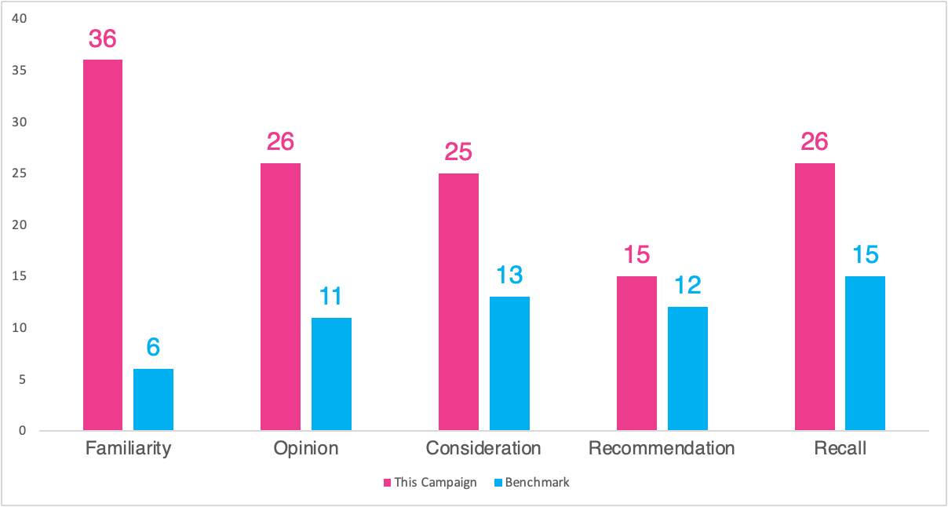
Category:
Beauty
A beauty brand partnered with Comscore and Univision to quantify and drive brand perception
Brand Perception
Challenge
A beauty brand sought to improve its brand perception among core 25-to 54-year-old Hispanic/Latinx females
Measurement Innovation
The brand ran a targeted branded content video campaign on Univision online platforms
To quantify the lift in positive brand association, Univision employed Comscore’s Social Media BrandLift™
This survey-based solution delivers verified information on how the activated audience thinks and feels about the brand partner
It also enables advertisers, publishers or influencer partners to measure industry-accepted, as well as bespoke KPIs across branded content campaigns
Target Segment
Hispanic/Latinx Females A25-54
Ethnicity included: 65% Mexican, 5% Puerto Rican, 4% Cuban, 25% Other
Learnings
The brand was able to understand how the campaign:
  Impacted positive brand sentiment across 5 areas, with double-digit increases across all metrics
  Positively impacted key brand association metrics and recall among its key Latinx target
Company / Viewing Source / Media Type
Comscore / Univision / Digital Video, Social Media
68% of the Latino female segment aged 25-34 associate the beauty brand with hydrating skin
60% of Latino social engagers recalled Univision’s premium branded content
96% of the Latino female segment aged 25-34, exposed to Univision’s campaign expressed ’more interest’ in beauty product brand
86% of surveyed Hispanic audiences reported being more interested in the beauty product brand after seeing the Univision campaign
pts
pts
pts
pts
pts
pts
pts
pts
pts
pts
*Shareablee’s Overall Survey benchmarks calculate the average percentage point change lifts from Non-Engaged to Engaged survey respondents across key survey questions (such as Recall or Purchase Consideration) for campaign assessment
Source: Comscore, Case study: Blinded Beauty Brand. Campaign dates: 10/15/21- 11/19/21.
This information is exclusively provided to VAB members and qualified marketers. Further distribution is prohibited.
PAGE 8

Slide 9

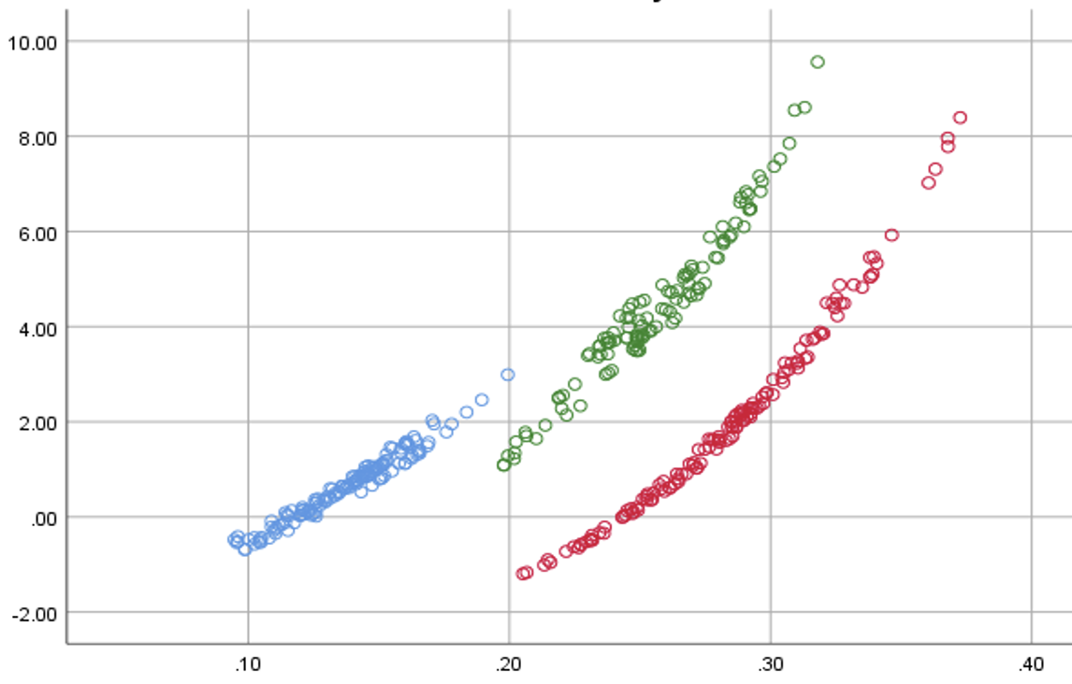
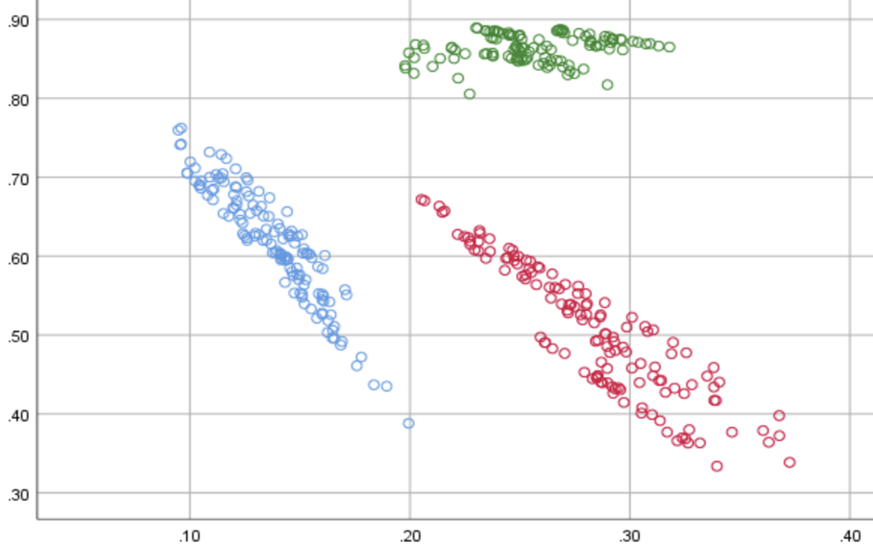

Category:
Consumer Packaged Goods (CPG)
A CPG company utilized EDO’s Behavioral Brand Power (BBP) metric to better evaluate how its own brand health had an impact on its competitors
Brand Perception
Challenge
A CPG brand wanted to know how its brand health impacts its own and competitors’ advertising results
Measurement Innovation
EDO’s Behavioral Brand Power (BBP) is a real-time brand health metric built on proprietary Share of Search (SoS) and Share of Voice (SoV) data
BBP allows a brand to quantify its consumer interest (SoS) relative to its ad visibility in the marketplace (SoV)
Target Segment
P2+
Learnings
A five-year campaign with 237 billion imps illustrated that BBP is a strong measure and tracker of brand health
Higher BBP insulates marketers to price competition and amplifies sensitivity to changes in media weight. Marketers who invest in their advertising generate positive ripple effects for the brand
Company / Viewing Source / Media Type
EDO, Inc. / ACR, Google API / National Linear TV
SoV Elasticity vs. BBP
As BBP increases, a brand’s sensitivity to Share of Voice increases – enabling greater consumer engagement impact from its media investment
Share of Voice (SoV) Elasticity *
CPG Brand A
CPG Brand B
CPG Brand C
BBP Metric
Price Elasticity vs. BBP
As BBP increases, a brand’s sensitivity to price changes decreases – which makes the advertiser more immune to price fluctuations
Price Elasticity *
CPG Brand A
CPG Brand B
CPG Brand C
BBP Metric
Source: EDO, Inc.. Campaign time period: March 2017 to March 2022.
* Price Elasticity is a measure of Share of Revenue’s sensitivity to a change in Price Per Unit
* SoV Elasticity is a measure of Share of Revenue’s sensitivity to a change in Share of Voice
This information is exclusively provided to VAB members and qualified marketers. Further distribution is prohibited.
PAGE 9

Slide 10

Category:
Healthcare
A healthcare brand worked with Samba TV to quantify the impact of their CTV campaign on 5 KPIs
Brand Perception / Targeting Optimization
Challenge
A major healthcare company sought to understand how their CTV campaign drove brand perception metrics across key audiences, with a focus on brand awareness and action intent
Measurement Innovation
Pairing Samba TV’s ACR viewership measurement with Lucid’s Brand Lift tool allows for deeper insights into campaign impact on awareness and consideration
Using Lucid’s Propensity Matched Control Methodology, Samba TV created an unexposed control group to measure campaign lift among those who were exposed to the advertising
Target Segment
A25+ including light TV-viewing cohorts, parents, African Americans & Hispanics
Learnings
The brand was able to determine campaign impact across 5 key brand perception metrics and compare to benchmarks. They saw lift in 4 out of 5 metrics, including brand awareness, ad recall, and action intent
The analysis revealed which target groups were most responsive, allowing for future target refinement. Key demographic groups (male, 25-54) responded best to the CTV Messaging
Company / Viewing Source / Media Type
Samba TV & Lucid / Pixel Tags / CTV
Control
Exposed
Lift
Significance
Benchmark lift*: 30.2%
Benchmark lift*: 12.1%
Source: Samba TV, Healthcare Case Study. Campaign time period: October 2021 – December 2021. *Benchmarks are provided at a category level from Brand Lift partner Lucid.
This information is exclusively provided to VAB members and qualified marketers. Further distribution is prohibited.
PAGE 10

Slide 11




Category:
Health
A DTC Health Tech brand partnered with Tatari
to identify optimal ad frequency for streaming campaigns
Frequency Management
Challenge
A Health Tech brand running local streaming campaigns had ad frequency concerns (over-serving ads to the same viewers). It sought to uncover the optimum frequency in order to expand its reach and increase lower-funnel metrics
Measurement Innovation
Tatari analyzed the impact different ad frequencies have on response and conversion rates
Net Funnel Efficiency (response rate x conversion rate), was used to identify the optimal weekly and daily frequency caps that should be put in place to drive lower-funnel impact
Target Segment
Streaming audiences that are incremental to linear TV DMA targets
Learnings
As a result of frequency implementation, the brand was able to increase the reach of it’s campaign by 95%, more effectively distributing impressions with the same budget
From a cost perspective, the brand saw a 65% reduction in Cost Per Website Sign-Up after implementing the above-mentioned caps
Company / Viewing Source / Media Type
Tatari / Streaming Platform / CTV
Overview Of Results for the Campaign
+65%
Reduction in Cost Per Website Sign-Up after implementing frequency caps
+95%
Increase in reach with impressions spread further with frequency caps
Source: Tatari, Case study: DTC Health Tech Case Study. Campaign dates: Q2 2020- Q2 2021.
This information is exclusively provided to VAB members and qualified marketers. Further distribution is prohibited.
PAGE 11

Slide 12

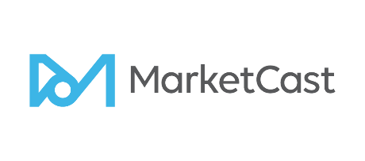
Category:
Financial Services
A financial services brand partnered with MarketCast to drive incremental reach and website conversions
Incremental Reach / Website Traffic
Challenge
A DTC financial services company sought to increase its reach of younger consumers in order to drive more website conversions of its online tax services platform
Measurement Innovation
MarketCast partnered with a CTV seller to reach a younger audience
To ensure results were not inflated by current customers or repeat visitors, MarketCast implemented its own certified web pixel that only fired for new conversions, not repeat visitors
To evaluate the impact of their campaign, using a third-party data segment, MarketCast built a custom synthetic control group of likely buyers who were unexposed to the campaign
Target Segment
All Household Product Intenders
Learnings
The brand was able to accurately quantify
the impact the CTV campaign had on new conversions, seeing a 3x lift vs. those unexposed to the advertising
Company / Viewing Source / Media Type
MarketCast / Smart TV ACR / Linear and OTT
Overview Of Results for the Campaign
3x
Lift in conversions amongst targeted
A18-29 product intenders vs. unexposed
21
%
Incremental reach of product intenders through CTV vs. linear TV
Source: MarketCast, Case study: How a D2C brand used CTV to reach a non-linear intender audience. Campaign dates: 04/04/20 – 06/05/20.
This information is exclusively provided to VAB members and qualified marketers. Further distribution is prohibited.
PAGE 12

Slide 13

Category:
Insurance
Insurance brand Amica used iSpot.tv’s Unified Measurement tool to optimize and justify linear and streaming TV advertising
Incremental Reach / Website Traffic
Challenge
To justify their linear and streaming TV advertising, Amica needed deeper insight into conversion rates, creative performance and reach of their campaign
Measurement Innovation
Using iSpot.tv Unified Measurement, Amica was able to measure
  Deduplicated reach and conversion rates of linear compared to streaming ads
  Granular performance measurement of various ad lengths and creatives
  Reach and conversion rates across individual OTT publishers
Target Segment
Any potential Amica customer
Learnings
The analysis allowed for creative optimization, demonstrating that the :15 streaming ads were more effective at driving conversions
Amica was able to use the analysis to more efficiently allocate between publishers
Amica was able to evaluate performance of its streaming ad linear components, with streaming ads converting at a 6x higher rate
Company / Viewing Source / Media Type
iSpot.tv / Smart TV / Linear TV / Streaming TV
Unified Measurement Publisher and Incremental Reach Example
Source: iSpot.tv, Case study: Amica x iSpot.TV. Campaign time period: Q4 2020.
This information is exclusively provided to VAB members and qualified marketers. Further distribution is prohibited.
PAGE 13

Slide 14



Category:
Consumer Packaged Goods (CPG)
A CPG brand worked with LiveRamp to identify
new audiences and increase campaign reach
Incremental Reach
Challenge
A major CPG brand was experiencing diminishing offline sales for HH’s exposed to ads 10+ times. This highlighted a need to reach new HHs and minimize waste
Measurement Innovation
LiveRamp helped the brand identify opportunities to adjust spend and increase campaign reach
This was done by suppressing heavily exposed homes across CTV and OTT. Those impressions were redirected to CTV households with little to no linear exposure to drive incremental reach
Target Segment
All households
Learnings
The CPG brand was able to drive incremental reach with unique HH reach increasing by 176% for the OTT/CTV campaign
Through this analysis, they were able to determine their ROAS and what was driving it – ROAS was 86%, mostly driven by light/med TV HHs that were previously challenging to reach
Company / Platform
LiveRamp, Data Plus Math (D+M) / Linear TV, OTT, Connected TV (CTV)
Campaign Results
More Reach
+176%
increase in unique HH reach
More Efficient
86%
ROAS
Source: LiveRamp, CPG brand case study. Campaign time period: Q1 – Q2 ‘21.
This information is exclusively provided to VAB members and qualified marketers. Further distribution is prohibited.
PAGE 14

Slide 15





Category:
Eyewear
A leading retail eyewear brand partnered with Upwave to measure full-funnel performance
Maximize Full-Funnel Outcomes
Challenge
A major retail eyewear brand sought to…
  Increase awareness to further develop their customer base and capture market share
  Understand what tactics, publishers, creative, target segment, etc. overperform or underperform in driving lift among key brand KPIs
  Understand the impact of their brand investment in moving potential customers down the brand funnel
Measurement Innovation
Upwave’s Brand Outcomes capability measured brand lift and tied top of funnel to bottom of funnel outcomes
The campaign measurement included a leading sports platform, multiple programmatic partners, and a variety of sports, news, entertainment and lifestyle cable networks, among others
Target Segment
HHs, HHI $100k+ and product-intenders
Learnings
The brand was able to measure performance across full-funnel KPIs, seeing double-digit increases
The brand was able to make campaign refinements with learnings on programming genres and creative executions
Company / Platform
Upwave / Digital Display, Connected TV, Linear TV
Behavioral targeting (past purchasers) saw increased KPI lifts in Awareness, Consideration and Purchase Intent, over Affinity
and In-Market (likely purchasers) targeting tactics
The highest lift across all KPIs was among an HHI $100k –giving the brand insight into audience appeal
Creative Concepts A-E lifted the Awareness KPI, but only Concept B and D moved customers down the brand funnel, seeing increases in Consideration and Purchase Intent
After looking into different program categories, the platform surfaced underperforming and overperforming genres, giving the brand the opportunity to reallocate dollars towards better performing genres
Awareness
Consideration
+12.4% (Creative B)
↓
↓
↓
Purchase Intent
+14.7% (Creative D)
Sitcom
Talk News
Reality
Lift
Source: Upwave, Retail eyewear brand case study. Campaign time period: Q3 – Q4 ’21.
This information is exclusively provided to VAB members and qualified marketers. Further distribution is prohibited.
PAGE 15

Slide 16

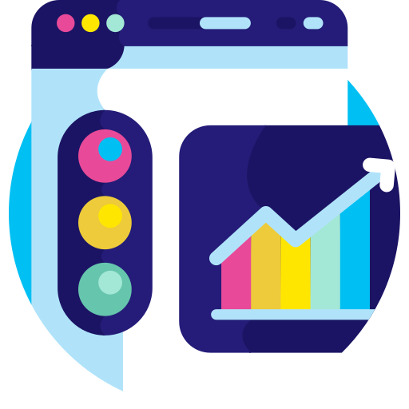

Category:
Financial Services
A financial services brand utilized LiveRamp’s creative analysis to understand the impact of its high-profile
sports sponsorships
Website Traffic
Challenge
A financial services brand wanted to quantify the impact of their high-impact linear TV sponsorships of a major sports league on website traffic
Measurement Innovation
The brand leveraged LiveRamp to conduct a linear creative analysis across ongoing campaigns. This included billboards, tagged tune-ins and signage around the intermission aired through use of post-log reporting
Target Segment
Non-customers
Learnings
The brand was able to identify which sponsorship elements were driving the most website traffic. Intermission signage and voiceovers proved most successful, resulting in 60% of total site visits
The brand attributed a 6% increase (vs. previous quarter) in new customer site visits to this sponsorship
Company / Platform
LiveRamp, Data Plus Math (D+M) / Linear TV
Linear TV Sponsorship Drove…
60%
Of total site visits
+6%
Overall increase in new customer site visits compared to the previous quarter
Source: LiveRamp, Financial Services brand case study. Campaign time period: August – September 2020.
This information is exclusively provided to VAB members and qualified marketers. Further distribution is prohibited.
PAGE 16

Slide 17


Category:
Insurance
A major insurance advertiser used VIZIO and Inscape data to determine the incremental audience reached via VIZIO Ads and the effectiveness of digital ads in driving new users to its site
Website Traffic
Challenge
An insurance brand wanted to drive traffic to its website for quote requests
Measurement Innovation
Ads were run through VIZIO’s FAST service WatchFree+, as well as the AVOD ad inventory VIZIO Ads has with programming partners
Inscape data was used to determine the brand’s reach within linear environments as well as the incremental audience VIZIO Ads reached through digital media
Web pixel was placed to tie on-site actions back to media exposure across both linear and digital environments
Target Segment
P18+
Learnings
The combination of Linear TV and CTV via VIZIO Ads drove the greatest conversion rate
By adding CTV on top of linear TV, the brand was able to add incremental reach to their campaign
Company / Viewing Source / Media Type
Vizio / VIZIO Ads / Linear and CTV
Campaign Results Overview
+12%
Incremental reach from VIZIO Ads
when combined with linear TV
Conversion Rate by Platform
Cross-Platform Performance
7x
conversion rate of “exposed both” over linear alone
+26%
conversion rate of “exposed both” over VIZIOads alone
Source: Vizio, Case study: Blinded Insurance Site Conversion. Campaign dates: Q2 2021.
This information is exclusively provided to VAB members and qualified marketers. Further distribution is prohibited.
PAGE 17

Slide 18

Category:
Internet Technology
An internet technology company partnered with
Samba TV to find efficient ways to drive site traffic
Website Traffic
Challenge
A major internet technology company sought to understand how their TV and digital campaigns drove their site traffic, as well as which screens and which creative units had the most impact
Measurement Innovation
To show the impact of the campaign on driving site traffic, Samba TV uses their Online Conversion Measurement to analyze lift compared to their Synthetic Control Group Methodologies
Target Segment
A35-64
Learnings
The analysis provided conversions* by screen so that the brand could optimize by device for future campaigns. Mobile ads showed the strongest conversion rate, driving the most audience to visit the website
The analysis allowed the brand to optimize by creative unit, revealing that the :15 second units outperformed the longer TV creatives. This has the potential to reduce the brand’s production costs and increase efficiency in future
Company / Viewing Source / Media Type
Samba TV / Automated Content Recognition (ACR) & Pixel Tags / Linear TV, CTV, Online Video
LIFT FROM CONTROL
44%
Avg. Freq: 2.1
Avg. Freq: 2.5
Avg. Freq: 2.3
Avg. Freq: 4.7
15s ads
30s ads
Source: Samba TV, Internet Technology Case Study. Campaign time period: November 2020 – December 2020. *Website traffic / visits.
This information is exclusively provided to VAB members and qualified marketers. Further distribution is prohibited.
PAGE 18

Slide 19
Category:
Tune-In
A major cable network utilized Vizio’s Inscape viewing behavior data to drive tune-in to the premiere of a flagship TV show
Tune-In
Challenge
A network wanted to drive tune-in to the season premiere of a flagship TV show and understand which tactics of its promotion were making the most impact on tune-in
Measurement Innovation
Vizio’s Inscape viewing behavior data determined how viewers engaged with the promotion across the devices targeted and which viewers ultimately tuned into the show
Vizio built a control group of Organic Viewers - those who were not exposed to the campaign to compare and contrast against
Target Segment
Targeting included existing network viewers, a competitive proxy show list, and retargeting of linear promos
Learnings
The analysis allowed the network to prove that those who were exposed to the promotion of the show were 64% likely to have tuned in for it vs. those who weren’t exposed to it
The network was able to determine which tactics had the greatest impact on tune-in, increasing efficiency
of future campaigns
*Household Connect generated the most positive results
Company / Viewing Source / Media Type
Vizio / VIZIO Ads / CTV and SmartCast
Campaign Results Overview
Watched TV Show
Lift vs. Control Group by Tactic
+64%
Higher than control
Source: Vizio, Case study: Season Premier Omnichannel. Campaign dates: Q2 2021. *Household connect allows advertisers to extend their campaigns beyond the TV to millions of additional touchpoints and devices, so viewers will see a complementary ad or call-to-action on their computer, tablet, or mobile device shortly after being presented with an ad on TV
This information is exclusively provided to VAB members and qualified marketers. Further distribution is prohibited.
PAGE 19

Slide 20

Category:
Entertainment
A streaming service partnered with Samba TV
to uncover actionable insights from media tactics
to drive tune-in for a new reality program
Tune-In
Challenge
A streaming service sought to understand the impact of their linear + digital video campaign on tune-in rates for the premiere of one of their reality shows
Measurement Innovation
To show the impact of the campaign on tune-in rate, Samba TV uses their Verified Tune-In Rate Measurement to analyze lift compared to their Synthetic Control Group Methodologies
Target Segment
Reality TV viewers, as well as heavy TV viewers, were selected from Samba TV’s viewership data and were targeted as likely viewers of the streaming services reality show
  Streaming Reality Viewers
  Heavy TV Viewers
  MTV, CBS, Bravo & E! Reality Viewers
Learnings
Through this analysis, the streaming platform learned the impact of its digital ad component, a 63% lift vs. the control
The service was able to determine optimal frequency levels, with peak impact occurring at 5 exposures in TV and >9 exposures in digital
The advertiser was able to glean insights into programming effectiveness, with the greatest impact seen among Streaming Reality viewers – a learning they can apply to future tune-in campaigns
Company / Viewing Source / Media Type
Samba TV / Automated Content Recognition (ACR) & Pixel Tags / Linear TV, CTV, Online Video
Digital Lift
+63%
Average Frequency
2.7
2.5
Source: Samba TV, Entertainment Case Study. Campaign time period: March 2021.
This information is exclusively provided to VAB members and qualified marketers. Further distribution is prohibited.
PAGE 20

Slide 21

Category:
Carbonated Beverage
A carbonated beverage advertiser utilized 605’s attribution solution to connect sales with viewership
of co-branded integrated programming
Online & Offline Sales
Challenge
A beverage brand sought to understand the impact of
two campaigns – an ad campaign for their carbonated beverage, and a product integration on a sub-brand
Specifically, they wanted to know the impact on 3 KPIs: Purchase Frequency, Conversions, Total Sales
Measurement Innovation
605’s attribution solutions leveraged 605 viewership/tune-in data, third party sales data and the client’s first-party digital data to measure the effectiveness of the brand’s cross-platform campaign compared to a “Matched Control”*
Target Segment
Customers who have previously made a purchase from the beverage brand (carbonated beverage brand target)
Customers who have previously made a purchase of one specific beverage flavor from the beverage brand (sub-brand target)
Learnings
The brand was able to see lifts vs. the ‘matched control’ for each vehicle individually, allowing them to more effectively allocate spend
The brand was able to see the relative impact on their core KPIs for the ad campaign vs. the product integration allowing for more informed strategy decisions in future
Company / Viewing Source / Media Type
605 / Automated Content Recognition (ACR), Set-Top Box / Linear TV (Large Entertainment Network), Digital (Large Entertainment Network’s digital platform)
CARBONATED BEVERAGE BRAND (ADS) | Index - Transactions |  | Incremental Sales
PLATFORM: | LINEAR |  | DIGITAL |  | ANY (LINEAR + DIGITAL)**
RESULTS: | LIFT vs. control | INDEX | LIFT vs. control | INDEX | LIFT
Purchase Frequency | 22% | 122 | 58% | 122 | 20.9%
Conversions | 22% | 112 | 6% | 73 | 22.0%
Total Sales | 11% | 140 | 3% | 101 | 11.1%
SUB-BRAND (PRODUCT PROGRAM INTEGRATION) | Index - Transactions
PLATFORM: | ANY (LINEAR + DIGITAL)**
LIFT PER EXPOSURE: vs. control | ANY | PREMIER EPISODE | 5+
Purchase Frequency | 34% | 41% | 51%
Conversions | 38% | 37% | 42%
Total Sales | 15% | 30% | 89%
Source: 605, Case study: Campaign for Carbonated Beverage Brand, Sales. Campaign dates: 2/7/2021 – 4/11/2021. *”Matched Control” = match each “exposed” HH to similar unexposed HH. **”Any (Linear + Digital)" is any exposure to the ad on Linear or Digital. A viewer could have seen both, but they were exposed on at least one platform during the campaign period.
This information is exclusively provided to VAB members and qualified marketers. Further distribution is prohibited.
PAGE 21

Slide 22
Considerations as you evaluate and add new solutions to your measurement plans
Research multiple measurement providers
Partner with the appropriate provider(s) whose data capabilities align with your objectives / KPIs
Understand the data sets being used, how they are sourced and what the reporting and outputs are
Ensure the accuracy, validity and transparency
of the datasets
Understand the cross-platform capabilities
of the measurement providers under review
Learn if you can optimize your campaigns based on the data outputs
Know if your precise target audience can be properly measured by the data provider
Ask how timely the campaign metrics / results will be reported
This information is exclusively provided to VAB members and qualified marketers. Further distribution is prohibited.
PAGE 22

Slide 23



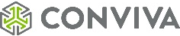






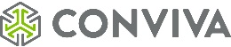
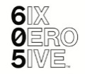



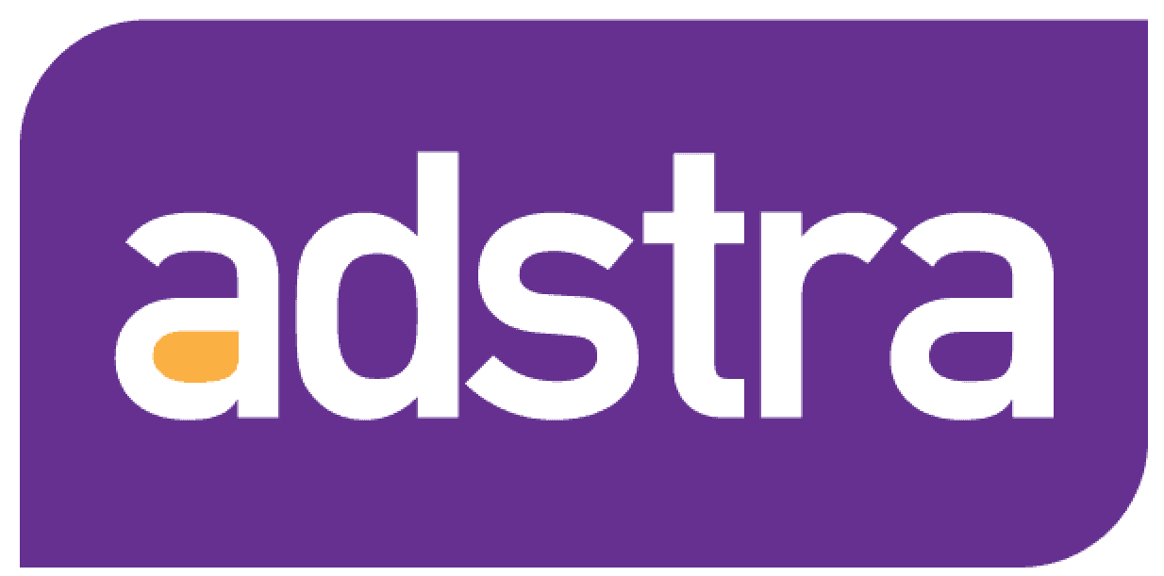



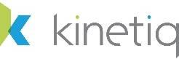

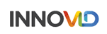

















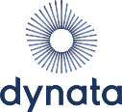


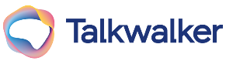









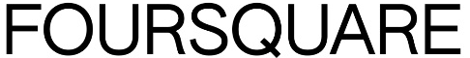
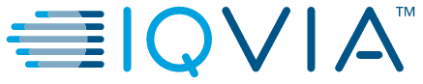





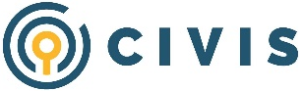
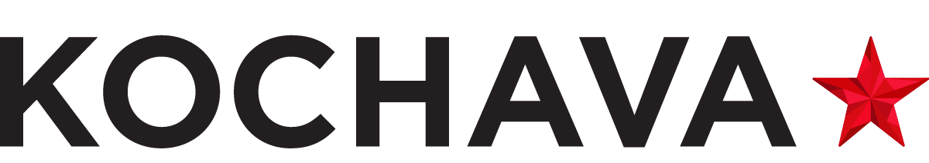




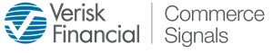

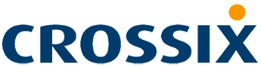

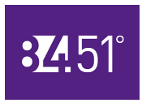
The companies included in this guide are just some of the data providers within the growing measurement ecosystem and we’re excited to bring you more case studies in this series each quarter throughout the year
Awareness
(Audience Measurement)
(Audience Verification)
(Identity Graph)
Consideration
(Brand Health Metrics)
(Creative & Content)
Intent
(Multi-Touch Attribution)
(Online / Offline Conversions)
Sales
(Category Specific)
Note: logos reflect a sampling of companies that provide measurement solutions within each funnel stage and is not meant to be an exhaustive list of all companies with related solutions; companies’ solutions can also cross funnel stages as well.
This information is exclusively provided to VAB members and qualified marketers. Further distribution is prohibited.
PAGE 23

Slide 24


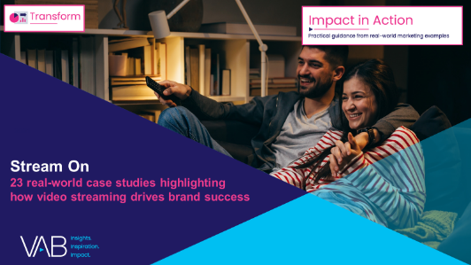
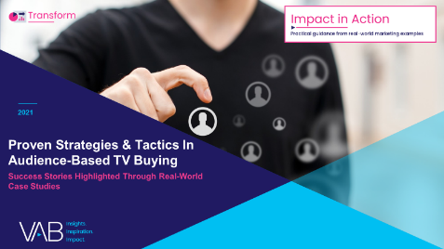
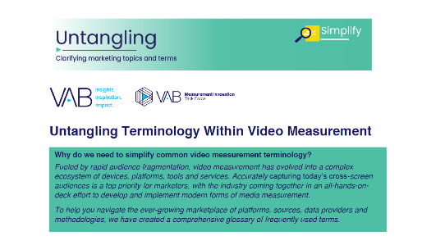
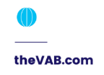
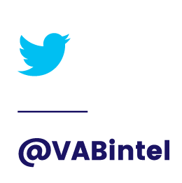

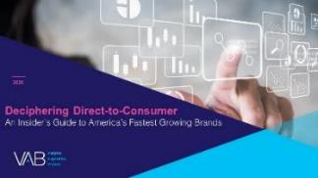
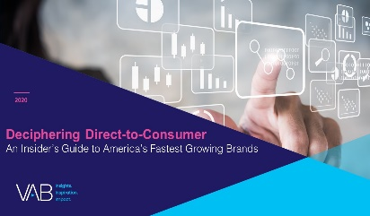
Creators
Benjamin Vandegrift
Leah Montner-Dixon
VP, Measurement Solutions
benjaminv@thevab.com
Associate Insights Director
leahm@thevab.com
Reed Kiely
Karolina Guillen
Associate Insights Director
reedk@thevab.com
Insights Manager
karolinag@thevab.com
Interested in learning more? Check out this related content:
VAB Members, brand marketers and agencies get free and immediate access to VAB’s content library. Get access at theVAB.com
Today's Innovations
In Measurement – Q1 2022
13 Case Studies From Industry Innovators
Stream On
23 Real-World Case Studies Highlighting How Video Streaming Drives Brand Success
Proven Strategies & Tactics In Audience-Based TV Buying
Success Stories Highlighted Through Real-World Case Studies
Untangling Terminology Within Video Measurement
This information is exclusively provided to VAB members and qualified marketers. Further distribution is prohibited.
PAGE 24

Slide 25


About VAB
VAB is an insights-driven organization that inspires marketers to reimagine their media strategies resulting in fully informed decisions.
Drawing on our marketing expertise, we simplify the complexities in our industry and discover new insights that transform the way marketers look at their media strategy.
We are committed to your business growth and proud to offer VAB members, brand marketers and agencies complimentary access to our continuously-growing Insights library. Get immediate access at theVAB.com.
Curious to learn more about VAB? Check out this quick video to see what we do and how we can help you develop business-driving marketing strategies.
This information is exclusively provided to VAB members and qualified marketers. Further distribution is prohibited.
PAGE 25

