Slide 1






Today’s Innovations in Measurement
Real-world case studies from industry innovators
1Q 2022 – First Edition

Slide 2

TV Measurement is critically important for marketers,
and often holds the key to business growth.
However, keeping up with the ever-evolving complex ecosystem of innovative platforms, tools, devices and services can be challenging. To help navigate, the VAB, in collaboration with
our Measurement Innovation Task Force, is launching a
quarterly educational series entitled Today’s Innovations in Measurement.
The focus of this new quarterly series is on case studies - giving you real-world examples of how brands are successfully adding new ways of measuring their video campaigns to optimize and more effectively gauge success.
This information is exclusively provided to VAB members and qualified marketers. Further distribution is prohibited.
PAGE 2

Slide 3



What You’ll Learn…
How brands are utilizing innovative, modern measurement approaches to maximize the effectiveness of their campaigns and achieve better outcomes
Be inspired by the insightful analysis and learnings revealed in these 13 real-world examples from across major product categories like automotive, QSR, pharmaceutical and CPG
The questions to consider as you evaluate and add new solutions to your measurement plans
Measurement
Innovations Series
Watch on-demand our 5-part seriesd ngnfdgodpfjgidfngonb gn
c
See these case studies brought to life in 30-minute webinars. Listen to industry leaders as they review their capabilities and case studies, as well as highlight key learnings. You’ll find inspiration and get a "behind the scenes look" at how marketers are igniting brand growth through measurement.
View all webinars on demand below!
Watch Here
This information is exclusively provided to VAB members and qualified marketers. Further distribution is prohibited.
PAGE 3

Slide 4






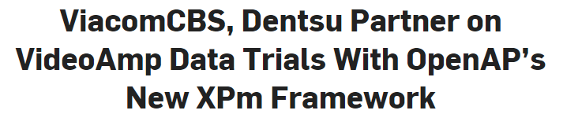
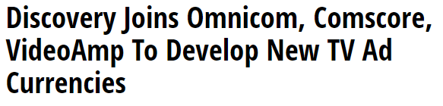







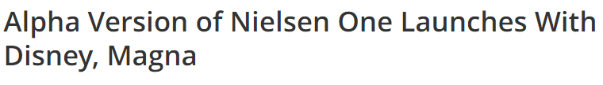
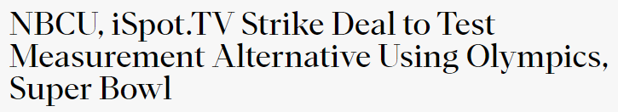
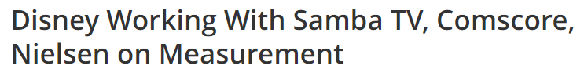



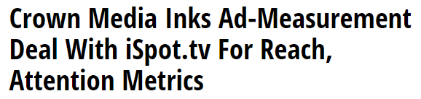
With a renewed sense of urgency, buyers and sellers are partnering across measurement providers and platforms to track today’s modern cross-platform viewer
“The greater goal of true cross screen measurement that focuses on strategic audiences and outcomes is the appropriate north star to focus on.”
- Dave Sederbaum, EVP, Head of Video Investment, Dentsu
(Adweek, 12/22/21)
Adweek, 12/16/21
MediaPost, 2/23/22
Broadcasting + Cable, 12/21/21
Broadcasting + Cable, 3/1/22
Variety, 1/13/22
“The marketplace dynamics (too little supply and too much demand) facilitated the transition beyond age/sex/demo, as buyers needed to create/accept alternative solutions to secure inventory. I believe this is a positive shift for our business as there are strong viable metrics that can improve our client’s business.”
- Carrie Drinkwater, Chief Investment Officer, Mediahub
(Adweek, 12/22/21)
“The measurement issue didn’t necessarily get ‘tackled’ but it is getting ‘addressed.’ We have more questions than answers, but conversations are now happening across both sides of the desk. What is really interesting is the challenge between how a campaign is measured vs. how it is traded.”
- Dani Benowitz, U.S. President, Magna Media Group
(Adweek, 12/22/21)
MediaPost, 3/15/22
This information is exclusively provided to VAB members and qualified marketers. Further distribution is prohibited.
PAGE 4

Slide 5








In this first edition of our series, we showcase real-world case studies from eight innovative measurement companies
Click the logos to go to each company’s website homepage to learn more about their measurement solutions.
This information is exclusively provided to VAB members and qualified marketers. Further distribution is prohibited.
PAGE 5

Slide 6










The case studies span 10 major product categories, from automotive and CPG to online delivery services and QSR
Automotive
Automotive
E-commerce
Casual Dining
CPG
Entertainment
Home Appliances
Non-Profit
Online Delivery Service
Pharma /
Health care
QSR
This information is exclusively provided to VAB members and qualified marketers. Further distribution is prohibited.
PAGE 6

Slide 7
8 Performance Objectives for Marketers:
Most marketers are seeking accurate measurement for one (or more) of the following:
Maximize
incremental reach
Understand delivery against advanced audiences
Achieve an accurate audience count across all platforms
Target audience optimization
Understand audience duplication across platforms
Grow competitive share of voice
(SOV)
Manage frequency
Gain insights on the interplay between linear TV & streaming (Convergent TV)
This information is exclusively provided to VAB members and qualified marketers. Further distribution is prohibited.
PAGE 7

Slide 8

Category:
Entertainment
Comscore helped prove a network garnered higher reach, engagement and incremental viewing in a niche automotive segment
Advanced Audiences /
Audience Duplication
Challenge
Pursuit Channel needed to win business away from their closest TV network competitor by proving their audience garnered superior reach, engagement, and incremental viewing metrics against niche automotive segments
Audience Measurement Innovation
Pursuit leveraged Comscore TV’s national reporting and automotive Advanced Audiences (AA) data to prove their network delivers an incremental audience of outdoor enthusiast viewers who have a higher index
of intent to buy both new and used pickups/SUVs compared to their competitor’s viewers
Target Segment
Total Network Audience (Pursuit vs. Network B)
Audience by Top 3 programs
Mid-sized truck buying intenders**
Learnings
Pursuit Channel won the automotive account away from their competitor because they were able to show their network reaches a continuously engaged audience of more likely auto purchase intenders
Company / Viewing Source / Media Type
Comscore / Set-Top Box / National Linear TV (Pursuit outdoor enthusiast network vs. competitive national network)
Pursuit won an auto account away from competitive Network B by proving:
Audience is more likely to be in-market for new or used pickups and SUVs
Continuous Second-by-Second Engagement Levels
Low audience overlap =
strong opportunities to reach incremental viewers
Top three programs revealed live AA metrics remained consistent throughout entire broadcast of the program, suggesting that viewers stayed engaged during ad spots
For example, the average Live AA
of DeerTech TV show, which airs between
10 - 10:30 am was 14,903 viewers
Lowest AA: 10:00 a.m. (12,864)
Peak AA: 10:25 a.m. (16,003).
14%
overlap duplication with Channel B viewers
283 Index
For intent to buy a new full-size pickup truck
Pursuit
Network B*
261 Index
For intent to buy a used full-size pickup truck
Source: Comscore, Pursuit Channel: Automotive Case Study - Network vs. Network, In A High-stakes Battle To Win The Business. Campaign time period: 5/31/21 – 8/8/21. *Competitive national network to Pursuit Channel. **Includes ‘intent to buy new non-luxury truck and SUV’ segments and ‘intent to buy used non-luxury truck and SUV’ segments. Indices based on national TV HH average.
This information is exclusively provided to VAB members and qualified marketers. Further distribution is prohibited.
PAGE 8

Slide 9
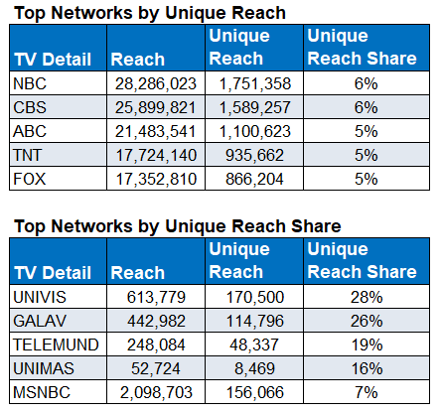

Category:
Automotive
Actionable insights from Samba TV enabled
a major auto marketer to more effectively balance their digital vs. TV strategy
Audience Duplication / Frequency Management
Challenge
A major automotive brand wanted to understand the interplay between their Linear TV and Digital media, seeking insights to increase efficiency & impact
Audience Measurement Innovation
Samba TV’s True Reach and Frequency (TRF) measurement provided insights into how the campaign performed across TV and Digital tactics, ultimately supporting the need for more balanced digital vs. Linear TV media mix going forward
Target Segment
U.S. HHs
Learnings
45% of Digital-delivered HH’s were incremental to the campaign (high unique reach factor)
Digital delivered a CPIR* 1/10th the cost of Linear TV
Within TV, Hispanic Networks delivered a far greater share of unique vs. duplicated audiences
Linear TV vs. Digital frequency required balancing
Company / Viewing Source / Media Type
Samba TV / Automated Content Recognition (ACR) / Linear, CTV, Online Video
Enabled by Samba TV’s True Reach & Frequency Measurement & Dashboards
2.6MM
Digital Only Exposed HHs
17.4
Average Frequency
17.7
TV
4.42
Digital
Source: Samba TV, Automotive Case Study. Campaign time period: February – June 2021. *Cost per incremental reach.
This information is exclusively provided to VAB members and qualified marketers. Further distribution is prohibited.
PAGE 9

Slide 10

Audience Duplication / Frequency Management
Category:
Casual Dining
A casual dining brand utilized 605 to
understand & measure audience reach
and composition across video platforms
Challenge
A casual dining brand wanted to understand and measure audience reach and demographic composition across TV and digital platforms
Audience Measurement Innovation
605 utilizes a custom weighting methodology designed to account for incomplete exposure datasets (due to digital tracking & ID resolution) and platform biases, enabling 605 to holistically measure & project national reach across individual and overlapping platforms
Target Segment
A18+, A21+, A18 34, A18-49
Learnings
The data-driven linear live campaign (TV C3) reached more households vs. national live and served a higher frequency of impressions to those HHs
TV & digital platforms (O&Os and digital TV*) reached mostly distinct audiences. Only 18.7% of households reached on digital platforms were also reached on TV
Households reached on Live+7 linear were about 2x
as likely to be reached on Digital O&O* than those reached on live TV
Company / Viewing Source / Media Type
605 / Automated Content Recognition (ACR),
Set-Top Box / Linear TV
Overview Of Platform Overlap For Each Target Segment
Reach (thousands)
Average Frequency
Target Segments
Platform | Digital TV | Digital O&O | TV C3
Digital TV | 58.4
Digital O&O | 1.9 | 1,094.4
TV C3 | 10.1 | 203.4 | 31,867.4
Digital TV | Digital O&O | TV C3
2.0
7.7 | 3.8
6.2 | 8.6 | 4.6
18+
Platform | Digital TV | Digital O&O | TV C3
Digital TV | 29.3
Digital O&O | 1.0 | 648.5
TV C3 | 5.2 | 127.9 | 14,764.3
Digital TV | Digital O&O | TV C3
2.0
8.2 | 3.8
6.2 | 8.5 | 4.6
18-34
Platform | Digital TV | Digital O&O | TV C3
Digital TV | 42.8
Digital O&O | 1.5 | 884.5
TV C3 | 7.5 | 168.8 | 21,733.1
Digital TV | Digital O&O | TV C3
2.0
7.4 | 3.8
6.3 | 8.5 | 4.5
18-49
Source: 605, Case study: Campaign for Casual Dining / Take Out. Campaign time period: 10/21/2019 – 12/30/2019. *Digital O&O (Owned & Operated) refers to ads placed on digital properties (i.e., apps) vs. digital TV which is more akin to linear TV viewed through web or app.
This information is exclusively provided to VAB members and qualified marketers. Further distribution is prohibited.
PAGE 10

Slide 11





Category:
Entertainment
Accurate Audience Count / Audience Duplication
NBC leveraged Conviva’s continuous, census
level measurement to understand de-duplicated
reach for key tentpole events
Challenge
NBC was looking for new measurement solutions to accurately capture their total audience for the Super Bowl and Winter Olympics
Audience Measurement Innovation
NBC leveraged Conviva’s measurement and their HH identifier that allows them to understand de-duplicated reach on streaming by accounting for scenarios like a single
household viewing events across multiple apps
Conviva data is collected directly from the video player and
acts as a publisher’s proprietary first-party data, capturing everything that happens during a video session, including
both content and ad breaks
Viewing Segment
Super Bowl and Winter Olympics Viewers
Learnings
NBC was able to:
  Better understand behaviors of HHs tuning into the events, including how many devices per HH were streaming & what content they were watching
  Get a deduplicated, cross-platform measurement of their audience across streaming & linear*
  Provide advertisers with next-day ad delivery reports
Company / Viewing Source / Media Type
Conviva, iSpot, NBCUniversal / SDK built into Video Player (Stream Sensor) / OTT, CTV, Mobile, Tablet, Desktop, Connected Devices
Leveraging continuous, census-level measurement, NBC measured:
Streaming Audience
10.5MM
Super Bowl Average Streaming Minute Audience
8:25PM
Time of peak viewership during Super Bowl
+279%
Increase in streaming activity during the Olympics opening ceremony
vs. 2018 opening ceremony
Streaming Audience by Device & Composition
78.4%
of Peacock viewing for the Super Bowl occurred on televisions with Roku, Samsung TV and Amazon Fire TV accounting for 68.5% of big screen viewing share
70.1%
of those streaming the Super Bowl came from ‘cord cutters’ or HHs without bundled pay TV service
Source: Conviva, Case study: Conviva Partners with iSpot to provide NBC deduplicated measurement for the Olympics and Super Bowl. Campaign time period: February 2022. *Using iSpot.TV for linear TV data, NBC matched Conviva’s Stream ID with iSpot’s identity to get a deduplicated view of consumption across all platforms.
This information is exclusively provided to VAB members and qualified marketers. Further distribution is prohibited.
PAGE 11

Slide 12
Category:
Automotive
An automotive brand utilized 605 to
understand which platforms drove the highest engagement via website visits
Incremental Reach / Accurate Audience Count / Audience Duplication
Challenge
An auto brand wanted to understand which tactics from their cross-platform campaign have an impact on driving consumers to website pages specific to a new car model
Audience Measurement Innovation
To determine causal impact, 605 utilized a “Matched Control” to remove outside influences and biases. This is done by applying machine learning methods to match each “treated” household to unexposed households that compose a “Matched Control” group
Target Segment
Conversion was measured both for any page on the Auto website, and at the page level for five distinct model-related pages
Learnings
The national linear campaign drove a +12% increase in website visitors. On top of this, cross platform targeted ads produced an additional +11% increase, indicating that the campaign is driving even further conversions
Out of all three platforms, OLV drove the highest engagement with +>100% lifts across most pages. Digital delivery increased digital engagement with the brand
Exposed households that converted tended to be younger, highly educated, and earn higher incomes
Company / Viewing Source / Media Type
605 / Automated Content Recognition (ACR), Set-Top Box / Linear TV, Addressable, Addressable VOD, Digital
 | All Reached Households |  |  |  |  | Uniquely Reached Households
Platform | Impressions | Reach | % Reach Overall | % Reach per Platform | Average Frequency | Unique Reach | % Unique Reach | Average Frequency
Full Campaign | 2,832,587 | 660,435 | 16.5% | — | 4.3 | — | — | —
Addressable Linear | 1,247,772 | 422,678 | 10.5% | 22.5% | 3.0 | 360,348 | 85.3% | 2.9
Addressable VOD | 1,226,973 | 250,710 | 6.2% | 6.9% | 4.9 | 188,544 | 75.2% | 4.9
OLV | 357,842 | 49,577 | 1.2% | 14.0% | 7.2 | 49,074 | 99.0% | 7.2
Effect Size
(percentage point difference)
% Visiting Auto Website
Source: 605, Case study: Campaign for Automotive Brand. Campaign time period: 4/5/2021 – 6/13/2021. OLV = online video. Percentage point differences are compared to the matched control group.
This information is exclusively provided to VAB members and qualified marketers. Further distribution is prohibited.
PAGE 12

Slide 13
Category:
Online Delivery Service
TVSquared by Innovid’s cross-platform TV measurement solution was utilized by an online service to extend reach and increase SOV
Incremental Reach / Audience Duplication / Grow SOV
Challenge
With a partnership base that will soon exceed 5,000 retailers, an online delivery service needed a strategy that would get their message above the noise of their competitors and make it as far-reaching and effective as possible
Audience Measurement Innovation
Always-on, cross-platform insights from TVSquared by Innovid enabled the advertiser
to track and act on its audience reach across platforms to maintain efficiencies and improve ROI
Target Segment
Men 25-54
Learnings
While CTV only represented 4% of total impressions, and 5% of reach, the audience reached across streaming was 87% unique to linear, opening the doors to nearly 30,000 first time customer purchases
Insights found that the level of app engagement was over 60% higher than web, and the media mix strategy resulted in a remarkably efficient cost per response (CPR). OTT’s CPR came in 25% lower and contributed a 22% increase in responses
Company / Viewing Source / Media Type
TVSquared by Innovid / Smart TV, ACR / Data-Driven Linear TV, CTV, OTT
Cross-platform strategy provided e-commerce advertiser
with the reach to stay on top of this competitive category
500MM+ Impressions
20MM+ HHs
(average per month)
Total Reach:
Web & App Visits:
1.7MM+
Share of Reach
CTV
5%
LINEAR
94%
1% overlap
CTV Unique Reach: 87%
Source: TVSquared by Innovid, Case study: Converged TV Campaign Extends Reach for Online Delivery Service. Campaign time period: April – September 2021. SOV = Share of Voice.
This information is exclusively provided to VAB members and qualified marketers. Further distribution is prohibited.
PAGE 13

Slide 14
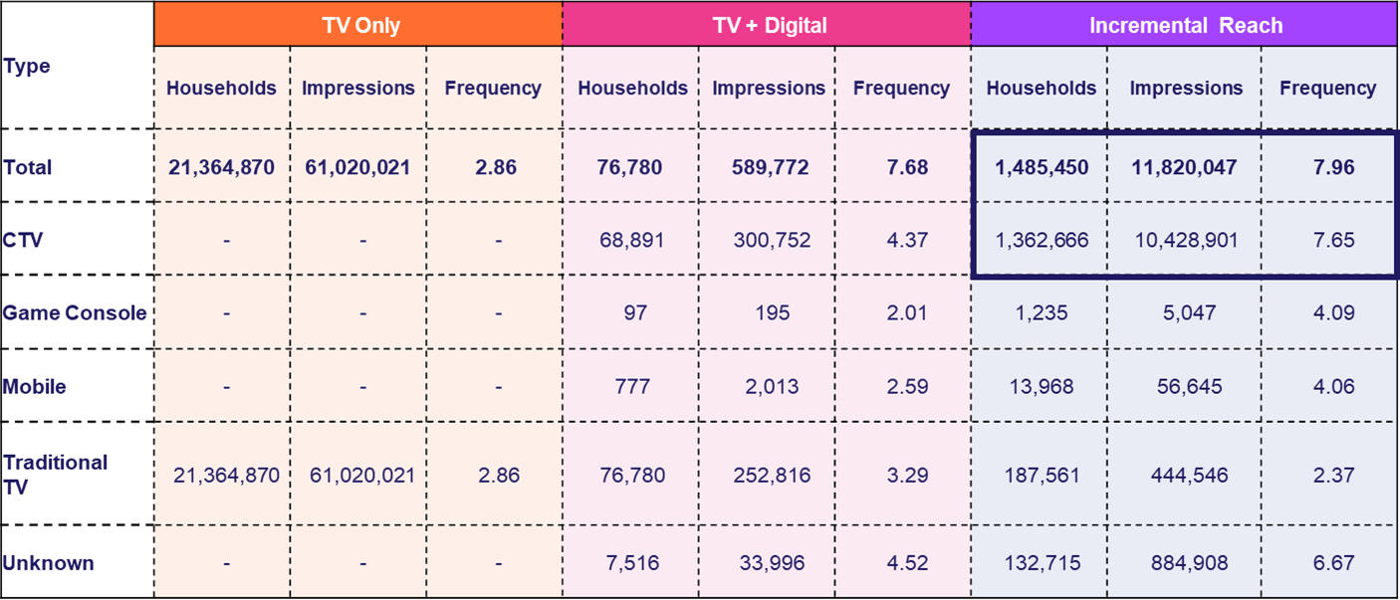
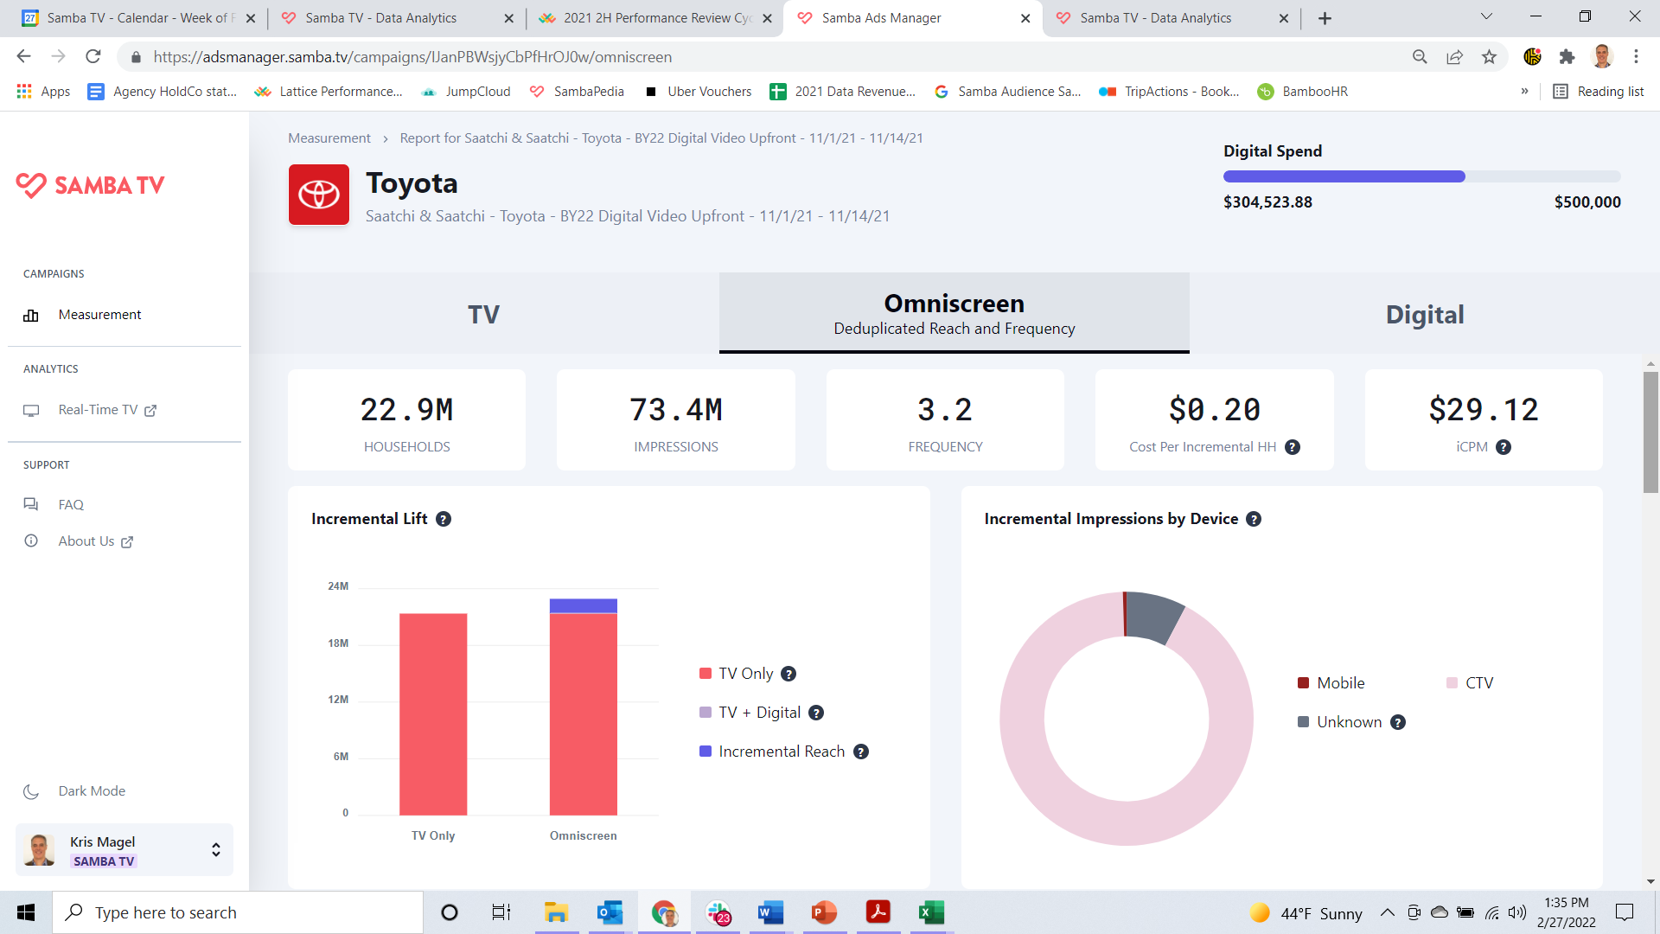

Category:
Automotive
Samba TV provided real-time measurement
to an auto manufacturer so they could optimize incremental reach vs. Linear TV
Incremental Reach / Optimization /
Frequency Management
Challenge
A major auto manufacturer sought to offset Linear TV over-frequency and maximize incremental reach to avoid oversaturating targeted viewers
Audience Measurement Innovation
Samba ACR data was used to create reach-enhancing audiences for addressable CTV targeting
As the client’s linear TV and CTV campaign rolled out, Samba’s Incremental Reach Measurement Dashboard enabled a real-time view of the incremental delivery of various target audiences
and tactics, enabling dynamic in-campaign target and tactic optimization
Target Segment
Multiple custom unexposed and light-viewing
target cohorts
Learnings
Achieved live and dynamic understanding of unreached (and over-reached) audiences, enabling optimization of media spend/allocation
Campaign delivered 95% incremental impressions
and +6.9% incremental omni-screen reach
Company / Viewing Source / Media Type
Samba TV / Automated Content Recognition (ACR) / Linear, CTV, Online Video
over 90% of CTV measured as incremental to client’s Linear TV campaign
Source: Samba TV, Automotive Case Study. Campaign time period: November 2021.
This information is exclusively provided to VAB members and qualified marketers. Further distribution is prohibited.
PAGE 14

Slide 15

Category:
Pharmaceuticals / Health care
Incremental Reach / Optimization /
Frequency Management
A pharma & health care company leveraged
Upwave’s Brand Optimization capability to
drive lift across both TV and digital
Challenge
A leading pharmaceutical and health care company wanted to measure reach among both broad and niche audiences utilizing targeting criteria beyond age and gender
Audience Measurement Innovation
The brand utilized Upwave’s Analytics Platform for Brand Advertising, which enabled them to optimize and reallocate across channels and monitor reach, frequency and penetration rate within their specific target audience
Target Segment
HHI $100K+
High-Level Job Title / Industry in Healthcare, Finance, Government
Learnings
Upwave’s Brand Optimization capability revealed that Digital alone was not as effective, running both TV and Digital together helped drive lift
Campaign lifted awareness among 11.9MM people, with the highest lift seem among affluent audiences
Company / Viewing Source / Media Type
Upwave / ACR, Event Tags / Linear TV, Digital (Display, Mobile, Desktop)
11.9MM
People with Lift
in Awareness
521MM
Total Digital Impressions
4.2B
Total TV Impressions
2.5X
More likely to reach those in the Hospital Leadership sector
3X
More likely to
reach those in the Government sector
5X
More likely to
reach those in the Finance sector
1.5X
More likely to
reach VP-level audience via Linear TV
Source: Upwave. Campaign time period: May – December 2021. Comparisons based against a representative control group.
This information is exclusively provided to VAB members and qualified marketers. Further distribution is prohibited.
PAGE 15

Slide 16

Category:
Automotive E-commerce
iSpot.tv’s user level data enabled DriveTime, an auto e-retailer, to optimize frequency and boost their Return on Ad Spend (ROAS)
Incremental Reach / Optimization /
Frequency Management
Challenge
In order to maximize ROAS, one of the largest used vehicle retailers in the US, DriveTime needed deeper insight into incremental results at the network level, as well as optimal frequency before diminishing returns
Audience Measurement Innovation
Using iSpot.tv’s Integrated User Level Data (IULD), DriveTime tied linear TV ad exposures to conversion events at the individual device level and tallied
the number of impressions per device
Through a lift analysis using an unexposed control group, iSpot.tv calculated incremental conversion events aligned to frequency of impressions
Spend and conversion rates at the individual network level was also looked at to calculate the Cost Per Incremental Visit (CPIV), also mapped to frequency
Target Segment
Any potential DriveTime customer segment
Learnings
The first linear TV ad impression had the highest incremental response rate at 60% with the incremental response rate diminishing as frequency increases
The rate at which TV ad response decreases as frequency increases was calculated to determine
optimal frequency for each TV network
Company / Viewing Source / Media Type
iSpot.tv / Smart TV / Linear TV
Incremental Response Calculations – Bounce TV Network (w/o 2/14/22) example
The first linear TV ad imp has the highest incremental response rate at 60% (160 index)
Frequency
Response
Baseline
Base
Incremental
Total
Index
Index
Lift
TV Count
0
1
1
160
100
60
7,543
Baseline for Base Freq 3
0
2
2
186
100
86
2,976
0
3
3
205
100
105
1,869
Baseline for Base Freq 1
1
1
2
186
160
26
Response Rate (Indexed)
2,523
1
2
3
205
160
45
1,128
1
3
4
220
160
60
662
2
1
3
205
186
19
1,572
2
2
4
220
186
34
666
2
3
5
233
186
48
436
3
1
4
220
205
15
1,060
3
2
5
233
205
29
398
3
3
6
244
205
39
271
Base Frequency: Impressions delivered through other networks (not Bounce)
Incremental Frequency: Impressions delivered through Bounce
Total Frequency: Sum of the previous two
iSpot IULD Impressions: 135k
Distinct Devices: 40k – 3.5 Avg Frequency
Audience Size: 160k – 25% Reach
Source: iSpot.tv, case study: DriveTime x iSpot.TV. Campaign time period: Q1 2022. Conversion events are driven by website traffic.
This information is exclusively provided to VAB members and qualified marketers. Further distribution is prohibited.
PAGE 16

Slide 17



Category:
Consumer Packaged Goods
Optimization /
Frequency Management /
Convergent TV Interplay
LiveRamp partnered with a CPG brand to
increased their cross-screen effectiveness by
suppressing overexposed linear audiences
Challenge
A major CPG brand was experiencing diminishing returns in offline sales lift once consumers were exposed past a frequency of 10. The overexposure represented 15 MM HHs per quarter, highlighting a need to optimize media spend in order to mitigate sizable waste
Audience Measurement Innovation
The brand worked with LiveRamp in order to identify actionable areas to redirect linear TV overexposure (see footnote for more details*):
  Built & activated audiences to suppress digital exposure across OTT impressions for households heavily exposed to linear ads
  Inversely, those OTT impressions were redirected to households with less or no linear ad exposure
Target Segment
All households
Learnings
Suppressing overexposed linear audiences led to more effective cross-screen outcomes across OTT/CTV (see charts on the right side)
Company / Viewing Source / Media Type
LiveRamp, Data Plus Math (D+M) / ACR, Ad Log Integration / National Linear TV, OTT
+176%
Increase in Unique HH Reach for the OTT Platform
+86%
Increase in ROAS**
for the OTT platform
Mostly sourced from Light / Medium TV Households that were previously harder to reach
Source: LiveRamp, Case study: How a Major CPG Brand Increased Cross-Screen Effectiveness by Suppressing Overexposed Linear Audiences. Campaign time period: 2Q 2021. Advanced TV Measurement: Data Plus Math. *Innovation Detail: Combining ad exposures from ACR data via Inscape partnership and ad logs integration with OTT publishers resolved to RampID & HHID, custom segment creation activated on OTT based on HHs exposed to a previous quarter’s brand national linear TV campaign schedule with 10+ ad frequency from STB data via Comscore partnership, and x-screen projection scaling methodology. **Return on ad spend.
This information is exclusively provided to VAB members and qualified marketers. Further distribution is prohibited.
PAGE 17

Slide 18
Category:
Non-Profit
TVSquared by Innovid helped a non-profit grow donations through cross-platform analytics that drove audience exposure and incremental reach
Incremental Reach / Optimization /
Frequency Management / Convergent TV Interplay
Challenge
A non-profit organization wanted to grow donations by expanding the reach of their
national media plan
Audience Measurement Innovation
TVSquared by Innovid provided cross-platform analysis and actionable insights throughout a national converged TV campaign allowing the advertiser to monitor and optimize their campaign
Target Segment
Women 35+
Learnings
The converged TV campaign delivered more than 2 billion impressions, with 18% of reach across CTV platforms only
The addition of CTV extended reach by 73%, providing a totally unique opportunity to speak to prospective donors, who contributed nearly 5,000 additional donations
While the average frequency for linear was 16, platform analytics demonstrated that the optimal was 6, proving that the linear portion of the campaign was oversaturating this specific audience
  For CTV, the average exposure was 5, but analytics showed that it had not yet reached the optimal frequency
Company / Viewing Source / Media Type
TVSquared by Innovid / Smart TV, ACR / Data-Driven Linear TV, CTV, OTT
Expanding national media plan to include CTV delivers cross-platform audience exposure, incremental reach and donations
2B+ Impressions
35MM+ HHs
(average per month)
Total Reach:
Share of Reach
CTV
18%
LINEAR
76%
6% overlap
CTV Unique Reach:
73%
campaign led to nearly 5K
additional donations
Source: TVSquared by Innovid, case study: Non-Profit Grows Donations with Converged TV Campaign. Campaign time period: April – June 2021.
This information is exclusively provided to VAB members and qualified marketers. Further distribution is prohibited.
PAGE 18

Slide 19


Category:
QSR
LiveRamp partnered with a QSR brand to optimize their converged TV campaign in order to drive incremental reach
Incremental Reach / Optimization /
Frequency Management / Convergent TV Interplay
Challenge
A major QSR brand needed to concretely identify how their key OTT/CTV partners overlapped with their linear TV buy
Audience Measurement Innovation
LiveRamp helped the brand create a learning agenda based on their OTT/CTV partnerships
(see footnote for more details*)
Focused on the brand’s most desired partners,
the plan centered on YOY comparisons on how well each OTT/CTV partner drove incremental reach relative to complement their linear TV buy
Target Segment
All households
Learnings
The brand gained the ability to better optimize toward incremental reach across OTT/CTV (see charts on the right side)
Company / Viewing Source / Media Type
LiveRamp, Data Plus Math (D+M) / ACR, Pixel Integration / National Linear TV, CTV, OTT
The brand gained the ability to evolve its linear media strategy
to maximize its incremental reach across OTT/CTV
Incremental OTT/CTV campaign reach averaged a 5x increase over the course of media flights, allowing the campaign to reach a wider audience
Eliminated wasted impressions going to HHs who had already
seen their benchmark of < 8 linear impressions per month
Source: LiveRamp, Case study: How a Major QSR Brand Revised their Linear Media Strategy Toward Driving Incremental Reach With CTV/OTT. Campaign time period: 9/28/2020-11/8/2020 & 11/9/2020-12/26/2020. Advanced TV Measurement: Data Plus Math. *Innovation Detail: Combining ad exposures from ACR data via Inscape partnership and D+M pixel integration with CTV/OTT publishers resolved to RampID & HHID, x-screen projection scaling methodology, custom report views to support insights agenda.
This information is exclusively provided to VAB members and qualified marketers. Further distribution is prohibited.
PAGE 19

Slide 20
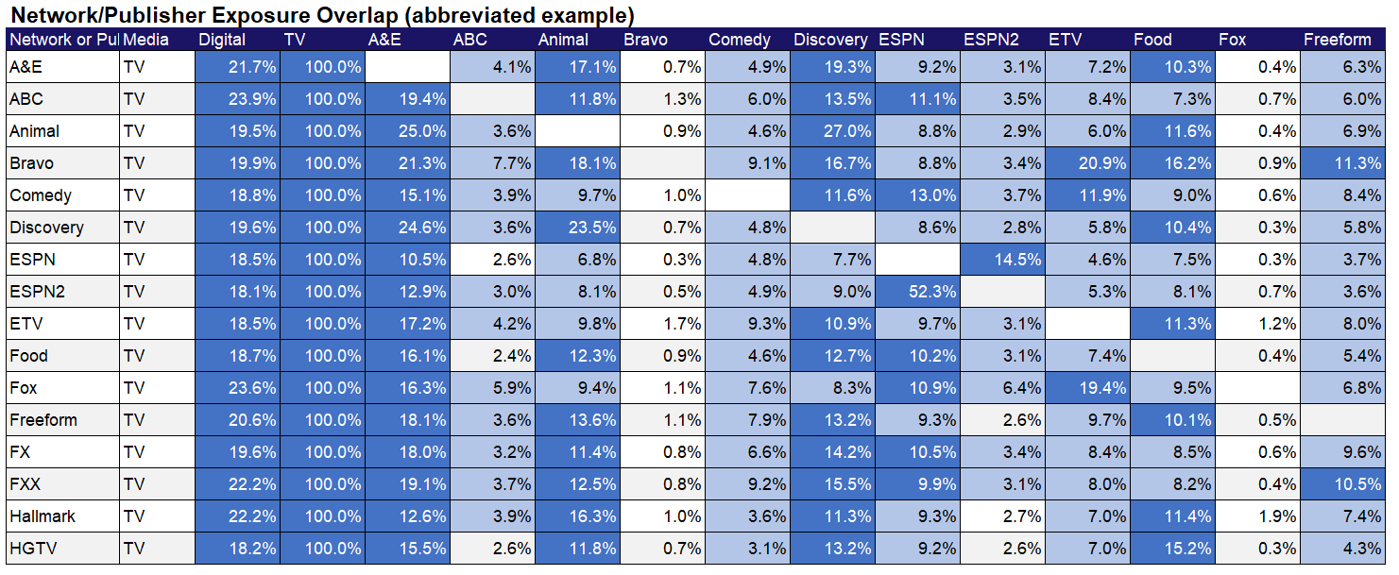
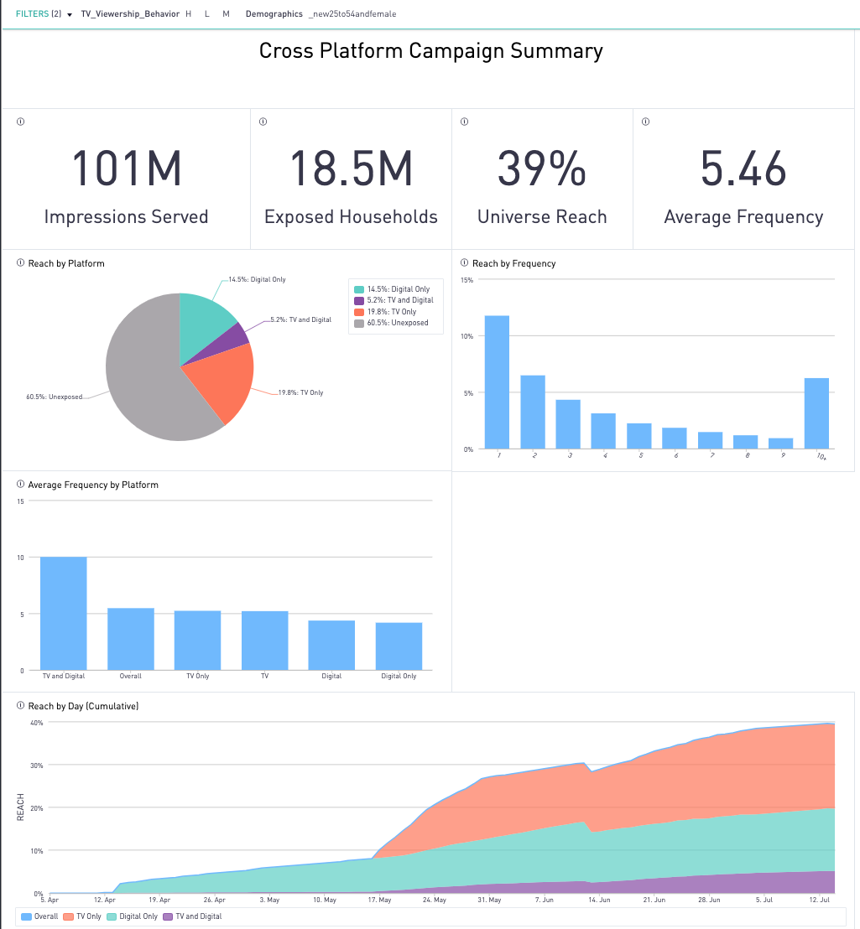
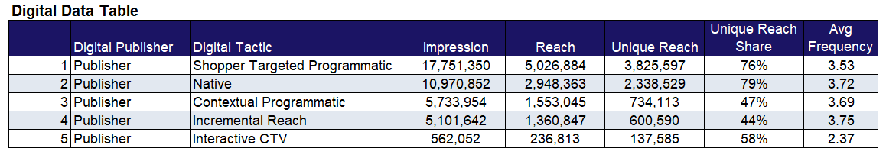
Category:
Home Appliances
Optimization /
Audience Duplication /
Frequency Management /
Convergent TV Interplay
A home appliance manufacturer employed
Samba TV’s deduplicated omniscreen insights
to optimize their publisher selection
Challenge
A major home appliance manufacturer wanted to know whether their Digital Media spend was contributing its “fair share” of impact, and what publishers and tactics were over/under-performing
Audience Measurement Innovation
Samba TV’s True Reach and Frequency (TRF) Measurement provided insights into how the campaign performed across TV and Digital tactics
Target Segment
U.S. households that include female adults
Learnings
Digital-only delivered significant unique reach (14.5%)
Television (5.2) frequency was appropriately balanced vs. Digital (4.4)
Shopper-targeted Programmatic and Native tactics delivered the most significant unique reach
ESPN and HGTV delivered the highest levels of
unique reach
Company / Viewing Source / Media Type
Samba TV / Automated Content Recognition (ACR) / Linear, CTV, Digital (CTV, OLV, Native Display)
Enabled by Samba TV’s True Reach & Frequency Measurement & Dashboards
Source: Samba TV, Home Appliances / Electronics Case Study. Campaign time period: April – July 2021.
This information is exclusively provided to VAB members and qualified marketers. Further distribution is prohibited.
PAGE 20

Slide 21
Considerations as you evaluate and add new solutions to your measurement plans
Research multiple measurement providers
Partner with the appropriate provider(s) whose data capabilities align with your objectives / KPIs
Understand the data sets being used, how they are sourced and what the reporting and outputs are
Ensure the accuracy, validity and transparency
of the datasets
Understand the cross-platform capabilities
of the measurement providers under review
Learn if you can optimize your campaigns based on the data outputs
Know if your precise target audience can be properly measured by the data provider
Ask how timely the campaign metrics / results will be reported
This information is exclusively provided to VAB members and qualified marketers. Further distribution is prohibited.
PAGE 21

Slide 22







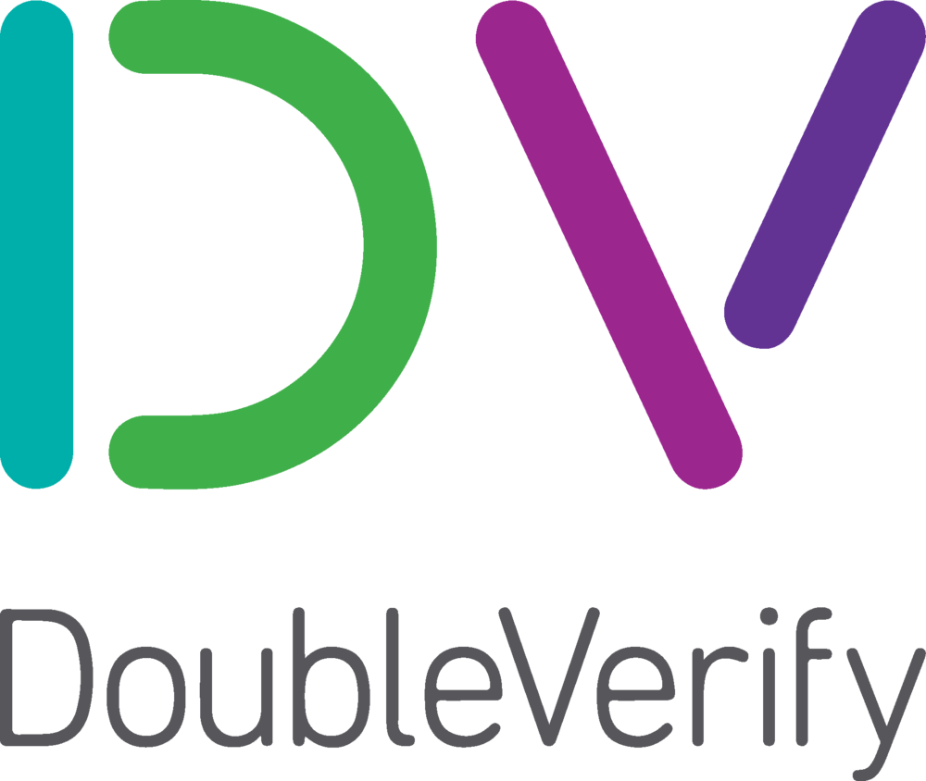








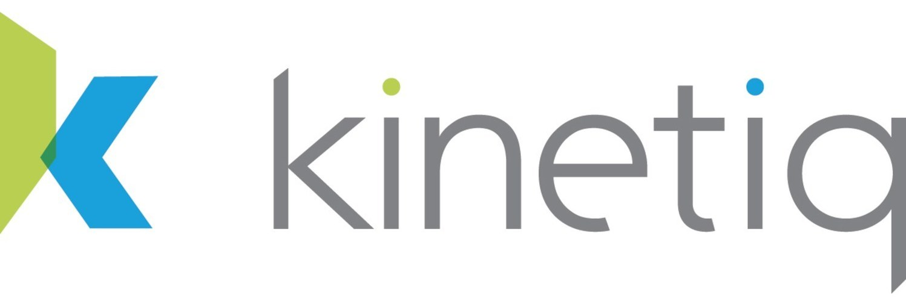


































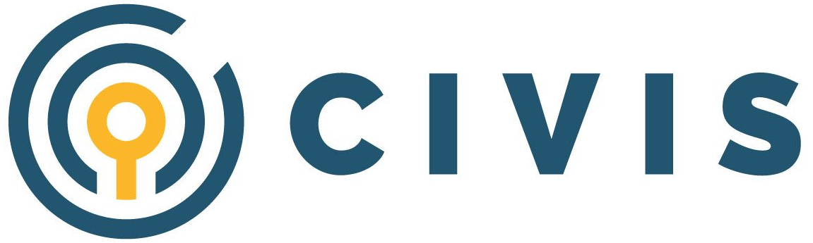









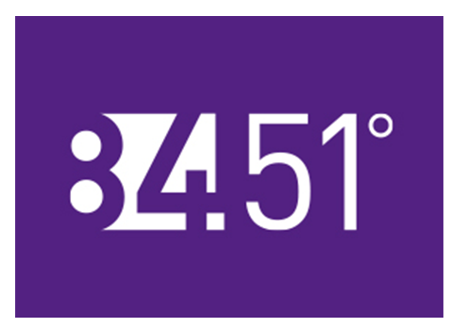
The companies included in this guide are just some of the data providers within the growing measurement ecosystem and we’re excited to bring you more case studies in this series each quarter throughout the year
Awareness
(Audience Measurement)
(Audience Verification)
(Identity Graph)
Consideration
(Brand Health Metrics)
(Creative & Content)
Intent
(Multi-Touch Attribution)
(Online / Offline Conversions)
Sales
(Category Specific)
Note: logos reflect a sampling of companies that provide measurement solutions within each funnel stage and is not meant to be an exhaustive list of all companies with related solutions; companies’ solutions can also cross funnel stages as well.
This information is exclusively provided to VAB members and qualified marketers. Further distribution is prohibited.
PAGE 22

Slide 23

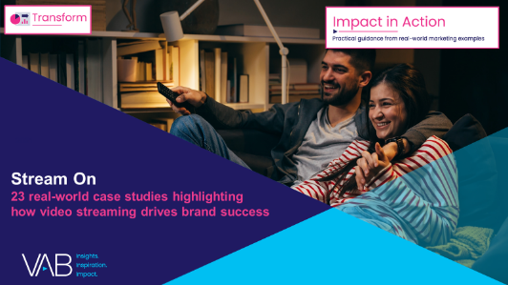

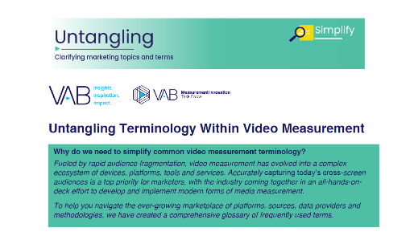
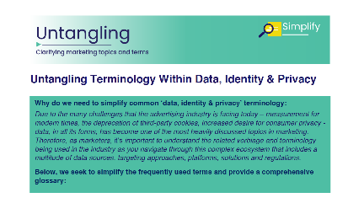





Creators
Jason Wiese
Leah Montner-Dixon
SVP, Director of Strategic Insights
jasonw@thevab.com
Associate Insights Director
leahm@thevab.com
Interested in learning more? Check out this related content:
VAB Members, brand marketers and agencies get free and immediate access to VAB’s content library. Get access at theVAB.com
Stream On
23 Real-World Case Studies Highlighting How Video Streaming Drives Brand Success
Proven Strategies & Tactics In Audience-Based TV Buying
Success Stories Highlighted Through Real-World Case Studies
Untangling Terminology Within Video Measurement
Untangling Terminology Within Data, Identity & Privacy
This information is exclusively provided to VAB members and qualified marketers. Further distribution is prohibited.
PAGE 23

Slide 24


About VAB
VAB is an insights-driven organization that inspires marketers to reimagine their media strategies resulting in fully informed decisions.
Drawing on our marketing expertise, we simplify the complexities in our industry and discover new insights that transform the way marketers look at their media strategy.
We are committed to your business growth and proud to offer VAB members, brand marketers and agencies complimentary access to our continuously-growing Insights library. Get immediate access at theVAB.com.
Curious to learn more about VAB? Check out this quick video to see what we do and how we can help you develop business-driving marketing strategies.
This information is exclusively provided to VAB members and qualified marketers. Further distribution is prohibited.
PAGE 24

