Slide 1

Think Locally:
Understanding Cable TV For The Local Marketplace
Member Center

Slide 2
Program Guide
Summary 3
TV’s Programming Investment 4-6
The Real Scale of MVPDs 7-15
Cable TV’s Audience Advantage 16-24
Cable TV’s Advertising Advantage 25-30
Igniting Today’s Headlines with Cable News 31-38
No Days Off With Live Sports Airing Everyday 39-45
“Live TV” Viewing Drives Social Conversations 46-54
Video On Demand: The Platform For Consumer Choice 55-59
Saying “Yes” To Addressability & Advanced Targeting 60-69
How TV Fuels Business Outcomes 70-77
Contact Information 78
Additional Member Slides 79-84
THINK LOCALLY

Slide 3
Summary
Consumer choice for video has never been higher and with over $225 billion invested in programming over the last five years, multiplatform TV brands are well-positioned as the primary resource to deliver a continuous stream of premium content.
The collective scale of MVPDs and high reach of TV provides both an audience and advertising advantage for cable TV that is unmatched. Among other genres, cable TV is the definitive source for breaking news and impassioned conversation within America’s endless news cycle as well as being the home to countless breathtaking moments in sports that unfold every night.
No longer just a passive viewing experience, the passion that surrounds TV content extends online and drives social conversation virtually every night of the year. In fact, some of the most “talked” about topics on social media revolve around TV programs and characters that people, from Gen Z to Boomers, are watching in real-time and completely immersed by.
Further cable TV capabilities include MVPD Video-On-Demand which offers the ultimate platform for consumer choice with libraries that easily dwarf those of the most popular SVOD services, while addressability provides advanced targeting options that align with matchable subscriber data at the set-top box level.
Most importantly, TV (and cable TV specifically) drives business outcomes. Through several VAB-conducted analyses we’ve seen significant upticks in website traffic, search and social curiosity nearly immediately after an advertiser launches a TV campaign. Of course, the powerful branding and “call-to-action” aspects of television also has the ability to drive brand sales and increase revenues.
Continue reading to learn more about cable TV for local market planning…
Think locally

Slide 4

TV’s Programming Investment

Slide 5
Ad-Supported TV Has Invested $225 Billion In Premium Content Over The Last 5 Years With Cable Leading The Charge
Programming Expenses
($Billions)
$57.4
$52.8
$53.8
$47.9
$49.2
$43.6
$44.9
$39.5
THINK LOCALLY
Source: SNL Kagan 2017

Slide 6
$225 Billion Has Fueled A Wealth of New Content –
Original Cable Programming Has Increased 68% Across Major Genres
Genre | # Originals/Jan’08 | # Originals/Jan’18
Drama | 57 | 230
Children | 141 | 179
Comedy | 51 | 157
General Documentary | 488 | 938
Instruction/ Advice | 373 | 298
Sports | 339 | 629
THINK LOCALLY
Source: Nielsen NPOWER program level Live; Ad-Supported Cable, Total Day, January ‘08 vs. January ‘18

Slide 7
The Real Scale of MVPDs

Slide 8
The Vast Majority of US Households, Nearly 100 Million, Subscribe To A Cable, Satellite, Or Telco Service
Cable+ Households
(000)
85%
of Total TV HHs
84%
of Total TV HHs
83%
of Total TV HHs
Cable+: A household that subscribes to Wired cable, Telco or Satellite service
THINK LOCALLY
Source: Nielsen Total Audience Report, Q2 ’17, Q4 ‘16, Q4 ’15. In Q2 ‘17, Nielsen changed its terminology for this analysis from “cable+” to “Total Multichannel.”

Slide 9
Over the Past 5 Years, Cable+ Has Remained Largely Unchanged
Contrary to the hype, last year Cable+ households declined by less than 1%
Cable+ Household Trend
(000)
vs. Year Prior
- 0.4%
- 1.8%
- 1.5%
- 0.7%
- 0.9%
THINK LOCALLY
Source: Nielsen Total Audience Report, Q2 ‘17, Q4 ‘16, Q4 ‘15, Q4 ‘14, Q4 ’13; Cable+ = Wired Cable, Telco, Satellite. In Q2 ‘17, Nielsen changed its terminology for this analysis from “cable+” to “Total Multichannel.”

Slide 10
The Majority Of Homes With Broadband Access Subscribe to A Cable, Satellite or Telco Provider
Most homes subscribe to triple-play bundles offering deals on phone, internet, and cable
Provider Type With Internet Access, Q2 2017
Households (%)
4%
16%
83%
Source: Nielsen Total Audience Report, Q2 ‘17, Total Multichannel includes wired cable, telco, satellite and virtual providers.
Broadband Only: A HH with at least one operable TV/monitor that receives video exclusively through a broadband internet connection instead of a traditional means (over the air, wired cable, telco, satellite). Broadcast Only: A mode of television content delivery that does not involve satellite transmission or cables (i.e. a paid service). Also commonly referred to as “over the air”

Slide 11
Although The Number Has Risen, Broadband Only Represents 4.8% Of All U.S. Households
THINK LOCALLY
Source: Nielsen Total Audience Report, Q4 ’14, Q4 ‘15, Q4 ’16, Q1 ‘17

Slide 12
If They Had Their Choice (If Cost Weren’t A Factor), 80% Of Cord Cutters/Nevers Would Prefer An MVPD Subscription
Indicates their preference for both the content they want and how it’s delivered
Almost one-quarter (22%) of Cord Nevers intend to subscribe to a traditional TV service in the next 6 months, reflective of Millennials aging out of income constraints
THINK LOCALLY
Source: SNL Kagan, 2015 S&P Global Market Intelligence; GFK MRI “Cord Evolution” 4/24/17

Slide 13



Although Millennials Have The Highest Likelihood To Be “Cord Nevers,” Most Plug Into Cable As Their Age And Income Increase
Cable Penetration by Millennial Life Stage
84%
71%
51%
Reliant
(living with a parent)
Self-Sufficient
(living on their own)
Budding Home With child
(married with children)
“A quarter (27%) of Millennial Cord Nevers say they intend to subscribe to a traditional TV service in the next 6 months – once they are better able to afford it and for the ability to channel surf”*
THINK LOCALLY
Source: MRI Doublebase 2017, cable= defined as cable tv service watched past week; reliant = respondent A18-34 lives with one or more parent; self-sufficient A18-34 lives in one person HH; Budding home= A18-34, married with kids at home; * GFK, MRI Cord Evolution 2017

Slide 14
Cord Cutters & Nevers Tend to Be Less Educated and More Likely To Work Part-Time
Cutters/Nevers tend to cluster at the lowest end of the educational levels. Nearly half have only a high school education or less
They are more likely to be employed part time, largely reflective of school-age Gen Z/ Millennials and retired Boomers
THINK LOCALLY
Source: 2016 MRI Gfk Doublebase; Target group defined as Household that does not subscribe to Cable, Satellite or Fiber Optic TV; Index is vs. Base of Adults A18+

Slide 15
Cord Cutters & Nevers Also Sit Lower On The Income Scale
Cord Cutters
Average Household Income - $52k
(% & Index vs. HHs)*
Cord Nevers
Average Household Income - $41k
(% & Index vs. HHs)*
THINK LOCALLY
Source: SNL Kagan, 2017 S&P Global Market Intelligence, 2017 cord cutter and cord never updates, May 2017; Gfk MRI “Cord Evolution”, 4/24/17; *Index is vs. total % of US HH in that HHI bracket

Slide 16
Cable TV’s Audience Advantage

Slide 17
Among The Adult Population, TV Continues To Have The Highest Reach Across All Devices
YOY Diff %
+1%
+2%
+5%
-1%
-3%
+13%
-5%
-1%
THINK LOCALLY
Source: VAB analysis of Nielsen Total Audience Report 2Q 2017, percentage of users among U.S. population, P18+. “YOY Diff %” reflects the YOY percentage point difference, i.e., Live + DVR/Time-Shifted TV increased one percentage point from 93% to 94%.

Slide 18
TV Also Has A Clear Cut “Time Spent” Advantage Even With The Double Digit Increases In Video Usage On Mobile Devices
YOY Diff %
-5%
+34%
+93%
-9%
+41%
-6%
-1%
+4%
THINK LOCALLY
Source: VAB analysis of Nielsen Total Audience Report 2Q 2017, minutes among users, P18+.

Slide 19
In Any Given Minute, Television’s Audience Far Surpasses That Of Any Other Device For Any Activity
PC
Smartphone
Tablet
THINK LOCALLY
Source: Nielsen Comparable Metrics Report Q2 2017; Data based on average week between March 27, 2017 – June 25, 2017. A18+ UE = 245,740,000. Video, Streaming Audio & Social Network is a subset of each device’s (App+Web)

Slide 20
TV’s Average Audience Among Millennials Surpasses Any Other Device For Video Consumption
PC
Smartphone
Tablet
THINK LOCALLY
Source: Nielsen Comparable Metrics Report Q2 2017; Data based on average week between March 27, 2017 – June 25, 2017. A18-34 UE = 73,460,000. Video, Streaming Audio & Social Network is a subset of each device’s (App+Web)

Slide 21
Overall, Households Spend More Time With Ad-Supported Cable TV Than Broadcast TV Throughout The Year
THINK LOCALLY
Source: VAB analysis of Nielsen Npower PowerPlay Report, Household, Total Day, Live. The figures in the above chart are rounded off to the nearest hour.

Slide 22
Within The Household, P18-34 Spend More Than Twice The Amount Of Time With Ad-Supported Cable TV Than Broadcast TV
THINK LOCALLY
Source: VAB analysis of Nielsen Npower PowerPlay Report, P18-34, Total Day, Live. The figures in the above chart are rounded off to the nearest hour.

Slide 23
Over The Year, P25-54 Also Spend More Than Double The Time With Ad-Supported Cable TV As They Do With Broadcast TV
THINK LOCALLY
Source: VAB analysis of Nielsen Npower PowerPlay Report, P25-54, Total Day, Live. The figures in the above chart are rounded off to the nearest hour.

Slide 24
In Any Given Minute, Ad-Supported Cable TV’s Average Audience Is Greater Than Broadcast TV In Each Key Demographic
How to read: in any given minute, 76% of the average P18-24 audience that’s watching ad-supported TV is watching cable TV
THINK LOCALLY
Source: VAB analysis of Nielsen Npower R&F Time Period Report, December 2017, Live+7

Slide 25
Cable TV’s Advertising Advantage

Slide 26
Ad-Supported Cable TV Owns A Majority Of The Commercial TV Inventory
On average, 74% of P18+ commercial GRPs reside on ad-supported cable TV across total day
% of P18+ GRPs By Daypart
December '17
THINK LOCALLY
Source: VAB Analysis of Nielsen Ad Intel data, reflects calendar month of December 2017 (1-31). P18+, C3 stream, GRPs are equivalized, “national” market. GRPs include direct response and local avails activity. Daypart definitions: Morning (M-Su 6a-9a), Daytime (M-Su 9a-4:30p), Early Fringe (M-Su 4:30p-7p), Prime Access (M-Sa 7p-8p), Prime (M-Sa 8p-11p; Su 7p-11p), Late News (M-Su 11p-11:30p), Late Fringe (M-Su 11:30-1a), Overnight (M-Su 1a-6a).

Slide 27
Ad-Supported Cable TV Advertising Inventory Is Prevalent Throughout The Day, Not Just Primetime
% Share of Total Ad-Supported Cable TV P18+ GRPs By Daypart
December '17
THINK LOCALLY
Source: VAB Analysis of Nielsen Ad Intel data, reflects calendar month of December 2017 (1-31). P18+, C3 stream, GRPs are equivalized, “national” market. GRPs include direct response and local avails activity. Daypart definitions: Morning (M-Su 6a-9a), Daytime (M-Su 9a-4:30p), Early Fringe (M-Su 4:30p-7p), Prime Access (M-Sa 7p-8p), Prime (M-Sa 8p-11p; Su 7p-11p), Late News (M-Su 11p-11:30p), Late Fringe (M-Su 11:30-1a), Overnight (M-Su 1a-6a).

Slide 28
Over The Last 10 Years, Ad-Supported Cable TV Has Seen An Increase In Eyeballs Against Advertisers’ Commercial Messaging
Ad-Supported Cable TV Average: A18+ GRPs
Month of December
‘07 vs ‘17
Daypart | 2007 | 2017
Total Day | 216,201 | 231,699
Morning | 11,364 | 15,128
Daytime | 62,587 | 68,245
Early Fringe | 27,692 | 29,640
Prime Access | 11,357 | 11,625
Prime | 53,015 | 54,294
Late News | 6,426 | 6,368
Late Fringe | 17,597 | 17,404
Overnight | 26,163 | 28,993
Change | % Change
+15,497 | +7%
+3,764 | +33%
+5,658 | +9%
+1,948 | +7%
+268 | +2%
+1,280 | +2%
-58 | -1%
-193 | -1%
+2,830 | +11%
THINK LOCALLY
Source: VAB Analysis of Nielsen Ad Intel data, reflects calendar month of December (1-31). P18+, C3 stream, GRPs are equivalized, “national” market. GRPs include direct response and local avails activity. Daypart definitions: Morning (M-Su 6a-9a), Daytime (M-Su 9a-4:30p), Early Fringe (M-Su 4:30p-7p), Prime Access (M-Sa 7p-8p), Prime (M-Sa 8p-11p; Su 7p-11p), Late News (M-Su 11p-11:30p), Late Fringe (M-Su 11:30-1a), Overnight (M-Su 1a-6a)

Slide 29
In Contrast, Local Broadcast TV Dayparts Have Suffered Double-Digit Decreases Over The Same Time Period
“All Measured DMAs” Average: Local Broadcast A18+ GRPs
Month of December
‘07 vs ‘17
Daypart | 2007 | 2017
Total Day | 59,306 | 51,668
Morning | 8,593 | 8,705
Daytime | 13,097 | 11,545
Early Fringe | 13,020 | 10,771
Prime Access | 7,431 | 6,288
Prime | 8,325 | 6,979
Late News | 4,071 | 2,971
Late Fringe | 3,171 | 2,675
Overnight | 1,598 | 1,734
Change | % Change
-7,639 | -13%
+112 | +1%
-1,552 | -12%
-2,249 | -17%
-1,143 | -15%
-1,345 | -16%
-1,100 | -27%
-497 | -16%
+135 | +8%
THINK LOCALLY
Source: VAB Analysis of Nielsen Ad Intel data, reflects calendar month of December (1-31). GRPs are equivilized. Local Broadcast Station Affiliates: ABC, CBS, NBC, FOX. Daypart definitions: Morning (M-Su 6a-9a), Daytime (M-Su 9a-4:30p), Early Fringe (M-Su 4:30p-7p), Prime Access (M-Sa 7p-8p), Prime (M-Sa 8p-11p; Su 7p-11p), Late News (M-Su 11p-11:30p), Late Fringe (M-Su 11:30-1a), Overnight (M-Su 1a-6a)

Slide 30
These Decreases Are Slightly More Pronounced Across Local Dayparts Within The Top 20 DMAs As Well
Top 20 Market Average: Local Broadcast A18+ GRPs
Month of December
‘07 vs ‘17
Daypart | 2007 | 2017
Total Day | 77,398 | 65,505
Morning | 11,283 | 9,626
Daytime | 18,212 | 15,332
Early Fringe | 15,555 | 12,565
Prime Access | 7,342 | 6,390
Prime | 11,868 | 10,821
Late News | 4,938 | 3,633
Late Fringe | 5,065 | 4,274
Overnight | 3,135 | 2,864
Change | % Change
-11,893 | -15%
-1,657 | -15%
-2,880 | -16%
-2,990 | -19%
-952 | -13%
-1,047 | -9%
-1,305 | -26%
-792 | -16%
-271 | -9%
Source: VAB Analysis of Nielsen Ad Intel data, reflects calendar month of December (1-31). GRPs are equivilized. Local Broadcast Station Affiliates: ABC, CBS, NBC, FOX. DMAs include: Atlanta, Boston, Chicago, Cleveland-Akron, Dallas-Ft. Worth, Denver, Detroit, Houston, Los Angeles, Miami-Ft. Lauderdale, Minneapolis-St. Paul, New York, Orlando, Philadelphia, Phoenix, Sacramento, San Francisco, Seattle-Tacoma, Tampa, Washington, DC. Daypart definitions: Morning (M-Su 6a-9a), Daytime (M-Su 9a-4:30p), Early Fringe (M-Su 4:30p-7p), Prime Access (M-Sa 7p-8p), Prime (M-Sa 8p-11p; Su 7p-11p), Late News (M-Su 11p-11:30p), Late Fringe (M-Su 11:30-1a), Overnight (M-Su 1a-6a)

Slide 31
Igniting Today’s Headlines:
Cable News Continues To Spark Ratings

Slide 32
TV Continues To Be The Most Widely Used Platform For Adults To Get Their News
THINK LOCALLY
Source: Pew Research Center “The Modern News Consumer,” released 7/7/16 with survey conducted Jan 12 – Feb 8, 2016 among 4,654 US adults 18+. “TV” includes cable, local, nightly network while “Online” includes social media, websites/apps.

Slide 33
TV Accounts For 91% Of The Total Time Spent Consuming News On Video-Enabled Devices
TV includes National Broadcast TV News, Local Broadcast TV News & National Cable TV News
Source: Nielsen Total Audience Report Q4 2016 – Adults 18+. National TV News (Nielsen National Television Panel, News summary type code, Broadcast – ABC, CBS, FOX, NBC, TEL, UNI; Cable – CNBC, CNN, FOXNC, MSNBC); Local TV News (Nielsen 25 LPM Markets, Local news genre, Broadcast – ABC, CBS, FOX, NBC, TEL, UNI); PC News (Netview, Current Events & Global News subcategory): Smartphone News (EMM, Current Events & Global News subcategory). Local Cable TV News data is not available within the report.

Slide 34
With Everchanging Updates To Current Events, News Remains Almost Exclusively A “Live” Or “Near Live” Viewing Experience
93% of total viewing of news programming was live
National TV News Programming: Viewership By Stream
% of Total Viewing Hours in Q4 2017
THINK LOCALLY
Source: Nielsen NPower R&F Program Report, Total Day, Live+7; P2+, P25-54 & P18-34; ad-supported cable TV + broadcast TV, based on Q4 2017 and reflects news category genre.

Slide 35
The Largest Growth In TV News Is With Cable Which Now Commands More Viewer Time Than Local Broadcast News
Average Weekly Time Spent With News In LPM Markets (Adults 18+)
(Hr:Min)
+94%
vs. ‘15
-1%
vs. ‘15
THINK LOCALLY
Source: Nielsen Local TV View, 2015 – Q1 2017. Time Spent based on population across Local People Meter markets. LPM = Local People Meter

Slide 36
Cable TV News Has A More Dual Audience Than The
Female-Skewing Local Broadcast News
THINK LOCALLY
Source: Nielsen Local TV View Q1 2017, data based on population across Local People Meter Markets, P18+. Local Cable TV News data is not available within the report.

Slide 37
Cable News Viewers Have Higher Incomes Than Other News Viewers
THINK LOCALLY
Source: Nielsen Local TV View Q1 2017, data based on population across Local People Meter Markets, P18+. Local Cable TV News data is not available within the report. Sums may not equal 100% due to rounding.

Slide 38
The Top 20 Markets Have Lost Almost 20% Of Their Local Broadcast GRPs Within “News-Focused” Dayparts Over The Last 10 Years
Top 20 Market Average: Local Broadcast A18+ GRPs
Month of December
‘07 vs ‘17
Daypart | 2007 | 2017
“News-Focused” Dayparts Total | 31,776 | 25,824
Morning | 11,283 | 9,626
Early Fringe | 15,555 | 12,565
Late News | 4,938 | 3,633
Change | % Change
-5,952 | -19%
-1,657 | -15%
-2,990 | -19%
-1,305 | -26%
Source: VAB Analysis of Nielsen Ad Intel data, reflects calendar month of December (1-31). GRPs are equivilized. Local Broadcast Station Affiliates: ABC, CBS, NBC, FOX. DMAs include: Atlanta, Boston, Chicago, Cleveland-Akron, Dallas-Ft. Worth, Denver, Detroit, Houston, Los Angeles, Miami-Ft. Lauderdale, Minneapolis-St. Paul, New York, Orlando, Philadelphia, Phoenix, Sacramento, San Francisco, Seattle-Tacoma, Tampa, Washington, DC. Daypart definitions: Morning (M-Su 6a-9a), Daytime (M-Su 9a-4:30p), Early Fringe (M-Su 4:30p-7p), Prime Access (M-Sa 7p-8p), Prime (M-Sa 8p-11p; Su 7p-11p), Late News (M-Su 11p-11:30p), Late Fringe (M-Su 11:30-1a), Overnight (M-Su 1a-6a)

Slide 39
No Days Off:
Live Sports Airing Everyday

Slide 40
TV Networks Are Projected To Spend Over $25 Billion Annually On Sports Programming By 2020; A 29% Increase From 2016
Collectively, Regional Sports Networks are projected to spend almost $1 billion more annually in sports programming by 2020
RSN Sports Costs
$3,942.0
$4,921.3
THINK LOCALLY
Source: SNL Kagan, 2017: programming cost estimates reflect ad-supported cable TV, broadcast TV & RSNs

Slide 41
Over 12,000 Live Sporting Events Are Shown On Ad-Supported TV Annually, With 89% Of Them Airing On Cable TV
THINK LOCALLY
Source: Nielsen NPower, Total Day, live originals only, January 1, 2017 – December 31, 2017; excludes Regional Sports Networks, local broadcast airings and digital airings of sports through MVPD / network TV apps.

Slide 42
There Are At Least Two Live Sporting Events Airing Every Single Day Of The Year On Ad-Supported Cable TV
A live sporting event aired on ad-supported cable TV every day (365 days) in 2017.
How to read: In 2017, 6 days featured between 2-9 live sporting events airing on ad-supported cable TV.
THINK LOCALLY
Source: Nielsen NPower, Total Day, live originals only, January 1, 2017 – December 31, 2017; excludes Regional Sports Networks, local broadcast airings and digital airings of sports through MVPD / network TV apps.

Slide 43
In Fact, On Average There Are At Least Seventeen Live Sporting Events Airing On Cable TV Each Day Throughout The Year
Average # of Live Sporting Events Each Day
2017
66
45
37
26
28
23
18
THINK LOCALLY
Source: Nielsen NPower, Total Day, live originals only, January 1, 2017 – December 31, 2017; excludes Regional Sports Networks, local broadcast airings and digital airings of sports through MVPD / network TV apps.

Slide 44
Even With The Increase In DVR Penetration, Sports Remains Almost Exclusively A “Live” Or “Near Live” Viewing Experience
Sports-Related National TV Programming: Viewership By Stream
% of Total Viewing Hours
P2+
P18-34
THINK LOCALLY
Source: Nielsen NPower R&F Program Report, Total Day, P2+ & P18-34, ad-supported cable TV + broadcast TV, based on calendar year; excludes Regional Sports Networks and local broadcast airings. Sports-related programming includes live sports, sports news, sports commentary, etc.

Slide 45
Within The Digital Realm, A Vast Majority Of Time Spent Online With Sports Content Is Through TV-Branded Platforms
Sports Category: % of Total Minutes Viewed Online
2017
P2+
P18-34
Note: “All The Rest” reflects non-premium TV-related websites like USA Today Sports, SB Nation, Scout.com, Reddit Sports, Deadspin.com, Big Lead Sports, etc
THINK LOCALLY
Source: comScore MediaMetrix, multiplatform media trend data, January-December 2017; comScore-defined sports category vs. custom created Sports TV Branded Website subcategory which includes digital platforms such as ESPN.com, Fox Sports, CBS Sports & NBC Sports.

Slide 46
“Live TV” Viewing Drives Online Social Conversations

Slide 47
The Vast Majority Of TV Viewing Across All Major Demos Is Done “Live”
“Live” vs. “Time-Shifted” Viewing Share
2Q ‘17 (Total Day)
THINK LOCALLY
Source: VAB analysis of Nielsen Total Audience Report 2Q 2017, Total Day, based on average quarterly time spent.

Slide 48
Cable Has A Higher Share Of Live Viewing As A Percent
Of Overall Time Spent During Primetime
“Live” vs. “Time-Shifted” Viewing Share
2Q ‘17 (Primetime)
P18+
P18-34
P18-49
P25-54
THINK LOCALLY
Source: VAB analysis of Nielsen NPower Time Period Report, 2Q 2017, Primetime, based on average quarterly time spent, Live vs. Live+7.

Slide 49
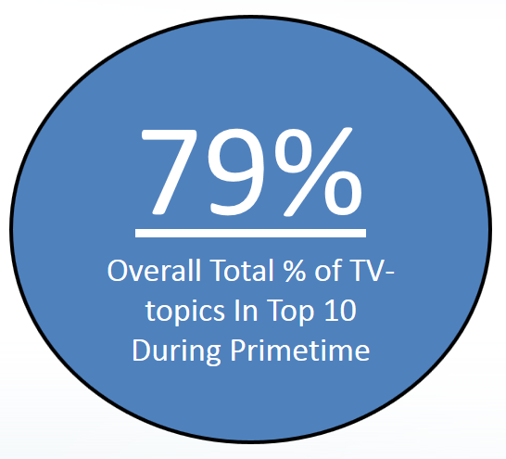
Ad-Supported TV Accounts For Nearly 8 Of The Top 10 Trending Twitter Topics At Night In The Fall Between October & November
Even though this analysis was done during the lead-up to the 2016 election, a time of heavy political discussion across the U.S., ad-supported TV dominated the top conversations on Twitter
8:15p
Total % of
TV-topics In Top 10: 64%
9:15p
Total % of
TV-topics In Top 10: 79%
10:15p
Total % of
TV-topics In Top 10: 85%
11:15p
Total % of
TV-topics In Top 10: 88%
THINK LOCALLY
49
Source: VAB custom analysis of Top 10 trending Twitter Topics each night (8:15p, 9:15p, 10:15p, 11:15p) aggregated during 4-week time period (10/10-2016 – 11/6/2016).
Results include both “direct” and “related” TV topics.

Slide 50
Ad-Supported TV Accounted For Nearly 7 Of The Top 10 Trending Twitter Topics At Night In The Summer Between May & June
67%
Overall Total % of TV-topics in Top 10 During Primetime
Although this analysis was conducted as the summer season was getting underway between May-June,
ad-supported TV continued to dominate the top social conversations on Twitter
8:30p
Total % of
TV-topics In Top 10: 50%
9:30p
Total % of
TV-topics In Top 10: 70%
10:30p
Total % of
TV-topics In Top 10: 76%
11:30p
Total % of
TV-topics In Top 10: 72%
THINK LOCALLY
Source: VAB custom analysis of Top 10 trending Twitter Topics each night (8:30p, 9:30p, 10:30p, 11:30p) aggregated during 4-week time period (5/15/2017 – 6/11/2017).
Results include both “direct” and “related” TV topics.

Slide 51
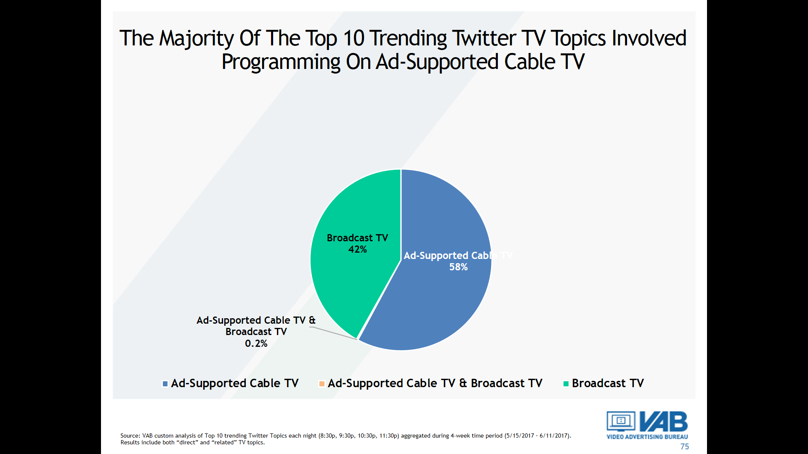
Typically, The Majority Of The Top 10 Trending Twitter TV Topics Involve Programming On Ad-Supported Cable TV
Four-Week Time Periods
% Breakout of Ad-Supported TV Topics By Medium
Oct-Nov ‘16
May-June ‘17
*Ad-Supported Cable TV & Broadcast TV includes programs or topics that aired, or were discussed, on multiple networks such as popular news or sports events.
Source: VAB custom analysis of Top 10 trending Twitter Topics each night (8:15p, 9:15p, 10:15p, 11:15p) aggregated during 4-week time period (10/10-2016 – 11/6/2016) & each night (8:30p, 9:30p, 10:30p, 11:30p) aggregated during 4-week time period (5/15/2017 – 6/11/2017) . Results include both “direct” and “related” TV topics.

Slide 52
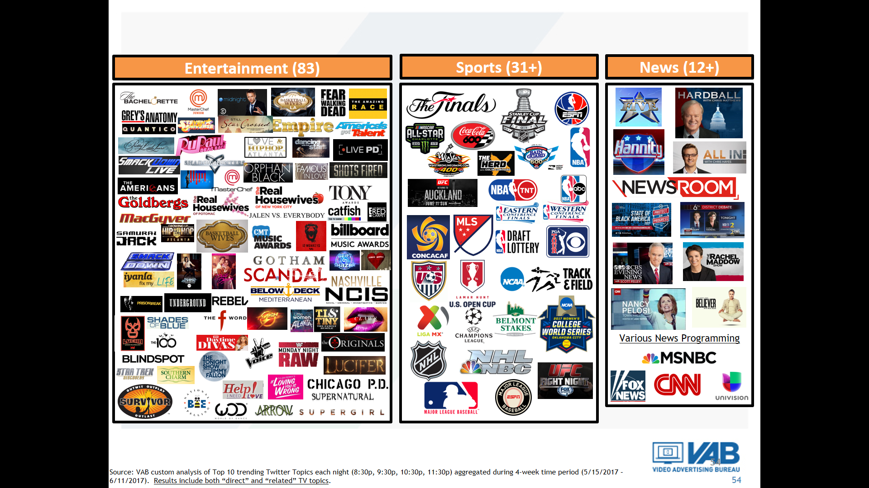
Over 125 TV Programs Trended In The Top 10 During The
Four Week Time Period Over The Summer
THINK LOCALLY
Source: VAB custom analysis of Top 10 trending Twitter Topics each night (8:30p, 9:30p, 10:30p, 11:30p) during 4-week time period (5/15/2017 – 6/11/2017). Results include both “direct” and “related” TV topics.

Slide 53



Ad-Supported TV Even Dominate Twitter’s Top 10 Trending Topics On Key Holidays During The 4th Quarter
75% of the aggregated top 10 trending topics across the five monitored holiday time periods were ad-supported TV-related topics
Thanksgiving Day
(11:45a-11:45p)
Christmas Eve
(8:45p-11:45p)
Christmas Day
(11:45a-11:45p)
New Year’s Eve
(8:45p-11:45p)
New Year’s Day
(8:45p-11:45p)
75%
75%
73%
78%
75%
% of Overall Top 10 Trending Topics on Twitter that were
ad-supported TV-related during each measurement time period
THINK LOCALLY
Source: VAB custom analysis of Top 10 trending Twitter Topics (United States) each night on the :45’s aggregated over each hour between 11a – 11p (11:45a-11:45p) during 11/23/2017, 12/25/17, 1/1/18 and on the :45’s of each primetime hour between 8p-11p (8:45p-11:45p) during 12/24/17 & 12/31/17.

Slide 54
During The Holidays, Just Like The Rest Of The Year, Nothing Else Gets People Talking Online Like Ad-Supported TV Programs
Five-Holiday Monitored Time Period
# of Top 10 Trending Programs / Content By Platform
(“Logan Paul” –
controversy surrounding “suicide forest” video)
(“Dedication 6” –
Lil Wayne released a new mixtape on Christmas)
(“Calvin” –
Calvin Johnson glitch in the Madden ‘18 Ultimate Team EA Sports Game)
(“MST3KTurkeyDay” –
MST3K marathon on Shout! Factory TV, Twitch, Pluto TV)
THINK LOCALLY
Source: VAB custom analysis of Top 10 trending Twitter Topics (United States) each night on the :45’s of each hour between 11a – 11p (11:45a-11:45p) during 11/23/2017, 12/25/17, 1/1/18 and on the :45’s of each primetime hour between 8p-11p (8:45p-11:45p) during 12/24/17 & 12/31/17.

Slide 55
Video On Demand:
The Ultimate Platform For Consumer Choice

Slide 56
MVPD VOD Users Tend To Be Younger, More Educated And Affluent
Watched Movies or TV Shows on VOD
Age
HHI
109 index vs. avg pop
33%
46%
$100K+
153 index vs. avg pop
Education
Ethnicity
49%
College & More
125 index vs. avg pop
THINK LOCALLY
Source: 2017 GfK MRI Doublebase, “Video-On-Demand # of Times Watched Past 30 days-TV/Shows/Movies (Any).” Base= A18+

Slide 57
Almost 75 Million Consumers Have Access To MVPD VOD
74,552,000
THINK LOCALLY
Source: Nielsen VOD penetration; January of each year, MVPD VOD.

Slide 58
MVPD VOD Libraries Have Been Rapidly Expanding To Meet The Desires Of Consumers Searching For Content At Any Time
THINK LOCALLY
Source: SNL Kagan Multichannel Market Trends; Count represents avg monthly selection, reflecting turnover and refreshed content and are not comparable to average titles available simultaneously. 2/17

Slide 59
In Fact, MVPD VOD Catalogues Easily Dwarf The Limited Libraries Of The Three Major SVOD Services
With something available on-demand for everyone, MVPD’s content variety truly is unmatched and only continues to grow
(Netflix, Hulu, Amazon)
Source: VAB analysis of SNL Kagan February 2018 data estimates (MVPD catalogs reflect cable and telco MVPDs, excludes satellite MVPDs) for end of year 2017, title counts represent reported average monthly selections at year end unless noted as an estimate, counts reflect turnover and refreshed content and are not comparable to average titles available simultaneously. SVOD data represents the latest month with available data in 2017: Netflix (May), Hulu (September) & Amazon (November). 2018 S&P Global Market Intelligence.

Slide 60
Saying “Yes” To Addressability:
Capitalizing On Cable TV’s Advanced Targeting Capabilities

Slide 61
Addressable TV’s Precision Targeting Delivers Unrivaled Relevancy For Advertisers
What Is Addressable TV?
The ability of an advertiser to deliver household-level TV advertising via the set-top box based on a defined audience-target developed through first-, second-, and/or third-party data. Under this method, the advertiser buys the audience and not specific networks or programs.
Addressable TV is a means of delivering the right ad to the right person by combining the unmatched reach of Television with the targeting precision and measurement capabilities of “one-to-one” marketing.
THINK LOCALLY

Slide 62
Approximately 64 Million U.S. Households Have Addressable TV Capabilities
As of early 2018, there are 64MM addressable TV HHs across the U.S., representing more than 54% of TV HHs
Addressable TV
AT&T / DIRECTV
DISH
Charter*
Altice
Comcast
Cox*
Verizon
*VOD / TV Everywhere app only
THINK LOCALLY
Source: IAB Advanced TV Targeting Primer based on TV provider shared data updated as of February 2018.

Slide 63
At 64MM HHs, Addressable TV Has A Larger Footprint Than Netflix & Other Popular Subscription Platforms
Source: Addressable TV HHs - IAB Advanced TV Targeting Primer based on TV provider shared data updated as of February 2018. Netflix – company financial reports for Dec ‘17. Spotify – March ‘17 data from SNL Kagan. Amazon Prime – Q4 ‘16 data from SNL Kagan published March ‘17; Amazon Prime Video users estimated based on SNL Kagan’s Feb ‘16 online consumer survey (72% of Prime subscribers use Prime video). HBO – Q2 ‘17 data from SNL Kagan (includes cable, DBS, Telco & OTT). SiriusXM – estimated based on SNL Kagan Dec ‘16 data. Roku – Nov ‘17 data from SNL Kagan (Roku defines active accounts as the number of distinct user accounts that have streamed content on the platform in the last 30 days). Hulu – paid subscribers only, Q1 ‘17 data from SNL Kagan published June ‘17. Sling TV – Q4 ‘17 data published by TechCrunch 2/20/18.

Slide 64
By The End of 2019, Addressable Is Expected To Grow To A
$3 Billion Segment Of TV Advertising
Addressable TV is projected to grow 642% over a three year period
THINK LOCALLY
Source: eMarketer, July 2017. Note: targeted TV ads delivered on a home-by-home basis via cable and satellite boxes; includes VOD; excludes connected TV, smart TV and OTT

Slide 65
Right Ads Reaching The Right People: The Benefits of Addressable TV
Major benefits of Addressable TV:
Precision
Goes beyond the traditional Nielsen demographics of age and sex to develop more precise targets based on granular demographics, geography, transactional / consumption & behavioral activities
Customized Creative / Tracking
Ability to develop creative for different target segments then learn which HHs respond to which message in order to craft future messages in a more personal & relevant way
Relevancy
Reduction of non-targeted ad impressions by eliminating ads seen by viewers who are unlikely to take action on an advertiser’s product or service while also allowing advertisers to frequency cap to avoid message wear-out
ROI Measurement & Testing
In-depth post-campaign reporting with attribution tracking through media partners and third-party data providers
THINK LOCALLY
Source: Based on a survey of media buyers and product marketers conducted by Adweek Brandshare on behalf of AT&T AdWorks. All 158 respondents had oversight of or involvement in purchasing advertising or media or were involved in marketing a specific product or service. All respondents were located in the U.S.

Slide 66
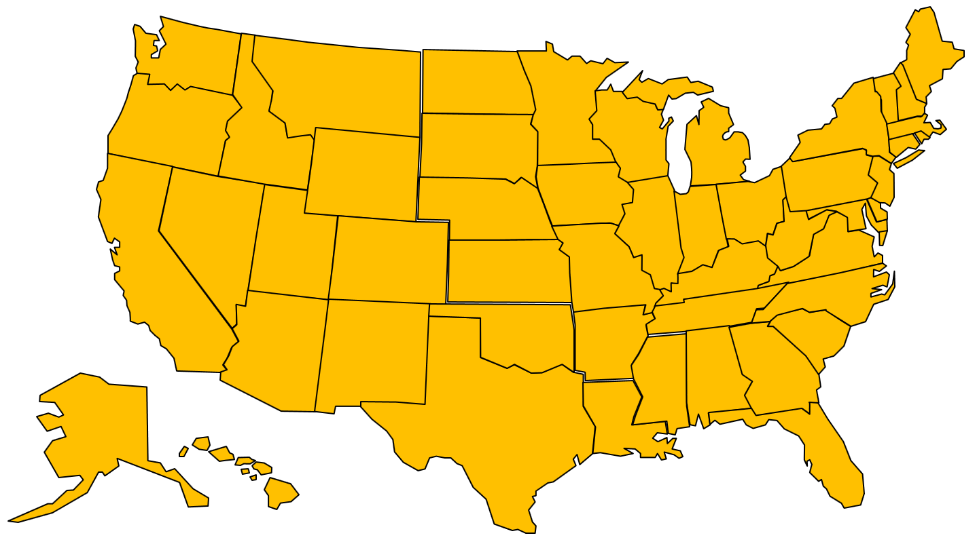

How Addressable TV Works
Addressable TV is not as complex as you might think; sophistication doesn’t have to mean difficult
5
Analyze
1
Nielsen Catalina
CPG
Results:
-Brand Lift
-Consideration
-Response
-Conversion
-Sales Lift
-ROI
-Frequency /
Creative
Impact
BRAND
Brand Data
Kantar Shopcom
CPG
Polk (IHS)
Auto
4
Experian
various
Acxiom
various
Your Ad Served
Crossix
Healthcare
IXI Services
Finance
Mastercard
Retail
3
2
Media Partner Viewership Data
Target
Households
Data Providers
1
Brand works with media partner on the objectives of campaign and provides relevant first-party data if available.
4
The brand’s ad is delivered only to the households in the target segment with zero waste.
2
The brand information is matched with the relevant third-party data provider who offer anonymized in-depth, vertical-specific knowledge in a privacy compliant manner.
5
After the addressable campaign is complete, the media partner / data provider analyzes the results of the campaign and provides the brand with post-buy media details and insights such as impact on brand awareness, purchase consideration and even sales conversion.
3
Based on the matching data, the data provider / media partner finds the specific households the brand wants to reach. Then they pinpoint and identify those households within the addressable TV footprint.
Source: AT&T “Addressable Television Best Practices”; Experian Addressable TV Whitepaper

Slide 67
An Addressable Advertiser Can Mine Data From Different Sources To Determine Their Target Audience
A precise, desired audience can be developed through first-, second- or third party data
First Party Data
Second Party Data
Third Party Data
Advertiser’s data about its own customers, prospects and website users
Potentially made up of purchase history, registered profiles, email subscribers
Can be completed and enriched by third party data
Data elements from partners or affiliates that a brand works with
Advertiser may share a customer who they would like to co-market to
Example: credit card company wants to target individuals who frequently travel on a specific airline
Data an advertiser acquires from other companies such as Experian or Axciom
Important to vet that third party data has both scale and accuracy
Can be used on its own, or with first and second party data to enrich targeting and segmentation
Third-party data is particularly useful for prospecting campaigns and can help “fill in the holes” of a marketer’s own customer database to build meaningful scale
THINK LOCALLY
Source: internal VAB information and Experian Addressable TV Whitepaper

Slide 68
When Implementing Addressable, Buying Audiences Across A Wider Range of Networks Would Further Increase Reach
Almost 50% of total time spent with ad-supported cable TV now happens outside of the top 20 nets as new networks have launched and program viewing further fragments
With this “one-to-one” targeting, value can be found in any program on any network
(42 measured nets)
(73 measured nets)
Top 20
(90 measured nets)
63%
Top 20
Top 20
55%
52%
THINK LOCALLY
Source: Nielsen NPower Reach & Frequency Program Report. Live, P18+, Total Day, Ad-supported cable TV networks only.

Slide 69
Addressability Provides Much Sought After Accountability Without The Digital Ad-Tech Problems
Addressable TV offers precise targeting capabilities and data collection without the problems most closely associated with digital ad-tech platforms
Addressable TV
Issue
Digital Ad-Tech
No issue
Addressable Ads only run when the TV is on
Bots / Fraud
Estimated 22% of desktop video spend is fraudulent
No issue
Always an opportunity to see as the ad covers 100% of the screen
Viewability
Only 58% of desktop video ads are viewable based on MRC standard
(video: 50% of pixels in view for 2 seconds)
No issue
Always an opportunity to see as ads can’t be blocked on screen
Ad-Blocking
28% of internet users have an ad-blocker installed
THINK LOCALLY
Source: bot / fraud data based on the ANA /White Ops 2016-2017 Bot Baseline “Fraud in Digital Advertising” report, May 2017; viewability stats from U.S. Media Quality Report, H1 2017, Integral Ad Science; internet ad-blocking figure based on eMarketer, Feb 2017 (desktop/laptop users), internet users of any age who access the internet at least once per month via desktop/laptop with an ad block enabled.

Slide 70
How TV Fuels Business Outcomes

Slide 71


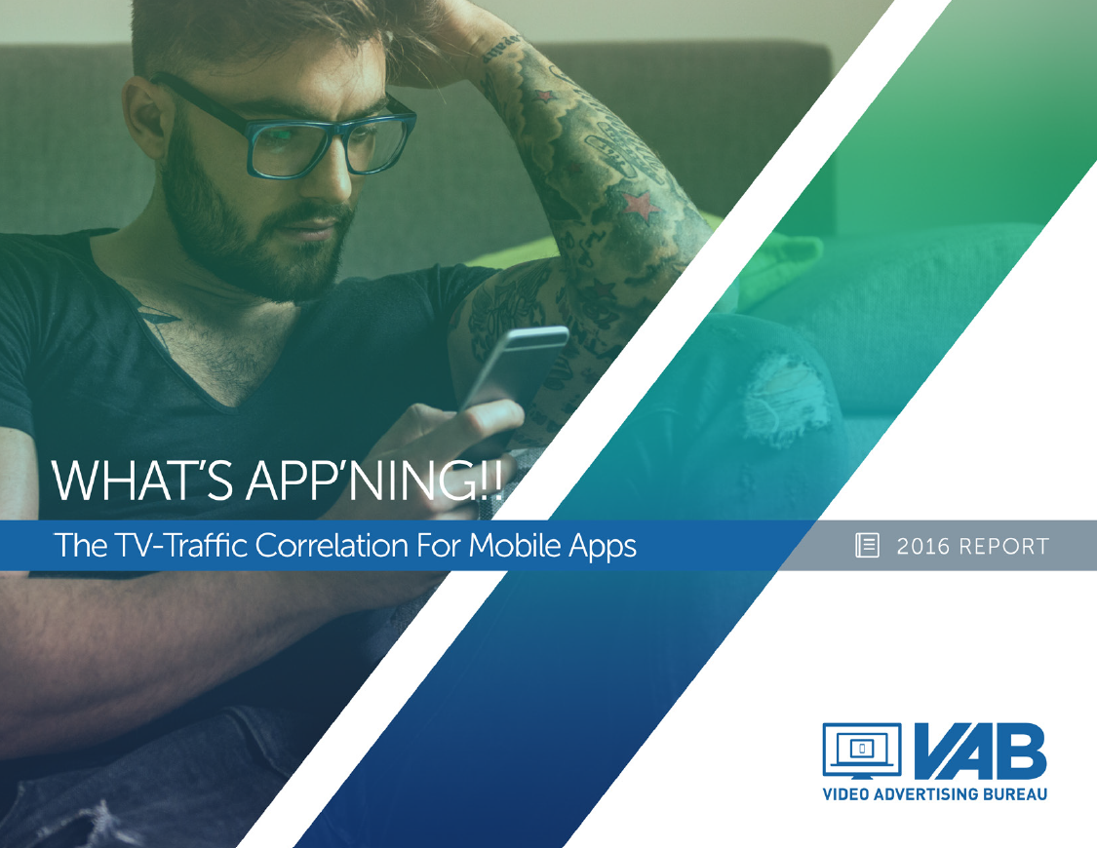
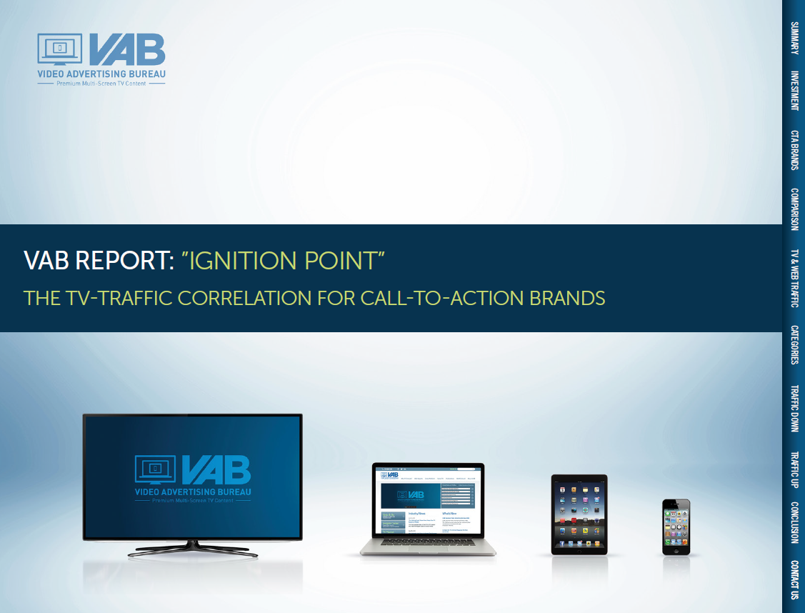
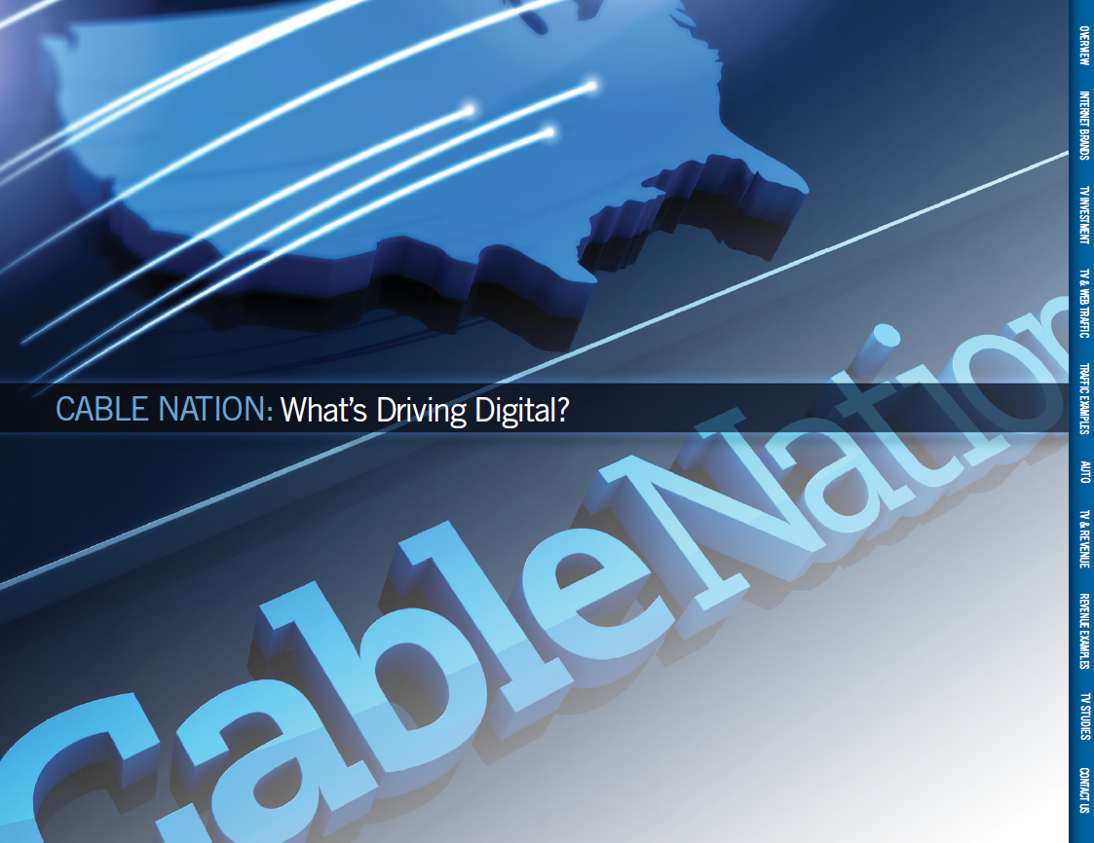
TV Expenditures Drive Website Traffic Across Categories
9 Reports in Total → 20 Categories → 400+ Brands
“The Market Changer’s Playbook”
(Various Disruptors)
“Shifting Gears” (Automotive)
“What’s Appn’ing”
(Mobile Apps)
“Ignition Point”
(Call-To-Action Categories*)
“What’s Driving Digital” (“Pure Play” Digital Brands)
35 Brands
20 Brands
60 Brands
125 Brands
75 Brands
90%
75%
77%**
82%
85%
TV Spend Vs. Website Traffic Correlation
THINK LOCALLY
*Ignition Point – “Call-To-Action” categories include restaurants, retail, travel, telco, financial & insurance. **What’s Appn’ing – 86% correlation for gaming app subcategory. % reflect that percentage of brands that saw a correlation between their TV spend & website traffic

Slide 72
Digital-Native “Disruptor” Brands See Their Website Traffic Skyrocket As Soon As They Launch A TV Campaign
Each company below saw an immediate double-digit lift in website visits once their TV campaign launched
Monthly Website Unique Visitors Comparison
Based Within A Three-Year Time Period (Mar ‘14 – Feb ‘17)
Company
Month Prior To TV Launch
Monthly Average: TV Launch – Feb ‘17
% Difference
23andMe
421
968
+130%
Airbnb
1,442
5,872
+307%
Birchbox
1,122
2,221
+98%
Blue Apron
159
1,872
+1,075%
Casper
131
512
+292%
Fitbit
4,598
14,247
+210%
Letgo
N/A
10,201
Lyft
7,920
13,048
+65%
Nest
N/A
1,576
Simplisafe
145
557
+284%
Sling
2,143
3,842
+79%
SoFi
248
593
+139%
Uber
N/A
30,955
Yelp
77,900
86,755
+11%
THINK LOCALLY
Source: comScore mediametrix multiplatform media trend; Total audience (P2+), March ‘14 – February ‘17. Nielsen Ad Intel, TV spend (national cable TV, national broadcast TV, Spanish language broadcast TV, Spanish language cable TV, spot TV, syndication TV), March ‘14 – February ‘17. N/A = not enough traffic for comScore to measure.

Slide 73
TV Is The Catalyst That Jumpstarts Greater Conversation, Exploration & Online Video Viewing Of “Breakout” Brands
TV leads to increased searches, social actions and non-paid online video views of a brand’s TV ad. In fact, these digital actions far outpace the collective increase in TV spend across the 14 “disruptors” measured.
14 “Brand Building” Disruptors*: TV Spend vs. “Digital Actions” YOY % Increase
2015 vs. 2016
Total Digital Actions (+184% YOY)
*Brands include: 23andMe, Airbnb, Birchbox, Blue Apron, Casper, Fitbit, Letgo, Lyft, Nest, Simplisafe, Sling, SoFi, Uber, Yelp
Source: TV spending based on Nielsen Ad Intel, TV spend (national cable TV, national broadcast TV, Spanish language broadcast TV, Spanish language cable TV, spot TV, syndication TV), CY 2015-2016. Digital actions based on iSpot.tv and reflects TV commercial-related searches (Google, Bing, Yahoo!), social actions (posts, likes, shares and comments related to TV ads on Facebook, Twitter, YouTube, iSpot.tv) and earned, not promoted, online video views of TV ads (YouTube, iSpot.tv). Digital actions are correlated to TV ad airing data.

Slide 74




Digital-Native “Disruptor” Brands Often See Their Revenues Take Off When They Launch A TV Campaign
Year Prior to TV Launch
Company
1st Year with TV
2016
(5 Year TV Advertiser)
TV Spend (000):
---
$1,608
$37,749
Revenue (000):
$66,053
$116,850
+77%
$846,589
13x
Founded in 2005
(7 Year TV Advertiser)
TV Spend (000):
---
$5,712
$245,439
Revenue (000):
$313,621
$370,137
+18%
$781,335
2.5x
Founded in 1999
(4 Year TV Advertiser)
TV Spend (000):
---
$11,551
$70,446
Revenue (000):
$4,000
$19,000
+375%
$200,000
50x
Founded in 2011
(5 Year TV Advertiser)
TV Spend (000):
---
$526
$1,963
Revenue (000):
$60,611
$82,299
+36%
$493,331
8x
Founded in 1999
%
=revenue increase between 1st year on TV and year prior
x
=revenue increase between 2016 and year prior to TV launch
Source: Revenues reflect U.S. only and are based on company filings (10-K, etc) via SEC.gov (except for Dollar Shave Club which is based on market analyst projections and company guidance). Nielsen Ad Intel, TV spend (national cable TV, national broadcast TV, Spanish language broadcast TV, Spanish language cable TV, spot TV, syndication TV), CY 2010-CY 2016. All brands reflected had to have a continuous annual TV investment from Year 1 of TV through 2016.

Slide 75




Revenues Also Spike When “Growing” Brands Heavy-Up
Their TV Investment As Well
Year Prior to TV Heavy-Up
Company
TV Heavy-Up Year
2016
(TV Heavy-Up in 2013)
TV Spend (000):
$1,961
$44,314
$177,955
Revenue (000):
$542,736
$857,001
+58%
$3,110,497
5.7x
Founded in 2002
(TV Heavy-Up in 2014)
TV Spend (000):
$8,261
$15,354
$26,446
Revenue (000):
$163,089
$231,867
+42%
$376,116
2.3x
Founded in 1989
(TV Heavy-Up in 2012)
TV Spend (000):
$6,888
$14,647
$24,824
$22,000
$45,514
+106%
$147,830
8x
Revenue (000):
z
Founded in 2007
(TV Heavy-Up in 2011)
TV Spend (000):
$7,685
$12,444
$53,545
Revenue (000):
$1,542,489
$1,822,032
+18%
$2,795,365
1.8x
Founded in 1987
%
=revenue increase between 1st year on TV and year prior
x
=revenue increase between 2016 and year prior to TV Heavy-Up
Source: Revenues reflect U.S. only and are based on company filings (10-K, etc) via SEC.gov. Nielsen Ad Intel, TV spend (national cable TV, national broadcast TV, Spanish language broadcast TV, Spanish language cable TV, spot TV, syndication TV), CY 2010-CY 2016. All brands reflected had to have a continuous annual TV investment from Year 1 of TV through 2016.

Slide 76




















Separately, We Also Found A Definitive Correlation Between TV Spend & Website Traffic Within The Automotive Category
15 of the 20 Automotive Manufacturers (75%) Analyzed Exhibited a Direct Correlation Between TV Spend & Website Traffic
15 Brands
11 Brands Were In Both TV Spend & Monthly Unique Visitors
4 Brands Were In Both TV Spend & Monthly Unique Visitors
5 Brands
Lack of correlation between TV Spend & Monthly Unique Visitors
THINK LOCALLY
Source: Nielsen Ad Intel. Total TV includes cable TV, broadcast TV, Spanish language cable TV, Spanish language broadcast TV, syndication TV, spot TV; comScore, mediametrix multiplatform, unique visitors Total Audience (P2+). Monthly TV Spend & monthly unique visitors based on Aug ‘14-Jul ’16 calendar months.

Slide 77
Automotive Category: TV Spend Impact On Manufacturers With A Definitive Correlation
Shifts in automotive brands’ TV spending aid in accelerating, or decelerating, their website traffic
15 Automotive Manufacturers: TV Spend vs. Unique Visitors
“Year Over Year” Comparison (Aug ’14 - Jul ‘15 vs Aug ’15 - Jul ‘16)
TV Spend Up /
Uniques Up
TV Spend Down / Uniques Down
11 Advertisers
On average:
+16% more TV Spend
+37% more Unique Visitors
4 Advertisers
On average:
-10% less TV Spend
-12% less Unique Visitors
THINK LOCALLY
Source: Nielsen Ad Intel. Total TV includes cable TV, broadcast TV, Spanish language cable TV, Spanish language broadcast TV, syndication TV, spot TV; comScore, mediametrix multiplatform, unique visitors Total Audience (P2+). Monthly TV Spend & monthly unique visitors based on Aug ‘14-Jul ’16 calendar months.

Slide 78


For More Information Visit Us Online
TheVAB.com
Follow us:
@VideoAdBureau
Like us:
facebook.com/VideoAdvertisingBureau

Slide 79
Additional Member Slides

Slide 80
From A Total Day Perspective, The Split Between Live &
Time-Shifted Is Similar Between Broadcast & Cable TV
“Live” vs. “Time-Shifted” Viewing Share
2Q ‘17 (Total Day)
P18+
P18-34
P18-49
P25-54
THINK LOCALLY
Source: VAB analysis of Nielsen NPower Time Period Report, 2Q 2017, Total Day, based on average quarterly time spent, Live vs Live+7.

Slide 81
Regardless of Market, Majority of TV Viewing is Live
Average Daily Time Spent (HH.MM) Per Adult 25-54
THINK LOCALLY
Source: Nielsen Local TV View, Live Data Stream, February 2017, P25-54, based on Total Population

Slide 82
Looking At Set Meter Markets, ‘Live TV’ Also Dominates
Average Daily Time Spent (HH.MM) Per Adult 25-54
THINK LOCALLY
Source: Nielsen Local TV View, Live Data Stream, February 2017, P25-54, based on Total Population

Slide 83
“Live TV” Also Dominates Among Hispanics…
THINK LOCALLY
Source: Nielsen Local TV View, February 2017, Persons 25-54, Total Day M-Su 3a-3a

Slide 84
“Live TV” Also Dominates Among The Black Demographic
THINK LOCALLY
Source: Nielsen Local TV View, February 2017, Persons 25-54, Total Day M-Su 3a-3a

