Slide 1



2020
The Rise Of FAANG
TV Ad Investment Strategies Behind Today’s Tech Giants

Slide 2






FAANG collectively spent $2.6 billion on TV in 2019 and their increasing investment reflects a 26% compound annual growth rate over the last four years
FAANG U.S. TV Spend
($$$ in Millions)
+18%
$2,599.3
+38%
$2,196.8
+45%
+8%
$1,478.8
$1,592.9
$1,019.2
Source: VAB analysis of Nielsen AdIntel, calendar year 2015-2019, as of February 2020. TV spend includes cable TV, broadcast TV, Spanish language cable TV, Spanish language broadcast TV, spot TV, and syndicated TV. U.S. TV spend only.
FAANG includes: Facebook, Apple, Amazon, Netflix and Google.
This information is exclusively provided to VAB members and qualified marketers. Further distribution is prohibited.
PAGE 2

Slide 3
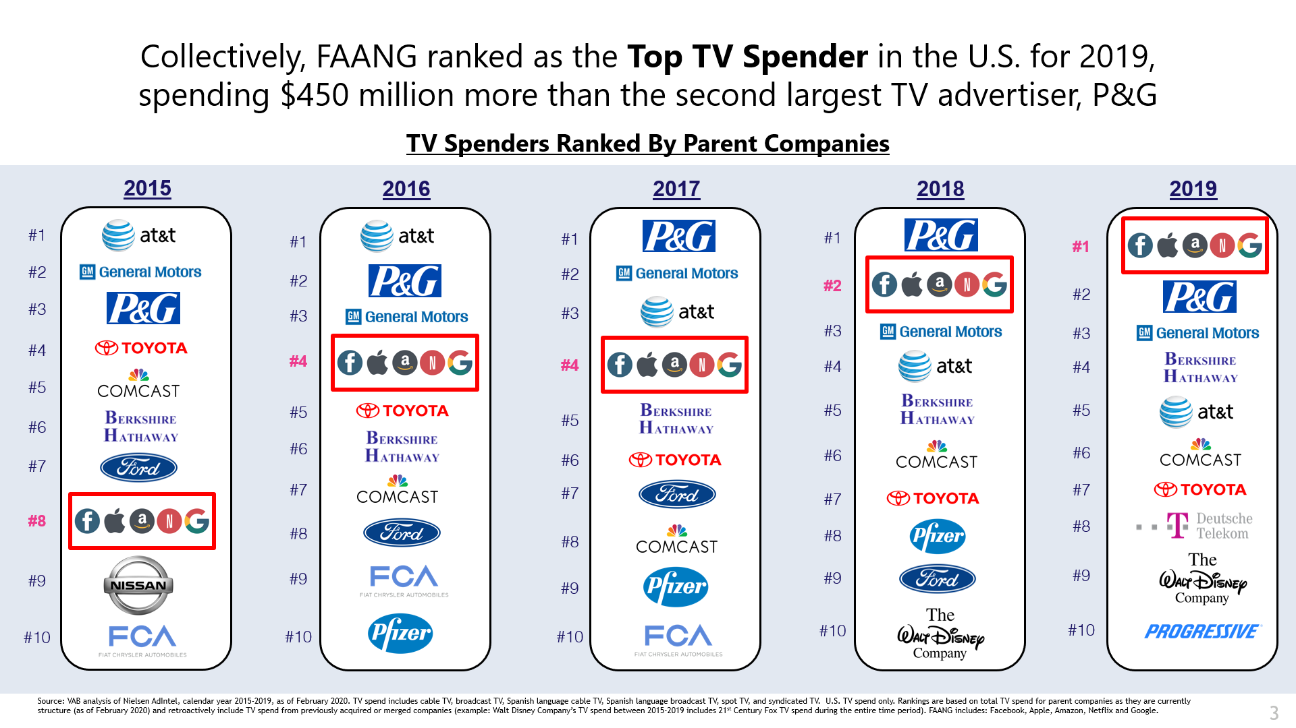
Collectively, FAANG ranked as the top TV spender in the U.S. for 2019, spending $450 million more than the second largest TV advertiser, P&G
TV Spenders Ranked By Parent Companies
Source: VAB analysis of Nielsen AdIntel, calendar year 2015-2019, as of February 2020. TV spend includes cable TV, broadcast TV, Spanish language cable TV, Spanish language broadcast TV, spot TV, and syndicated TV. U.S. TV spend only. Rankings are based on total TV spend for parent companies as they are currently structure (as of February 2020) and retroactively include TV spend from previously acquired or merged companies (example: Walt Disney Company’s TV spend between 2015-2019 includes 21st Century Fox TV spend during the entire time period). FAANG includes: Facebook, Apple, Amazon, Netflix and Google.
This information is exclusively provided to VAB members and qualified marketers. Further distribution is prohibited.
PAGE 3

Slide 4

In 2019, FAANG focused their TV spend on overall branding and core products with video streaming collectively accounting for 16% of spend
FAANG’s % of TV Spend By Category
2019
Source: VAB analysis of Nielsen AdIntel, calendar year 2015-2019, as of February 2020. TV spend includes cable TV, broadcast TV, Spanish language cable TV, Spanish language broadcast TV, spot TV, and syndicated TV. U.S. TV spend only.
FAANG includes: Facebook, Apple, Amazon, Netflix and Google. Video Streaming includes spend associated with platforms and individual programs.
This information is exclusively provided to VAB members and qualified marketers. Further distribution is prohibited.
PAGE 4

Slide 5


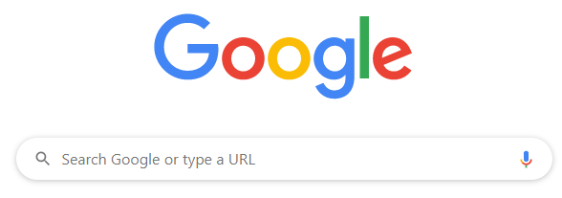
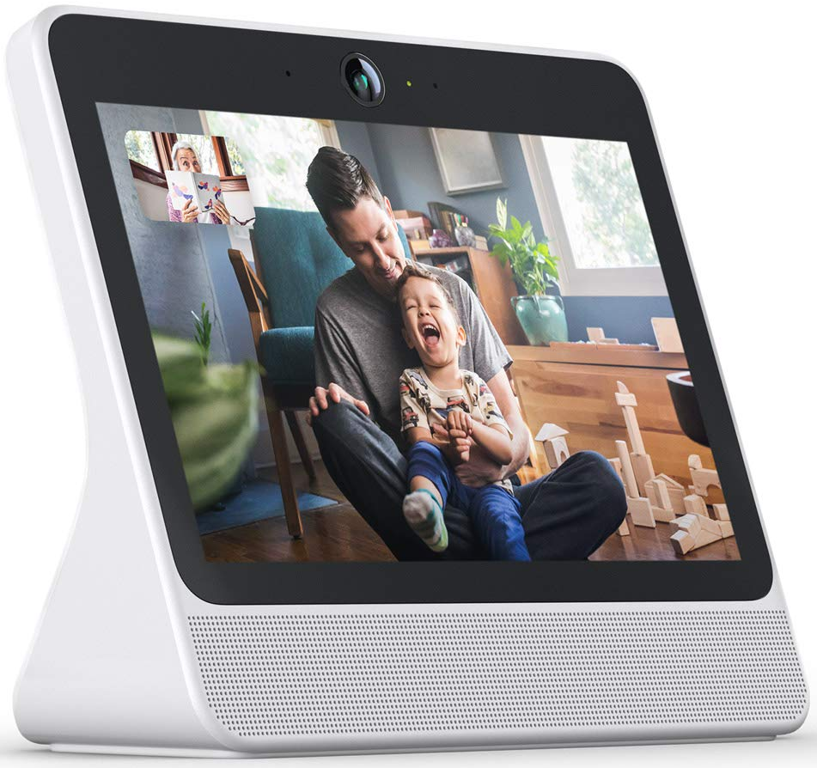

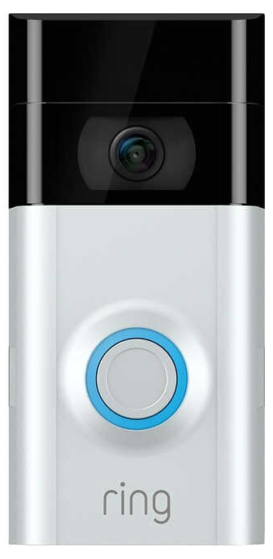

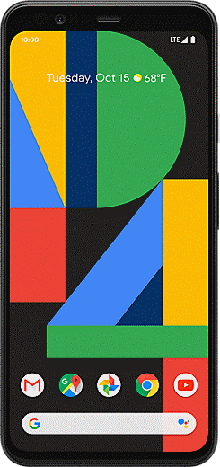

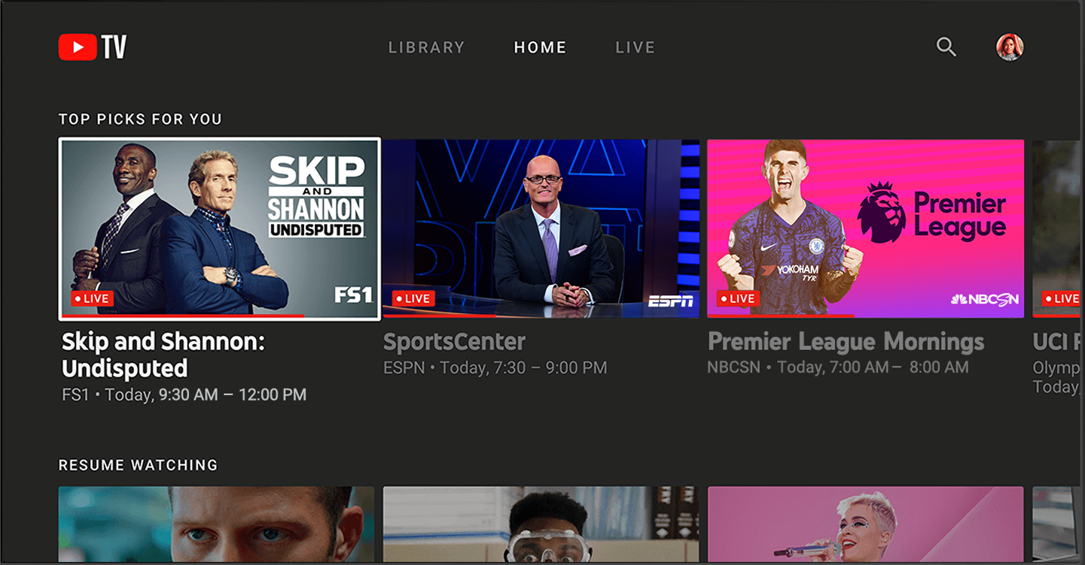
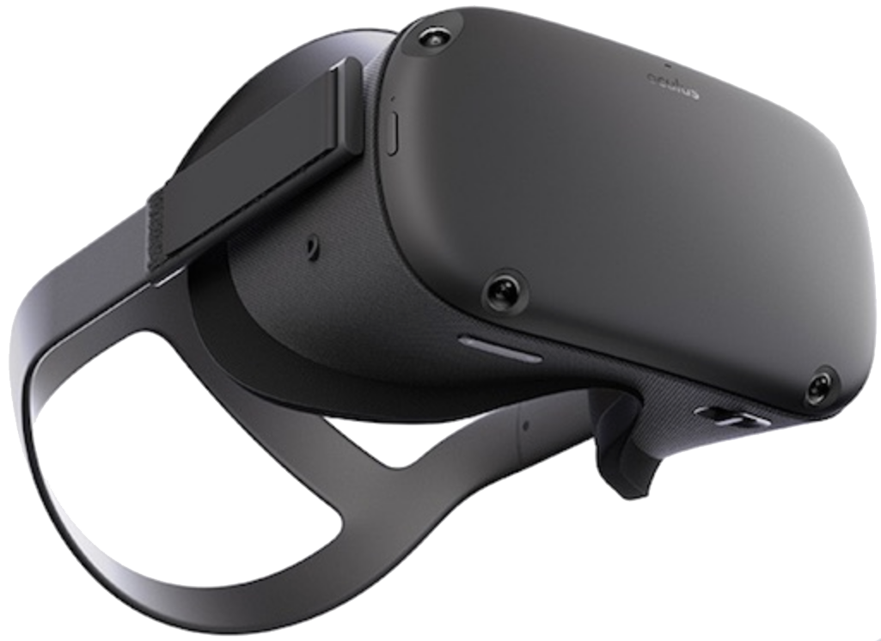

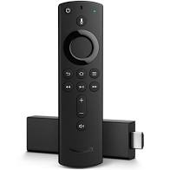
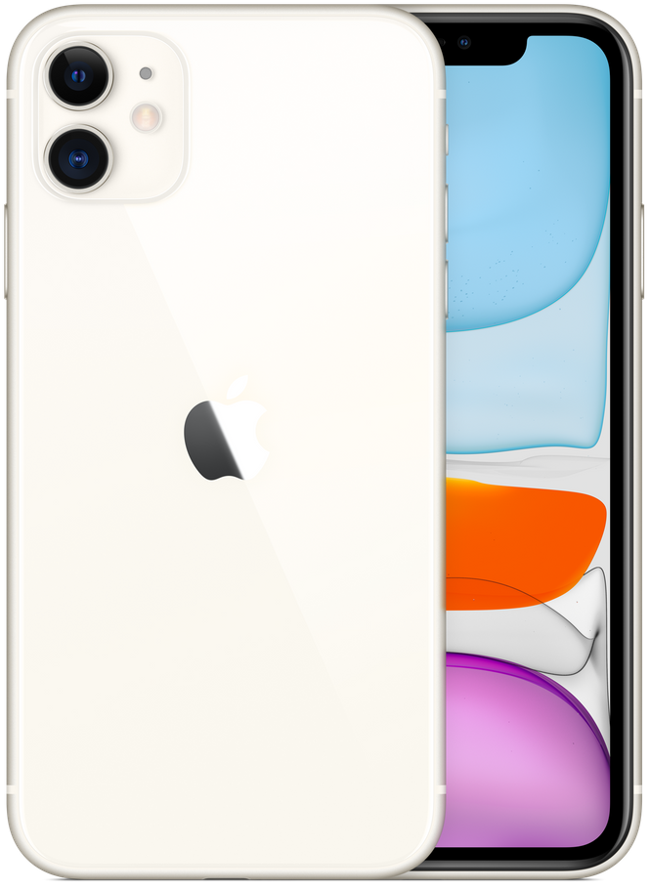





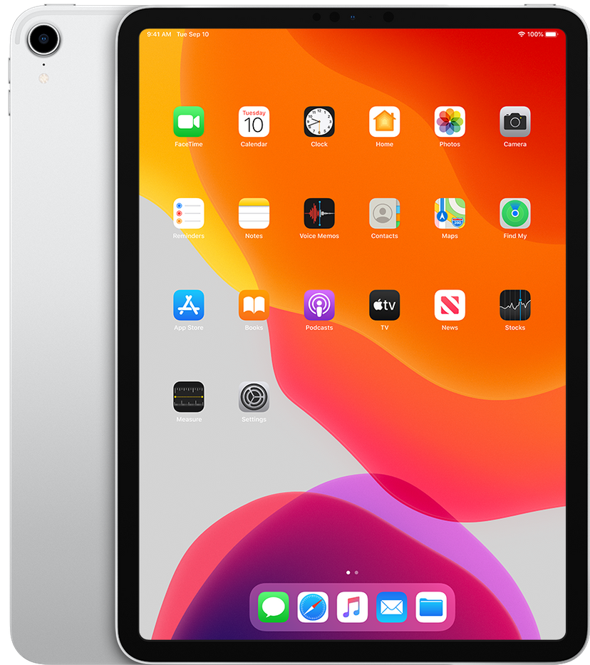
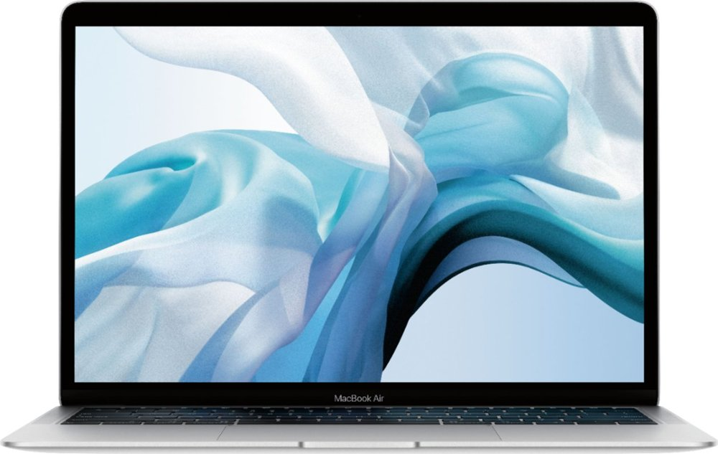
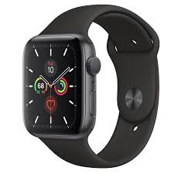







Beyond increased branding, FAANG advertised multiple products and services through TV to reach desirable, tech-enthusiast audiences
at scale
FAANG’s Top Products & Services Advertised on TV
2019
Branding
Google Search
Facebook
Groups
Portal
Pixel 4
Nest
YouTube TV
Ring
Video Doorbell
iPhone 11
Echo
Amazon
Fire TV
Branding
Google Home
Oculus Quest
iPad
MacBook
Apple Watch 5
Beats by Dr. Dre
AirPods
Source: VAB analysis of Nielsen AdIntel, calendar year 2015-2019, as of February 2020. TV spend includes cable TV, broadcast TV, Spanish language cable TV, Spanish language broadcast TV, spot TV, and syndicated TV. U.S. TV spend only.
FAANG includes: Facebook, Apple, Amazon, Netflix and Google.
This information is exclusively provided to VAB members and qualified marketers. Further distribution is prohibited.
PAGE 5

Slide 6
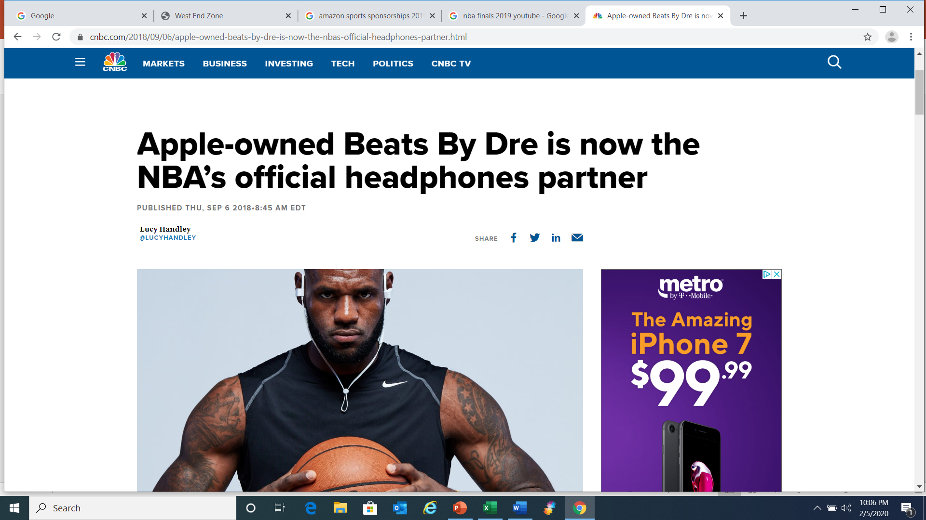
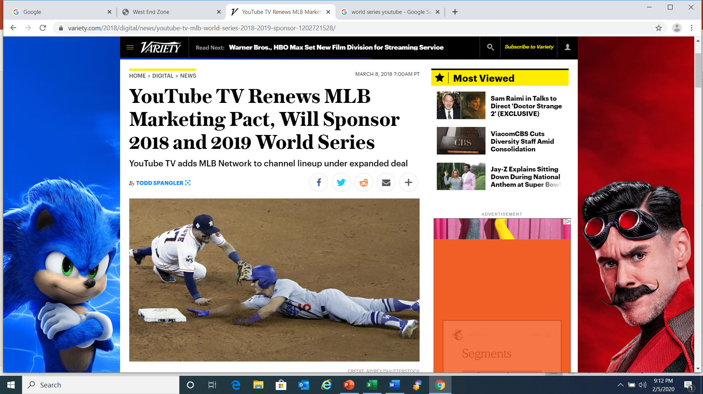
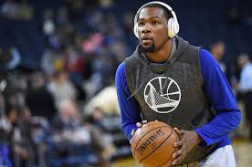
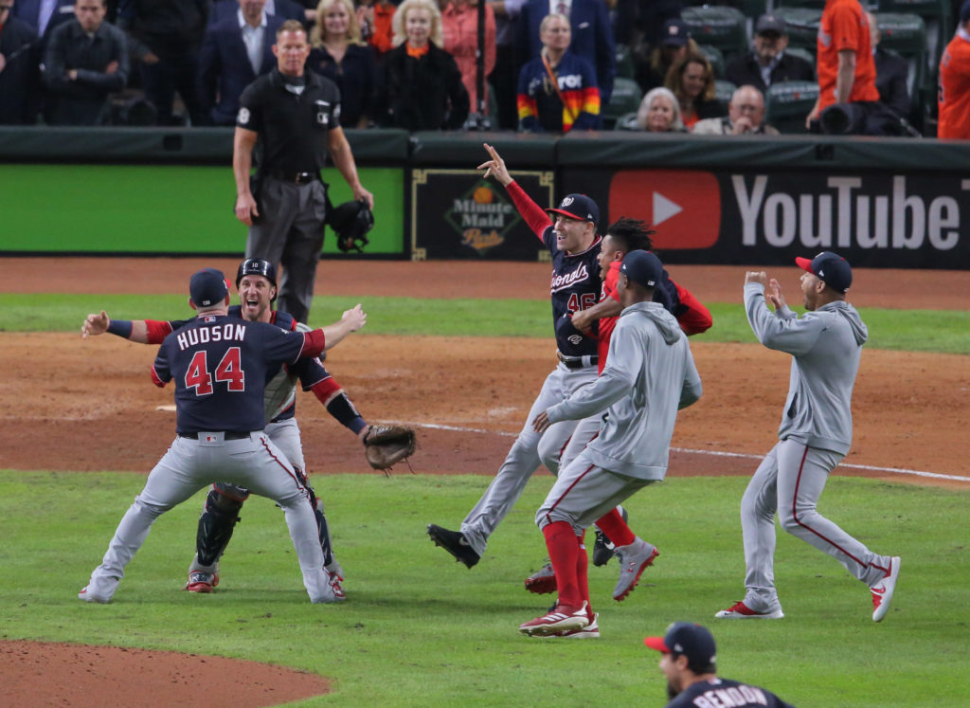
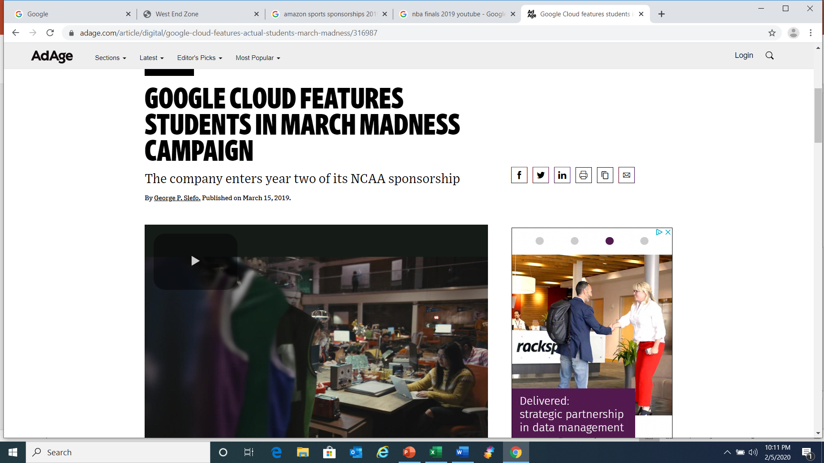
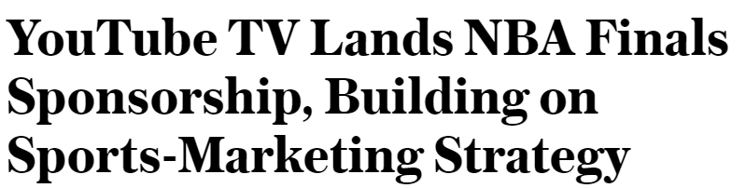
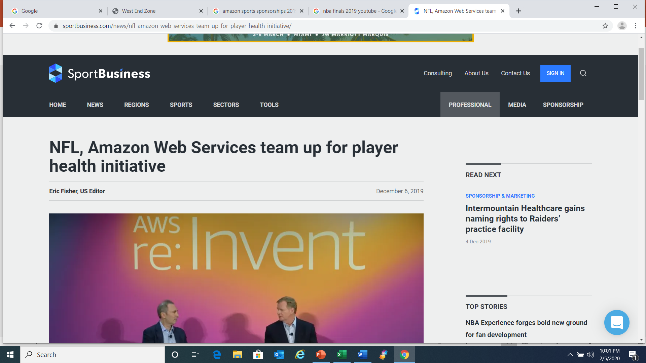

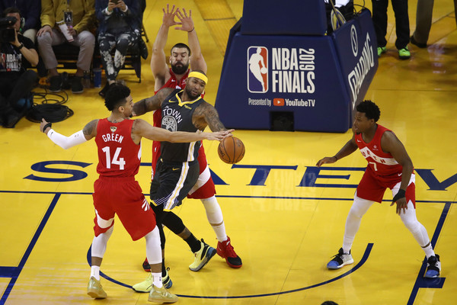
Several brands have major partnerships with sports leagues which includes heavy advertising and placement exposure during live televised events
This information is exclusively provided to VAB members and qualified marketers. Further distribution is prohibited.
PAGE 6

Slide 7
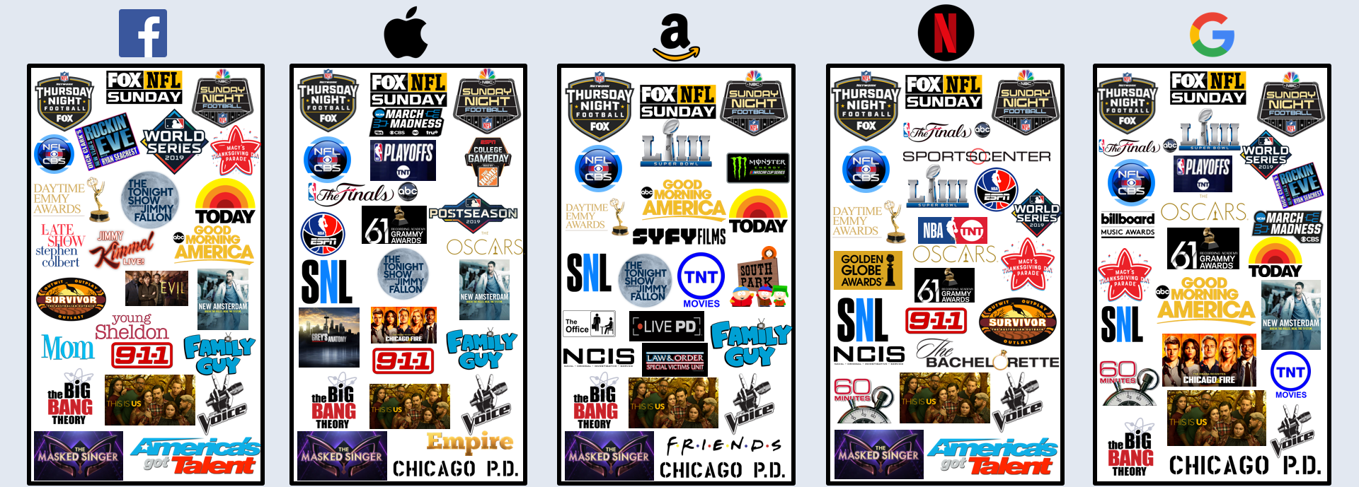
In addition to sports, FAANG invests heavily within culturally relevant
live shows (specials, awards, morning/late night talk) and popular entertainment programs
Top TV Programming By Spend
2019
Source: VAB analysis of Nielsen AdIntel, calendar year 2015-2019, as of February 2020. TV spend includes cable TV, broadcast TV, Spanish language cable TV, Spanish language broadcast TV, spot TV, and syndicated TV. U.S. TV spend only. FAANG includes: Facebook, Apple, Amazon, Netflix and Google. Above charts reflect 25 of the top TV programming based on expenditures from Nielsen AdIntel. Note: TV programming is not listed in order of expenditure but rather loosely grouped by sports, live events and scripted/reality entertainment programming.
This information is exclusively provided to VAB members and qualified marketers. Further distribution is prohibited.
PAGE 7

Slide 8
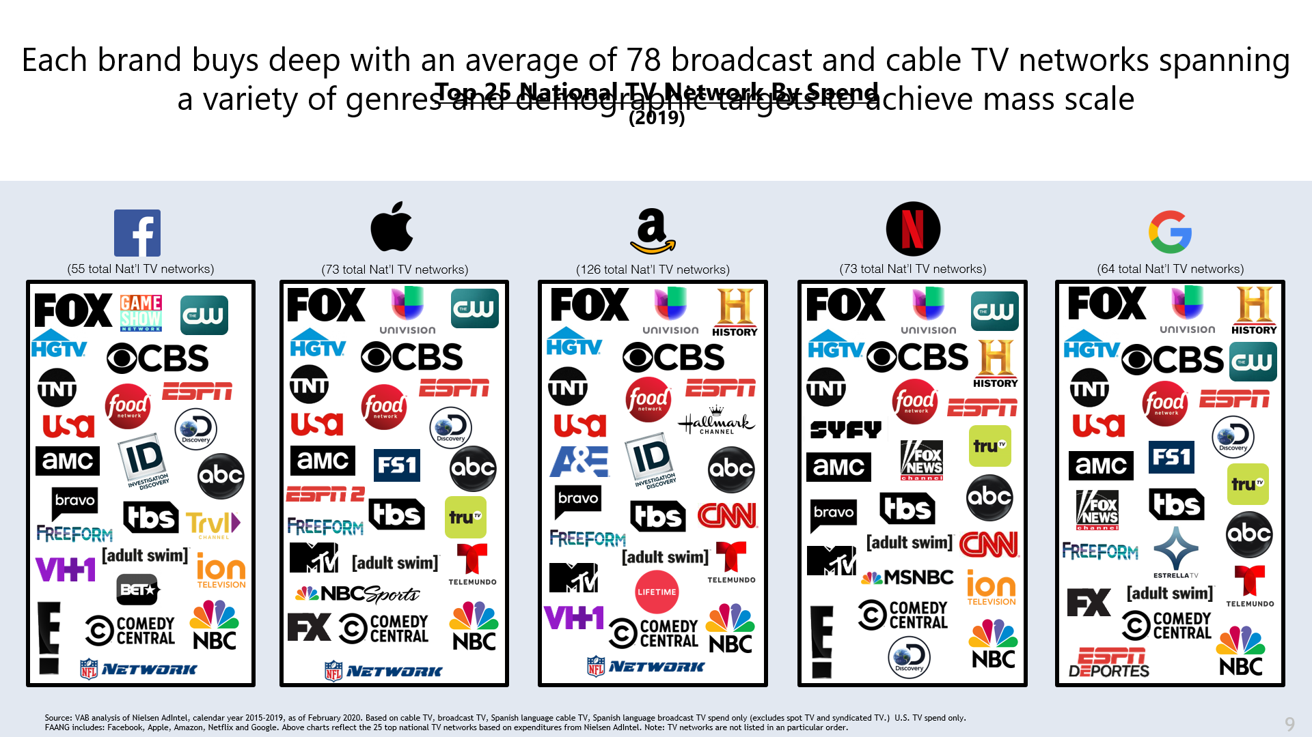
Each brand buys deep with an average of 78 broadcast and cable TV networks spanning a variety of genres and demographic targets to achieve mass scale
Top 25 National TV Network By Spend
2019
Source: VAB analysis of Nielsen AdIntel, calendar year 2015-2019, as of February 2020. Based on cable TV, broadcast TV, Spanish language cable TV, Spanish language broadcast TV spend only (excludes spot TV and syndicated TV.) U.S. TV spend only.
FAANG includes: Facebook, Apple, Amazon, Netflix and Google. Above charts reflect the 25 top national TV networks based on expenditures from Nielsen AdIntel. Note: TV networks are not listed in any particular order.
This information is exclusively provided to VAB members and qualified marketers. Further distribution is prohibited.
PAGE 8

Slide 9



Key takeaways about FAANG’s growing TV investment and their rise
to becoming the top TV spender
Brand Building &
Top-Of-Mind Awareness
New Product / Service Launch Support
Maximizing Reach
And Impact
In this highly competitive environment, even the most ubiquitous brands need TV
to keep their brand name,
and core product offerings, continually ‘top-of-mind’
among a broad audience
and grow market share.
The mass reach and engagement of TV allows brands to quickly build scale
in support of new product/ services launches and the storytelling nature of the medium allows them to differentiate
the product / service and its’ features from competitors.
Complementing impact with TV continuity through a mix of high-profile sports and live event programming during
the year coupled with a deep roster of broadcast and cable networks covering a variety
of demographic and psychographic segments.
This information is exclusively provided to VAB members and qualified marketers. Further distribution is prohibited.
PAGE 9

Slide 10



Register for Complimentary Access to VAB Insights

