Slide 1
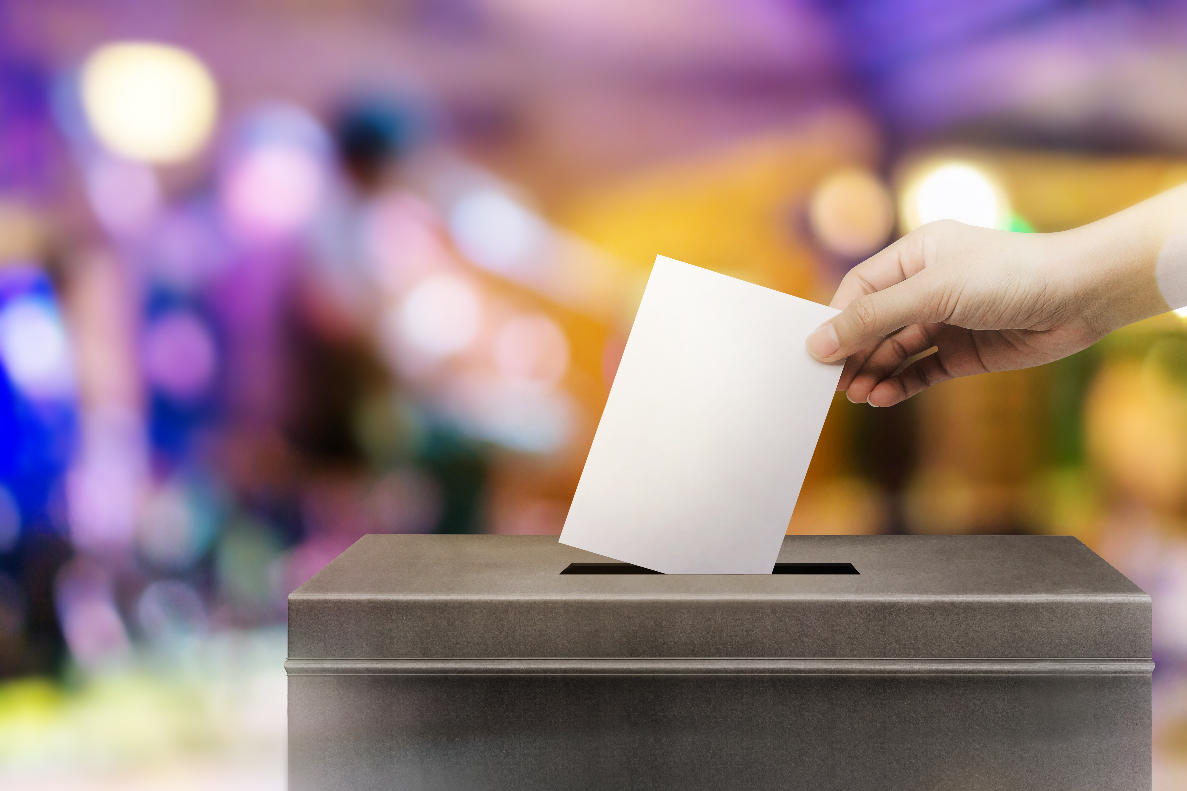


2020
The Path To Victory
Understanding How ‘Share Of Voice’ Impacts Election Outcomes

Slide 2
The Ballot
1
A Matter Of Principle
Applying Core Marketing Tenets To Political Advertising
6
The Candidate-Constituency Connection
The Emergence Of Connected TV As A Political Ad Platform
2
7
Appendix
‘Hotly-Contested’ & ‘Late Heat Up’ Races Detail
‘Share Of Voice’ Analysis Methodology
3
Election Results
Examining The Outcomes Of 62 ‘Hotly-Contested’ Races
8
Members Exclusive Section
A Deeper Dive Into TV Spending
4
Election Results
Examining The Outcomes Of 12 ‘Late Heat-Up’ Races
9
Members Exclusive Section
Political Media Buying Firm Analysis
5
Early Polling
Forecasting 2020’s ‘Hotly Contested’ Races

Slide 3
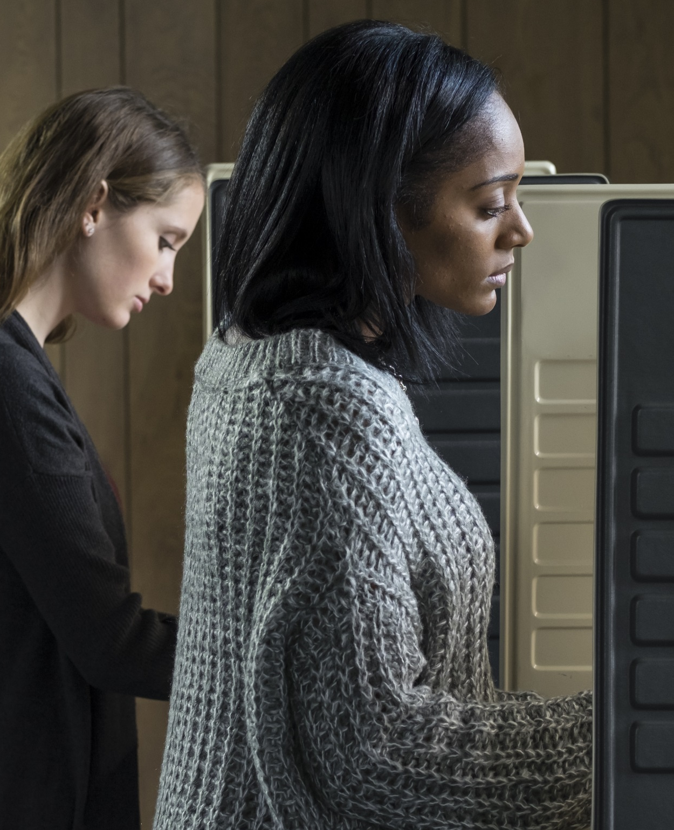

Political Candidates As ‘Brands’
Political candidates are not unlike direct-to-consumer products or other brands in more traditional categories such as CPG, automotive or financial in that their goal is to deliver a message to consumers (i.e., ‘voters’) in hopes that it will resonate and lead to an action taken which, in turn, will grow their market share (i.e., ‘votes received’).
Which is why success in this category is aided by the adherence to core marketing principles that are similarly followed by countless other brand products. One of these central tenets is the belief that growing ‘share of voice’ will grow ‘share of market.’
A key distinction that sets the political category apart from others is its ability to quantify ‘winners’ and losers’ at a set point in time. Because of this, we put the
‘SOV → SOM’ marketing theory to the test.
In this report, The Path To Victory, we analyzed the most competitive, hotly contested races of the 2018 midterm cycle (74 in total) to understand to what extent TV spend and ‘share of voice’ across candidates impacted the election outcomes.
Continue reading for inspiration as the 2020 election cycle kicks into full gear, non-political marketers can also gain some insights from this analysis as well for annual brand planning.
PAGE 3
This information is exclusively provided to VAB members and qualified marketers. Further distribution is prohibited.

Slide 4

A Matter Of Principle
Applying Core Marketing Tenets
To Political Advertising

Slide 5
Share of Voice → Share of Market
For those brands looking to grow, research has shown that there is a direct correlation between their share of voice and market share.
“Research showed that brands with a high share of voice tended to grow while those with low SOV tended to shrink”
– Les Binet & Peter Field, Media In Focus – Marketing Effectiveness In The Digital Era
In this aspect, political candidates are no different than traditional brands:
For candidates looking to garner votes in an election, they need to have a healthy share of voice within their specific market / district
Furthermore, they will also typically need to ‘outshout’ their competitors to ensure victory
While Political is a unique category of its own with a focus on people, not products, and the ability to identify ‘winners’ and ‘losers’ at specific intervals in time;
success in this category is driven by the adherence to common marketing tenets similar to those found in more ‘traditional’ brand categories.
A key distinction in what sets the political category apart from other traditional brand categories is that quantifiable ‘winners’ and ‘losers’ are easily identifiable at set points in time.
Based on this, we set out to construct an analysis to understand the correlation between competitive share of voice via their media spend and share of market via their votes received (i.e. election results).
This information is exclusively provided to VAB members and qualified marketers. Further distribution is prohibited.
PAGE 5
PAGE 1

Slide 6






Within the battle for share of voice, success is often achieved by following a set of proven marketing principles
to decide where and how to invest media budgets
Click here to read more about marketing principles in A Matter of Principle
Balance broad-based reach with hyper-targeting to grow market share
Protect your ‘brand’
by investing only in premium, viewable content where ads are guaranteed to be seen
‘Brand’ building media, such as premium video, fosters a deep emotional connection
The balance of brand building and short-term tactics drives both immediate demand and long-term equity
This information is exclusively provided to VAB members and qualified marketers. Further distribution is prohibited.
PAGE 6

Slide 7
In the 2018 midterm election cycle, TV was the most popular media vehicle implemented by political advertisers, accounting for almost 60% of total media
2018 Midterm Campaign Spending By Media
$ in Millions
Source: VAB analysis of Borrell and Associates, Bracing For Impact: 2018 Advertising Set To Break Records, September 2018 Update. Chart reflects media spending only.
This information is exclusively provided to VAB members and qualified marketers. Further distribution is prohibited.
PAGE 7

Slide 8

TV is the media of choice for many political advertisers because it delivers on proven marketing principles
Broad Reach, viewability and emotional connection to TV programming aids in influencing voters throughout their decision making process
Click here to read more about TV’s influence on voters in It’s A Matter of Trust
Regardless of demographic or party affiliation, voters are most influenced by TV brands throughout the election cycle
Voter’s Decision Making Process
Awareness
Consideration
Interest
Action
Discover Candidates / Issues
Gather Information
Generate Interest
Cast the Final Vote
Television is most likely where voters first learn about political candidates/ issues
Television is most likely to have prompted a voter to take an action (seek info about political candidates/ issues, discuss with others)
Television is relied on most to keep voters informed through the election cycle
Television is the media that most influences a person’s final vote
Summary of findings from ‘It’s A Matter Of Trust: Media’s Influence On Voters’ (VAB custom study 2018)
This information is exclusively provided to VAB members and qualified marketers. Further distribution is prohibited.
PAGE 8
PAGE 1

Slide 9
‘Share Of Voice’
Analysis Methodology

Slide 10

‘Share Of Voice’ Analysis Overview
We analyzed the total reported TV spend for each candidate within the most competitive races –
‘hotly contested’ and ones that ‘heated up’ late - across the U.S. House of Representatives, U.S. Senate and Gubernatorial races during the
2018 midterm election cycle to determine what,
if any, effect a candidate’s share of voice had on
election outcomes
In total, our analysis examines 74 races:
  55 U.S. House of Representative races
  9 U.S. Senate races
  10 Gubernatorial races
This information is exclusively provided to VAB members and qualified marketers. Further distribution is prohibited.
PAGE 10

Slide 11
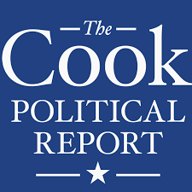
How were the ‘hotly contested’ and ‘late heat-up’ races determined?
Source: Cook Political Report
What Were The Competitive Races?
Race rating definitions by Cook Political Report
To determine the appropriate races for this analysis, we reviewed the races monitored by the Cook Political Report, an independent, non-partisan publication that continually analyzes elections and campaigns for the U.S. House of Representatives, U.S. Senate and Gubernatorial races.
Cook gives a rating to each race based on its anticipated competitiveness, the most competitive races for our analysis were established based on their initial rating in 2018 and then monitored through their last (i.e., ‘late’) rating prior to election day.
Likely Democratic
Likely Republican
Likely
These seats are not considered competitive at this point, but have the potential to become engaged.
Lean
Democratic
Lean
Republican
Lean
These are considered competitive races, but one party has an advantage.
Toss Up
Toss Up
These are the most competitive; either party has a good chance of winning.
‘Early’ 2018 Rating Dates:
US House – 1/8/18
US Senate – 2/1/18
Gubernatorial – 1/26/18
‘Late’ 2018 Rating Dates:
US House – 9/7/18
US Senate – 10/26/18
Gubernatorial – 10/26/18
We focused on ‘leans’ and ‘toss ups’ for our analysis
of ‘hotly-contested’ & ‘late heat-up’ races
This information is exclusively provided to VAB members and qualified marketers. Further distribution is prohibited.
PAGE 11
PAGE 1

Slide 12



How was each candidate’s TV investment in these races reported?
Who Spent What In These Races?
Developing A Holistic View Of Political TV Spend
To understand candidates' TV investment, we utilized
Kantar Media’s Campaign Media Analysis Group (CMAG) Political investment tool. This tool monitors the political-related media spend through a proprietary system utilizing multiple first-party sources.
Kantar CMAG compiles political advertising spend through relationships with station groups, gathering competitive information in real time. They also utilize the FCC political public file to check and supplement data already gathered.
For the selected races that Kantar monitors, TV spend is available throughout the election cycle from the primary time period through the general election. In 2018, reporting began in the first broadcast week of January.
Political-related TV spend includes dollars placed by candidates, political parties, political action committees (PACs), special interest groups, etc. A majority of total spending is typically attributable back to a specific candidate however some activity from politically-neutral organizations are not assigned a candidate designation.
This information is exclusively provided to VAB members and qualified marketers. Further distribution is prohibited.
PAGE 12
PAGE 1

Slide 13
Election Results
Examining The Outcomes
Of 62 ‘Hotly-Contested’ Races

Slide 14
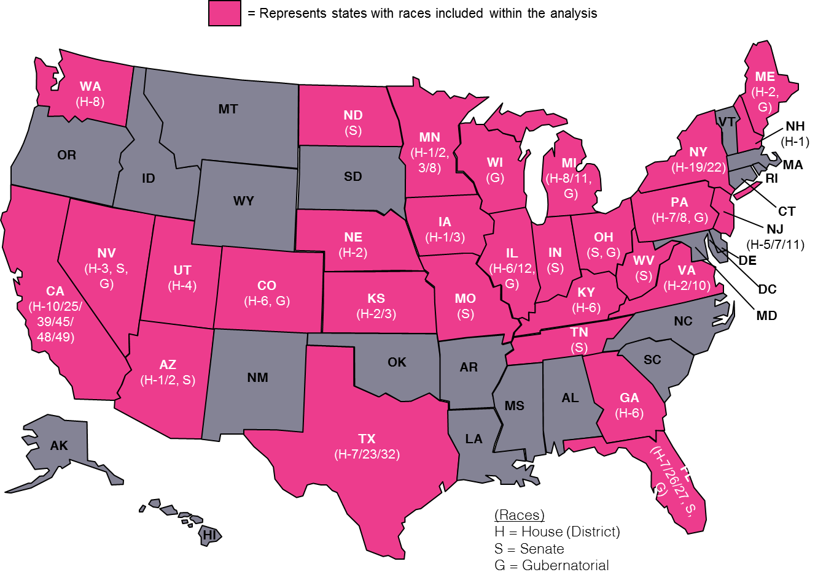
The geography of the ‘hotly-contested’ races
We analyzed 62 ‘hotly-contested’ races that were rated either ‘leans’ or ‘toss ups’ at the beginning of 2018 and had reported TV spend from Kantar CMAG
These races spanned 29 states throughout the country within three race segments:
‘Hotly-Contested’ Races Analyzed
U.S. House of Representatives - 44
U.S. Senate – 9
Gubernatorial - 9
Source: VAB analysis of Cook Political Report, ‘Hotly-Contested’ races are ‘Toss-Up’ or ‘Lean’ ratings based on the ‘early’ ratings date for the 2018 midterm elections: US House of Representatives (1/8/18), US Senate (2/1/18) and Gubernatorial (1/26/18).
This information is exclusively provided to VAB members and qualified marketers. Further distribution is prohibited.
PAGE 14

Slide 15
Across these 62 races, there was $1.7 billion collectively spent on TV during the entire 2018 election cycle
These dollars were funded through two segments:
Candidate: spending directly from the candidate’s campaign, their political party or candidate / political party co-op funded ads
Issue-Based: spending from PACs and other ‘special interest / policy’ groups. Most of these dollars are attributable back to a specific candidate (79%) while the remainder reflects politically-neutral organizations or dollars with no clear candidate designation.
Since these 62 races were ‘battlegrounds’ it’s no surprise ‘issue-based’ spend made up a significant portion of total TV dollars.
Source: VAB analysis of Kantar CMAG Political Competitive Data Gathering, 2018 Midterm Election data measured from 12/26/17 to 11/20/18 across both primary and general election spend. TV Platforms: Cable TV, Broadcast TV, Spanish Language Broadcast TV and Satellite TV. Candidate spend sources: candidate, party and candidate/party co-op ads. Issue-Based spend sources: election-affiliated (e.g. PACs, Congressional Leadership Fund, Majority Forward, One Nation) and policy-affiliated issue spending from interest groups (e.g. Americans For Prosperity, Clean Air Moms Action, Patients For Affordable Drugs Action).
This information is exclusively provided to VAB members and qualified marketers. Further distribution is prohibited.
PAGE 15

Slide 16
Although the average Gubernatorial candidate and their party spent more on their campaign, the average Senate race had more total dollars in TV
This is driven by the influx of PAC dollars looking to maintain, or change, control of Congress (especially in these ‘hotly-contested’ races) and ‘special interest’ groups seeking to influence the legislative agenda with candidates on the national level
$513.1
(44 races)
$634.9
(9 races)
$560.2
(9 races)
Source: VAB analysis of Kantar CMAG Political Competitive Data Gathering, 2018 Midterm Election data measured from 12/26/17 to 11/20/18 across both primary and general election spend. TV Platforms: Cable TV, Broadcast TV, Spanish Language Broadcast TV and Satellite TV. Candidate spend sources: candidate, party and candidate/party co-op ads. Issue-Based spend sources: election-affiliated (e.g. PACs, Congressional Leadership Fund, Majority Forward, One Nation) and policy-affiliated issue spending from interest groups (e.g. Americans For Prosperity, Clean Air Moms Action, Patients For Affordable Drugs Action).
This information is exclusively provided to VAB members and qualified marketers. Further distribution is prohibited.
PAGE 16

Slide 17

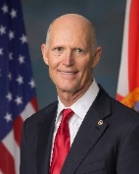
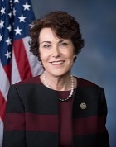
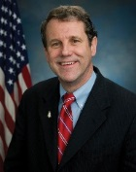
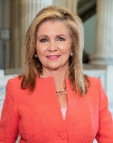
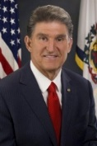
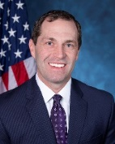
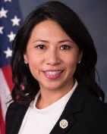
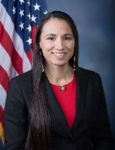
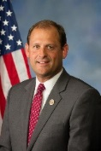
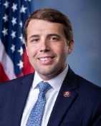
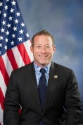
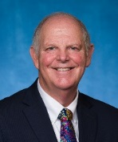
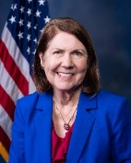
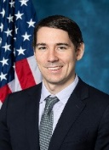
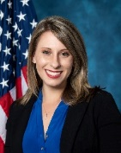
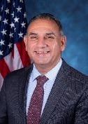
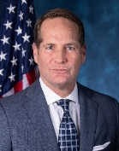
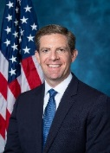
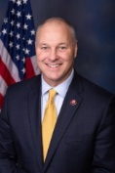
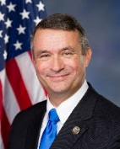
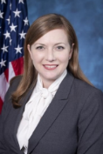
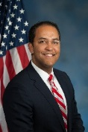
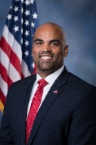
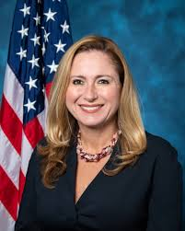
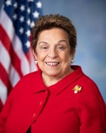
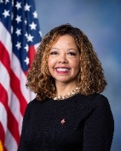
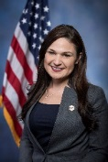
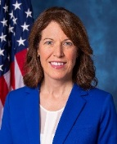
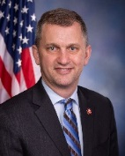
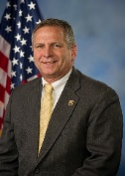
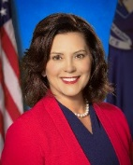
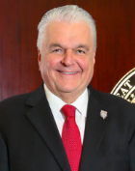
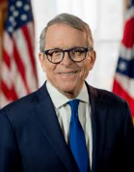
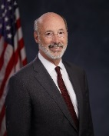
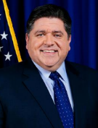
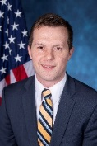
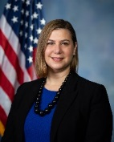
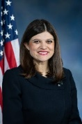
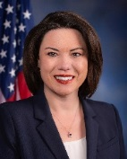
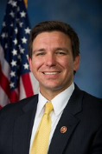
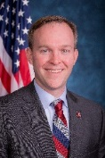
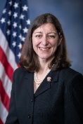
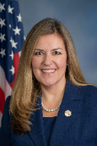
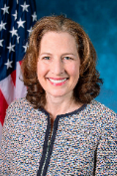
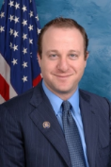
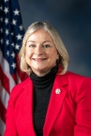















The winners of the 62 most competitive ‘hotly-contested’ races
These races within our analysis represented a mix of Democrats and Republicans but skewed towards the Democratic party
Kyrsten Sinema
US Senate: AZ - Dem
Rick Scott
US Senate: FL - Rep
Jacky Rosen
US Senate: NV - Dem
Sherrod Brown
US Senate: OH - Dem
Marsha Blackburn
US Senate: TN - Rep
Joe Manchin
US Senate: WV - Dem
Jason Crow
US House: CO(6) - Dem
Stephanie Murphy
US House: FL(7) - Dem
Sharice Davids
US House: KS(3) - Dem
Andy Barr
US House: KY(6) - Rep
Chris Pappas
US House: NH(1) - Dem
Josh Gottheimer
US House: NJ(5) - Dem
Tom O’Halleran
US House: AZ(1) - Dem
Ann Kirkpatrick
US House: AZ(2) - Dem
Josh Harder
US House: CA(10) - Dem
Katie Hill
US House: CA(25) - Dem
Gil Cisneros
US House: CA(39) - Dem
Harley Rouda
US House: CA(48) - Dem
Mike Levin
US House: CA(49) - Dem
Pete Stauber
US House: MN(8) - Rep
Don Bacon
US House: NE(2) - Rep
Lizzie Pannill Fletcher
US House: TX(7) - Dem
Will Hurd
US House: TX(23) - Rep
Colin Allred
US House: TX(32) - Dem
Debbie Mucarsel-Powell
US House: FL(26) - Dem
Donna Shalala
US House: FL(27) - Dem
Lucy McBath
US House: GA(6) - Dem
Abby Finkenaur
US House: IA(1) - Dem
Cindy Axne
US House: IA(3) - Dem
Sean Casten
US House: IL(6) - Dem
Mike Bost
US House: IL(12) - Rep
Gretchen Whitmer
Governor: MI - Dem
Steve Sisolak
Governor: NV - Dem
Mike DeWine
Governor: OH - Rep
Tom Wolf
Governor: PA - Dem
JB Pritzker
Governor: IL - Dem
Jared Golden
US House: ME(2) - Dem
Elissa Slotkin
US House: MI(8) - Dem
Haley Stevens
US House: MI11) - Dem
Angie Craig
US House: MN(2) - Dem
Ron DeSantis
Governor: FL - Rep
Ben McAdams
US House: UT(4) - Dem
Elaine Luria
US House: VA(2) - Dem
Jennifer Wexton
US House: VA(10) - Dem
Kim Schrier
US House: WA(8) - Dem
Jared Polis
Governor: CO - Dem
Susan Wild
US House: PA(7) - Dem
Matt Cartwright
US House: PA(8)- Dem
47 democrat winners
15 republican winners
Mike Braun
US Senate: IN - Rep
Josh Hawley
US Senate: MO - Rep
Kevin Cramer
US Senate: ND - Rep
Jim Hagedorn
US House: MN(1) - Rep
Dean Phillips
US House: MN(3) - Dem
Steve Watkins
US House: KS(2) - Rep
Katie Porter
US House: CA(45) - Dem
Janet Mills
Governor: ME - Dem
Tony Evers
Governor: WI - Dem
Tom Malinowsky
US House: NJ(7)- Dem
Mikie Sherrill
US House: NJ(11) - Dem
Susie Lee
US House: NV(3) - Dem
Antonio Delgado
US House: NY(19)- Dem
Anthony Brindisi
US House: NY(22)- Dem
Source: VAB analysis of Cook Political Report, based on ‘early’ ratings date for the 2018 midterm election: US House (1/8/18) and Gubernatorial (1/26/18) and ‘late’ ratings date: US House (9/7/18) and Gubernatorial (10/26/18), ‘Hotly-Contested’ races are ‘Toss-Up’ or ‘Lean’ ratings.
This information is exclusively provided to VAB members and qualified marketers. Further distribution is prohibited.
PAGE 17
This information is exclusively provided to VAB members and qualified marketers. Further distribution is prohibited.

Slide 18
Definitive correlation between ‘share of voice’ and election outcomes
85% of the winners had the highest TV SOV among all opponents during the totality of the election cycle (from primary season through election day). Additionally, two winners that did not have a correlation had a SOV very close to their opponent.
53 ‘Hotly Contested’ Winners With Highest TV SOV
9 ‘Hotly Contested’ Winners Without Highest TV SOV
Click here to see the appendix with a full analysis of all 62 ‘hotly-contested’ race winners
44% vs. 45% opponent SOV
35% vs. 38% opponent SOV
Source: VAB analysis of Kantar CMAG Political Competitive Data Gathering, 2018 Midterm Election data measured from 12/26/17 to 11/20/18. TV Platforms: Cable TV, Broadcast TV, Spanish Language Broadcast TV and Satellite TV. TV Spend Sources: candidates, political parties, PACs and interest groups; Race Rating based on VAB analysis of Cook Political Report, ‘early’ rating represents US House (1/8/18), US Senate (2/1/18) and Gubernatorial (1/26/18), ‘Hotly-Contested’ races are ‘Toss-Up’ or ‘Lean’ ratings. Note: Share of Voice = Share of TV spend within their race. Total election cycle reflects all dollars spent between 12/26/17 – 11/20/18 (includes primary and general election).
This information is exclusively provided to VAB members and qualified marketers. Further distribution is prohibited.
PAGE 18
This information is exclusively provided to VAB members and qualified marketers. Further distribution is prohibited.

Slide 19
Across the 85% of ‘hotly contested’ races that had a correlation between SOV and outcomes during the entire election cycle, the average winner had a distinct ‘share
of voice’ TV advantage of 60% vs. their nearest competitor’s average of 33%
This equates to the winner investing
81% more dollars in TV through the
entire election cycle than their
closest opponent.
How To Read: the winner had an average TV share of voice of 60% across the total election cycle for all 53 correlated (winner/highest SOV) races
Source: VAB analysis of Kantar CMAG Political Competitive Data Gathering, 2018 Midterm Election data measured from 12/26/17 to 11/20/18. TV Platforms: Cable TV, Broadcast TV, Spanish Language Broadcast TV and Satellite TV. TV Spend Sources: candidates, political parties, PACs and interest groups; Race Rating based on VAB analysis of Cook Political Report, ‘early’ rating reflects US House (1/8/18), US Senate (2/1/18) and Gubernatorial (1/26/18), ‘Hotly-Contested’ races are ‘Toss-Up’ or ‘Lean’ ratings. Note: Share of Voice = Share of TV spend within their race. Total election cycle reflects all dollars spent between 12/26/17 – 11/20/18 (includes primary and general election). Closest opponent = next largest TV spender.
This information is exclusively provided to VAB members and qualified marketers. Further distribution is prohibited.
PAGE 19

Slide 20
From a race segmentation perspective, the 44 U.S. House of Representative races had a 91% correlation between election winners and the candidate with the highest TV ‘share of voice’ throughout the election cycle
All three segments had a correlation above two-thirds of total races and the average ‘correlated’ winner had a very strong SOV advantage against their competitors
Average TV SOV For Winners With A Correlation
Total Election Cycle (Primary + General)
U.S. House
91% correlation
(40 out of 44 races)
U.S. Senate
67% correlation
(6 out of 9 races)
Gubernatorial
78% correlation
(7 out of 9 races)
88% more dollars in TV than closest opponent
72% more dollars in TV than closest opponent
76% more dollars in TV than closest opponent
How To Read (U.S. House example): the winner had an average TV share of voice of 63% across the total election cycle for all 53 correlated (winner/highest SOV) races
Source: VAB analysis of Kantar CMAG Political Competitive Data Gathering, 2018 Midterm Election data measured from 12/26/17 to 11/20/18. TV Platforms: Cable TV, Broadcast TV, Spanish Language Broadcast TV and Satellite TV. TV Spend Sources: candidates, political parties, PACs and interest groups; Race Rating based on VAB analysis of Cook Political Report, ‘early’ rating reflects US House (1/8/18), US Senate (2/1/18) and Gubernatorial (1/26/18), ‘Hotly-Contested’ races are ‘Toss-Up’ or ‘Lean’ ratings. Note: Share of Voice = Share of TV spend within their race. Total election cycle reflects all dollars spent between 12/26/17 – 11/20/18 (includes primary and general election). Closest opponent = next largest TV spender.
This information is exclusively provided to VAB members and qualified marketers. Further distribution is prohibited.
PAGE 20

Slide 21
Although we began this analysis by looking at 2018 midterm election TV spend in its totality, a large majority of the political TV spend - almost 80% - occurs after the primary period and as lead up to the general election
Source: VAB analysis of Kantar CMAG Political Competitive Data Gathering, 2018 Midterm Election data measured from 12/26/17 to 11/20/18. TV Platforms: Cable TV, Broadcast TV, Spanish Language Broadcast TV and Satellite TV. TV Spend Sources: candidates, political parties, PACs and interest groups; Race Rating based on VAB analysis of Cook Political Report, ‘early’ rating reflects US House (1/8/18), US Senate (2/1/18) and Gubernatorial (1/26/18), ‘Hotly-Contested’ races are ‘Toss-Up’ or ‘Lean’ ratings.
This information is exclusively provided to VAB members and qualified marketers. Further distribution is prohibited.
PAGE 21

Slide 22
Definitive correlation between ‘share of voice’ and election outcomes
A similar correlation trend holds for the general election time period as well, 85% of the winners had a higher TV SOV than their opponent. Additionally, three winners that did not have a correlation had a SOV very close to their opponent
53 ‘Hotly Contested’ Winners With Highest TV SOV
9 ‘Hotly Contested’ Winners Without Highest TV SOV
=Within the 62 races, two winners changed buckets from the ‘total election cycle’ correlation. Within this analysis, Steve Sisolak (Nevada Governor) did not have a correlation and Josh Hawley (Missouri Senator) did have a correlation.
Click here to see the appendix with a full analysis of all 62 ‘hotly-contested’ race winners
44% vs. 45% opponent SOV
35% vs. 38% opponent SOV
47% vs. 51% opponent SOV
Source: VAB analysis of Kantar CMAG Political Competitive Data Gathering, 2018 Midterm Election data measured from 12/26/17 to 11/20/18 across both primary and general election spend. TV Platforms: Cable TV, Broadcast TV, Spanish Language Broadcast TV and Satellite TV. TV Spend Sources: candidates, political parties, PACs and interest groups; Race Rating based on VAB analysis of Cook Political Report, ‘early’ rating represents US House (1/8/18), US Senate (2/1/18) and Gubernatorial (1/26/18), ‘Hotly-Contested’ races are ‘Toss-Up’ or ‘Lean’ ratings. Note: Share of Voice = Share of TV spend within their race. Reflects TV dollars just attributable to the general election (excludes dollars towards primary election).
This information is exclusively provided to VAB members and qualified marketers. Further distribution is prohibited.
PAGE 22
This information is exclusively provided to VAB members and qualified marketers. Further distribution is prohibited.

Slide 23
The SOV advantage correlation trends were slightly stronger for the general election
Across the 85% of races that had a correlation between SOV and outcomes this time period, the average winner had a distinct ‘share of voice’ TV advantage of 64% vs. their main opponent’s average of 35%.
This equates to the winner investing
84% more dollars in TV during the general election period than their closest opponent.
How To Read: the winner had an average TV share of voice of 64% during the general election for all 53 correlated (winner/highest SOV) races
Source: VAB analysis of Kantar CMAG Political Competitive Data Gathering, 2018 Midterm Election data measured from 12/26/17 to 11/20/18. TV Platforms: Cable TV, Broadcast TV, Spanish Language Broadcast TV and Satellite TV. TV Spend Sources: candidates, political parties, PACs and interest groups; Race Rating based on VAB analysis of Cook Political Report, ‘early’ rating reflects US House (1/8/18), US Senate (2/1/18) and Gubernatorial (1/26/18), ‘Hotly-Contested’ races are ‘Toss-Up’ or ‘Lean’ ratings. Note: Share of Voice = Share of TV spend within their race. Reflects TV dollars just attributable to the general election (excludes dollars towards primary election).
This information is exclusively provided to VAB members and qualified marketers. Further distribution is prohibited.
PAGE 23

Slide 24
From a race segmentation perspective, the correlation for U.S. Senate increased slightly when analyzing just the general election time period while Gubernatorial decreased slightly and the U.S. House remained consistent
All three segments had a correlation above two-thirds of total races and the average ‘correlated’ winner continued to have a very strong SOV advantage considering
that almost all general elections featured only one major opponent
Average TV SOV For Winners With A Correlation
General Election Only
U.S. House
91% correlation
(40 out of 44 races)
U.S. Senate
78% correlation
(7 out of 9 races)
Gubernatorial
67% correlation
(6 out of 9 races)
95% more dollars in TV than closest opponent
53% more dollars in TV than closest opponent
60% more dollars in TV than closest opponent
How To Read (U.S. House example): the winner had an average TV share of voice of 66% during the general election for all 53 correlated (winner/highest SOV) races
Source: VAB analysis of Kantar CMAG Political Competitive Data Gathering, 2018 Midterm Election data measured from 12/26/17 to 11/20/18. TV Platforms: Cable TV, Broadcast TV, Spanish Language Broadcast TV and Satellite TV. TV Spend Sources: candidates, political parties, PACs and interest groups; Race Rating based on VAB analysis of Cook Political Report, ‘early’ rating reflects US House (1/8/18), US Senate (2/1/18) and Gubernatorial (1/26/18), ‘Hotly-Contested’ races are ‘Toss-Up’ or ‘Lean’ ratings. Note: Share of Voice = Share of TV spend within their race. Reflects TV dollars just attributable to the general election (excludes dollars towards primary election). Closest opponent = next largest TV spender.
This information is exclusively provided to VAB members and qualified marketers. Further distribution is prohibited.
PAGE 24

Slide 25
Winners in the Senate and Gubernatorial general election races were on air for four weeks longer than their opponent and also had a higher average weekly SOV for the duration of their campaign
Average # Of Weeks ‘On Air’ For The 53 Races With A Correlation
General Election Only
For the U.S. House, while the TV campaign length for the average race was the same for both the winner and opponent within this analysis, the winner had a large SOV advantage on a weekly basis.
Average Weekly
TV Spend
$602K
$384K
$1.4MM
$1.3MM
$1.1MM
$872K
(40 races)
(7 races)
(6 races)
Source: VAB analysis of Kantar CMAG Political Competitive Data Gathering, 2018 Midterm Election data measured from 12/26/17 to 11/20/18. TV Platforms: Cable TV, Broadcast TV, Spanish Language Broadcast TV and Satellite TV. TV Spend Sources: candidates, political parties, PACs and interest groups; Race Rating based on VAB analysis of Cook Political Report, ‘early’ rating reflects US House (1/8/18), US Senate (2/1/18) and Gubernatorial (1/26/18), ‘Hotly-Contested’ races are ‘Toss-Up’ or ‘Lean’ ratings. Note: Share of Voice = Share of TV spend within their race. Reflects TV dollars just attributable to the general election (excludes dollars towards primary election). Closest opponent = next largest TV spender.
This information is exclusively provided to VAB members and qualified marketers. Further distribution is prohibited.
PAGE 25

Slide 26
A deeper dive exploring how ‘share of voice’ impacted some
of these ‘hotly-contested’ races…

Slide 27



There are several ways that TV advertising can change the course of an election
Securing Victory
From Fringe To Contender
Dethroning Incumbents
Whether you’re viewed as the favorite or an underdog, building awareness and delivering your message to voters through strong levels of TV advertising gives candidates a higher propensity to win.
Investment in TV to build share of voice during the election cycle can prop up a candidate and destabilize an opponent which can turn a formerly ‘fringe’ candidate into a true contender by election day.
Incumbents sometimes become complacent with their election status. This sense of security often means that they don’t invest much on media which allows challengers to more easily gain a ‘share of voice’ advantage leading to an unexpected victory on election day.
This information is exclusively provided to VAB members and qualified marketers. Further distribution is prohibited.
PAGE 27

Slide 28




Securing Victory: competitive races that became non-competitive closer to election day
Several races that were originally considered ‘competitive’ became non-competitive closer to election day as the eventual winners went heavy on TV and easily won the SOV battle against their main opponent
Total Election Cycle TV SOV
Cook Report
Race Rating Movement
Result
TV Spend ($)
# of Weeks on TV
Governor:
Pennsylvania
Tom Wolf
(Dem) Incumbent
85%
$17.8MM
35
Lean (Dem)
→ Non-Monitored
Secured the race
early and won
vs. 15% for main opponent
vs. 13 wks for main opponent
US Senate:
Ohio
Sherrod Brown
(Dem) Incumbent
86%
$13.9MM
20
Lean (Dem)
→ Likely (Dem)
Secured the race
early and won
vs. 11% for main opponent
vs. 11 wks for main opponent
US House:
Minnesota 8
Pete Stauber
(Rep)
68%
$7.4MM
9
Toss Up
→ Non-Monitored
Secured the race
early and won
vs. 32% for main opponent
vs. 8 wks for main opponent
US House:
Nebraska 2
Don Bacon
(Rep) Incumbent
56%
$1.9MM
10
Toss Up
→ Non-Monitored
Secured the race
early and won
vs. 34% for main opponent
vs. 13 wks for main opponent
Source: VAB analysis of Kantar CMAG Political Competitive Data Gathering, 2018 Midterm Election data measured from 12/26/17 to 11/20/18. TV Platforms: Cable TV, Broadcast TV, Spanish Language Broadcast TV and Satellite TV. TV Spend Sources: candidates, political parties, PACs and interest groups; Race Rating based on VAB analysis of Cook Political Report, ‘early’ rating reflects US House (1/8/18), US Senate (2/1/18) and Gubernatorial (1/26/18), ‘late’ rating reflects US House (9/7/18), US Senate (10/26/18) and Gubernatorial (10/26/18), ‘Hotly-Contested’ races are ‘Toss-Up’ or ‘Lean’ ratings. Note: Share of Voice = Share of TV spend within their race. Total election cycle reflects all dollars spent between 12/26/17 – 11/20/18 (includes primary and general election). Race Rating Movement reflects the change from ‘early’ rating to ‘late’ rating.
This information is exclusively provided to VAB members and qualified marketers. Further distribution is prohibited.
PAGE 28

Slide 29




From Fringe To Contender: ‘toss up’ races that became ‘leans’ closer to election day
Several ‘toss up’ races shifted in favor of the candidate who grabbed a higher ‘share of voice’ within their district as election day drew near
Total Election Cycle TV SOV
Cook Report
Race Rating Movement
Result
TV Spend ($)
# of Weeks on TV
US House:
Washington 8
Kim Schrier
(Dem)
59%
$12.6MM
12
Toss Up
→ Lean (Dem)
Swung a toss up
to a lean & won
vs. 40% for main opponent
vs. 11 wks for main opponent
US House:
Michigan 11
Haley Stevens
(Dem)
70%
$7.8MM
10
Toss Up
→ Lean (Dem)
Swung a toss up
to a lean & won
vs. 19% for main opponent
vs. 19 wks for main opponent
US House:
New Jersey 11
Mikie Sherrill
(Dem)
100%
$2.6MM
4
Toss Up
→ Lean (Dem)
Swung a toss up
to a lean & won
US House:
Arizona 2
Ann Kirkpatrick
(Dem)
55%
$1.2MM
7
Toss Up
→ Lean (Dem)
Swung a toss up
to a lean & won
vs. 39% for main opponent
vs. 8 wks for main opponent
Source: VAB analysis of Kantar CMAG Political Competitive Data Gathering, 2018 Midterm Election data measured from 12/26/17 to 11/20/18. TV Platforms: Cable TV, Broadcast TV, Spanish Language Broadcast TV and Satellite TV. TV Spend Sources: candidates, political parties, PACs and interest groups; Race Rating based on VAB analysis of Cook Political Report, ‘early’ rating reflects US House (1/8/18), US Senate (2/1/18) and Gubernatorial (1/26/18), ‘late’ rating reflects US House (9/7/18), US Senate (10/26/18) and Gubernatorial (10/26/18), ‘Hotly-Contested’ races are ‘Toss-Up’ or ‘Lean’ ratings. Note: Share of Voice = Share of TV spend within their race. Total election cycle reflects all dollars spent between 12/26/17 – 11/20/18 (includes primary and general election). Race Rating Movement reflects the change from ‘early’ rating to ‘late’ rating.
This information is exclusively provided to VAB members and qualified marketers. Further distribution is prohibited.
PAGE 29

Slide 30




Dethroning Incumbents: challengers who achieved a higher SOV and beat the incumbent
Several challengers spent heavily in TV ($10MM+) to gain the ‘share of voice’ advantage and unseat incumbents who had served multiple terms in Congress
Total Election Cycle TV SOV
Cook Report
Race Rating Movement
Result
TV Spend ($)
# of Weeks on TV
US Senate:
Florida
Rick Scott
(Rep)
54%
$93.8MM
29
Lean (Dem)
→ Toss Up
Took an
incumbent’s seat
vs. 32% for main opponent
vs. 11 wks for main opponent
US House:
California 25
Katie Hill
(Dem)
67%
$12.7MM
9
Toss Up
→ Toss Up
Took an
incumbent’s seat
vs. 33% for main opponent
vs. 12 wks for main opponent
US House:
California 48
Harley Rouda
(Dem)
67%
$14.7MM
18
Toss Up
→ Toss Up
Took an
incumbent’s seat
vs. 17% for main opponent
vs. 12 wks for main opponent
US House:
Colorado 6
Jason Crow
(Dem)
66%
$11.5MM
10
Toss Up
→ Toss Up
Took an
incumbent’s seat
vs. 33% for main opponent
vs. 11 wks for main opponent
Source: VAB analysis of Kantar CMAG Political Competitive Data Gathering, 2018 Midterm Election data measured from 12/26/17 to 11/20/18. TV Platforms: Cable TV, Broadcast TV, Spanish Language Broadcast TV and Satellite TV. TV Spend Sources: candidates, political parties, PACs and interest groups; Race Rating based on VAB analysis of Cook Political Report, ‘early’ rating reflects US House (1/8/18), US Senate (2/1/18) and Gubernatorial (1/26/18), ‘late’ rating reflects US House (9/7/18), US Senate (10/26/18) and Gubernatorial (10/26/18), ‘Hotly-Contested’ races are ‘Toss-Up’ or ‘Lean’ ratings. Note: Share of Voice = Share of TV spend within their race. Total election cycle reflects all dollars spent between 12/26/17 – 11/20/18 (includes primary and general election). Race Rating Movement reflects the change from ‘early’ rating to ‘late’ rating.
This information is exclusively provided to VAB members and qualified marketers. Further distribution is prohibited.
PAGE 30

Slide 31
Election Results
Examining The Outcomes
Of 12 ‘Late Heat Up’ Races

Slide 32

With the addition of
12 ‘late heat up’ races,
this overall analysis includes 74 races spanning 31 states throughout the country
Source: VAB analysis of Cook Political Report, ‘Hotly-Contested’ races are ‘Toss-Up’ or ‘Lean’ ratings based on the ‘early’ ratings date for the 2018 midterm elections: US House of Representatives (1/8/18), US Senate (2/1/18) and Gubernatorial (1/26/18); ‘late’ ratings date reflects US House (9/7/18), US Senate (10/26/18) and Gubernatorial (10/26/18).
This information is exclusively provided to VAB members and qualified marketers. Further distribution is prohibited.
PAGE 32

Slide 33












The 12 ‘late heat up’ races analyzed featured non-incumbent winners in elections that were not originally monitored as competitive by Cook Political Report but became ‘toss ups’ or ‘leans’ closer to the election
12 ‘Late Heat Up’ Races: The Winners
‘Late Heat Up’ Races Analyzed
US House of Representatives - 11
Gubernatorial – 1
12 Races by the Numbers
$128 million spent on TV during the entire 2018 election cycle
‘Candidate’ TV Spend: 67% vs. 33% from ‘Issue-Based’
87% of TV spend was allocated to the general election
Brian Kemp
Governor: GA - Rep
Bryan Steil
US House: WI (1) - Rep
Ross Spano
US House: FL (15) – Rep
Lauren Underwood
US House: IL (14) - Dem
Andrew Kim
US House: NJ (3) - Dem
Xochitl Torres Small
US House: NM (2) - Dem
Steven Horsford
US House: NV (4) - Dem
Joe Cunningham
US House: SC (1) - Dem
Denver Riggleman
US House: VA (5) - Rep
Abigail Spanberger
US House: VA (7) - Dem
Michael Waltz
US House: FL (6) – Rep
Carol Miller
US House: WV (3) - Rep
Source: VAB analysis of Cook Political, ‘early’ rating reflects US House (1/8/18) and Gubernatorial (1/26/18), ‘late’ rating reflects US House (9/7/18) and Gubernatorial (10/26/18). Note: Races shown are non-incumbent winners in races that were rated as ‘non-monitored’ or ‘likely’ in the early rating and moved to ‘lean’ or ‘toss-up’ in the ‘late’ ratings.
This information is exclusively provided to VAB members and qualified marketers. Further distribution is prohibited.
PAGE 33

Slide 34
Definitive correlation between ‘share of voice’ and election outcomes
As with the ‘hotly contested races, a similar trend holds true: 83% of the winners had the highest TV SOV among all opponents during the totality of the election cycle (from primary season through election day)
10 ‘Late Heat Up’ Winners With Highest TV Share of Voice
Brian Kemp
Governor: GA - Rep
Bryan Steil
US House: WI (1) - Rep
Ross Spano
US House: FL (15) – Rep
Lauren Underwood
US House: IL (14) - Dem
Andrew Kim
US House: NJ (3) - Dem
Xochitl Torres Small
US House: NM (2) - Dem
Steven Horsford
US House: NV (4) - Dem
Joe Cunningham
US House: SC (1) - Dem
Denver Riggleman
US House: VA (5) - Rep
Abigail Spanberger
US House: VA (7) - Dem
2 ‘Late Heat Up’ Non-Incumbent Winners Without Highest TV Share of Voice
Click here to see the appendix with a full analysis of all 12 ‘Late Heat Up’ race winners
Michael Waltz
US House: FL (6) – Rep
Carol Miller
US House: WV (3) - Rep
Source: VAB analysis of Kantar CMAG Political Competitive Data Gathering, 2018 Midterm Election data measured from 12/26/17 to 11/20/18. TV Platforms: Cable TV, Broadcast TV, Spanish Language Broadcast TV and Satellite TV. TV Spend Sources: candidates, political parties, PACs and interest groups; Race Rating based on VAB analysis of Cook Political Report, ‘early’ rating represents US House (1/8/18), US Senate (2/1/18) and Gubernatorial (1/26/18), ‘Hotly-Contested’ races are ‘Toss-Up’ or ‘Lean’ ratings. Note: Share of Voice = Share of TV spend within their race. Total election cycle reflects all dollars spent between 12/26/17 – 11/20/18 (includes primary and general election). Note: Races shown are non-incumbent winners in races that were rated as ‘non-monitored’ or ‘likely’ in the early rating and moved to ‘lean’ or ‘toss-up’ in the ‘late’ ratings.
This information is exclusively provided to VAB members and qualified marketers. Further distribution is prohibited.
PAGE 34
This information is exclusively provided to VAB members and qualified marketers. Further distribution is prohibited.

Slide 35
Across the 10 ‘late heat up’ races that had a correlation between SOV and outcomes during the entire election cycle, the average winner had a distinct ‘share of voice’
TV advantage of 60% vs. their nearest competitor’s average of 36%
This equates to the winner investing
66% more dollars in TV through
the entire election cycle than their
closest opponent.
How To Read: the winner had an average TV share of voice of 60% across the total election cycle for all 10 correlated (winner/highest SOV) races
Source: VAB analysis of Kantar CMAG Political Competitive Data Gathering, 2018 Midterm Election data measured from 12/26/17 to 11/20/18. TV Platforms: Cable TV, Broadcast TV, Spanish Language Broadcast TV and Satellite TV. TV Spend Sources: candidates, political parties, PACs and interest groups; Race Rating based on VAB analysis of Cook Political Report, ‘early’ rating represents US House (1/8/18), US Senate (2/1/18) and Gubernatorial (1/26/18), ‘Hotly-Contested’ races are ‘Toss-Up’ or ‘Lean’ ratings. Note: Share of Voice = Share of TV spend within their race. Total election cycle reflects all dollars spent between 12/26/17 – 11/20/18 (includes primary and general election). Note: Races shown are non-incumbent winners in races that were rated as ‘non-monitored’ or ‘likely’ in the early rating and moved to ‘lean’ or ‘toss-up’ in the ‘late’ ratings.
This information is exclusively provided to VAB members and qualified marketers. Further distribution is prohibited.
PAGE 35

Slide 36
Early Polling
Forecasting 2020’s ‘Hotly Contested’ Races

Slide 37
= Represents states with ‘hotly-contested’ monitored 2020 race
As of July 2020,
Cook Political Report
is predicting that the Presidential election will be ‘hotly-contested’ in
14 states:
Five ‘Toss-up’ states:
  Arizona, Florida, Georgia, Maine, North Carolina
Nine ‘Lean’ states:
  Michigan, Minnesota, Nebraska, New Hampshire, Pennsylvania, Wisconsin, Iowa, Ohio, Texas
WA
ME
MT
ND
VT
MN
NH
OR
NY
MA
ID
SD
WI
RI
MI
WY
PA
CT
IA
OH
NJ
NE
IL
IN
NV
UT
WV
VA
DE
CO
KS
MO
DC
CA
KY
NC
MD
TN
OK
AR
SC
AZ
NM
AL
GA
MS
AK
TX
LA
FL
HI
Source: VAB analysis of Cook Political 2020 ratings, ‘Hotly-Contested’ states are ‘Toss-Up’ or ‘Lean’ ratings based on the latest available electoral college ratings date for the 2020 Presidential election (7/13/20). Note: 48 states and the District of Columbia each allocate their Electoral College votes on a winner-take-all basis. Maine and Nebraska each award two electoral votes to the statewide winner and one electoral vote to the winner in each congressional district.
This information is exclusively provided to VAB members and qualified marketers. Further distribution is prohibited.
PAGE 37

Slide 38
= Represents states with ‘hotly-contested’ monitored 2020 race
In addition to the Presidential election,
Cook Political Report
is anticipating there will be 70 non-presidential ‘hotly contested’ races across 30 states:
Gubernatorial: two races
Senate: 10 races
House of Representatives: 58 races
ME
(P, S, H-2)
WA
(H-3)
MT
(G, S, H-AL)
ND
VT
MN
(P, H-1/2/7)
NY
(H-2/11/ 19/22/24)
NH
(P, H-1)
OR
WI
(P)
MA
ID
SD
MI
(P, H-3/11)
RI
WY
PA
(P, H-1/7/8/10)
IA
(P, S, H-1/2/3)
CT
NE
(P. H-2)
OH
(P, H-1)
NJ
(H-2/3/7)
IL
(H-13/14)
IN
(H-5)
NV
(H-3)
UT
(H-4)
WV
VA
(H-2/5/7)
DE
CO
(S)
KS
(S, H-2/3)
MO
(H-2)
DC
CA
(H-21/25/48)
KY
NC
(P, G, S, H-8)
MD
TN
OK
(H-5)
AR
SC
(H-1)
AZ
(P, S, H-1/6)
NM
(H-2)
AL
(S)
GA
(P, S, H-6/7)
MS
AK
TX
(P, H-7/10/21/22/23/24/32)
LA
FL
(P, H-15/26)
(Races)
P = Presidential
G = Gubernatorial
S = Senate
H = House (District)
HI
Source: VAB analysis of Cook Political 2020 ratings, ‘Hotly-Contested’ races are ‘Toss-Up’ or ‘Lean’ ratings based on the latest available ratings date for the 2020 elections: Presidential (7/13/20), Gubernatorial (4/3/20), US Senate (6/18/20) and US House of Representatives (7/16/20).
This information is exclusively provided to VAB members and qualified marketers. Further distribution is prohibited.
PAGE 38

Slide 39

















With the 2020 political advertising cycle in full swing, candidates have been making the ‘big bets’ on TV to better their path to victory
This information is exclusively provided to VAB members and qualified marketers. Further distribution is prohibited.
PAGE 39

Slide 40
The Candidate-Constituency Connection
The Emergence Of Connected TV
As A Political Ad Platform

Slide 41

Complementing Broad Awareness With Precision Targeting
Political campaigns and their agencies know more about individual and household behaviors than ever before.
The ability to apply data in audience targeting and deliver the right message, to the right person (or specific voting segment) at the right time within a video environment is crucial as candidates battle each other for every vote.
Complementing Linear TV with Connected TV / OTT platforms allows candidates to target, or ‘heavy-up’ against, their best prospects (i.e., voters) through precise demographic characteristics, behavioral segmentations and geographic locations.
In fact, Connected TV / OTT advertising is projected to grow significantly during this election cycle spurred by increased household penetration, evolving media consumption habits, enhanced targeting capabilities and greater advertiser acceptance.
This information is exclusively provided to VAB members and qualified marketers. Further distribution is prohibited.
PAGE 41

Slide 42
Connected TV penetration has been growing steadily every year and now
over two-thirds of TV households can be reached through this platform
+63%
Increase vs 2014
Source: VAB analysis of S&P Global Intelligence, Kagan Smart TV set estimated penetration of total US TVHHs, 2014-2020
This information is exclusively provided to VAB members and qualified marketers. Further distribution is prohibited.
PAGE 42

Slide 43

As Connected TV penetration grows so does its ability to reach unduplicated viewers and target others with message reinforcement
Click here to read more about reaching viewers on OTT in Linear TV & OTT
The data below for Adults 18+ indicates that 73% of reach is derived from linear TV alone, 22% is derived from those reached by a combination of linear TV + OTT, and 6% is derived from those reached by the OTT-alone
Reach Duplication, Adults 18+
Linear TV, Linear TV + OTT, OTT-only
22% of adults can be reached through a combination of Linear TV & OTT
6% of adults can be reached only through OTT
OTT-
Only
6%
Linear TV Only
Primary Reach driver
Linear TV + OTT
Reinforcement & Relevance Opportunity
OTT-Only
Incremental Reach Opportunity
Reach Duplication – Adults 18+
Reach duplication expressed another way:
Linear
TV only
73%
OTT- only 6%
Linear TV + OTT 22%
Source: VAB analysis of Nielsen Media Impact; A18+. 4/1-4/30/18, Linear TV = Include Cable and Broadcast TV Programs, Live viewing plus 7 days after the broadcast; OTT = Desktop and laptop video streaming, does not include the two major subscription (non-ad supported) video platforms, Netflix and Amazon; TV + OTT = those reached on OTT and Linear TV
This information is exclusively provided to VAB members and qualified marketers. Further distribution is prohibited.
PAGE 43

Slide 44
OTT political ad spend is set to see a significant spike in this election cycle due to the increased penetration of - and time spent with – the platforms and services, the ability to target niche voter segments and the capacity to serve different creative messaging
24x
vs last Presidential cycle (2016)
Projected
(Presidential)
(Presidential)
(Midterm)
Source: Tru Optik, Political Data Cloud 2019, “The New Political Battlegrounds CTV and Streaming Audio”
This information is exclusively provided to VAB members and qualified marketers. Further distribution is prohibited.
PAGE 44

Slide 45

Key Takeaways
While political is its own unique category, brand (i.e., ‘candidate’) success is driven by the adherence to common marketing tenets such as how increased ‘share of voice’ leads
to increased ‘share of market’
Across 62 ‘hotly contested’ races within our analysis, 85% of
the winners had the highest TV SOV amongst all candidates
On average, these winners had a distinct ‘share of voice’ advantage of 60% vs. their closest opponent’s average of 33%, which equates to 81% more TV dollars during the election cycle
Across race segments (House, Senate, Gubernatorial), winners ‘out-shouted’ their opponents each week they were on air on average while the Senate and Gubernatorial winners also ran significantly longer TV campaigns
The 2020 election year is shaping up to be a record-breaker
for multiscreen video advertising in the political category
This information is exclusively provided to VAB members and qualified marketers. Further distribution is prohibited.
PAGE 45

Slide 46


Creators
Jason Wiese
SVP, Director of Strategic Insights
jasonw@thevab.com
Reed Kiely
Insights Manager
reedk@thevab.com

Slide 47

Appendix
Deep Dive By ‘Hotly-Contested’ &
‘Late Heat Up’ Races

Slide 48
62 ‘Hotly-Contested’ Races: Winner detail on all 44 of the ‘hotly-contested’ U.S. House races
Race | Race Winner | Incumbent? | TV Spend $ (000) | Share of Voice | Highest Share of Voice? | Early Cook Rating (1/8/18) | Late Cook Rating (9/7/18)
US House: AZ 1 | Tom O'Halleran (Dem) | Yes | $1,663 | 66% | Yes | Lean | Lean
US House: AZ 2 | Ann Kirkpatrick (Dem) | No | $1,201 | 55% | Yes | Toss Up | Lean
US House: CA 10 | Josh Harder (Dem) | No | $10,613 | 55% | Yes | Lean | Toss Up
US House: CA 25 | Katie Hill (Dem) | No | $12,647 | 67% | Yes | Toss Up | Toss Up
US House: CA 39 | Gil Cisneros (Dem) | No | $9,040 | 51% | Yes | Lean | Toss Up
US House: CA 45 | Katie Porter (Dem) | No | $6,395 | 41% | No | Lean | Toss Up
US House: CA 48 | Harley Rouda (Dem) | No | $14,664 | 67% | Yes | Toss Up | Toss Up
US House: CA 49 | Mike Levin (Dem) | No | $4,621 | 33% | Yes | Toss Up | Likely
US House: CO 6 | Jason Crow (Dem) | No | $11,506 | 66% | Yes | Toss Up | Lean
US House: FL 7 | Stephanie Murphy (Dem) | Yes | $879 | 100% | Yes | Lean | Likely
US House: FL 26 | Debbie Mucarsel-Powell (Dem) | No | $11,709 | 58% | Yes | Toss Up | Toss Up
US House: FL 27 | Donna Shalala (Dem) | No | $3,355 | 61% | Yes | Lean | Lean
US House: GA 6 | Lucy McBath (Dem) | No | $3,678 | 60% | Yes | Lean | Toss Up
US House: IA 1 | Abby Finkenauer (Dem) | No | $4,131 | 67% | Yes | Toss Up | Lean
US House: IA 3 | Cindy Axne (Dem) | Yes | $6,597 | 57% | Yes | Lean | Toss Up
US House: IL 6 | Sean Casten (Dem) | No | $9,423 | 54% | Yes | Toss Up | Lean
US House: IL 12 | Mike Bost (Rep) | Yes | $5,058 | 51% | Yes | Lean | Lean
US House: KS 2 | Steve Watkins (Rep) | No | $5,250 | 44% | No | Lean | Toss Up
US House: KS 3 | Sharice Davids (Dem) | No | $6,136 | 56% | Yes | Lean | Lean
US House: KY 6 | Andy Barr (Rep) | Yes | $6,390 | 50% | Yes | Lean | Toss Up
US House: ME 2 | Jared Golden (Dem) | No | $8,427 | 49% | Yes | Lean | Toss Up
US House: MI 8 | Elissa Slotkin (Dem) | No | $12,882 | 61% | Yes | Lean | Toss Up
Source: VAB analysis of Kantar CMAG Political Competitive Data Gathering, 2018 Midterm Election data measured from 12/26/17 to 11/20/18. TV Platforms: Cable TV, Broadcast TV, Spanish Language Broadcast TV and Satellite TV. TV Spend Sources: candidates, political parties, PACs and interest groups; ‘Hotly-Contested’ races are ‘Toss-Up’ or ‘Lean’ ratings. Race Rating based on VAB analysis of Cook Political Report. Note: Share of Voice = Share of TV spend within their race. Total election cycle reflects all dollars spent between 12/26/17 – 11/20/18 (includes primary and general election).
This information is exclusively provided to VAB members and qualified marketers. Further distribution is prohibited.
PAGE 48

Slide 49
62 ‘Hotly-Contested’ Races: Winner detail on all 44 of the ‘hotly-contested’ U.S. House races, Continued...
Race | Race Winner | Incumbent? | TV Spend $ (000) | Share of Voice | Highest Share of Voice? | Early Cook Rating (1/8/18) | Late Cook Rating (9/7/18)
US House: MI 11 | Haley Stevens (Dem) | No | $7,382 | 70% | Yes | Toss Up | Lean
US House: MN 1 | Jim Hagedorn (Rep) | No | $5,983 | 40% | No | Toss Up | Toss Up
US House: MN 2 | Angie Craig (Dem) | No | $7,060 | 60% | Yes | Toss Up | Lean
US House: MN 3 | Dean Phillips (Dem) | No | $7,287 | 42% | No | Lean | Lean
US House: MN 8 | Pete Stauber (Rep) | No | $7,381 | 68% | Yes | Toss Up | Non-Monitored
US House: NE 2 | Don Bacon (Rep) | Yes | $1,944 | 56% | Yes | Toss Up | Non-Monitored
US House: NH 1 | Chris Pappas (Dem) | No | $677 | 100% | Yes | Toss Up | Likely
US House: NJ 5 | Josh Gottheimer (Dem) | Yes | $600 | 100% | Yes | Lean | Likely
US House: NJ 7 | Tom Malinowski (Dem) | No | $6,528 | 55% | Yes | Lean | Toss Up
US House: NJ 11 | Mikie Sherrill (Dem) | No | $2,580 | 100% | Yes | Toss Up | Lean
US House: NV 3 | Susie Lee (Dem) | No | $6,941 | 55% | Yes | Toss Up | Lean
US House: NY 19 | Antonio Delgado (Dem) | No | $8,424 | 57% | Yes | Toss Up | Toss Up
US House: NY 22 | Anthony Brindisi (Dem) | No | $8,376 | 52% | Yes | Lean | Toss Up
US House: PA 7 | Susan Wild (Dem) | No | $1,267 | 100% | Yes | Lean | Lean
US House: PA 8 | Matt Cartwright (Dem) | Yes | $1,175 | 52% | Yes | Lean | Likely
US House: TX 7 | Lizzie Pannill Fletcher (Dem) | No | $10,443 | 57% | Yes | Toss Up | Toss Up
US House: TX 23 | Will Hurd (Rep) | Yes | $6,643 | 53% | Yes | Lean | Lean
US House: TX 32 | Colin Allred (Dem) | No | $10,165 | 61% | Yes | Lean | Toss Up
US House: UT 4 | Ben Mcadams (Dem) | No | $2,848 | 54% | Yes | Lean | Toss Up
US House: VA 2 | Elaine Luria (Dem) | No | $5,559 | 63% | Yes | Toss Up | Toss Up
US House: VA 10 | Jennifer Wexton (Dem) | No | $9,643 | 57% | Yes | Toss Up | Lean
US House: WA 8 | Kim Schrier (Dem) | No | $12,598 | 59% | Yes | Toss Up | Lean
Source: VAB analysis of Kantar CMAG Political Competitive Data Gathering, 2018 Midterm Election data measured from 12/26/17 to 11/20/18. TV Platforms: Cable TV, Broadcast TV, Spanish Language Broadcast TV and Satellite TV. TV Spend Sources: candidates, political parties, PACs and interest groups; ‘Hotly-Contested’ races are ‘Toss-Up’ or ‘Lean’ ratings. Race Rating based on VAB analysis of Cook Political Report. Note: Share of Voice = Share of TV spend within their race. Total election cycle reflects all dollars spent between 12/26/17 – 11/20/18 (includes primary and general election).
This information is exclusively provided to VAB members and qualified marketers. Further distribution is prohibited.
PAGE 49

Slide 50
62 ‘Hotly-Contested’ Races: Winner detail on all 9 of the ‘hotly-contested’
U.S. Senate races
Race | Race Winner | Incumbent? | TV Spend $ (000) | Share of Voice | Highest Share of Voice? | Early Cook Rating (2/1/18) | Late Cook Rating (10/26/18)
US Senate: AZ | Kyrsten Sinema (Dem) | No | $30,310 | 48% | Yes | Toss Up | Toss Up
US Senate: FL | Rick Scott (Rep) | No | $93,843 | 54% | Yes | Lean | Toss Up
US Senate: IN | Mike Braun (Rep) | No | $37,840 | 44% | No | Toss Up | Toss Up
US Senate: MO | Josh Hawley (Rep) | No | $33,095 | 35% | No | Toss Up | Toss Up
US Senate: ND | Kevin Cramer (Rep) | No | $9,814 | 44% | No | Lean | Lean
US Senate: NV | Jacky Rosen (Dem) | No | $45,839 | 58% | Yes | Toss Up | Toss Up
US Senate: OH | Sherrod Brown (Dem) | Yes | $13,851 | 86% | Yes | Lean | Likely
US Senate: TN | Marsha Blackburn (Rep) | No | $29,311 | 49% | Yes | Toss Up | Toss Up
US Senate: WV | Joe Manchin (Dem) | Yes | $16,621 | 41% | Yes | Toss Up | Lean
Source: VAB analysis of Kantar CMAG Political Competitive Data Gathering, 2018 Midterm Election data measured from 12/26/17 to 11/20/18. TV Platforms: Cable TV, Broadcast TV, Spanish Language Broadcast TV and Satellite TV. TV Spend Sources: candidates, political parties, PACs and interest groups; ‘Hotly-Contested’ races are ‘Toss-Up’ or ‘Lean’ ratings. Race Rating based on VAB analysis of Cook Political Report. Note: Share of Voice = Share of TV spend within their race. Total election cycle reflects all dollars spent between 12/26/17 – 11/20/18 (includes primary and general election).
This information is exclusively provided to VAB members and qualified marketers. Further distribution is prohibited.
PAGE 50

Slide 51
62 ‘Hotly-Contested’ Races: Winner detail on all 9 of the ‘hotly-contested’ Gubernatorial races
Race | Race Winner | Incumbent? | TV Spend $ (000) | Share of Voice | Highest Share of Voice? | Early Cook Rating (1/26/18) | Late Cook Rating (10/26/18)
Governor: CO | Jared Polis (Dem) | No | $17,577 | 42% | Yes | Lean | Lean
Governor: FL | Ron Desantis (Rep) | No | $50,630 | 28% | Yes | Toss Up | Toss Up
Governor: IL | JB Pritzker (Dem) | No | $51,454 | 52% | Yes | Toss Up | Likely
Governor: ME | Janet Mills (Dem) | No | $302 | 23% | No | Toss Up | Toss Up
Governor: MI | Gretchen Whitmer (Dem) | No | $19,203 | 34% | Yes | Toss Up | Lean
Governor: NV | Steve Sisolak (Dem) | No | $20,815 | 47% | Yes | Toss Up | Toss Up
Governor: OH | Mike Dewine (Rep) | No | $46,514 | 63% | Yes | Lean | Toss Up
Governor: PA | Tom Wolf (Dem) | Yes | $17,780 | 85% | Yes | Lean | Likely
Governor: WI | Tony Evers (Dem) | No | $7,463 | 20% | No | Lean | Toss Up
Source: VAB analysis of Kantar CMAG Political Competitive Data Gathering, 2018 Midterm Election data measured from 12/26/17 to 11/20/18. TV Platforms: Cable TV, Broadcast TV, Spanish Language Broadcast TV and Satellite TV. TV Spend Sources: candidates, political parties, PACs and interest groups; ‘Hotly-Contested’ races are ‘Toss-Up’ or ‘Lean’ ratings. Race Rating based on VAB analysis of Cook Political Report. Note: Share of Voice = Share of TV spend within their race. Total election cycle reflects all dollars spent between 12/26/17 – 11/20/18 (includes primary and general election).
This information is exclusively provided to VAB members and qualified marketers. Further distribution is prohibited.
PAGE 51

Slide 52
12 ‘Late Heat Up’ Races - Winner detail on all races (U.S. House and Gubernatorial)
Race | Race Winner | Incumbent? | TV Spend $ (000) | Share of Voice | Highest Share of Voice? | Early Cook Rating* | Late Cook Rating**
US House: FL (15) | Ross Spano (Rep) | No | $2,461 | 50% | Yes | Non-Monitored | Toss Up
US House: IL (14) | Lauren Underwood (Dem) | No | $4,834 | 76% | Yes | Non-Monitored | Toss Up
US House: NJ (3) | Andy Kim (Dem) | No | $9,299 | 57% | Yes | Non-Monitored | Toss Up
US House: NM (2) | Xochitl Torres-Small (Dem) | No | $5,493 | 64% | Yes | Non-Monitored | Toss Up
US House: NV (4) | Steven Horsford (Dem) | No | $7,419 | 70% | Yes | Non-Monitored | Lean
US House: SC (1) | Joe Cunningham (Dem) | No | $526 | 69% | Yes | Non-Monitored | Lean
US House: VA (5) | Denver Riggleman (Rep) | No | $1,959 | 59% | Yes | Non-Monitored | Lean
US House: VA (7) | Abigail Spanberger (Dem) | No | $5,768 | 57% | Yes | Non-Monitored | Toss Up
US House: WI (1) | Bryan Steil (Rep) | No | $3,635 | 64% | Yes | Non-Monitored | Lean
US House: WV (3) | Carol Miller (Rep) | No | $2,081 | 36% | No | Non-Monitored | Toss Up
US House: FL (6) | Michael Waltz (Rep) | No | $1,950 | 21% | No | Non-Monitored | Toss Up
Governor: GA | Brian Kemp (Rep) | No | $17,893 | 38% | Yes | Non-Monitored | Lean
Source: VAB analysis of Kantar CMAG Political Competitive Data Gathering, 2018 Midterm Election data measured from 12/26/17 to 11/20/18. TV Platforms: Cable TV, Broadcast TV, Spanish Language Broadcast TV and Satellite TV. TV Spend Sources: candidates, political parties, political action groups and interest groups; Race Rating based on VAB analysis of Cook Political Report, *’early’ rating represents US House (1/8/18) and Gubernatorial (1/26/18), **’late’ rating represents US House (9/7/18) and Gubernatorial (10/26/18), Note: Races shown are non-incumbent winners in ‘late heat-up’ races that were rated as non-monitored in the early rating and moved to ‘lean’ or ‘toss-up’ in the late ratings. Total election cycle reflects all dollars spent between 12/26/17 – 11/20/18 (includes primary and general election).
This information is exclusively provided to VAB members and qualified marketers. Further distribution is prohibited.
PAGE 52

Slide 53
Members Exclusive Section
A Deeper Dive Into TV Spending

Slide 54
79% of the winners within the 62 ‘hotly-contested’ races analyzed showed a direct correlation between highest cable TV ‘share of voice’ among all candidates and election outcomes (i.e., victory)
Additionally, one winner that did not have a correlation had a cable TV SOV very close to their opponent
49 Winners With Highest Cable TV Share Of Voice
Kyrsten Sinema
US Senate: AZ - Dem
Rick Scott
US Senate: FL - Rep
Jacky Rosen
US Senate: NV - Dem
Sherrod Brown
US Senate: OH - Dem
Marsha Blackburn
US Senate: TN - Rep
Joe Manchin
US Senate: WV - Dem
Jason Crow
US House: CO(6) - Dem
Stephanie Murphy
US House: FL(7) - Dem
Sharice Davids
US House: KS(3) - Dem
Andy Barr
US House: KY(6) - Rep
Chris Pappas
US House: NH(1) - Dem
Josh Gottheimer
US House: NJ(5) - Dem
Tom O’Halleran
US House: AZ(1) - Dem
Ann Kirkpatrick
US House: AZ(2) - Dem
Josh Harder
US House: CA(10) - Dem
Mike Bost
US House: IL(12) - Rep
Gil Cisneros
US House: CA(39) - Dem
Harley Rouda
US House: CA(48) - Dem
Anthony Brindisi
US House: NY(22)- Dem
Pete Stauber
US House: MN(8) - Rep
Don Bacon
US House: NE(2) - Rep
Lizzie Pannill Fletcher
US House: TX(7) - Dem
Will Hurd
US House: TX(23) - Rep
Colin Allred
US House: TX(32) - Dem
Debbie Mucarsel-Powell
US House: FL(26) - Dem
Donna Shalala
US House: FL(27) - Dem
Lucy McBath
US House: GA(6) - Dem
Abby Finkenaur
US House: IA(1) - Dem
Cindy Axne
US House: IA(3) - Dem
Kim Schrier
US House: WA(8) - Dem
Susan Wild
US House: PA(7) - Dem
Gretchen Whitmer
Governor: MI - Dem
Steve Sisolak
Governor: NV - Dem
Jared Polis
Governor: CO - Dem
Tom Wolf
Governor: PA - Dem
JB Pritzker
Governor: IL - Dem
Jared Golden
US House: ME(2) - Dem
Elissa Slotkin
US House: MI(8) - Dem
Haley Stevens
US House: MI11) - Dem
Angie Craig
US House: MN(2) - Dem
Ron DeSantis
Governor: FL - Rep
Ben McAdams
US House: UT(4) - Dem
Elaine Luria
US House: VA(2) - Dem
Antonio Delgado
US House: NY(19)- Dem
Steve Watkins
US House: KS(2) - Rep
Tom Malinowsky
US House: NJ(7)- Dem
Mikie Sherrill
US House: NJ(11) - Dem
Matt Cartwright
US House: PA(8)- Dem
Mike Levin
US House: CA(49) - Dem
13 Winners Without Highest Cable TV Share Of Voice
Mike Braun
US Senate: IN - Rep
Katie Hill
US House: CA(25) - Dem
Sean Casten
US House: IL(6) - Dem
Tony Evers
Governor: WI - Dem
Josh Hawley
US Senate: MO - Rep
Kevin Cramer
US Senate: ND - Rep
Jim Hagedorn
US House: MN(1) - Rep
Dean Phillips
US House: MN(3) - Dem
Jennifer Wexton
US House: VA(10) - Dem
Susie Lee
US House: NV(3) - Dem
Mike DeWine
Governor: OH - Rep
Janet Mills
Governor: ME - Dem
Katie Porter
US House: CA(45) - Dem
47% vs. 49% opponent SOV
Source: VAB analysis of Kantar CMAG Political Competitive Data Gathering, 2018 Midterm Election data measured from 12/26/17 to 11/20/18. TV Platforms: Cable TV, Broadcast TV, Spanish Language Broadcast TV and Satellite TV. TV Spend Sources: candidates, political parties, PACs and interest groups; Race Rating based on VAB analysis of Cook Political Report, ‘early’ rating represents US House (1/8/18), US Senate (2/1/18) and Gubernatorial (1/26/18), ‘Hotly-Contested’ races are ‘Toss-Up’ or ‘Lean’ ratings. Note: Share of Voice = Share of TV spend within their race. Based on TV dollars attributable to a candidate (‘N/A’ dollars not affiliated with a candidate are excluded). Total election cycle reflects all dollars spent between 12/26/17 – 11/20/18 (includes primary and general election).
This information is exclusively provided to VAB members and qualified marketers. Further distribution is prohibited.
PAGE 54
This information is exclusively provided to VAB members and qualified marketers. Further distribution is prohibited.

Slide 55
62 ‘Hotly-Contested’ Races: Winners’ cable TV SOV detail on all races (U.S. House, U.S. Senate, Gubernatorial)
Race | Race Winner | Incumbent? | Cable TV Spend $ (000) | Cable TV SOV | Closest Opponent's Cable TV SOV | Highest Cable TV Share of Voice? | Early Cook Rating* | Late Cook Rating**
US House: AZ 1 | Tom O'Halleran (Dem) | Yes | $194 | 100% | 0% | Yes | Lean | Lean
US House: AZ 2 | Ann Kirkpatrick (Dem) | No | $166 | 54% | 46% | Yes | Toss Up | Lean
US House: CA 10 | Josh Harder (Dem) | No | $1,816 | 60% | 39% | Yes | Lean | Toss Up
US House: CA 25 | Katie Hill (Dem) | No | $3,289 | 47% | 53% | No | Toss Up | Toss Up
US House: CA 39 | Gil Cisneros (Dem) | No | $5,096 | 50% | 43% | Yes | Lean | Toss Up
US House: CA 45 | Katie Porter (Dem) | No | $3,048 | 31% | 67% | No | Lean | Toss Up
US House: CA 48 | Harley Rouda (Dem) | No | $5,517 | 54% | 37% | Yes | Toss Up | Toss Up
US House: CA 49 | Mike Levin (Dem) | No | $1,075 | 36% | 24% | Yes | Toss Up | Likely
US House: CO 6 | Jason Crow(Dem) | No | $1,776 | 60% | 40% | Yes | Toss Up | Lean
US House: FL 7 | Stephanie Murphy (Dem) | Yes | $130 | 100% | 0% | Yes | Lean | Likely
US House: FL 26 | Debbie Mucarsel-Powell (Dem) | No | $2,203 | 58% | 42% | Yes | Toss Up | Toss Up
US House: FL 27 | Donna Shalala (Dem) | No | $725 | 69% | 29% | Yes | Lean | Lean
US House: GA 6 | Lucy McBath ((Dem) | No | $645 | 51% | 49% | Yes | Lean | Toss Up
US House: IA 1 | Abby Finkenauer (Dem) | No | $1,156 | 70% | 30% | Yes | Toss Up | Lean
US House: IA 3 | Cindy Axne (Dem) | Yes | $1,199 | 55% | 45% | Yes | Lean | Toss Up
US House: IL 6 | Sean Castan (Dem) | No | $3,333 | 44% | 56% | No | Toss Up | Lean
US House: IL 12 | Mike Bost (Rep) | Yes | $1,237 | 73% | 27% | Yes | Lean | Lean
US House: KS 2 | Steve Watkins (Rep) | No | $975 | 53% | 47% | Yes | Lean | Toss Up
US House: KS 3 | Sharice Davids (Dem) | No | $951 | 56% | 44% | Yes | Lean | Lean
US House: KY 6 | Andy Barr (Rep) | Yes | $922 | 59% | 38% | Yes | Lean | Toss Up
US House: ME 2 | Jared Golden (Dem) | No | $1,101 | 60% | 40% | Yes | Lean | Toss Up
US House: MI 8 | Elissa Slotkin (Dem) | No | $1,873 | 63% | 37% | Yes | Lean | Toss Up
US House: MI 11 | Haley Stevens (Dem) | No | $1,040 | 51% | 37% | Yes | Toss Up | Lean
US House: MN 1 | Jim Hadedorn (Rep) | No | $524 | 37% | 63% | No | Toss Up | Toss Up
US House: MN 2 | Angie Craig (Dem) | No | $631 | 60% | 40% | Yes | Toss Up | Lean
US House: MN 3 | Dean Phillips (Dem) | No | $500 | 23% | 76% | No | Lean | Lean
US House: MN 8 | Pete Stauber (Rep) | No | $988 | 93% | 7% | Yes | Toss Up | Non-Monitored
US House: NE 2 | Don Bacon (Rep) | Yes | $526 | 68% | 29% | Yes | Toss Up | Non-Monitored
US House: NH 1 | Chris Pappas (Dem) | No | $149 | 100% | 0% | Yes | Toss Up | Likely
US House: NJ 5 | Josh Gottheimer (Dem) | Yes | $600 | 100% | 0% | Yes | Lean | Likely
US House: NJ 7 | Tom Malinowski (Dem) | No | $4,969 | 55% | 45% | Yes | Lean | Toss Up
Source: VAB analysis of Kantar CMAG Political Competitive Data Gathering, 2018 Midterm Election data measured from 12/26/17 to 11/20/18 across both primary and general election spend. Cable TV Platforms: Cable TV and Satellite TV. TV Spend Sources: candidates, political parties, political action groups and interest groups; Race Rating based on VAB analysis of Cook Political, Early rating represents US House (1/8/18), US Senate (2/1/18) and Gubernatorial (1/26/18), Late rating represents US House (9/7/18), US Senate (10/26/18) and Gubernatorial (10/26/18), ‘Hotly-Contested’ races are Toss-Up or Lean ratings. Based on TV dollars attributable to a candidate (‘N/A’ dollars not affiliated with a candidate are excluded).
This information is exclusively provided to VAB members and qualified marketers. Further distribution is prohibited.
PAGE 55

Slide 56
62 ‘Hotly-Contested’ Races: Winners’ cable TV SOV detail on all races (U.S. House, U.S. Senate, Gubernatorial), Continued...
Race | Race Winner | Incumbent? | Cable TV Spend $ (000) | Cable TV SOV | Closest Opponent's Cable TV SOV | Highest Cable TV Share of Voice? | Early Cook Rating* | Late Cook Rating**
US House: NJ 11 | Mikie Sherrill (Dem) | No | $870 | 100% | 0% | Yes | Toss Up | Lean
US House: NV 3 | Susie Lee (Dem) | No | $439 | 38% | 62% | No | Toss Up | Lean
US House: NY 19 | Antonio Delgado (Dem) | No | $4,178 | 57% | 43% | Yes | Toss Up | Toss Up
US House: NY 22 | Anthony Brindisi (Dem) | No | $1,119 | 66% | 34% | Yes | Lean | Toss Up
US House: PA 7 | Susan Wild (Dem) | No | $200 | 100% | 0% | Yes | Lean | Lean
US House: PA 8 | Matt Cartwright (Dem) | Yes | $259 | 58% | 42% | Yes | Lean | Likely
US House: TX 7 | Lizzie Pannill Fletcher (Dem) | No | $1,754 | 61% | 29% | Yes | Toss Up | Toss Up
US House: TX 23 | Will Hurd (Rep) | Yes | $1,126 | 58% | 42% | Yes | Lean | Lean
US House: TX 32 | Colin Allred (Dem) | No | $1,843 | 66% | 34% | Yes | Lean | Toss Up
US House: UT 4 | Ben Mcadams (Dem) | No | $249 | 57% | 43% | Yes | Lean | Toss Up
US House: VA 2 | Elaine Luria (Dem) | No | $879 | 69% | 31% | Yes | Toss Up | Toss Up
US House: VA 10 | Jennifer Wexton (Dem) | No | $1,702 | 47% | 53% | No | Toss Up | Lean
US House: WA 8 | Kim Schrier (Dem) | No | $1,906 | 54% | 45% | Yes | Toss Up | Lean
US Senate: AZ | Kyrsten Sinema (Dem) | No | $7,501 | 61% | 39% | Yes | Toss Up | Toss Up
US Senate: FL | Rick Scott (Rep) | No | $16,567 | 65% | 35% | Yes | Lean | Toss Up
US Senate: IN | Mike Braun (Rep) | No | $7,618 | 44% | 53% | No | Toss Up | Toss Up
US Senate: MO | Josh Hawley (Rep) | No | $6,299 | 44% | 56% | No | Toss Up | Toss Up
US Senate: ND | Kevin Cramer (Rep) | No | $1,496 | 36% | 64% | No | Lean | Lean
US Senate: NV | Jacky Rosen (Dem) | No | $10,890 | 64% | 36% | Yes | Toss Up | Toss Up
US Senate: OH | Sherrod Brown (Dem) | Yes | $2,282 | 67% | 24% | Yes | Lean | Likely
US Senate: TN | Marsha Blackburn (Rep) | No | $7,834 | 62% | 38% | Yes | Toss Up | Toss Up
US Senate: WV | Joe Manchin (Dem) | Yes | $4,605 | 50% | 38% | Yes | Toss Up | Lean
Governor: CO | Jared Polis (Dem) | No | $3,272 | 51% | 16% | Yes | Lean | Lean
Governor: FL | Ron Desantis (Rep) | No | $7,725 | 24% | 19% | Yes | Toss Up | Toss Up
Governor: IL | JB Pritzker (Dem) | No | $13,831 | 60% | 32% | Yes | Toss Up | Likely
Governor: ME | Janet Mills (Dem) | No | $0 | 0% | 41% | No | Toss Up | Toss Up
Governor: MI | Gretchen Whitmer (Dem) | No | $2,706 | 37% | 22% | Yes | Toss Up | Lean
Governor: NV | Steve Sisolak (Dem) | No | $4,643 | 59% | 36% | Yes | Toss Up | Toss Up
Governor: OH | Mike Dewine (Rep) | No | $3,256 | 35% | 58% | No | Lean | Toss Up
Governor: PA | Tom Wolf (Dem) | Yes | $3,952 | 93% | 7% | Yes | Lean | Likely
Governor: WI | Tony Evers (Dem) | No | $1,421 | 47% | 49% | No | Lean | Toss Up
Source: VAB analysis of Kantar CMAG Political Competitive Data Gathering, 2018 Midterm Election data measured from 12/26/17 to 11/20/18 across both primary and general election spend. Cable TV Platforms: Cable TV and Satellite TV. TV Spend Sources: candidates, political parties, political action groups and interest groups; Race Rating based on VAB analysis of Cook Political, Early rating represents US House (1/8/18), US Senate (2/1/18) and Gubernatorial (1/26/18), Late rating represents US House (9/7/18), US Senate (10/26/18) and Gubernatorial (10/26/18), ‘Hotly-Contested’ races are Toss-Up or Lean ratings. Based on TV dollars attributable to a candidate (‘N/A’ dollars not affiliated with a candidate are excluded).
This information is exclusively provided to VAB members and qualified marketers. Further distribution is prohibited.
PAGE 56

Slide 57
75% of the winners within the 12 ‘late heat up’ races analyzed showed a direct correlation between highest cable TV ‘share of voice’ among all candidates and election outcomes (i.e., victory)
9 ‘Late Heat Up’ Winners With Highest Cable TV Share Of Voice
Brian Kemp
Governor: GA - Rep
Bryan Steil
US House: WI (1) - Rep
Ross Spano
US House: FL (15) – Rep
Lauren Underwood
US House: IL (14) - Dem
Andrew Kim
US House: NJ (3) - Dem
Xochitl Torres Small
US House: NM (2) - Dem
Joe Cunningham
US House: SC (1) - Dem
Denver Riggleman
US House: VA (5) - Rep
Abigail Spanberger
US House: VA (7) - Dem
3 ‘Late Heat Up’ Winners Without Highest Cable Share Of Voice
Steven Horsford
US House: NV (4) - Dem
Michael Waltz
US House: FL (6) – Rep
Carol Miller
US House: WV (3) - Rep
Source: VAB analysis of Kantar CMAG Political Competitive Data Gathering, 2018 Midterm Election data measured from 12/26/17 to 11/20/18 across both primary and general election spend. Cable TV Platforms: Cable TV and Satellite TV. TV Spend Sources: candidates, political parties, political action groups and interest groups; Race Rating based on VAB analysis of Cook Political, Early rating represents US House (1/8/18) and Gubernatorial (1/26/18), Late rating represents US House (9/7/18) and Gubernatorial (10/26/18), Note: Cable Share of Voice = Share of Cable TV spend in that race. Based on TV dollars attributable to a candidate (‘N/A’ dollars not affiliated with a candidate are excluded). Races shown are non-incumbent winners in ‘late heat-up’ races that were rated as non-measured or likely in the early rating and moved to lean or toss-up in the late ratings.
This information is exclusively provided to VAB members and qualified marketers. Further distribution is prohibited.
PAGE 57
This information is exclusively provided to VAB members and qualified marketers. Further distribution is prohibited.

Slide 58
12 ‘Late Heat-Up’ Races: Winners’ cable TV SOV detail on all races (U.S. House and Gubernatorial)
Race | Race Winner | Incumbent? | Cable TV Spend $ (000) | Cable TV SOV | Closest Opponent's Cable TV SOV | Highest Cable TV Share of Voice? | Early Cook Rating* | Late Cook Rating**
US House: FL (6) | Michael Waltz (Rep) | No | $728 | 38% | 36% | Yes | Non-Measured | Toss Up
US House: FL (15) | Ross Spano (Rep) | No | $523 | 45% | 55% | No | Non-Measured | Toss Up
US House: IL (14) | Lauren Underwood (Dem) | No | $1,403 | 56% | 44% | Yes | Non-Measured | Toss Up
US House: NJ (3) | Andy Kim (Dem) | No | $3,731 | 61% | 39% | Yes | Non-Measured | Toss Up
US House: NM (2) | Xochitl Torres-Small (Dem) | No | $652 | 62% | 38% | Yes | Non-Measured | Toss Up
US House: NV (4) | Steven Horsford (Dem) | No | $81 | 21% | 79% | No | Non-Measured | Lean
US House: SC (1) | Joe Cunningham (Dem) | No | $252 | 82% | 18% | Yes | Non-Measured | Lean
US House: VA (5) | Denver Riggleman (Rep) | No | $351 | 57% | 43% | Yes | Non-Measured | Lean
US House: VA (7) | Abigail Spangerger (Dem) | No | $1,495 | 54% | 46% | Yes | Non-Measured | Toss Up
US House: WI (1) | Bryan Steil (Rep) | No | $1,138 | 72% | 28% | Yes | Non-Measured | Lean
US House: WV (3) | Carol Miller (Rep) | No | $109 | 22% | 53% | No | Non-Measured | Toss Up
Governor: GA | Brian Kemp (Rep) | No | $4,536 | 45% | 25% | Yes | Non-Measured | Lean
Source: VAB analysis of Kantar CMAG Political Competitive Data Gathering, 2018 Midterm Election data measured from 12/26/17 to 11/20/18 across both primary and general election spend. Cable TV Platforms: Cable TV and Satellite TV. TV Spend Sources: candidates, political parties, political action groups and interest groups; Race Rating based on VAB analysis of Cook Political, Early rating represents 1/8/18, *Early rating represents US House (1/8/18) and Gubernatorial (1/26/18), **Late rating represents US House (9/7/18) and Gubernatorial (10/26/18). Note: Cable TV Share of Voice only includes spend correlated to candidates, N/A dollars not included. Based on TV dollars attributable to a candidate (‘N/A’ dollars not affiliated with a candidate are excluded). Note: Races shown are non-incumbent winners in ‘late heat-up’ races that were rated as non-measured or likely in the early rating and moved to lean or toss-up in the late ratings.
This information is exclusively provided to VAB members and qualified marketers. Further distribution is prohibited.
PAGE 58

Slide 59
Members Exclusive Section
Political Media Buying Firm Analysis

Slide 60

Who are the largest political media buying firms when it comes to placing dollars on TV?
Political Media Buying Firm Analysis
(2018 Midterm Election)
Source: VAB analysis of Kantar CMAG Political Competitive Data Gathering, 2018 Midterm Election data measured from 12/26/17 to 11/20/18 across both primary and general election spend. TV Platforms: Cable TV, Broadcast TV, Spanish Language Broadcast TV and Satellite TV. TV Spend Sources: candidates, political parties, political action groups and interest groups.
This information is exclusively provided to VAB members and qualified marketers. Further distribution is prohibited.
PAGE 60

Slide 61

Which political media buying firms invest a greater share of their
TV dollars into cable TV than others?
Political Media Buying Firm Analysis By Cable Mix %
(2018 Midterm Election)
Source: VAB analysis of Kantar CMAG Political Competitive Data Gathering, 2018 Midterm Election data measured from 12/26/17 to 11/20/18 across both primary and general election spend. TV Platforms: Cable TV, Broadcast TV, Spanish Language Broadcast TV and Satellite TV. TV Spend Sources: candidates, political parties, political action groups and interest groups.
This information is exclusively provided to VAB members and qualified marketers. Further distribution is prohibited.
PAGE 61

