Slide 1





The Passion
of the Cinema
Tapping into people’s excitement for quality, premium video content
October 2023

Slide 2


Cinema is an integral, engaging platform within the premium video ecosystem
Audiences have an excitement for high-quality, premium video entertainment, with many even considering it part of their identity which drives attention, consideration and purchase intent for brands that align with this kind of content.
Within premium video, Cinema elicits unbridled consumer engagement and to illustrate the passion of movie goers, we take a deep dive into this summer’s cultural phenomenon of ‘Barbenheimer’ when two completely different films were released in theaters on
the same weekend, which drove large audiences to their local cineplexes and collectively broke several box office records.
We highlight how the ‘Barbenheimer’ movement made both Barbie and Oppenheimer bigger than Taylor Swift, Beyonce and Lionel Messi during the summer and delve into the movies coming soon
to theaters that will provide marketers opportunities to identify with consumers and create premium brand associations.
This information is exclusively provided to VAB members and qualified marketers.
PAGE 2

Slide 3

Audiences have an excitement around premium video entertainment and even consider it part of their identity

Slide 4






The premium video ecosystem consists of several different content and distribution platforms accessible from both in and outside the home
vMVPD
(Virtual MVPD)
Streaming
(SVOD, AVOD & FAST)
Premium video refers to
high-quality, professionally produced, audiovisual content, primarily encompassing movies and TV shows which are often distributed through multiscreen TV platforms, streaming services and movie theaters.
Premium Video Ecosystem
TV Network Extensions
(TV Network Apps &
Set-top-box VOD)
Cinema
Linear TV
(Cable & Broadcast)
This information is exclusively provided to VAB members and qualified marketers.
PAGE 4

Slide 5



Audiences genuinely have an excitement for quality, premium video content across platforms
Viewers’ Passion for Premium Video
Linear TV
Streaming
Cinema
76%
75%
95%
of adults say that
‘they just love watching TV’*
of adults say that
‘they love streaming
TV shows’*
of adults say that
‘going to movies is an event
I make plans for in advance’**
Source: *MRI-Simmons Cord Evolution, August 2023. Base = Adults 18+, any agree. **NCM, Behind the Screens Survey, August 2022.
This information is exclusively provided to VAB members and qualified marketers.
PAGE 5

Slide 6
A key benefit of platforms like cinema, TV and streaming is the high level of ad attention they achieve relative to other digital and social channels
Avg. Seconds Viewed of :15 Ad by Platform
(Comparing second x second viewing via eye-tracking methodology*)
Cinema, TV & Streaming
Digital & Social
Cinema
Linear TV
CTV
In-Stream*
In-Article
Social**
11.3
Secs
7.4
Secs
7.3
Secs
3.0
Secs
2.4
Secs
1.6
Secs
Source: *NCM & Lumen, ‘Cinema in the Media Mix,’ March 2023; Cinema attention is based on an in-theater second-by-second eye tracking study with Lumen Research conducted in November 2022; Linear TV & CTV reflects platform norms from TVision data. In-Stream & Social reflects digital norms from Attention Economy figures based on US Lumen mobile passive panel data. *In-Stream reflects the average of two platforms (2.6 secs & 3.3 Secs). **Social reflects the average of two platforms (2.0 Secs & 1.1 Secs).
This information is exclusively provided to VAB members and qualified marketers.
PAGE 6

Slide 7





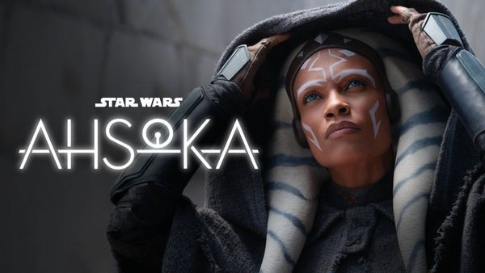
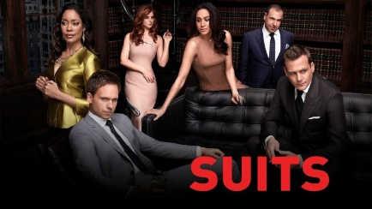

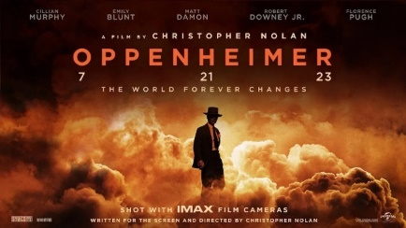

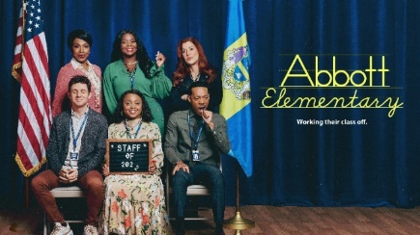

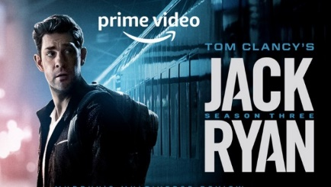

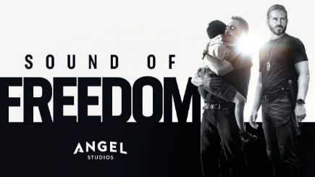
This ad attention is driven by the high-quality, long-form content that each premium video platform consistently provides to audiences
Sampling of Premium Video Programming
Linear TV
Streaming
Cinema
This information is exclusively provided to VAB members and qualified marketers.
PAGE 7

Slide 8



Consumers view premium entertainment video content as part of their identity and share this passion with others
53%
54%
38%
‘My passion for my
favorite entertainment
franchises is part of my identity’
‘I make an effort to pass
on my passion for my favorite
entertainment franchises to my friends and family members
(my spouse, my children, etc.)’
‘I interact with, and extend, my favorite entertainment franchises by creating my own fan-made
content (reviews, analyses,
designs, artwork, etc.)’
Source: Dentsu Consumer Navigator: Entertainment 2023, September 2023.
This information is exclusively provided to VAB members and qualified marketers.
PAGE 8

Slide 9



Brand associations with premium entertainment video content drives attention, consideration and purchase intent
If a brand sponsors or collaborates with your favorite entertainment properties…
52%
51%
49%
‘I will pay more attention’
‘My opinion will improve’
‘I will consider purchasing’
Source: Dentsu Consumer Navigator: Entertainment 2023, September 2023.
This information is exclusively provided to VAB members and qualified marketers.
PAGE 9

Slide 10
Because they crave the best premium video content regardless of screen, TV viewers and streamers are also likely to be habitual movie-goers
Movie Attendance Frequency by Platform Viewers
2.9x
TV viewers are nearly three times more likely to be heavy movie-goer than a light movie-goer.
2.4x
Streamers are two and a half times more likely to be heavy movie-goer than a light movie-goer.
Source: Screenvision Media, Screen Engine Data, November 2022, Q: How do you/your household connect to media? - Subscribe to cable; Q Do you/your household subscribe, use or borrow any streaming services (free or paid)? – Yes. Base: Total Respondents.
This information is exclusively provided to VAB members and qualified marketers.
PAGE 10

Slide 11
With that said, the theatrical release of Barbie and Oppenheimer created more excitement than any other premium video content this summer
Cinema, TV & Streaming Content: Google Trends Index*
reflects a selection of top movies, linear TV and streaming programs
Barbie:
7/22 Max: 100
Oppenheimer
7/22 Max: 55
The Summer I Turned Pretty
7/14 Max: 10
Sweet Magnolias
7/23: Max: 4
The Bear
6/25 Max: 9
The Witcher
7/3 Max: 5
Suits
7/9 Max: 5
Justified: City Primeval
7/19 Max: 4
Ahsoka
8/23 Max: 11
One Piece
8/31 Max: 13
Yellowstone
6/18 Max: 6
Hijack
8/2 Max: 2
Source: VAB analysis of Google Trends, United States only, All Categories, Web Search, 06/01/23-08/30/23. *Google Trends Index represents search interest relative to the highest point on the chart for the given region and time period, a value of 100 is the peak popularity for the term, a value of 50 means that the term is half as popular. The date for each content represents the highest relative trend index (i.e., ‘max’) achieved during the measurement period.
This information is exclusively provided to VAB members and qualified marketers.
PAGE 11

Slide 12
In fact, Barbie and Oppenheimer were even bigger than Taylor Swift, Beyonce and Messi during the summer
Entertainment Content: Google Trends Index*
reflects a selection of top movies, artists, sports & social media stories
Barbie:
7/22 Max: 100
Film’s opening weekend
Wimbledon
7/16 Max: 52
Carlos Alcaraz ends Novak Djokovic’s 34-match win streak
Oppenheimer
7/22 Max: 55
Film’s opening weekend
U.S. Open
6/18 Max: 45
American outsider Wyndham Clark wins his first major
Threads
7/6 Max: 31
After Meta launched Threads on 7/5, its’ trend peaked the next day
Taylor Swift
8/10 Max: 28
Singer performs sold out
Era’s Tour in the U.S.
Messi
6/7 Max: 19
Soccer star joins Inter Miami CF
Beyonce
7/30 Max: 5
Singer performs U.S. leg of her Renaissance Tour
Source: VAB analysis of Google Trends, United States only, All Categories, Web Search, 06/01/23-08/30/23. *Google Trends Index represents search interest relative to the highest point on the chart for the given region and time period, a value of 100 is the peak popularity for the term, a value of 50 means that the term is half as popular. The date for each content represents the highest relative trend index (i.e., ‘max’) achieved during the measurement period.
This information is exclusively provided to VAB members and qualified marketers.
PAGE 12

Slide 13
Cinema as a video platform elicits unbridled passion, engagement and experience
Let’s look at the ‘Barbenheimer’ cultural phenomenon as a case study…

Slide 14


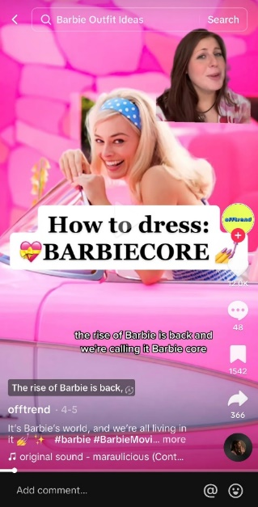
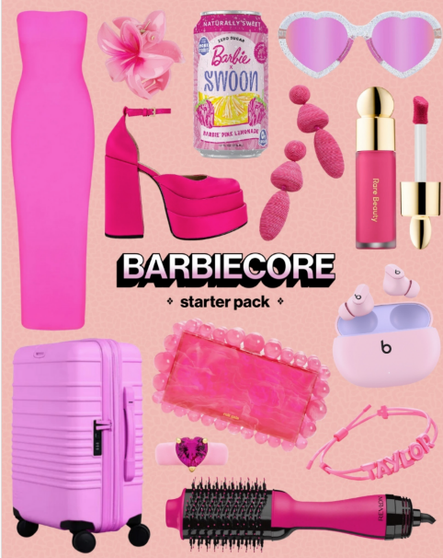



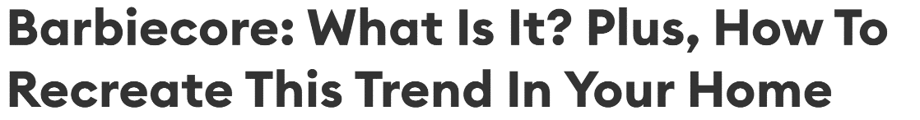

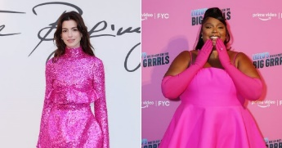

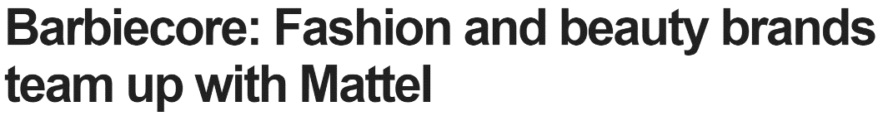
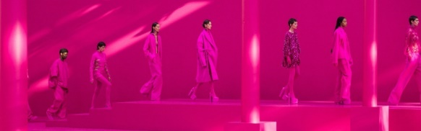

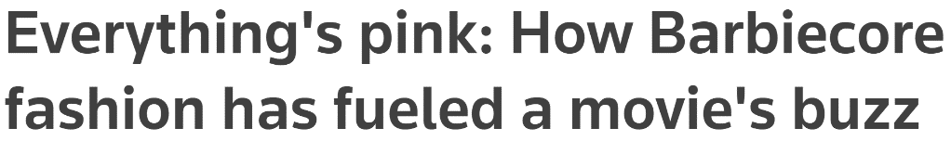



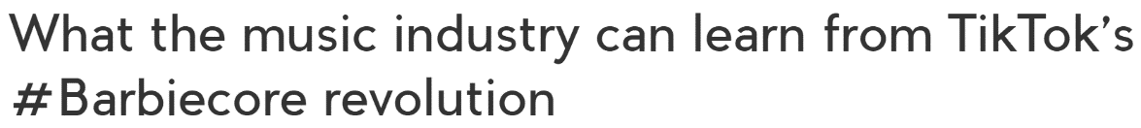
Anticipation for ‘Barbie’ started a full year before release as ‘Barbiecore’ became a popular user hashtag on TikTok and other platforms
‘Barbiecore’ in the News
‘Barbiecore’ Influence
Social Media
On TikTok, the ‘Barbiecore’ hashtag has gained ~700 million views since the Barbie movie was announced in 2022. The trend is seen through videos on fashion, design, aesthetic and femininity.
Fashion
Valentino’s 2022 collection brought ‘Barbiecore’ back to the forefront of fashion and has since grown in popularity following the premiere of the Barbie movie.
…and More
Brands are releasing a tidal wave of singular feminine, pink-colored products to capitalize on the current trend.
This information is exclusively provided to VAB members and qualified marketers.
PAGE 14

Slide 15

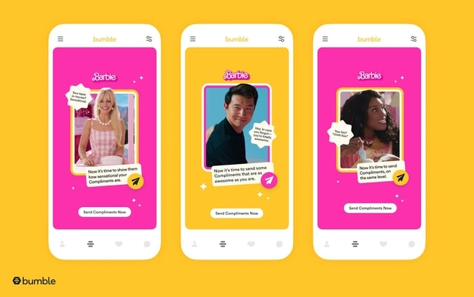
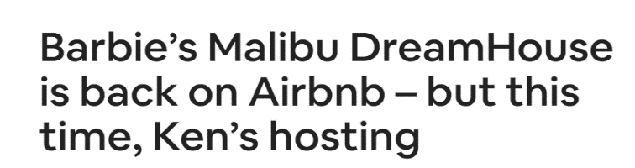
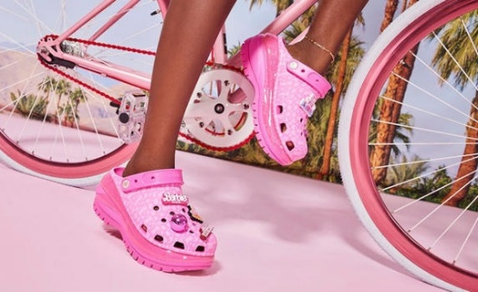

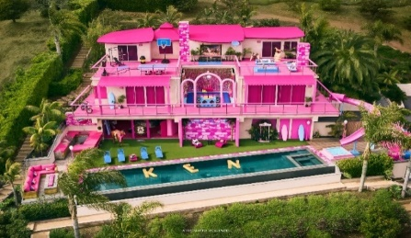
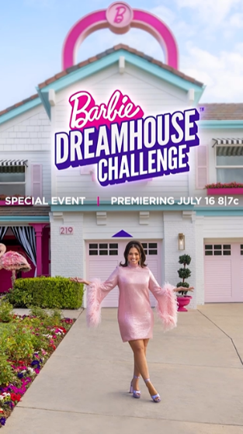
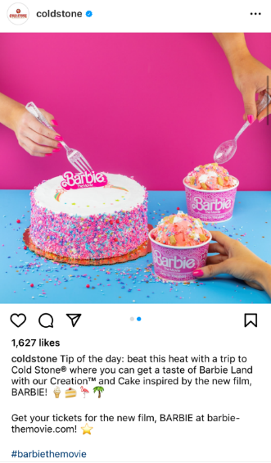
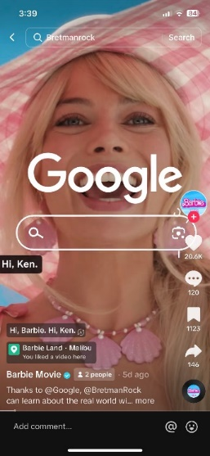
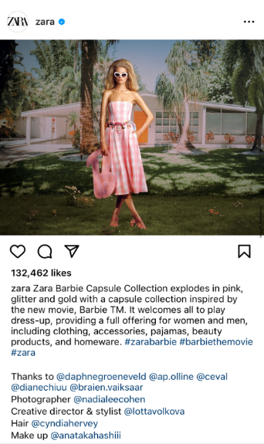
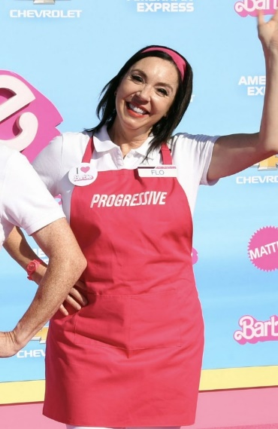
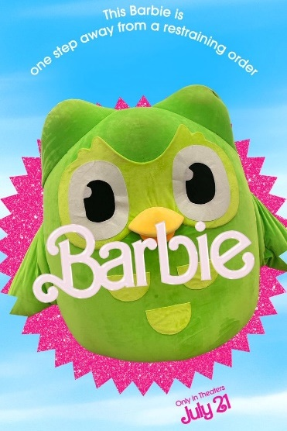
Seeking premium associations, brands across categories joined the cultural zeitgeist around Barbie-mania through promotional tie-ins
XBOX partnered with Barbie to create custom consoles and controllers
Bumble advertisement featuring Barbie
Airbnb creates Barbie’s dream house and Ken’s mojo dojo casa
Crocs partners with Barbie to create custom shoes
Krispy Kreme
Barbie donut
HGTV hosts Barbie Dreamhouse Challenge
Cold Stone launches special Barbie ice cream
Google features
Barbie in Ad
Zara creates Barbie clothing line
Progressive launches a Barbie themed commercial
Duolingo’s social media post using Barbie trends
This information is exclusively provided to VAB members and qualified marketers.
PAGE 15

Slide 16

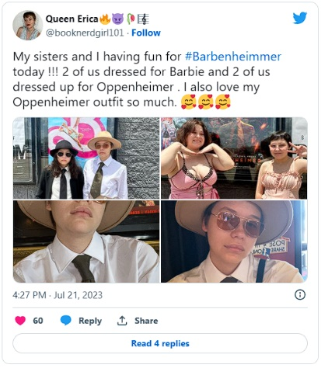
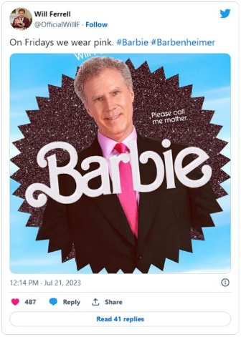
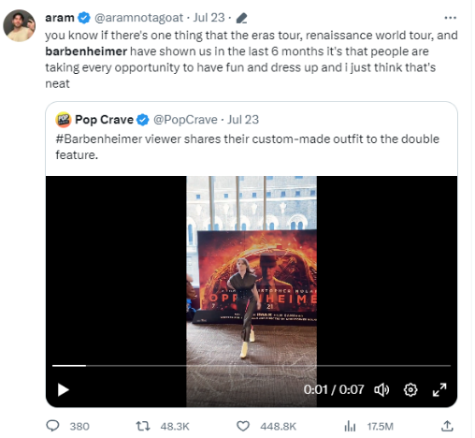
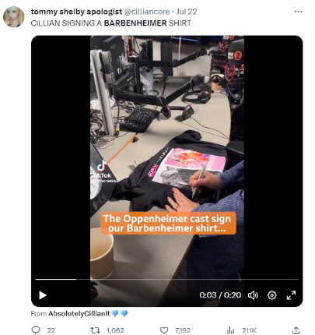
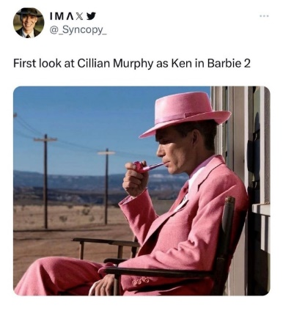

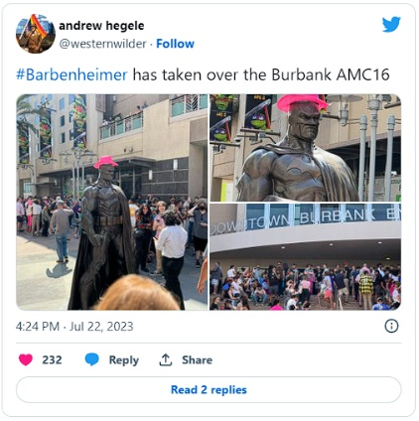
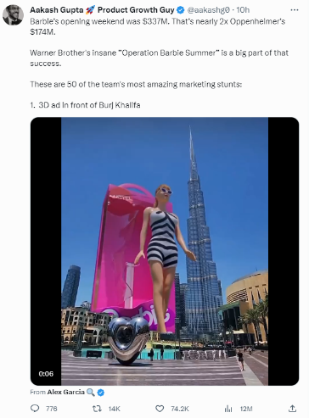
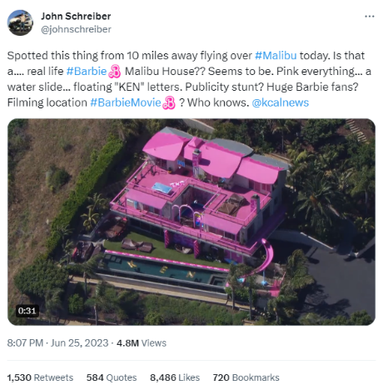
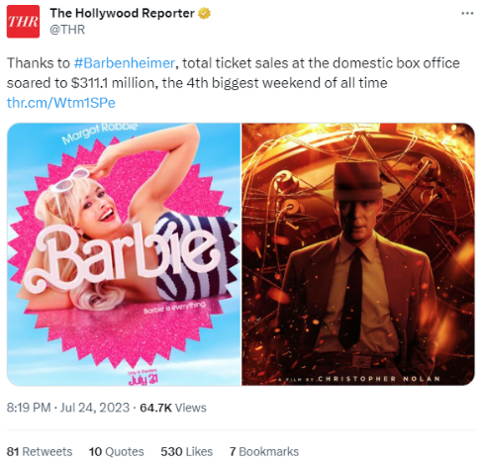
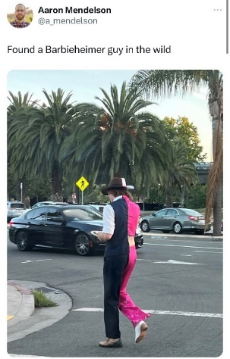
Momentum continued to build this year on social media which also included Oppenheimer and the coining of the popular term ‘Barbenheimer’
Sampling of Social Media Posts Around ‘Barbenheimer,’ Barbie & Oppenheimer
July 24th, 2023
Don’t dismiss ‘Barbenheimer’ as a fleeting social media trend—it’s a genius marketing lesson
July 18th, 2023
The 'Barbenheimer’ phenomenon: How a movie meme inspired the 'crazy, weird' double feature
July 18th, 2023
'Barbenheimer': How the shared release date of 'Barbie' and 'Oppenheimer' has taken social media by storm
This information is exclusively provided to VAB members and qualified marketers.
PAGE 16

Slide 17

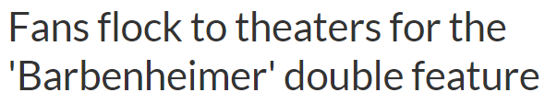


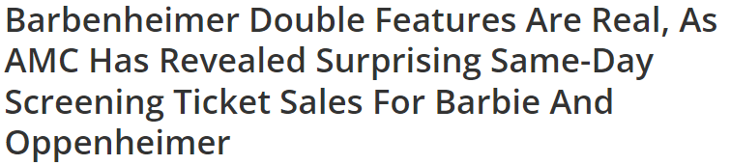
‘Barbenheimer’ became a cultural movement, with movie goers purchasing double-feature tickets to watch both films on the same day
‘Barbenheimer’ Same-Day Double Feature Sales by AMC Stubs Members
July 22nd, 2023
July 24th, 2023
‘Barbenheimer’: Blockbuster for ‘Barbie’ and ‘Oppenheimer’ as double feature brought in big bucks
July 10th, 2023
Source: Variety, ‘AMC Theatres Says More Than 20,000 Moviegoers Have Already Booked ‘Barbie’-‘Oppenheimer’ Double Features’, 7/10/23. The Wrap, ‘AMC Says ‘Barbie,’ ‘Oppenheimer’ Double-Feature Ticket Sales Have Doubled in Past Week’, 7/17/23. Adam Aron, @CEOAdam on Twitter, 7/21/23. Note: Figured reflect cumulative sales across the weeks (i.e. – by opening weekend, 60,000 AMC Stubs members had bought double-feature tickets).
This information is exclusively provided to VAB members and qualified marketers.
PAGE 17

Slide 18
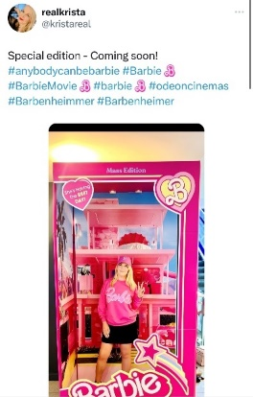
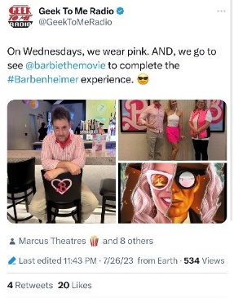
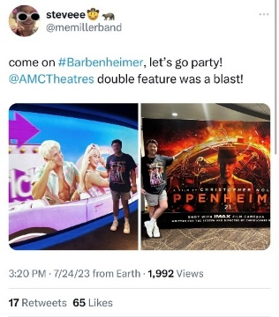
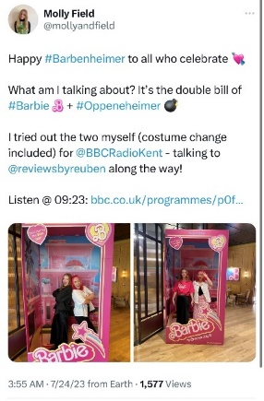
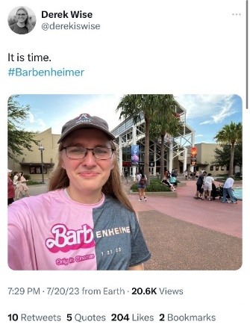
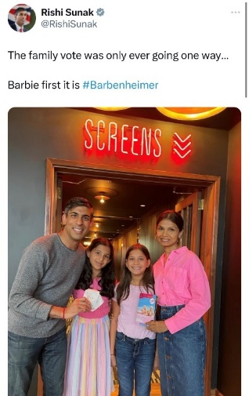
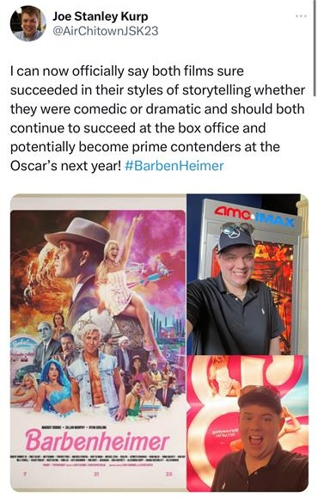
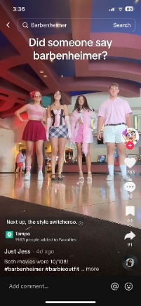
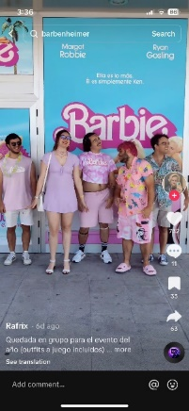
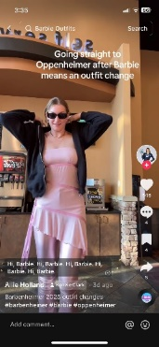
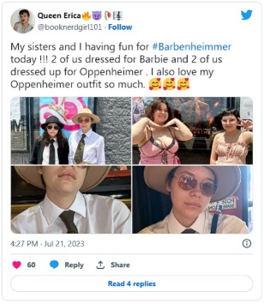
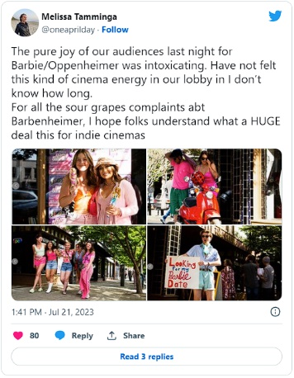
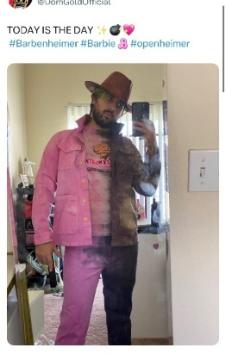
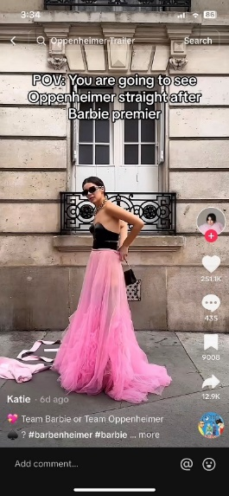













‘Barbenheimer’ drew passionate fans that dressed for the occasion as a social event with family and friends at their local cineplex
Fans showed their excitement for ‘Barbenheimer’ by wearing outfits split between the bright pink of ‘Barbie’ and the black of ‘Oppenheimer’
This information is exclusively provided to VAB members and qualified marketers.
PAGE 18

Slide 19















For Oppenheimer, many Christopher Nolan fans even traveled for hours,
or took a road trip, to see the film in its intended IMAX format experience
Sampling of Social Media Posts Around Oppenheimer in IMAX 70MM
July 15th, 2023
‘Oppenheimer’ Inspires Road Trips and Far-Flung Flights as Movie Buffs Clamor for the Ideal Viewing Experience
July 17th, 2023
For ‘Oppenheimer,’ These Fans Go to Great Lengths for Just 30 Screens
The IMAX 70-millimeter format is usually associated with action. But Christopher Nolan says his biopic benefited from the tall image.
July 27th, 2023
July 24th, 2023
Nolan fans are traveling hours to see 'Oppenheimer' in its intended 70mm IMAX format
Aug 7, 2023
This information is exclusively provided to VAB members and qualified marketers.
PAGE 19

Slide 20


As a result, both ‘Barbie’ and ‘Oppenheimer’ smashed already mounting box office projections on the same opening weekend
Domestic Box Office Projections vs. Opening Weekend Box Office
$ in MM
Barbie
Oppenheimer
+195%
Opening Weekend vs. 6/22 projection
+120%
Opening Weekend vs. 6/22 projection
$100 - $109 MM
$55 - $65 MM
$65 - $74 MM
$50 - $60 MM
$35 - $40 MM
$32 - $37 MM
$34 - $39 MM
$31 - $36 MM
Four Weeks Out from Opening
Three Weeks Out from Opening
Two Weeks Out from Opening
One Week Out from Opening
Four Weeks Out from Opening
Three Weeks Out from Opening
Two Weeks Out from Opening
One Week Out from Opening
(7/21-7/23)
(7/21-7/23)
Source: Projections based on The Quorum, ‘6-Weeks Out Film Tracking Report’ – 6/22/23, 6/29/23, 7/6/23, 7/13/23. Chart projections reflect a median of projection range (Barbie’s 6/22 projection was $50MM to $60MM, with a median of $55MM; Oppenheimer’s 6/22 projection was $35MM to $40MM, with a media of $37.5MM). Opening Weekend $$$ based on finalized opening weekend box office per boxofficemojo.com.
This information is exclusively provided to VAB members and qualified marketers.
PAGE 20

Slide 21


Collectively, ‘Barbie’ and ‘Oppenheimer’s opening weekend box office nearly doubled its projected revenues from just one week prior to release
Domestic Box Office Projections vs. Opening Weekend Box Office
$ in MM
+173%
Opening Weekend vs. 7/13 projection
$245
$142
$93
$95
$104
(6/22)
(6/29)
(7/6)
(7/13)
(7/19 – 7/21)
Source: Projections based on The Quorum, ‘6-Weeks Out Film Tracking Report’ – 6/22/23, 6/29/23, 7/6/23, 7/13/23. Chart projections reflect a median of projection range (Barbie’s 6/22 projection was $50MM to $60MM, with a median of $55MM; Oppenheimer’s 6/22 projection was $35MM to $40MM, with a media of $37.5MM). Opening Weekend $$$ based on finalized opening weekend box office per boxofficemojo.com.
This information is exclusively provided to VAB members and qualified marketers.
PAGE 21

Slide 22


Several box office records were broken during ‘Barbenheimer’ weekend which shows the vibrancy of the movie going experience
Domestic Opening Weekend Box Office Records
(7/21-7/23/23)
7/21-7/23 Weekend Total Box Office
$311MM
Barbie
$162MM
Oppenheimer
$83MM
Highest grossing weekend
of 2023
Biggest R-rated opening weekend of 2023
First weekend ever with two movies opening over $80MM
Biggest single box office day
of 2023 ($70.8MM)
Highest weekend ever for a movie that finished #2
Fourth biggest total domestic weekend ever
Highest July opening for a non-sequel or non-remake
Largest biopic opening weekend
Biggest summer weekend ever
Largest opening weekends for:
A female directed film
A film with a female protagonist
Margot Robbie
Ryan Gosling
Biggest IMAX release of 2023
Highest total box office weekend since 2019
Highest non-Batman opening for Christopher Nolan
Source: VAB analysis of BoxOffice Mojo, weekend of 7/21/23. Yahoo, ‘All the box office records 'Barbenheimer' has broken’, 7/25/23. CNBC, ‘‘Barbenheimer’ tops $235 million in domestic debut, eyes second-highest box office weekend ever‘, 7/23/23.
This information is exclusively provided to VAB members and qualified marketers.
PAGE 22

Slide 23









‘Barbenheimer’ opening weekend audience far exceeded the annual attendance of the four major sports plus other popular summer activities
Cinema: Estimated Opening Weekend Adult 18+ Admissions
+
18.5 MM
(combined)
12.8 MM
5.8 MM
Other ‘Out-of-Home’ Activities by Comparison (Adult 18+)
4 Major Sports Leagues – regular season combined attendance reach (last 12 months): 14.4 MM
Went to a bar / club
in last week: 5.8 MM
Went to the beach
in last week: 5.2 MM
Went to a concert / live music in last week: 841K
Source: Deadline, based on data from EntTelligence, ‘‘Barbie’ Still Gorgeous With Best YTD $162M Opening; ‘Oppenheimer’ Detonates $82M+ In Incredible $300M+ U.S. Box Office Weekend – Monday AM Update’, 7/24/23. ‘Other activities’ based on MRI-Simmons Fall 2022 Doublebase USA study, P18+, Sports attendance reflects P18+ reach for regular season games in the last 12 months, ‘concert / live music’ includes country, rock, classical, Hip-Hop/R&B, music festivals or other.
This information is exclusively provided to VAB members and qualified marketers.
PAGE 23

Slide 24
Representative of overall movie attendance, ‘Barbie’ and ‘Oppenheimer’ complemented each other by welcoming all types of audiences
Barbie skewed female, under 35+, families and teens while Oppenheimer skewed male, over 35 and ‘non-family’ adult groups
Opening Weekend Demographics by Movie
7/21-7/23/23
Gender
Age
Audience Type Comp %
Barbie
71%
Female
Barbie
72%
35 or under
Barbie
53%
Families & Teens
Oppenheimer
58%
Male
Oppenheimer
58%
Over 35
Oppenheimer
90%
Adults without children
or teenagers
Source: Screendollars, ‘Newsletter Issue No. 278’, 7/23/23, industry data provided by EntTelligence.
This information is exclusively provided to VAB members and qualified marketers.
PAGE 24

Slide 25
















In the ultimate sign of brand love, fans created also created their own art that combined film universes to create ‘Barbenheimer’ mashups
This information is exclusively provided to VAB members and qualified marketers.
PAGE 25

Slide 26
2023 has also featured additional theatrical successes that have delighted audiences

Slide 27










Movies based on well-known intellectual property (IP) mixed with some surprise hits have entertained large audiences throughout the year
2023 Domestic Box Office Revenues
Barbie
$620MM
Release date: July 21, 2023
The Super Mario
Bros. Movie
$575MM
Release date: April 5, 2023
Spider-Man: Across the Spider-Verse
$381MM
Release date: June 2, 2023
Guardians of the Galaxy Vol. 3
$359MM
Release date: May 5, 2023
Oppenheimer
$315MM
Release date: July 21, 2023
The Little Mermaid
$298MM
Release date: May 26, 2023
Avatar: The Way
of Water
$283MM
Release date: December 16, 2022
Ant-Man and the Wasp: Quantumania
$215MM
Release date: February 17, 2023
John Wick: Chapter 4
$187MM
Release date: March 24, 2023
Sound of Freedom
$183MM
Release date: July 4, 2023
Source: Box Office Mojo, ‘Domestic Box Office For 2023‘, as of 9/11/23
This information is exclusively provided to VAB members and qualified marketers.
PAGE 27

Slide 28




While specialty theatrical films are highly targeted towards cultured, influential, young professional ‘Sophisticates’
2023 Specialty Films Box Office
Opening Weekend Audience Comp %
27%
P25-34
34%
P25-34
50%
P25-34
33%
P25-34
(P25-34 represents 13.6% of U.S. population)
Source: Air = Deadline, ‘‘Super Mario Bros’ Hits High Scores: Record Opening For Animated Pic At $377M+ WW, 5-Day U.S. Record $204M+; ‘Air’ Soars To $20M – Sunday Box Office Update’, 4/9/23; You Hurt My Feelings = Deadline, ‘Little Mermaid’ Still Swimming To $117M+ Opening Boosted By $80M Promo Campaign, Biggest For Disney Live-Action Title – Monday AM Update’, 5/29/23; Theater Camp = Deadline, ‘‘Theater Camp’ Hits High Note With Searchlight’s Best Limited Opening Since ‘Jojo Rabbit’ – Specialty Box Office’, 7/16/23; A Thousand and One = Deadline ‘‘Dungeons & Dragons’ Locks Up $38.5M Opening: Is This Enough To Start A Franchise? – Sunday Box Office’, 4/2/23. Sophisticates represent P25-44 that value premium experiences, download Engaging the ‘Sophisticates’ at the Cinema to learn more.
This information is exclusively provided to VAB members and qualified marketers.
PAGE 28

Slide 29
Most recently, Taylor Swift’s ‘The Eras Tour’
is another success story that highlights the passion, engagement and scale of cinema

Slide 30














Once Taylor Swift announced her ‘Eras Tour’ film, fans generated additional buzz online in anticipation of the theatrical release
This information is exclusively provided to VAB members and qualified marketers.
PAGE 30

Slide 31






Fans immediately planned their trip to the local cineplex as a major social event and communal experience with friends and family
% of Taylor Swift’s ‘Eras Tour’ moviegoers planning to attend with…
Groups of 4+
73%
Friends
71%
Family
57%
Spouse or
Significant Other
47%
Kids
32%
Source: Screenvision & eWorks Research, ‘Taylor Swift: The Eras Tour Research’, 9/15 – 9/17/23.
This information is exclusively provided to VAB members and qualified marketers.
PAGE 31

Slide 32















This excitement translated into breaking presale ticket records for any theatrical release
September 5, 2023
September 7, 2023
September 1, 2023
August 31, 2023
Taylor Swift: The Eras Tour
September 1, 2023
September 11, 2023
$37MM+
In U.S. single-day ticket sales
for AMC, Regal and Cinemark within the first 24 hours
(vs. “Star Wars: The Force Awakens” at $20M)
September 1, 2023
$100MM+
Proj. U.S. opening weekend
(vs. Hannah Montana and Miley Cyrus: Best
of Both Worlds Concert $31M opening in 2008)
Source: Deadline, ‘Taylor Swift: The Eras Tour’ Industry First Day Presales $37M+, Bigger Than ‘Force Awakens’; Concert Pic Headed For $70M+ Opening, 9/1/2023. The Hollywood Reporter, Taylor Swift Box Office: Theater Owners Predict Record $100M Opening for Eras Tour Concert Pic, 9/5/2023.
This information is exclusively provided to VAB members and qualified marketers.
PAGE 32

Slide 33





Highlighting cinema’s scale, ‘The Eras Tour’ opening weekend is expected to draw nearly double the attendance of her 5-month U.S. stadium tour
‘The Eras’ Tour: Stadium Concert Tickets vs. Movie Tickets
‘The Eras’ Stadium Tour
(First leg of the U.S. tour 3/17-8/9)
‘Taylor Swift: The Eras Tour’ U.S. Theatrical Release
(10/13 release date)
2.8MM
5MM+
Total attendance for first leg of U.S. Tour (52 Shows)
Projected tickets sold for U.S.
opening weekend of film release
Source: VAB Analysis of Billboard Pro, Taylor Swift’s Eras Tour on Track to Sell $590M in Tickets. Here’s Where That Money Goes’, 12/16/22. *The Hollywood Reporter, ‘Taylor Swift Box Office: Theater Owners Predict Record $100M Opening for Eras Tour Concert Pic’, 9/5/23. ‘The Eras’ stadium tour 2.8 total attendance estimate is based on 54K avg. stadium tickets sold per stadium, 52 shows in the first leg of the tour. The theatrical release 5MM+ projected tickets sold estimate is based on $100M opening week projection with tickets estimated to be sold at $19.89.
This information is exclusively provided to VAB members and qualified marketers.
PAGE 33

Slide 34
More highly engaging releases will be coming soon to a movie theater near you

Slide 35










The theatrical pipeline continues to be filled with high-profile movies and specialty film releases, even as the actors’ strike nears resolution
Upcoming Cinema Releases
Priscilla
Release date: November 3, 2023
The Marvels
Release date: November 10, 2023
The Hunger Games: The Ballad
of Songbirds and Snakes
Release date: November 17, 2023
Next Goal Wins
Release date: November 17, 2023
Wish
Release date: November 22, 2023
Napoleon
Release date: November 22, 2023
Renaissance:
A Film by Beyonce
Release date: December 1, 2023
Wonka
Release date: December 15, 2023
Aquaman and
The Lost Kingdom
Release date: December 20, 2023
Ferrari
Release date: December 25, 2023
Source: Fandango, Movies Coming Soon, 2023. Note: Release dates planned as of 10/10/23 and subject to change.
This information is exclusively provided to VAB members and qualified marketers.
PAGE 35

Slide 36
With its high-quality content and passionate audiences, cinema is an integral platform in the premium video ecosystem that delivers scale, immediacy, cultural connection and strong engagement to marketers’ holistic video campaigns
Cinema ‘seasonality’ now covers all twelve months as theatrical release successes are seen throughout the year with both well-known ‘IP’ movies and surprising crowd pleasers
Even with a five-month long writers and actors strike,
the upcoming theatrical release slate continues to be filled with high-profile movies and specialty films which provides marketers with more opportunities for premium brand associations in a highly-attentive environment
Key Marketer Takeaways
This information is exclusively provided to VAB members and qualified marketers.
PAGE 36

Slide 37






Creators
Jason Wiese
Reed Kiely
SVP, Director of Strategic Insights
jasonw@thevab.com
Director, Data Insights & Trends
reedk@thevab.com
At the Movies
15 Reasons to Include Cinema Within
a Video Campaign
I Know What You Did This Summer
Harnessing Consumer Momentum
at the Movies (2022)
Karolina Guillen
Insights Manager
karolinag@thevab.com
Discover more
Looking for more data, insights and takeaways? Check out this related VAB content
Capturing the ‘Elusives’
at the Cinema
How Brands Can Reach Young, Diverse and Cordless Consumers
Engaging the ‘Sophisticates’
at the Cinema
How Brands Can Reach Adults 25-44 That Value Premium Experiences
You Oughta Know
Why All Impressions Aren’t Created Equal & What It Means for Video Measurement
Engaging Frequent Video Streamers Through Cinema
VAB Members, brand marketers and agencies get free and immediate access to VAB’s content library. Get access at theVAB.com
This information is exclusively provided to VAB members and qualified marketers.
PAGE 37

Slide 38


About VAB
VAB plays a dual role in the video advertising industry. We are leading
the change to bring about a more innovative and transparent marketplace. We also provide the insights and thought leadership that enables marketers to develop business-driving marketing strategies.
Drawing on our marketing expertise, we simplify the complexities in our industry and discover new insights that transform the way marketers look at their media strategy.
We are committed to your business growth and proud to offer VAB members, brand marketers and agencies complimentary access to our continuously-growing Insights library. Get immediate access at theVAB.com.
This information is exclusively provided to VAB members and qualified marketers.
PAGE 38

