Slide 1
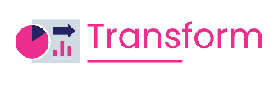
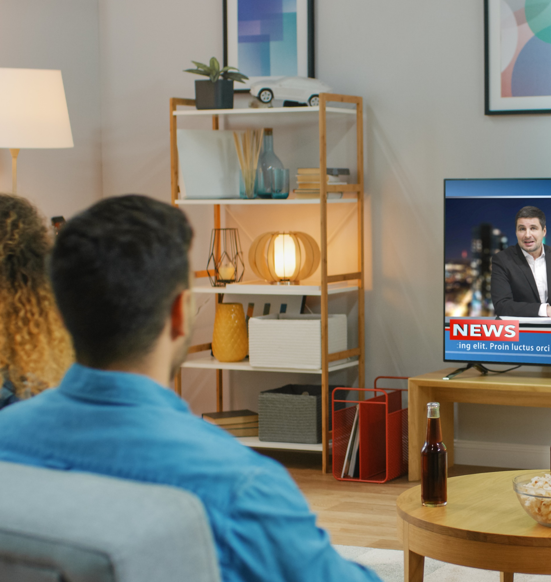



The Lead Story
How Multiscreen TV Drives Cross-Partisan Engagement for Political Ad Campaigns

Slide 2
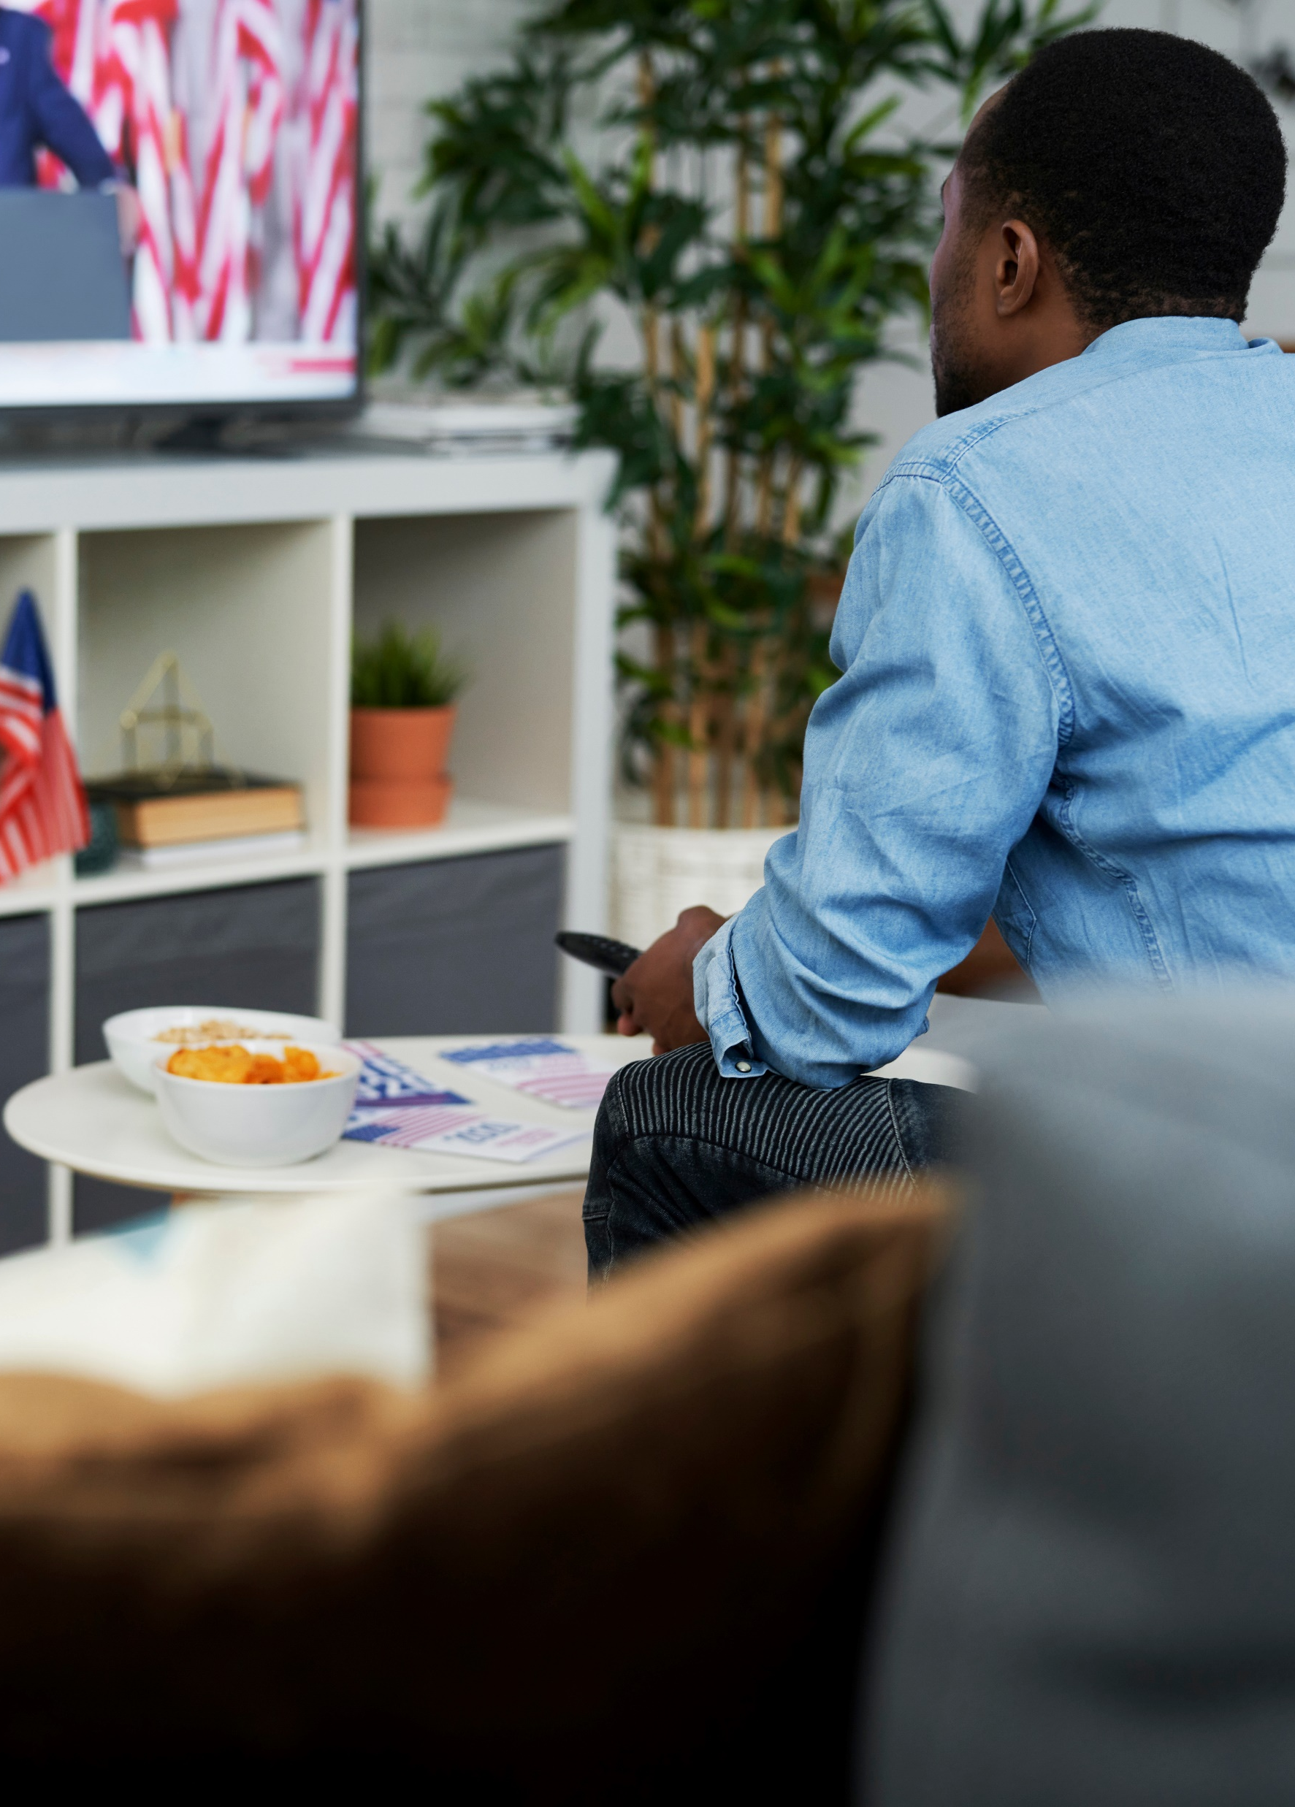

Multiscreen TV delivers cross-partisan engagement across content and screens
Today’s voters, regardless of political involvement or party affiliation, move fluidly across trusted multiscreen TV platforms, spanning both linear and streaming, to stay informed on current events and political issues. For marketers, this creates the opportunity to reach audiences broadly and repeatedly in high-quality viewing environments that are positively perceived and can inform, engage and ultimately drive action.
VAB conducted a survey with Dynata to understand how multiscreen TV drives cross-partisan engagement for political ad campaigns. This report examines where viewers spend their time, which sources they trust most and how different TV contexts contribute to stronger interest and outcomes for political messaging.
Throughout this report, ‘multiscreen TV’ refers to the combined ecosystem of ad-supported linear and streaming TV. Together, these platforms deliver unified scale and trusted environments across screens, positioning TV as the go-to source for reliable information amidst a sea of choices and waves of misinformation.
See appendix for greater details behind the custom study methodology and make-up of the 2,319 A18+ U.S. respondents. Survey fielded in December 2025.
This information is exclusively provided to VAB members and qualified marketers.
PAGE 2

Slide 3






We examined behaviors and sentiments across 5 key voting and party affiliation groups to understand their commonalities and differences
5 Key Groups Examined in This Analysis
Voting Group
Party Affiliation
Potential Voters
Non-Voters
Republicans
Democrats
Independents
Source: Dynata, Media Consumption and Political Sentiment survey, fielded December 2025 (n=2,319). Survey base: A18+ U.S. respondents. Voter respondents (n=1,514), Non-Voter respondents (n=680), Republican respondents (n=636), Democrat respondents (n=612), Independent respondents (n=546). Potential Voter = I am a registered voter,’ or ‘I am planning to vote in the midterm/local elections in 2026’ or ‘I typically vote with a mail-in ballot.’ Non-Voter = ‘I am not a registered voter,’ ‘I am not planning to vote in the midterm/local elections in 2026,’ ‘I did not vote in the most recent local/state elections,’ ‘I didn’t vote in the last presidential election,’ and ‘I don’t typically vote with a mail-in ballot.’
This information is exclusively provided to VAB members and qualified marketers.
PAGE 3

Slide 4

1
As voters prioritize issues over party identity, credible environments like TV news are essential for delivering balanced information

Slide 5
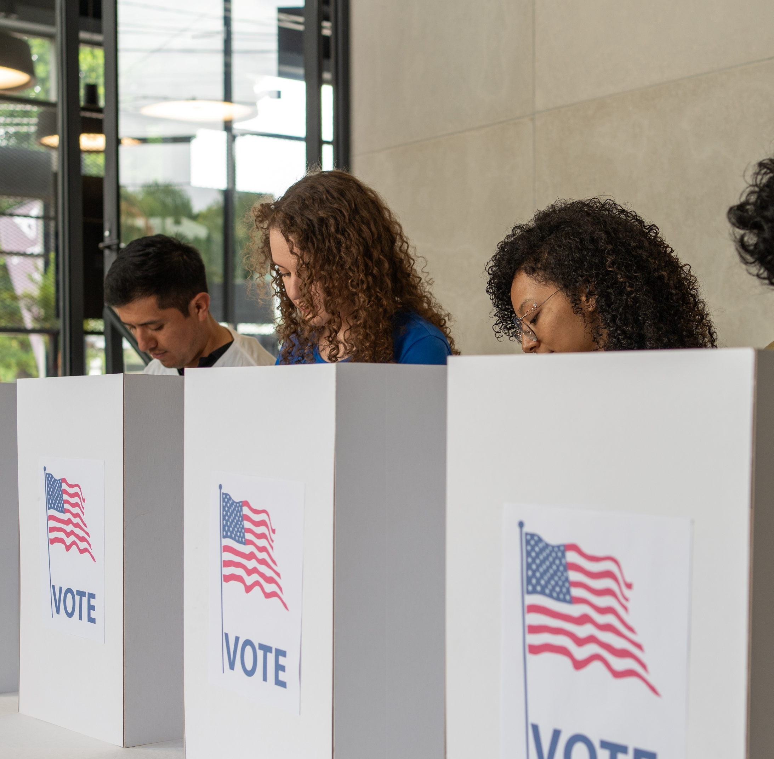
Issue-based initiatives resonate more strongly than party affiliation messaging, reflecting how most voters evaluate choices
% of respondents who vote based on the issue, not the party affiliation
65%
of potential voters
58%
of Republicans
58%
of Democrats
78%
of Independents
Source: Dynata, Media Consumption and Political Sentiment survey, fielded December 2025 (n=2,319). Survey base: A18+ U.S. respondents. Q21. Please rate your agreement with the following statements – ‘I vote based on the issue, not party affiliation’. Based on respondents who selected ‘strongly agree’ or ‘agree’ [Top 2 Box]. Base = Voter Respondents. Potential Voter respondents (n=1,514), Republican respondents (n=535), Democrat respondents (n=530), Independent respondents (n=401).
This information is exclusively provided to VAB members and qualified marketers.
PAGE 5

Slide 6

Because of this, most voters prefer that political ads focus on the issues rather than a candidate
% of respondents who prefer ads that focus on the issues (vs. those who prefer ads that focus on the candidate)
75%
of potential voters
(vs. 16%)
46%
of non-voters
(vs. 9%)
72%
of Republicans
(vs. 17%)
75%
of Democrats
(vs. 15%)
68%
of Independents
(vs. 15%)
Source: Dynata, Media Consumption and Political Sentiment survey, fielded December 2025 (n=2,319). Survey base: A18+ U.S. respondents. Q33. Please select which statement most accurately describes political advertising. Base = Ad Exposed Respondents (n=1,473). Voter respondents (n=1,021), Non-Voter respondents (n=372), Republican respondents (n=402), Democrat respondents (n=414), Independent respondents (n=345).
This information is exclusively provided to VAB members and qualified marketers.
PAGE 6

Slide 7



This makes credible, middle-ground environments like TV news especially important for advertisers seeking reach without polarization
TV news is perceived as more balanced compared to social media posts, which often reflect individual perspectives and can lean more partisan
% more likely to feel TV news offers positive representations
of moderate or bipartisan views vs. social media*
Potential Voters
Non-Voters
+38%
more likely
(36% vs. 26%)
+12%
more likely
(27% vs. 24%)
Republicans
Democrats
Independents
+22%
more likely
(33% vs. 27%)
+48%
more likely
(44% vs. 30%)
+33%
more likely
(31% vs. 24%)
Source: Dynata, Media Consumption and Political Sentiment survey, fielded December 2025 (n=2,319). Survey base: A18+ U.S. respondents. Q29. How would you rate the representation of moderate or bipartisan views in the following media? Based on respondents who selected ‘excellent’ or ‘good’ [Top 2 Box]. Base = Total Respondents. Potential Voter respondents (n=1,514), Non-Voter respondents (n=680), Republican respondents (n=636), Democrat respondents (n=612), Independent respondents (n=546). *e.g., on Instagram, Facebook.
This information is exclusively provided to VAB members and qualified marketers.
PAGE 7

Slide 8
Audiences turn to reliable TV news sources to stay informed on political issues far more than any other platform
Potential voters are 60% more likely to use TV news to stay informed than they are social media
Which of the following do you use to stay informed about key national political issues?
% of respondents
Source: Dynata, Media Consumption and Political Sentiment survey, fielded December 2025 (n=2,319). Survey base: A18+ U.S. respondents. Q20. Which of the following do you use to stay informed about key national political issues (e.g. the economy)? Base = Voter Respondents. Voter respondents (n=1,514), Republican respondents (n=535), Democrat respondents (n=530), Independent respondents (n=401). TV news = national or local. Social media posts = Instagram, TikTok, X, Facebook, etc. Discussion-based social media = Reddit, X, Bluesky, etc.
This information is exclusively provided to VAB members and qualified marketers.
PAGE 8

Slide 9
2
Today’s voters are active, ad-supported multiscreen TV viewers, which makes omnichannel strategies vital for the success of political ad campaigns

Slide 10
Voters are twice as likely than non-voters to be pay-TV subscribers and more likely to be streamers which makes omnichannel campaigns vital
Voters can be reached across paid, ad-supported TV and streaming, making multiscreen TV an efficient way to deliver broad, repeated exposure
% of respondents who subscribe or have access to the following
(Cable or satellite)
(Netflix, Hulu, etc.)
(Tubi, Pluto TV, etc.)
(Cable or satellite)
(Netflix, Hulu, etc.)
(Tubi, Pluto TV, etc.)
Source: Dynata, Media Consumption and Political Sentiment survey, fielded December 2025 (n=2,319). Survey base: A18+ U.S. respondents. Q1. Which of the following do you subscribe to or have access to? Base = Total Respondents. Voter respondents (n=1,514), Non-Voter respondents (n=680), Republican respondents (n=636), Democrat respondents (n=612), Independent respondents (n=546).
This information is exclusively provided to VAB members and qualified marketers.
PAGE 10

Slide 11
Nine out of ten people who stream, regardless of their voting status or party affiliation, can be reached by ads through a paid streaming service
Voters can be reached through cable, satellite and streaming, making multiscreen TV an efficient way to deliver broad, repeated exposure
% of respondents who subscribe or have access to paid streaming services with ads*
92%
91%
92%
90%
90%
Source: Dynata, Media Consumption and Political Sentiment survey, fielded December 2025 (n=2,319). Survey base: A18+ U.S. respondents. Q2. Do you subscribe to or have access to paid streaming services with ads? Base = Respondents who subscribe to paid streaming services (n=1,612). Potential Voter respondents (n=1,114), Non-Voter respondents (n=411), Republican respondents (n=436), Democrat respondents (n=458), Independent respondents (n=383).
This information is exclusively provided to VAB members and qualified marketers.
PAGE 11

Slide 12
TV and streaming serve as primary discovery channels for political candidates, positioning TV as an early entry point for awareness
Potential voters are almost twice as likely to learn about political candidates from multiscreen TV compared to social media platforms
Where are you most likely to learn about a political candidate and their views for the first time?
% of respondents
Source: Dynata, Media Consumption and Political Sentiment survey, fielded December 2025 (n=2,319). Survey base: A18+ U.S. respondents. Q19. Where are you most likely to learn about a political candidate and their views for the first time? Base = Voter Respondents. Voter respondents (n=1,514), Republican respondents (n=535), Democrat respondents (n=530), Independent respondents (n=401). TV = linear TV or streaming. Social Media = Instagram, TikTok, X, Facebook, etc.
This information is exclusively provided to VAB members and qualified marketers.
PAGE 12

Slide 13
3
The trust, credibility and connection that are the hallmarks of TV news, and multiscreen TV overall, create habitual and highly engaging touchpoints for political advertisers throughout the election season

Slide 14
TV news is the primary starting point for understanding current events or issues for voters, while social media is viewed as more supplemental
% of respondents who get information on current events through the following platforms
Source: Dynata, Media Consumption and Political Sentiment survey, fielded December 2025 (n=2,319). Survey base: A18+ U.S. respondents. Q4. Where do you typically get information about current events? Base = Total Respondents. Voter respondents (n=1,514), Non-Voter respondents (n=680), Republican respondents (n=636), Democrat respondents (n=612), Independent respondents (n=546). Respondents could select any media.
This information is exclusively provided to VAB members and qualified marketers.
PAGE 14

Slide 15
Voters are much more likely than non-voters to watch local and national TV news which is a highly engaged touchpoint across political affiliations
% of respondents who typically watch local TV news
% of respondents who typically watch national TV news
61%
of potential voters
38%
of non-voters
57%
of potential voters
25%
of non-voters
60%
of Republicans
63%
of Democrats
55%
of Independents
58%
of Republicans
53%
of Democrats
47%
of Independents
Source: Dynata, Media Consumption and Political Sentiment survey, fielded December 2025 (n=2,319). Survey base: A18+ U.S. respondents. Q3. In a typical week, which of the following do you watch on TV? Base = TV Respondents (n=1,988). Potential Voter respondents (n=1,367), Non-Voter respondents (n=520), Republican respondents (n=558), Democrat respondents (n=544), Independent respondents (n=477).
This information is exclusively provided to VAB members and qualified marketers.
PAGE 15

Slide 16
Americans, both voters and non-voters, overwhelmingly trust TV news over any other digital media source like search, social or AI
Collectively, potential voters are almost 9x more likely to trust TV news than social media platforms
% of respondents who trust the following media sources the most
50%
of total respondents rank AI lowest for trust
Source: Dynata, Media Consumption and Political Sentiment survey, fielded December 2025 (n=2,319). Survey base: A18+ U.S. respondents. Q11. Please rank your level of trust with information from the following sources. Based on respondents who ranked media #1 = ‘I trust this source the most’. Base = All News Respondents (n=1,276). Voter respondents (n=988), Non-Voter respondents (n=226), Republican respondents (n=413), Democrat respondents (n=389), Independent respondents (n=309).
This information is exclusively provided to VAB members and qualified marketers.
PAGE 16

Slide 17
People across voting involvement and party affiliations are much more likely to appreciate the unbiased perspectives offered by TV news
% of respondents who are satisfied with the following…
Unbiased perspective in TV news reports
Source: Dynata, Media Consumption and Political Sentiment survey, fielded December 2025 (n=2,319). Survey base: A18+ U.S. respondents. Q10. Please indicate your overall level of satisfaction with the following. Reflects respondents who answered ‘satisfied’ or ‘very satisfied’ & ‘dissatisfied’ or ‘very dissatisfied.’ Base = All News Respondents (n=1,276). Potential Voter respondents (n=988), Non-Voter respondents (n=226), Republican respondents (n=413), Democrat respondents (n=389), Independent respondents (n=309).
This information is exclusively provided to VAB members and qualified marketers.
PAGE 17

Slide 18
More specifically, Americans trust the accuracy and quality of journalism that TV news provides
% of respondents who are satisfied with the following…
Accuracy of TV news reports
Quality of journalism / reporting on TV news
Source: Dynata, Media Consumption and Political Sentiment survey, fielded December 2025 (n=2,319). Survey base: A18+ U.S. respondents. Q10. Please indicate your overall level of satisfaction with the following. Reflects respondents who answered ‘satisfied’ or ‘very satisfied’ & ‘dissatisfied’ or ‘very dissatisfied.’ Base = All News Respondents (n=1,276). Potential Voter respondents (n=988), Non-Voter respondents (n=226), Republican respondents (n=413), Democrat respondents (n=389), Independent respondents (n=309).
This information is exclusively provided to VAB members and qualified marketers.
PAGE 18

Slide 19
Along with accuracy and quality, people value the speediness of information that TV news provides especially in their local community
% of respondents who are satisfied with the following…
Speed of breaking news coverage on TV
Information about my community from local TV news
Source: Dynata, Media Consumption and Political Sentiment survey, fielded December 2025 (n=2,319). Survey base: A18+ U.S. respondents. Q10. Please indicate your overall level of satisfaction with the following. Reflects respondents who answered ‘satisfied’ or ‘very satisfied’ & ‘dissatisfied’ or ‘very dissatisfied.’ Base = All News Respondents (n=1,276). Potential Voter respondents (n=988), Non-Voter respondents (n=226), Republican respondents (n=413), Democrat respondents (n=389), Independent respondents (n=309).
This information is exclusively provided to VAB members and qualified marketers.
PAGE 19

Slide 20
Social media is far more likely than TV programs to be viewed as a source of fake or misleading information across all groups
Potential voters are almost 3x more likely to believe social media platforms are most likely to provide fake or misleading information vs. TV
Which source, if any, do you believe is the most likely to provide fake or misleading information?
% of respondents
Source: Dynata, Media Consumption and Political Sentiment survey, fielded December 2025 (n=2,319). Survey base: A18+ U.S. respondents. Q30. Which source, if any, do you believe is the most likely to provide fake or misleading information? Base = Total Respondents. Voter respondents (n=1,514), Non-Voter respondents (n=680), Republican respondents (n=636), Democrat respondents (n=612), Independent respondents (n=546). TV = broadcast, cable or satellite.
This information is exclusively provided to VAB members and qualified marketers.
PAGE 20

Slide 21




Meaningful reach is not confined to TV news alone, as entertainment and sports programming provides significant scale to also engage with voters
% of respondents who watch the following on TV in a typical week
Sports
Drama
True Crime / Mystery
Reality
Potential Voters
60%
64%
53%
40%
Non-Voters
34%
51%
50%
36%
Republicans
62%
56%
52%
40%
Democrats
52%
68%
57%
41%
Independents
56%
61%
51%
38%
Source: Dynata, Media Consumption and Political Sentiment survey, fielded December 2025 (n=2,319). Survey base: A18+ U.S. respondents. Q3. In a typical week, which of the following do you watch on TV? Base = TV Respondents (n=1,988). Potential Voter respondents (n=1,367), Republican respondents (n=558), Democrat respondents (n=544), Independent respondents (n=477).
This information is exclusively provided to VAB members and qualified marketers.
PAGE 21

Slide 22
4
Multiscreen TV drives to actionable outcomes for both political and non-political advertisers across audiences, regardless of voter involvement or party affiliation

Slide 23

Due to the trust of TV and distrust of online, people are much more likely to feel that political ads are more authentic on TV than social media
% more likely to feel political ads on TV are more authentic vs. ads on social media
Potential Voters
Non-Voters
2x
more likely
(37% vs. 19%)
+31%
more likely
(25% vs. 19%)
Republicans
Democrats
Independents
2x
more likely
(40% vs. 19%)
2x
more likely
(30% vs. 21%)
+75%
more likely
(32% vs. 18%)
Source: Dynata, Media Consumption and Political Sentiment survey, fielded December 2025 (n=2,319). Survey base: A18+ U.S. respondents. Q33. Please select which statement most accurately describes political advertising. Base = Ad Exposed Respondents (n=1,473). Voter respondents (n=1,021), Non-Voter respondents (n=372), Republican respondents (n=402), Democrat respondents (n=414), Independent respondents (n=345).
This information is exclusively provided to VAB members and qualified marketers.
PAGE 23

Slide 24
The ‘halo effect’ of trust drives potential voters to take several actions to learn more information after they see a political ad on TV
Have you done any of the following after seeing a political ad on TV?
% of respondents
Visited the candidate’s
social media
Checked voter registration
status / polling station
Use a voice assistant (e.g. Siri, Alexa) to learn more about the candidate or issue
Scan a QR code / text the phone number to learn more about the candidate or issue
Potential Voters
30%
24%
16%
12%
Non-Voters
12%
5%
6%
4%
Republicans
29%
25%
18%
11%
Democrats
33%
23%
15%
11%
Independents
23%
17%
16%
14%
Source: Dynata, Media Consumption and Political Sentiment survey, fielded December 2025 (n=2,319). Survey base: A18+ U.S. respondents. Q34. Have you done any of the following after seeing a political ad on TV? Base = Ad Exposed Respondents (n=1,142). Voter respondents (n=858), Non-Voter respondents (n=222), Republican respondents (n=323), Democrat respondents (n=350), Independent respondents (n=276).
This information is exclusively provided to VAB members and qualified marketers.
PAGE 24

Slide 25
Beyond political ads, people are much more likely to purchase products from advertisers in TV news because of their trust in the content
Potential voters are 42% more likely than not to buy from advertisers adjacent to breaking news story on local TV news
% who say ads shown in the following would make them either ‘more likely’ or ‘less likely’ to purchase
Following a breaking news story on my local TV news channel
During national TV news
Source: Dynata, Media Consumption and Political Sentiment survey, fielded December 2025 (n=2,319). Survey base: A18+ U.S. respondents. Q35. Would any of the following impact your willingness to purchase a product or service after seeing an ad? Base = Ad Exposed Respondents (n=1,473). Voter respondents (n=1,021), Non-Voter respondents (n=372), Republican respondents (n=402), Democrat respondents (n=414), Independent respondents (n=345).
This information is exclusively provided to VAB members and qualified marketers.
PAGE 25

Slide 26
People are also more likely than not to purchase products from advertisers adjacent to either political TV ads or political TV programming
Potential voters are 50% more likely than not to buy from advertisers adjacent to a televised political debate or town hall
% who say ads shown in the following would make them either ‘more likely’ or ‘less likely’ to purchase
Right after a political ad
During a political debate / town hall
Source: Dynata, Media Consumption and Political Sentiment survey, fielded December 2025 (n=2,319). Survey base: A18+ U.S. respondents. Q35. Would any of the following impact your willingness to purchase a product or service after seeing an ad? Base = Ad Exposed Respondents (n=1,473). Voter respondents (n=1,021), Non-Voter respondents (n=372), Republican respondents (n=402), Democrat respondents (n=414), Independent respondents (n=345).
This information is exclusively provided to VAB members and qualified marketers.
PAGE 26

Slide 27

With voters prioritizing issues over party identity, trusted multiscreen environments like TV news are essential for delivering balanced information and issue-focused messaging
Voters can be reached across multiple ad-supported video touchpoints, making multiscreen TV more reliable for broad, cross-partisan reach than digital-first approaches like social media
TV news delivers scale, trust, credibility and authenticity for political advertisers throughout the election season
Sports and entertainment genres offer meaningful incremental reach beyond news programming, allowing political advertisers to connect with voters in additional highly engaging environments
Multiscreen TV content and advertising drives consumer action across audiences for both political and non-political advertisers
Key Marketer Takeaways
This information is exclusively provided to VAB members and qualified marketers.
PAGE 27

Slide 28



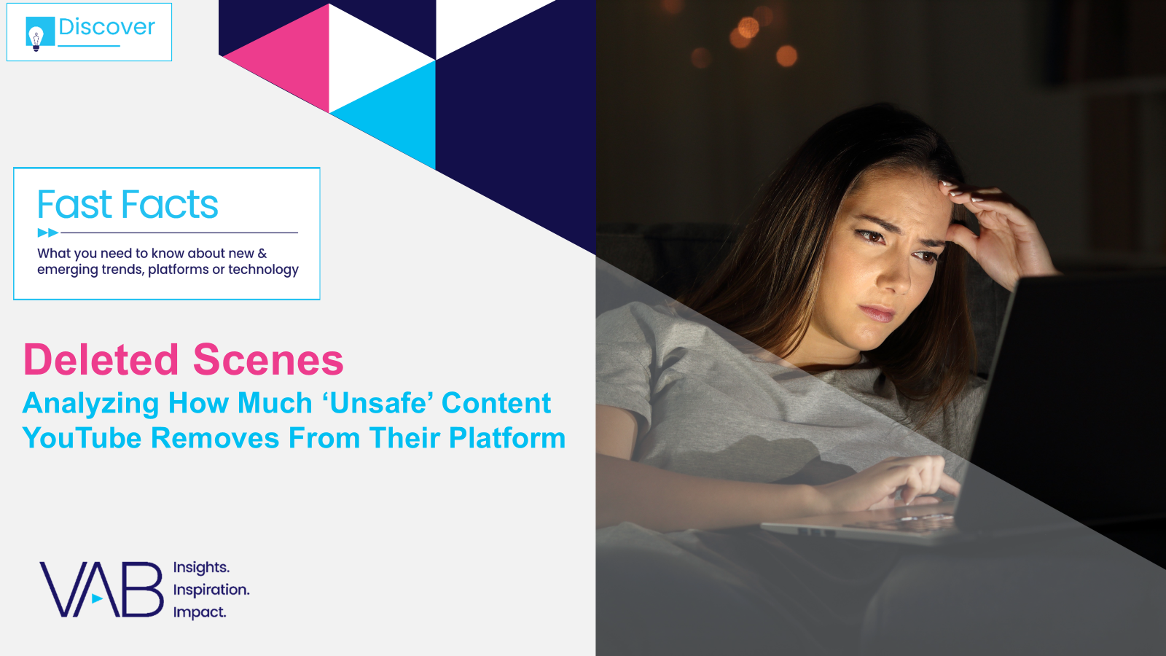

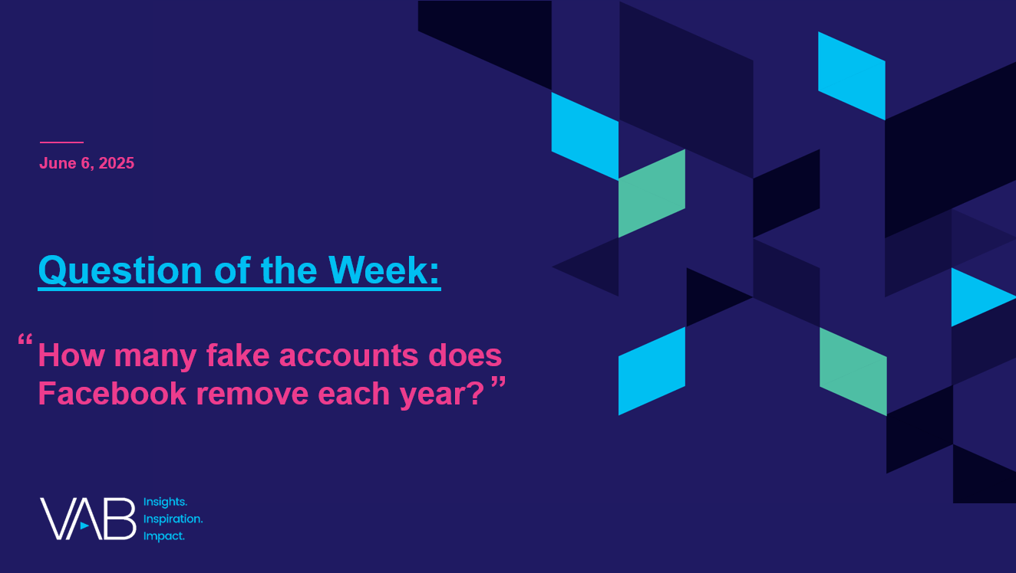

Creators
Jason Wiese
Leah Pujalte
EVP, Strategic Insights & Measurement
jasonw@thevab.com
VP, Audience & Behavioral Insights
leahm@thevab.com
Karolina Guillen
Amanda Cashman
The Power of Premium Video
What it Means for Multiscreen TV and Why it Matter to Marketers
The Illusions of the Internet
Uncovering the Fallacies & Realities
of Audience, Advertising & Content
Associate Director, Insights, Strategy & Analytics karolinag@thevab.com
Insights Analyst
amandac@thevab.com
Discover more
Looking for more data, insights and takeaways? Check out this related VAB content
The Credibility Crisis
How People Find Trusted News Amidst a Wave of Misinformation
Deleted Scenes
Analyzing How Much ‘Unsafe’ Content YouTube Removes From Their Platform
Visit the VAB’s Political Marketing Resource Center to stay informed during prime election seasons.
A Commanding Presence
How Ad Continuity in Multiscreen TV Drives Incremental Growth for Brands
“How many fake accounts does Facebook remove each year?”
VAB Members, brand marketers and agencies get free and immediate access to VAB’s content library. Get access at theVAB.com
This information is exclusively provided to VAB members and qualified marketers.
PAGE 28

Slide 29


About VAB
VAB plays a dual role in the video advertising industry. We are leading the change to bring about a more innovative and transparent marketplace. We also provide the insights and thought leadership that enables marketers to develop business-driving marketing strategies.
Drawing on our marketing expertise, we simplify the complexities in our industry and discover new insights that transform the way marketers look at their media strategy.
We are committed to your business growth and proud to offer VAB members, brand marketers and agencies complimentary access to our continuously-growing Insights library. Get immediate access at theVAB.com.
This information is exclusively provided to VAB members and qualified marketers.
PAGE 29

Slide 30
Appendix:
Custom Study Methodology & Respondent Demographics

Slide 31

Custom Study Methodology
In December 2025, VAB conducted a survey with Dynata to understand how Americans engage with political and news content across today’s fragmented media landscape.
The results are based on 2,319 U.S. adults 18+. This study examines where voters turn for trustworthy information and how they evaluate journalistic integrity in today’s media landscape.
The analysis explores the evolving role of multiscreen TV news and highlights how traditional and streaming TV environments continue to inform and engage audiences within a rapidly changing news ecosystem.
This information is exclusively provided to VAB members and qualified marketers.
PAGE 31

Slide 32
Age composition varies meaningfully by voter status and party affiliation, with distinct generational skews across each group
Respondent Age
Source: Dynata, Media Consumption and Political Sentiment survey, fielded December 2025 (n=2,319). Survey base: A18+ U.S. respondents. D1. Please enter your age. Voter respondents (n=1,514), Non-Voter respondents (n=680), Republican respondents (n=636), Democrat respondents (n=612), Independent respondents (n=546).
This information is exclusively provided to VAB members and qualified marketers.
PAGE 32

Slide 33
Gender is largely balanced overall, with non-voters and Democrats skewing female and Republicans and Independents skewing male
Respondent Gender
Source: Dynata, Media Consumption and Political Sentiment survey, fielded December 2025 (n=2,319). Survey base: A18+ U.S. respondents. D2. Please select your gender. Voter respondents (n=1,514), Non-Voter respondents (n=680), Republican respondents (n=636), Democrat respondents (n=612), Independent respondents (n=546). Numbers may not add to 100% due to exclusion of ‘prefer not to answer’ responses which amounted to under 1% for most respondents.
This information is exclusively provided to VAB members and qualified marketers.
PAGE 33

Slide 34
Respondents skew predominantly White, somewhat above Census benchmarks, with greater diversity among Democrats and non-voters
Respondent Race
Source: Dynata, Media Consumption and Political Sentiment survey, fielded December 2025 (n=2,319). Survey base: A18+ U.S. respondents. D3. Which of the following best describes you? Voter respondents (n=1,514), Non-Voter respondents (n=680), Republican respondents (n=636), Democrat respondents (n=612), Independent respondents (n=546).
This information is exclusively provided to VAB members and qualified marketers.
PAGE 34

Slide 35
Hispanic identification is higher among non-voters and Democrats, while Republicans are least likely to identify as Hispanic
Hispanic / Latino Descent
Source: Dynata, Media Consumption and Political Sentiment survey, fielded December 2025 (n=2,319). Survey base: A18+ U.S. respondents. D4. Do you identify as Hispanic of Latino? Voter respondents (n=1,514), Non-Voter respondents (n=680), Republican respondents (n=636), Democrat respondents (n=612), Independent respondents (n=546).
This information is exclusively provided to VAB members and qualified marketers.
PAGE 35

Slide 36
Regional distribution is relatively balanced overall, with the Central region indexing highest across most groups
Respondent Region
Source: Dynata, Media Consumption and Political Sentiment survey, fielded December 2025 (n=2,319). Survey base: A18+ U.S. respondents. D5. What state do you live in? [REGION]. Voter respondents (n=1,514), Non-Voter respondents (n=680), Republican respondents (n=636), Democrat respondents (n=612), Independent respondents (n=546).
This information is exclusively provided to VAB members and qualified marketers.
PAGE 36

Slide 37
Education levels are mixed overall, with voters more likely to hold college degrees and non-voters skewing high school or less
Respondent Education
Source: Dynata, Media Consumption and Political Sentiment survey, fielded December 2025 (n=2,319). Survey base: A18+ U.S. respondents. D8. What is the highest level of education that you have completed? Voter respondents (n=1,514), Non-Voter respondents (n=680), Republican respondents (n=636), Democrat respondents (n=612), Independent respondents (n=546). Numbers may not add to 100% due to exclusion of ‘none of the above’ and ‘prefer not to answer’ responses which amounted to 0% - 1% for most respondents.
This information is exclusively provided to VAB members and qualified marketers.
PAGE 37

Slide 38
Voters are more likely to be employed full-time, while non-voters show higher levels of unemployment and part-time work
Respondent Employment Status
Source: Dynata, Media Consumption and Political Sentiment survey, fielded December 2025 (n=2,319). Survey base: A18+ U.S. respondents. D9. Which of the following best describes your employment status? Voter respondents (n=1,514), Non-Voter respondents (n=680), Republican respondents (n=636), Democrat respondents (n=612), Independent respondents (n=546).
This information is exclusively provided to VAB members and qualified marketers.
PAGE 38

Slide 39
Non-voters skew lower income, while voters and partisans are more evenly distributed across middle and higher income brackets
Respondent HHI
Source: Dynata, Media Consumption and Political Sentiment survey, fielded December 2025 (n=2,319). Survey base: A18+ U.S. respondents. D10. What is your annual combined household income before taxes? Voter respondents (n=1,514), Non-Voter respondents (n=680), Republican respondents (n=636), Democrat respondents (n=612), Independent respondents (n=546).
This information is exclusively provided to VAB members and qualified marketers.
PAGE 39

