Slide 1



Case Study Corner
xx
Tech & Telco Category
Brand success stories highlighted through real-world multiscreen TV case studies

Slide 2





7 Tech & Telco category ‘real world’ case studies showcasing how multiscreen TV drives business outcomes across the funnel
Upper Funnel Outcomes
Awareness
Multiscreen TV campaigns that expand reach and drive brand recall against a brand’s best customer prospects*
Sampling of ‘awareness-based’ outcomes that can be measured:
Reach / Reach Extension / Incremental Reach
Ad / Brand Recall
Cost Efficiencies (Reach / Targeted IMPs)
Mid-to-Lower Funnel Outcomes
Action
Multiscreen TV campaigns that increase the likelihood the intended audience will be motivated to act*
Sampling of ‘action-based’ outcomes that can be measured:
Conversion Rates (website traffic,
app downloads, subscription sign-ups,
tune-in, foot traffic)
Sales / Revenues
Optimizations / ROI
Cost Efficiencies (Conversions)
Full-Funnel Outcomes
Awareness + Action
Multiscreen TV campaigns that expand reach and drive brand recall while also increasing the likelihood that the intended audience will be motivated to act*
Sampling of full-funnel outcomes:
Reach → Brand Recall → Conversion Rates → Sales → Optimizations →
Cost Efficiencies
*based on campaign KPIs
This information is exclusively provided to VAB members and qualified marketers.
PAGE 2

Slide 3
Upper Funnel
Case Studies
Awareness
Multiscreen TV campaigns expand reach
and drive brand recall against a brand’s
best customer prospects
Sampling of ‘awareness-based’ outcomes that can be measured:
    Reach / Reach Extension / Incremental Reach
    Ad / Brand Recall
    Cost Efficiencies (Reach / Targeted IMPs)
How Multiscreen TV drives
Awareness
This information is exclusively provided to VAB members and qualified marketers.
PAGE 3

Slide 4






Category:
Technology
An optimized test campaign led to significant reach for a consumer electronic (DTC) brand
Challenge
Looking to increase awareness and attract new customers, a DTC consumer electronics brand sought to optimize their existing OTT campaign to ensure new households were being targeted
Solution
TVSquared (Innovid) optimized the brand’s publisher mix, heavying up where net new impressions were available and determining the ideal frequency (between 4-6x/mo), driving better ROI and minimizing waste
Target Segment
Households unexposed to other publishers
Results
By optimizing delivery and frequency by focusing on unique audience reach, “wasted” impressions were reduced and household reach was boosted 35% per month
Company / Platform
TVSquared / OTT
1 9
+150%
+35%
New publishers added over 6-month period
Increase in OTT ad spend in 2nd half 2020 by advertiser after testing OTT in early 2020
Increase in net new HHs reached per month
Source: TVSquared, Case study: Extending Audience Reach with OTT. Flight duration: August 2020-Jan 2021.
This information is exclusively provided to VAB members and qualified marketers.
PAGE 4

Slide 5


Category:
Telco
DIRECTV utilized a pause ad campaign to successfully drive an increase in brand recall and a decrease in brand rejection
Challenge
A wireless telcom brand sought to understand the effectiveness of an emerging ad format, pause ads, and drive key brand health metrics.
Solution
13-week pause ad campaign
Target Segment
HHs who pause content on DIRECTV and DIRECTV STREAM
Results
The pause ads campaign drove an increase in ad recall and a decrease in brand rejection
The campaign also strengthened association with brand ideas based on increased endorsements for multiple key brand attributes
Company / Platform
DIRECTV / Linear TV, OTT
Brand Metrics
+54%
lift
-21% decline
+24%
+31%
Brand Perception Lift
‘Understands my needs
better than my competitor’
Brand Perception Lift
‘Has attractive offers
and promotions’
Source: DIRECTV, Case study: Pause Ads Telco Wireless Brand. Camp flight: 9/23/20 – 12/27/20. Case study results are based on individual campaign factors. DIRECTV makes no performance warranties. Control: Represents 10% of DTV HHs within the target that did not receive exposure to the addressable ad. Data used from Kantar for brand health study.
This information is exclusively provided to VAB members and qualified marketers.
PAGE 5

Slide 6

Category:
Technology
A tech brand worked with DISQO to prove the value and impact of its cross-platform campaign on its brand health metrics
Challenge
A technology brand needed to prove the ability
of their cross-platform campaign to impact brand perception metrics
Measurement Innovation
The brand leveraged DISQO’s Brand and Outcomes Lift solution to prove their campaign’s impact across a variety of attitudinal and behavioral metrics
They were able to do this by comparing “exposed” and “un-exposed” groups developed by DISQO
Target Segment
P18+
Learnings
The analysis showed how each ad media platform played a role in generating significant lifts across a variety of brand perception KPIs
Company / Viewing Source / Media Type
DISQO / Linear TV, Online Display and Video (including Mobile and Desktop Social)
Campaign Results Overview
Audiences were
2.3x
Social Audiences were
+36%
More likely to search for the
technology after campaign exposure
More likely to purchase the client’s products
KPI Impact Over Un-Exposed by Top Platform
Across all attitudinal, perception & persuasion metrics.
Online Only
+15%
Online Only
+15%
TV Only
+25%
TV Only
+17%
TV Only
+15%
Source: DISQO, Case study: Technology Case Study. Campaign dates: Q4 2019.
This information is exclusively provided to VAB members and qualified marketers.
PAGE 6

Slide 7
Category:
Telco
DIRECTV enabled an addressable + pause ad campaign for a wireless provider to drive lifts across key brand attributes like brand awareness, ad recall and purchase intent
Challenge
To generate growth and maintain stability of a wireless provider’s brand metrics in market
Solution
13-week addressable and pause ads media campaign
Target Segment
All eligible HHs in hyperlocal zip codes that are not current customers
Results
The campaign achieved increases in unaided awareness, aided brand awareness, ad recall and nearly all brand attributes
Including pause ads with the addressable campaign increased the campaign’s target reach by 5% while the two formats worked cohesively to generate growth and maintain stability for the remaining brand metrics
Company / Media Type
DIRECTV / Addressable TV
+170%
+113%
+72%
+63%
Brand Metrics
TV Ad Awareness
(recall vs. do not recall)
Brand Metrics
Likelihood to Switch
(recall vs. do not recall)
Brand Attributes
Provides Good Value
(recall vs. do not recall)
Brand Attributes
Understands My Needs Better Than
My Competitors
(recall vs. do not recall)
+17%
+12%
8.8x
5.8x
Brand Favorability
Pause Ads Exposure
(target vs. control)
Aided Brand Awareness
Pause Ads Exposure
(target vs. control)
Campaign Norms
Unaided Brand Awareness
(target vs. norm)
Campaign Norms
Purchase Intent
(target vs. norm)
Source: DIRECTV, Case Study: Addressable + Pause Ads for a Telcom Wireless Provider. Analysis conducted within DIRECTV footprint. Case study results are based on individual campaign factors. DIRECTV makes no performance warranties. Control: represents 10% of DTV HHs within the target that did not receive exposure to the addressable or pause ad. Data used: Advertiser first-party data, third-party data & Kantar.
This information is exclusively provided to VAB members and qualified marketers.
PAGE 7

Slide 8
Mid-To-Lower Funnel
Case Studies
Action
Multiscreen TV campaigns increase the likelihood that the intended audience will be motivated to act
(e.g., make a purchase, download an app, sign-up
for a subscription, make a booking, etc.)
Sampling of ‘action-based’ outcomes that can be measured:
    Conversion Rates (website traffic, app downloads, subscription sign-ups, tune-in, foot traffic)
    Sales / Revenues
    Optimizations / ROI
    Cost Efficiencies (Conversions)
How Multiscreen TV drives
Action
This information is exclusively provided to VAB members and qualified marketers.
PAGE 8

Slide 9


Category:
Technology
An internet technology company partnered with Samba TV to find efficient ways to drive site traffic
Challenge
A major internet technology company sought to understand how their TV and digital campaigns drove their site traffic, as well as which screens and which creative units had the most impact
Measurement Innovation
To show the impact of the campaign on driving site traffic, Samba TV uses their Online Conversion Measurement to analyze lift compared to their Synthetic Control Group Methodologies
Target Segment
A35-64
Learnings
The analysis provided conversions* by screen so that the brand could optimize by device for future campaigns. Mobile ads showed the strongest conversion rate, driving the most audience to visit the website
The analysis allowed the brand to optimize by creative unit, revealing that the :15 second units outperformed the longer TV creatives. This has the potential to reduce the brand’s production costs and increase efficiency in future
Company / Viewing Source / Media Type
Samba TV / Automated Content Recognition (ACR) & Pixel Tags / Linear TV, CTV, Online Video
LIFT FROM CONTROL
44%
Avg. Freq: 2.1
Avg. Freq: 2.5
Avg. Freq: 2.3
Avg. Freq: 4.7
15s ads
30s ads
Source: Samba TV, Internet Technology Case Study. Campaign time period: November 2020 – December 2020. *Website traffic / visits.
This information is exclusively provided to VAB members and qualified marketers.
PAGE 9

Slide 10


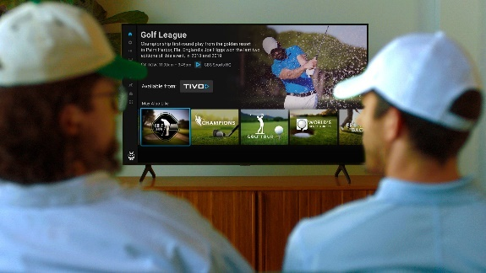

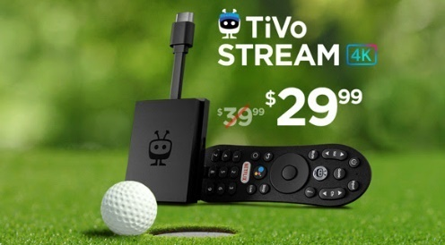
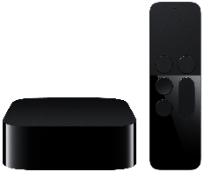
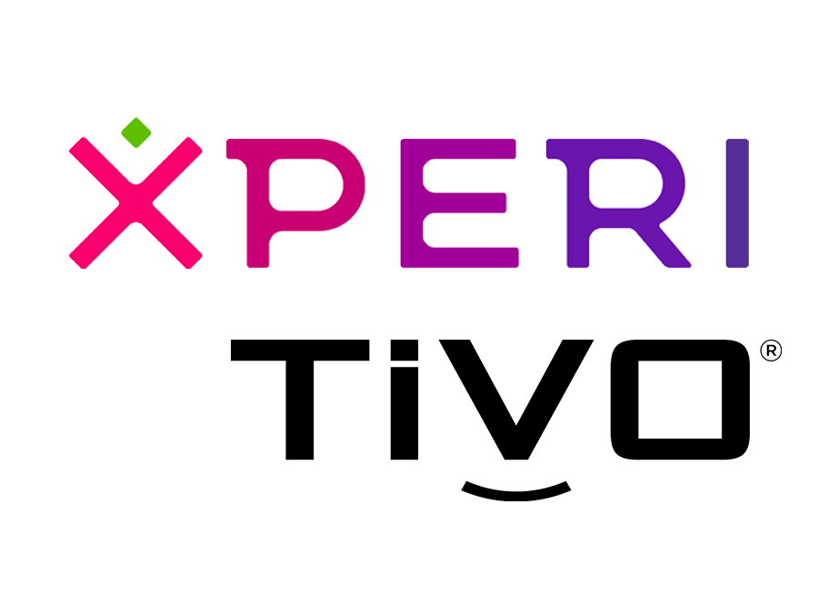
Category:
Technology
TiVo extended campaign reach through data-driven CTV advertising targeting sport enthusiasts, which drove a double-digit lift in device sales
Challenge
TiVo wanted to drive awareness for their new Stream 4K dongle and boost device sales
Solution
Launched campaign targeting households of sports enthusiasts during a premier golf tournament to promote their new Stream 4k product and inspire online conversion
  Content Affinity: Reach active sports fans by leveraging first-party, deterministic STB viewership data on CTV ad spots during the broadcast
  Sequential Targeting: Identify households exposed to the ad & extend campaign reach by digitally targeting them with secondary messages
  Conversion Attribution: By matching IP addresses to online sales during the campaign window, attributed sales lift from households exposed to the ad
Target Segment
Sports Enthusiasts
Results
CTV advertising generated a +25% lift in Stream 4K sales vs. households not exposed to the ad
Company / Platform / Media Type
TiVo, Xperi / Streaming Only / Connected TV (CTV)
+25%
Lift in Stream 4K Sales
Compared to households not exposed to ad
Source: TiVo & Xperi, Case study: TiVo Extends Campaign Reach and Lifts Device Sales with Data-Driven CTV Advertising. Campaign time period: flight date – 6/21/21-6/29/21; measurement period - 6/21/21 - 7/5/21, which was extended beyond the campaign window to capture Stream 4K purchases post-flight.
This information is exclusively provided to VAB members and qualified marketers.
PAGE 10

Slide 11
Awareness
How Multiscreen TV drives
Full-Funnel Outcomes
Multiscreen TV campaigns expand reach
and drive brand recall against a brand’s
best customer prospects
Action
Multiscreen TV campaigns increase the likelihood
that the intended audience will be motivated to act
(e.g., visit a website, download an app, sign-up
for a subscription, make a purchase, etc.)
Case Studies
This information is exclusively provided to VAB members and qualified marketers.
PAGE 11

Slide 12




Category:
Electric Skateboards
Onewheel leveraged a convergent TV strategy to reach an incremental audience and drive lower funnel outcomes
Challenge
Following a live YouTube event product launch, electric skateboard brand Onewheel wanted to increase awareness and ultimately drive purchases for a new product line using a comprehensive convergent TV strategy
Solution
The linear TV execution was designed to boost brand/product awareness and involved targeting sports events that aired following the YouTube event
The CTV strategy focused on reaching a younger and more incremental audience to those being reached on linear TV
  Executed an ad blitz on Hulu and other streaming publishers such as Discovery, Peacock and Paramount+
For the second phase, Onewheel worked with Tatari to trigger conversions via programmatic retargeting ads on connected TV to reach viewers who had visited Onewheel’s website but didn’t make a purchase
Target Segment
Younger consumers and audiences incremental to linear TV for streaming portion of campaign
  Hulu ad blitz: Adults 18-49
Results
Onewheel was able to reach an audience incremental to linear with 72% of the reach being exclusive to streaming
Company / Media Type
Tatari / Linear TV, Connected TV (CTV)
Campaign Results
The streaming campaign allowed Onewheel to reach an incremental audience to linear, with
72% of the reach being exclusive to streaming
The effort stayed close to the brand’s typical efficiency goals while still scaling up and increasing incremental sales
KEY TAKEAWAYS
Optimization and retargeting tools have transformed TV, especially connected TV, into an effective channel for driving sales
TV’s increased addressability can be used for retargeting by identifying people who have visited a website but not bought, and using connected TV ads to move them toward conversion
Improved data streams and attribution techniques ensure that brands can measure the impact of TV campaigns all the way to the cash register
Source: Tatari, ‘Full Funnel Vision’ immersive case study experience featuring Onewheel. Campaign time period: Fall 2021. Read more about the campaign here.
This information is exclusively provided to VAB members and qualified marketers.
PAGE 12

Slide 13








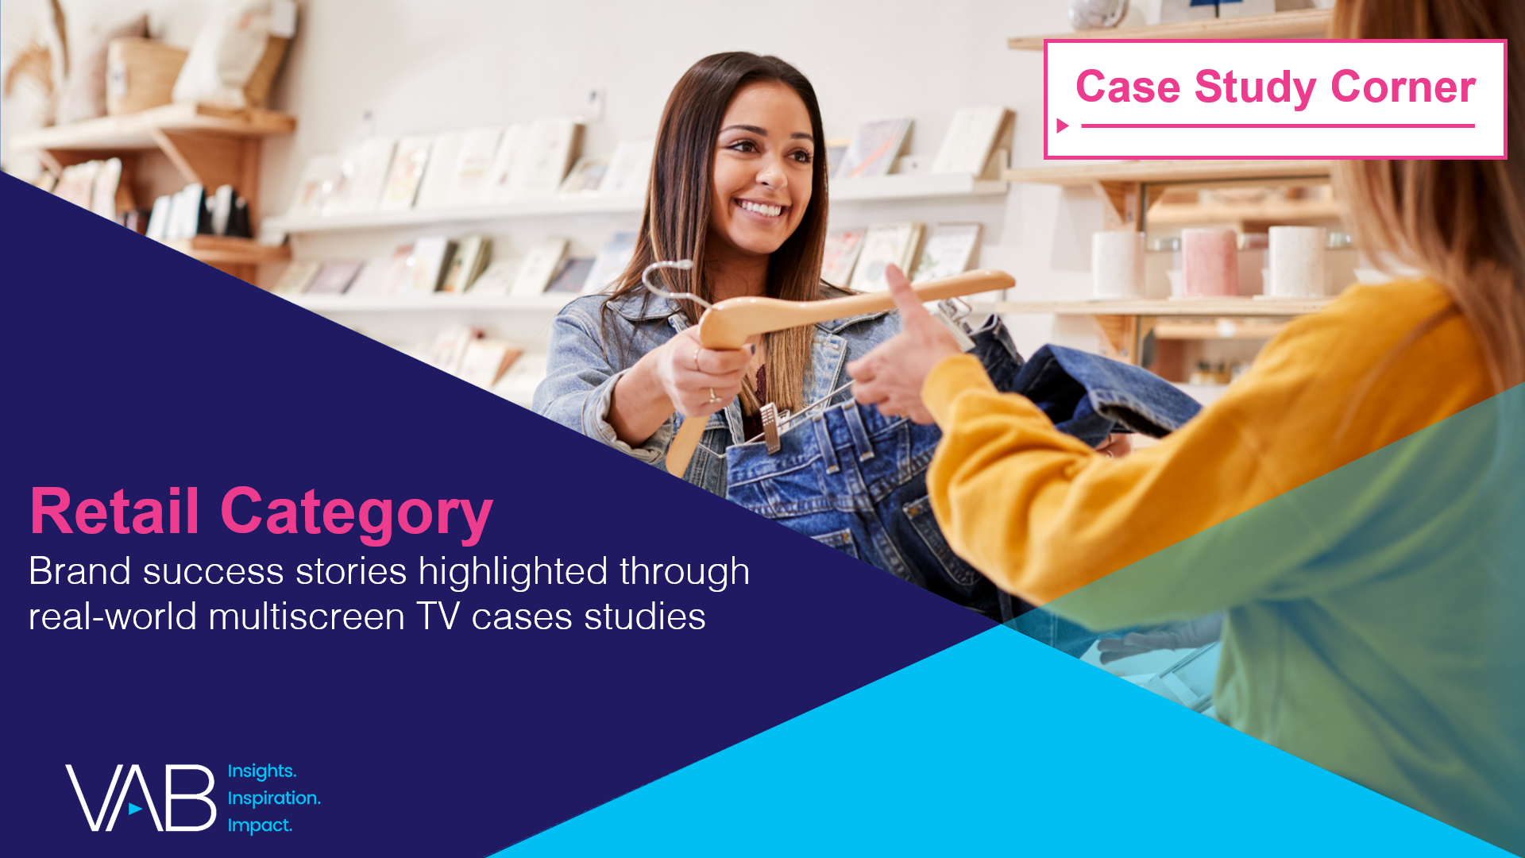

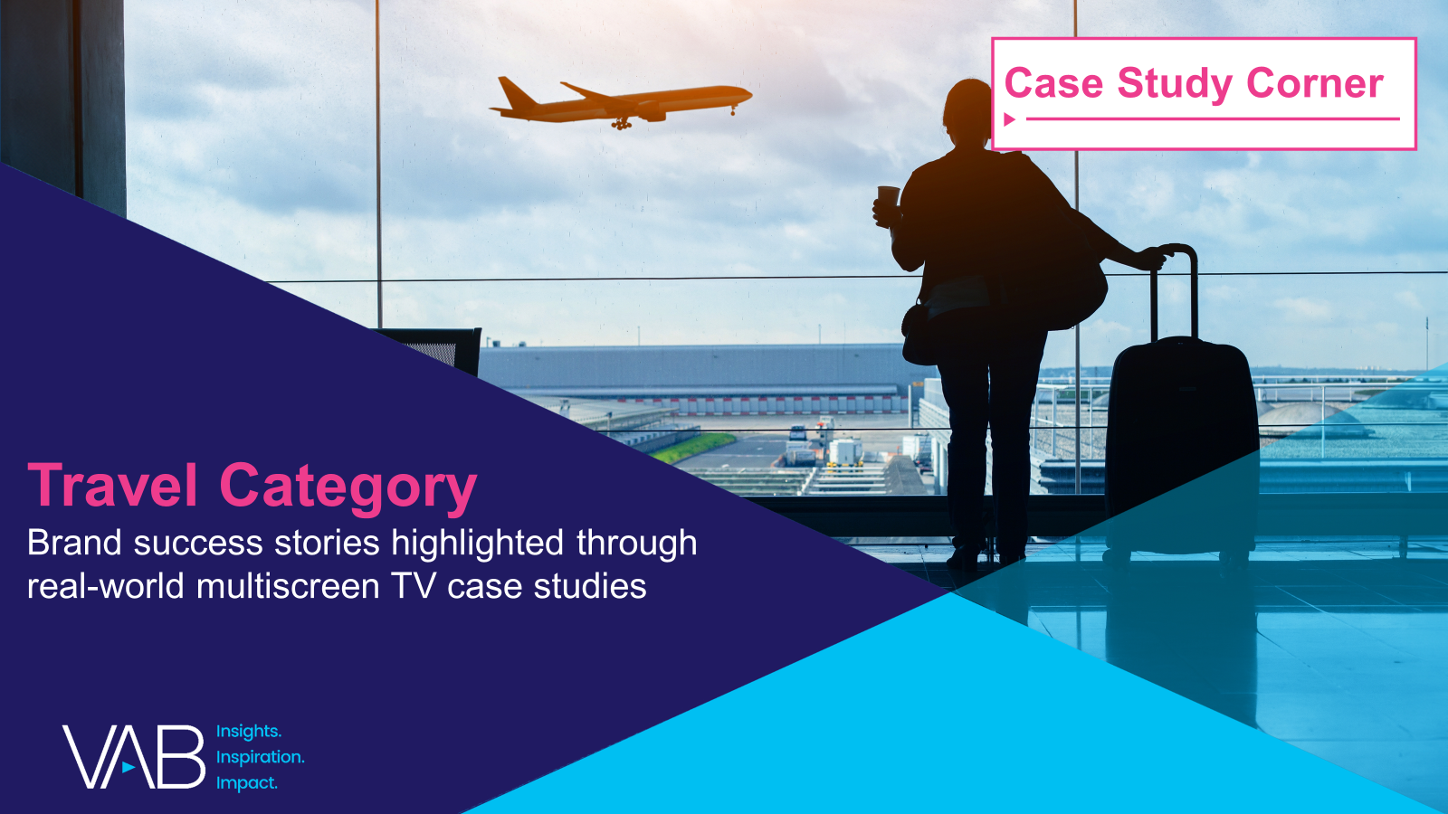
Want more? VAB has a wealth of case studies across additional categories
Business-to-Business (B2B)
Consumer Packaged Goods (CPG)
Entertainment & Tune-In
Financial Services & Insurance
Health, Wellness & Beauty
Home
Pharmaceuticals
Restaurants
Retail
Technology
Travel
Access more case studies at www.thevab.com
This information is exclusively provided to VAB members and qualified marketers.
PAGE 13

Slide 14



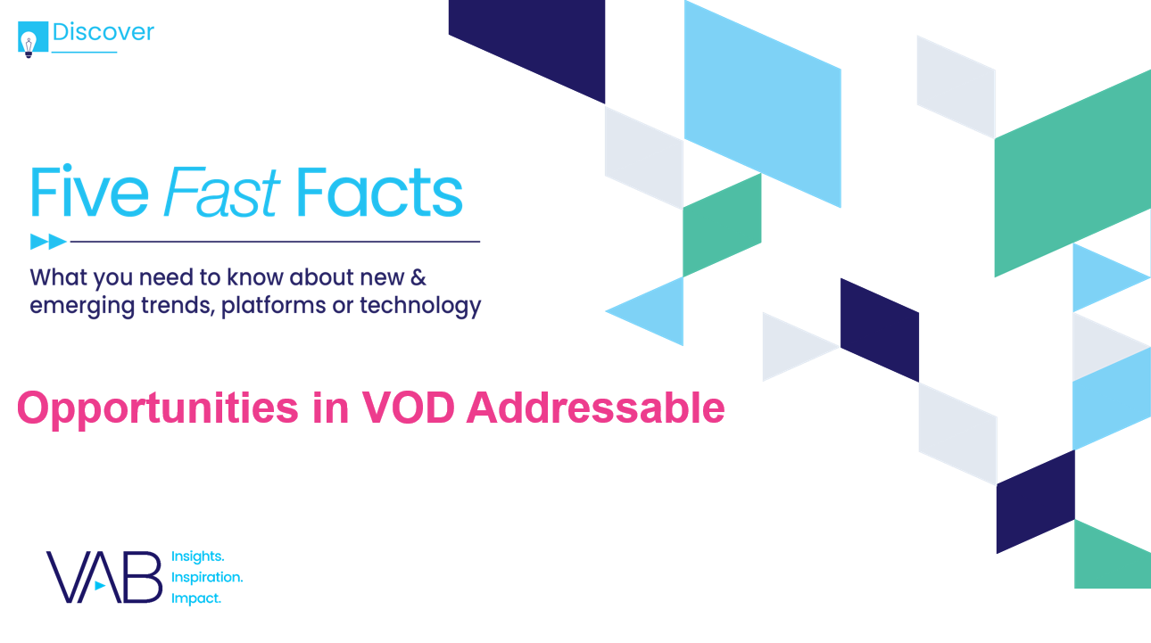



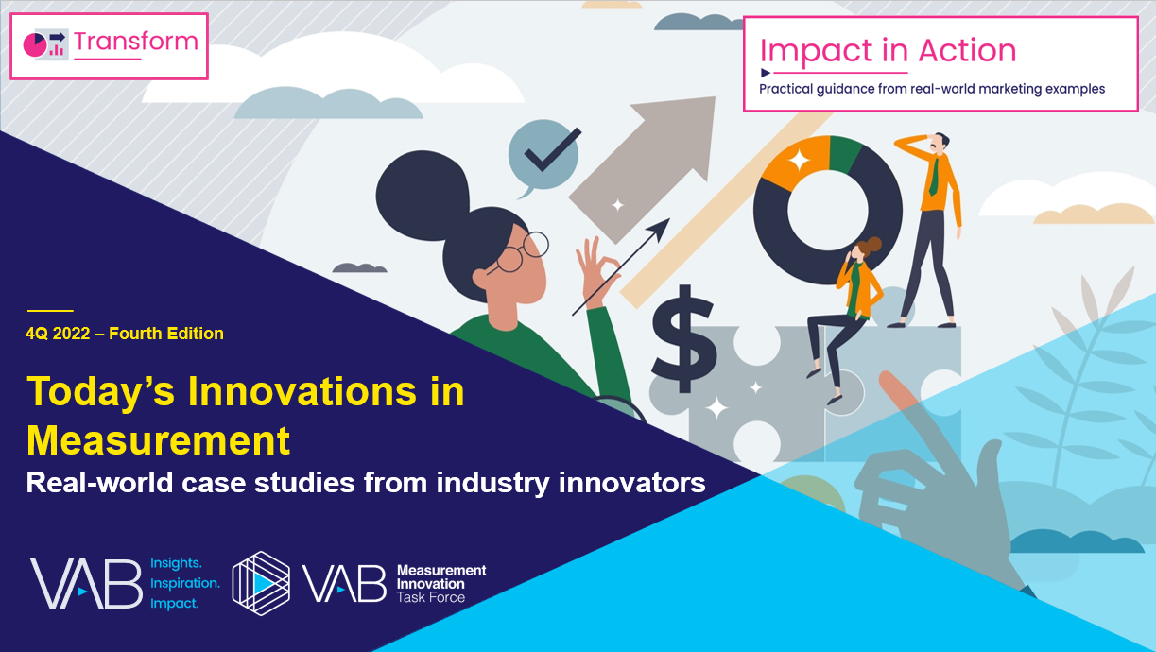
Want more? VAB also has case studies organized across multiscreen TV platforms including linear TV and streaming / CTV
Stream On
How can a convergent TV strategy drive business
results for my brand?
Proven Strategies & Tactics In Audience-Based TV Buying
Opportunities in VOD Addressable
Q1 ‘22 Today’s Innovations in Measurement
Q2 ‘22 Today’s Innovations in Measurement
Q3 ‘22 Today’s Innovations in Measurement
Q4 ‘22 Today’s Innovations in Measurement
Access more case studies at www.thevab.com
This information is exclusively provided to VAB members and qualified marketers.
PAGE 14

Slide 15


About VAB
VAB plays a dual role in the video advertising industry. We are leading the change to bring about a more innovative and transparent marketplace. We also provide the insights and thought leadership that enables marketers to develop business-driving marketing strategies.
Drawing on our marketing expertise, we simplify the complexities in our industry and discover new insights that transform the way marketers look at their media strategy.
We are committed to your business growth and proud to offer VAB members, brand marketers and agencies complimentary access to our continuously-growing Insights library. Get immediate access at theVAB.com.
This information is exclusively provided to VAB members and qualified marketers.
PAGE 15

