Slide 1





2021
Analyzing Outcomes From
The “Tech Giants’” TV Investment
How brands can apply these winning marketing
strategies to their common business challenges

Slide 2


The ‘Tech Giants,’ commonly referred to as the acronym GAFAM (Google, Apple, Facebook, Amazon, Microsoft), have become nearly ubiquitous in society. This is especially true during the pandemic, as many offer goods or services that have taken on heightened importance and relevance to our everyday lives.
Despite their deep pockets and big names, in 2020 these brands had to overcome many of the same challenges other brands commonly face: threats to their SOV, competition from category challengers, need to support new product launches and the urgency to quickly pivot and meet a new set of consumer needs due to the pandemic.
We distill the winning marketing strategies of these data-driven, outcomes-obsessed brands and show how you can learn and apply to your own brand.
This information is exclusively provided to VAB members and qualified marketers. Further distribution is prohibited.
PAGE 2

Slide 3

Insights Behind The Tech Giants’ 2020 TV Investment Strategies

Slide 4





During a year of COVID-driven economic uncertainty, GAFAM invested $2.7 Billion in TV, focusing messaging on pandemic related products & services
Google
GAFAM U.S. Total TV Spend
2020 ($$$ in Millions)
Apple
Facebook
$2.7 Billion
Total ‘Tech Giant’
TV Spend
Amazon
Microsoft
Source: VAB analysis of Nielsen AdIntel, calendar year 2020. TV spend includes cable TV, broadcast TV, Spanish language cable TV, Spanish language broadcast TV, spot TV, and syndicated TV. U.S. TV spend only. GAFAM includes Google (Alphabet), Apple, Facebook, Amazon and Microsoft
This information is exclusively provided to VAB members and qualified marketers. Further distribution is prohibited.
PAGE 4

Slide 5










Rather than relying solely on their own platforms or digital media during this time of economic austerity, GAFAM invested heavily in TV becoming the #1 US advertiser during the pandemic
Amazon would rank as the #4 TV advertiser overall by itself
Rank | Company | CY 2020 U.S. Total TV Spend
1 |  | $2.7 B
2 |  | $2.4 B
3 |  | $1.4 B
4 |  | $1.2 B
5* |  | $923 MM
6 |  | $911 MM
7 |  | $888 MM
8 |  | $882 MM
9 |  | $864 MM
10 |  | $840 MM
Source: VAB analysis of Nielsen AdIntel, calendar year 2020. TV spend includes cable TV, broadcast TV, Spanish language cable TV, Spanish language broadcast TV, spot TV, and syndicated TV. U.S. TV spend only. Rankings are based on total TV spend for parent companies based on their subsidiaries and brands as of March 2021. GAFAM includes Google (Alphabet), Apple, Facebook, Amazon and Microsoft. *Amazon, which would’ve ranked #4 (excluding GAFAM combination), shifted into #1 for the purposes of this chart.
This information is exclusively provided to VAB members and qualified marketers. Further distribution is prohibited.
PAGE 5

Slide 6
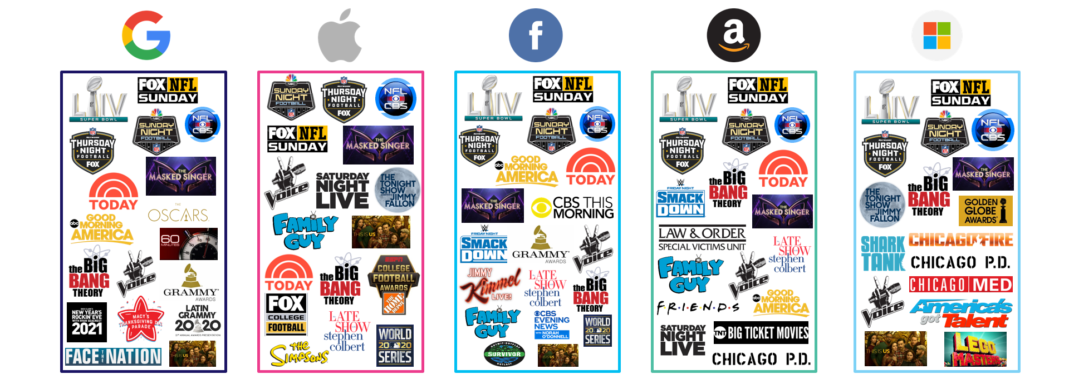
With the pandemic keeping people indoors and in front of their TVs, GAFAM invested in marquee, premium content including ‘buzzed about’ entertainment programs, specials, live shows and sports
Sampling of Top TV Programs Advertised On
2020
Source: VAB analysis of Nielsen AdIntel, calendar year 2020. TV spend includes cable TV, broadcast TV, Spanish language cable TV, Spanish language broadcast TV, spot TV, and syndicated TV. U.S. TV spend only. GAFAM includes Google (Alphabet), Apple, Facebook, Amazon and Microsoft.
This information is exclusively provided to VAB members and qualified marketers. Further distribution is prohibited.
PAGE 6
This information is exclusively provided to VAB members and qualified marketers. Further distribution is prohibited.

Slide 7






With large budgets, these brands had the luxury of choice on how to invest and, grounded by data, they saw the value of a wide list of networks and programming to drive outcomes
The average GAFAM brand advertised across 86 broadcast and cable TV networks to maximize scale and engage wide audiences
U.S. National TV Networks Advertised On
2020
Source: VAB analysis of Nielsen AdIntel, calendar year 2020. TV spend includes cable TV, broadcast TV, Spanish language cable TV and Spanish language broadcast TV. U.S. TV spend only. GAFAM includes Google (Alphabet), Apple, Facebook, Amazon and Microsoft.
This information is exclusively provided to VAB members and qualified marketers. Further distribution is prohibited.
PAGE 7

Slide 8
A Look At Outcomes Supported By GAFAM’s TV Investments In 2020…
And The Lessons Brands Can Learn From Them

Slide 9
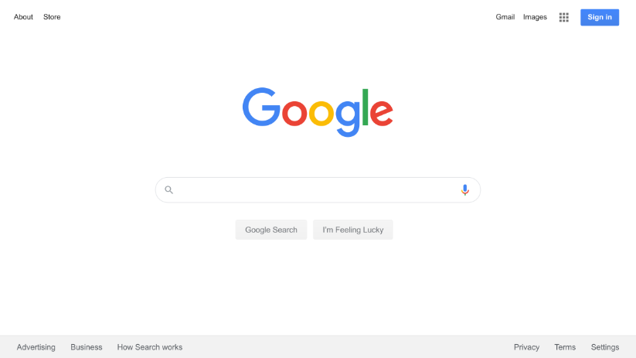
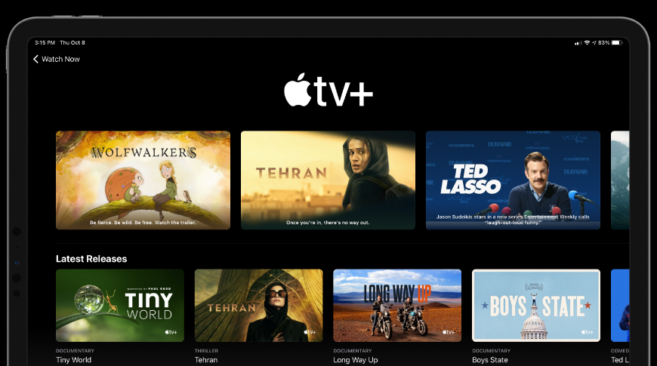



Through five outcomes-based analyses, we can learn successful marketing strategies that can be applied to a variety of common brand challenges
How a brand can successfully adjust its investment priorities to align with changes in consumer behavior.
How a new product can benefit from creating a sustained presence on TV beyond the launch.
How a brand that creates a share
of voice advantage can drive product consideration.
How a widely-used service can continue to benefit from maintaining its SOV.
How a brand tapped into a consumer need and created a SOV advantage to become the category leader.
Google Search
Apple TV+
Oculus Quest 2
Amazon
Microsoft Teams
This information is exclusively provided to VAB members and qualified marketers. Further distribution is prohibited.
PAGE 9
This information is exclusively provided to VAB members and qualified marketers. Further distribution is prohibited.

Slide 10


Observing the heightened need for information during the pandemic, Google prioritized investment in its Search product driving higher, more habitual, user engagement
Google Search
2019
2020
% YoY
Change
# YoY
Change
‘Google Search’ Brand TV Spend
$109.5 MM
$195.4 MM
+78%
+$85.9 MM
Avg. Monthly Unique Visitors
205.9 MM
210.7 MM
+2%
+4.8 MM
Total Annual Visits
2.5 B
4.1 B
+63%
+1.6 B
Total Annual
Page Views
9.2 B
15.9 B
+73%
+6.7 B
Source: VAB analysis of Nielsen AdIntel, calendar year 2019 & 2020 (‘Google Search Engine’ brand). TV spend includes cable TV, broadcast TV, Spanish language cable TV, Spanish language broadcast TV, spot TV, and syndicated TV. U.S. TV spend only. VAB analysis of Comscore mediametrix multiplatform media trend data, total audience (Desktop P2+, Mobile 18+), U.S. only, Jan ‘19 – Dec ‘20 (calendar months). Comscore data represents ‘Google Search’ (which includes images, video, news pages, etc)
This information is exclusively provided to VAB members and qualified marketers. Further distribution is prohibited.
PAGE 10

Slide 11


The steady increase in usage after the Apple TV+ launch demonstrates the importance and impact of continued investment
A sustained TV presence from launch through the pandemic enabled Apple TV+ to steadily grow its total viewer time spent in line with their TV investment
Apple TV+ - Cumulative Monthly U.S. Total TV Spend & Time Spent
2020
Cume TV spend:
$174.7 MM
(Nov ‘19 launch – Dec ’20)
How to read - Ex: Dec ‘20 represents total measured time spent & TV spend from Nov ‘19 – Dec ’20 for Apple TV+
Source: VAB analysis of Nielsen AdIntel, Nov ‘19 – Dec ‘20 (calendar months). TV spend includes cable TV, broadcast TV, Spanish language cable TV, Spanish language broadcast TV, spot TV, and syndicated TV. U.S. TV spend only. VAB analysis of Comscore mediametrix multiplatform media trend data, total audience (Desktop P2+, Mobile 18+), Nov ‘19 – Dec ‘20 (calendar months), data represents Apple TV (mobile app).
This information is exclusively provided to VAB members and qualified marketers. Further distribution is prohibited.
PAGE 11

Slide 12

Facebook’s Oculus Quest 2 highlights how brands can increase consumer consideration by dominating share of voice
Facebook’s Oculus Quest 2 dominated search queries with their SOV advantage in the VR category: $67 MM in 4Q ’20 TV spend vs. no spending by its competitors
Weekly Google Search Trend Indices & Total U.S. TV Spend
2020
Oct 13
Release Date
Google Search Index*
TV Spend
Source: VAB analysis of Nielsen AdIntel, 10/4/20-1/1/21, TV spend includes cable TV, broadcast TV, Spanish language cable TV, Spanish language broadcast TV, spot TV, and syndicated TV. U.S. TV spend only; VAB analysis of Google Trends, United States only, All Categories, Web Search, 10/4/20-1/1/21, SOV = Share of voice. *Google Search Index represents search interest relative to the highest point on the chart for the given region and time period, a value of 100 is the peak popularity for the term, a value of 50 means that the term is half as popular.
This information is exclusively provided to VAB members and qualified marketers. Further distribution is prohibited.
PAGE 12

Slide 13


Amazon saw continued benefit in prioritizing its TV investment as it aligns with their annual U.S. revenue growth over the last five years
Although over 55% of US households are Amazon Prime subscribers and online ordering has grown during the pandemic, Amazon continued to drive scale and immediacy of message with TV.
2015
2016
2017
2018
2019
2020
5-Year Trend
2015 v 2020
Total U.S. Annual
TV Spend (MM)
$262.5
$436.5
$476.4
$725.6
$1,093.9
$1,068.3
+307%
$$ Diff (MM)
+$174.5
+$39.4
+$249.2
+$368.3
-$25.5
Total U.S. Annual
Revenue (MM)
$70,500
$90,300
$120,500
$160,100
$193,600
$263,500
+274%
$$ Diff (MM)
+$19,800
+$30,200
+$39,600
+$33,500
+$69,600
Source: VAB analysis of Nielsen AdIntel, calendar years 2015 - 2020. TV spend includes cable TV, broadcast TV, Spanish language cable TV, Spanish language broadcast TV, spot TV, and syndicated TV. U.S. TV spend only. Revenues are based on annual company filings (10-K) for United States revenue via SEC.gov (EDGAR). https://www.statista.com/statistics/861060/total-number-of-households-amazon-prime-subscription-usa/
This information is exclusively provided to VAB members and qualified marketers. Further distribution is prohibited.
PAGE 13

Slide 14



By quickly pivoting to recognize a new consumer demand and driving SOV behind its relevant
product, Microsoft Teams established itself as
the leading business communications platform
In total, Microsoft invested $172 MM in TV to support Teams during calendar year 2020 (campaign launched in January)
10-Month COVID Time Period vs. Previous 10-Months
May ’19 -
Feb ‘20
Mar ’20 -
Dec ‘20
%
Change
#
Change
Total U.S.
TV Spend
$20.0 MM
$152.4 MM
+661%
+$132.4 MM
Avg. Monthly
Unique Visitors
11.8 MM
32.3 MM
+173%
+20.4 MM
Time Period Cume
Total Hours Spent
68.5 MM
379.1 MM
+453%
+310.6 MM
May ’19 -
Feb ‘20
Mar ’20 -
Dec ‘20
%
Change
#
Change
Total U.S.
TV Spend
N/A
$0.5 MM
N/A
+$0.48 MM
Avg. Monthly
Unique Visitors
5.1 MM
4.9 MM
-6%
-0.3 MM
Time Period Cume
Total Hours Spent
101.1 MM
49.3 MM
-51%
-51.7 MM
Source: VAB analysis of Nielsen AdIntel, calendar months of May 2019 - December 2020. TV spend includes cable TV, broadcast TV, Spanish language cable TV, Spanish language broadcast TV, spot TV, and syndicated TV. U.S. TV spend only. VAB analysis of Comscore mediametrix multiplatform media trend data, total audience (Desktop P2+, Mobile 18+), May ‘19 – Dec ‘20 (calendar months)
This information is exclusively provided to VAB members and qualified marketers. Further distribution is prohibited.
PAGE 14

Slide 15
Although these brands enjoy significant awareness and deep pockets, the winning formula they applied to tackle their marketing challenges can be applied to many brands:
Identify a consumer need.
Invest in advertising behind it.
Add the scale and immediacy of marketing elements like multiscreen TV.
What’s important for marketers to know?
This information is exclusively provided to VAB members and qualified marketers. Further distribution is prohibited.
PAGE 15

Slide 16




Creators
Jason Wiese
Reed Kiely
SVP, Director of Strategic Insights
jasonw@thevab.com
Insights Manager
reedk@thevab.com
Discover more
Looking for more data, insights and takeaways? Check out this related VAB content
The Halo Effect
TV as a Growth Engine
Direct Effect
Driving Intent For Emerging DTC Brands
The Lessons Brands Can Learn From The Impact of Presidential Election Ad Spending
What Is Audience-Based Buying?
Untangling and Simplifying Marketing Topics and Terms
VAB Members, brand marketers and agencies get free and immediate access to VAB’s content library. Get access at theVAB.com
This information is exclusively provided to VAB members and qualified marketers. Further distribution is prohibited.
PAGE 16

Slide 17

About VAB
VAB is an insights-driven organization that inspires marketers to reimagine their media strategies resulting in fully informed decisions.
Drawing on our marketing expertise, we simplify the complexities in our industry and discover new insights that transform the way marketers look at their media strategy.
Transform
We help you build your brand by focusing on core marketing principles that will help drive tangible business outcomes.
Simplify
We save you time by bringing you the latest data & actionable takeaways you can use to inform your marketing plans.
Discover
We keep you one step ahead with the latest thinking so you can create innovative, forward-looking strategies.
We are committed to your business growth and proud to offer VAB members, brand marketers and agencies complimentary access to our continuously-growing Insights library. Get immediate access at theVAB.com.
This information is exclusively provided to VAB members and qualified marketers. Further distribution is prohibited.
PAGE 17

