Slide 1


Slide 2
Time-Shifting: More Choices For Watching More Content
Time-Shifting refers to the ability of a consumer to access premium TV content when, where, and how it is most convenient for them. The options for time-shifting have grown, driven by the increasing demand consumers have to enjoy more content they love on their terms with more choices available to them.
This freedom of choice appeals to a wide range of viewers across age groups, income brackets and ethnicities, with each group having a specific preference on how they access content beyond live airings.
This three-report series will highlight the main ways consumers can time-shift their TV viewing: DVR, Video-on-Demand (VOD), and TV Everywhere (TVE). We will define each, size the landscape, discuss how many consumers are time-shifting, and review the profiles of time-shifting consumers.
VAB: Tailor-Made Television

Slide 3
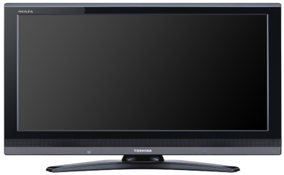




There Are Three Main Ways A Viewer Can Watch TV Content Outside Of A Live Airing
DVR (Digital Video Recorder): a Set-Top Box that records and stores television shows for viewing at a later time. Some MVPDs (Cable, Telco or Satellite Provider) offer Cloud DVR service, which allows users to view DVR’d content on mobile devices via the MVPD app, or on a computer via the MVPD’s website.
VOD (Video-On-Demand): allows users to select and watch video content when they choose to, rather than at a specific broadcast time. This report is specifically referring to VOD viewed through MVPDs (Cable, Telco or Satellite Provider) via their set-top-box.
  TVE (TV Everywhere): the ability for a viewer to watch TV and film content whenever and wherever they choose across devices (Smart TV, connected device, tablet, mobile device or computer). Content can be accessed through either a broadcast or cable programmer (via MVPD authentication/user log-in) or an MVPD app (like Comcast Xfinity & Spectrum TV).
VAB: Tailor-Made Television

Slide 4
First, It Should Be Noted That Live TV Remains The Reigning Champ Of TV Viewing Time, Regardless Of The Time Of Day
VAB: Tailor-Made Television
Source: comScore TV Essentials, U.S., Full Year 2016, Live +15 Day DVR; comScore State of VOD Trend Report, Total U.S.
Audience; Time-Shifted TV includes VOD and DVR.

Slide 5
Convenience (Not Ad Avoidance) Is The Top Reason For Time-Shifting Programs
This Convenience Allows Users The Opportunity To Consume More Content By Catching Up On Missed Shows And Binging Multiple Episodes
Top Reasons For Time-shifting TV Shows
VAB: Tailor-Made Television
Source: HUB Entertainment research 3/15; Survey of 1,210 TV consumers 16-74 who watch at least 5 hours of TV/week and have broadband home access; What do you consider to be the biggest benefits of watching episodes of a current show at a later time?

Slide 6



Despite All Of The Options Consumers Have, Half Of Time-Shifted Viewing Is Through MVPDs Via DVR, Set-Top VOD And TV Everywhere
34%
Total from “Big 3” SVOD
52%
Total from MVPD Sources
VAB: Tailor-Made Television
Source: Hub Entertainment Research, The Battle for Share of Mind, January 2018. TVE: Authenticated TV Everywhere, from
a network or pay TV operator’s website/app; Based on total viewing (TV & movies).

Slide 7
Consumers’ Appetite for Premium Content is Strong and is the Driving Force Behind Increased Use of Time-Shifting Methods
Members Only
Change in Frequency of Source Use vs. One Year Ago
Among Those Who Use Each
10%
DVR
42%
18%
TVE: MVPD Site or App
36%
19%
TVE: Network Site or App
28%
VAB: Tailor-Made Television
Source: Hub Entertainment Research, TV Redefined: The New Definition of “Watching TV”, August 2017.

Slide 8
There Are Three Main Ways A Viewer Can Watch TV Content Outside Of A Live Airing
DVR (Digital Video Recorder): a Set-Top Box that records and stores television shows for viewing at a later time. Some MVPDs (Cable, Telco or Satellite Provider) offer Cloud DVR service, which allows users to view DVR’d content on mobile devices via the MVPD app, or on a computer via the MVPD’s website.
VOD (Video-On-Demand): allows users to select and watch video content when they choose to, rather than at a specific broadcast time. This report is specifically referring to VOD viewed through MVPDs (Cable, Telco or Satellite Provider) via their set-top-box.
  TVE (TV Everywhere): the ability for a viewer to watch TV and film content whenever and wherever they choose across devices (Smart TV, connected device, tablet, mobile device or computer). Content can be accessed through either a broadcast or cable programmer (via MVPD authentication/user log-in) or an MVPD app (like Comcast Xfinity & Spectrum TV).
VAB: Tailor-Made Television

Slide 9
MVPD Video-on-Demand – What You Need To Know
More Access
  75 million consumers - primarily affluent, younger and educated - have access to MVPD VOD in the U.S.
More Content
  MVPD is the original bingeing platform as 73% of VOD users like to catch up on multiple episodes at one time
  Choice has exploded as the average MVPD library now reflects 93,200 titles per month, far surpassing what the three major SVOD services offer
  Time spent with VOD has seen a double-digit increase over the last two years
More Advertising Opportunities
  In the past 3 years, VOD ad impressions have increased nearly threefold
  With pods averaging less than four advertisers per break, VOD offers exclusive environments for advertisers’ messaging
  VOD ad insertion capabilities allow for advanced targeting and ensure viewability—no bots or fraud
VAB: Tailor-Made Television

Slide 10
In The U.S. Almost 75 Million Consumers Have Access To MVPD VOD
74,552,000
VAB: Tailor-Made Television
Source: Nielsen VOD penetration; January of each year, MVPD VOD.

Slide 11
These 75 Million VOD Users Tend To Be Younger and More Affluent Than The Average Adult
Watch VOD Programming
Age
HHI
52
104
62%
120
187
46
89
46%
152
69
112
144
96
121
112
127
Education
Ethnicity
51
126
134
69
62
50%
125
83
133
72
106
102
104
VAB: Tailor-Made Television
Source: 2017 GfK MRI Doublebase, “Video-On-Demand # of Times Watched Past 30 days-TV/Shows/Movies (Any)”;
Includes index v. general population.

Slide 12
Many Viewers Binge On VOD Programming Since It Offers The Convenience Of Watching What They Want, When They Want
VAB: Tailor-Made Television
Source: Nielsen Global VOD Survey 3Q15, Total Audience; North America

Slide 13
Recognizing This Consumer Demand For Customized Viewing, The Amount Of VOD Content Made Available Through MVPDs Has Exploded
VAB: Tailor-Made Television
Source: SNL Kagan Multichannel Trends; Count represents average monthly title selections among U.S. wireline operators, reflecting turnover and refreshed content and are not comparable to average titles available simultaneously. 2/18

Slide 14
In Fact, MVPD VOD Catalogues Easily Dwarf The Limited Libraries Of The Three Major SVOD Services
With Something Available On-demand For Everyone, MVPD’s Content Variety Truly Is Unmatched And Only Continues To Grow
(Netflix, Hulu, Amazon)
Source: VAB analysis of SNL Kagan February 2018 data (MVPD catalogs reflect cable and telco MVPDs, excludes satellite MVPDs) for end of year 2017, title counts represent reported average monthly selections at year end unless noted as an estimate, counts reflect turnover and refreshed content and are not comparable to average titles available simultaneously, includes TV Shows and Movies. SVOD data represents the latest month with available data: Netflix (January 2018), Hulu (December 2017) & Amazon (November 2017)), includes TV Shows and Movies.
14

Slide 15
Time Spent With MVPD VOD Has Increased 11% In The Past Two Years
Average Monthly VOD Plays Per TV
15.9
16.5
VAB: Tailor-Made Television
Source: comScore State of VOD Report 2017; MVPD VOD; Monthly Averages; 2015 is based on the full year and 2017 is through 3Q17.

Slide 16
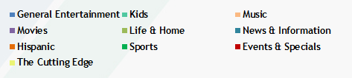
General Entertainment And Kids Shows Account For The Majority Of VOD Plays And Time Spent
46% (218 index) of VOD Viewers Have Kids Living At Home, Accounting for the Large Proportion of Kids Content Viewed Via VOD
VAB: Tailor-Made Television
Source: comScore State of VOD Report 2017, MVPD VOD, Q3 2017; 2017 GfK MRI Doublebase, “Video-On-Demand # of Times Watched Past 30 days-TV/Shows/Movies (Any)”.

Slide 17

VOD Offers Growing Advertising Opportunity

Slide 18
VOD Users Have A Positive Attitude Towards TV in General And TV Advertising Specifically
Index
101
107
109
104
106
101
105
101
VAB: Tailor-Made Television
Source: 2017 GfK MRI Doublebase, “Video-On-Demand # of Times Watched Past 30 days-TV/Shows (Any)”;
includes index v. general population.

Slide 19
Set-Top-Box VOD Is One Of The Biggest Areas Of Growth Within The VOD Advertising Ecosystem
Dynamically Inserted STB VOD Ads Increased 35% YOY, Accounting For 19% Of Total Share In Q4 2017
+10% YOY
+35% YOY
+13% YOY
+44% YOY
+23% YOY
VAB: Tailor-Made Television
Source: FreeWheel VMR Report, Q4 2017; Ad View Composition and Growth by Device, U.S. Q4 2013 – Q4 2017.

Slide 20
In The Past Three Years, VOD Ad Impressions Have Increased Nearly Threefold
-15% YOY
+34% YOY
+32% YOY
+14% YOY
+2% YOY
VAB: Tailor-Made Television
Source: 2018 Canoe Ventures, LLC. VOD Ad Impression: 2017 Full-Year Insights Report; January 2014 – December 2017. Impressions based on 36M households on Charter Spectrum, Comcast, and Cox.

Slide 21
Weekends Deliver More Ad Impressions On An Average Daily Basis Than Weekdays
Heavier Use On Weekends Demonstrates VOD Viewers’ Motivation To Watch On Their Own Time
VAB: Tailor-Made Television
Source: 2018 Canoe Ventures, LLC. VOD Ad Impression: 2017 Full-Year Insights Report; January 2014 – December 2017. Impressions based on 36M households on Charter Spectrum, Comcast, and Cox.

Slide 22
The Majority Of Ad Impressions Are Available In The Mid-Roll Ad Break
VAB: Tailor-Made Television
Source: 2018 Canoe Ventures, LLC. VOD Ad Impression: 2017 Full-Year Insights Report; January 2014 – December 2017. Impressions based on 36M households on Charter Spectrum, Comcast, and Cox.

Slide 23
On Average, There Is Very Little Clutter Within VOD Pod Breaks Which Allows For More Focused Attention To Ads
VOD Offers A Level Of Premium Exclusivity To Advertisers By Pod Break
VAB: Tailor-Made Television
Source: 2018 Canoe Ventures, LLC. VOD Ad Impression: 2017 Full-Year Insights Report; January 2014 – December 2017. Impressions based on 36M households on Charter Spectrum, Comcast, and Cox.

Slide 24
Time-Shifting Segmentation

Slide 25
VOD Viewers Are Likely To Be Affluent Adults Who Enjoy Binge-Watch Programming With Their Kids
DVR User
VOD Viewer
TVE Viewer
Slightly older than VOD viewers & more affluent than TVE users
Median Age: 47
Average HHI: $92K
Younger than DVR users & the most affluent & educated Median Age: 43
Average HHI: $93K
The youngest and most ethnically diverse viewers
Median Age: 39
Average HHI: $67K
Who:
Drama, Reality, Thrillers & Soap Operas
General Entertainment & Kids Programming
Live TV & Sports, Library Content, Exclusive Content, & Current Episodes
What:
Throughout the day, with the majority occurring outside of Primetime
On their own time, when they can binge-watch multiple episodes
Whenever & Wherever
When:
Convenience and watching on their own time
Convenience and having a range of content available
Binge-watching premium content on the go
Why:
On a TV through a set-top-box recorder or on mobile devices via Cloud DVR through an MVPD
On a TV viewed through MVPDs (Cable, Telco or Satellite Provider) via their set-top-box
Across devices through either a broadcast or cable programmer or an MVPD app
How:
VAB: Tailor-Made Television
Source: 2017 GfK MRI Doublebase, DVR User: “How often watch TV programs in the following ways compared to 12 months ago-Using a DVR”; VOD Viewer: “Video-On-Demand # of Times Watched Past 30 days-TV/Shows/Movies (Any); TVE Viewer: Watch TV programs in the following ways - Through a TV network’s app”.

Slide 26
These VOD Viewers Are Younger Than DVR Users & The Most Affluent & Educated Out Of All Groups
DVR User
VOD Viewer
TVE Viewer
Slightly older than VOD viewers & more affluent than TVE users
Median Age: 47
Average HHI: $92K
Younger than DVR users & the most affluent & educated Median Age: 43
Average HHI: $93K
The youngest and most ethnically diverse viewers
Median Age: 39
Average HHI: $67K
Who:
Drama, Reality, Thrillers & Soap Operas
General Entertainment & Kids Programming
Live TV & Sports, Library Content, Exclusive Content, & Current Episodes
What:
Throughout the day, with the majority occurring outside of Primetime
On their own time, when they can binge-watch multiple episodes
Whenever & Wherever
When:
Convenience and watching on their own time
Convenience and having a range of content available
Binge-watching premium content on the go
Why:
On a TV through a set-top-box recorder or on mobile devices via Cloud DVR through an MVPD
On a TV viewed through MVPDs (Cable, Telco or Satellite Provider) via their set-top-box
Across devices through either a broadcast or cable programmer or an MVPD app
How:
VAB: Tailor-Made Television
Source: 2017 GfK MRI Doublebase, DVR User: “How often watch TV programs in the following ways compared to 12 months ago-Using a DVR”; VOD Viewer: “Video-On-Demand # of Times Watched Past 30 days-TV/Shows/Movies (Any); TVE Viewer: Watch TV programs in the following ways - Through a TV network’s app”.

Slide 27
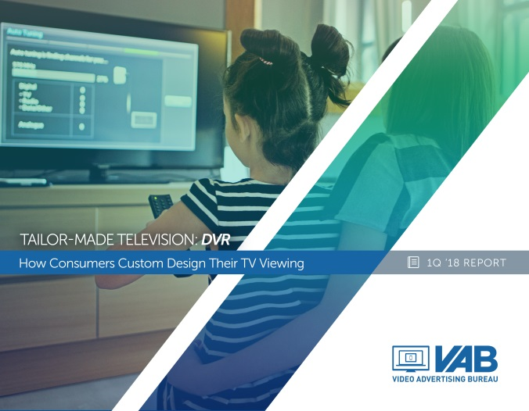


For More Information on Time-Shifted Viewing, Check Out All Of The Reports From Our Series
Tailor-Made Television: How Consumers Custom Design Their TV Viewing
DVR
Video-On-Demand
TV Everywhere
Find All Three Reports Here

Slide 28


