Slide 1


Slide 2
Time-Shifting: More Choices For Watching More Content
Time-Shifting refers to the ability of a consumer to access premium TV content when, where, and how it is most convenient for them. The options for time-shifting have grown, driven by the increasing demand consumers have to enjoy more content they love on their terms with more choices available to them.
This freedom of choice appeals to a wide range of viewers across age groups, income brackets and ethnicities, with each group having a specific preference on how they access content beyond live airings.
This three-report series will highlight the main ways consumers can time-shift their TV viewing: DVR, Video-on-Demand (VOD), and TV Everywhere (TVE). We will define each, size the landscape, discuss how many consumers are time-shifting, and review the profiles of time-shifting consumers.
VAB: Tailor-Made Television

Slide 3
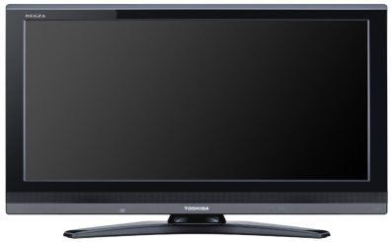



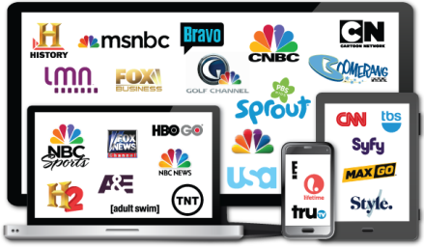
There Are Three Main Ways A Viewer Can Watch TV Content Outside Of A Live Airing
DVR (Digital Video Recorder): a Set-Top Box that records and stores television shows for viewing at a later time. Some MVPDs (Cable, Telco or Satellite Provider) offer Cloud DVR service, which allows users to view DVR’d content on mobile devices via the MVPD app, or on a computer via the MVPD’s website.
VOD (Video-On-Demand): allows users to select and watch video content when they choose to, rather than at a specific broadcast time. This report is specifically referring to VOD viewed through MVPDs (Cable, Telco or Satellite Provider) via their set-top-box.
  TVE (TV Everywhere): the ability for a viewer to watch TV and film content whenever and wherever they choose across devices (Smart TV, connected device, tablet, mobile device or computer). Content can be accessed through either a broadcast or cable programmer (via MVPD authentication/user log-in) or an MVPD app (like Comcast Xfinity & Spectrum TV).
VAB: Tailor-Made Television

Slide 4
First, It Should Be Noted That Live TV Remains The Reigning Champ Of TV Viewing Time, Regardless Of The Time Of Day
VAB: Tailor-Made Television
Source: comScore TV Essentials, U.S., Full Year 2016, Live +15 Day DVR; comScore State of VOD Trend Report, Total U.S.
Audience; Time-Shifted TV includes VOD and DVR.

Slide 5
Convenience (Not Ad Avoidance) Is The Top Reason For Time-Shifting Programs
This Convenience Allows Users The Opportunity To Consume More Content By Catching Up On Missed Shows And Binging Multiple Episodes
Top Reasons For Time-shifting TV Shows
VAB: Tailor-Made Television
Source: HUB Entertainment research 3/15; Survey of 1,210 TV consumers 16-74 who watch at least 5 hours of TV/week and have broadband home access; What do you consider to be the biggest benefits of watching episodes of a current show at a later time?

Slide 6



Despite All Of The Options Consumers Have, Half Of Time-Shifted Viewing Is Through MVPDs Via DVR, Set-Top VOD And TV Everywhere
34%
Total from “Big 3” SVOD
52%
Total from MVPD Sources
VAB: Tailor-Made Television
Source: Hub Entertainment Research, The Battle for Share of Mind, January 2018. TVE: Authenticated TV Everywhere, from
a network or pay TV operator’s website/app; Based on total viewing (TV & movies).

Slide 7
Consumers’ Appetite for Premium Content is Strong and is the Driving Force Behind Increased Use of Time-Shifting Methods
Members Only
Change in Frequency of Source Use vs. One Year Ago
Among Those Who Use Each
10%
DVR
42%
18%
TVE: MVPD Site or App
36%
19%
TVE: Network Site or App
28%
VAB: Tailor-Made Television
Source: Hub Entertainment Research, TV Redefined: The New Definition of “Watching TV”, August 2017.

Slide 8
There Are Three Main Ways A Viewer Can Watch TV Content Outside Of A Live Airing
DVR (Digital Video Recorder): a Set-Top Box that records and stores television shows for viewing at a later time. Some MVPDs (Cable, Telco or Satellite Provider) offer Cloud DVR service, which allows users to view DVR’d content on mobile devices via the MVPD app, or on a computer via the MVPD’s website.
VOD (Video-On-Demand): allows users to select and watch video content when they choose to, rather than at a specific broadcast time. This report is specifically referring to VOD viewed through MVPDs (Cable, Telco or Satellite Provider) via their set-top-box.
  TVE (TV Everywhere): the ability for a viewer to watch TV and film content whenever and wherever they choose across devices (Smart TV, connected device, tablet, mobile device or computer). Content can be accessed through either a broadcast or cable programmer (via MVPD authentication/user log-in) or an MVPD app (like Comcast Xfinity & Spectrum TV).
VAB: Tailor-Made Television

Slide 9
TV Everywhere (Via MVPD Authentication) –
What You Need To Know
More Access
  There are 61 million TVE users – many of whom are young and ethnically diverse - a 136% increase over the last five years
  50% of MVPD subscribers use TVE at least on a weekly basis
More Content
  9.2 billion annual TVE views, a 331% increase over the last five years
More Mobility
  24% of users access a TVE platform while on a lunch break at work, 21% access while a passenger in a car and 19% access during dinner at home
More Discovery
  Users browse for programming one-third of the time when they log onto a TVE platform
More Value
  60% of heavy TVE users consider their MVPD subscription a good or excellent value
VAB: Tailor-Made Television

Slide 10



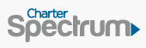




































































































There Are Dozens of Authenticated “TV Everywhere” Network & MVPD Apps Available To Subscribers
“TV Everywhere”
(Networks & MVPD with Authentication*)
VAB: Tailor-Made Television
Source: comScore OTT Intelligence, U.S., April 2017. *Network TV App definition excludes premium networks such as HBO and Showtime and Skinny Bundles such as Sling.

Slide 11
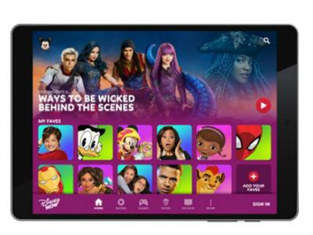


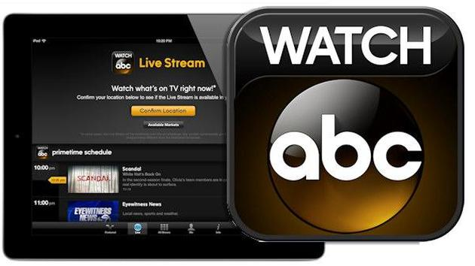


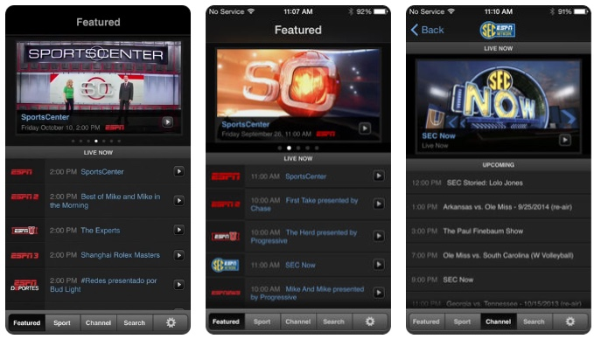

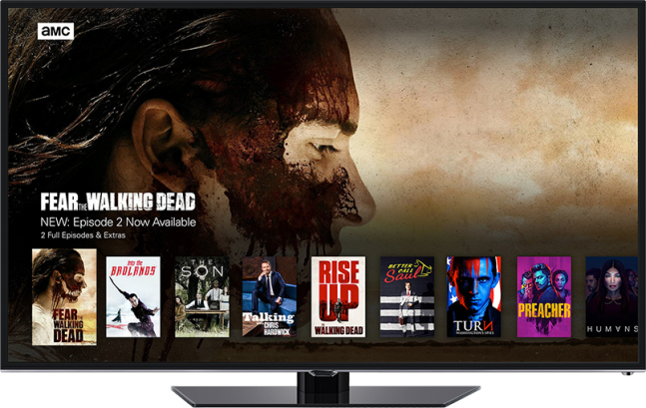
“TV Everywhere” Encompasses A Range Of Content, From Live TV & Exclusive Content To Current & Past-Season Libraries
Examples:
Library Content
Live TV
Exclusive Content
Live Sports
Current Episodes
VAB: Tailor-Made Television

Slide 12
“TV Everywhere” Awareness Has Increased Considerably
Over The Last Four Years
Source: TiVo, Q2 2017 Video Trends Report: Consumer Behavior Across Pay-TV, PVOD, OTT, TVE, Streaming Devices and Content Discovery.

Slide 13
There Are Over 61 Million “TV Everywhere” Users,
A 136% Increase Over The Last Five Years
Half (51%) of TV Households Are Accessing TV Everywhere
VAB: Tailor-Made Television
Source: 2016 SNL Kagan, As of August 2016, Includes authenticated video views from cable, DBS and telco service providers; Nielsen National Universe Estimates, 2018. Blue bars on graph reflect estimated figures; green bars reflect projections.

Slide 14
61% Of Users Find That The Process Of Using TV Everywhere Is Easy
The Process Of Using TVE Was…
VAB: Tailor-Made Television
Source: CTAM & Hub Entertainment Research, TVE Tracking: November 2017 Results. Q5S: All in all, how would you rate the process of using TV Everywhere to try and watch a show in this situation? Was it… TVE Users - MVPD Subscribers (18-64).

Slide 15
More People Are Consuming More Content Through “TV Everywhere” Platforms
“TV Everywhere” Views Are Outpacing Unique Users As They Become More Comfortable With Viewing Content This Way
VAB: Tailor-Made Television
Source: 2016 SNL Kagan, As of August 2016, Includes authenticated video views from cable, DBS and telco service providers. Blue bars on graph reflect estimated figures; green bars reflect projections.

Slide 16
TVE Viewers Are Watching More Content Because
They’re Highly Engaged With Quality Programming
VAB: Tailor-Made Television
Source: 2017 GfK MRI Doublebase, “Watch TV programs in the following ways - Through a TV network’s app”; Includes index v. general population.

Slide 17
They Most Rely Upon TVE Apps To Watch The Content They Love When On The Go
VAB: Tailor-Made Television
Source: 2017 GfK MRI Doublebase, “Watch TV programs in the following ways – TV network’s app”; Includes index v. general population.

Slide 18
TVE Has Allowed Users To Access TV Content In A Variety Of “Non-Traditional” Places Both In And Out Of The Home
Thus, “TV Everywhere” Has Created Many More Opportunities Throughout The Day For People To Watch TV Content Beyond The Living Room Or Bedroom
VAB: Tailor-Made Television
Source: CTAM & Hub Entertainment Research, TVE Tracking: November 2017 Results. Q5X: And tell us if you’ve ever used TV Everywhere in each of the following situations? MVPD Subscribers (A18-64).

Slide 19
Despite Prevalent Use Of TVE On The Go, The Fastest Growing Devices Are Connected TVs, Which Provide The Biggest Screen
% Change: 2015 vs. 2017
-15%
+60%
-15%
VAB: Tailor-Made Television
Source: Adobe Digital Insights, The State of Digital Video, 2017. North America, Data from January of each year.

Slide 20

“TVE” Demographics

Slide 21
TV Everywhere Viewers Are Younger And More Ethnically Diverse Than The Average Adult
Age
Watched A TV Network’s App
HHI
41%
139
107
50
141
100
69
32%
106
106
95
138
99
95
95
122
Education
Ethnicity
93
102
145
42%
130
107
97
86
121
98
101
128
100
VAB: Tailor-Made Television
Source: 2017 GfK MRI Doublebase, “Watch TV programs in the following ways - Through a TV network’s app”; Includes index v. general population.

Slide 22
TVE Usage Continues To Grow Across Key Demographics Of MVPD Subscribers, Especially Millennials
MVPD Subscribers’ TVE Use
Millennials
(A18-34)
Gen X
(A35-49)
Boomers
(A50-64)
VAB: Tailor-Made Television
Source: CTAM & Hub Entertainment Research, TVE Tracking: November 2017 Results; Light TVE Users: once per month or less, Moderate TVE Users: weekly or several times per month, Heavy TVE Users: daily or several times per week.

Slide 23
“TVE” Usage & Value

Slide 24
Half of MVPD Subscribers Use Their Provider’s “TV Everywhere” Platform At Least On A Weekly Basis
Extent of TVE Use in Past Six Months
64% of MVPD Subscribers Access TVE Using Their Subscription Across Devices
VAB: Tailor-Made Television
Source: CTAM & Hub Entertainment Research, TVE Tracking: November 2017 Results. Q4D: For which of these have you entered your [PROVIDER] account information in the past SIX MONTHS in order to watch streaming full-length TV shows, sports programs, or movies online?; Light TVE Users: once per month or less, Moderate TVE Users: weekly or several times per month, Heavy TVE Users: daily or several times per week.

Slide 25
Most Users Are Looking For Something Specific When They Log-On, But TVE Is Also Good For Discovering Programs As Well
When You Use TVE, What Percent Of The Time Do You Have….
VAB: Tailor-Made Television
Source: CTAM & Hub Entertainment Research, TVE Tracking: November 2017 Results. Q5F: When you use TV Everywhere, about what percent of the time do you have a specific show in mind you want to watch, and what percent do you have nothing specific in mind? MVPD Subscribers (18-64).

Slide 26
TVE Usage Increases The Value Viewers Place On Their MVPD Subscription
Perceived Value of Service from MVPD Provider
A18-64 MVPD subscribers
Excellent or
Good Value
60%
61%
47%
43%
VAB: Tailor-Made Television
Source: CTAM & Hub Entertainment Research, TVE Tracking: November 2017 Results. Q2D: How would you rate the value of your [provider] subscription, based on what you get for what you pay?; Light TVE Users: once per month or less, Moderate TVE Users: weekly or several times per month, Heavy TVE Users: daily or several times per week.

Slide 27
Nearly Half Of The Programming Viewers Access Through TVE Is Live Streamed Rather Than Library Content
4 Out Of The Last 10 Times Consumers Used TVE, They Streamed A Show As It Aired Live
# Of Times TVE Users Live Streamed
(Out Of Last 10 Times Using TVE)
VAB: Tailor-Made Television
Source: CTAM & Hub Entertainment Research, TVE Tracking: November 2017 Results. Q5T: Of the last 10 times you’ve used TV Everywhere, how many times, if any, did you watch a show as it was streaming live?

Slide 28
Members Only
64% Live Stream More, Or The Same Amount Of, Content Now Through TVE Than They Did A Year Ago
Frequency Of Live Streaming With TVE
VAB: Tailor-Made Television
Source: CTAM & Hub Entertainment Research, TVE Tracking: November 2017 Results. Q5U: Compared to one year ago, are you using TV Everywhere to watch shows streaming live? TVE Users - MVPD Subscribers (18-64).

Slide 29
75% Of TVE Users Find Live Streaming To Be A Valuable Feature Of Their MVPD Subscription
This Is Especially Apparent Among Millennials, Who Are The Heaviest TVE Users
Value Of Live Streaming With TVE
VAB: Tailor-Made Television
Source: CTAM & Hub Entertainment Research, TVE Tracking: November 2017 Results. Q5V: Does the ability to watch shows streaming live make TV Everywhere…?TVE Users - MVPD Subscribers (18-64).

Slide 30
Time-Shifting Segmentation

Slide 31
TVE Users Are Likely To Be Multicultural, Young Adults Who Binge-Watch Content “On The Go”
DVR User
VOD Viewer
TVE Viewer
Slightly older than VOD viewers & more affluent than TVE users
Median Age: 47
Average HHI: $92K
Younger than DVR users & the most affluent & educated Median Age: 43
Average HHI: $93K
The youngest and most ethnically diverse viewers
Median Age: 39
Average HHI: $67K
Who:
Drama, Reality, Thrillers & Soap Operas
General Entertainment & Kids Programming
Live TV & Sports, Library Content, Exclusive Content, & Current Episodes
What:
Throughout the day, with the majority occurring outside of Primetime
On their own time, when they can binge-watch multiple episodes
Whenever & Wherever
When:
Convenience and watching on their own time
Convenience and having a range of content available
Binge-watching premium content on the go
Why:
On a TV through a set-top-box recorder or on mobile devices via Cloud DVR through an MVPD
On a TV viewed through MVPDs (Cable, Telco or Satellite Provider) via their set-top-box
Across devices through either a broadcast or cable programmer or an MVPD app
How:
VAB: Tailor-Made Television
Source: 2017 GfK MRI Doublebase, DVR User: “How often watch TV programs in the following ways compared to 12 months ago-Using a DVR”; VOD Viewer: “Video-On-Demand # of Times Watched Past 30 days-TV/Shows/Movies (Any); TVE Viewer: Watch TV programs in the following ways - Through a TV network’s app”.

Slide 32
These TVE Viewers Are The Youngest, Most Ethnically Diverse Group Among The Three Segments
DVR User
VOD Viewer
TVE Viewer
Slightly older than VOD viewers & more affluent than TVE users
Median Age: 47
Average HHI: $92K
Younger than DVR users & the most affluent & educated Median Age: 43
Average HHI: $93K
The youngest and most ethnically diverse viewers
Median Age: 39
Average HHI: $67K
Who:
Drama, Reality, Thrillers & Soap Operas
General Entertainment & Kids Programming
Live TV & Sports, Library Content, Exclusive Content, & Current Episodes
What:
Throughout the day, with the majority occurring outside of Primetime
On their own time, when they can binge-watch multiple episodes
Whenever & Wherever
When:
Convenience and watching on their own time
Convenience and having a range of content available
Binge-watching premium content on the go
Why:
On a TV through a set-top-box recorder or on mobile devices via Cloud DVR through an MVPD
On a TV viewed through MVPDs (Cable, Telco or Satellite Provider) via their set-top-box
Across devices through either a broadcast or cable programmer or an MVPD app
How:
VAB: Tailor-Made Television
Source: 2017 GfK MRI Doublebase, DVR User: “How often watch TV programs in the following ways compared to 12 months ago-Using a DVR”; VOD Viewer: “Video-On-Demand # of Times Watched Past 30 days-TV/Shows/Movies (Any); TVE Viewer: Watch TV programs in the following ways - Through a TV network’s app”.

Slide 33
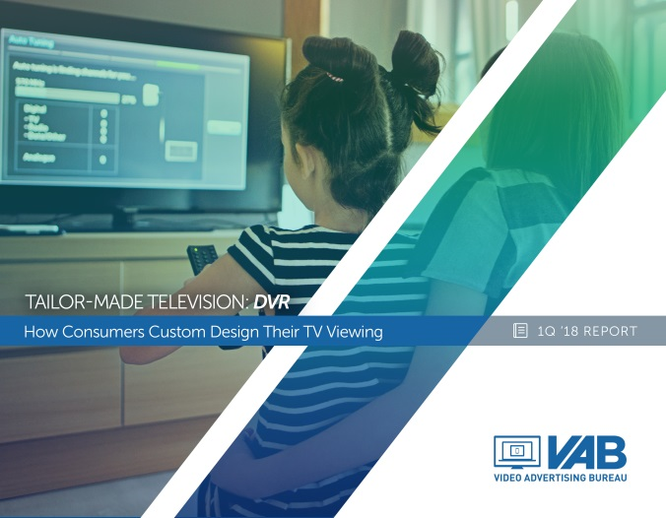


For More Information on Time-Shifted Viewing, Check Out All Of The Reports From Our Series
Tailor-Made Television: How Consumers Custom Design Their TV Viewing
DVR
Video-On-Demand
TV Everywhere
Find All Three Reports Here

Slide 34


