Slide 1
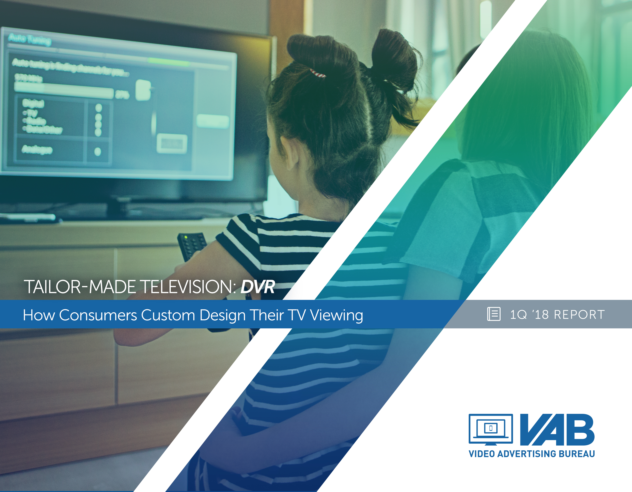

Slide 2
Time-Shifting: More Choices For Watching More Content
Time-Shifting refers to the ability of a consumer to access premium TV content when, where, and how it is most convenient for them. The options for time-shifting have grown, driven by the increasing demand consumers have to enjoy more content they love on their terms with more choices available to them.
This freedom of choice appeals to a wide range of viewers across age groups, income brackets and ethnicities, with each group having a specific preference on how they access content beyond live airings.
This three-report series will highlight the main ways consumers can time-shift their TV viewing: DVR, Video-on-Demand (VOD), and TV Everywhere (TVE). We will define each, size the landscape, discuss how many consumers are time-shifting, and review the profiles of time-shifting consumers.
VAB: Tailor-Made Television

Slide 3
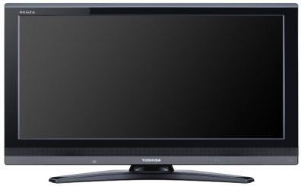




There Are Three Main Ways A Viewer Can Watch TV Content Outside Of A Live Airing
DVR (Digital Video Recorder): a Set-Top Box that records and stores television shows for viewing at a later time. Some MVPDs (Cable, Telco or Satellite Provider) offer Cloud DVR service, which allows users to view DVR’d content on mobile devices via the MVPD app, or on a computer via the MVPD’s website.
VOD (Video-On-Demand): allows users to select and watch video content when they choose to, rather than at a specific broadcast time. This report is specifically referring to VOD viewed through MVPDs (Cable, Telco or Satellite Provider) via their set-top-box.
  TVE (TV Everywhere): the ability for a viewer to watch TV and film content whenever and wherever they choose across devices (Smart TV, connected device, tablet, mobile device or computer). Content can be accessed through either the a broadcast or cable programmer (via MVPD authentication/user log-in) or an MVPD app (like Comcast Xfinity & Spectrum TV).
VAB: Tailor-Made Television

Slide 4
First, It Should Be Noted That Live TV Remains The Reigning Champ Of TV Viewing Time, Regardless Of The Time Of Day
VAB: Tailor-Made Television
Source: comScore TV Essentials, U.S., Full Year 2016, Live +15 Day DVR; comScore State of VOD Trend Report, Total U.S.
Audience; Time-Shifted TV includes VOD and DVR.

Slide 5
Convenience (Not Ad Avoidance) Is The Top Reason For Time-Shifting Programs
This Convenience Allows Users The Opportunity To Consume More Content By Catching Up On Missed Shows And Binging Multiple Episodes
Top Reasons For Time-shifting TV Shows
VAB: Tailor-Made Television
Source: HUB Entertainment research 3/15; Survey of 1,210 TV consumers 16-74 who watch at least 5 hours of TV/week and have broadband home access; What do you consider to be the biggest benefits of watching episodes of a current show at a later time?

Slide 6



Despite All Of The Options Consumers Have, Half Of Time-Shifted Viewing Is Through MVPDs Via DVR, Set-Top VOD And TV Everywhere
34%
Total from “Big 3” SVOD
52%
Total from MVPD Sources
VAB: Tailor-Made Television
Source: Hub Entertainment Research, The Battle for Share of Mind, January 2018. TVE: Authenticated TV Everywhere, from
a network or pay TV operator’s website/app; Based on total viewing (TV & movies).

Slide 7
Consumers’ Appetite for Premium Content is Strong and is the Driving Force Behind Increased Use of Time-Shifting Methods
Members Only
Change in Frequency of Source Use vs. One Year Ago
Among Those Who Use Each
10%
DVR
42%
18%
TVE: MVPD Site or App
36%
19%
TVE: Network Site or App
28%
VAB: Tailor-Made Television
Source: Hub Entertainment Research, TV Redefined: The New Definition of “Watching TV”, August 2017.

Slide 8
There Are Three Main Ways A Viewer Can Watch TV Content Outside Of A Live Airing
DVR (Digital Video Recorder): a Set-Top Box that records and stores television shows for viewing at a later time. Some MVPDs (Cable, Telco or Satellite Provider) offer Cloud DVR service, which allows users to view DVR’d content on mobile devices via the MVPD app, or on a computer via the MVPD’s website.
VOD (Video-On-Demand): allows users to select and watch video content when they choose to, rather than at a specific broadcast time. This report is specifically referring to VOD viewed through MVPDs (Cable, Telco or Satellite Provider) via their set-top-box.
  TVE (TV Everywhere): the ability for a viewer to watch TV and film content whenever and wherever they choose across devices (Smart TV, connected device, tablet, mobile device or computer). Content can be accessed through either a broadcast or cable programmer (via MVPD authentication/user log-in) or an MVPD app (like Comcast Xfinity & Spectrum TV).
VAB: Tailor-Made Television

Slide 9
DVR Usage – What You Need To Know
Just over half of Households (54%) have a DVR, which means 46% of HHs don’t have the ability to record programs for playback.
  DVR use is concentrated among adults aged 35-54
DVR owners love TV content, those households with a DVR:
  Watch 37% more TV than households without a DVR
  Watch the overwhelming majority (81%+) of their programming live
DVR viewing occurs throughout the day with only 39% of total time spent happening during Primetime.
Programming like News and Sports is most often viewed live due to their ‘real time’ nature, as well as non-fiction genres like Travel and Documentaries.
Viewers are recording content from across a wide variety of genres and topics, signaling their commitment and interest in getting more TV programming.
VAB: Tailor-Made Television

Slide 10

Just Over Half Of U.S. TV Households Own A DVR
Total U.S. DVR Penetration
Non-DVR HHs
45.7%
DVR HHs
54.3%
(54,640,000 TV HHs)
(64,960,000 TV HHs)
While DVR Penetration Has Been Steadily Rising, Just Over Half Of HHs Have A DVR
VAB: Tailor-Made Television
Source: Nielsen National Media Related UEs, February of each year.

Slide 11
DVR Users Are More Affluent & Educated Than The Average Adult
Watch TV Programs Using A DVR
(Index vs. Avg Population)
Age
HHI
77
158
43
81
45%
149
70
87
42%
121
109
146
100
119
124
120
Education
Ethnicity
48
88
126
55
67
50%
123
89
124
85
112
119
102
VAB: Tailor-Made Television
Source: 2017 GfK MRI Doublebase, “How often watch TV programs in the following ways compared to 12 months ago-
Using a DVR”; Includes index v. general population.

Slide 12
Homes With A DVR Consume 37% More Television Than Non-DVR Homes
Time Spent Per Week With TV
DVR v. Non-DVR HH
Primetime
+49%
+37%
Total Day
VAB: Tailor-Made Television
Source: VAB Analysis of Nielsen NPower Live+7 HUT/PUT; Time Spent of DVR vs. Non-DVR HH; Prime=M-Sa 8-11&Su 7-11p; M-Su 6a-6a; 9/25/2017 – 1/14/2018.
Notes:
12

Slide 13
This Is Also True Among Affluent Homes;
DVR Homes Are Heavier Consumers Of TV Than Non-DVR Homes
Time Spent Per Week With TV
DVR v. Non-DVR HH ($100K+ HHI)
Primetime
+31%
+27%
Total Day
VAB: Tailor-Made Television
Source: VAB Analysis of Nielsen NPower Live+7 HUT/PUT; Time Spent of Affluent (HH w/ $100K+) DVR vs. Non-DVR HH; Prime=M-Sa 8-11&Su 7-11p; M-Su 6a-6a; 9/25/2017 – 1/14/2018.
Notes:
13

Slide 14
Households With A DVR Watch Significantly More Live TV Than Recorded TV
Across Demos, Time Spent Viewing Live Dominates
% Live v. Playback Minutes: Total Day
VAB: Tailor-Made Television
Source: Nielsen NPower R&F Time Period Report, Total Day, Base= DVR HHs, Live vs. Live+7, Ad-supported Cable TV, broadcast TV, 9/25/17 – 1/14/18.

Slide 15
Even For Prime, The Most Time Shifted Daypart, The Majority Is Viewed Live
% Live v. Playback Minutes: Primetime
VAB: Tailor-Made Television
Source: Nielsen NPower R&F Time Period Report, Primetime, Base= DVR HHs, Live vs. Live+7, Ad-supported Cable TV, broadcast TV, 9/25/17 – 1/14/18.

Slide 16
Similarly, Affluent Consumers, Who Have The Most Means To Time-shift, Are Viewing The Majority Of Their Primetime TV Live
% Live V. Playback Minutes In HHI $100K+: Primetime
VAB: Tailor-Made Television
Source: Nielsen NPower R&F Time Period Report, Primetime, Base= DVR HHs, Live vs. Live+7, Ad-supported Cable TV, broadcast TV, 9/25/17 – 1/14/18.

Slide 17
DVR Usage Has Been Steadily Rising Over The Last Two Years Among Older Demos, While Millennials’ Use Has Declined
35:00
30:00
25:00
Hrs:min
20:00
15:00
10:00
5:00
% Change
2015 vs. 2017
-1.2%
-18.8%
-18.2%
-6.9%
+4.1%
+14.1%
VAB: Tailor-Made Television
Source: Nielsen Total Audience Report 2Q17, 2Q16.

Slide 18
Two-Thirds Of Active Daily DVR Users Spend Less Than Two Hours Per Day Watching Content Through A DVR
DVR Households Typically Watch 7 Hours Total of Ad-Supported TV Per Day, With The Majority Watched Live
“On Average, How Much Of Your Daily TV Viewing Time Is Spent Watching Previously Recorded/DVRed TV Shows & Movies?”
(Base: people who watch DVR content daily)
VAB: Tailor-Made Television
Source: VAB analysis of data from TiVo, Q3 2017 Online Video and Pay-TV Trends Report: Consumer Behavior Across Pay-TV, OTT, Connected Devices and Content Discovery. Daily Time Spent Watching TV: VAB analysis of Nielsen R&F Time Period Report, Live +7, Households, broadcast calendar comparison (3Q’17); “TV” reflects all ad-supported broadcast & cable TV.

Slide 19
Only 39% Of Total Time Spent With DVR Viewing Is Done During Primetime Hours
Share Of Average Minutes Viewed In DVR Playback By Daypart: A18-49
All Dayparts
VAB: Tailor-Made Television
Source: VAB Analysis of Nielsen NPower; Base= DVR; Viewing Source = DVR Playback; 9/25/2017 - 1/14/2018.
Notes:
19

Slide 20
From A Genre Perspective, Sports And News Have The Highest Rate Of Live Viewing Due To Their “Real-Time” Nature
VAB: Tailor-Made Television
Source: comScore TV Essentials, U.S., Full Year 2016, Live +15 Day DVR, Total U.S. Audience.

Slide 21
At The Same Time, Viewers Demonstrate Their Commitment To The TV Content They Love And Crave By Recording A Wide Variety Of Programming
Non-Fiction TV Is One Of The Least Time-Shifted Genres
VAB: Tailor-Made Television
Source: comScore TV Essentials, U.S., Full Year 2016, +15 Day DVR, Total U.S. Audience.

Slide 22
Which Makes Sense Since They Primarily Watch TV Programs To Be Entertained
VAB: Tailor-Made Television
Source: 2017 GfK MRI Doublebase, “How often watch TV programs in the following ways compared to 12 months ago-
Using a DVR”.

Slide 23

Time-Shifting Segmentation

Slide 24
DVR Users Are Likely To Be Mature, Affluent Adults Who Enjoy The Convenience Of TV Viewing On Their Own Time
DVR User
VOD Viewer
TVE Viewer
Slightly older than VOD viewers & more affluent than TVE users
Median Age: 47
Average HHI: $92K
Younger than DVR users & the most affluent & educated Median Age: 43
Average HHI: $93K
The youngest and most ethnically diverse viewers
Median Age: 39
Average HHI: $67K
Who:
Drama, Reality, Thrillers & Soap Operas
General Entertainment & Kids Programming
Live TV & Sports, Library Content, Exclusive Content, & Current Episodes
What:
Throughout the day, with the majority occurring outside of Primetime
On their own time, when they can binge-watch multiple episodes
Whenever & Wherever
When:
Convenience and watching on their own time
Convenience and having a range of content available
Binge-watching premium content on the go
Why:
On a TV through a set-top-box recorder or on mobile devices via Cloud DVR through an MVPD
On a TV viewed through MVPDs (Cable, Telco or Satellite Provider) via their set-top-box
Across devices through either a broadcast or cable programmer or an MVPD app
How:
VAB: Tailor-Made Television
Source: 2017 GfK MRI Doublebase, DVR User: “How often watch TV programs in the following ways compared to 12 months
ago-Using a DVR”; VOD Viewer: “Video-On-Demand # of Times Watched Past 30 days-TV/Shows/Movies (Any) ;
TVE Viewer: Watch TV programs in the following ways - Through a TV network’s app”.

Slide 25
These DVR Users Are Slightly Older Than VOD Viewers & More Affluent Than TVE Viewers
DVR User
VOD Viewer
TVE Viewer
Slightly older than VOD viewers & more affluent than TVE users
Median Age: 47
Average HHI: $92K
Younger than DVR users & the most affluent & educated Median Age: 43
Average HHI: $93K
The youngest and most ethnically diverse viewers
Median Age: 39
Average HHI: $67K
Who:
Drama, Reality, Thrillers & Soap Operas
General Entertainment & Kids Programming
Live TV & Sports, Library Content, Exclusive Content, & Current Episodes
What:
Throughout the day, with the majority occurring outside of Primetime
On their own time, when they can binge-watch multiple episodes
Whenever & Wherever
When:
Convenience and watching on their own time
Convenience and having a range of content available
Binge-watching premium content on the go
Why:
On a TV through a set-top-box recorder or on mobile devices via Cloud DVR through an MVPD
On a TV viewed through MVPDs (Cable, Telco or Satellite Provider) via their set-top-box
Across devices through either a broadcast or cable programmer or an MVPD app
How:
VAB: Tailor-Made Television
Source: 2017 GfK MRI Doublebase, DVR User: “How often watch TV programs in the following ways compared to 12 months
ago-Using a DVR”; VOD Viewer: “Video-On-Demand # of Times Watched Past 30 days-TV/Shows/Movies (Any) ;
TVE Viewer: Watch TV programs in the following ways - Through a TV network’s app”.

Slide 26



For More Information on Time-Shifted Viewing, Check Out All Of The Reports From Our Series
Tailor-Made Television: How Consumers Custom Design Their TV Viewing
DVR
Video-On-Demand
TV Everywhere
Find All Three Reports Here

Slide 27


