Slide 1
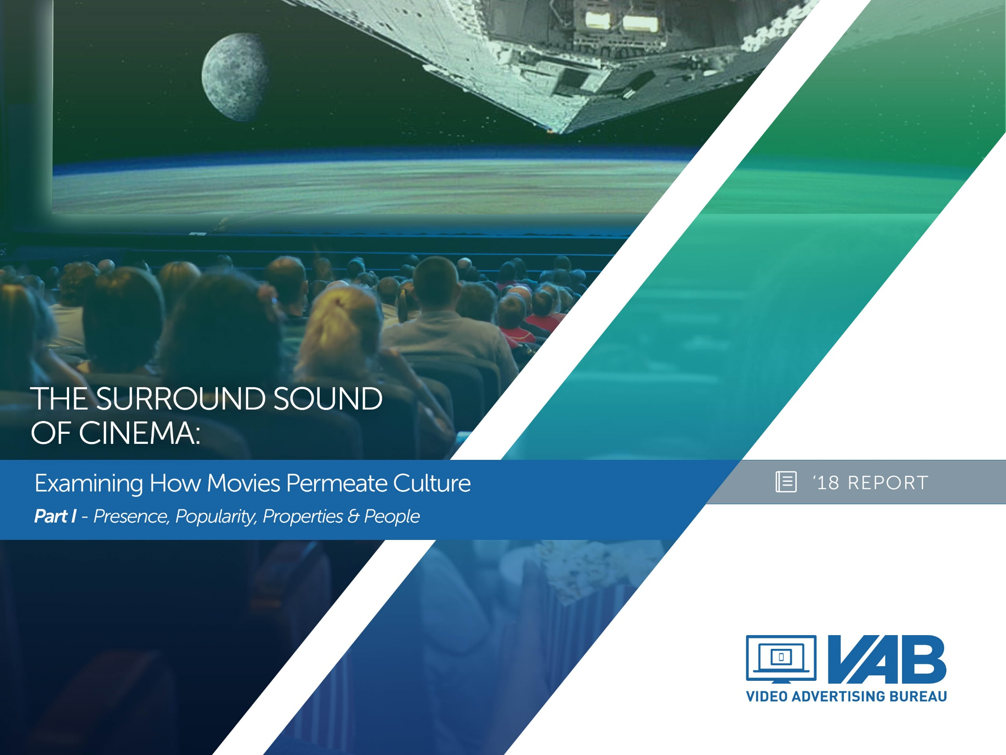
The Surround Sound of Cinema:
Examining How Movies Permeate Culture
Part I – Presence, Popularity, Properties & People

Slide 2
Opening Credits
Pop Quiz: The Questions 3
Plot Summary: Movies Are Ubiquitous & Audiences Are Passionate 4-7
Presence: Cinema’s Reach & Scale 8-15
Popularity: Impacting Culture Beyond The Cineplex 16-22
Properties: From Mega Franchises To Independents 23-28
People: From Real-Life Actors To Fictional Characters 29-34
Plot Summary Reminder 35
Points Of Contact 36
THE SURROUND SOUND OF CINEMA: PART i

Slide 3
Before We Dive Into The Report, It’s Pop Quiz Time!
Do you think you can answer these questions correctly? Don’t worry, all the information you need is provided in the following pages of Part I & Part II of this report series.
What % of people visit a dining venue before or after going to the movies?__________
How many people in the U.S. visit a movie-focused website or app each month?__________________
How many film soundtracks have reached the top five on the Billboard 200 chart over the last five years?_______
What movie became the highest-grossing horror movie of all time in 2017?______________
In 2016, what baby name, inspired by a movie villain, saw the largest spike in popularity from the previous year?________________
By what percentage did tourism to Norway increase after the theatrical release of Frozen?____________
Between 2015-2016, how many U.S. states hosted a movie production shoot?_________
How much did someone pay at an auction in 2017 for Star Lord’s “hero” helmet from Guardians of the Galaxy?___________
How many fan fiction stories based on movies are currently posted on fanfiction.net website?______________
To the closest billion, how much money did licensed goods based on movies and other entertainment properties generate in 2016 global retail sales?______________
THE SURROUND SOUND OF CINEMA: PART I

Slide 4
The Surround Sound Of Cinema: Movies Are Ubiquitous
Movies are ubiquitous and thus they have the power to shape culture and influence society as a whole. Almost all adults go to a local cineplex at least once a year as cinema continues to outdraw other major entertainment options by a wide margin.
The popularity of movies can be seen throughout the cultural landscape; they are responsible for some of the most viral content online, they are a popular genre of music and they are the source material for many ultra-successful Broadway shows…even pet ownership is influenced by movies.
From popular franchises like Despicable Me to thought-provoking, award-winning films like Hidden Figures, 2017 saw films across genres achieve record-setting milestones while actors and characters drove many pop culture moments.
The impact of movies isn’t just confined to the cineplex either, in addition to gathering around the TV in record numbers to watch movie-based award shows, they also spark people’s interest in traveling to locations inspired by settings from their favorite films.
This passion also manifests into immersive experiences for many as they actively engage in fan communities, dress up as their favorite characters, design their own fan art, write their own fictional stories inspired by movies and even form their own theories about the future of their favorite franchises.
Cinema also has the power to create halo effects, positively affecting countless other industries such as restaurants, consumer products, theater & music, literature, tourism and related websites, just to name a few. Beyond commerce, films also serve a greater purpose as they influence science, social causes and public opinion while serving as an inspiration for people throughout society.
Keep reading to see how movies permeate culture and be on the lookout for the release of Part II which will take a further dive into places, passions, products & purpose.
THE SURROUND SOUND OF CINEMA: PART I

Slide 5
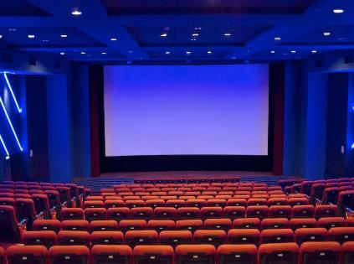
The Surround Sound Of Cinema: Permeating Culture With 8 “P’s”
Presence
Popularity
Properties
Places
Passion
Products
Purpose
People
-Cinema’s reach & scale makes it the most popular “away from home” entertainment choice in America
-Whether through science or social causes, cinema has the power to influence and inspire society
-From music to theatre and from costumes to pets, movies have a cultural impact far beyond the cineplex
-Licensed products from movies targeting babies through boomers generate billions of dollars in sales annually
-Mega franchises have lived in the public consciousness for generations while many thought-provoking “smaller” films have managed to make a lasting impact on society
-Movies are truly an immersive experience that extends outside the theater as fans embrace their passions through the consumption and creation of more content within devoted communities
-Special bonds develop with real-life actors and fictional characters to the point that many people consider them almost like family
-Movies create overwhelming consumer interest & visitation for locations both near and far, even for places as far away as Kazakhstan
THE SURROUND SOUND OF CINEMA: PART I

Slide 6
In This First Report Of Our Two-Part Series, We Focus On The First Four “P’s”
Presence
Popularity
Properties
Places
Passion
Products
Purpose
People
-Cinema’s reach & scale makes it the most popular “away from home” entertainment choice in America
-Whether through science or social causes, cinema has the power to influence and inspire society
-From music to theatre and from costumes to pets, movies have a cultural impact far beyond the cineplex
-Licensed products from movies targeting babies through boomers generate billions of dollars in sales annually
-Mega franchises have lived in the public consciousness for generations while many thought-provoking “smaller” films have managed to make a lasting impact on society
-Movies are truly an immersive experience that extends outside the theater as fans embrace their passions through the consumption and creation of more content within devoted communities
-Special bonds develop with real-life actors and fictional characters to the point that many people consider them almost like family
-Movies create overwhelming consumer interest & visitation for locations both near and far, even for places as far away as Kazakhstan
THE SURROUND SOUND OF CINEMA: PART I

Slide 7
In Summary, Cinema Delivers A Mass Audience Of The Most Passionate, Engaged, Rabid Fans Anywhere
Almost everyone goes to the movies…
…They rush to watch newly-released trailers online…
Presence
Popularity
86% of adults 18-49 go to the movies each year
Movie trailers can garner millions of online views in their first 24 hours after release
…Then they go to see recent theatrical releases in droves…
…And they look at their favorite characters almost like family
Properties
People
The top-grossing movies in Sci-Fi, Young Adult, Horror, Animation & Musical genres have all been released within the last 5 years
Movie characters are like family, and many have even been around for much longer (52+ years of James Bond, 40+ years of Luke Skywalker, 40+ years of Rocky)
THE SURROUND SOUND OF CINEMA: PART I

Slide 8

Presence:
Cinema’s Reach & Scale

Slide 9
The Film & Television Industry Is Not Just New York & Los Angeles, It’s An Industry That Employs Millions Across All 50 States
WA
ME
MT
ND
VT
MN
NH
$131 Billion contributed to the American Economy annually
OR
WI
NY
MA
SD
CT
ID
MI
RI
WY
PA
NJ
2 Million American Jobs in All 50 States
IA
NE
OH
MD
NV
IL
IN
DE
UT
WV
CO
VA
KS
MO
$51 Billion in wages for production & distribution jobs
CA
KY
TN
NC
OK
AR
SC
AZ
88,000 small businesses contribute to production
NM
MS
AL
GA
AK
LA
TX
FL
HI
THE SURROUND SOUND OF CINEMA: PART I
Source: Motion Picture Association of America, data based on 2015 for film & television industry. https://www.mpaa.org/jobs-economy/

Slide 10
Almost All Adults 18-49 Go To The Movies At Least Once A Year
In 2016, the typical moviegoer bought 5.3 tickets over the course of the year while adults 18-24 went to the movies an average of 6.5 times a year, an increase of 0.6 from 2015.
THE SURROUND SOUND OF CINEMA: PART I
Source: Nielsen Media Impact, based on Nielsen Total Media Fusion/GfK MRI Survey of The American Consumer, 6/25/16 – 6/24/17. Cinema reflects Screenvision and NCM footprint. Frequency data based on The MPAA Theatrical Market Statistics Report 2016.

Slide 11
Gen Z & Millennials Represent Over Half Of The Movie-Going Audience, Making It A More Targeted Medium Than The Internet
P6-34 Audience Composition
Cinema vs. Total Internet
THE SURROUND SOUND OF CINEMA: PART I
Source: Nielsen Cinema Audience Report, October 2017 for cinema audience composition. comScore October 2017, mediametrix multiplatform for Total Internet based on unique visitors. Composition for both cinema and digital based on P2+.

Slide 12
Cinema Continues To Draw More People Than All Theme Parks And Major U.S. Sports Combined
In 2016, 10x more people went to the cinema than attended a live sporting event within the four major leagues
THE SURROUND SOUND OF CINEMA: PART I
Source: The MPAA Theatrical Market Statistics Report 2016; attendance reflects U.S. / Canada.

Slide 13
In Fact, Going To The Movies Is The Most Popular “Away From Home” Entertainment
Leisure Activities – Attended / Participated In Last 12 Months
Adults 18+
THE SURROUND SOUND OF CINEMA: PART I
Source: GfK MRI 2017 Doublebase

Slide 14
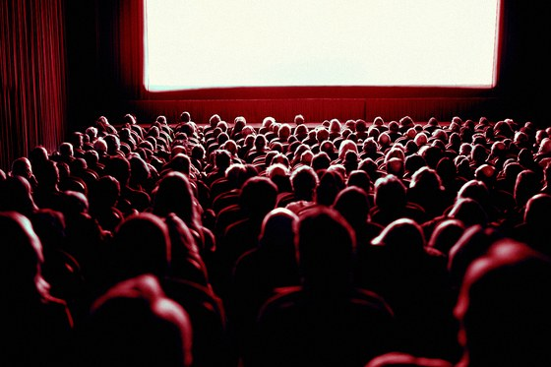











A Trip To The Cinema Creates A Halo Effect By Positively Impacting Surrounding Businesses As Well
When people go to the movies, 45% visit a dining venue before or after watching the movie.
21% visit a nightlife venue before or after.
Before A Movie
Moviegoers tend to visit coffee shops or breakfast places
After A Movie
Moviegoers tend to dine at casual restaurants
THE SURROUND SOUND OF CINEMA: PART I
Source: Foursquare Location Intelligence, Entertainment & Moviegoer Foot Traffic Trend Report, February 2017.

Slide 15






Outside Of The Cineplex, 143 Million People In The U.S. Visit
A Movie-Focused Website Or Mobile App Each Month
Informational Databases
68.7MM monthly visitors
Movie Theaters
Ticketing
19.0MM monthly visitors
31.6MM monthly visitors
Movies:
The Online Ecosystem
Industry News
Reviews
4.9MM monthly visitors
11.9MM monthly visitors
Entertainment News
11.2MM monthly visitors
THE SURROUND SOUND OF CINEMA: PART I
Source: comScore, MediaMetrix, multi-platform, P2+ for desktop / P18+ for mobile, October 2017. “Total audience visiting a movie-focused website/app” & “movie theaters” based on MediaMetrix Audience Duplication, multi-platform, total audience, entertainment – movies subcategory, October 2017. Movie theaters include Regal Entertainment, AMC Entertainment, Cinemark USA & MovieGoer Network.

Slide 16

Popularity:
Impacting Culture Beyond The Cineplex

Slide 17



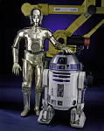




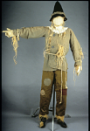






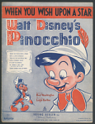
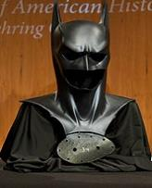
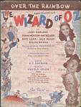

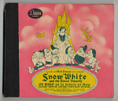

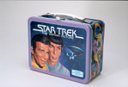

Cinema Has Had A Long History Of Cultural Impact
And Continues To Be An Integral Part Of American Society
Items Currently on Display, or Held, By The Smithsonian’s National Museum of American History in Washington, DC
Early model strip
of 35mm film
“Cleopatra” Mutoscope movie poster
Ruby slippers from
The Wizard of Oz
Peter Pan thermos
R2-D2 & C-3PO from Return of the Jedi
Alien egg prop
Golden ticket from Charlie and the Chocolate Factory
Rambo lunch box
Scarecrow from The Wizard of Oz
Toy Story 2-themed McDonald’s chicken McNuggets box
Hat from Indiana Jones and the Last Crusade
Marilyn Monroe evening gloves
Aladdin
thermos
Jumanji VHS
Videocassette
The Magic of Lassie lunch box
“When You Wish Upon A Star” sheet music from Pinocchio
Batman mask from Batman & Robin
“Over The Rainbow” sheet music from The Wizard of Oz
“Heigh-Ho” sound recording from Snow White
Boxing gloves from Rocky II
Dr. Strangelove
film advertisement
Star Trek: The Motion Picture lunch box
“Tom Mix” style cowboy hat
THE SURROUND SOUND OF CINEMA: PART I
Source: Smithsonian / The National Museum of American History archives

Slide 18
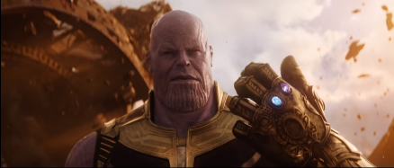
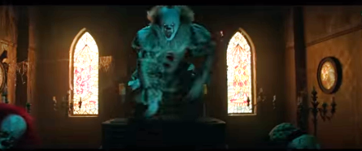
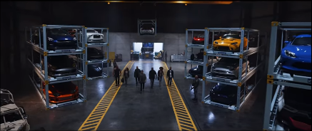
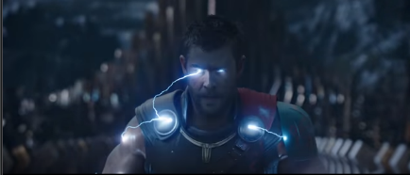
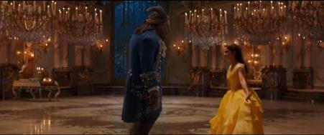
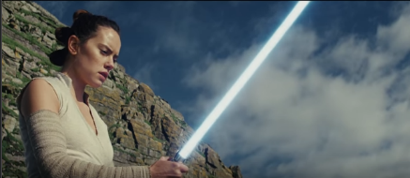
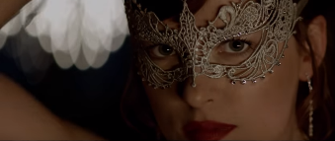

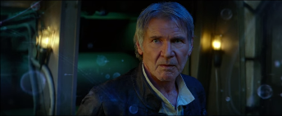

Trailers Are Some Of The Most Viral Content Online, With Many Garnering Over A Hundred Million Views In Their First 24 Hours
Avengers: Infinity War
230 Million Views (Official Trailer)
IT
197 Million Views (Official Teaser Trailer)
The Fate of the Furious
139 Million Views (Official Trailer)
Thor: Ragnarok
136 Million Views (Official Teaser Trailer)
Beauty and the Beast
128 Million Views (Official Trailer)
Star Wars: The Last Jedi
120 Million Views (Official Trailer)
50 Shades Darker
114 Million Views (Official Trailer)
The Incredibles 2
113 Million Views (Official Teaser Trailer)
Star Wars: The Force Awakens
112 Million Views (Official Trailer)
Captain America: Civil War
95 Million Views (Official Trailer #2)
THE SURROUND SOUND OF CINEMA: PART I
Source: IMDB.com “Top 10 Most Viewed Online Trailers in the First 24 Hours” across the internet (as of 12/14/17). Figures represent # of views for the first 24 hours after release.

Slide 19
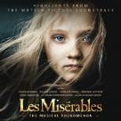

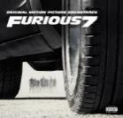


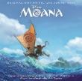

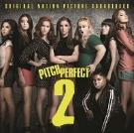
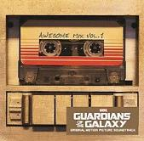
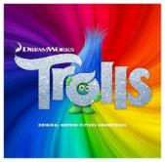
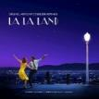
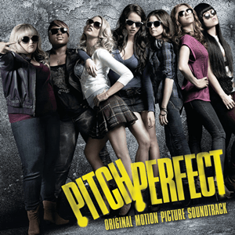
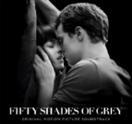
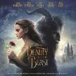

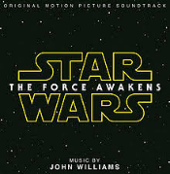


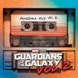
19 Film Soundtracks Have Reached The Top Five On The Billboard 200 Chart Over The Last Five Years
In fact, 72 movie soundtracks have hit #1 on the Billboard 200 since it’s formation in 1963
2013
2014
2015
2016
2017
1
1
1
1
1
23 weeks on chart
34 weeks on chart
46 weeks on chart
2
2
116 weeks on chart
1
66 weeks on chart
1
3
53 weeks on chart
2
33 weeks on chart
31 weeks on chart
3
2
115 weeks on chart
61 weeks on chart
28 weeks on chart
3
5
5
126 weeks on chart
54 weeks on chart
5
5
26 weeks on chart
5
25 weeks on chart
11 weeks on chart
14 weeks on chart
9 weeks on chart
31 weeks on chart
THE SURROUND SOUND OF CINEMA: PART I
#
= peaked at this ranking on the Billboard 200 chart
http://www.billboard.com/music/soundtrack/chart-history. # of weeks reflect all weeks when soundtrack was ranked on the Billboard 200 chart; as of 11/15/17.

Slide 20
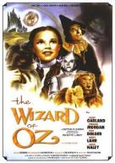
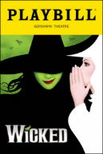
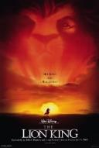

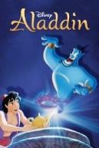
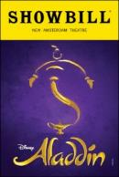
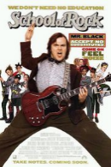



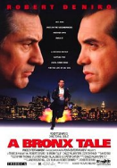
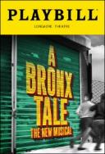
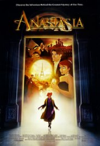

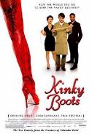
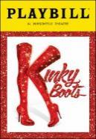


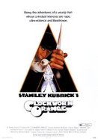










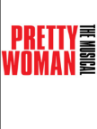


Film Adaptations Are Behind A Majority Of The Most Popular Shows Currently On Broadway
8 out of the Top 15 (53%) Most Popular Current Broadway Shows Are Inspired By Movies
The Wizard of Oz
The Lion King
Aladdin
School of Rock
Waitress
2
3
6
8
9
A Bronx Tale
Anastasia
Kinky Boots
Elf
A Clockwork Orange
10
12
15
n/a
n/a
Coming Soon in 2018!
Frozen
Mean Girls
Moulin Rouge!
King Kong
Pretty Woman
The Devil Wears Prada
THE SURROUND SOUND OF CINEMA: PART I
#
= popularity ranking based on Broadway.com
Source: www.broadway.com, as on November 7, 2017

Slide 21

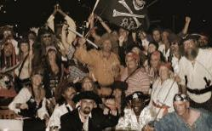




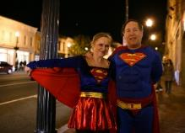

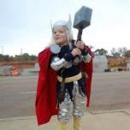
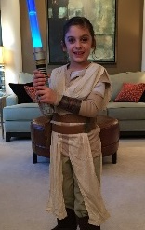
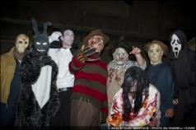
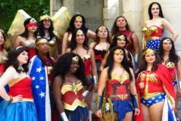
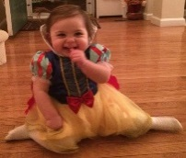

Movies Inspire A Majority Of The Most Popular Halloween Costumes For Both Adults & Kids
Halloween costume sales are a big business with an estimated $3.4 billion being spent in 2017
Movie-Inspired Halloween Costumes In Top 10 Ranking
Children
Adults
#1 – Action / Superhero
#2 – Batman Character
#2 – Batman Character
#4 – Pirate
#4 – Spider-Man
#5 – Star Wars Character
#7(t) – Marvel Superhero
#5 – Marvel Superhero
#8 – DC Superhero
#7(t) – Pirate
#9 – Slasher Movie Villain
#10 – Wonder Woman
#8 – Disney Princess
#10 – Wonder Woman
THE SURROUND SOUND OF CINEMA: PART I
Source: National Retail Federation, 2017 Annual Halloween Spending Survey, conducted by Prosper Insights & Analytics

Slide 22




Movies Can Even Popularize Different Types Of Pets While Increasing Sales & Adoption Rates
Blue Tang Fish
In 2016, some retailers reported an increase in sales as high as a three-fold after the movie’s release
Turtles
In 2014, the CBC reported that sales of pet turtles rose 20% in the month after the movie’s release
Guinea Pigs
In 2009, Pets at Home reported a 15% rise in sales after the film went into wide release
Rats
In 2007, Pets at Home reported a 50% surge in sales in the first month following the film’s release
THE SURROUND SOUND OF CINEMA: PART I
Source: CBC, Pets at Home statements

Slide 23
Properties:
From Mega Franchises To Independents

Slide 24







Many Popular Franchises Have Lived In The Public Consciousness For Years, Often Stretching Across Generations
Spider-Man / X-Men / Marvel Cinematic Universe
32 Movies: 2000 - Present
Total U.S. Grosses: $6.8 Billion
Batman & DC Extended Universe
16 Movies: 1989 - Present
Total U.S. Grosses: $4.0 Billion
Star Wars
9 Movies: 1977 - Present
Total U.S. Grosses: $3.8 Billion
J.K. Rowling’s Wizarding World
10 Movies: 2001 - Present
Total U.S. Grosses: $2.6 Billion
James Bond
25 Movies: 1963 - Present
Total U.S. Grosses: $2.1 Billion
Middle Earth
6 Movies: 2001 - 2014
Total U.S. Grosses: $1.8 Billion
The Fast and the Furious
8 Movies: 2001 - Present
Total U.S. Grosses: $1.5 Billion
THE SURROUND SOUND OF CINEMA: PART I
Source: www.boxofficemojo.com. Lifetime domestic theatrical grosses, franchise category, as of 12/26/17.

Slide 25




























































Additionally, Each Year Countless Cinematic Films Contribute To Culture

Slide 26




















Recent Movies Across Major Genres Have Become Hugely Popular & Many Have Even Broken Box Office Records
Movies Released In Last Five Years That Rank In The Top #10 For Domestic Box Office Gross By Genre
Superhero / Comic Book Adaptation
Science Fiction
Young Adult
3
5
6
9
10
1
3
4
9
1
4
(2015)
$459.0MM
(2017)
$412.6MM
(2013)
$409.0MM
(2016)
$408.1MM
(2017)
$389.8MM
(2015)
$936.7MM
(2015)
$652.3MM
(2016)
$532.3MM
(2017)
$397.3MM
(2013)
$424.7MM
(2014)
$337.1MM
Horror / Thriller
Animation
1
4
10
1
5
7
8
9
10
(2017)
$327.5MM
(2017)
$175.5MM
(2013)
$137.4MM
(2016)
$486.3MM
(2013)
$400.7MM
(2016)
$368.4MM
(2013)
$368.1MM
(2015)
$356.5MM
(2016)
$341.3MM
THE SURROUND SOUND OF CINEMA: PART I
#
= all-time genre ranking based on lifetime domestic theatrical gross
Source: www.boxofficemojo.com. Lifetime domestic theatrical grosses as of 12/26/17 (five years = 2013- YTD 2017); top 10 films; comic book adaptation, sci-fi – adventure films excluding “superhero” and “animated” movies, young-adult book adaptations (books aimed at 10-17 year old’s), horror films, animated films.

Slide 27












In 2017, Movies Drove Many Pop Culture Moments While Several Individual Films Achieved “All-Time” Milestones
The infamous Oscar night best picture announcement flub sparked multiple top #5 trending topics on Twitter that night
Hidden Figures was the first movie with multiple female leads to be #1 at the box office in multiple weeks since 2011
The Despicable Me franchise became the highest grossing animated franchise ever with a $3.6 billion worldwide gross
It became the highest grossing horror movie of all time
Beauty and the Beast became the highest grossing musical of all time
Wonder Woman became the highest grossing female-directed movie of all time
The Marvel Cinematic Universe became the first film franchise to gross more than $11 billion worldwide, by the end of the year it had grossed over $13 billion
Dunkirk became the highest-grossing World War II film of all time
Get Out’s Jordan Peele is the first black writer-director with a $100MM+ debut
THE SURROUND SOUND OF CINEMA: PART I
Source: www.boxofficemojo.com.

Slide 28


















The Future Continues To Be Bright With These
“Culture Driving” Movies Coming Soon To A Cineplex Near You
Cinema as the surround sound of popular culture will only continue with soon-to-be released franchise sequels, re-makes and long-awaited films from major directors and producers
Avengers: Infinity War
Jurassic World: Fallen Kingdom
Solo: A Star Wars Story
Ant-Man and the Wasp
Bohemian Rhapsody
X-Men: Dark Phoenix
Black Panther
Ready Player One
Hellboy
The Incredibles 2
Tomb Raider
Fifty Shades Freed
Pacific Rim: Uprising
Maze Runner: The Death Cure
Isle of Dogs
The Irishman
MI 6 – Mission Impossible
Deadpool 2
THE SURROUND SOUND OF CINEMA: PART I

Slide 29
People:
From Real-Life Actors To Fictional Characters

Slide 30
















Several Of Today’s Most Powerful Celebrities Are Entrenched Movie Stars Or Up-And-Coming Film Actors
8 of the top 20 most powerful celebrities across entertainment (music, film, theater, TV, comedy, etc) are movie stars
Dwayne “The Rock” Johnson
Jennifer Lawrence
Chris Pratt
Ryan Reynolds
Donald Glover
Kate McKinnon
Adam Driver
Margot Robbie
THE SURROUND SOUND OF CINEMA: PART I
Source: Business Insider; Dec 28, 2016 – “The A-List: The 20 Most Powerful Entertainment Stars”

Slide 31












Film Characters Have Lived For Decades, With Some People Knowing Their Stories Better Than Their Own Family Members
52+ Years of James Bond
From Dr. No (1963) to Spectre (2015)
40+ Years of Luke Skywalker
From Star Wars: A New Hope (1977) to The Last Jedi (2017)
40+ Years of Rocky Balboa
From Rocky (1976) to Creed (2015)
37+ Years of Captain Kirk
From Star Trek (1979) to Star Trek Beyond (2015)
28+ Years of Bruce Wayne
From Batman (1989) to Batman v Superman: Dawn of Justice (2016)
16+ Years of Dominic Toretto
From The Fast and the Furious (2001) to The Fate of the Furious (2017)
THE SURROUND SOUND OF CINEMA: PART I
Source: www.boxofficemojo.com

Slide 32




















People Are So Passionate Over The Characters They Feel Bonded To That They Rigorously Debate New Casting Choices
Ben Affleck cast as Batman
Who will be cast as Young Han Solo?
Gal Gadot cast as Wonder Woman
THE SURROUND SOUND OF CINEMA: PART I

Slide 33












But There’s No Debate That If You’re Looking For Strong Female Characters, You Can #SeeHer Everywhere At The Cinema
Moana
Letty from The Fate of the Furious
Rey from Star Wars: The Last Jedi
Imperator Furiosa from Mad Max: Fury Road
Katherine, Dorothy & Mary from Hidden Figures
Black Widow from The Avengers
Diana Prince aka Wonder Woman
Beatrice Prior From Divergent
Belle From Beauty and the Beast
Jyn from Rogue One
Katniss Everdeen From The Hunger Games
Elsa from Frozen
THE SURROUND SOUND OF CINEMA: PART I

Slide 34





Interestingly, The Largest Spikes In Baby Name Popularity Are Primarily Due To Film Characters & Actors
Movie-Inspired Baby Names: 2016 vs. 2015 Ranking
Name
2016
2015
Diff
Rank*
Popularity Inspired By…
“Kylo”
#901
#3,269
+2,368
1
Kylo Ren from the new Star Wars trilogy, introduced in the 2015 film, Force Awakens
“Creed”
#982
#1,352
+370
2
Creed was a 2015 spin-off and sequel to the popular Rocky film series
“Benicio”
#975
#1,331
+356
3
A popular actor, Benicio Del Toro was confirmed to have joined the cast of The Last Jedi in early 2016
“Adonis”
#394
#701
+307
4
The star of the movie Creed, played by Michael B. Jordan, was named Adonis Johnson Creed
“Saoirse”
#983
#1,448
+465
3
Saoirse Ronan is a young Irish-American actress who was nominated for a Best Actress Oscar in 2016 for the movie Brooklyn
“Alessia”
#827
#1,175
+348
7
In 2016, Alessia Cara recorded the hit song “How Far I’ll Go” for the Moana movie soundtrack
THE SURROUND SOUND OF CINEMA: PART I
*Rank based on popularity(#) increase
Source: Social Security Administration, baby names list ranked by largest YOY popularity increase

Slide 35
Reminder: Cinema Delivers A Mass Audience Of The Most Passionate, Engaged, Rabid Fans Anywhere
Almost everyone goes to the movies…
…They rush to watch newly-released trailers online…
Presence
Popularity
86% of adults 18-49 go to the movies each year
Movie trailers can garner millions of online views in their first 24 hours after release
…Then they go to see recent theatrical releases in droves…
…And they look at their favorite characters almost like family
Properties
People
The top-grossing movies in Sci-Fi, Young Adult, Horror, Animation & Musical genres have all been released within the last 5 years
Movie characters are like family, and many have even been around for much longer (52+ years of James Bond, 40+ years of Luke Skywalker, 40+ years of Rocky)
THE SURROUND SOUND OF CINEMA: PART I

Slide 36


For More Information Visit Us Online
TheVAB.com
Follow us:
@VideoAdBureau
Like us:
facebook.com/VideoAdvertisingBureau

