Slide 1

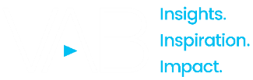
February 13, 2026
Question of the Week:
“
How much do Super Bowl ads drive consumer action, like search?
”
Super Bowl LX (2026)

Slide 2
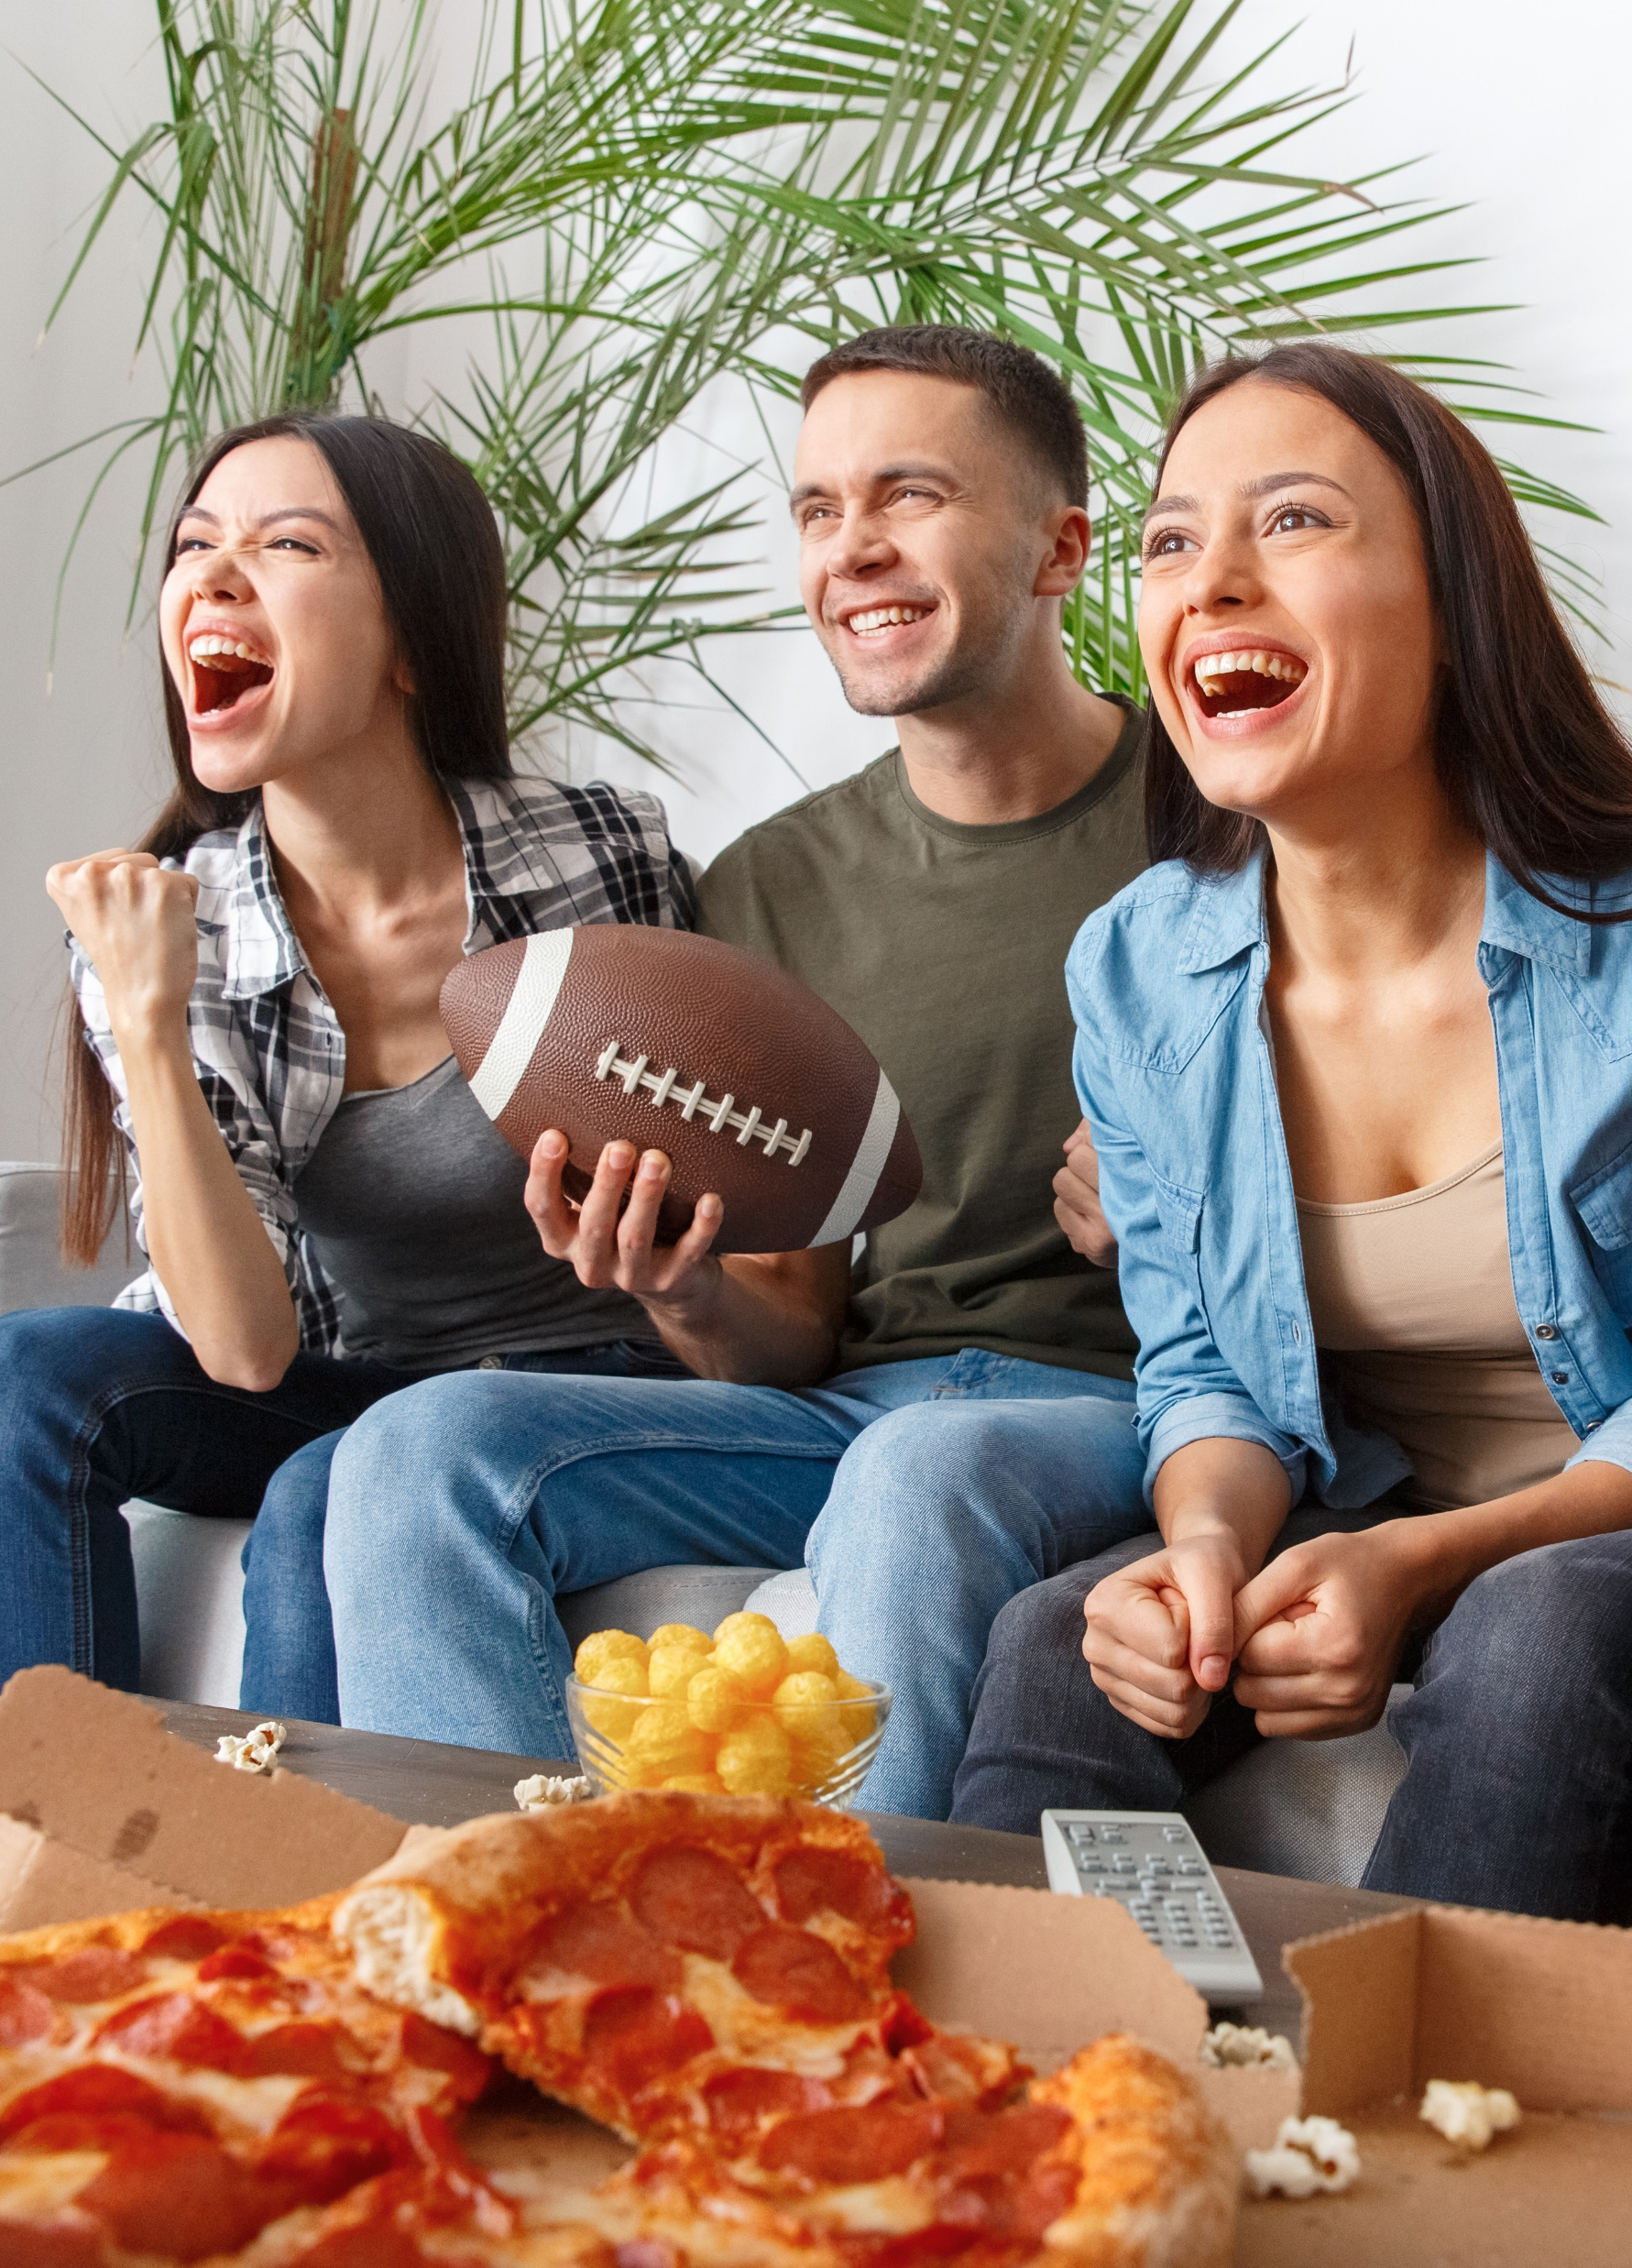
The Super Bowl drives mid-funnel results for all types of advertisers and strategies
Reach new audiences. Raise awareness. Create interest. Enhance brand image. Rebuild brand equity. Reshape brand perception. Build momentum. Introduce a new brand or product line. Foster consumer action. Drive sales. Accelerate growth.
There were several objectives and strategies that advertisers had for their Super Bowl spot(s), but regardless of their goal, the massive audience and live, engaging content of multiscreen TV delivered mid-funnel outcomes, by driving significant lifts in branded search for brands of all types.
From an advertising perspective, the Super Bowl is for everyone – well-established companies, young brands, first time advertisers, long time advertisers, ‘challenger’ brands, new products, brands in emerging categories and everything in between.
Our second annual analysis with a whole new set of 15 Super Bowl advertisers shows similar results to last year: brands saw anywhere between a 67% – 14x immediate lift in branded search from curious consumers on Super Bowl night.
These results highlight the power of truly Premium Video but are not an anomaly.
As we have shown in other recent analyses – Breaking Through, Welcome to TV
and Direct Momentum – multiscreen TV consistently drives consumer action for brands.
This information is exclusively provided to VAB members and qualified marketers.
PAGE 2

Slide 3

The Super Bowl delivers outsized mid-funnel results for all types of advertisers across a variety of marketing strategies
1
2
3
4
5
‘First Time’
Super Bowl
TV Advertisers
‘Consistent’
Super Bowl
TV Advertisers
‘Returning Player’ Super Bowl
TV Advertisers
‘Young’
Life Stage
Brands
‘Well Established’
Life Stage
Brands
6
7
8
9
10
Product Line
Extensions
Challenger
Brands
‘Emerging’ Category Brands
Women-Targeted Products & Services
‘Business-to-Business’ Companies
11
12
13
14
15
Brand Refreshes or Repositioning
Global Brand Introduction to the U.S.
Brand
Partnerships
Immersive Brand Experiences
Streaming Only + Regional Market Overlay
click through the appropriate box if you would like to be brought directly to the corresponding slide
This information is exclusively provided to VAB members and qualified marketers.
PAGE 3

Slide 4

To understand the effect that Super Bowl ads
have on mid-funnel outcomes, we analyzed Google Search Trends for 15 advertisers –
one from each segment on the previous page
How to read the charts:
Google Search Index = represents search interest relative to the highest point during a specific time period for a given region (U.S. for this analysis), a value of 100 is the peak popularity for the term, a value of 50 means that the term is half as popular.

Slide 5
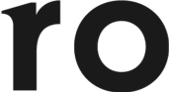

‘First Time’ Super Bowl TV Advertiser
Ro: A first-time Super Bowl advertiser used their ad to reshape consumer perception of its brand as a more comprehensive health care provider
Branded online search more than doubled on Super Bowl night vs. week prior and was 41% higher than the second highest week over the last 12 months
2.3x
Weekly Google Trends Index: Ro
12-month trend leading up to the Superbowl (Weeks of 2/9/2025 – 2/8/2026)
vs. prior week
Super Bowl
(100 index)
Second Highest Week
(71 index)
“As soon as the spot airs, we know we’re going to see a whole lot of traffic come to our site, but what we are really expecting and hoping for is to reshape how we’re perceived in the category."
Week Before Super Bowl
(44 index)
Will Flaherty
SVP of Growth, Ro
(AdExchanger, 2/6/26)
Source: VAB analysis of Google Trends, United States only, All Categories, Web Search, Weeks of 2/9/25 – 2/8/26. Google Search Index represents search interest relative to the highest point on the chart for the given region and time period, a value of 100 is the peak popularity for the term, a value of 50 means that the term is half as popular. Note: Light blue line marks the date of Super Bowl LX. Click here to view Ro's Super Bowl commercial (via iSpot.tv). Search trend based on ro.co.
This information is exclusively provided to VAB members and qualified marketers.
PAGE 5

Slide 6
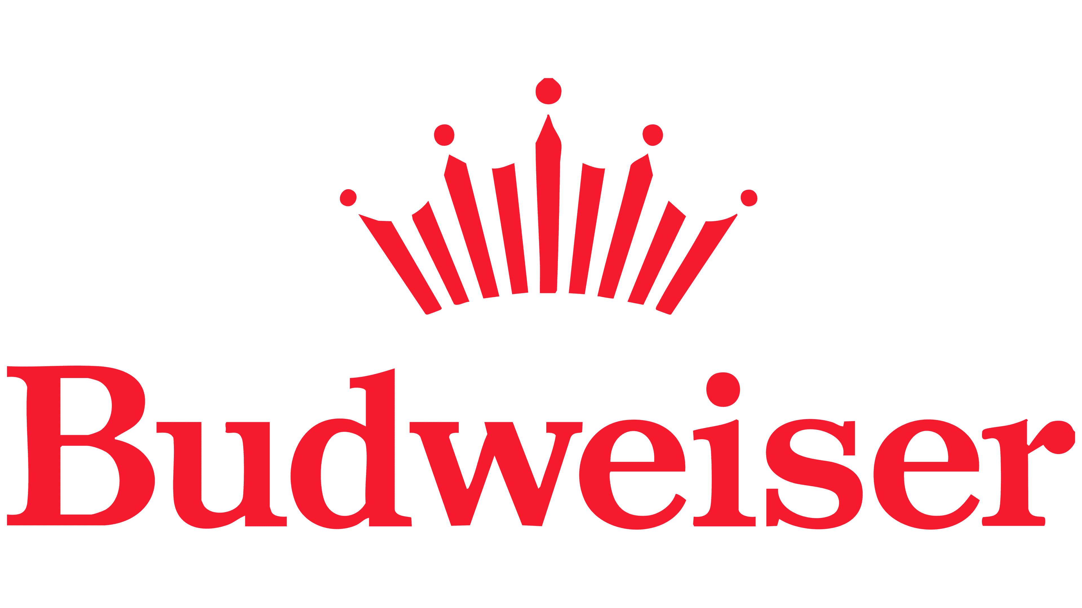
‘Consistent’ Super Bowl TV Advertiser
Budweiser: A popular ad among viewers that not only enhances their brand image but creates a ‘halo effect’ across the Anheuser-Busch portfolio
Branded online search increased more than 5x on Super Bowl night vs. week prior
5x
Weekly Google Trends Index: Budweiser
12-month trend leading up to the Superbowl (Weeks of 2/9/2025 – 2/8/2026)
vs. prior week
Super Bowl
(100 index)
“As we celebrate Budweiser’s 150th anniversary and America’s 250th birthday, we knew we had to rise to the occasion in a way only Budweiser can. This year’s spot will leave fans awestruck and proud to enjoy a Budweiser as they celebrate our shared milestone moments.”
Week Before Super Bowl
(20 index)
Todd Allen
SVP of Marketing, Budweiser
(Forbes, 2/1/26)
Source: VAB analysis of Google Trends, United States only, All Categories, Web Search, Weeks of 2/9/25 – 2/8/26. Google Search Index represents search interest relative to the highest point on the chart for the given region and time period, a value of 100 is the peak popularity for the term, a value of 50 means that the term is half as popular. Note: Light blue line marks the date of Super Bowl LX. Click here to view Budweiser’s Super Bowl commercial (via iSpot.tv).
This information is exclusively provided to VAB members and qualified marketers.
PAGE 6

Slide 7
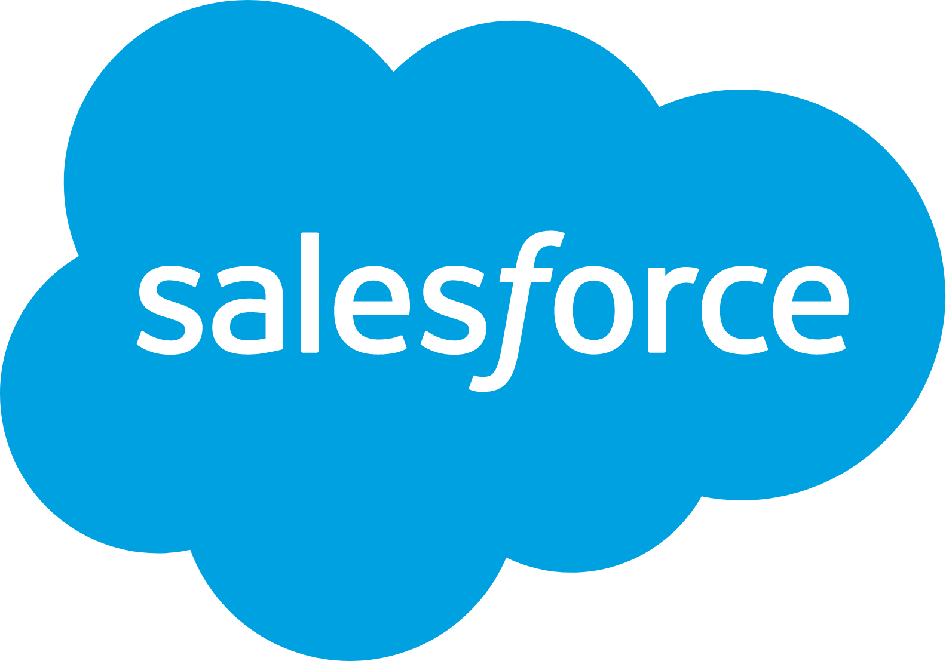
‘Returning Player’ Super Bowl TV Advertiser
Salesforce: In its 2nd consecutive appearance after a two-year hiatus, the brand enlisted popular creator MrBeast to promote a $1MM prize giveaway
Branded online search doubled on Super Bowl night vs. week prior and was 32% higher than the second highest week over the last 12 months
2x
Weekly Google Trends Index: Salesforce
12-month trend leading up to the Superbowl (Weeks of 2/9/2025 – 2/8/2026)
vs. prior week
Super Bowl
(100 index)
Second Highest Week
(76 index)
“We’ve had over 53M people hit this page since the spot ran. 1.32M in the last 15 minutes. Beyond any expectation
we could have had.”
2025 Super Bowl
(64 index)
Week Before Super Bowl
(51 index)
Marc Benioff
CEO, Salesforce
(X, 2/9/26)
Source: VAB analysis of Google Trends, United States only, All Categories, Web Search, Weeks of 2/9/25 – 2/8/26. Google Search Index represents search interest relative to the highest point on the chart for the given region and time period, a value of 100 is the peak popularity for the term, a value of 50 means that the term is half as popular. Note: Light blue line marks the date of Super Bowl LX. Click here to view Salesforce's Super Bowl commercial (via iSpot.tv).
This information is exclusively provided to VAB members and qualified marketers.
PAGE 7

Slide 8
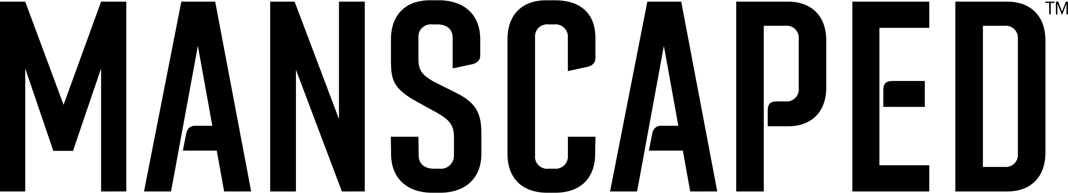
‘Young’ Life Stage Brand
Manscaped: Within ten years of its founding, their Super Bowl debut ad sought to reach new audiences after growing their retail footprint
Branded online search more than doubled on Super Bowl night vs. week prior and was 20% higher than the second highest week over the last 12 months
2.3x
Weekly Google Trends Index: Manscaped
12-month trend leading up to the Superbowl (Weeks of 2/9/2025 – 2/8/2026)
vs. prior week
Super Bowl
(100 index)
Second Highest Week
(83 index)
Manscaped started shifting more lower-funnel dollars into upper-funnel branding budgets last year to build awareness.
“We started with a heavy focus on DTC,
but the maturity of the brand’s retail footprint and the need to grow it audience is what pushed us to flip our media composition”
Week Before Super Bowl
(44 index)
Marcelo Kertesz
CMO, Manscaped
(AdExchanger, 2/6/26)
Source: VAB analysis of Google Trends, United States only, All Categories, Web Search, Weeks of 2/9/25 – 2/8/26. Google Search Index represents search interest relative to the highest point on the chart for the given region and time period, a value of 100 is the peak popularity for the term, a value of 50 means that the term is half as popular. Note: Light blue line marks the date of Super Bowl LX. Click here to view Manscaped’s Super Bowl commercial (via iSpot.tv).
This information is exclusively provided to VAB members and qualified marketers.
PAGE 8

Slide 9
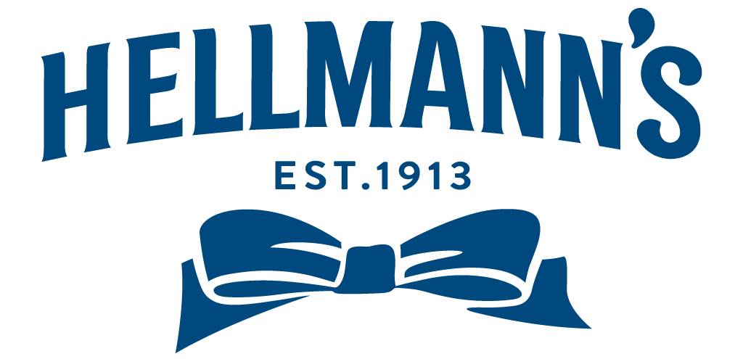
‘Well Established’ Life Stage Brand
Hellmann’s: This 113-year-old brand has had an ad in the last six Super Bowl as they continue their connection and commitment to consumers
Branded online search increased 4x on Super Bowl night vs. week prior and was 39% higher than the second highest week in the past year (Super Bowl LIX)
4x
Weekly Google Trends Index: Hellmann’s
12-month trend leading up to the Superbowl (Weeks of 2/9/2025 – 2/8/2026)
vs. prior week
Super Bowl
(100 index)
2025 Super Bowl
(72 index)
“Over the past six years, we’ve worked to build a meaningful presence within football culture, and returning to the Big Game reflects our commitment to celebrating fans of all kinds over a common love for game day dishes”
Week Before Super Bowl
(26 index)
Jessica Grigoriou, SVP Marketing, Condiments at Unilever North America
(USA Today, 2/8/26)
Source: VAB analysis of Google Trends, United States only, All Categories, Web Search, Weeks of 2/9/25 – 2/8/26. Google Search Index represents search interest relative to the highest point on the chart for the given region and time period, a value of 100 is the peak popularity for the term, a value of 50 means that the term is half as popular. Note: Light blue line marks the date of Super Bowl LX. Click here to view Hellmann’s Super Bowl commercial (via iSpot.tv).
This information is exclusively provided to VAB members and qualified marketers.
PAGE 9

Slide 10
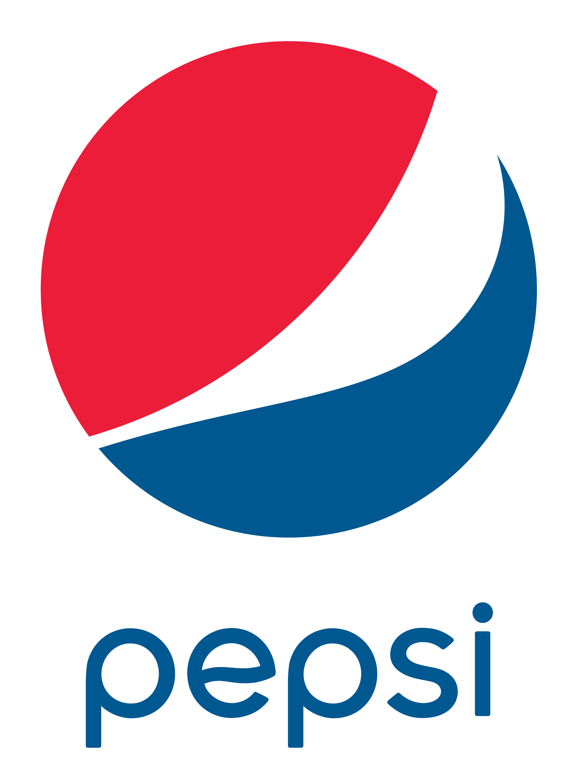
Product Line Extension
Pepsi Zero Sugar: Leveraged their Super Bowl ad to increase awareness for a fast-growing brand variant in a highly competitive category
Branded online search increased 67% on Super Bowl night vs. week prior and was 43% higher than the second highest week over the last 12 months
+67%
Weekly Google Trends Index: Pepsi Zero Sugar
12-month trend leading up to the Superbowl (Weeks of 2/9/2025 – 2/8/2026)
vs. prior week
Super Bowl
(100 index)
Second Highest Week
(70 index)
“The Super Bowl’s ability to deliver mass reach in a fragmented media environment makes it a powerful stage for growing brands. It’s the one time you can still reach consumers across cohorts, across generations, all at once.”
Week Before Super Bowl
(60 index)
Mark Kirkham
CMO, PepsiCo's U.S. Beverages
(Ad Age, 12/17/25)
Source: VAB analysis of Google Trends, United States only, All Categories, Web Search, Weeks of 2/9/25 – 2/8/26. Google Search Index represents search interest relative to the highest point on the chart for the given region and time period, a value of 100 is the peak popularity for the term, a value of 50 means that the term is half as popular. Note: Light blue line marks the date of Super Bowl LX. Click here to view Pepsi Zero Sugar’s Super Bowl commercial (via iSpot.tv).
This information is exclusively provided to VAB members and qualified marketers.
PAGE 10

Slide 11
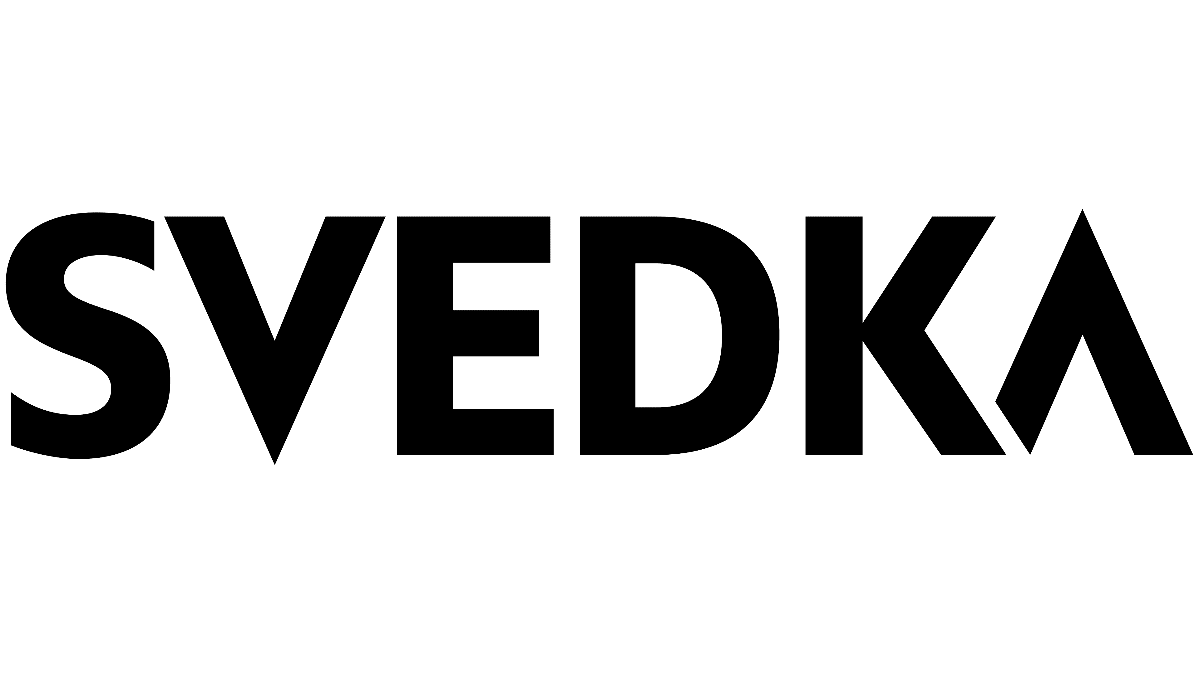
Challenger Brand
Svedka: After being acquired, this challenger in a very competitive category invested in a Super Bowl ad to rebuild its brand equity among consumers
Branded online search more than doubled on Super Bowl night vs. week prior and was 64% higher than the second highest week over the last 12 months
2.3x
Weekly Google Trends Index: Svedka
12-month trend leading up to the Superbowl (Weeks of 2/9/2025 – 2/8/2026)
vs. prior week
Super Bowl
(100 index)
Week Before Super Bowl
(43 index)
“When we acquired Svedka, it had been declining for quite some time. Now that Svedka has returned to growth the brand’s Super Bowl debut is meant to introduce Svedka to new consumers and rebuild its brand equity with others”
Second Highest Week
(61 index)
Sara Saunders
CMO, Sazerac
(Wall Street Journal, 12/3/25)
Source: VAB analysis of Google Trends, United States only, All Categories, Web Search, Weeks of 2/9/25 – 2/8/26. Google Search Index represents search interest relative to the highest point on the chart for the given region and time period, a value of 100 is the peak popularity for the term, a value of 50 means that the term is half as popular. Note: Light blue line marks the date of Super Bowl LX. Click here to view Svedka’s Super Bowl commercial (via iSpot.tv).
This information is exclusively provided to VAB members and qualified marketers.
PAGE 11

Slide 12
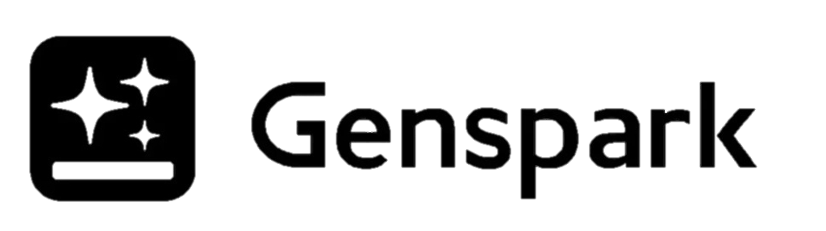
Brand in an ‘Emerging’ Category
Genspark: This AI productivity platform startup secured two Super Bowl spots to showcase the accessibility of its product to a mass audience
Branded online search increased over 14x on Super Bowl night vs. week prior
14x
Weekly Google Trends Index: Genspark
12-month trend leading up to the Superbowl (Weeks of 2/9/2025 – 2/8/2026)
vs. prior week
Super Bowl
(100 index)
“Our challenge was that people look at AI and feel psychologically distant … a tool that you might be afraid of, we want it to be very accessible to everyone.”
“We want people to conceive of us as an AI [platform] for work that’s very easy for everyone to use. That’s why we want to be in the Super Bowl, but come out unlike a very techie company.”
Week Before Super Bowl
(7 index)
Jennifer Lin
Marketing Lead, Genspark
(Ad Age, 2/8/26)
Source: VAB analysis of Google Trends, United States only, All Categories, Web Search, Weeks of 2/9/25 – 2/8/26. Google Search Index represents search interest relative to the highest point on the chart for the given region and time period, a value of 100 is the peak popularity for the term, a value of 50 means that the term is half as popular. Note: Light blue line marks the date of Super Bowl LX. Click here to view GenSpark’s Super Bowl commercial (via iSpot.tv).
This information is exclusively provided to VAB members and qualified marketers.
PAGE 12

Slide 13
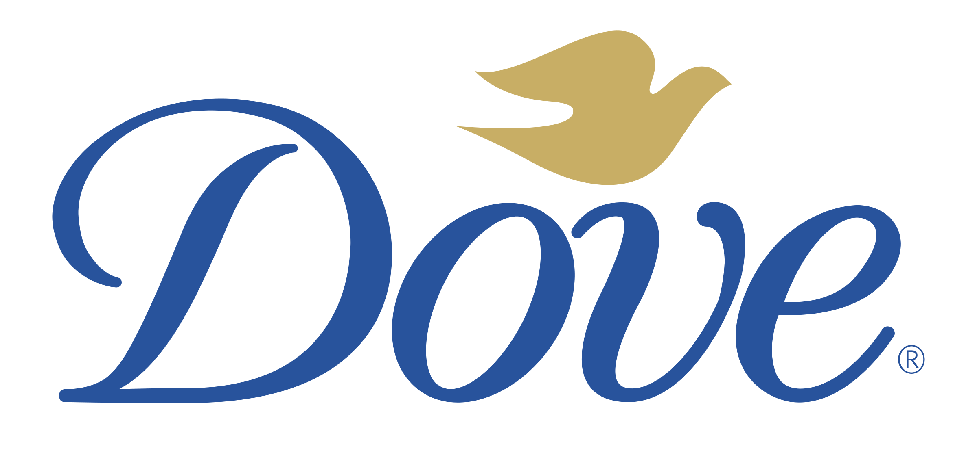
Women-Targeted Products & Services
Dove: The brand used its Super Bowl ad to champion girls’ body confidence through support of the Dove Body Confident Sports Program
Branded online search increased over 6x on Super Bowl night vs. week prior
6.3x
Weekly Google Trends Index: Dove Body Confident
12-month trend leading up to the Superbowl (Weeks of 2/9/2025 – 2/8/2026)
vs. prior week
Super Bowl
(100 index)
“Sports have the power to build confidence, resilience and joy, yet body pressures continue to push too many girls out of the sports they love. That's why we're returning to football's biggest night to lift up their body confidence and shout: You're amazing. You're strong. You belong.”
Week Before Super Bowl
(16 index)
Marcela Melero, Chief Growth Officer, Dove Personal Care & Masterbrand in North America
(USA Today, 2/8/26)
Source: VAB analysis of Google Trends, United States only, All Categories, Web Search, Weeks of 2/9/25 – 2/8/26. Google Search Index represents search interest relative to the highest point on the chart for the given region and time period, a value of 100 is the peak popularity for the term, a value of 50 means that the term is half as popular. Note: Light blue line marks the date of Super Bowl LX. Click here to view Dove’s Super Bowl commercial (via iSpot.tv).
This information is exclusively provided to VAB members and qualified marketers.
PAGE 13

Slide 14
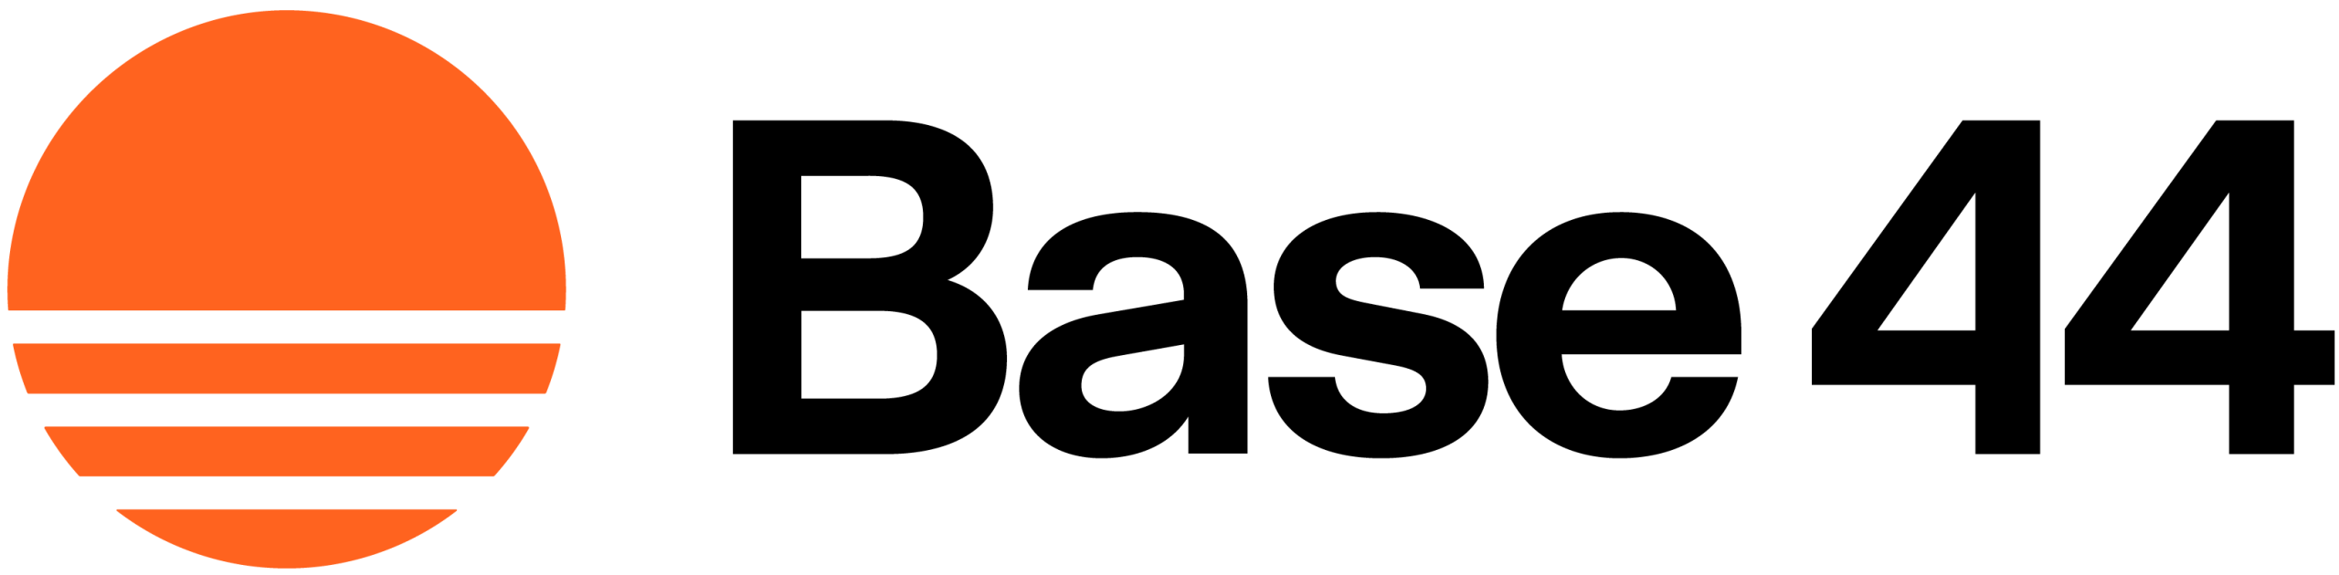
‘Business-to-Business’ Companies
Base44: This AI-powered custom app builder platform used their Super Bowl ad to continue the momentum of their recent customer growth
Branded online search more than doubled on Super Bowl night vs. week prior
2.1x
Weekly Google Trends Index: Base44
12-month trend leading up to the Superbowl (Weeks of 2/9/2025 – 2/8/2026)
vs. prior week
Super Bowl
(100 index)
“The pace of growth at Base44 over the past year has been extraordinary, and appearing during the Big Game is a marker of that momentum.”
Week Before Super Bowl
(48 index)
Shay Korin
VP of Marketing, Base44
(Wix Newsroom, 1/28/26)
Source: VAB analysis of Google Trends, United States only, All Categories, Web Search, Weeks of 2/9/25 – 2/8/26. Google Search Index represents search interest relative to the highest point on the chart for the given region and time period, a value of 100 is the peak popularity for the term, a value of 50 means that the term is half as popular. Note: Light blue line marks the date of Super Bowl LX. Click here to view Base44’s Super Bowl commercial (via iSpot.tv).
This information is exclusively provided to VAB members and qualified marketers.
PAGE 14

Slide 15
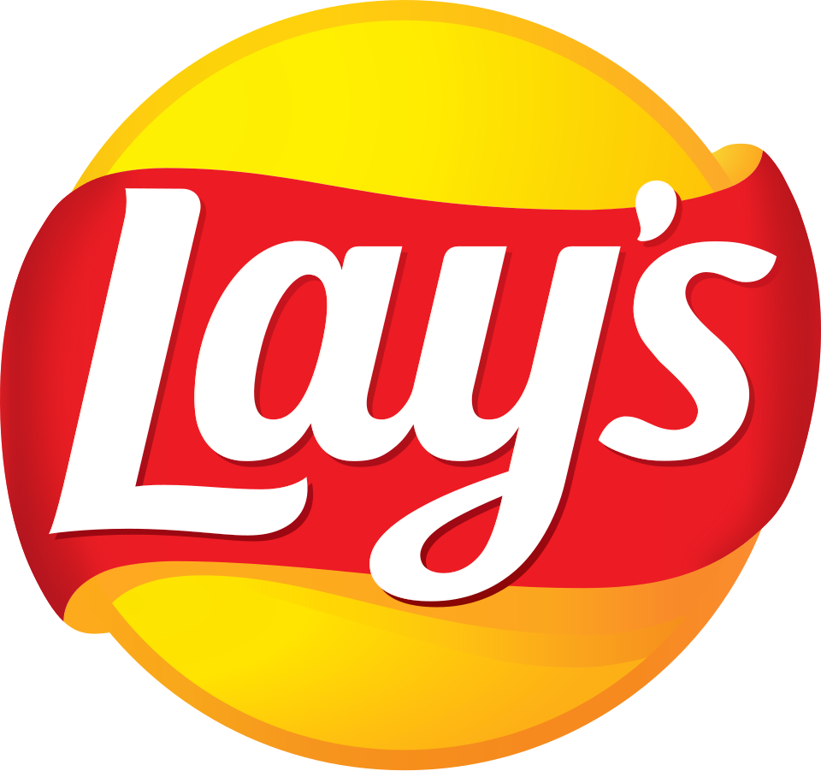
Brand Refresh or Repositioning
Lay’s: Making their second consecutive appearance, the potato chip brand used this year’s Super Bowl ad to create awareness for their brand refresh
Branded online search increased more than 4x on Super Bowl night vs. week prior and was 2.5x higher than the second highest week in the past year (Super Bowl LIX)
4x
Weekly Google Trends Index: Lay’s
12-month trend leading up to the Superbowl (Weeks of 2/9/2025 – 2/8/2026)
vs. prior week
Super Bowl
(100 index)
“There’s no better moment than the Super Bowl to continue the Lay’s story as we kick off our largest brand refresh in our history.”
2025 Super Bowl
(39 index)
Week Before Super Bowl
(25 index)
Hernán Tantardini
CMO, PepsiCo Foods U.S.
(Adweek, 1/27/26)
Source: VAB analysis of Google Trends, United States only, All Categories, Web Search, Weeks of 2/9/25 – 2/8/26. Google Search Index represents search interest relative to the highest point on the chart for the given region and time period, a value of 100 is the peak popularity for the term, a value of 50 means that the term is half as popular. Note: Light blue line marks the date of Super Bowl LX. Click here to view Lay’s Super Bowl commercial (via iSpot.tv).
This information is exclusively provided to VAB members and qualified marketers.
PAGE 15

Slide 16
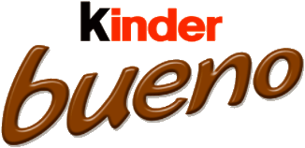
Global Brand Introduction to the U.S.
Kinder Bueno: A European chocolate brand aired in the Super Bowl to introduce themselves to America and accelerate U.S.-based growth
Branded online search more than doubled on Super Bowl night vs. week prior
2.4x
Weekly Google Trends Index: Kinder Bueno
12-month trend leading up to the Superbowl (Weeks of 2/9/2025 – 2/8/2026)
vs. prior week
Super Bowl
(100 index)
“Making our big game debut represents a transformative moment for Kinder Bueno as we accelerate our growth in the U.S. market.”
Week Before Super Bowl
(41 index)
Chad Stubbs, CMO of Ferrero North America
(Press release, Ferrero North America, 1/15/26)
“This is one of the biggest cultural moments of the year, and it's the perfect stage to really introduce Kinder Bueno to America.”
Neal Finkler, VP of Kinder Snacking
(Press release, Ferrero North America, 1/15/26)
Source: VAB analysis of Google Trends, United States only, All Categories, Web Search, Weeks of 2/9/25 – 2/8/26. Google Search Index represents search interest relative to the highest point on the chart for the given region and time period, a value of 100 is the peak popularity for the term, a value of 50 means that the term is half as popular. Note: Light blue line marks the date of Super Bowl LX. Click here to view Kinder Bueno’s Super Bowl commercial (via iSpot.tv).
This information is exclusively provided to VAB members and qualified marketers.
PAGE 16

Slide 17
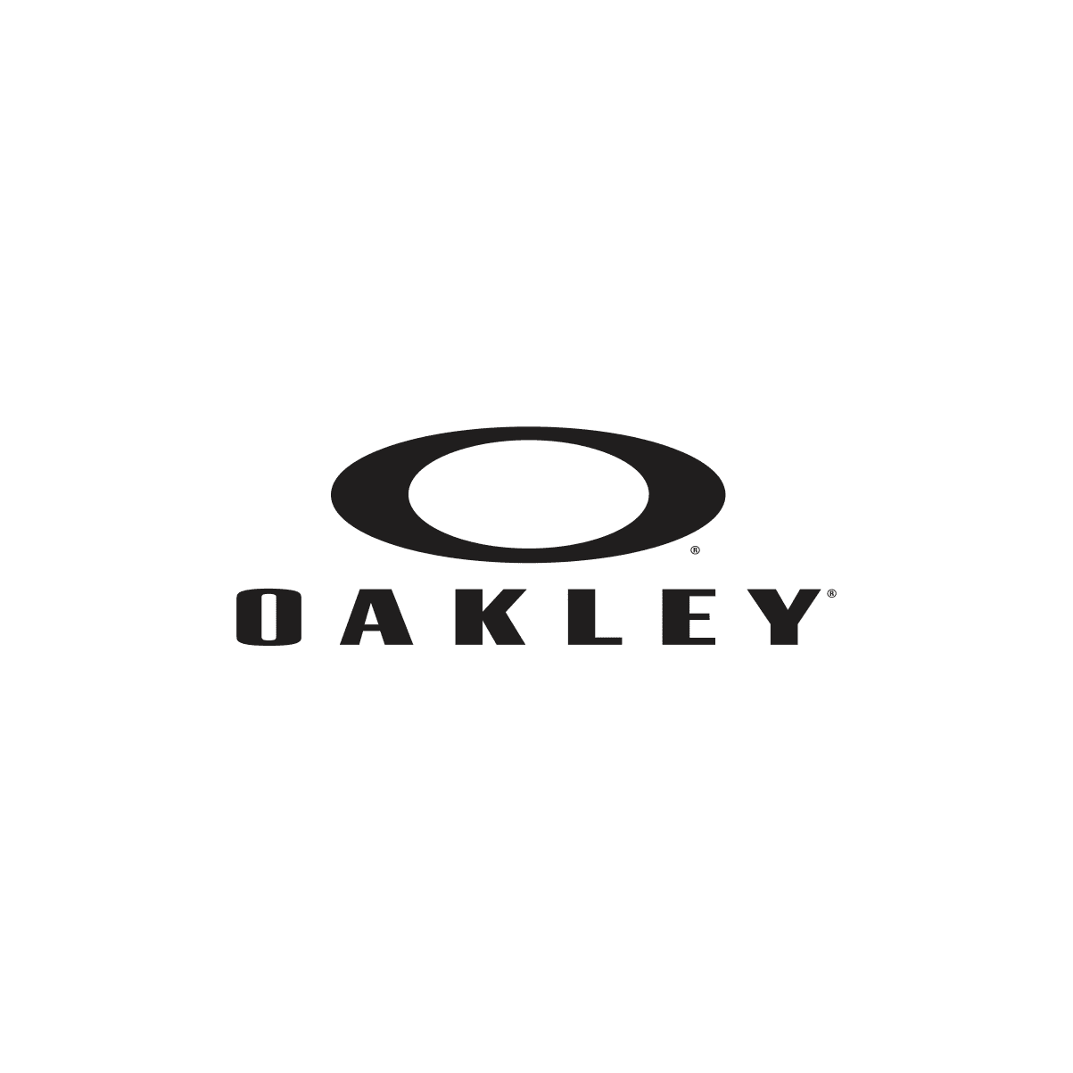
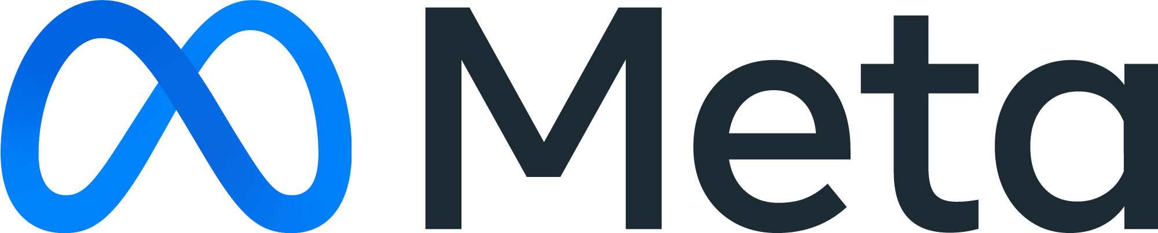
Brand Partnerships
Oakley Meta: This partnership utilized a Super Bowl ad to accelerate growth of their latest wearable AI tech for consumers
Branded online search increased nearly 3x on Super Bowl night vs. week prior and was 52% higher than the second highest week over the last 12 months
2.6x
Weekly Google Trends Index: Oakley x Meta
12-month trend leading up to the Superbowl (Weeks of 2/9/2025 – 2/8/2026)
vs. prior week
Super Bowl
(100 index)
Second Highest Week
(66 index)
“This work brings our Athletic Intelligence brand platform to life featuring Marshawn Lynch, iShowSpeed, Spike Lee, Olympians, and world-champion athletes. And we’re leveraging the biggest stage in the U.S. to accelerate growth
of Meta Glasses.”
Week Before Super Bowl
(38 index)
Kimberley Blanding
Head of Marketing, Meta AI Wearables
(LinkedIn, 2/8/26)
Source: VAB analysis of Google Trends, United States only, All Categories, Web Search, Weeks of 2/9/25 – 2/8/26. Google Search Index represents search interest relative to the highest point on the chart for the given region and time period, a value of 100 is the peak popularity for the term, a value of 50 means that the term is half as popular. Note: Light blue line marks the date of Super Bowl LX. Click here to view Oakley x Meta’s Super Bowl commercial (via iSpot.tv).
This information is exclusively provided to VAB members and qualified marketers.
PAGE 17

Slide 18
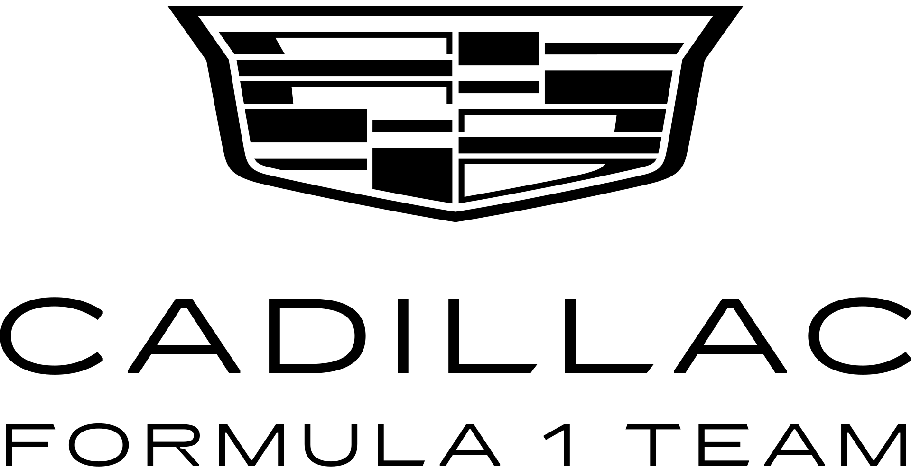
Immersive Brand Experience
Cadillac Formula 1: The brand immersed Super Bowl viewers through the unveiling of their race car’s visual identity ahead of its debut season in F1
Branded online search increased more than 5x on Super Bowl night vs. week prior and was almost 3x higher than the second highest week in the last 12 months
5x
Weekly Google Trends Index: Cadillac F1
12-month trend leading up to the Superbowl (Weeks of 2/9/2025 – 2/8/2026)
vs. prior week
Super Bowl
(100 index)
“We’re not trying to tell you to come into a warehouse with all of our executives.
With millions of everyday Americans watching the Super Bowl, we’re coming to you and we’re going to show you something amazing so we can pull you into our world.”
Second Highest Week
(35 index)
Week Before Super Bowl
(19 index)
Ahmed Iqbal
CMO, Cadillac F1
(Ad Age, 2/8/26)
Source: VAB analysis of Google Trends, United States only, All Categories, Web Search, Weeks of 2/9/25 – 2/8/26. Google Search Index represents search interest relative to the highest point on the chart for the given region and time period, a value of 100 is the peak popularity for the term, a value of 50 means that the term is half as popular. Note: Light blue line marks the date of Super Bowl LX. Click here to view Cadillac's Super Bowl commercial (via iSpot.tv).
This information is exclusively provided to VAB members and qualified marketers.
PAGE 18

Slide 19
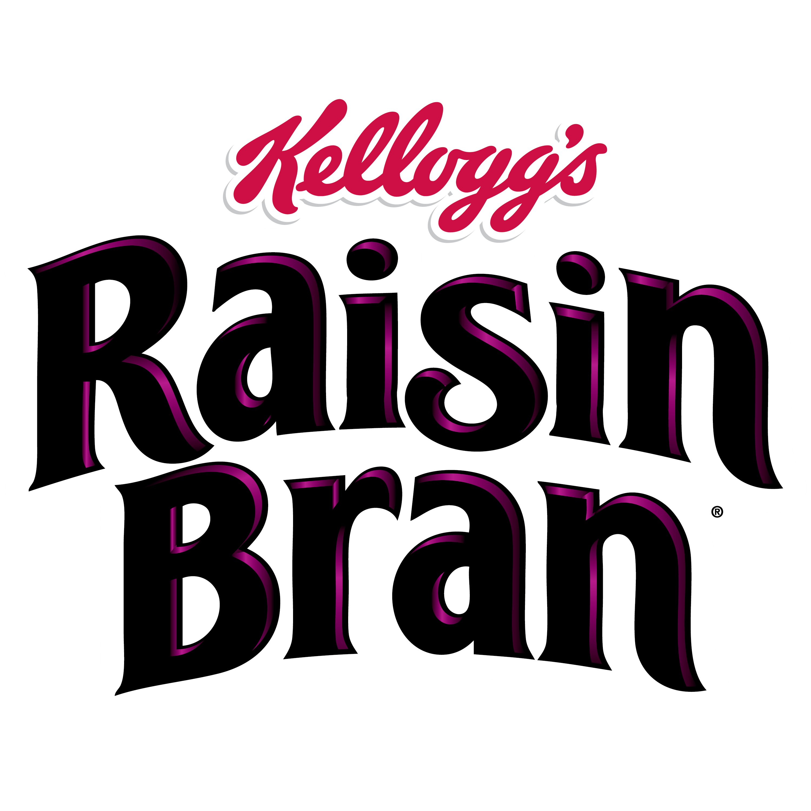
Streaming Only + Regional Markets Overlay
Raisin Bran: Utilized Super Bowl streaming platforms to extend reach among younger audiences beyond linear spots in strategic markets
Branded online search doubled on Super Bowl night vs. week prior
2x
Weekly Google Trends Index: Raisin Bran
12-month trend leading up to the Superbowl (Weeks of 2/9/2025 – 2/8/2026)
vs. prior week
Super Bowl
(100 index)
“The Super Bowl these days is an ecosystem of screens. It’s not one spot on one game…especially among a younger demographic. That’s a demo we especially wanted to reach in this Super Bowl effort, and so streaming was strategic for us.”
Week Before Super Bowl
(48 index)
Doug VandeVelde
Chief Growth Officer, WK Kellogg Co
(Ad Age, 2/3/26)
Source: VAB analysis of Google Trends, United States only, All Categories, Web Search, Weeks of 2/9/25 – 2/8/26. Google Search Index represents search interest relative to the highest point on the chart for the given region and time period, a value of 100 is the peak popularity for the term, a value of 50 means that the term is half as popular. Note: Light blue line marks the date of Super Bowl LX. Click here to view Raisin Bran’s Super Bowl commercial (via Ad Age). Six regional markets included New York, Los Angeles, Chicago, Grand Rapids, Cincinnati and Fort Smith, Arkansas.
This information is exclusively provided to VAB members and qualified marketers.
PAGE 19

Slide 20
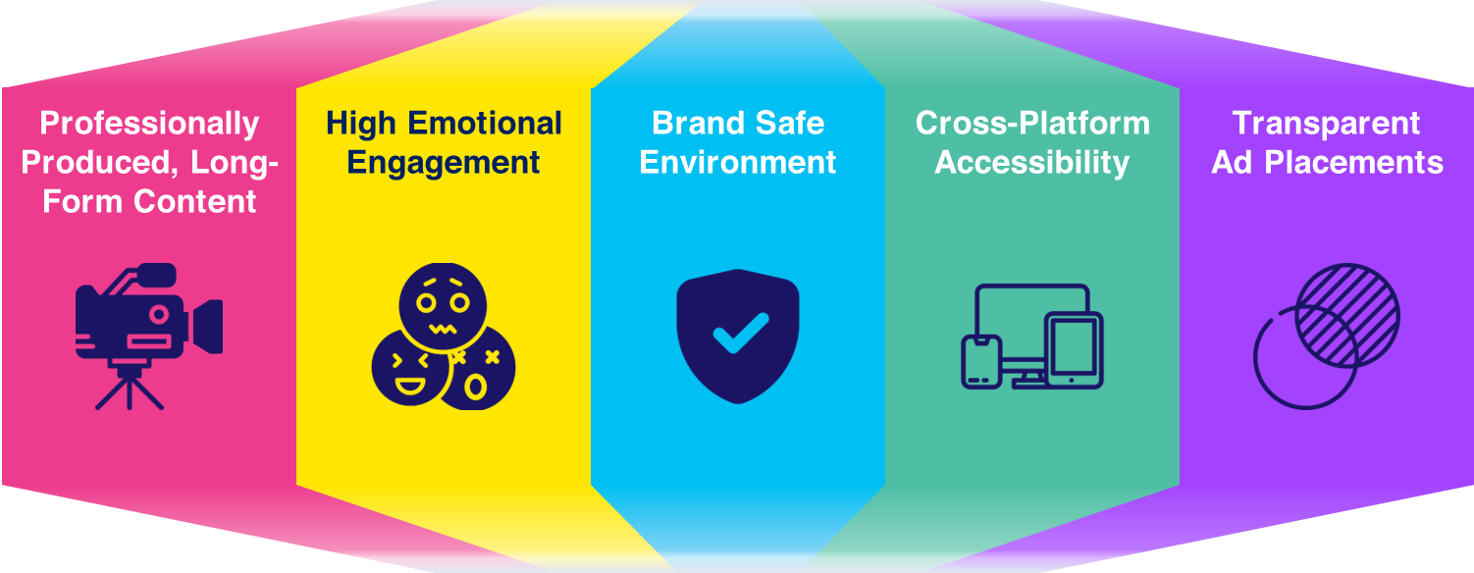
The power of truly Premium Video enables multiscreen TV to drive
mid-funnel results across brands of all types, regardless of messaging
15 Super Bowl Advertisers Analyzed
Represents a cross-section of categories*, brand strategies, messaging, creative executions and call-to-actions
The Power of Premium Video
Premium Video = Multiscreen TV
Click here to learn more about the attributes of Premium Video
*categories include health & wellness, beer, men’s lifestyle, food, beverages, liquor, consumer packaged goods, AI platforms , wearable tech, automotive and more.
This information is exclusively provided to VAB members and qualified marketers.
PAGE 20

Slide 21

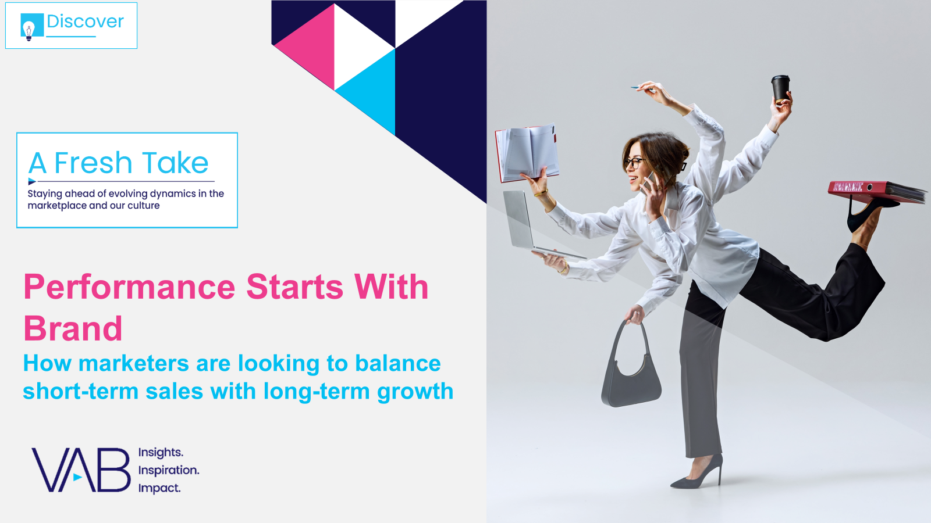

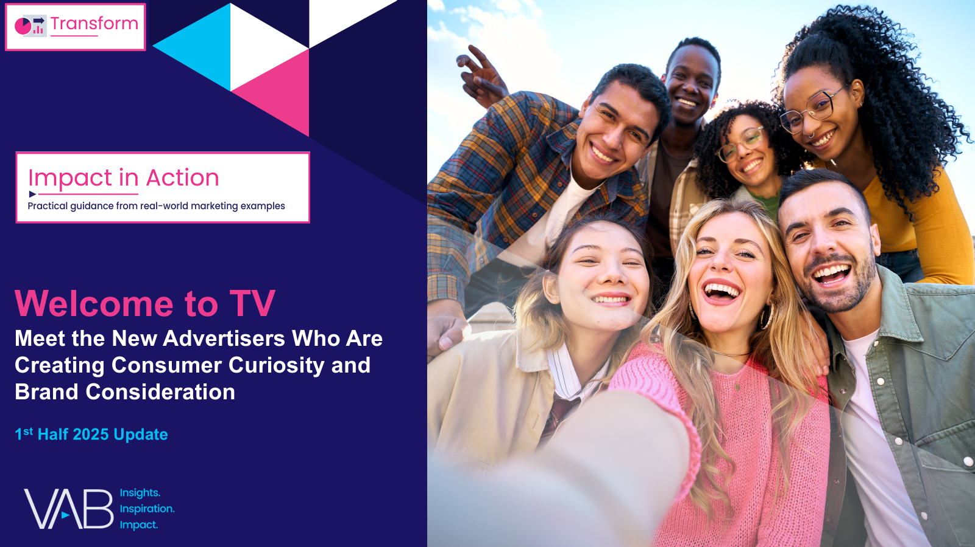
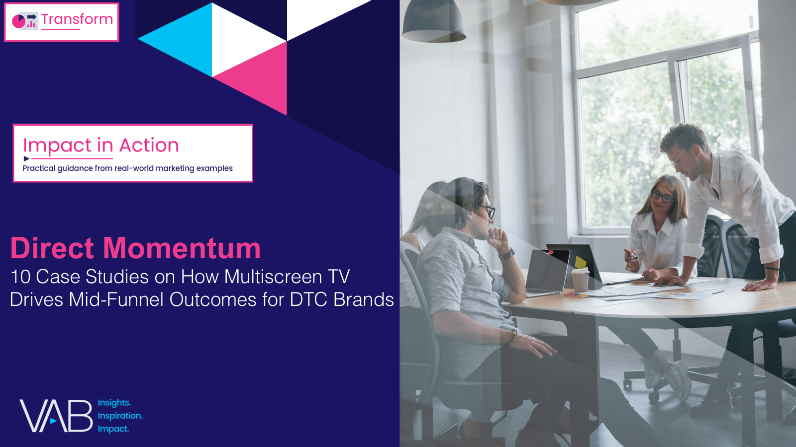
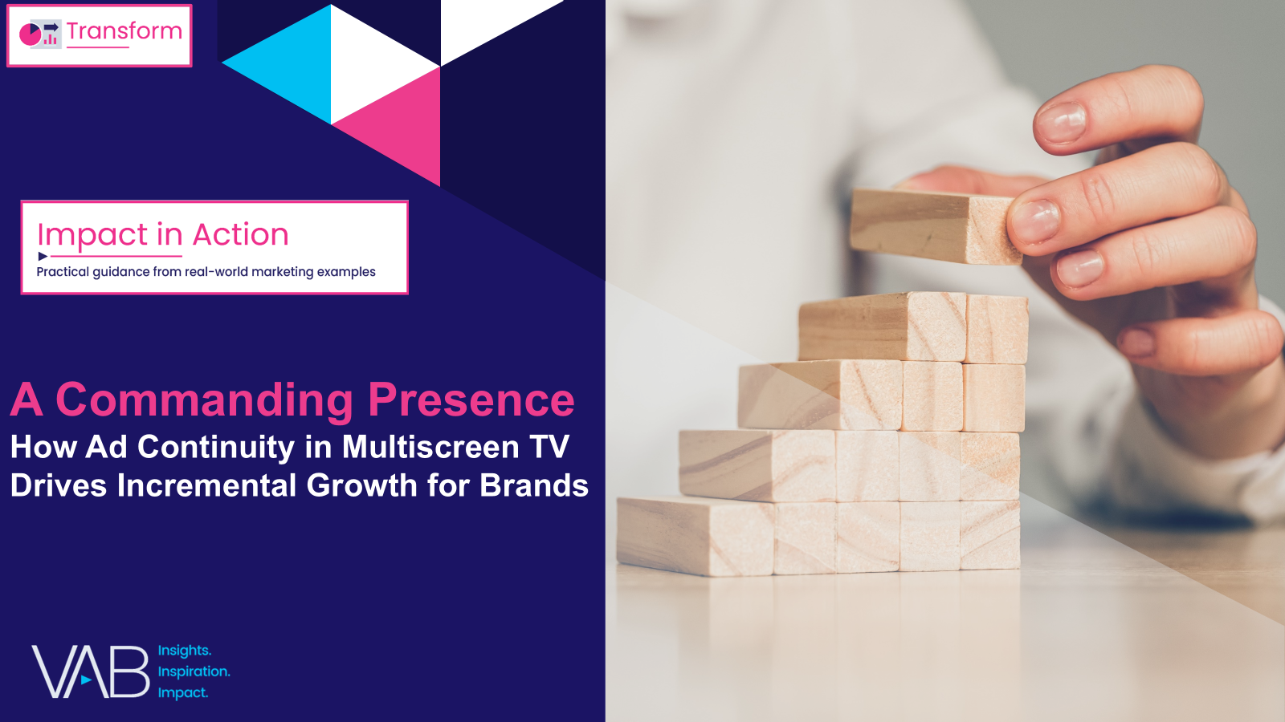
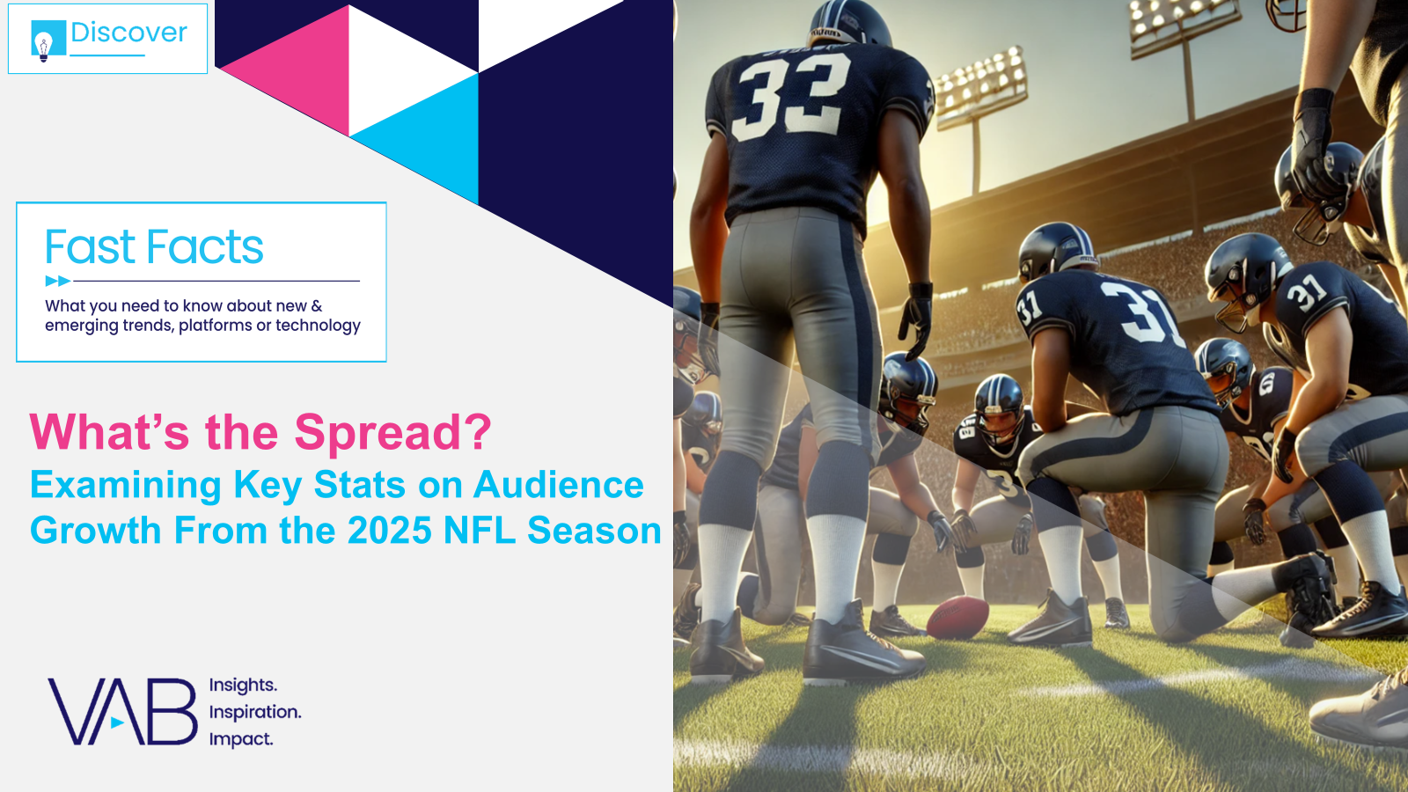
Download these other VAB resources to see how marketers are leveraging Premium Video / Multiscreen TV to build their brand
Performance Starts With Brand
How Marketers Are Looking to Balance Short-Term Sales with Long-Term Growth
The Power of Premium Video
What it Means for Multiscreen TV
and Why it Matter to Marketers
Welcome to TV
Meet the New Advertisers Who Are Creating Consumer Curiosity and Brand Consideration
Direct Momentum
10 Case Studies on How Multiscreen TV Drives Mid-Funnel Outcomes for DTC Brands
A Commanding Presence
How Ad Continuity in Multiscreen TV Drives Incremental Growth for Brands
What’s the Spread?
Examining Key Stats on Audience Growth From
the 2025 NFL Season
This information is exclusively provided to VAB members and qualified marketers.
PAGE 21

Slide 22

About VAB
VAB plays a dual role in the video advertising industry. We are leading the change to bring about a more innovative and transparent marketplace. We also provide the insights and thought leadership that enables marketers to develop business-driving marketing strategies.
Drawing on our marketing expertise, we simplify the complexities in our industry and discover new insights that transform the way marketers look at their media strategy.
We are committed to your business growth and proud to offer VAB members, brand marketers and agencies complimentary access to our continuously-growing Insights library. Get immediate access at theVAB.com.
This information is exclusively provided to VAB members and qualified marketers.
PAGE 22

