Slide 1

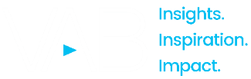
February 14, 2025
Question of the Week:
“
How much do Super Bowl ads drive consumer action, like search?
”

Slide 2
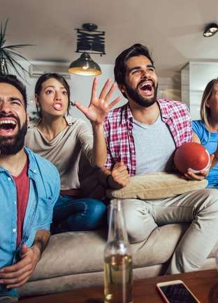
The Super Bowl drives mid-funnel results for all types of advertisers and strategies
Raise awareness. Create interest. Enhance brand perception. Build momentum. Introduce a new brand or product. Establish relevancy and brand fame. Drive sales. Gain market share. Test and learn.
There were several objectives and strategies that advertisers had for their Super Bowl spot(s), but regardless of their goal, the massive audience and live, engaging content of multiscreen TV delivered mid-funnel outcomes, by driving significant lifts in branded search for brands of all types.
From an advertising perspective, the Super Bowl is for everyone – well-established companies, young brands, first time advertisers, new products, local market targeted advertisers and everything in between.
And the results are in across our analysis of 15 Super Bowl advertisers: brands saw anywhere between a 2x – 50x immediate lift in branded search from curious consumers on Super Bowl night.
These results highlight the power of truly premium video but are not an anomaly.
As we have shown in other recent analyses – Breaking Through and Welcome to TV – multiscreen TV consistently drives consumer action for brands of all stripes
and messaging, with the Super Bowl being just the latest example.
This information is exclusively provided to VAB members and qualified marketers.
PAGE 2

Slide 3

The Super Bowl delivers outsized mid-funnel results for all types of advertisers across a variety of marketing strategies
1
2
3
4
5
‘First Time’
Super Bowl
TV Advertisers
‘Consistent’
Super Bowl
TV Advertisers
‘Returning Player’ Super Bowl
TV Advertisers
‘Lapsed but Back’
Super Bowl
TV Advertisers
‘Young’
Life Stage
Brands
6
7
8
9
10
‘Well Established’
Life Stage
Brands
Product Line
Extensions
Challenger
Brands
Women-Targeted Products & Services
‘Direct-to-Consumer’ Brands
11
12
13
14
15
‘Business-to-Business’ Companies
App-Based
Products & Services
Global Brand Introduction to the U.S.
Regional Markets Focused
Local Market
Targeted
click through the appropriate box if you would like to be brought directly to the corresponding slide
This information is exclusively provided to VAB members and qualified marketers.
PAGE 3

Slide 4

To understand the effect that Super Bowl ads
have on mid-funnel outcomes, we analyzed Google Search Trends for 15 advertisers –
one from each bucket on the previous page
How to read the charts:
Google Search Index = represents search interest relative to the highest point during a specific time period for a given region, a value of 100 is the peak popularity for the term, a value of 50 means that the term is half as popular.

Slide 5
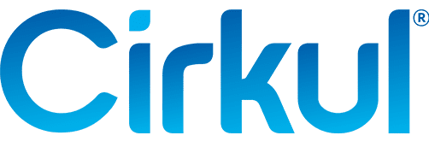

‘First Time’ Super Bowl TV Advertiser
Cirkul: A first-time Super Bowl advertiser, this water bottle brand’s goal was to continue its rapid growth by building awareness among a mass audience
Search increased almost 8x on Super Bowl night vs. week prior and was 3.5x higher than the second highest week over the last 12 months
7.7x
Weekly Google Trends Index – Cirkul
12-month trend leading up to the Superbowl (Weeks of 2/4/2024 – 2/9/2025)
vs. prior week
Super Bowl
(100 index)
“Now a rapidly growing and profitable company with our own US-based manufacturing, we’re ready to introduce
a bigger audience to Cirkul and take
the brand to the next level, and our
first Super Bowl ad is the perfect
way to kick that off.”
Second Highest Week
(29 index)
Week Before Super Bowl
(13 index)
Garrett Waggoner
CEO & Co-Founder, Cirkul
(Little Black Book, 2/6/25)
Source: VAB analysis of Google Trends, United States only, All Categories, Web Search, Weeks of 2/4/24 – 2/9/25. Google Search Index represents search interest relative to the highest point on the chart for the given region and time period, a value of 100 is the peak popularity for the term, a value of 50 means that the term is half as popular. Note: Light blue line marks the date of Super Bowl LIX. Click here to view Cirkul’s Super Bowl commercial (via iSpot.tv).
This information is exclusively provided to VAB members and qualified marketers.
PAGE 5

Slide 6
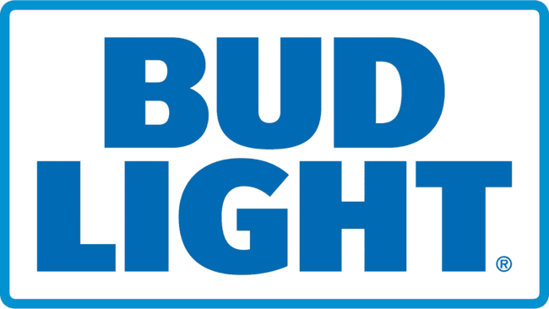
‘Consistent’ Super Bowl TV Advertiser
Bud Light: A long-time advertiser that utilized its Super Bowl ad to enhance their brand perception among a mass audience
Search increased 3x on Super Bowl night vs. week prior and was 67% higher than the second highest week over the last 12 months (last year’s Super Bowl)
3x
Weekly Google Trends Index – Bud Light
12-month trend leading up to Superbowl LIX (Weeks of 2/4/2024 – 2/9/2025)
vs. prior week
Super Bowl
(100 index)
“Humor has been a staple for Bud Light advertising for years, and there’s no bigger stage to make people laugh than the Super Bowl, so we really wanted to lean into the humor, and I think we’ve landed that with our spot this year.”
Second Highest Week
(60 index)
Week Before Super Bowl
(35 index)
Todd Allen
SVP of Marketing, Bud Light
(The Hollywood Reporter, 1/30/25)
Source: VAB analysis of Google Trends, United States only, All Categories, Web Search, Weeks of 2/4/24 – 2/9/25. Google Search Index represents search interest relative to the highest point on the chart for the given region and time period, a value of 100 is the peak popularity for the term, a value of 50 means that the term is half as popular. Note: Light blue line marks the date of Super Bowl LIX. Click here to view Bud Light’s Super Bowl commercial (via iSpot.tv).
This information is exclusively provided to VAB members and qualified marketers.
PAGE 6

Slide 7
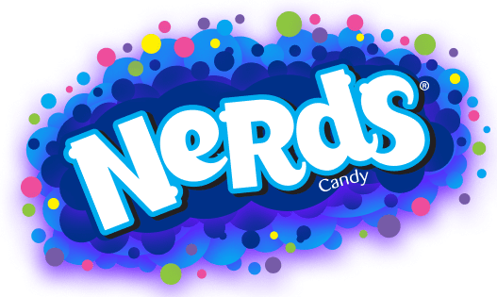
‘Returning Player’ Super Bowl TV Advertiser
Nerds: After a successful 2024 Super Bowl debut, the brand returned to the Big Game to expand awareness across more people
Search more than doubled on Super Bowl night vs. week prior and was 39% higher than the second highest week over the last 12 months (SB TV spot announcement)
2.3x
Weekly Google Trends Index – Nerds
12-month trend leading up to Superbowl LIX (Weeks of 2/4/2024 – 2/9/2025)
vs. prior week
Super Bowl
(100 index)
Announced Superbowl Commercial
(72 index)
“After the tremendous Nerds response following our Big Game activation earlier this year…we knew we had to come back and make another splash. While we have grown household penetration, we want to introduce more people to our incredible Nerds brand. We look forward to
re-engaging with fans and taking Nerds back to the world’s biggest stage.”
Week Before Super Bowl
(43 index)
Greg Guidotti
CMO, Ferrara Candy Co., Inc
(Candy USA, 11/13/2024)
Source: VAB analysis of Google Trends, United States only, All Categories, Web Search, Weeks of 2/4/24 – 2/9/25. Google Search Index represents search interest relative to the highest point on the chart for the given region and time period, a value of 100 is the peak popularity for the term, a value of 50 means that the term is half as popular. Note: Light blue line marks the date of Super Bowl LIX. Click here to view Nerds’ Super Bowl commercial (via iSpot.tv).
This information is exclusively provided to VAB members and qualified marketers.
PAGE 7

Slide 8
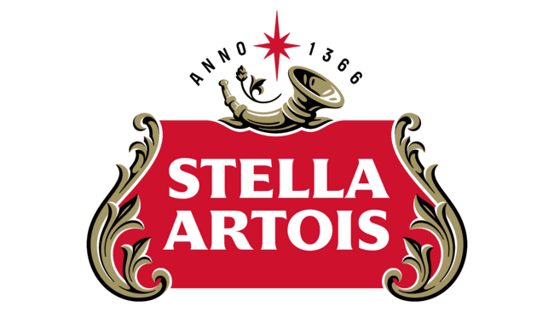
‘Lapsed but Back’ Super Bowl TV Advertiser
Stella Artois: After a six-year hiatus, the brand returned to the Super Bowl and leveraged David Beckham and Matt Damon to build on momentum
Search increased 6x on Super Bowl night vs. week prior and was 2.6x higher than the second highest week over the last 12 months (‘The Bear’ announcement)
6x
Weekly Google Trends Index – Stella Artois
12-month trend leading up to Superbowl LIX (Weeks of 2/4/2024 – 2/9/2025)
vs. prior week
Super Bowl
(100 index)
“The Super Bowl [...] is arguably the biggest moment to kick off the year. We saw a massive opportunity to build on the strong momentum built in 2024 by doubling down and making a statement.”
Collaboration with ‘The Bear’ Announced
(38 index)
Week Before Super Bowl
(17 index)
Chris Jones
VP of Marketing for Premium Brands, Anheuser-Busch InBev
(The Drum, 2/4/25)
Source: VAB analysis of Google Trends, United States only, All Categories, Web Search, Weeks of 2/4/24 – 2/9/25. Google Search Index represents search interest relative to the highest point on the chart for the given region and time period, a value of 100 is the peak popularity for the term, a value of 50 means that the term is half as popular. Note: Light blue line marks the date of Super Bowl LIX. Click here to view Stella Artois’ Super Bowl commercial (via iSpot.tv).
This information is exclusively provided to VAB members and qualified marketers.
PAGE 8

Slide 9
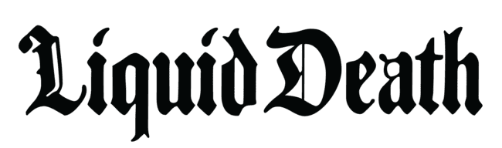
‘Young’ Life Stage Brand
Liquid Death: Less than seven years after their founding, the brand invested in a Super Bowl ad to introduce themselves to new audiences
Search increased 10x on Super Bowl night vs. week prior and was almost 6x higher than the second highest week over the last 12 months
10x
Weekly Google Trends Index – Liquid Death
12-month trend leading up to Superbowl LIX (Weeks of 2/4/2024 – 2/9/2025)
vs. prior week
Super Bowl
(100 index)
“While we have a massive audience of loyal fans,
the Super Bowl is a great opportunity to introduce ourselves to new people and educate everyone about our entire line of healthy beverages.”
Andy Pearson
VP of Creative, Liquid Death
(Muse by Clios, 2/9/25)
Second Highest Week
(17 index)
Week Before Super Bowl
(10 index)
“[There is] no cheaper way to reach over
100 million unique people who want to pay attention to the commercials.”
Mike Cessario
CEO, Liquid Death
(Adweek, 2/9/25)
Source: VAB analysis of Google Trends, United States only, All Categories, Web Search, Weeks of 2/4/24 – 2/9/25. Google Search Index represents search interest relative to the highest point on the chart for the given region and time period, a value of 100 is the peak popularity for the term, a value of 50 means that the term is half as popular. Note: Light blue line marks the date of Super Bowl LIX. Click here to view Liquid Death’s Super Bowl commercial (via iSpot.tv).
This information is exclusively provided to VAB members and qualified marketers.
PAGE 9

Slide 10
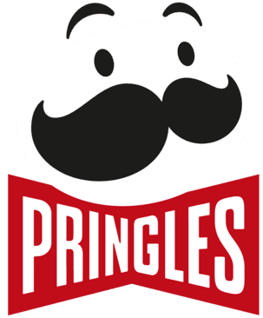
‘Well Established’ Life Stage Brand
Pringles: Introduced in 1968, this nearly sixty-year-old brand invested in a Super Bowl ad to seek out fame and relevancy among consumers
Search more than doubled on Super Bowl night vs. week prior and was 79% higher than the second highest week over the last 12 months
2x
Weekly Google Trends Index – Pringles
12-month trend leading up to Superbowl LIX (Weeks of 2/4/2024 – 2/9/2025)
vs. prior week
Super Bowl
(100 index)
“We are seeking fame.
I think we’re doing it in a
way that is really ownable
and recognizable by us.”
Second Highest Week
(56 index)
Week Before Super Bowl
(46 index)
Sarah Reinecke
US VP of Salty Snack Marketing, Kellanova
(Marketing Brew, 2/4/25)
Source: VAB analysis of Google Trends, United States only, All Categories, Web Search, Weeks of 2/4/24 – 2/9/25. Google Search Index represents search interest relative to the highest point on the chart for the given region and time period, a value of 100 is the peak popularity for the term, a value of 50 means that the term is half as popular. Note: Light blue line marks the date of Super Bowl LIX. Click here to view Pringles’ Super Bowl commercial (via iSpot.tv).
This information is exclusively provided to VAB members and qualified marketers.
PAGE 10

Slide 11
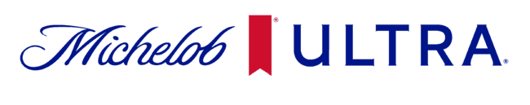
Product Line Extension
Michelob Ultra: Leveraged their Super Bowl ad to build awareness for their non-alcohol beer label, Michelob Ultra Zero, within the spot
Search increased more than 5x on Super Bowl night vs. week prior for both Michelob Ultra and Michelob Ultra Zero and was +3.5x higher than the second highest week
Weekly Google Trends Index
12-month trend leading up to Superbowl LIX (Weeks of 2/4/2024 – 2/9/2025)
6.3x / 5x
vs. prior week
Super Bowl
(100 index)
“We have an exciting full-year dedicated campaign [for Zero] combined with moments where we will leverage our Michelob Ultra assets media placements in high viewership sports moments like the Super Bowl, the FIFA Club World Cup and the NBA Finals.”
Week Before Super Bowl
(19 index)
Second Highest Week
(22 index)
Second Highest Week
(26 index)
Week Before Super Bowl
(16 index)
Ricardo Marques
VP of Marketing, Michelob Ultra
(Ad Age, 1/15/25)
Source: VAB analysis of Google Trends, United States only, All Categories, Web Search, Weeks of 2/4/24 – 2/9/25. Google Search Index represents search interest relative to the highest point on the chart for the given region and time period, a value of 100 is the peak popularity for the term, a value of 50 means that the term is half as popular. Note: Light blue line marks the date of Super Bowl LIX. Click here to view Michelob Ultra’s Super Bowl commercial (via iSpot.tv).
This information is exclusively provided to VAB members and qualified marketers.
PAGE 11

Slide 12
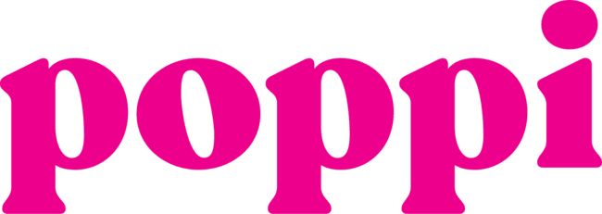
Challenger Brand
poppi: A challenger brand in a highly competitive category invested in a Super Bowl ad to gain market share by increasing awareness
Search increased 10x on Super Bowl night vs. week prior and was almost 6x higher than the second highest week over the last 12 months
10x
Weekly Google Trends Index – Poppi
12-month trend leading up to Superbowl LIX (Weeks of 2/4/2024 – 2/9/2025)
vs. prior week
Super Bowl
(100 index)
“There is no bigger soda moment than the Super Bowl, and we’re thrilled to have been a part of it for the second year in a row. This is the biggest way to reach a mass audience and introduce new fans to the poppi brand.”
Second Highest Week
(17 index)
Week Before Super Bowl
(10 index)
Allison Ellsworth
Co-Founder, poppi
(PR Newswire, 2/9/25)
Source: VAB analysis of Google Trends, United States only, All Categories, Web Search, Weeks of 2/4/24 – 2/9/25. Google Search Index represents search interest relative to the highest point on the chart for the given region and time period, a value of 100 is the peak popularity for the term, a value of 50 means that the term is half as popular. Note: Light blue line marks the date of Super Bowl LIX. Click here to view poppi’s Super Bowl commercial (via iSpot.tv).
This information is exclusively provided to VAB members and qualified marketers.
PAGE 12

Slide 13
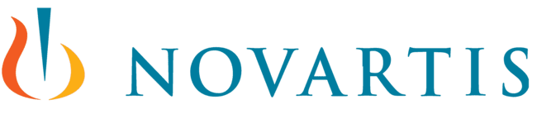
Women-Targeted Products & Services
Novartis: Drove search of their own brand and the ‘YourAttentionPlease’ website through their Super Bowl ad on breast health targeting women
Search more than doubled on Super Bowl night vs. week prior for both ‘YourAttentionPlease.com’ and Novartis
Weekly Google Trends Index
12-month trend leading up to Superbowl LIX (Weeks of 2/4/2024 – 2/9/2025)
3.5x / 2.5x
vs. prior week
Super Bowl
(100 index)
“What we’re trying to do is use this platform [Super Bowl] to enable an action to be taken. Women’s attention on the Super Bowl these days, and in football specifically, is a real opportunity to [put out] this larger message. It really is about reframing the narrative.”
Week Before Super Bowl
(38 index)
Week Before Super Bowl
(28 index)
Gail Horwood
CMO & Chief Experience Officer, Novartis
(Adweek, 2/10/25)
Source: VAB analysis of Google Trends, United States only, All Categories, Web Search, Weeks of 2/4/24 – 2/9/25. Google Search Index represents search interest relative to the highest point on the chart for the given region and time period, a value of 100 is the peak popularity for the term, a value of 50 means that the term is half as popular. Note: Light blue line marks the date of Super Bowl LIX. Click here to view Novartis’ Super Bowl commercial (via iSpot.tv).
This information is exclusively provided to VAB members and qualified marketers.
PAGE 13

Slide 14
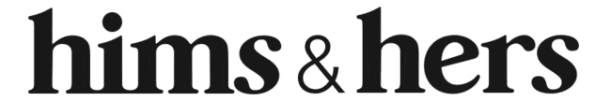
‘Direct-to-Consumer’ Brand
Hims & Hers: Launched a Super Bowl ad for the first time to raise awareness on the impact of obesity through their new GLP-1 medication
Search increased 6x on Super Bowl night vs. week prior and was almost 3x higher than the second highest week over the last 12 months
6x
Weekly Google Trends Index – Hims & Hers
12-month trend leading up to Superbowl LIX (Weeks of 2/4/2024 – 2/9/2025)
vs. prior week
Super Bowl
(100 index)
“We’re advertising at the Big Game for the first time ever aiming to raise awareness to a critical issue… with a bold and direct spot showcasing the impact of obesity and the realities of the lack of access to life-saving weight loss treatments.”
Second Highest Week
(35 index)
Week Before Super Bowl
(17 index)
Dan Kenger
Chief Design Officer, Hims & Hers
(Forbes, 2/3/2025)
Source: VAB analysis of Google Trends, United States only, All Categories, Web Search, Weeks of 2/4/24 – 2/9/25. Google Search Index represents search interest relative to the highest point on the chart for the given region and time period, a value of 100 is the peak popularity for the term, a value of 50 means that the term is half as popular. Note: Light blue line marks the date of Super Bowl LIX. Click here to view Hims & Hers’ Super Bowl commercial (via iSpot.tv).
This information is exclusively provided to VAB members and qualified marketers.
PAGE 14

Slide 15
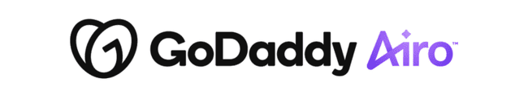
‘Business-to-Business’ Company
GoDaddy Airo: This AI-powered solution for businesses used their Super Bowl ad to introduce their product to millions of potential customers
Search increased more than 8x on Super Bowl night vs. week prior and was almost 5x higher than the second highest week over the last 12 months
8.3x
Weekly Google Trends Index – GoDaddy
12-month trend leading up to Superbowl LIX (Weeks of 2/4/2024 – 2/9/2025)
vs. prior week
Super Bowl
(100 index)
“We launched GoDaddy Airo with the goal of empowering anyone with an idea to be able to start their business in minutes. Advertising during Super Bowl LIX presents an incredible opportunity to introduce this game-changing experience to millions of people, especially those dreaming of becoming their own boss.”
Second Highest Week
(21 index)
Week Before Super Bowl
(12 index)
Aman Bhutani
CEO, GoDaddy
(PR Newswire 11/12/24)
Source: VAB analysis of Google Trends, United States only, All Categories, Web Search, Weeks of 2/4/24 – 2/9/25. Google Search Index represents search interest relative to the highest point on the chart for the given region and time period, a value of 100 is the peak popularity for the term, a value of 50 means that the term is half as popular. Note: Light blue line marks the date of Super Bowl LIX. Click here to view GoDaddy’s Super Bowl commercial (via iSpot.tv).
This information is exclusively provided to VAB members and qualified marketers.
PAGE 15

Slide 16
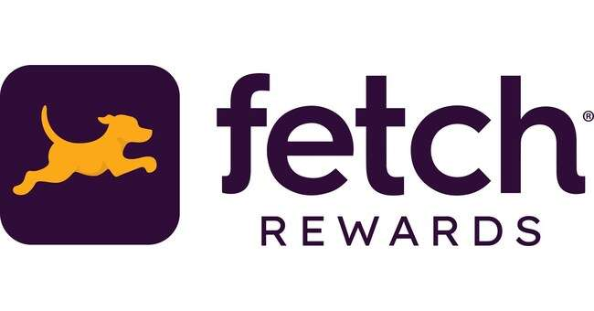
App-Based Products & Services
Fetch Rewards: This app utilized its Super Bowl ad to build accessibility by boosting awareness and engagement with a $1.2 million giveaway
Search increased more than 4x on Super Bowl night vs. week prior
4.4x
Weekly Google Trends Index – Fetch Rewards
12-month trend leading up to Superbowl LIX (Weeks of 2/4/2024 – 2/9/2025)
vs. prior week
Super Bowl
(100 index)
“A decade ago, Fetch was built on the belief that earning rewards should be effortless and accessible for everyone. This moment is about bringing that mission to life – in the biggest possible way, on the biggest possible stage.”
Week Before Super Bowl
(23 index)
West Schroll
CEO, Fetch Rewards
(USA Today, 2/9/25)
Source: VAB analysis of Google Trends, United States only, All Categories, Web Search, Weeks of 2/4/24 – 2/9/25. Google Search Index represents search interest relative to the highest point on the chart for the given region and time period, a value of 100 is the peak popularity for the term, a value of 50 means that the term is half as popular. Note: Light blue line marks the date of Super Bowl LIX. Click here to view Fetch Rewards’ Super Bowl commercial (via iSpot.tv).
This information is exclusively provided to VAB members and qualified marketers.
PAGE 16

Slide 17

Global Brand Introduction to U.S.
MSC Cruises: A Swiss-Italian based global cruise line used the Super Bowl to introduce themselves to the biggest American audience possible
Search more than doubled on Super Bowl night vs. week prior and was 82% higher than the second highest week over the last 12 months
2.2x
Weekly Google Trends Index – MSC Cruises
12-month trend leading up to Superbowl LIX (Weeks of 2/4/2024 – 2/9/2025)
vs. prior week
Super Bowl
(100 index)
“[Orlando Bloom and Drew Barrymore] embody what we want people to know about our brand, that we’re a unique blend of European style and American comfort…We wanted to introduce MSC to all of America in the biggest way possible.”
Week Before Super Bowl
(45 index)
Second Highest Week
(55 index)
Suzanne Salas
EVP, Marketing, Ecommerce & Sales, MSC Cruises
(Adweek, 2/9/25)
Source: VAB analysis of Google Trends, United States only, All Categories, Web Search, Weeks of 2/4/24 – 2/9/25. Google Search Index represents search interest relative to the highest point on the chart for the given region and time period, a value of 100 is the peak popularity for the term, a value of 50 means that the term is half as popular. Note: Light blue line marks the date of Super Bowl LIX. Click here to view MSC’s Super Bowl commercial (via iSpot.tv).
This information is exclusively provided to VAB members and qualified marketers.
PAGE 17

Slide 18
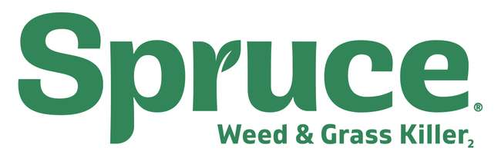
Regional Markets Focused
Spruce Weed Killer: Used its Super Bowl ad to boost brand awareness and drive interest across 19 southern markets where spring arrives first
Search increased more than 50x on Super Bowl night vs. week prior
50x
Weekly Google Trends Index – Spruce Weed Killer
12-month trend leading up to Superbowl LIX (Weeks of 2/4/2024 – 2/9/2025)
vs. prior week
Super Bowl
(100 index)
“We really believe that the lawn and garden category is an incredibly important one for consumers, and we think that we can take our deep consumer understanding and delight more consumers in the house and out of the house.”
Week Before Super Bowl
(2 index)
Maris Croswell
CEO, Spruce
(Variety, 1/28/25)
Source: VAB analysis of Google Trends, United States only, All Categories, Web Search, Weeks of 2/4/24 – 2/9/25. Google Search Index represents search interest relative to the highest point on the chart for the given region and time period, a value of 100 is the peak popularity for the term, a value of 50 means that the term is half as popular. Note: Light blue line marks the date of Super Bowl LIX. Click here to view Spruce’s Super Bowl commercial (via iSpot.tv).
This information is exclusively provided to VAB members and qualified marketers.
PAGE 18

Slide 19
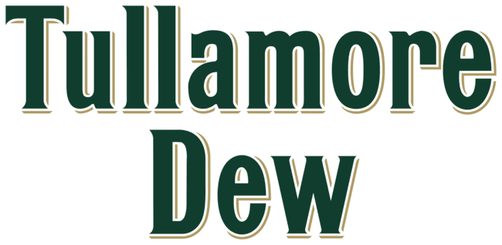
Local Market Targeted
Tullamore D.E.W: An Irish Whiskey brand ran its first Super Bowl ad locally in Chicago to test the response in hopes of investing nationally later
Search increased more than 8x on Super Bowl night vs. week prior and was 69% higher than the second highest week over the last 12 months
8.3x
Weekly Google Trends Index (Chicago Only) – Tullamore D.E.W
12-month trend leading up to Superbowl LIX (Weeks of 2/4/2024 – 2/9/2025)
vs. prior week
Super Bowl
(100 index)
“Not everybody can afford to do the
full-on national buy, [our team] saw this year’s local buy as an opportunity to ‘dip our toe in the water’ of the Super Bowl. This is the first step in trying to get there [running a national Super Bowl campaign down the line].”
Second Highest Week
(59 index)
Week Before Super Bowl
(12 index)
Paul Coffey
Sr Brand Manager, Tullamore DEW Irish Whiskey
(Marketing Brew, 2/5/25)
Source: VAB analysis of Google Trends, Chicago only, All Categories, Web Search, Weeks of 2/4/24 – 2/9/25. Google Search Index represents search interest relative to the highest point on the chart for the given region and time period, a value of 100 is the peak popularity for the term, a value of 50 means that the term is half as popular. Note: Light blue line marks the date of Super Bowl LIX. Click here to view Tullamore Dew’s Super Bowl commercial (via iSpot.tv).
This information is exclusively provided to VAB members and qualified marketers.
PAGE 19

Slide 20
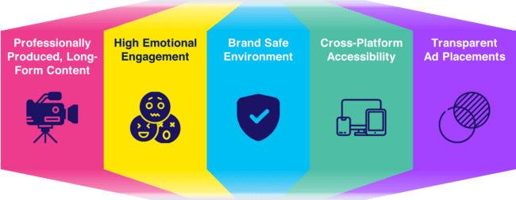
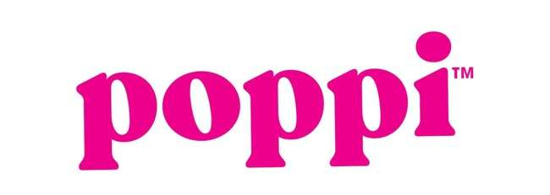
The power of truly premium video enables multiscreen TV to drive
mid-funnel results across brands of all types, regardless of messaging
15 Super Bowl Advertisers Analyzed
Represents a cross-section of categories*, brand strategies, messaging, creative executions and call-to-actions
The Power of Premium Video
Premium Video = Multiscreen TV
Click here to learn more about the attributes of premium video
*categories include beer, candy, lawn & garden, liquor, pharma, snacks, soda, travel, water and website hosting
This information is exclusively provided to VAB members and qualified marketers.
PAGE 20

Slide 21

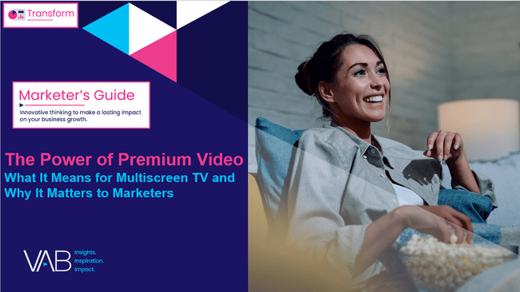
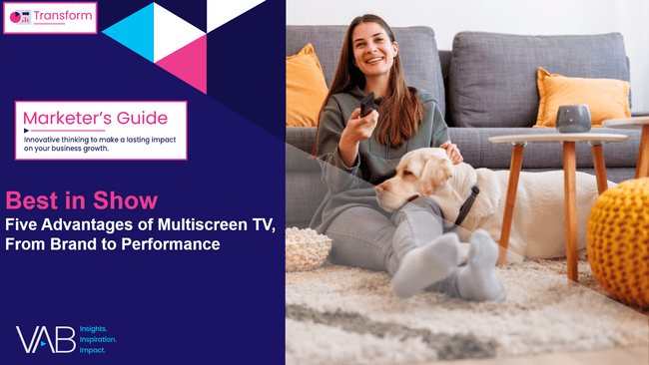
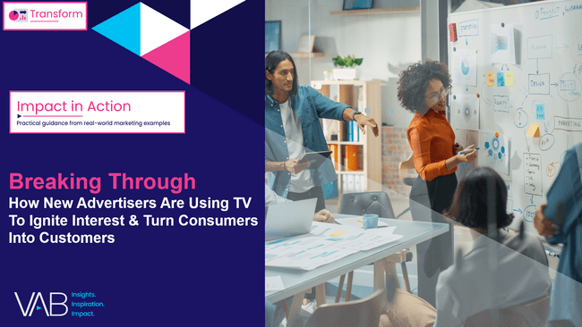
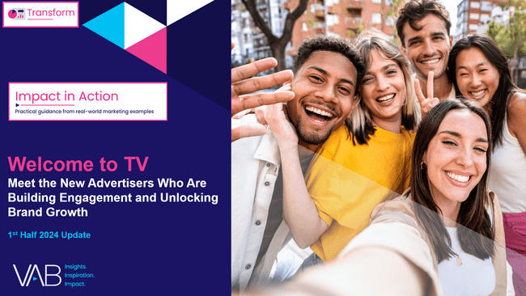
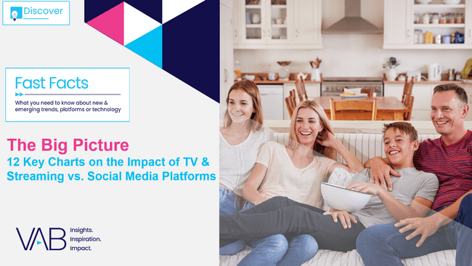
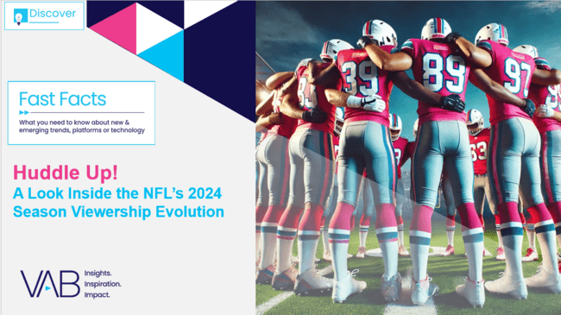
Download these other VAB resources to see how marketers are leveraging multiscreen TV / premium video to build their brand
The Power of Premium Video
What it Means for Multiscreen TV
and Why it Matter to Marketers
Best in Show
Five Advantages of Multiscreen TV,
From Brand to Performance
Breaking Through
How New Advertisers Are Using TV
To Ignite Interest & Turn Consumers Into Customers
Welcome to TV
Meet the New Advertisers Who Are Building Engagement and Unlocking Brand Growth
The Big Picture
12 Key Charts on the Impact of TV & Streaming vs. Social Media Platforms
Huddle Up!
A Look Inside the NFL’s 2024 Season
Viewership Evolution
This information is exclusively provided to VAB members and qualified marketers.
PAGE 21

Slide 22

About VAB
VAB plays a dual role in the video advertising industry. We are leading the change to bring about a more innovative and transparent marketplace. We also provide the insights and thought leadership that enables marketers to develop business-driving marketing strategies.
Drawing on our marketing expertise, we simplify the complexities in our industry and discover new insights that transform the way marketers look at their media strategy.
We are committed to your business growth and proud to offer VAB members, brand marketers and agencies complimentary access to our continuously-growing Insights library. Get immediate access at theVAB.com.
This information is exclusively provided to VAB members and qualified marketers.
PAGE 22

