Slide 1
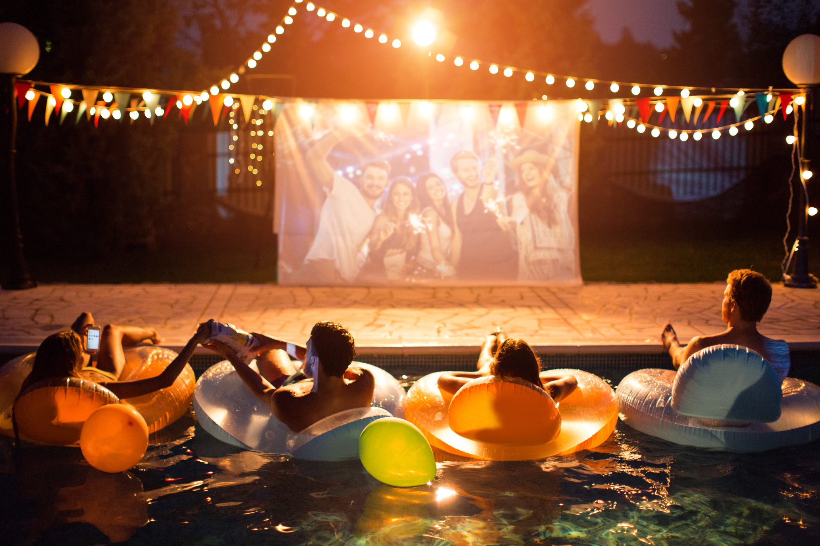

VIDEO ADVERTISING BUREAU - REPORT 2019
.................
Summer Forecast
Heating Up With Premium Multiscreen Video
Notes:
Premium - https://www.istockphoto.com/photo/pool-movie-night-party-gm487371742-73308125

Slide 2
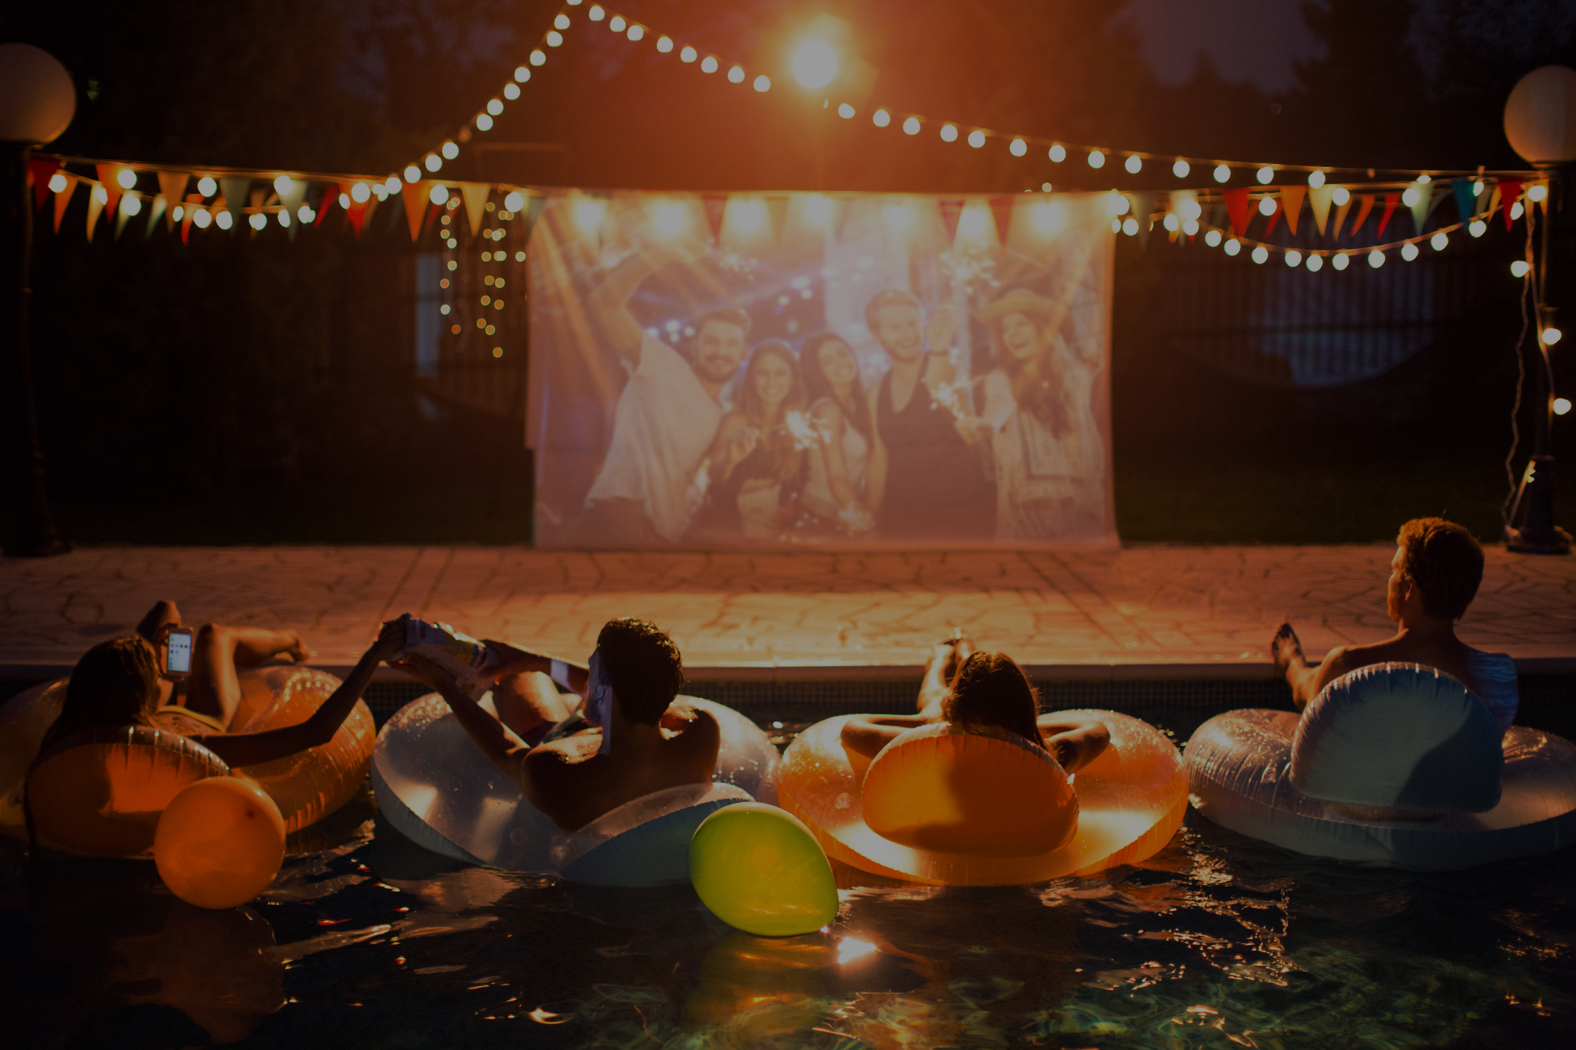
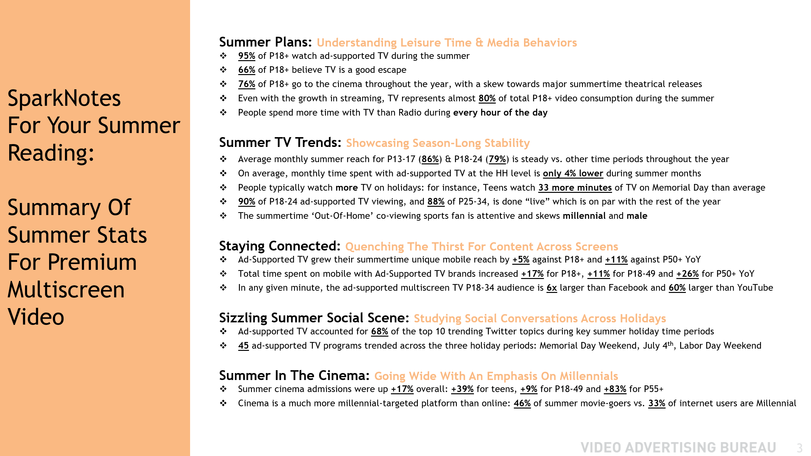
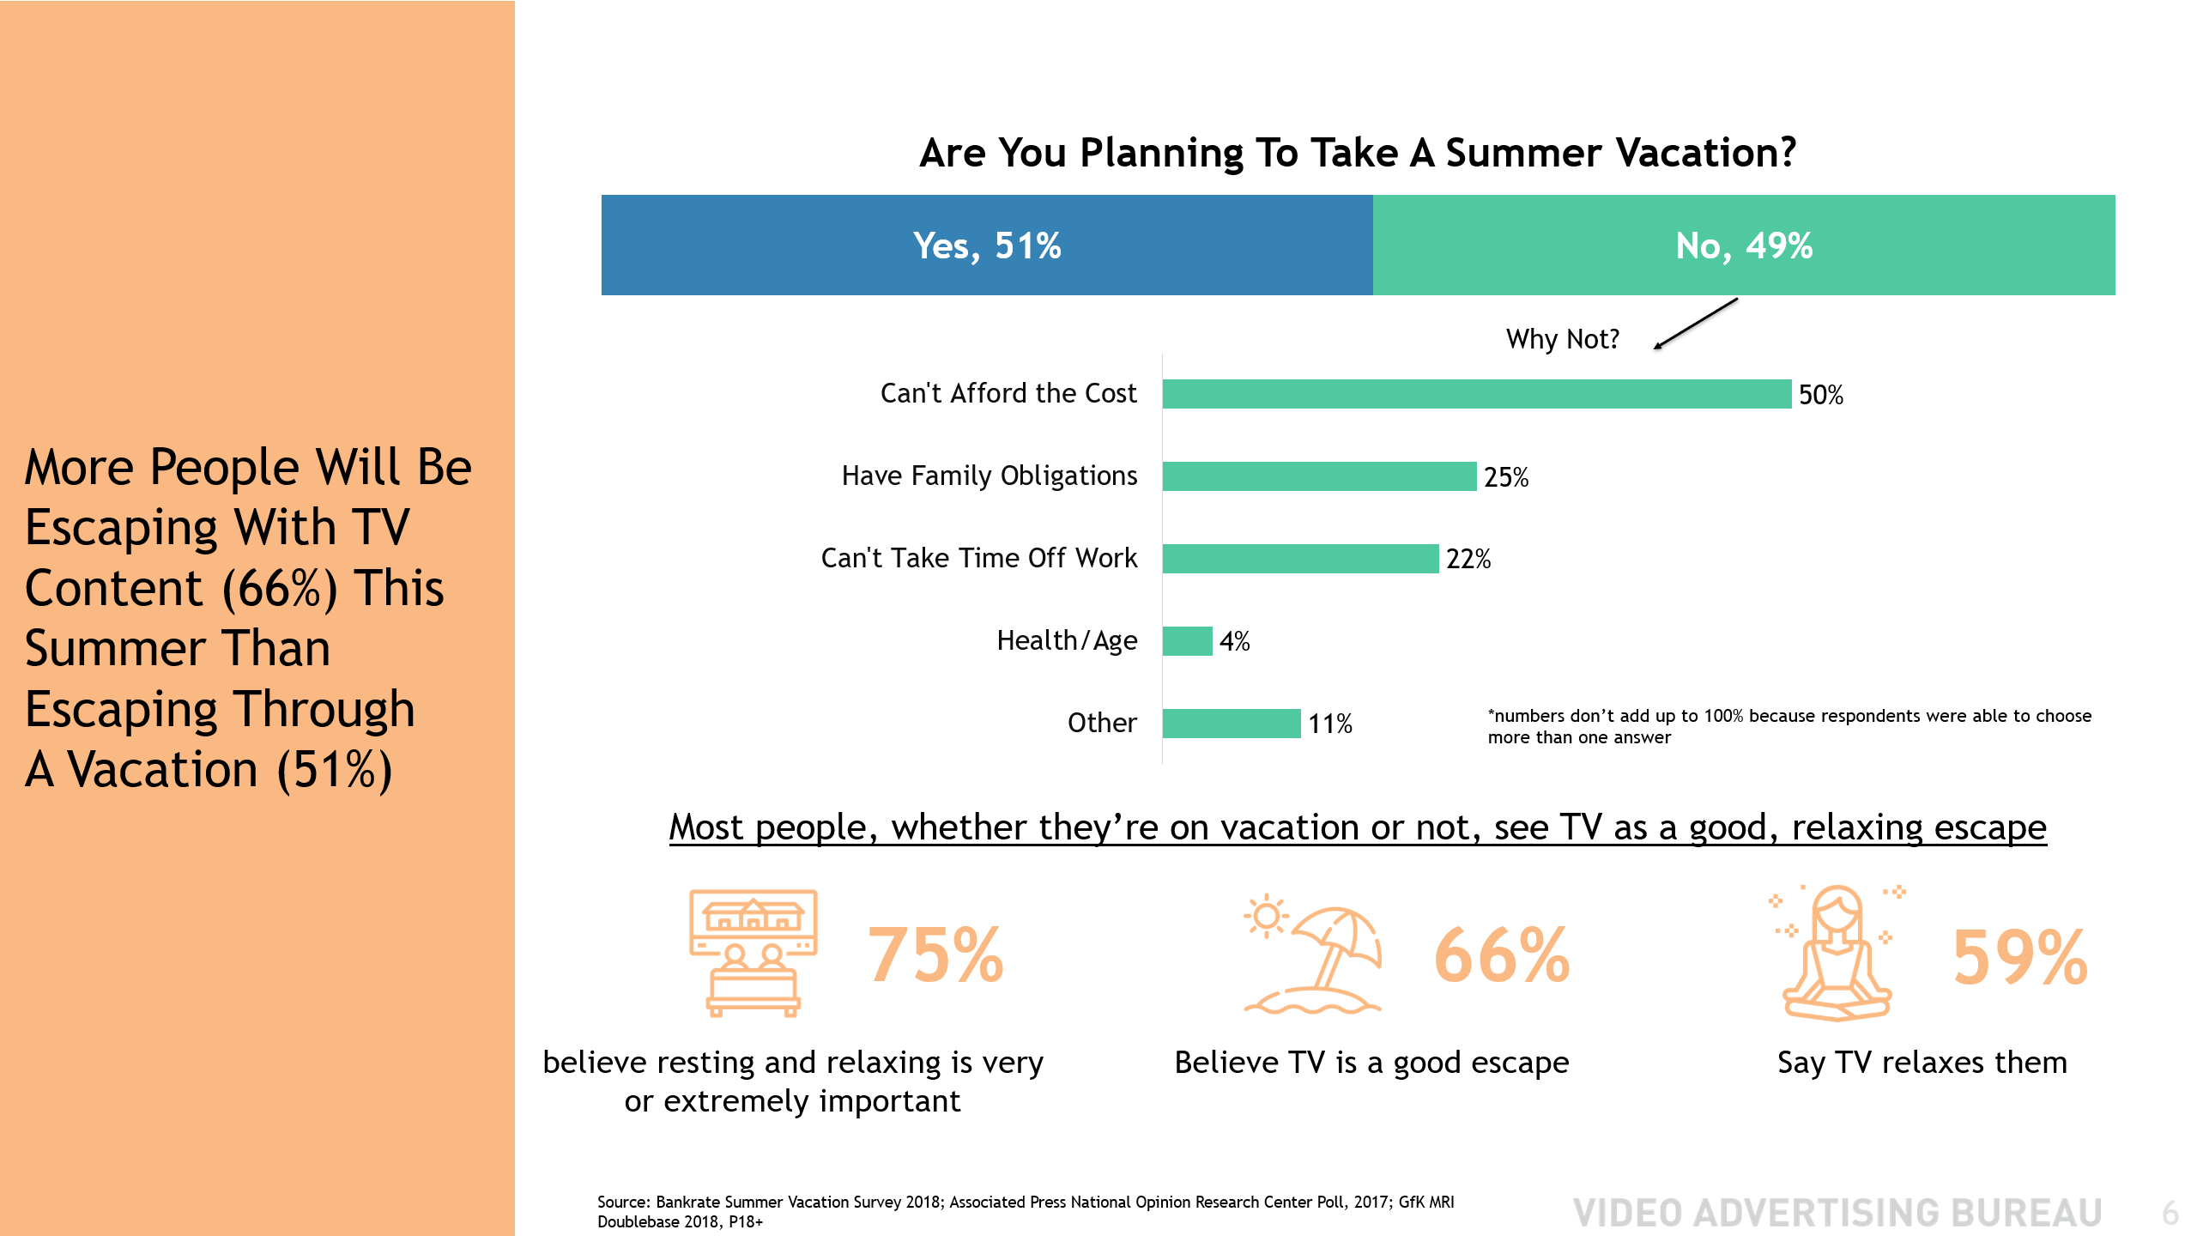
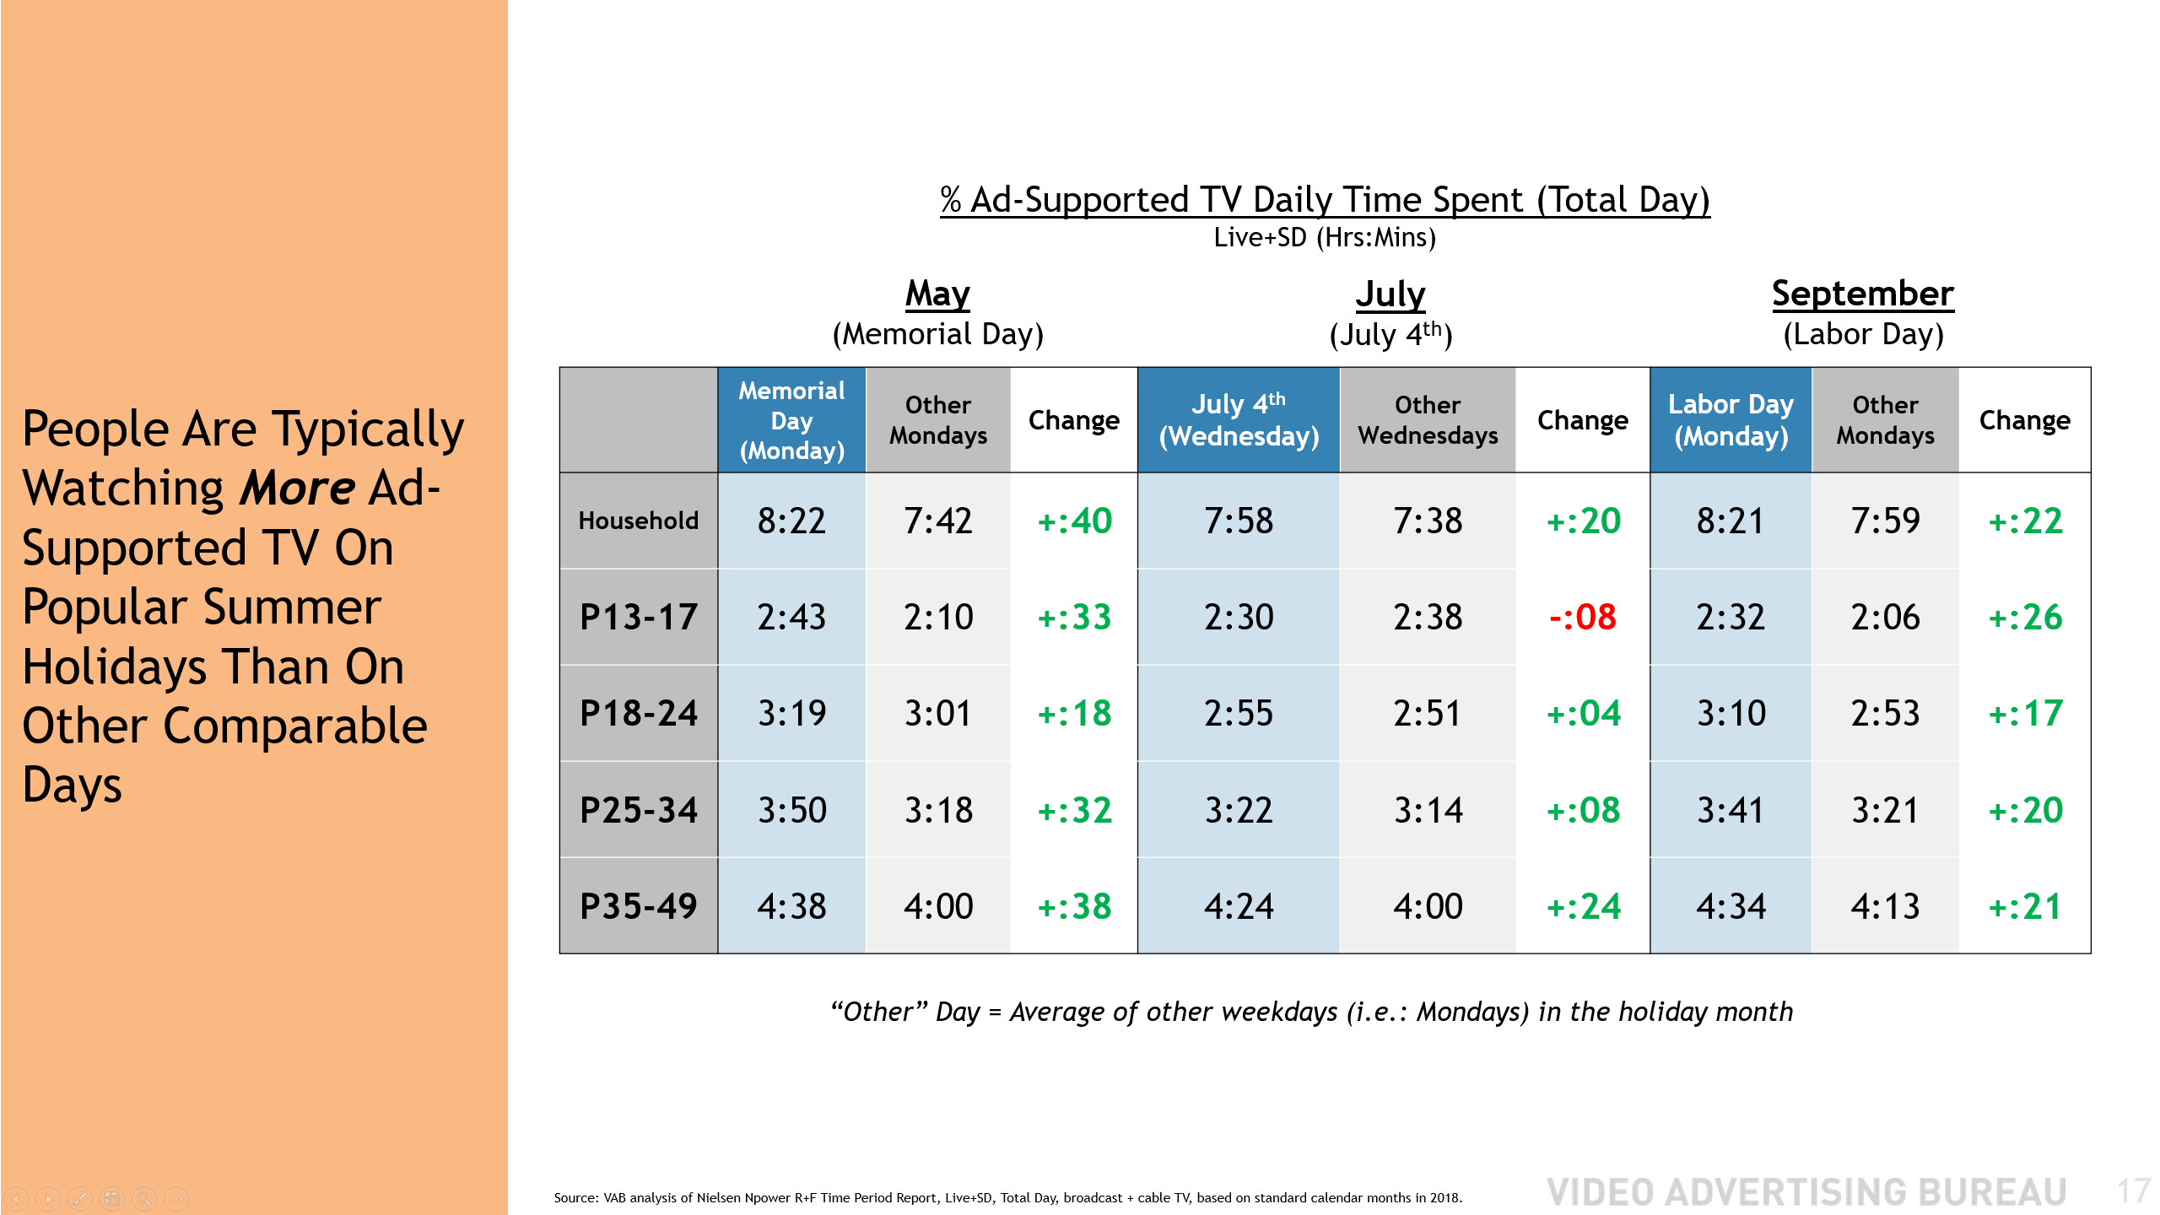
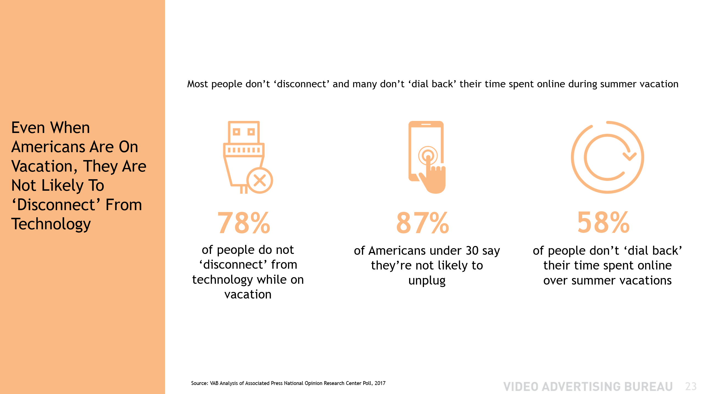
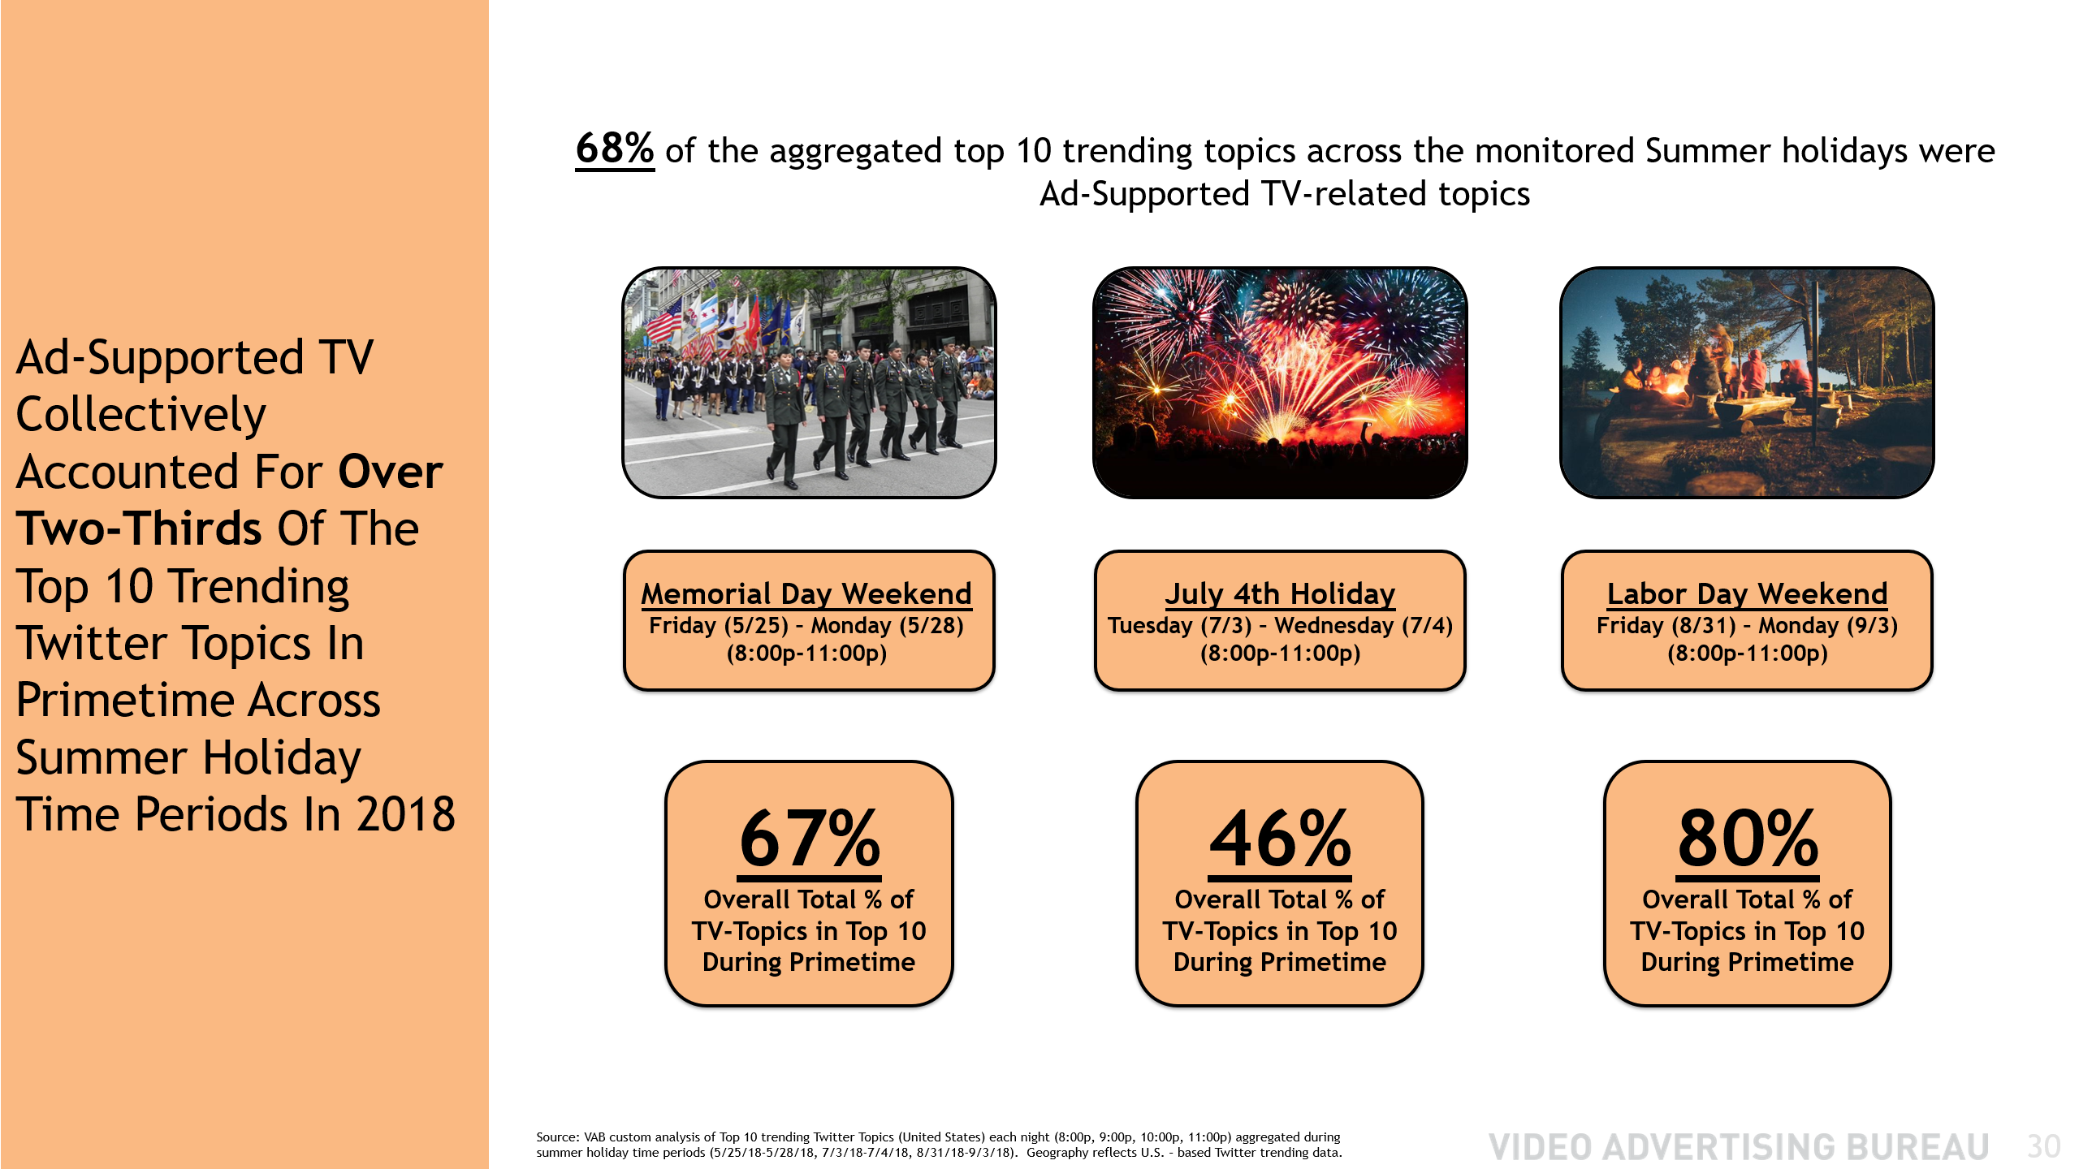
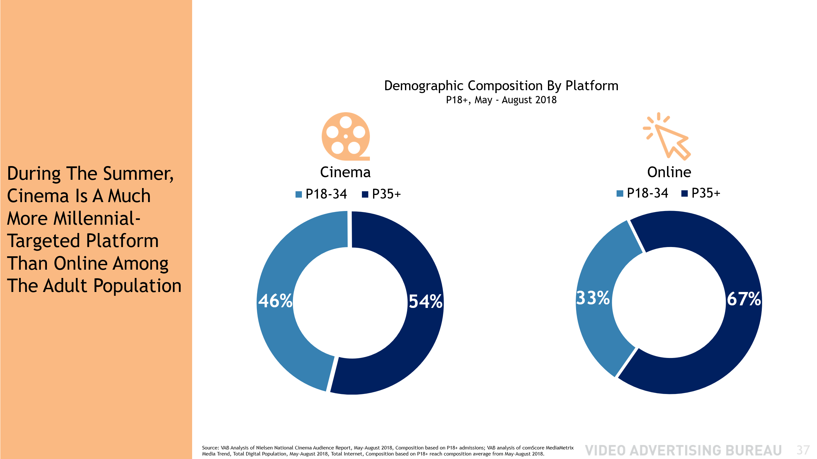
Contents
1
2
1
SparkNotes For Your Summer Reading
Summer Plans
Understanding Leisure Time & Media Behaviors
3
2
3
Summer TV Trends
Showcasing Season-Long Stability
4
4
Staying Connected
Quenching The Thirst For Content Across Screens
5
5
Sizzling Summer Social Scene
Studying Social Conversations Across Holidays
6
6
Summer In The Cinema
Going Wide With An Emphasis On Millennials

Slide 3
Summer Plans: Understanding Leisure Time & Media Behaviors
95% of P18+ watch ad-supported TV during the summer
66% of P18+ believe TV is a good escape
76% of P18+ go to the cinema throughout the year, with a skew towards major summertime theatrical releases
Even with the growth in streaming, TV represents almost 80% of total P18+ video consumption during the summer
People spend more time with TV than Radio during every hour of the day
Summer TV Trends: Showcasing Season-Long Stability
Average monthly summer reach for P13-17 (86%) & P18-24 (79%) is steady vs. other time periods throughout the year
On average, monthly time spent with ad-supported TV at the HH level is only 4% lower during summer months
People typically watch more TV on holidays: for instance, Teens watch 33 more minutes of TV on Memorial Day than average
90% of P18-24 ad-supported TV viewing, and 88% of P25-34, is done “live” which is on par with the rest of the year
The summertime ‘Out-Of-Home’ co-viewing sports fan is attentive and skews millennial and male
Staying Connected: Quenching The Thirst For Content Across Screens
Ad-Supported TV grew their summertime unique mobile reach by +5% against P18+ and +11% against P50+ YoY
Total time spent on mobile with Ad-Supported TV brands increased +17% for P18+, +11% for P18-49 and +26% for P50+ YoY
In any given minute, the ad-supported multiscreen TV P18-34 audience is 6x larger than Facebook and 60% larger than YouTube
Sizzling Summer Social Scene: Studying Social Conversations Across Holidays
Ad-supported TV accounted for 68% of the top 10 trending Twitter topics during key summer holiday time periods
45 ad-supported TV programs trended across the three holiday periods: Memorial Day Weekend, July 4th, Labor Day Weekend
Summer In The Cinema: Going Wide With An Emphasis On Millennials
Summer cinema admissions were up +17% overall: +39% for teens, +9% for P18-49 and +83% for P55+
Cinema is a much more millennial-targeted platform than online: 46% of summer movie-goers vs. 33% of internet users are Millennial
SparkNotes
For Your Summer Reading:
Summary Of Summer Stats For Premium Multiscreen Video
3

Slide 4
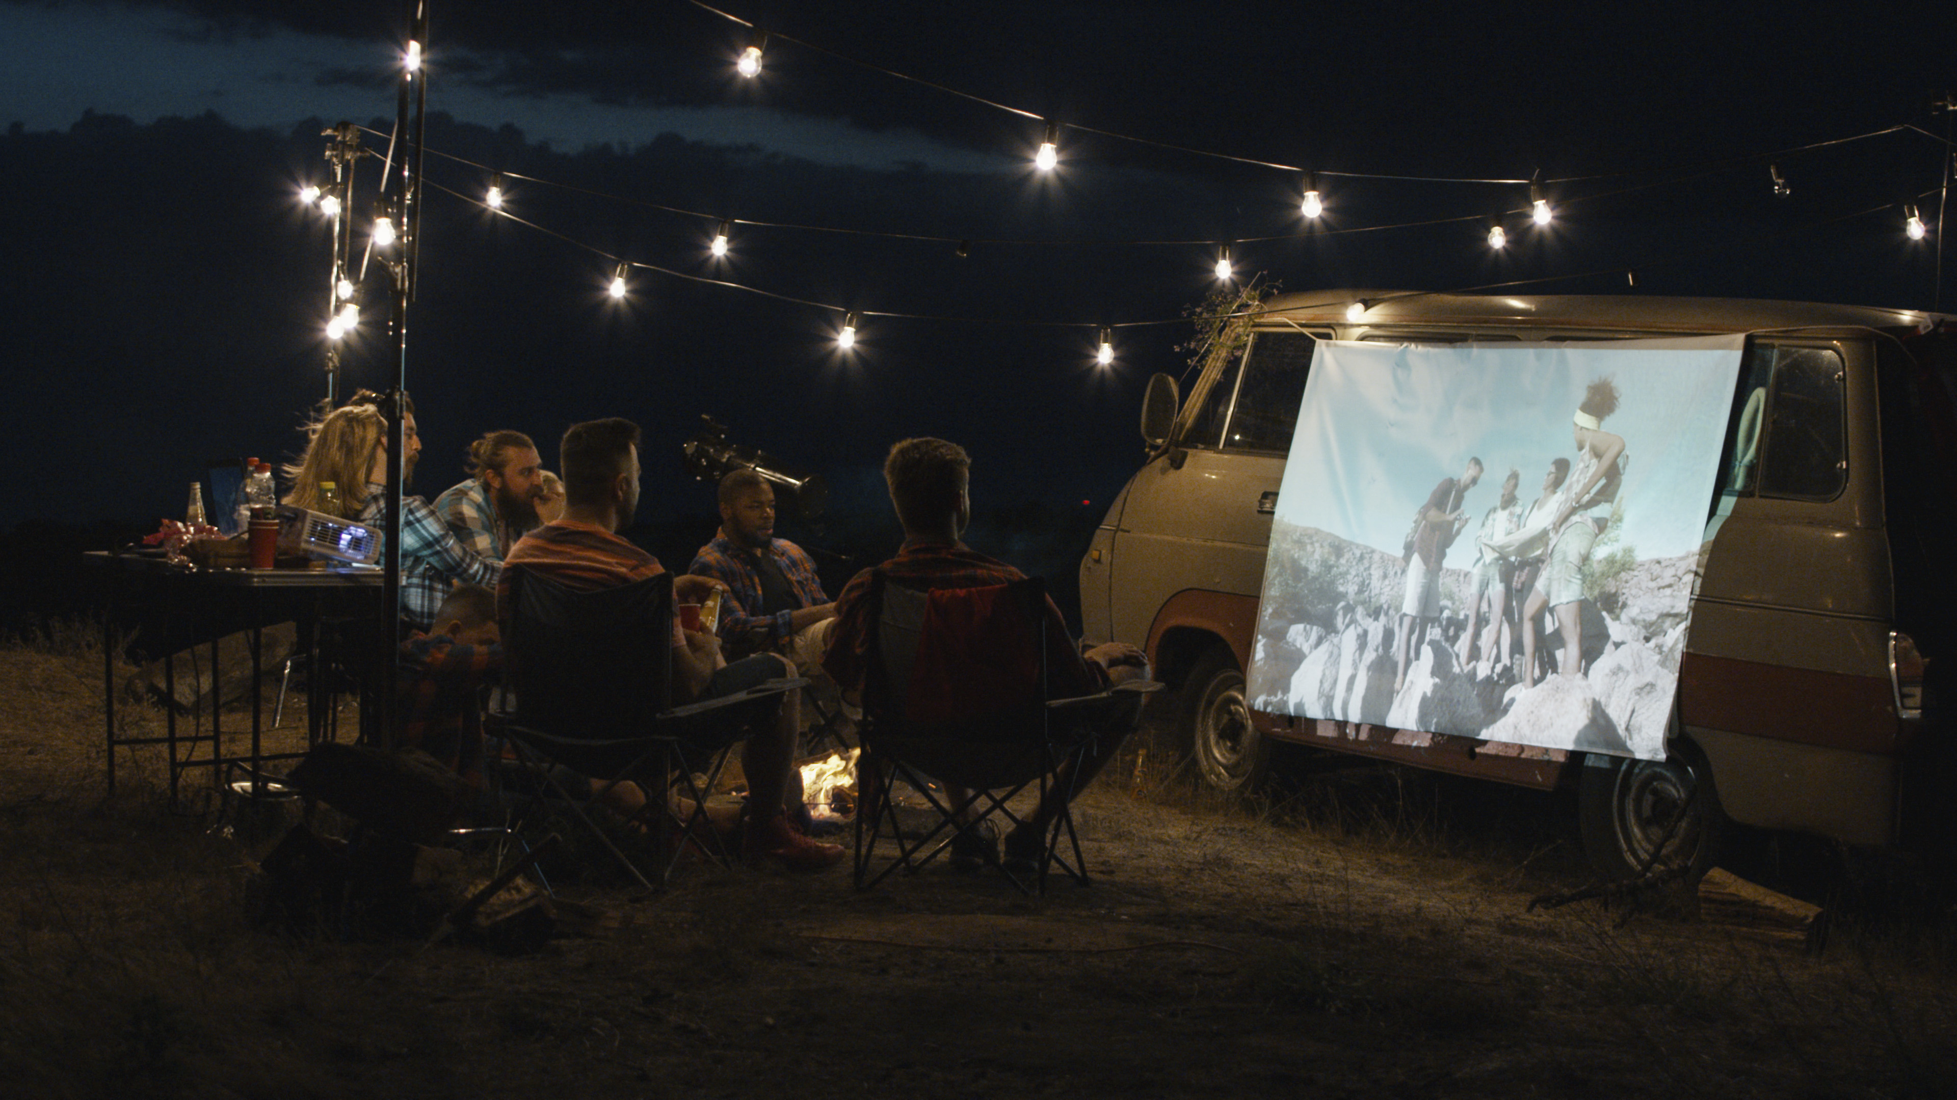
Summer Plans:
Understanding Leisure Time & Media Behaviors
Notes:
https://www.istockphoto.com/photo/friends-watching-movie-in-campsite-gm1010850322-272426429

Slide 5
Watching Ad-Supported TV & Going To The Local Cineplex Are The Two Most Popular Leisure Time Activities
*“participated in last 12 months” except for “watched ad-supported TV” which only reflects viewership during summer months
Source: TV data based on VAB Analysis of Nielsen Npower R+F Time Period Report, P18+, 5/25/18-9/3/18, Live+7, Viewing Sources Ad-Supported Cable & Broadcast TV; “went to cinema” based on MPAA’s analysis of P2+ attendance demographics from 2018 MPAA THEME Report; all other Leisure Activities based on GFK MRI 2018 Doublebase, P18+
5

Slide 6



Why Not?
More People Will Be Escaping With TV Content (66%) This Summer Than Escaping Through
A Vacation (51%)
*numbers don’t add up to 100% because respondents were able to choose more than one answer
Most people, whether they’re on vacation or not, see TV as a good, relaxing escape
75%
66%
59%
believe resting and relaxing is very or extremely important
Believe TV is a good escape
Say TV relaxes them
Source: Bankrate Summer Vacation Survey 2018; Associated Press National Opinion Research Center Poll, 2017; GfK MRI Doublebase 2018, P18+
6

Slide 7
Although Streaming Across Devices Is Increasing, TV Dwarfs All Other Audio Or Video Platforms And Represents Almost 80% Of Total Video Consumption During Summer
PC
Smartphone
Tablet
Source: VAB analysis of Nielsen Total Audience Report Q3 2018; Data based on weekly time spent averages among U.S. population in Q3 2018, P18+.
7

Slide 8
In Any Given Minute, The Millennial TV Audience Is Larger Than The Millennial Audience For Any Other Audio Or Video Platform…
TV Also Represents 51% Of Total Millennial Video Consumption
During Summer
PC
Smartphone
Tablet
Source: VAB analysis of Nielsen Total Audience Report Q3 2018; Data based on weekly time spent averages among U.S. population in Q3 2018, P18-34.
8

Slide 9
% Share of Time Spent By Hour
Linear TV vs. Radio, Q2 ‘18
Across All Hours Of The Day In Summer Months, More Time Is Spent With TV Than With Radio, Even During Radio’s Important Drive Time Dayparts
Morning (AM) Drive
Afternoon (PM) Drive
Source: VAB analysis of data from the Nielsen Total Audience Report 2Q 2018; percent shares based on medium’s % of total hours, TV includes live + time-shifted TV.
9

Slide 10
In what ways have you used your digital device to engage with the TV content you were watching
or the audio content you were listening to?
In Terms Of Summertime Second Screen Usage, TV Viewers Are 40% More Likely Than Audio Listeners To Take A Digital Action After Seeing / Hearing A Brand Being Advertised
Source: VAB analysis of data from the Nielsen Total Audience Report 2Q 2018. The audio universe includes terrestrial radio, satellite radio, streaming audio on smartphones and tablets, and podcasts.
10

Slide 11
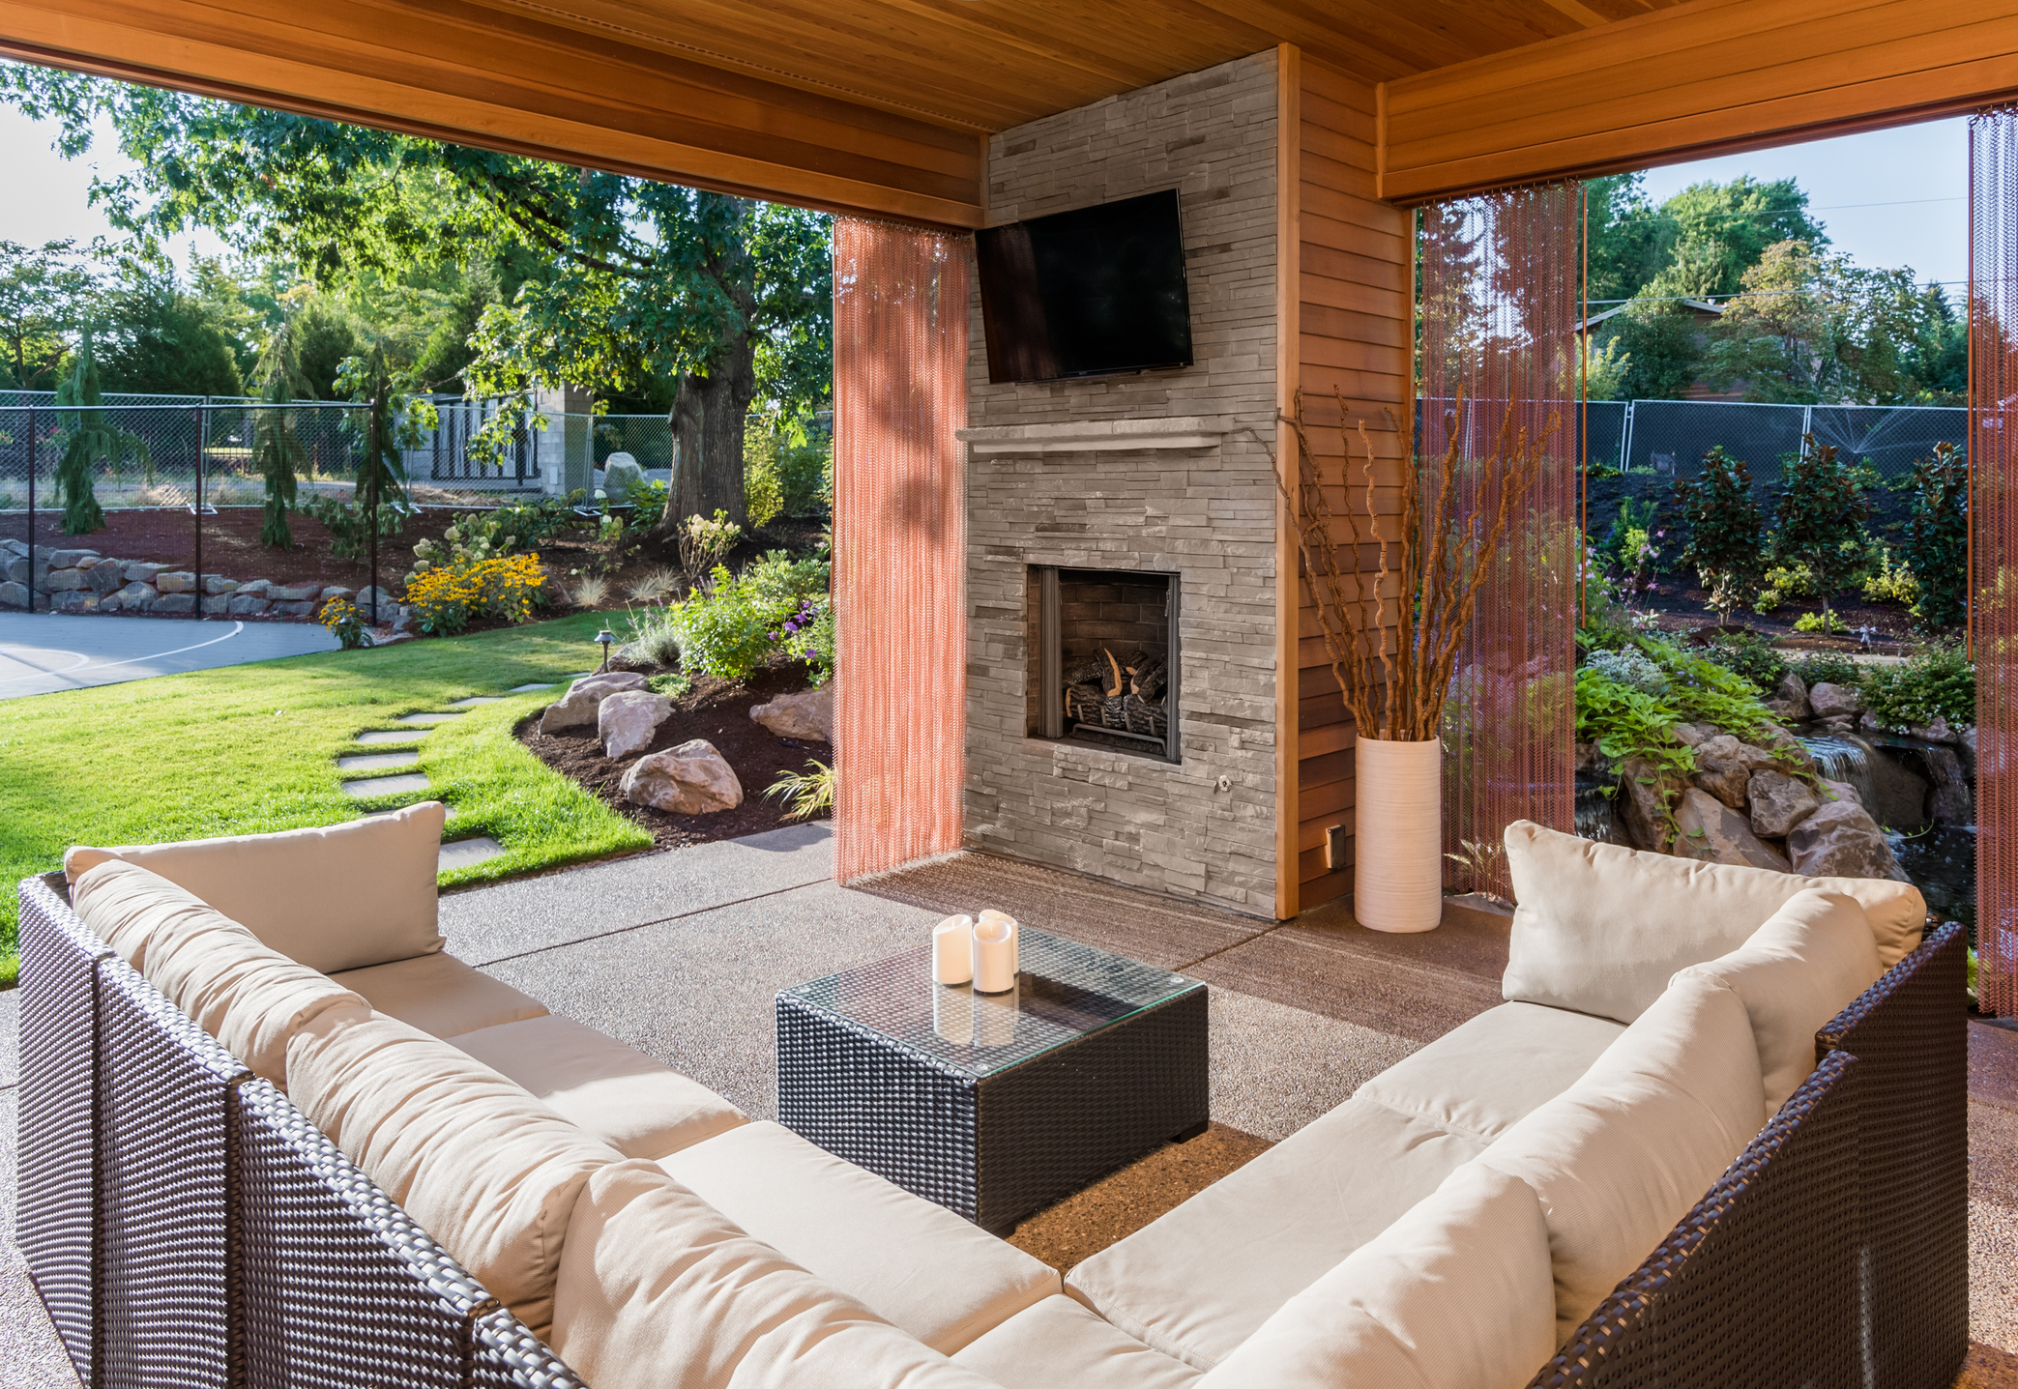
Summer TV Trends:
Showcasing Season-Long Stability
Notes:
https://www.istockphoto.com/photo/covered-patio-exterior-behind-new-luxury-home-gm514933928-88337569

Slide 12
Monthly Household Reach Remains Steady During Summer Months Compared To Non-Summer Months
Annual Monthly Average
95%
Source: VAB analysis of Nielsen NPower R+F Time Period Report, Household, Total Day, broadcast + cable TV, based on standard calendar months in 2018, Live+7
12

Slide 13
Monthly average
Monthly average
Monthly average
Monthly Reach Also Holds Relatively Steady Across Demos During Summer Vs. Non-Summer Months
Source: VAB analysis of Nielsen Npower R+F Time Period Report, Total Day, broadcast + cable TV, based on standard calendar months in 2018, Live+7
13

Slide 14
% Ad-Supported TV Daily Reach (Total Day)
Live+SD
Even On Popular Summer Holidays, Daily Reach Is Fairly Comparable To An Average Day Within The Same Month…
May
(Memorial Day)
July
(July 4th)
September
(Labor Day)
 | Memorial Day (Monday) | Other Mondays | PP Change | July 4th (Wednesday) | Other Wednesdays | PP Change | Labor Day (Monday) | Other Mondays | PP Change
Household | 80% | 81% | -1% | 75% | 78% | -3% | 79% | 81% | -2%
P13-17 | 39% | 34% | +5% | 32% | 35% | -3% | 35% | 31% | +4%
P18-24 | 37% | 34% | +3% | 30% | 32% | -2% | 31% | 31% | -
P25-34 | 50% | 47% | +3% | 42% | 43% | -1% | 45% | 47% | -2%
P35-49 | 68% | 66% | +2% | 59% | 61% | -2% | 65% | 65% | -
…These Summer Holidays Do Typically See A Significant Increase In Time Spent Watching TV As Well
(See Slide 17)
“Other” Day = Average of other weekdays (i.e: Mondays) in the holiday month
Source: VAB analysis of Nielsen Npower R+F Time Period Report, Live+SD, Total Day, broadcast + cable TV, based on 2018 dates, Live+SD.
14

Slide 15
On Average, Monthly Time Spent With Ad-Supported TV At The HH Level Is Only 4% Lower During Summer Months
229:13
212:40
196:51
202:27
211:50
209:49
212:56
199:31
202:32
201:59
194:10
197:47
Annual Monthly Average
205:56
Source: VAB analysis of Nielsen Npower R+F Time Period Report, Total Day, Household, broadcast + cable TV, based on standard calendar months in 2018, Live+7
15

Slide 16
Across Demos, Monthly Time Spent With Ad-Supported TV Is Only 7% Lower On Average During Summer Months Vs. Non-Summer Months…
Although Teen Summer Viewership Is Flat Vs. The Rest Of The Year
Monthly average
Monthly average
Monthly average
29:27
28:24
27:25
39:31
34:43
35:32
60:57
54:07
57:16
95:37
87:07
95:41
Source: VAB analysis of Nielsen Npower R+F Time Period Report, Total Day, broadcast + cable TV, based on standard calendar months in 2018, Live+7
16

Slide 17
% Ad-Supported TV Daily Time Spent (Total Day)
Live+SD (Hrs:Mins)
May
(Memorial Day)
July
(July 4th)
September
(Labor Day)
 | Memorial Day (Monday) | Other Mondays | Change | July 4th (Wednesday) | Other Wednesdays | Change | Labor Day (Monday) | Other Mondays | Change
Household | 8:22 | 7:42 | +:40 | 7:58 | 7:38 | +:20 | 8:21 | 7:59 | +:22
P13-17 | 2:43 | 2:10 | +:33 | 2:30 | 2:38 | -:08 | 2:32 | 2:06 | +:26
P18-24 | 3:19 | 3:01 | +:18 | 2:55 | 2:51 | +:04 | 3:10 | 2:53 | +:17
P25-34 | 3:50 | 3:18 | +:32 | 3:22 | 3:14 | +:08 | 3:41 | 3:21 | +:20
P35-49 | 4:38 | 4:00 | +:38 | 4:24 | 4:00 | +:24 | 4:34 | 4:13 | +:21
People Are Typically Watching More Ad-Supported TV On Popular Summer Holidays Than On Other Comparable Days
“Other” Day = Average of other weekdays (i.e.: Mondays) in the holiday month
Source: VAB analysis of Nielsen Npower R+F Time Period Report, Live+SD, Total Day, broadcast + cable TV, based on standard calendar months in 2018.
17

Slide 18
The Large Majority Of Ad-Supported TV Viewing During The Summer Is Done ‘Live’ And Is Even Slightly Higher Than Non-Summer Months
Annual Monthly Average
89%
Source: VAB analysis of Nielsen NPower R+F Time Period Report, all TV Households, Total Day, broadcast + cable TV, based on standard calendar months in 2018, Live & Live+7
18

Slide 19
‘Live’ TV Also Represents The Large Majority Of Ad-Supported TV Viewing Across Demos, With Summer Months Very Similar To Non-Summer Months
Monthly average
Monthly average
Monthly average
Source: VAB analysis of Nielsen Npower R+F Time Period Report, based on TV demo population, Total Day, broadcast + cable TV, based on standard calendar months in 2018, Live & Live+7
19

Slide 20
% of Ad-Supported TV Programming Co-Viewed
P2+, Primetime
Summer Primetime TV Co-Viewing Levels Are Also In Line With Non-Summer Months
Annual Monthly Average
42% Co-Viewed
Source: VAB analysis of Nielsen Npower Co-Viewing Program Report, Primetime, P2+ Primary Target, P2+ Secondary Target, Ad-Supported Cable and Broadcast, based on standard calendar months in 2018, Live+7
20

Slide 21







Who Are The Out-Of-Home Linear TV Sports Viewers?
Co-Viewing Extends To Summertime ‘Out-Of-Home’ Sports Fans Who Like To Go Out And Watch Games With Friends
These Fans Are Attentive And Skew Millennial & Male
53%
Millennial
38
Average Age
38%
Female
62%
Male
Are They Watching Summer Sports In Groups?
P18+: 3.4 People
Females: 3.5 People
Males: 3.3 People
Where Do They Choose To Watch?
Are They Listening and Attentive?
66%
of ‘Out-Of-Home’ Sports Viewers were able to hear all of the program
Most summer sports viewers pay attention to at least 50% of both ads and telecast
74% viewed in other locations beyond restaurants / bars
Source: Nielsen 2018, “The Out-Of-Home (OOH) Linear TV Summer Sports Viewer” Infographic based on the summer sports survey which was fielded to a national sample from June 25 – July 3, 2018 and covered the FIFA World Cp, MLB, PGA and NASCAR
21

Slide 22

Staying Connected:
Quenching The Thirst For Content Across Screens
Notes:
https://www.istockphoto.com/photo/hat-and-sunglasses-with-tablet-on-colorful-cloth-on-white-sand-beach-top-view-gm947081992-258606295

Slide 23



Most people don’t ‘disconnect’ and many don’t ‘dial back’ their time spent online during summer vacation
Even When Americans Are On Vacation, They Are Not Likely To ‘Disconnect’ From Technology
78%
87%
58%
of people do not ‘disconnect’ from technology while on vacation
of Americans under 30 say they’re not likely to unplug
of people don’t ‘dial back’ their time spent online over summer vacations
Source: VAB Analysis of Associated Press National Opinion Research Center Poll, 2017
23
Notes:
https://www.istockphoto.com/photo/man-sitting-on-beach-reading-ebook-gm882229578-245527849
https://www.istockphoto.com/photo/friends-hanging-out-at-pool-party-gm896294670-247528453
https://www.istockphoto.com/photo/handsome-man-waiting-in-airport-lounge-using-a-digital-tablet-gm910516914-250750575

Slide 24
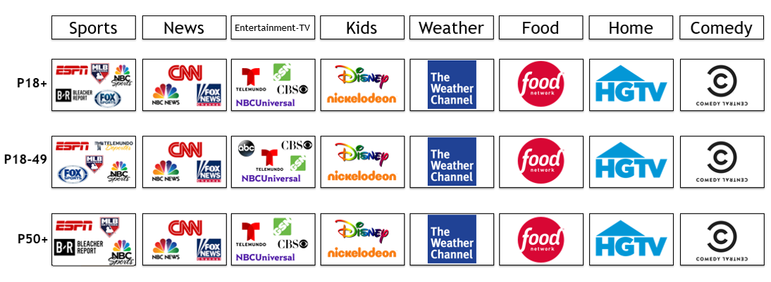
Ad-Supported TV Brands That Rank In The Top 5 Digital Platforms By Major Content Genre
There Is A Thirst For TV Content Online During The Summer As Many Ad-Supported TV Brands Rank In The Top 5 Digital Platforms Across Genres
Source: VAB analysis of comScore Media Metrix Key Measures multi-platform (desktop + mobile) data, P18+, P18-49 and P50+, June 2018, based on categories (top 5 rankings based on “Total Minutes Viewed”).
24

Slide 25
In Fact, Ad-Supported TV-Branded Digital Platforms Collectively Continue To Grow Their Unique Mobile Reach During The Summer
Monthly average
Monthly average
+5%
+2%
+11%
Source: VAB analysis of comScore MediaMetrix Audience Duplication, mobile only, unique visitors; P18+, P18-49, and P50+, 2017 and 2018 averages by summer months (June-September). Ad-Supported Television Brands represents all measured Ad-Supported Cable nets, Broadcast Television and MVPDs.
25
Notes:
https://www.istockphoto.com/photo/man-sitting-on-beach-reading-ebook-gm882229578-245527849
https://www.istockphoto.com/photo/friends-hanging-out-at-pool-party-gm896294670-247528453
https://www.istockphoto.com/photo/handsome-man-waiting-in-airport-lounge-using-a-digital-tablet-gm910516914-250750575

Slide 26
Continued Growth In Both Unique Reach And Average Usage Has Led To Double-Digit Growth In Total Minutes Spent On
Ad-Supported TV-Branded Mobile Platforms During
The Summer
Monthly average
Monthly average
+17%
+11%
+26%
Source: VAB analysis of comScore MediaMetrix Audience Duplication, mobile only, total minutes (MM); P18+, P18-49, and P50+, 2017 and 2018 averages by summer months (June-September). Ad-Supported Television Brands represents all measured Ad-Supported Cable nets, Broadcast Television and MVPDs.
26
Notes:
https://www.istockphoto.com/photo/man-sitting-on-beach-reading-ebook-gm882229578-245527849
https://www.istockphoto.com/photo/friends-hanging-out-at-pool-party-gm896294670-247528453
https://www.istockphoto.com/photo/handsome-man-waiting-in-airport-lounge-using-a-digital-tablet-gm910516914-250750575

Slide 27
In Any Given Minute During The Summer, The Combined Multiscreen TV P18+ Audience Is, On Average, 13x Larger Than Facebook And 6x Larger Than YouTube
Multiscreen (TV + online)
Multiscreen (TV + online)
Multiscreen (TV + online)
Multiscreen (TV + online)
Source: multi-screen TV data based on VAB Analysis of Nielsen Npower R+F Time Period Report, 2018, P18+, Live+7, includes all ad-supported TV viewing sources & VAB analysis of comScore audience duplication, P18+, 2018 data (mediametrix, multiplatform). Ad-Supported Television Brands represents all measured Ad-Supported Cable nets, Broadcast Television and MVPDs. Digital platform data: comScore Media Trend, P18+, 2018 except for YouTube data which is based on VAB analysis of comScore Video Metrix, 2018, P18+.
27

Slide 28
Against Millennials, The Combined Multiscreen TV Audience During The Summer Is, On Average, 6x Larger Than Facebook And 60% Larger Than YouTube
Multiscreen (TV + online)
Multiscreen (TV + online)
Multiscreen (TV + online)
Multiscreen (TV + online)
Source: multi-screen TV data based on VAB Analysis of Nielsen Npower R+F Time Period Report, 2018, P18-34, Live+7, includes all ad-supported TV viewing sources & VAB analysis of comScore audience duplication, P18-34, 2018 data (mediametrix, multiplatform). Ad-Supported Television Brands represents all measured Ad-Supported Cable nets, Broadcast Television and MVPDs. Digital platform data: comScore Media Trend, P18-34, 2018 except for YouTube data which is based on VAB analysis of comScore Video Metrix, 2018, P18-34.
28

Slide 29
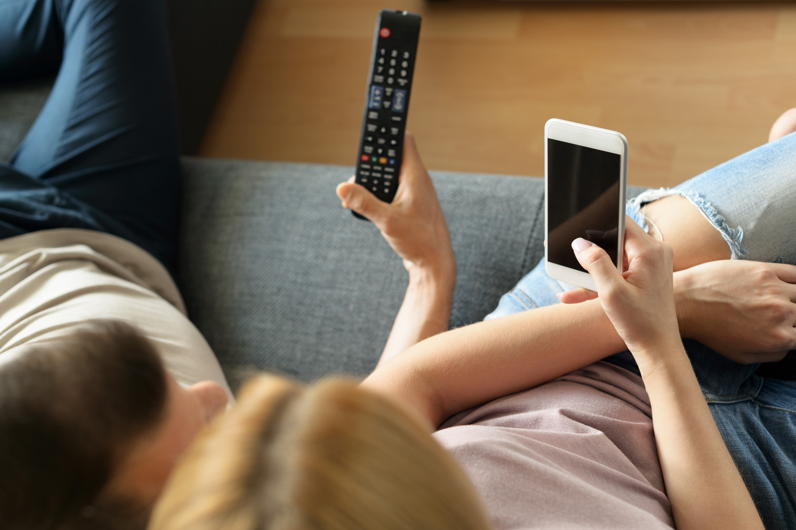
Sizzling Summer Social Scene:
Studying Social Conversations Across Holidays
Notes:
https://www.istockphoto.com/photo/in-the-evening-beautiful-young-woman-relaxes-on-a-couch-in-her-cozy-living-room-she-gm889642002-246617800

Slide 30
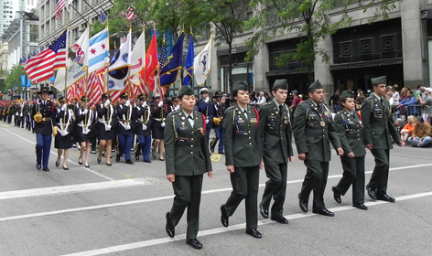

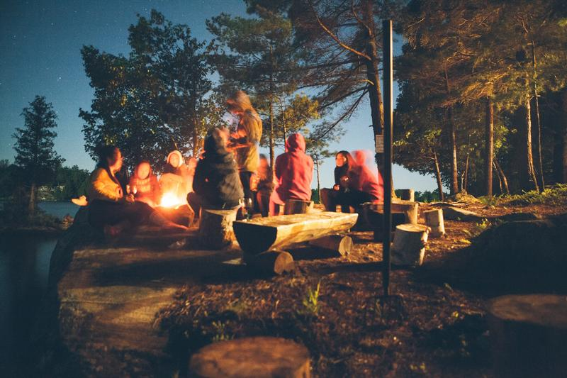
68% of the aggregated top 10 trending topics across the monitored Summer holidays were Ad-Supported TV-related topics
Ad-Supported TV Collectively Accounted For Over Two-Thirds Of The Top 10 Trending Twitter Topics In Primetime Across Summer Holiday Time Periods In 2018
Memorial Day Weekend
Friday (5/25) – Monday (5/28)
(8:00p-11:00p)
July 4th Holiday
Tuesday (7/3) – Wednesday (7/4)
(8:00p-11:00p)
Labor Day Weekend
Friday (8/31) – Monday (9/3)
(8:00p-11:00p)
67%
Overall Total % of TV-Topics in Top 10 During Primetime
46%
Overall Total % of TV-Topics in Top 10 During Primetime
80%
Overall Total % of TV-Topics in Top 10 During Primetime
Source: VAB custom analysis of Top 10 trending Twitter Topics (United States) each night (8:00p, 9:00p, 10:00p, 11:00p) aggregated during summer holiday time periods (5/25/18-5/28/18, 7/3/18-7/4/18, 8/31/18-9/3/18). Geography reflects U.S. – based Twitter trending data.
30
Notes:
https://www.istockphoto.com/photo/navy-marching-gm1075697746-288017516
https://www.istockphoto.com/photo/silhouetted-people-watching-a-fireworks-display-gm929264972-254833906

Slide 31
# of TV Trending Programs In The Twitter Top 10 During Each Holiday Time Period
Genre Parity:
Sports Made Up 53% And Entertainment Made Up 40% Of
Ad-Supported TV Programs That Trended In The
Top 10 Across The Three Summer Holiday Periods In 2018
18
17
12
Friday (5/25) – Monday (5/28)
Tuesday (7/3) – Wednesday (7/4)
Friday (8/31) – Monday (9/1)
Source: VAB custom analysis of Top 10 trending Twitter Topics (United States) each night (8:00p, 9:00p, 10:00p, 11:00p) aggregated during summer holiday time periods (5/25/18-5/28/18, 7/3/18-7/4/18, 8/31/18-9/3/18). Geography reflects U.S. – based Twitter trending data.
31

Slide 32
% Breakout of Ad-Supported TV Topics By Medium
Cable Represents The Majority Of The Ad-Supported TV Top 10 Trending Topics During The Summer Holidays
*Ad-Supported Cable TV & Broadcast TV includes programs and topics that aired, or were discussed, on multiple networks
Source: VAB custom analysis of Top 10 trending Twitter Topics (United States) each night (8:00p, 9:00p, 10:00p, 11:00p) aggregated during summer holiday time periods (5/25/18-5/28/18, 7/3/18-7/4/18, 8/31/18-9/3/18). Geography reflects U.S. – based Twitter trending data.
32

Slide 33

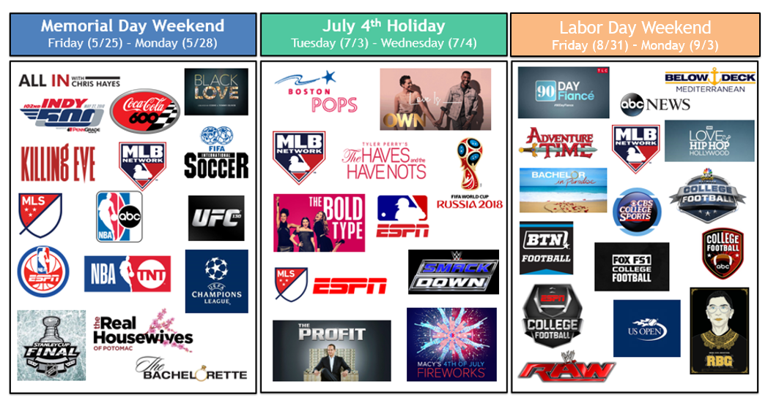
45 Ad-Supported TV Programs Trended In The Top 10 Across The Three Summer Holiday Periods
Source: VAB custom analysis of Top 10 trending Twitter Topics (United States) each night (8:00p, 9:00p, 10:00p, 11:00p) aggregated during summer holiday time periods (5/25/18-5/28/18, 7/3/18-7/4/18, 8/31/18-9/3/18). Geography reflects U.S. – based Twitter trending data.
33

Slide 34
Summer Holidays Monitored Time Period
# of Unique Top 10 Programs / Content By Platform
Even During Summer Holidays When Friends & Family Are Gathered Together, Nothing Gets People Talking Online Like Ad-Supported TV Programs
(Solo: A Star Wars Story, Scarlett Johansson casted in Rub & Tug)
(Alex Jones rant on #SecondCivilWar, Nicki Minaj wardrobe malfunction at MIA Festival)
(Tyga interviewed on #QueenRadio, Drake dis-track ‘Duppy Freestyle’ on Pusha-T)
(Coverage of Capitol July 4th celebrations)
(#ALLIN Wrestling Event)
Source: VAB custom analysis of Top 10 trending Twitter Topics (United States) each night (8:00p, 9:00p, 10:00p, 11:00p) aggregated during summer holiday time periods (5/25/18-5/28/18, 7/3/18-7/4/18, 8/31/18-9/3/18). Geography reflects U.S. – based Twitter trending data. Ad-Supported TV total doesn’t add to 47 programs as laid out is slide 31 since two programs trended during multiple holidays.
34

Slide 35
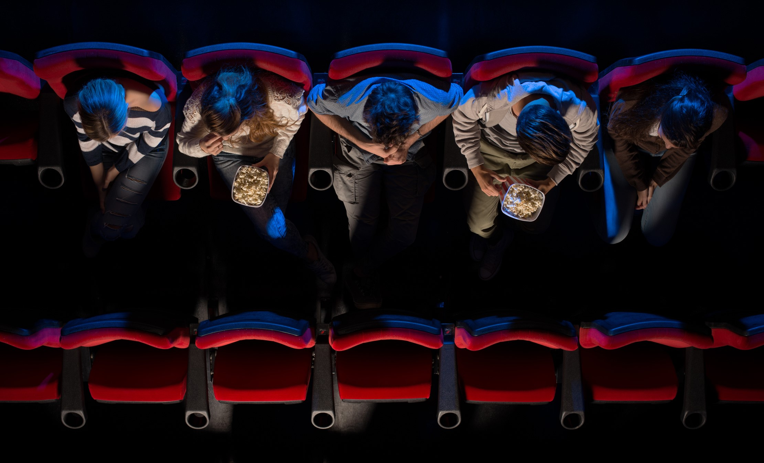
Summer In The Cinema:
Going Wide With An Emphasis On Millennials

Slide 36
Cinema Admissions By Demo
May-August 2017 vs. 2018
(millions)
Total (P2+) Summer Cinema Admissions Were Up +17% YoY In 2018; With Increases Against All Major Demos
+9%
+11%
+2%
+17%
+39%
+83%
Source: Nielsen National Cinema Audience Report, May-August 2017 & May-August 2018, Admissions cumed across months in period
36

Slide 37


Demographic Composition By Platform
P18+, May - August 2018
During The Summer, Cinema Is A Much More Millennial-Targeted Platform Than Online Among The Adult Population
Cinema
Online
Source: VAB Analysis of Nielsen National Cinema Audience Report, May-August 2018, Composition based on P18+ admissions; VAB analysis of comScore MediaMetrix Media Trend, Total Digital Population, May-August 2018, Total Internet, Composition based on P18+ reach composition average from May-August 2018.
37

Slide 38
% Who Are “Likely” or “Very Likely” To Take A Specific Action As A Result of Seeing A Cinema Advertisement
April-August 2018
Movie-Going Millennials In The Summer Are Even More Likely To Take An Action Based On Cinema Advertising Than The Average Adult
109
Index
111
Index
110
Index
“Index” example: Millennials are 11% more likely than the average adult 18+ to say they’re likely or very likely to go shopping as a result of seeing a cinema ad.
Source: Nielsen National Cinema Audience Report, April-August 2018, VAB Custom Question: QM35: Likelihood of … As Result of Seeing an Advertisement in Movie Theater/Theater Lobby (top box – Very Likely); P18+ Base: 7,7710 respondents, P18-34+ Base: 4,295 respondents.
38

Slide 39
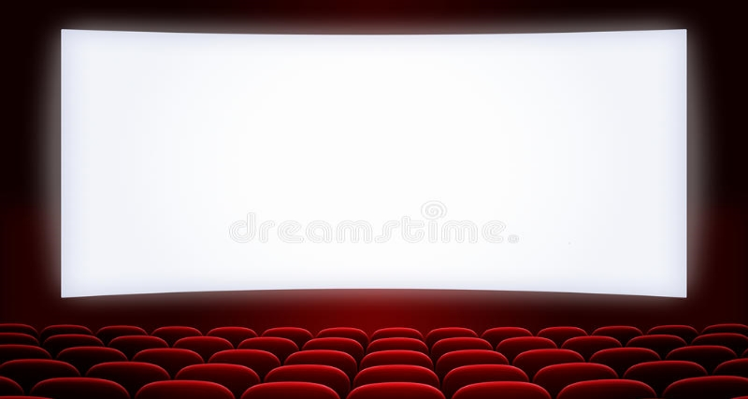















April 26
May 10
May 24
May 31
May 31
Big Theatrical Releases Are Slated Throughout Summer 2019 Featuring Engaging Stories, Top Stars & Popular Franchises
June 7
June 7
June 14
June 21
June 28
July 5
July 19
July 26
August 9
August 16
Note: Some release dates are tentative
39
Notes:
https://www.istockphoto.com/photo/empty-cinema-screen-with-audience-gm453554783-24692123

Slide 40




Contact Us
Jason Wiese
SVP, Director of Strategic Insights
jasonw@thevab.com
Join Our Email List
Reed Kiely
Senior Multi-Platform Video Analyst reedk@thevab.com
VAB
(Video Advertising Bureau)
@VideoAdBureau

