Slide 1





I Know What You Did This Summer
Harnessing consumer momentum at the movies

Slide 2


We crave experiences.
As we entered 2022, consumers began to more confidently embrace a post-pandemic future,
where they could once again satisfy their hunger
for experiences – especially communal, social events.
This ‘celebratory’ environment is seen in many places, but, most notably, at the Cinema. The movie-going experience offers marketers a unique opportunity to engage consumers who are energized, attentive and receptive.
This information is exclusively provided to VAB members and qualified marketers. Further distribution is prohibited.
PAGE 2

Slide 3

1
Cinema delivers on people’s
‘post-pandemic’ need for shared, communal experiences

Slide 4

After two years of the pandemic, Americans have become increasingly comfortable with communal experiences and activities
72% of adults 18-34 and 66% of adults 18-49 are seeking out opportunities for live in-person events and experiences now more than ever before*
% of U.S. adults who say, given the current situation with the coronavirus outbreak, they feel comfortable doing each of the following
Source: Pew Research Center, ‘Increasing Public Criticism, Confusion Over COVID-19 Response in U.S.’. Survey conducted January 24-30, 2022. *Screenvision Custom Study; Screen Engine/ASI, LLC (www.screenengineasi.com), April-May 2022.
This information is exclusively provided to VAB members and qualified marketers. Further distribution is prohibited.
PAGE 4

Slide 5
Their comfort with returning to normalcy is also extending to movie-going
Furthermore, there is nearly universal satisfaction from moviegoers specifically - 89% of adult 18+ moviegoers and 93% of adult 18-34 moviegoers are comfortable with attending movie theaters*
% of U.S. adults who said they feel comfortable ‘going to the movies’
April ‘20
June ‘20
April ‘21
June ‘21
April ‘22
June ‘22
51%
60%
63%
41%
12%
22%
Gen Z:
77%
Millennials:
70%
Gen Xers:
65%
Source: Morning Consult, ‘Tracking the Return to Normal: Entertainment’, April ‘20 = 4/30/20, June ‘20 = 6/26/20, April ‘21 = 4/25/21, June ‘21 = 6/20/21, April ‘22 = 4/23/22, June ‘22 = 6/20/22. *Screenvision Custom Study; Screen Engine/ASI, LLC (www.screenengineasi.com), April-May 2022. How comfortable are you attending the movies in the movie theater currently? (very / somewhat / not very / not at all comfortable); %’s reflect ‘very’ or ‘somewhat’ comfortable.
This information is exclusively provided to VAB members and qualified marketers. Further distribution is prohibited.
PAGE 5

Slide 6

“The cinema is a magical place to escape.
Total immersion in the film, nobody interrupts me.
I get to have my favorite movie popcorn and Coke Zero.
I get to laugh with friends. Nothing compares!”
- A verbatim from a current moviegoer
(in response to ‘why they prioritize seeing a movie at a movie theater’)
Source: NCM, ‘Behind The Screens’ Survey, June 2022. n=528, surveyed between June 7-13, 2022. Verbatims based on answers to the open-ended question ‘why are you likely to prioritize going to see a new movie at the movie theater?’
This information is exclusively provided to VAB members and qualified marketers. Further distribution is prohibited.
PAGE 6

Slide 7
By summer, movie-going was by far the preferred entertainment ‘celebration’ across all key audiences
The communal aspect and accessibility of movie theaters also resonates with diverse audiences as 93% of Black, 91% of Hispanic and 93% of Asian audiences say that ‘going to the movies’ is one of their favorite leisure activities
“Which of the following are among your favorite leisure activities?”
Respondents could choose multiple activities
Source: NCM, ‘Behind The Screens’ Panel, August 2022. n=1,402, surveyed between August 3-8, 2022.
This information is exclusively provided to VAB members and qualified marketers. Further distribution is prohibited.
PAGE 7

Slide 8
Excited for returning to an activity that they enjoyed pre-pandemic,
most moviegoers headed out to see the latest summer movie during
their first week of release
“When do you typically see a movie you want to see in the theater?”
Respondents had to choose one response
72%
82%
Source: Screenvision Custom Study; Screen Engine/ASI, LLC (www.screenengineasi.com), April-May 2022. “Heavy’ moviegoers are planning to see 14 movies in the theater during 2022 (median average) vs. ‘all adult moviegoers’ who are planning to see eight movies in the theater during 2022 (median average).
This information is exclusively provided to VAB members and qualified marketers. Further distribution is prohibited.
PAGE 8

Slide 9
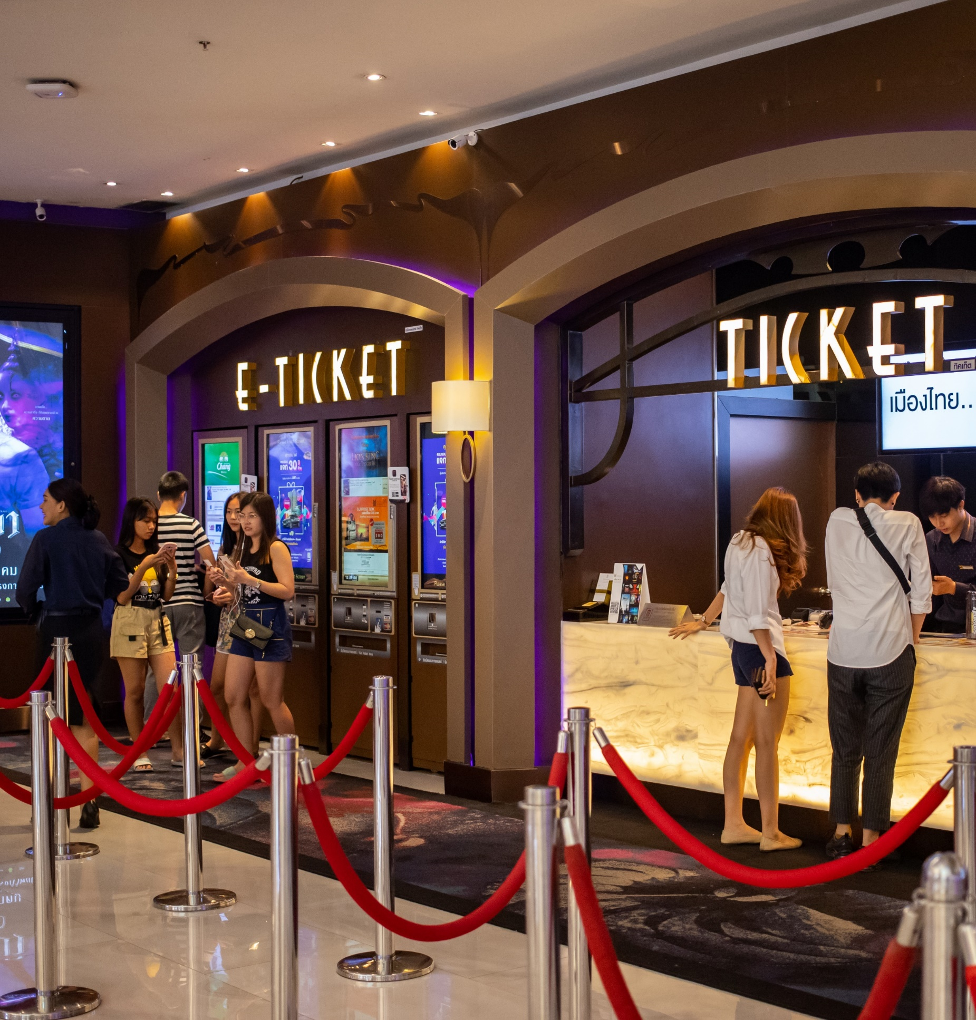
People clamor to see the latest releases whenever they can, with audiences heading to the movies throughout the weekend
Share of Cinema Attendance by Time Period
based on the Saturday of opening weekend for select major summer releases*
Source: Screendollars Newsletter, average based attendance figures reported by Screendollars for the following movies: Dr. Strange in the Multiverse of Madness (Screendollars, 5/9/22), Jurassic World: Dominion (Screendollars – 6/12/22), Lightyear (Screendollars – 6/19/22), Minions: The Rise of Gru (Screendollars – 7/3/22), Thor: Love and Thunder (Screendollars – 7/10/22), Nope (Screendollars – 7/24/22).
This information is exclusively provided to VAB members and qualified marketers. Further distribution is prohibited.
PAGE 9

Slide 10
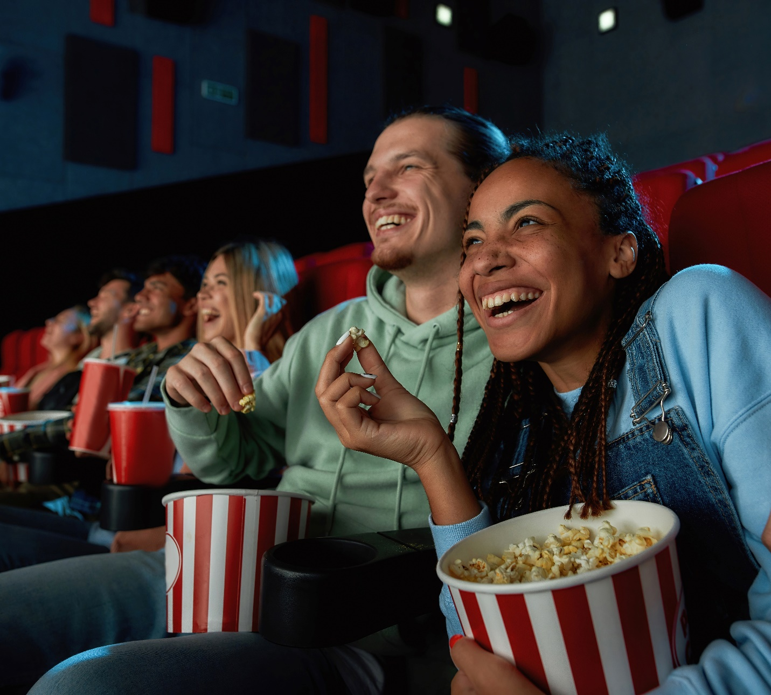
Their excitement and treatment of movie-going as an ‘event’ has even led them to splurge on concession items to further enhance their shared experience with others
Average Spending on Concessions
per admission ticket
+30%
Source: Kagan, a media research group within the TMT offering of S&P Global Market Intelligence, Exhibition Market Projections, as of July 15, 2022.
This information is exclusively provided to VAB members and qualified marketers. Further distribution is prohibited.
PAGE 10

Slide 11
2
Cinema successes delivered scale across audiences this summer

Slide 12
Cinema grosses nearly returned to pre-pandemic levels during the summer even though there were less than half the number of films in theaters
During the average week between January - July, there were 114 films playing in movie theaters in 2019 vs. 52 in 2022, with a very similar comparison during the summer*
Domestic Box Office Revenue
$ in MM
Summer
% of 2019 Box Office Revenue
42%
60%
68%
50%
81%
92%
86%
Source: VAB analysis of Box Office Mojo, Domestic Box Office Revenue, Jan ’19 = 1/4-1/31/19, Feb ‘19 = 2/1-2/28/19, Mar ‘19 = 3/1-3/28/19, Apr ‘19 = 3/29-5/2/19, May ‘19 = 5/3-5/30/19, Jun ‘19 = 5/31-6/27/19, Jul ‘19 = 6/28-7/25/19, Jan ‘22 = 1/7-2/3/22, Feb ‘22 = 2/4-3/3/22, Mar ‘22 = 3/4- 3/31/22, Apr ‘22 = 4/1-5/5/22, May = 5/6-6/2/22, Jun ’22 = 6/3-6/30/22, Jul ‘22 = 7/1-7/28/22. *As for wide releases (those opening in 2K+ theater locations), there were 75 movies in 2019 vs. 46 in 2022 between January – August of each respective year, and 42 movies in 2019 vs. 22 movies in 2022 between May – August of each respective year, according to Comscore Box Office Essentials.
This information is exclusively provided to VAB members and qualified marketers. Further distribution is prohibited.
PAGE 12

Slide 13
Millions of Americans flocked to movie theaters during the summer,
with cinema as a platform reaching over two-thirds of adults 18-34 and over half of adults 18-49 and 25-54
Avg. Weekly Reach & Rating
in Summer*
3-Month Cume Reach
in Summer*
10 Million
(14.2 rating)
47 Million
(67% reach)
P18-34
14 Million
(10.8 rating)
73 Million
(56% reach)
P18-49
12 Million
(9.5 rating)
61 Million
(50% reach)
P25-54
Source: Box Office Mojo, Epicenter Cinema Data, Summer = May-July 2022, ratings calculations based on the Nielsen Universe Estimates. Domestic box office (May 1 – July 31, 2022). Ratings and reach were converted to absolute numbers (millions) within each demographic based on the 2021-2022 Nielsen Universe Estimates.
This information is exclusively provided to VAB members and qualified marketers. Further distribution is prohibited.
PAGE 13

Slide 14












Cementing itself as ‘must see’ social events, more adults attended the opening weekend of new movie releases than participated in other popular summertime activities like baseball, bars, beaches or listening to beats
Cinema: Estimated 3-Day Opening Weekend Adult 18+ Admissions
13.5 MM
10.8 MM
10 MM+
9.1 MM*
8.4 MM*
4 MM+
2.4 MM
1.4 MM
Other ‘Out-of-Home’ Activities by Comparison (Adult 18+)
Went to an MLB regular season or playoff game in last 12 months: 7.3 MM
Went to a bar / club
in last week: 5.8 MM
Went to the beach
in last week: 5.8 MM
Went to a concert / live music
in last week: 942K
Source: Screendollars Newsletter, based on data from EntTelligence. * Top Gun: Maverick’s estimated 4-day opening weekend over Memorial Day weekend – 11.4 MM; Minions: The Rise of Gru’s estimated 4-day opening weekend over July 4th weekend – 9.7 MM. ‘Other activities’ based on MRI-Simmons Fall 2021 Doublebase USA study, P18+, ‘concert / live music’ includes country, rock, classical, or other.
This information is exclusively provided to VAB members and qualified marketers. Further distribution is prohibited.
PAGE 14

Slide 15

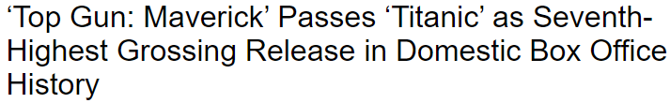

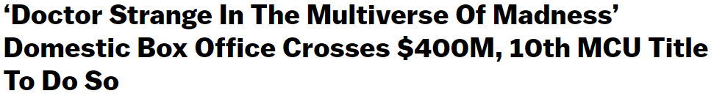

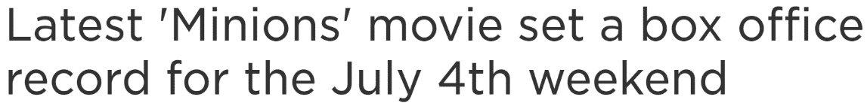

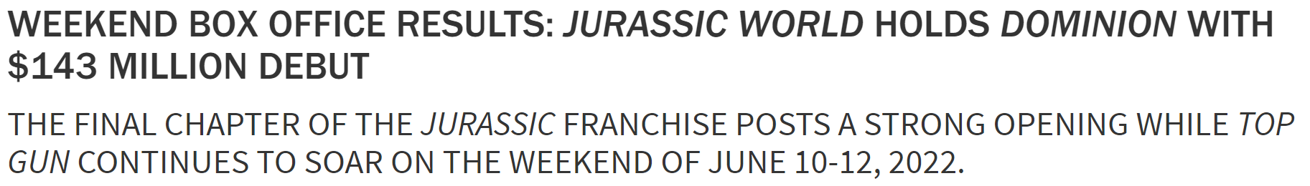
The summer box office was hot, driven by the latest chapters from fan favorite franchises and other long-awaiting movies
August 7, 2022
Domestic Box Office: Top 10 Movies of 2022 YTD
$$$ in millions
June 16, 2022
July 6, 2022
June 12, 2022
Source: Box Office Mojo, ‘Domestic Box Office for 2022’ as of 8/15/22.
This information is exclusively provided to VAB members and qualified marketers. Further distribution is prohibited.
PAGE 15

Slide 16









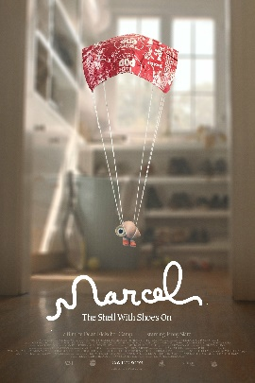



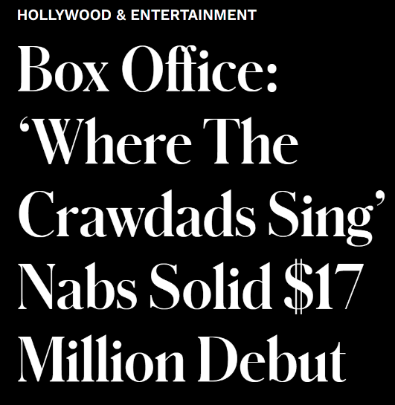



Many ‘specialty’ films also performed well at the box office as cinephiles sought out independent pictures with unique storylines and complex character development
July 31, 2022
Domestic Box Office: Top 10 Specialty Films of 2022 YTD
MM = millions
July 10, 2022
Where the
Crawdads Sing
($72.7MM)
Everything Everywhere All at Once
($69.7MM)
The Northman
($34.2 MM)
Father Stu
($20.9MM)
X
($11.8MM)
July 17, 2022
Highest opening weekend per-screen average of any 2022 film so far ($51K)*
July 17, 2022
April 4, 2022
Mrs. Harris Goes
to Paris
($8.9MM)
Men
($7.6MM)
Marcel the Shell
with Shoes On
($5.4MM)
The Outfit
($3.3MM)
The Worst Person
in the World
($3.0MM)
Highest opening weekend per-screen average of any foreign film on the last two years ($33.7K)*
Source: Spotlight Cinema Networks and Box Office Mojo, ‘Domestic Box Office for 2022’ as of 8/15/22. Reflects films that open in less than 1K theater locations.
This information is exclusively provided to VAB members and qualified marketers. Further distribution is prohibited.
PAGE 16

Slide 17






Between blockbusters and specialty films, there was something for everyone at the movies this summer with a cross section of releases geared towards the ‘Elusives’ and ‘Sophisticates’ audiences
‘Elusives’
(young, diverse, ‘cordless’)
‘Sophisticates’
(influential, cultured, adults 25-44)
% of P18-34 opening weekend attendance
% of P25+ opening weekend attendance
The Black Phone
Lightyear
Doctor Strange:
MoM
Thor: Love
and Thunder
Top Gun
Mrs. Harris Goes to Paris
Elvis
Nope
64%
61%
61%
53%
87%
87%
80%
63%
Click here to download “Capturing the ‘Elusives’ at the Cinema” to learn about the opportunities to reach this audience
Click here to download “Engaging the ‘Sophisticates’ at the Cinema” to learn about the opportunities to reach this audience
Source: 2022 Comscore Post-Trak reported box office demographics for opening weekend of above movies, with supplemental data from deadline.com.
This information is exclusively provided to VAB members and qualified marketers. Further distribution is prohibited.
PAGE 17

Slide 18
Diverse audiences who enjoy the fun, communal, ‘event-like’ feel of the cinema gravitated towards superhero, family and suspense/horror genres
Race/Ethnicity Composition by Movie
Based on Opening Weekend Audience
65%
Superhero
61%
60%
Action
54%
40%
75%
Drama
38%
35%
Suspense
65%
65%
Family
60%
59%
54%
Source: 2022 Comscore Post-Trak reported box office demographics for opening weekend of above movies, with supplemental data from deadline.com. Ratings by Movie Genre: Superhero (PG-13), Action (PG-13 = Jurassic World, Top Gun; R = Bullet Train), Drama (PG = Mrs. Harris Goes to Paris, PG-13 = Elvis, R = Beast), Suspense (R), Family (PG).
This information is exclusively provided to VAB members and qualified marketers. Further distribution is prohibited.

Slide 19
3
Cinema’s momentum is driven largely by video streamers who are also frequent moviegoers

Slide 20














Cinema achieved summertime success even amid a backdrop of popular content released exclusively on streaming services, signifying that movie-going and home streaming is not an ‘either / or’ proposition, it’s ‘both’
Exclusive, Original Movies
(released during the summer)
Exclusive, Original TV Series
(released during the summer)
Stranger Things
Season 4 on Netflix
(7 episodes released on 5/27/22 and 2 episodes released on 7/1/22)
The Boys
Season 3 on Amazon Prime
(3 episodes released on 6/3/22, next 5 episodes weekly through 7/8/22)
Obi-Wan Kenobi
Season 1 on Disney+
(3 episodes released on 5/27/22, next 4 weekly through 6/22/22)
Westworld
Season 4 on HBO Max
(8 episodes released between 6/26-8/14/22)
Hustle
Netflix
(release date: 6/3/22)
Spiderhead
Netflix
(release date: 6/11/22)
Father of the Bride
HBO Max
(release date: 6/16/22)
Persuasion
Netflix
(release date: 7/5/22)
The Gray Man
Netflix
(release date: 7/22/22)
Prey
Hulu
(release date: 8/5/22)
Ms. Marvel
Season 1 on Disney+
(6 episodes released between 6/8 - 7/13/22)
Only Murders in the Building
Season 2 on Hulu
(10 episodes released between 6/28 - 8/23/22)
The Summer
I Turned Pretty
Season 1 on Amazon Prime
(7 episodes released on 6/17/22)
Black Bird
Season 1 on Apple TV+
(6 episodes released between 7/18 - 8/5/22)
This information is exclusively provided to VAB members and qualified marketers. Further distribution is prohibited.
PAGE 20

Slide 21
Although we live in an ‘on-demand’ world, consumers overwhelmingly support theatrical releases for new movies
“How do you prefer movies to be released?”
Respondents had to choose one response
Release exclusively in theaters, then available for streaming 90 days later
Release exclusively in theaters, then available for streaming 45 days later
Release both in theaters and on streaming services at the same time
Release exclusively on streaming services,
and not in theaters at all
78%
prefer that movies receive a theatrical release vs.
6% who think movies should be released exclusively through streaming
Source: Morning Consult, survey conducted April 30 – May 3, 2022, among a representative sample of 2,210 U.S. adults, with an unweighted margin of error of +/- 2 percentage points. The balance to 100% not included reflects respondents who answered, ‘don’t know / no opinion.’ ‘Any Movie’ represents ‘movies in general’
This information is exclusively provided to VAB members and qualified marketers. Further distribution is prohibited.
PAGE 21

Slide 22

Even with an option to stream a new release, people are prioritizing going to the movie theater over streaming at home
98%
of moviegoers say that
new releases on streaming platforms do not hinder their plans to go to the movie theater
Source: NCM, ‘Behind The Screens’ Panel, August 2022. n=1,402, surveyed between August 3-8, 2022, A18+.
This information is exclusively provided to VAB members and qualified marketers. Further distribution is prohibited.
PAGE 22

Slide 23
Streamers crave video entertainment and heavy streamers are more likely to be frequent moviegoers
Movie Theater Attendance Over The Last Month
By number of streaming services subscribed to
67%
54%
39%
24%
Source: Morning Consult, ‘Why Video Streaming’s Impact on Theater Attendance Is Overblown’ 7/13/22. Numbers may not add up to 100% due to rounding.
This information is exclusively provided to VAB members and qualified marketers. Further distribution is prohibited.
PAGE 23

Slide 24
‘Frequent’ video streamers plan to see as many movies in the theater as overall ‘frequent’ moviegoers
# of Movies Planned to See in Theaters in 2022
median average by segment
Video Streamer Segments
Heavy / Medium Comparison
Source: Screenvision Custom Study; Screen Engine/ASI, LLC (www.screenengineasi.com), April-May 2022. ‘Heavy / Medium’ moviegoers is an average of the # of movies planned to see in 2022 between ‘Heavy’ and ‘Medium’ moviegoers. ‘Light’ streamers stream 5 hours per week (median average), ‘Medium’ streamers stream 10 hours per week (median average), ‘Heavy’ streamers stream 25 hours per week (median average) and ‘Heavy / Medium’ streamers stream 16 hours per week (median average).
This information is exclusively provided to VAB members and qualified marketers. Further distribution is prohibited.
PAGE 24

Slide 25
Frequent streamers were just as excited as frequent moviegoers to head out to their local cineplex to see the latest summer movie during their first week of release
“When do you typically see a movie you want to see in the theater?”
Respondents had to choose one response
76%
73%
Source: Screenvision Custom Study; Screen Engine/ASI, LLC (www.screenengineasi.com), April-May 2022. “Heavy / Medium’ moviegoers are planning to see 10 movies in the theater during 2022 (median average) vs. ‘Heavy / Medium’ streamers who are also planning to see 10 movies in the theater during 2022 (median average). ‘Because I’m excited’ is the #1 reason why both ‘Heavy / Medium ‘ moviegoers and ‘Heavy / Medium’ streamers say they see a movie within the first couple weeks of release. ‘Heavy / Medium’ streamers stream 16 hours per week (median average).
This information is exclusively provided to VAB members and qualified marketers. Further distribution is prohibited.
PAGE 25

Slide 26





Frequent moviegoers and frequent streamers both agree that cinema creates the most immersive, exciting, memorable, attentive experiences which enables marketers to uniquely engage these consumers
% who said ‘watching movies in a theater’ best delivers on the following...
vs. ‘watching original movies / shows on streaming platforms (respondents had to select only one platform)
Most immersive experience
Most unique experience
Most excitement / anticipation
of content
Memorability
of content
Most attention paid to content
‘Heavy / Medium’
Moviegoers
94%
94%
89%
86%
83%
‘Heavy / Medium’ Streamers
93%
93%
87%
83%
81%
Source: Screenvision Custom Study; Screen Engine/ASI, LLC (www.screenengineasi.com). April-May 2022. “Heavy / Medium’ moviegoers are planning to see 10 movies in the theater during 2022 (median average). ‘Heavy / Medium’ streamers stream 16 hours per week (median average).
This information is exclusively provided to VAB members and qualified marketers. Further distribution is prohibited.
PAGE 26

Slide 27
Why do people prioritize the theater over the home?
The social currency provided by cinema – the exclusiveness and FOMO – the communal atmosphere and the viewing experience on the largest screen possible
“If a new show debuts on a streaming platform at the same time a new movie debuts in theaters,
which are you likely to prioritize seeing and why?”
Respondents who prioritize seeing a new movie in theaters
Answers relating to having a limited time in-theaters or a fear of missing out
Answers relating to the experience
“Because I want to experience it with all the other people excited for the movie. I love the camaraderie of us fans at opening night!”
“I can always watch the show that’s streaming at home any time. I am a huge fan of movies and love to be at the premiere the exact night it hits theaters and I love the atmosphere of the audience.”
“I can stream whenever I feel like it. Movies are limited-time offers. They are also just more
of an experience, more exciting”
“I prefer new movies at the theater because of the theater experience. I love the bigger screens and surround sounds. Also, the interaction with other moviegoers can be exciting.”
“I like to be the first one to see a movie without having anything spoiled.”
“There's just something magical about the big screen and seeing it with a crowd is better because of the shared reactions.”
Source: NCM, ‘Behind The Screens’ Survey, June 2022. n=528, surveyed between June 7-13, 2022. Verbatims based on answers to the open-ended question ‘why are you likely to prioritize going to see a new movie at the movie theater?’
This information is exclusively provided to VAB members and qualified marketers. Further distribution is prohibited.
PAGE 27

Slide 28
4
A consistent pipeline of new movie releases coming soon to a theater near you

Slide 29














The theatrical release schedule is filled with high-profile, buzzed-about movies and familiar favorite franchises upcoming in 4Q ’22 and beyond…
Avatar:
The Way of Water
December 16, 2022
Ant-Man and the Wasp: Quantumania
February 17, 2023
Dungeons and
Dragons
March 3, 2023
Halloween Ends
October 14, 2022
Black Adam
October 21, 2022
Black Panther 2
November 11, 2022
Creed III
March 3, 2023
John Wick 4
March 24, 2023
Guardians of the Galaxy, Vol 3
May 5, 2023
Fast X
May 19, 2023
Spider-Man: Across the Spider-Verse
June 2, 2023
Transformers:
Rise of the Beasts
June 9, 2023
Untitled
Indiana Jones
June 30, 2023
Mission: Impossible
Dead Reckoning
July 14, 2023
Note: Release dates as of 8/23/22 per Comscore Release Calendar, dates are subject to change
This information is exclusively provided to VAB members and qualified marketers. Further distribution is prohibited.
PAGE 29

Slide 30












…And theaters will also feature a steady mix of award-winning,
high-quality, sophisticated, specialty films with compelling storylines
Triangle of Sadness
October 7, 2022
Tar
October 7, 2022
Decision to Leave
October 14, 2022
The Banshees of Inisherin
October 21, 2022
My Policeman
October 21, 2022
Armageddon Time
October 28, 2022
Winner of the Palme d’Or at the Cannes Film Festival
Best Picture Oscar contender according to Variety
Cannes Film Festival Best Director Winner
Best Picture Oscar contender according to Variety
Toronto Film Festival’s Tribute Award for Performance
Best Picture Oscar contender according to Variety
The Fabelmans
November 11, 2022
She Said
November 18, 2022
Nanny
November 25, 2022
Women Talking
December 2, 2022
Empire of Light
December 9, 2022
Corsage
December 23, 2022
Best Picture Oscar contender according to Variety
Based on a New York Times best-selling book
Sundance Film Festival U.S Grand Jury Prize: Dramatic
Best Picture Oscar contender according to Variety
Toronto Film Festival’s Ebert Director Award Winner
Cannes Film Festival Best Performance Winner
Source: Release dates as of 8/23/22 per Comscore Release Calendar, subject to change. Reflects films that are projected to open in less than 1K theater locations.
This information is exclusively provided to VAB members and qualified marketers. Further distribution is prohibited.
PAGE 30

Slide 31
A consistent pipeline of upcoming major theatrical releases, complemented by a steady release of specialty films, will continue the movie momentum with a projected return to pre-pandemic box office grosses by 2024
U.S. Cinema Box Office Ticket Sales with Projections
$ in Billions
Source: Kagan, a media research group within the TMT offering of S&P Global Market Intelligence, Exhibition Market Projections, estimates as of July 15, 2022.
This information is exclusively provided to VAB members and qualified marketers. Further distribution is prohibited.
PAGE 31

Slide 32
Cinema offers marketers an opportunity to align their brands with an energized, lean-in, equity-building content environment for diverse audiences of all ages
Marketers looking for immediate audience reach
(e.g., new product launch, a consumer promotion, seasonal campaign) would benefit from the proven ability of cinema to quickly amass scale and reach
of a campaign
Cinema campaigns offer marketers a way to reach frequent video streamers, who are also frequent moviegoers, at unique moments when they are fully immersed in, and highly attentive to, video content outside of the home
Key Marketer Takeaways
This information is exclusively provided to VAB members and qualified marketers. Further distribution is prohibited.
PAGE 32

Slide 33




Creators
Jason Wiese
Reed Kiely
SVP, Director of Strategic Insights
jasonw@thevab.com
Associate Insights Director
reedk@thevab.com
Karolina Guillen
Insights Manager
karolinag@thevab.com
Discover more
Looking for more data, insights and takeaways? Check out this related VAB content
Capturing the ‘Elusives’
at the Cinema
How Brands Can Reach Young, Diverse and Cordless Consumers
Engaging the ‘Sophisticates’
at the Cinema
How Brands Can Reach Adults 25-44 That Value Premium Experiences
The Power of Super Cinema Goers
Super Spenders, Social and Active Consumers
A Fresh Take On Engaging Frequent Video Streamers Through Cinema
VAB Members, brand marketers and agencies get free and immediate access to VAB’s content library. Get access at theVAB.com
This information is exclusively provided to VAB members and qualified marketers. Further distribution is prohibited.
PAGE 33

Slide 34


About VAB
VAB is an insights-driven organization that inspires marketers to reimagine their media strategies resulting in fully informed decisions.
Drawing on our marketing expertise, we simplify the complexities in our industry and discover new insights that transform the way marketers look at their media strategy.
We are committed to your business growth and proud to offer VAB members, brand marketers and agencies complimentary access to our continuously-growing Insights library. Get immediate access at theVAB.com.
Curious to learn more about VAB? Check out this quick video to see what we do and how we can help you develop business-driving marketing strategies.
This information is exclusively provided to VAB members and qualified marketers. Further distribution is prohibited.
PAGE 34

