Slide 1





How can I drive in-store traffic with streaming?
2021
Marketer FAQs

Slide 2

We scoured the industry for real-world examples of how today's most innovative marketers are using streaming within their video campaigns to deliver on their business objectives.
In these Marketer FAQs, you will find real-world guidance on common questions marketers have when developing streaming video campaigns.
This information is exclusively provided to VAB members and qualified marketers. Further distribution is prohibited.
PAGE 2

Slide 3

In this Marketer FAQ series, you’ll find answers to these often-asked questions on the impact of streaming video
1
2
3
4
How do I use streaming to extend the reach of my video campaign beyond linear TV?
How do I use streaming video
to boost sales?
How can I make an impact on a local level with streaming?
How can I drive in-store traffic with streaming?
Click here to download the other pieces in this series
This information is exclusively provided to VAB members and qualified marketers. Further distribution is prohibited.
PAGE 3

Slide 4


Category:
QSR
A QSR brand drove incremental visitation through a convergent, audience-based campaign
Streaming + Multiscreen TV
Challenge
A QSR brand sought to bring awareness to a new product offering and drive in-store visits through a convergent, audience-based campaign
Solution
ViacomCBS’ as-run and impression-level delivery data, combined with Foursquare’s location data & attribution methodology, enabled measurement of incremental foot traffic compared to concurrent non-targeted inventory
Target Segment
High Value QSR Custom Target
Results*
Vantage-targeted inventory exceeded Foursquare’s performance benchmarks, driving greater reach and in-store visits, with 1:1 environments yielding the most significant impact
Company / Platform / Media Type
ViacomCBS Vantage, Foursquare / Streaming + Multiscreen / Linear TV, STB live linear addressable and VOD, EyeQ** [CTV/OTT (desktop, mobile)]
Vantage-targeted campaign drove…..
Target Segment Delivery:
Campaign achieved a 38% gain in impressions delivered in target segment vs. vs non-targeted concurrent buy
Incremental Visits:
Across all platforms, Vantage inventory drove a statistically significant lift of 4.3%
Increased Store Visitation:
Vantage cross-platform campaign outperformed non-targeted media by more than 7x
Better Performance Than Category Benchmarks:
Overall campaign performance exceeded Foursquare’s omnichannel campaign behavioral lift benchmark by +50%
1:1 exposure yielded most significant impact
1:1 environments*** delivered 24% lift in target segment reach
Vantage live linear addressable & targeted OTT media together drove 34% lift, a 10x increase over linear alone, and 3x over the non-targeted digital media campaign.
Source: ViacomCBS, Attribution case study: ViacomCBS and Foursquare show increased media impact by measuring multi channel campaign. Segmentation source: MRI-Simmons. Attribution partner: Foursquare. Optimizer: ViacomCBS’ Vantage (proprietary). Comparable benchmarks: non-targeted media on same platforms. Campaign time period: Q3 2020. *Total campaign delivered 87% cost efficiency on incremental visits, with streaming showing the greatest efficiency. **Encompasses Pluto TV and all ViacomCBS O&O apps including CBS All Access. ***1:1 environments: STB live linear addressable and VOD, CTV, OTT.
This information is exclusively provided to VAB members and qualified marketers. Further distribution is prohibited.
PAGE 4

Slide 5




Category:
Tax Services
Utilizing audience-based OTT strategies, a tax services provider drove tax filing conversion rates for both their online services and retail locations
Streaming + Multiscreen TV
Challenge
A leading tax services provider wanted to improve conversions for their services online and in their retail locations
Solution
Using addressable advertising, powered by AdSmart, an audience-targeted campaign launched aiming to reach a custom competitor target modeled from the client’s 1st-party data across NBCU
Targeted impressions were delivered dynamically as viewers watched NBCU’s FEP content across their O&O CTV apps, STB VOD, and Hulu
Target Segment*
Custom lookalike target modeled from client
1st party data made up of retail tax filers and online/DIY tax filers
Results
Campaign drove lift for tax filings overall, delivering lift in conversion rates and more efficient costs-per-conversion
Company / Platform / Media Type
NBCU / Streaming & Multiscreen / NBCU O&O apps on Connected Devices, NBCU on Hulu (CTV, Desktop, Mobile), NBCU STB VOD
Overall lift for tax filings
+10%
lift in tax filing conversion rate
+10%
lift in online/DIY tax filing conversion rate
+10%
lift in retail tax filing conversion rate
2020 campaign results vs. 2019 campaign results
+66%
more efficient cost per conversion
+2.5%
higher tax filings conversion rate
Source: NBCU, Financial (Tax Services) Case Study. Campaign time period: Q1 2020. *Based on TransUnion data.
This information is exclusively provided to VAB members and qualified marketers. Further distribution is prohibited.
PAGE 5

Slide 6
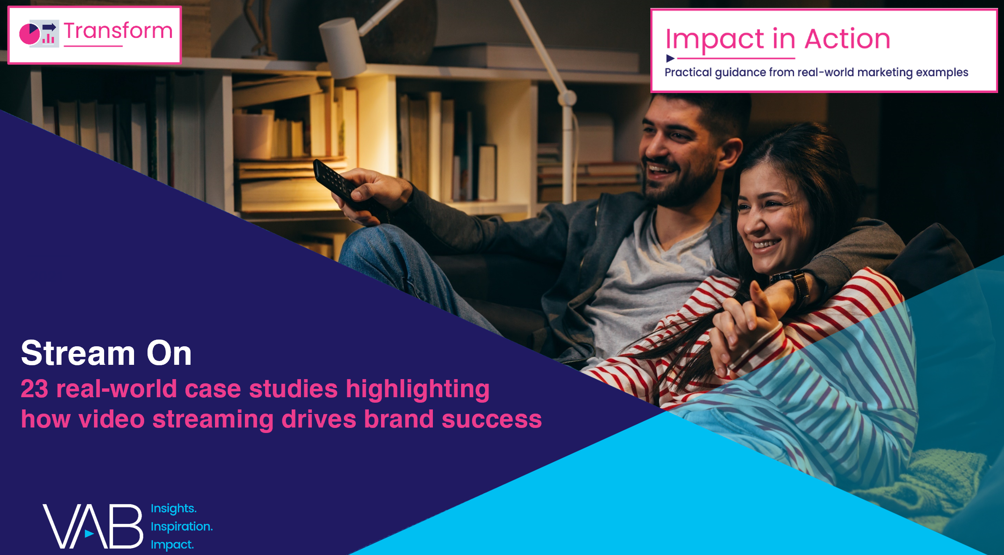
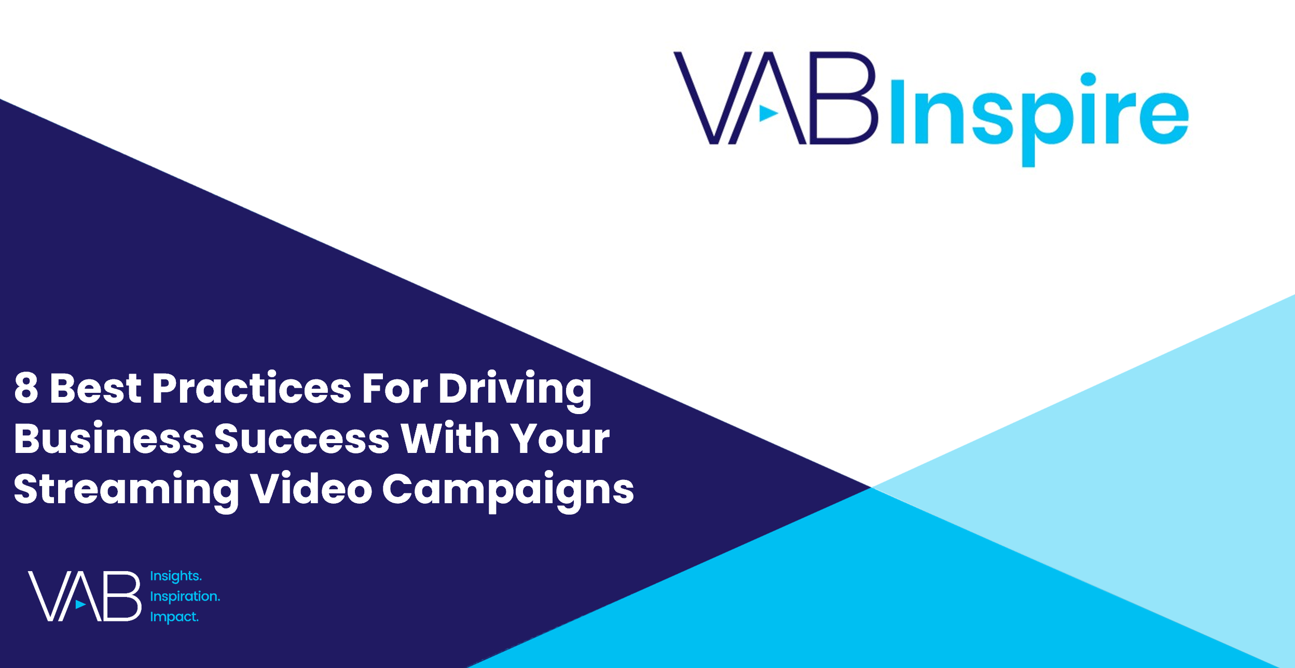
Interested in more?
Download Stream On for the full 23 case studies across 15 product categories
View this webinar to learn the 8 best practices marketers employ when creating successful streaming campaigns
This information is exclusively provided to VAB members and qualified marketers. Further distribution is prohibited.
PAGE 6

Slide 7


About VAB
VAB is an insights-driven organization that inspires marketers to reimagine their media strategies resulting in fully informed decisions.
Drawing on our marketing expertise, we simplify the complexities in our industry and discover new insights that transform the way marketers look at their media strategy.
We are committed to your business growth and proud to offer VAB members, brand marketers and agencies complimentary access to our continuously-growing Insights library. Get immediate access at theVAB.com.
Curious to learn more about VAB? Check out this quick video to see what we do and how we can help you develop business-driving marketing strategies.
This information is exclusively provided to VAB members and qualified marketers. Further distribution is prohibited.
PAGE 7

