Slide 1





How can I make an impact on a local level with streaming?
2021
Marketer FAQs

Slide 2

We scoured the industry for real-world examples of how today's most innovative marketers are using streaming within their video campaigns to deliver on their business objectives.
In these Marketer FAQs, you will find real-world guidance on common questions marketers have when developing streaming video campaigns.
This information is exclusively provided to VAB members and qualified marketers. Further distribution is prohibited.
PAGE 2

Slide 3

In this Marketer FAQ series, you’ll find answers to these often-asked questions on the impact of streaming video
1
2
3
4
How do I use streaming to extend the reach of my video campaign beyond linear TV?
How do I use streaming video
to boost sales?
How can I make an impact on a local level with streaming?
How can I drive in-store traffic with streaming?
Click here to download the other pieces in this series
This information is exclusively provided to VAB members and qualified marketers. Further distribution is prohibited.
PAGE 3

Slide 4


Category:
Financial
A financial advertiser extended reach beyond linear TV activity via a geo-targeted streaming campaign
Streaming + Multiscreen TV
Challenge
Financial brand wanted to extend reach beyond its traditional TV campaign while reinforcing its message among light TV viewers and maintaining its existing budget
Solution
A geo-targeted streaming campaign was added to the advertiser’s existing TV campaign, delivering its message within similar premium, long-form content
Bottom 1/3 of households based on total viewing were defined as “light TV” viewing households to measure success
Target Segment
A25-64
Results
Campaign delivered +10% more households and increased frequency +29% (4.0x to 5.2x) with even greater results seen among “light TV viewer” households
Company / Platform / Media Type
Effectv / ‘Effectv Streaming’* + Multiscreen TV / Linear TV, Connected TV (CTV), STB VOD, Mobile & Web
Incremental Benefits From Streaming
Total Campaign
More Reach
+10%
more households reached
by adding streaming
More Frequency
+29%
more frequency (4.0 to 5.2)
for the cross-platform campaign
“Light TV” Viewing Households
More Reach
+20%
more “light TV” households reached by adding streaming
More Frequency
+79%
more frequency (2.3 to 4.1)
for the cross-platform campaign
Source: Effectv, Automotive Case Study. Based on analysis of Effectv Streaming advertising campaigns (2021). Campaign time period: January 2021. This analysis is based upon aggregated ad exposure data of viewing by Comcast households. Comcast households with a pay TV service representing the bottom 1/3 of TV viewing were defined as “Light TV viewing households”. *’Effectv Streaming’ consists of premium, mostly long-form video across multiple devices including Connected TV (CTV), set-top-box VOD (STB VOD), mobile and web.
This information is exclusively provided to VAB members and qualified marketers. Further distribution is prohibited.
PAGE 4

Slide 5





Category:
Home Furnishings
Streaming + Multiscreen (non-TV)
A furniture brand used cross-channel insights
from a local streaming campaign to ensure incremental reach of the right audience at an optimal frequency
Challenge
A furniture brand wanted to increase unique reach in local markets within a 10-mile radius & extend their media investments by targeting advanced audiences on digital mediums
Solution
Measured to establish a baseline in the first 4 weeks of the campaign to understand audience composition per unique local market & tactic across channels
Activated custom suppression segments to remove households that were exposed to the brand’s linear campaign messages
Optimized campaign tactics and strategy in-flight, leveraging a combination of CTV and 3-screen activation to validate the use of suppression segments for driving incremental reach across the brand’s digital buy
Target Segment
Custom in-market target audience at local level
Results
VideoAmp measured 1.9MM incremental users and garnered a 1.94% click-through-rate (CTR) average per local market and a 93.96% video completion rate
Company / Platform / Media Type
VideoAmp / Streaming + Multiscreen (non-linear) / OTT
1.9MM
Incremental Users Reached
1.94%
Click-Through-Rate (CTR) Average Per Local Market
93.96%
Video Completion Rate
Source: VideoAmp, Case study: Furniture Brand Finds Comfort in Reaching Cross-Channel Local Audiences. Campaign time period: August 2020.
This information is exclusively provided to VAB members and qualified marketers. Further distribution is prohibited.
PAGE 5

Slide 6

Category:
Automotive
Streaming + Linear TV
A geo-targeted, audience-based campaign
drove website traffic for an automotive brand
Challenge
An auto brand sought to efficiently maximize reach and drive website traffic with an audience-based, cross-platform campaign
Solution
An audience-based TV campaign ran across 41 networks, with 70% of impressions running outside primetime
Enhanced with 20% of overall investment in a targeted streaming campaign to support and expand overall reach
Entire campaign was geographically targeted to the area where majority of sales originated
Target Segment
In-market for new vehicles
Results
Nearly half (43%) of households reached via streaming were incremental to TV. Campaign also generated a positive impact on website traffic, increasing immediate visitors to brand’s website +419 in one month
Company / Platform / Media Type
Effectv / ‘Effectv Streaming’*** + Linear TV / Linear TV, Connected TV (CTV) STB VOD, Mobile & Web
AWARENESS*
CONSIDERATION**
TV Outcomes
Streaming Outcomes
Web Results
+13%
more likely for TV viewers
to be in the target audience
78%
of targeted impressions came from an audience-based campaign with the remainder from fixed programming
43%
of households reached with streaming were incremental to TV
21%
of streaming impressions delivered were to households with no TV service
81%
of streaming impressions were served via the TV screen
+419
Immediate visitors to their website within one month
2+
Visits within the month from these immediate visitors
Source: Effectv, Automotive Case Study. Based on analysis of Effectv Streaming advertising campaigns (2021); Web site results provided by TVSquared analysis. Time period: February 2021. *The “Awareness” portion of the analysis consisted of aggregated ad exposure data of viewing by Comcast households. **The “Consideration” portion of the analysis consisted of third-party web site evaluation by TVSquared; Immediate visitors are defined as additional (above pre-determined baseline) web site visitors occurring within 30 minutes of a cable TV ad airing. ***’Effectv Streaming’ consists of premium, mostly long-form video across multiple devices including Connected TV (CTV), set-top-box VOD (STB VOD), mobile and web.
This information is exclusively provided to VAB members and qualified marketers. Further distribution is prohibited.
PAGE 6

Slide 7





Category:
Retail
A national retailer realized the impact of regional TV and streaming campaigns on driving website traffic and sales through cross-screen campaign insights
Streaming + Linear TV
Challenge
A national retailer’s holiday 2020 campaign goal required driving shopper behavior across the brand’s core brick & mortar footprint while monitoring ecommerce outcomes
Solution
Media agency Mediahub used an audience-first approach to target shoppers across live linear & streaming devices within a regionalized footprint while measuring website visits post ad-exposure
Ampersand’s Targeted TV solution delivered a geo-targeted, multiscreen campaign across premium live & on-demand platforms, which was measured in partnership with TVSquared to demonstrate how TV exposure drives web traffic*
Target Segment
A25-54
Results
Campaign insights revealed:
  Optimal linear TV dayparts and networks: daytime drove 33% of immediate site visitors
  Streaming TV insights demonstrated timely impact of campaign, with 30% of website visitors & order confirmations occurring within 2 days of ad exposure
Company / Platform / Media Type
Ampersand’s Targeted TV solution / Streaming + Linear TV / Local Linear TV, OTT, Connected TV (CTV), Desktop, Mobile, Tablet
Local Targeted TV
Impact on Outcomes
Streaming TV
9% Direct
(<10min)
Website Visits
Website Visits
320,994
Immediate visitors
30 minutes
Retailer Site
91% Drag
(10-30min)
99,242
Responses
6 days
435,038
Repeat Visitors
14 days
39,321
Within 14 days
Order Confirmations
7,580
Within 6 days
Linear Results
Streaming Results
Cable TV ad exposure insights identified areas to drive increased performance based on the following:
Diversify Dayparts: Daytime and Weekend Daytime drove 33% of immediate visitors
Heavy Up Networks: 3 networks drove 21% of immediate visitors
27% of website responses & 36% of on-site order confirmations occurred during the weeks of Thanksgiving & Cyber Monday (11/12-12/6)
30% of website visitors + order confirmations occurred within 2-days of ad exposure
26% of all visitors/responses were from Daytime whereas 22% were from Prime
Source: Ampersand, Case study: Targeted TV Effectiveness: Local multi-screen holiday TV campaign drives shopper engagement + sales. Campaign time period: flight date – 9/28/20-12/25/20; measurement period – 10/13/20-12/27/20. Campaign agency: Mediahub. Data partner: TVSquared. Geos: 19 total based on store proximity. Frequency: even weekly pacing + 95% video completion rate (VCR). Actions measured: retailer site visitation (any page), order confirmation page. Attribution based on website visitation following linear ad or digital ad exposure; Attribution windows: Local targeted TV – 30 minutes = immediate response, 14 days from Immediate Response = Return Response; Streaming – within 7 days Post Initiative Exposure. *Website visits measured by TVSquared pixels.
This information is exclusively provided to VAB members and qualified marketers. Further distribution is prohibited.
PAGE 7

Slide 8

Category:
Automotive (Ford)
A geo-targeted multiscreen campaign with tailored
creative had a direct impact on sales for a local Ford dealership
Streaming + Multiscreen TV
Challenge
A local Ford dealership was looking to expand their primary customer base and conquest sales from competitive dealerships in a geography 20+ miles south of their location
Solution
Spectrum Reach developed new creative with new relevant, targeted messaging to use in a multiscreen campaign aimed at Ford customers
In partnership with Experian and IHS Markit, Spectrum was able to isolate exposed / unexposed viewers to measure the direct impact of the campaign on business outcomes
Target Segment
Ford Car & Truck Buyers
Results
Reach: A total of 94,975 HHs were exposed to a Ford Dealer Commercial
Sales: Exposed homes bought a total of 185 cars – essentially, 1 car sold for every 500 homes exposed to an ad
Scale: Spectrum HHs accounted for 61% of all Palm Coast Ford sales for the 3-month time period. Among that group, 80% were exposed to the ad
Company / Platform / Media Type
Spectrum Reach / Streaming + Multiscreen / Linear TV, streaming TV and addressable online video, display and search
Overall Dealership Multiscreen Impact
+52%
+8%
+13%
Site Traffic
Leads
Sales
Overall Dealership Conversion Lift
Conquest Geography Sales Lift
121.25%
263%
The unique messaging and introduction of Multiscreen TV in the conquest geography drove sales up by 263%
Those exposed to the ad were more than 2X as likely to buy a new vehicle from Palm Coast Ford vs. unexposed
Source: Spectrum Reach, Custom Case study: How Campaign Attribution Made Palm Coast Ford, a Believer in Multiscreen Media. Data partners: Experian, IHS Markit. Campaign time period: Dec 14, 2020 – Feb 28, 2021. Traffic, Leads and Sales based on purchased made by exposed HH within 90 days of exposure. Conquest: sales during
Oct-Dec 2021 compared to Jan-Apr, 2021.
This information is exclusively provided to VAB members and qualified marketers. Further distribution is prohibited.
PAGE 8

Slide 9
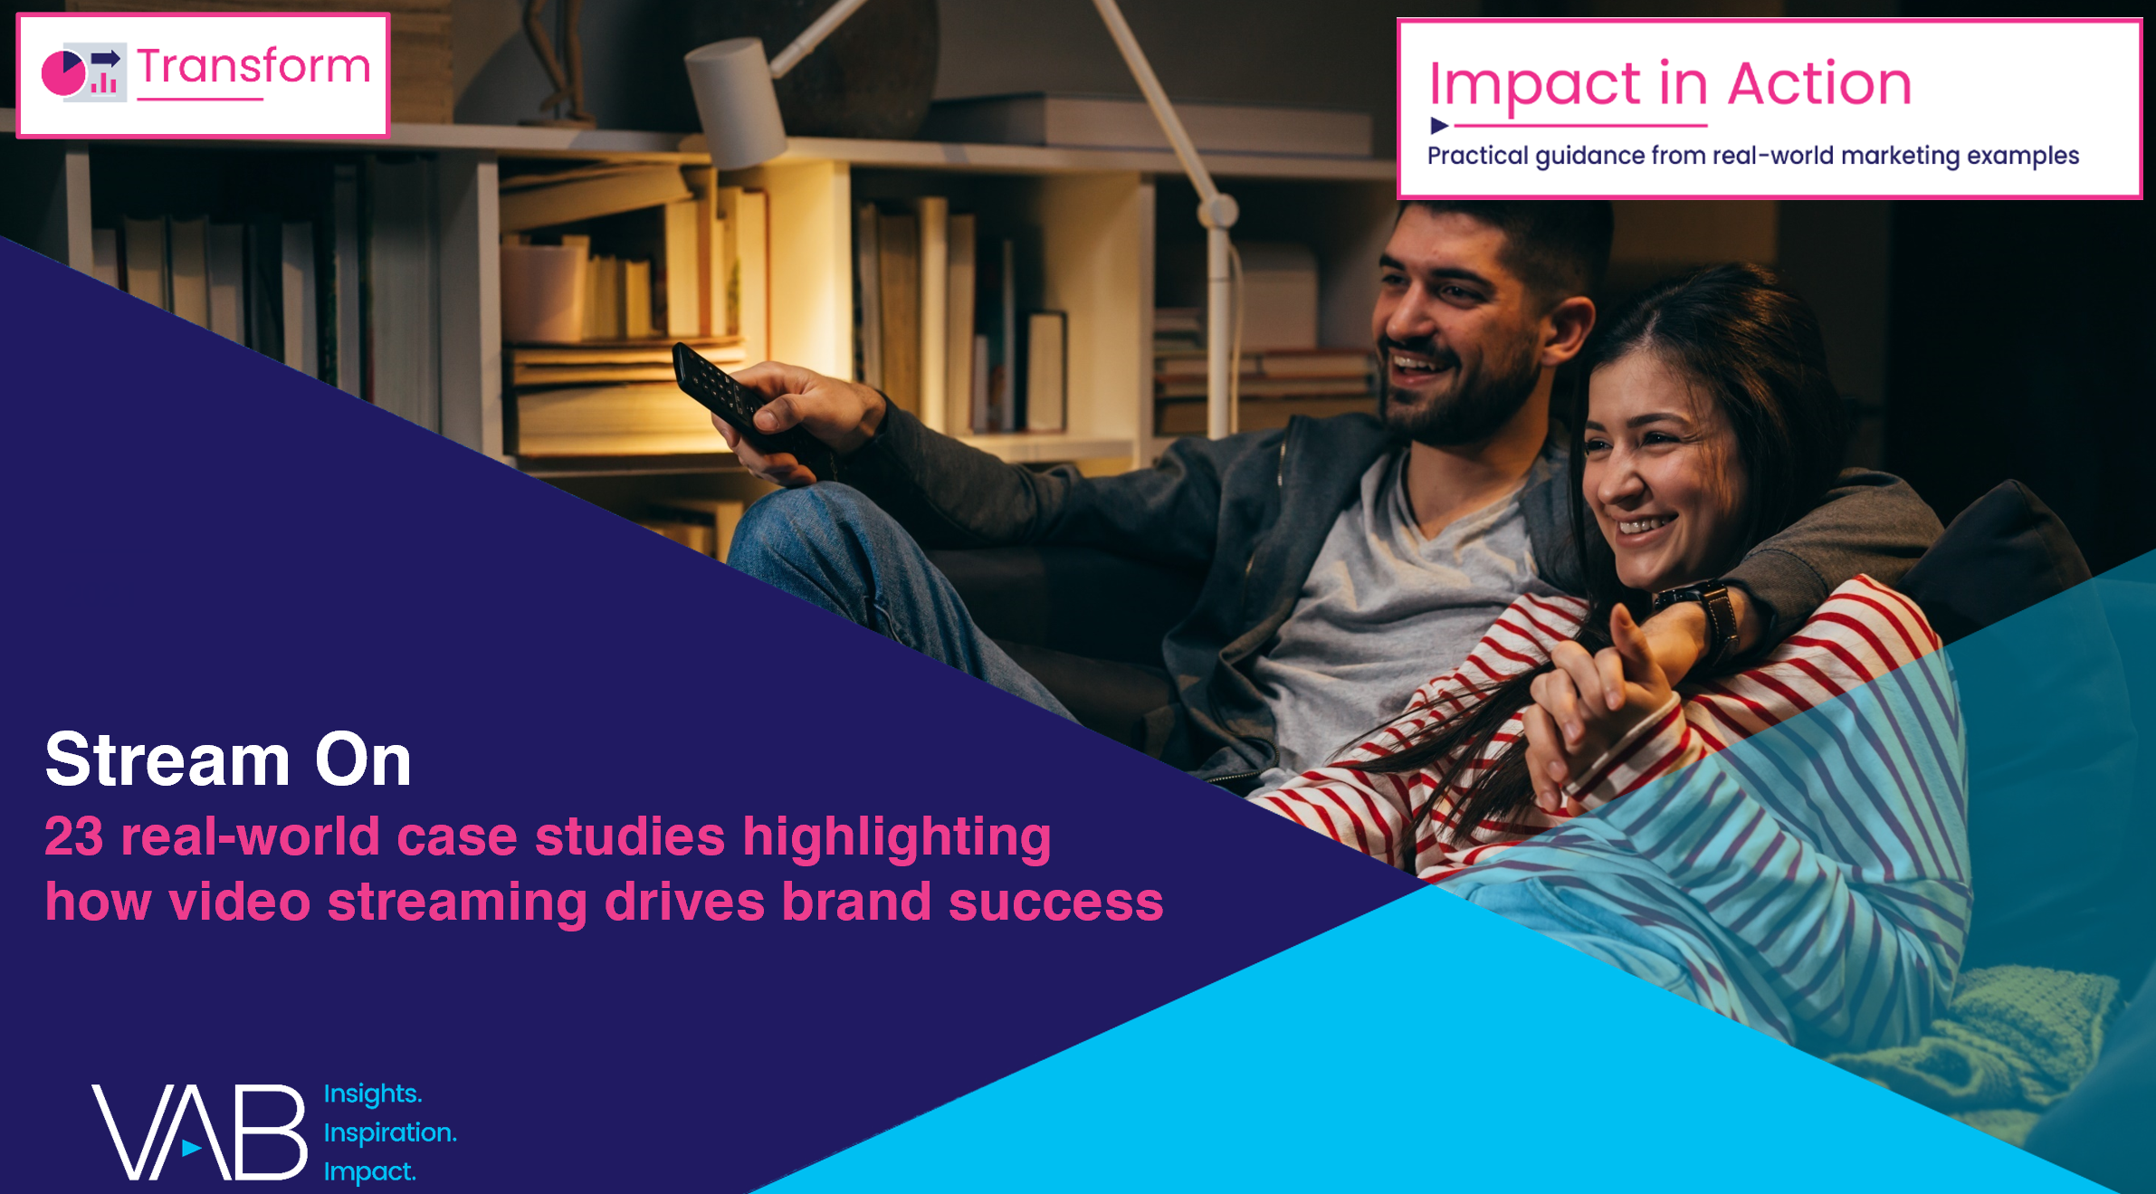
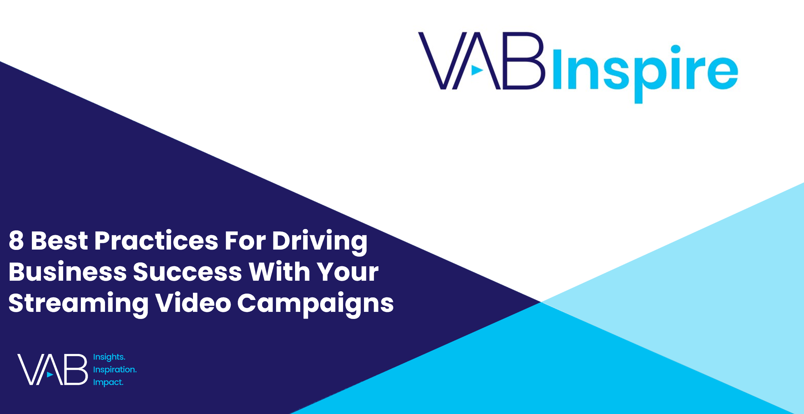
Interested in more?
Download Stream On for the full 23 case studies across 15 product categories
View this webinar to learn the 8 best practices marketers employ when creating successful streaming campaigns
This information is exclusively provided to VAB members and qualified marketers. Further distribution is prohibited.
PAGE 9

Slide 10


About VAB
VAB is an insights-driven organization that inspires marketers to reimagine their media strategies resulting in fully informed decisions.
Drawing on our marketing expertise, we simplify the complexities in our industry and discover new insights that transform the way marketers look at their media strategy.
We are committed to your business growth and proud to offer VAB members, brand marketers and agencies complimentary access to our continuously-growing Insights library. Get immediate access at theVAB.com.
Curious to learn more about VAB? Check out this quick video to see what we do and how we can help you develop business-driving marketing strategies.
This information is exclusively provided to VAB members and qualified marketers. Further distribution is prohibited.
PAGE 10

