Slide 1


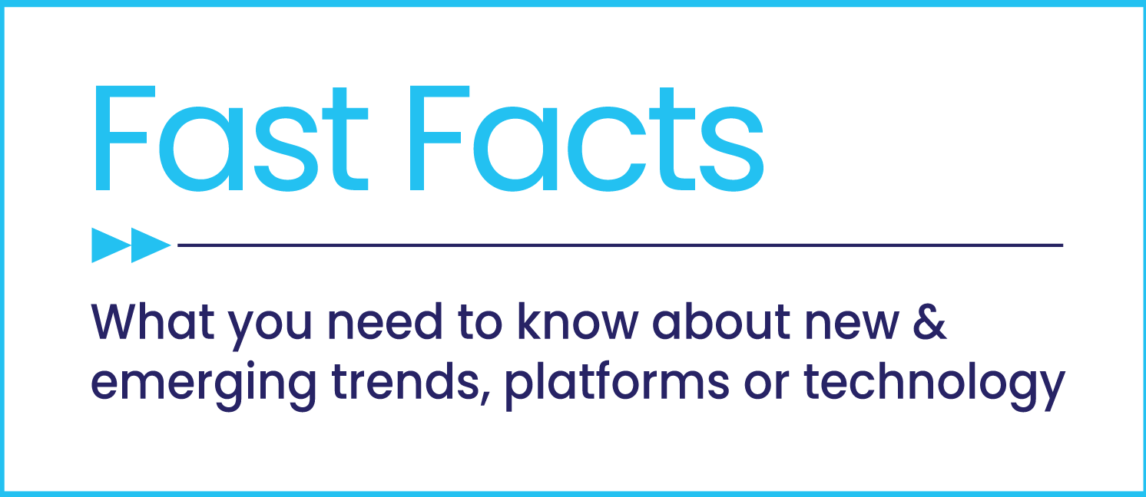


The Odyssey of
Content Discovery
How TV advertising builds streaming audiences and creates engagement opportunities

Slide 2


There are nearly 600 new, original scripted programs available to watch.
As a result, content discovery and deciding “What should I watch?” have never been more challenging for consumers.
Savvy streaming platforms competing for consumers’ attention and consideration have found success by investing in linear TV advertising to build and retain their audiences.
The benefit for advertisers? The influx of viewers to these streaming platforms creates a more robust advertising environment, strengthening reach and engagement opportunities.
This information is exclusively provided to VAB members and qualified marketers. Further distribution is prohibited.
PAGE 2

Slide 3

With an increasing number of options available to consumers, discovering streaming content has grown very challenging

Slide 4

1
Consumers have more choice than ever when deciding what they want to watch on TV
Estimated Number of Scripted Original Series
Across Broadcast, Cable & Streaming
+23%
vs. 2017
Source: DirecTV, Cutting Through the Clutter, February 2023.
This information is exclusively provided to VAB members and qualified marketers. Further distribution is prohibited.
PAGE 4

Slide 5
2
People are accessing TV programming across several different connection points
Share of Monthly Time Spent With TV
February 2023
Source: VAB analysis of Nielsen, ‘The Gauge’, February 20232, Total Day, P2+, ‘Other’ includes all other TV including all other tuning (unmeasured sources), unmeasured video on demand (VOD), streaming through a cable set top box, gaming and other device (DVD playback) use.
This information is exclusively provided to VAB members and qualified marketers. Further distribution is prohibited.
PAGE 5

Slide 6
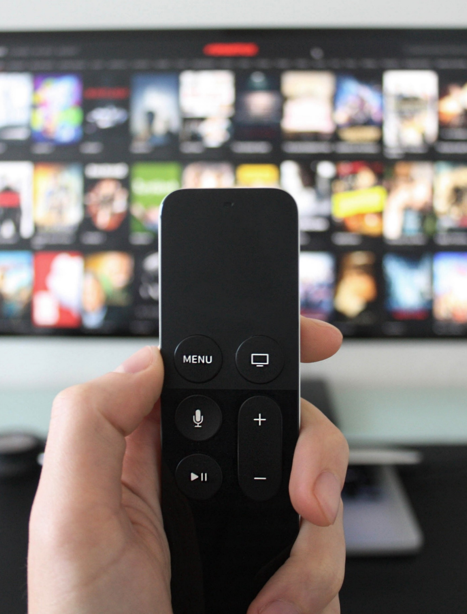
3
As streaming options increase, the number of video services consumers watch has also significantly increased
Average Total Services Used To Consume Video Content
+68%
vs Q4 2020
Source: TiVo, Video Trends Report Q4 2021 & Q4 2022, includes pay-TV subscriptions.
This information is exclusively provided to VAB members and qualified marketers. Further distribution is prohibited.
PAGE 6

Slide 7


As viewing shifts, consumers are now more likely to go to streaming first to start their search for what to watch on TV
4
64% of adults are always on the hunt for new shows to stream*
Where do you look first for something to watch?
53%
of streamers are watching more streaming TV this year than last, an increase of 20% from 2021**
Source: Hub, Evolution of Video Branding, February 2023. *MRI Cord Evolution, November 2022 Study, P18+, any agree. **Magnite, Streaming Continues To Surge, 2023.
This information is exclusively provided to VAB members and qualified marketers. Further distribution is prohibited.
PAGE 7

Slide 8

5
However, only about one-third of viewers know exactly what they want to watch when they start searching for streaming content
Which of the best describes your intentions when choosing what to watch?
Source: Warner Bros. Discovery, Content Discovery Paths: Capturing Attention in a Noisy World, from Informa’s Media Insights & Engagement Conference 1/31/23.
This information is exclusively provided to VAB members and qualified marketers. Further distribution is prohibited.
PAGE 8

Slide 9

6
More content across more platforms overwhelms many consumers which leads to lengthy indecision when trying to select what to watch
Average Time to Make a Selection While Streaming
Time in minutes:seconds
+52%
vs March 2019
48%
agree that the amount of streaming video services and content available feels overwhelming to me
Source: Nielsen, Audience insights, December 2022.
This information is exclusively provided to VAB members and qualified marketers. Further distribution is prohibited.
PAGE 9

Slide 10
Linear TV advertising is the catalyst in consumers' content discovery journey

Slide 11
7
Consumers encounter an average of seven touchpoints on their journey when looking for new content to stream
Number of Touchpoints Consumers Encounter On Content Discovery Journey
Source: Warner Bros. Discovery - Content Discovery Paths: Capturing Attention in a Noisy World, from Informa’s Media Insights & Engagement Conference 1/31/23, ‘Touchpoint’ examples include: Trailer/ad on TV, recommendations from friends on social media, searched online, in-app recommended content, etc.
This information is exclusively provided to VAB members and qualified marketers. Further distribution is prohibited.
PAGE 11

Slide 12
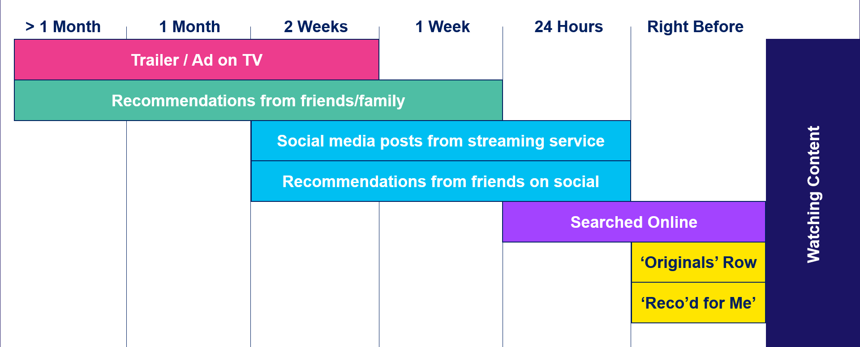
8
TV ad exposure is typically one of the first consumer touchpoints for content which stokes initial awareness and engagement
How long before you watched this TV show/movie did you see each of these?
Source: Warner Bros. Discovery - Content Discovery Paths: Capturing Attention in a Noisy World, from Informa’s Media Insights & Engagement Conference 1/31/23. ‘Originals’ Row & “Reco’d for Me’ are both based on in-app platform exposure.
This information is exclusively provided to VAB members and qualified marketers. Further distribution is prohibited.
PAGE 12

Slide 13
9
TV is the top advertising platform for content discovery and can create a ‘halo effect’ that impacts recommendations from others
64% of people want to tell their friends about TV shows they have seen an ad for on their TV screen*
Top Sources of Discovery for Streaming Content
= advertising sources
= non-advertising sources
Source: Conviva, State of Streaming: Content Discovery 2021, Note: excludes non-advertising selections below 20%. *DirecTV, Cutting Through the Clutter, February 2023.
This information is exclusively provided to VAB members and qualified marketers. Further distribution is prohibited.
PAGE 13

Slide 14
10
Collectively, streaming platforms have nearly doubled their annual
TV ad investment as they breakthrough and increase engagement
Streaming Categories: Annual TV Advertising Spend
$ in MM
+79%
vs 2020
Source: VAB analysis of Nielsen AdIntel, CY 2018-2022, TV spend includes cable TV, broadcast TV, Spanish language cable TV, Spanish language broadcast TV, spot TV, and syndicated TV. U.S. TV spend only, excludes promos. Streaming Categories include: Streaming Channel, Streaming Player, Streaming Program and Streaming Services-Video.
This information is exclusively provided to VAB members and qualified marketers. Further distribution is prohibited.
PAGE 14

Slide 15
11
Streaming services’ TV ads are now more likely to feature specific programs to further aid viewers in content discovery
Streaming Categories: Annual TV Ad Spend
$ in MM
$2,540
$2,313
$1,369
$762
$839
Source: VAB analysis of Nielsen AdIntel, CY 2018-2022, TV spend includes cable TV, broadcast TV, Spanish language cable TV, Spanish language broadcast TV, spot TV, and syndicated TV. U.S. TV spend only, excludes promos. Streaming Categories include: Streaming Channel, Streaming Player, Streaming Program and Streaming Services-Video.
This information is exclusively provided to VAB members and qualified marketers. Further distribution is prohibited.
PAGE 15

Slide 16
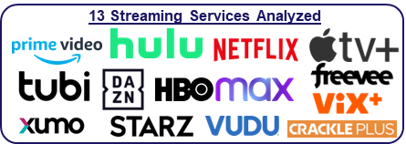
There is a close correlation between TV ad investment and increased platform usage
12
Streaming services leverage the scale, engagement and legitimacy of TV to foster ‘word of mouth’ and drive streaming content discovery by consumers; because of this, streamers with TV campaigns have seen their ‘total time spent’ viewership grow in line with their TV ad investment
Streaming Services - Cumulative Quarterly U.S. Total TV Ad Spend & Time Spent
How to read - Ex: Q4 ‘22 represents total measured time spent & TV spend from Q1 ‘20 – Q4 ‘22 for the 13 streaming services.
Source: VAB analysis of Nielsen AdIntel, Jan ‘20 – Dec ‘22 (calendar months). TV spend includes cable TV, broadcast TV, Spanish language cable TV, Spanish language broadcast TV, spot TV, and syndicated TV. U.S. TV spend only, excludes promos. VAB analysis of Comscore mediametrix multiplatform media trend data, total audience (Desktop P2+, Mobile 18+), Jan ‘20 – Dec ‘22 (calendar months). Chart analysis represents a mix of both SVOD & AVOD streaming services, with monitored cume TV spend from Nielsen Ad Intel and measured cume audience data from Comscore (Netflix, Hulu, Amazon Prime Video, Apple TV+, Starz, DAZN, Crackle+, HBO Max, VIX+, Xumo, Vudu, Tubi TV & Amazon Freevee).
This information is exclusively provided to VAB members and qualified marketers. Further distribution is prohibited.
PAGE 16

Slide 17

13
TV advertising builds audiences, resulting in increased consumer engagement opportunities and a more vibrant advertising environment
Did you do anything after watching this TV show/movie (you discovered)?
71%
of viewers took action related to the title
after viewings
Source: Warner Bros. Discovery - Content Discovery Paths: Capturing Attention in a Noisy World, from Informa’s Media Insights & Engagement Conference 1/31/23.
This information is exclusively provided to VAB members and qualified marketers. Further distribution is prohibited.
PAGE 17

Slide 18

Consumers have never had more choice and access to premium video content across platforms, but there are discovery challenges that come along with the volume of content.
TV advertising is proven effective for driving awareness and action in a highly competitive category.
TV advertising is a catalyst that increases streaming content discovery, enabling services to build scale
and drive more viewership resulting in increased engagement opportunities and a more vibrant advertising environment
Key Marketer Takeaways
This information is exclusively provided to VAB members and qualified marketers. Further distribution is prohibited.
PAGE 18

Slide 19

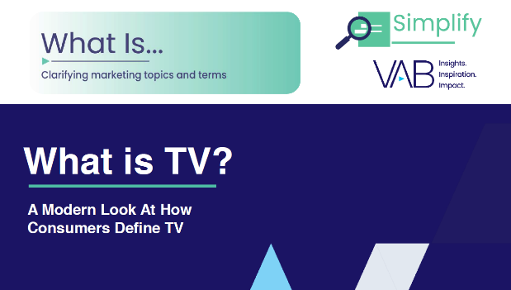
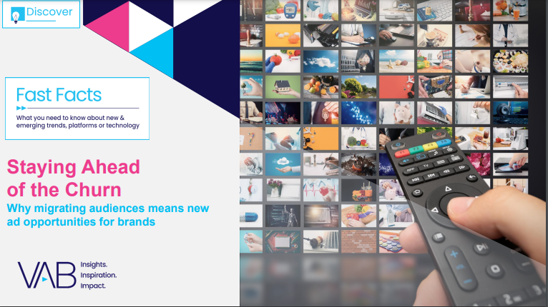

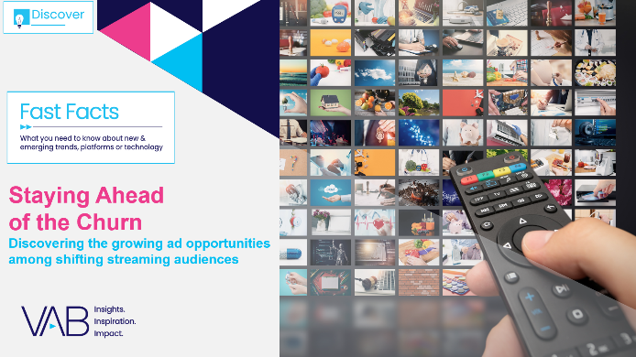

Creators
Jason Wiese
Reed Kiely
SVP, Director of Strategic Insights
jasonw@thevab.com
Associate Insights Director
reedk@thevab.com
Setting the Stage
15 Streaming Trends That Will Impact Marketing Plans in 2023
What is TV?
A Modern Look At How Consumers Define TV
Discover more
Looking for more data, insights and takeaways? Check out this related VAB content
Staying Ahead of the Churn
Why migrating audiences means new
ad opportunities for brands
25 Ways TV Grows Brands
Powering Performance Through
Full-Funnel Business Outcomes
Through Upfront season, marketers are making important decisions about their video investment strategy.
We’re here to help.
Visit our Upfront Planning Resource Center
for a curated a list of resources filled with the data, analysis and insights needed to make informed investment decisions.
How can streaming deliver incremental audiences in Convergent TV?
What are the 7 key reasons advertisers launch TV campaigns?
VAB Members, brand marketers and agencies get free and immediate access to VAB’s content library. Get access at theVAB.com
This information is exclusively provided to VAB members and qualified marketers. Further distribution is prohibited.
PAGE 19

Slide 20


About VAB
VAB is an insights-driven organization that inspires marketers to reimagine their media strategies resulting in fully informed decisions.
Drawing on our marketing expertise, we simplify the complexities in our industry and discover new insights that transform the way marketers look at their media strategy.
We are committed to your business growth and proud to offer VAB members, brand marketers and agencies complimentary access to our continuously-growing Insights library. Get immediate access at theVAB.com.
Curious to learn more about VAB? Check out this quick video to see what we do and how we can help you develop business-driving marketing strategies.
This information is exclusively provided to VAB members and qualified marketers. Further distribution is prohibited.
PAGE 20

