Slide 1


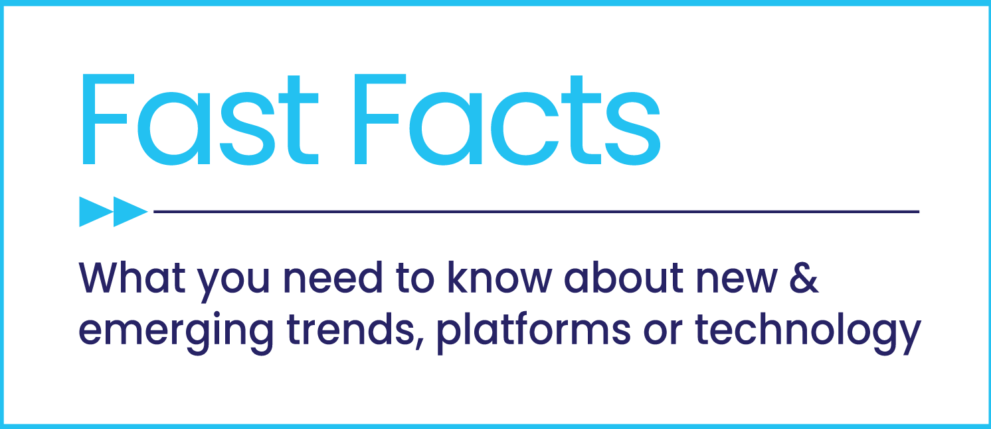


Staying Ahead of the Churn
Why migrating audiences means new ad opportunities for brands

Slide 2


How can marketers turn subscription churn into an engagement opportunity?
Churn, the constant audience turnover and migration among subscription-based platforms, has been lamented for years. As platforms grow in number, this churn has accelerated.
Why this impacts advertisers: Highly desirable audiences like young adults and affluent households are migrating towards ad-supported services – especially FAST platforms - in search of different content and greater value.
The opportunity: You’ll see how churn creates more engagement opportunities as the audience deceleration of pure subscription services leads to increased growth for ad-supported streaming.
This information is exclusively provided to VAB members and qualified marketers. Further distribution is prohibited.
PAGE 2

Slide 3
1
The percentage of people who have canceled a paid subscription service has increased over the last year
% of consumers that dropped an SVOD service in the last 6 months
+50%
YoY increase
29%
say that they are likely to cancel one or more SVOD services in the next 6 months
Source: TiVo, Video Trends Report, Q4 ’22.
This information is exclusively provided to VAB members and qualified marketers. Further distribution is prohibited.
PAGE 3

Slide 4









Lack of content and perceived value are the most common reasons for canceling a streaming service
2
55% of consumers have cancelled their subscription after watching a single program because, ‘other than the movie/TV show I watched, no other content interested me’*
% of those who have canceled a streaming service in the last 6 months for the following reason
Source: Media Insights & Engagement Conference, January 2023, Hub Research Intelligence: TV’s Competition – It’s Not Who You Think session. *Samba TV, The Harris Poll, 8/29/22-9/1/22.
This information is exclusively provided to VAB members and qualified marketers. Further distribution is prohibited.
PAGE 4

Slide 5
3
Younger audiences are more likely to cancel multiple subscription services once they finish what they wanted to watch
% of times in the last year someone signed up for a streaming service to see something and
cancelled / paused their membership after they finished watching it
49%
40%
66%
12%
43%
4%
27%
Source: Variety VIP+, Dare to Stream, November 2022.
This information is exclusively provided to VAB members and qualified marketers. Further distribution is prohibited.
PAGE 5

Slide 6
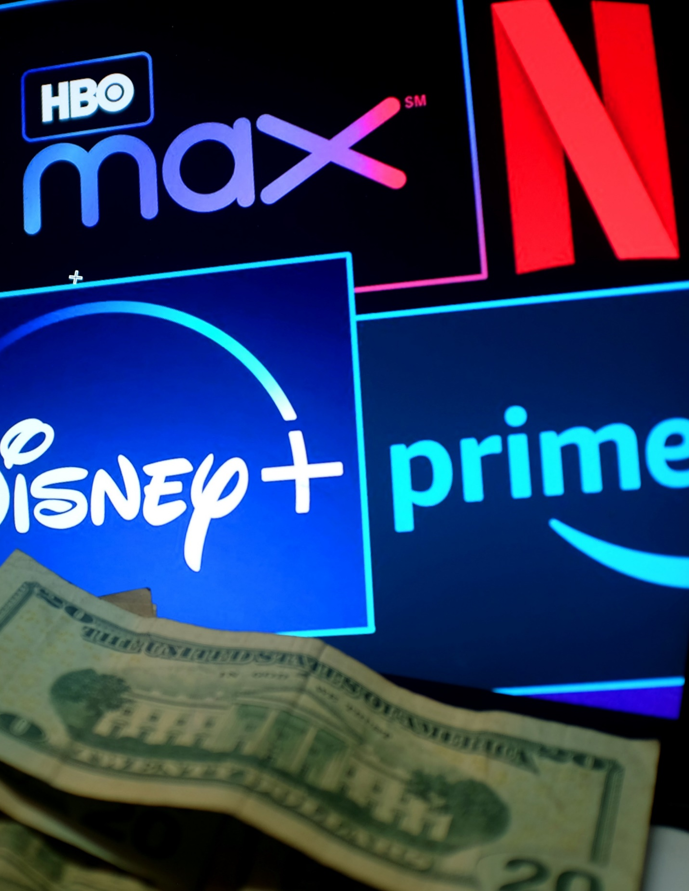
4
Higher income households are also more likely to cancel a service as they look to optimize value across a larger group of subscriptions
‘How likely are you to cancel at least one of your streaming services in the next 6 months?’
(likely or very likely)
Average # of SVODs
2.9
3.2
3.5
Source: Media Insights & Engagement Conference, January 2023, Magid: Churn and Burn or Retain and Sustain session.
This information is exclusively provided to VAB members and qualified marketers. Further distribution is prohibited.
PAGE 6

Slide 7

5
Although more consumers are canceling paid subscriptions, the total number of services used to consume video content is at an all time high
Average number of total services used to consume video content
+30%
YOY
Source: TiVo, Video Trends Report, Q4 ’21 & Q4 ’22, includes pay-TV subscriptions.
This information is exclusively provided to VAB members and qualified marketers. Further distribution is prohibited.
PAGE 7

Slide 8




6
As streamers cancel a service, they look for replacements that offer different content to complement their overall video consumption
Reasons for accessing new streaming services
42%
41%
40%
37%
To access original content exclusive to streaming platforms
To watch a particular program that I have heard about
To expand the content that
I have available
To watch programs that I used to watch on TV and can’t find anywhere else
Source: Nielsen, What’s old is new again: Bundles could help consumers cope with increasing streaming service choice, May 2022; based on Nielsen streaming media consumer survey.
This information is exclusively provided to VAB members and qualified marketers. Further distribution is prohibited.
PAGE 8

Slide 9

7
Streamers that are canceling subscriptions are migrating towards
ad-supported services in search of new content and greater value
% of Households Increasing Their Ad-Supported Streaming
2022 vs. 2021
36%
13%
23%
New to ad-supported streaming services
Increased number of
ad-supported streaming services
Source: ARF DASH, Full Year 2022, longitudinal sample vs. 2021, AVOD. TV Deconstructed: Latest Findings From the DASH Study, Full Year 2022.
This information is exclusively provided to VAB members and qualified marketers. Further distribution is prohibited.
PAGE 9

Slide 10
8
Consumers are very tolerant of ads within content which increases the value proposition of ad-supported streaming services
‘Which statement comes closest to how you feel about ads during TV shows and movies?’
‘Content matters the most: If I’m really interested
in a show it doesn’t matter to me if there are ads’
‘Can tolerate a certain number of ads but if there’s too many I’ll go elsewhere’
‘Can’t tolerate them: I’d never consider a service with ads, no matter how much I like the shows’
84%
83%
Source: Media Insights & Engagement Conference, January 2023. Hub Research Intelligence: TV’s Competition – It’s Not Who You Think session.
This information is exclusively provided to VAB members and qualified marketers. Further distribution is prohibited.
PAGE 10

Slide 11
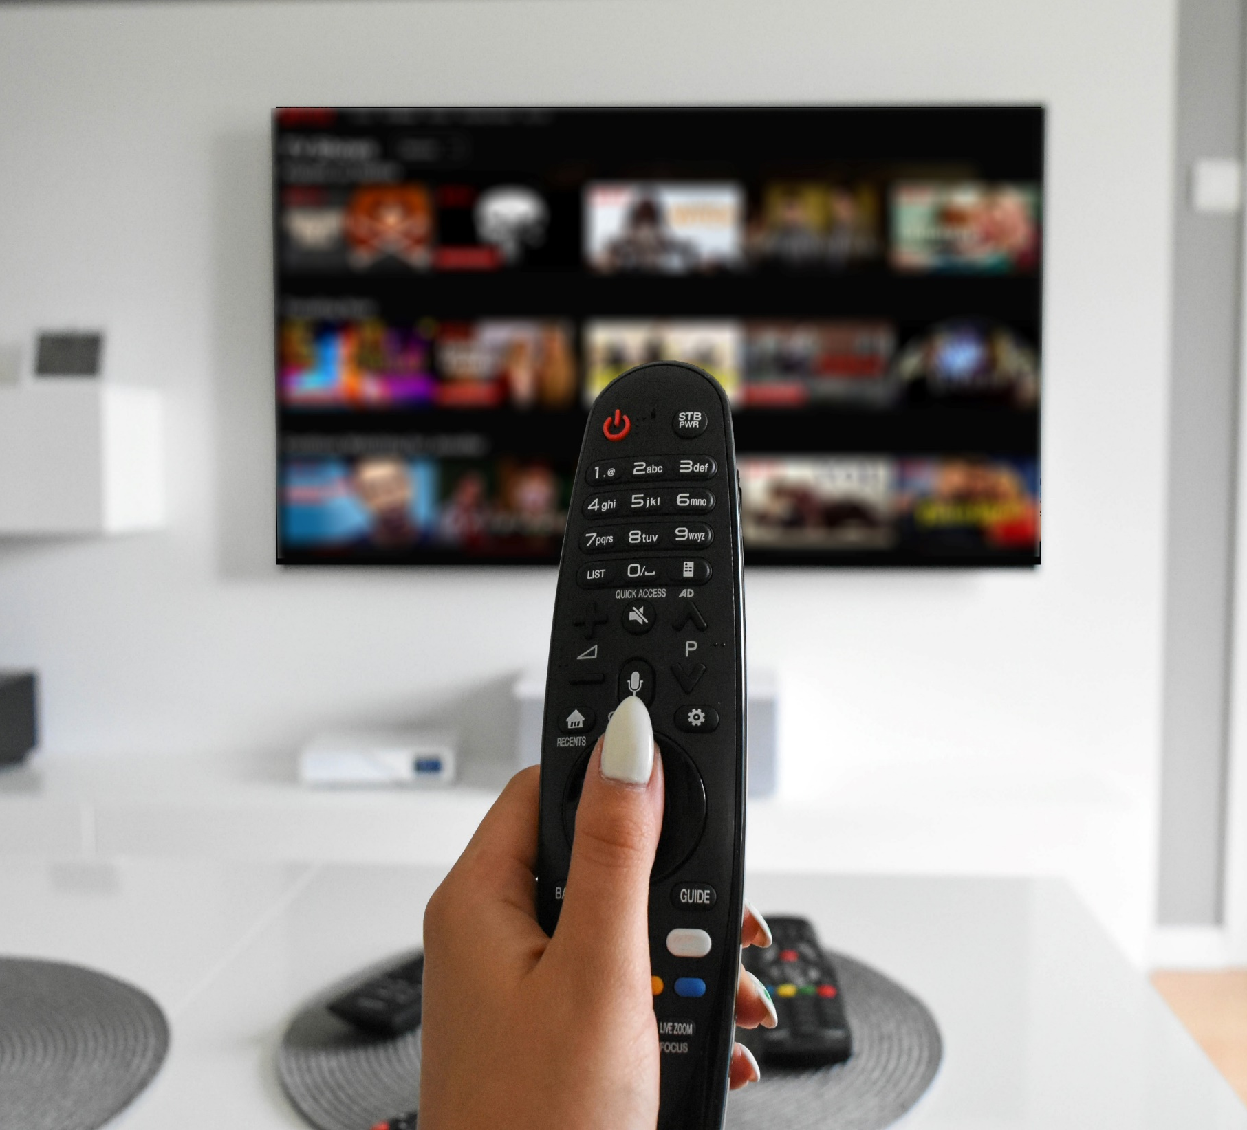


9
Two-thirds of streamers now prefer services that offer an ad-supported option
Which kind of subscription do you prefer?
66%
34%
32%
Free with ads
Tiered plan that offers a less expensive option with advertising
Source: Media Insights & Engagement Conference, January 2023. Hub Research Intelligence: TV’s Competition – It’s Not Who You Think session.
This information is exclusively provided to VAB members and qualified marketers. Further distribution is prohibited.
PAGE 11

Slide 12

10
Younger and affluent audiences are increasing their adoption of FAST services which creates more advertising opportunities for brands
% of U.S. streamers that watch FAST services
(Free Ad-supported Streaming TV)
+66%
YoY
+90%
YoY
+65%
YoY
Source: VAB analysis of MRI-Simmons November 2021 & November 2022 Cord Evolution Study, P18+, P18-34 and HHI $75k+. Base = ‘streamed in the past 12 months.’ November ‘22: FAST = used any of the following streaming services in the past 12 months: Peacock (free service w/ limited commercials), Roku Channel, Tubi TV, Freevee (formerly IMDb TV), Pluto, Samsung TV Plus, Xumo, Local Now. November ‘21: FAST = used any of the following streaming services in the past 12 months: Roku Channel, Tubi TV, Freevee (formerly IMDb TV), Pluto, Samsung TV Plus, Xumo, Local Now.
This information is exclusively provided to VAB members and qualified marketers. Further distribution is prohibited.
PAGE 12

Slide 13






11
FAST services offer value and a wide range of curated content which appeals to the younger and more affluent audiences
Top reasons for watching / signing up for a FAST (free ad-supported streaming TV) service
The ability to access free content I want to see in exchange for watching ads
A specific TV program or movie
I wanted to see
The wide variety of content offered which complements my other video subscriptions
40% / 36% / 39%
39% / 35% / 36%
32% / 30% / 34%
Easy access to a large library of 'classic' programming at any time
The availability of curated channels focused on niche / specialty topics
Easy access to recent or current programming at any time
33% / 28% / 33%
28% / 32% / 32%
28% / 30% / 31%
Source: Hub Research, 2023 Evolution of Video Branding Study, custom research conducted for VAB, March 2023.
This information is exclusively provided to VAB members and qualified marketers. Further distribution is prohibited.
PAGE 13

Slide 14
12
Wider viewer adoption of FAST has fostered a migration from subscription services among highly desirable audiences for brands
SVOD & FAST Services: Total Aggregated Minutes (YoY Difference)
February 2023 vs. February 2022
P18+
P18-34
HHI $75K+
SVOD
FAST
SVOD
FAST
SVOD
FAST
-2%
YOY
+39%YOY
+25%YOY
+70%YOY
-6%
YOY
+22%
YOY
Source: VAB analysis of Comscore mediametrix multiplatform, Mediatrend data, P18+, P18-34 and households with $75K+ income. February 2023 vs. February 2022. Based on total cume minutes across five measured platforms for both SVOD and FAST. SVOD includes Amazon Prime Video, Apple+, DAZN, Netflix and STARZ. FAST includes Tubi, Freevee, Vudu, Xumo and Crackle.
This information is exclusively provided to VAB members and qualified marketers. Further distribution is prohibited.
PAGE 14

Slide 15

Consumers are using more sources than ever to access video content, but there is a clear migration of some consumers shifting from subscription services to ad-supported streaming as they
search for greater value and different content to complement their overall viewing consumption
As streaming competition intensifies and churn continues to increase among subscription services, highly desirable audiences - such as adults 18-34 and affluent households - are more likely to adopt
additional ad-supported options, especially FAST services, which creates more opportunities for brands to engage with these highly desirable audiences
Key Marketer Takeaways
This information is exclusively provided to VAB members and qualified marketers. Further distribution is prohibited.
PAGE 15

Slide 16

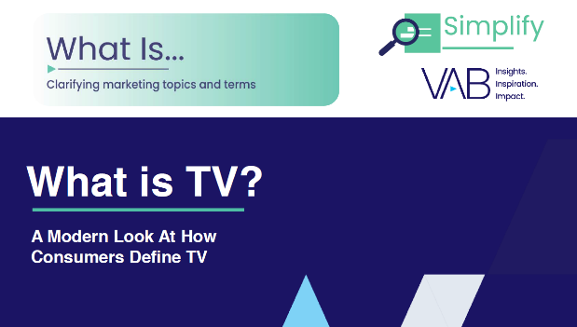
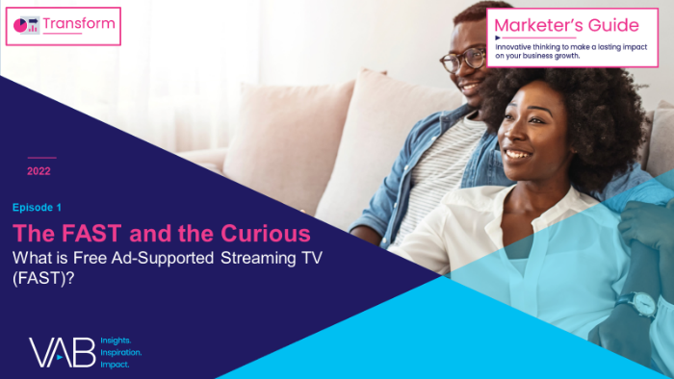
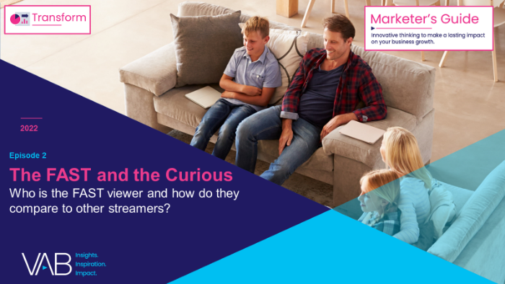
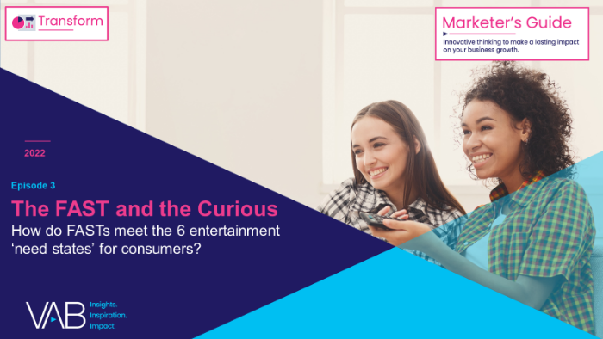
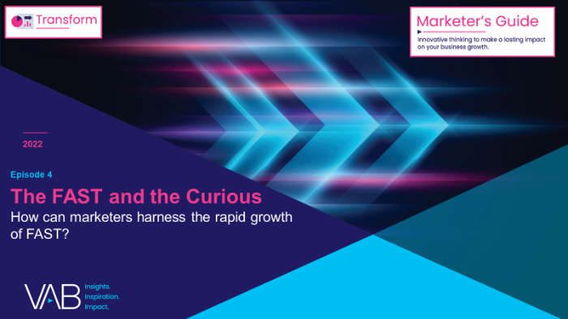
Creators
Jason Wiese
Reed Kiely
SVP, Director of Strategic Insights
jasonw@thevab.com
Associate Insights Director
reedk@thevab.com
Setting the Stage
15 Streaming Trends That Will Impact Marketing Plans in 2023
What is TV?
A Modern Look At How Consumers Define TV
Karolina Guillen
Insights Manager
karolinag@thevab.com
Discover more
Looking for more data, insights and takeaways? Check out this related VAB content
The FAST and the Curious Ep. 1
What is Free Ad-Supported Streaming TV (FAST)?
The FAST and the Curious Ep. 2
Who is the FAST viewer and how do they compare to other streamers?
Through Upfront season, marketers are making important decisions about their video investment strategy.
We’re here to help.
Visit our Upfront Planning Resource Center
for a curated a list of resources filled with the data, analysis and insights needed to make informed investment decisions.
The FAST and the Curious Ep. 3
How do FASTs meet the 6 entertainment need states for consumers?
The FAST and the Curious Ep. 4
How can marketers harness the rapid growth of FAST?
VAB Members, brand marketers and agencies get free and immediate access to VAB’s content library. Get access at theVAB.com
This information is exclusively provided to VAB members and qualified marketers. Further distribution is prohibited.
PAGE 16

Slide 17


About VAB
VAB is an insights-driven organization that inspires marketers to reimagine their media strategies resulting in fully informed decisions.
Drawing on our marketing expertise, we simplify the complexities in our industry and discover new insights that transform the way marketers look at their media strategy.
We are committed to your business growth and proud to offer VAB members, brand marketers and agencies complimentary access to our continuously-growing Insights library. Get immediate access at theVAB.com.
Curious to learn more about VAB? Check out this quick video to see what we do and how we can help you develop business-driving marketing strategies.
This information is exclusively provided to VAB members and qualified marketers. Further distribution is prohibited.
PAGE 17

