Slide 1





2021
Stream On
23 real-world case studies highlighting how video streaming drives brand success

Slide 2

We scoured the industry for real-world examples of how today's most innovative marketers are using streaming within their video campaigns.
With 23 case studies across 15 categories,
we showcase how brands are successfully achieving KPIs like incremental reach, brand favorability, ad recall, website visits and sales.
You will find real-world guidance on common questions marketers have when developing video streaming campaigns.
This information is exclusively provided to VAB members and qualified marketers. Further distribution is prohibited.
PAGE 2

Slide 3

What You’ll Learn…
Click through any common question to be brought directly to the appropriate section
1
2
3
4
How do I use streaming to extend the reach of my video campaign beyond linear TV?
How do I use video streaming to boost sales?
How do I use streaming to increase my share
of voice?
How do I use streaming
to reach new audiences?
5
6
7
8
How can I make an impact on a local level with streaming?
How can I use streaming to build brand love?
How can I drive in-store traffic with streaming?
How can I use interactive ad units to motivate consumer action?
This information is exclusively provided to VAB members and qualified marketers. Further distribution is prohibited.
PAGE 3

Slide 4
What You’ll Learn…
1
2
3
4
How do I use streaming to extend the reach of my video campaign beyond linear TV?
How do I use video streaming to boost sales?
How do I use streaming to increase my share
of voice?
How do I use streaming
to reach new audiences?
5
6
7
8
How can I make an impact on a local level with streaming?
How can I use streaming to build brand love?
How can I drive in-store traffic with streaming?
How can I use interactive ad units to motivate consumer action?
This information is exclusively provided to VAB members and qualified marketers. Further distribution is prohibited.
PAGE 4

Slide 5



Category:
Automotive (Luxury)
Streaming + Linear TV
A luxury auto advertiser’s streaming campaign on Tubi delivered on cross-channel incremental reach
Challenge
A luxury auto advertiser wanted to extend the reach of their video campaign beyond linear TV
Solution
Tubi partnered with TVSquared who combined ACR and digital measurement to understand the incremental reach that Tubi offered beyond the advertiser's linear investments
Target Segment
Household Income $75K+
Results
89% of Tubi’s audience was incremental to the linear buy, and only 3% of media volume overlapped between Tubi and linear campaigns
Company / Platform / Media Type
Tubi / Streaming + Linear TV / OTT + Linear TV
LINEAR
OTT
89%
of Tubi’s Audience was incremental to linear investments
 | Share of Impressions | Reach of Proportion | Avg. Frequency
OTT | 14% | 12% | 3.4
LINEAR | 83% | 86% | 2.8
OVERLAP | 3% | 1% | 6.3
Source: Tubi, Case study: Tubi drives incremental reach. Campaign time period: 6/16/21-6/30/21. ACR and digital measurement via TVSquared.
This information is exclusively provided to VAB members and qualified marketers. Further distribution is prohibited.
PAGE 5

Slide 6




Category:
Financial
A financial services brand reached incremental audiences and drove efficiencies via a cross-channel campaign
Streaming + Linear TV
Challenge
A leading financial services brand wanted to grow awareness and adoption of its free digital product, particularly by untapped audiences that hadn’t previously been reached with its linear-only campaigns
Solution
Simulmedia used its Cross-Channel Insights platform to identify the client’s target on both CTV and linear while gauging overlap of audiences between the two
Simulmedia accessed premium CTV inventory across dozens of publishers to pinpoint most
cost-effective impressions
Target Segment
Audiences unexposed to brand’s linear-only campaigns
Results
86% of audience reached by CTV campaign was only reached on CTV
Less than 2% of exposed HHs were reached by both linear and CTV campaigns
With 3% of overall spend, CTV campaign drove nearly 10% in incremental reach
Company / Platform / Media Type
Simulmedia / Streaming + Linear TV / Connected TV (CTV), Optimized Linear TV
Cross-Channel Measurement
Finding Unique Audiences on CTV
LINEAR
CTV
903K
86%
10%
Unique devices reached
Were reached only on CTV, through the financial service’s CTV campaign
CTV campaign drove almost 10% in incremental reach
Source: Simulmedia, Case Study: How Simulmedia Drove Incremental CTV Reach. Campaign time period: 6/14/2021-7/2/2021.
Source: Simulmedia, Case Study: How Simulmedia Drove Incremental CTV Reach. Campaign time period: 6/14/2021-7/2/2021.
This information is exclusively provided to VAB members and qualified marketers. Further distribution is prohibited.
PAGE 6

Slide 7






Category:
Insurance
Streaming + Linear TV
A leading mutual insurance company optimized
their OTT campaign, enabling expanded reach, greater brand awareness and increased website visits
Challenge
Mutual insurance company Amica wanted to justify and optimize their investment in streaming and measure incremental conversions* across OTT publishers compared to their linear TV campaigns
Solution
Utilized iSpot Unified Measurement to analyze the incremental reach and compare the performance of ads running across linear TV and major streaming providers, with the ability to compare at an individual OTT publisher level
Target Segment
Custom audience target
Results
Streaming served as a valuable complement to traditional TV buys, driving 6x higher conversion rates than linear TV ads alone
With visibility into deduplicated reach & conversion rates of linear vs. streaming ads, Amica determined :15s streaming ads were most effective in driving conversions, allowing them to adjust their media plan
Company / Platform / Media Type
iSpot.tv / Streaming + Linear TV / Linear TV, OTT (Connected TV)
With the help of Unified Measurement, Amica was able to:
6X
Prove that streaming ads converted at a 6x higher rate than linear ads alone
Identify OTT publishers with higher conversion rates
to continue to invest in
Determine that :15s streaming ads were more effective in driving conversions and adjust media plan accordingly
Source: iSpot.tv, Case study: Justifying and Optimizing Linear and Streaming TV Advertising. Campaign time period: Q2 2020. *Primary conversion KPI: web visits.
This information is exclusively provided to VAB members and qualified marketers. Further distribution is prohibited.
PAGE 7

Slide 8



Category:
Automotive (Luxury)
A luxury auto brand achieved incremental reach among previously-unexposed audiences by targeting qualified segments across OTT
Streaming + Multiscreen (non-TV)
Challenge
A luxury automotive brand wanted to drive incremental reach of those who hadn’t seen their linear ad, while controlling and optimizing frequency of ad-exposed viewers by tercile
Solution
Created a custom suppression segment comprised of viewers already exposed to brand’s ad on linear, layered with granular digital qualifiers
Targeted new, qualified audiences across OTT, as well as retargeted light & medium ad-exposed viewers across digital
Delivered cross-screen reach & frequency reporting to identify overlap of ad exposed audiences across linear & digital to ensure the brand’s ad reached the right viewers, at the right time
Target Segment
Auto intenders who had not previously engaged with the brand
Third-party audience who have been exposed via linear TV
Results
VideoAmp measured 3.2MM in incremental reach across OTT, an increase of 74% vs. linear TV, for an overall cost savings of $701K
Company / Platform / Media Type
VideoAmp / Streaming + Multiscreen (non-linear) / OTT
3.2MM
74%
$701K
Incremental Reach Across OTT
Increase Reach Compared to Linear
In Overall Cost Savings
Source: VideoAmp, Case study: Luxury Automotive Brand Leaves No Household Behind with 3.2M Incremental Reach Across OTT. Campaign time period: February 2019.
This information is exclusively provided to VAB members and qualified marketers. Further distribution is prohibited.
PAGE 8

Slide 9

Category:
Fitness
A fitness advertiser was able to monitor & optimize
a cross-platform campaign aimed at driving incremental reach and online registrations
Streaming + Linear TV
Challenge
A fitness advertiser launched a 2-part cross-platform TV campaign & needed a single source for converged TV measurement and attribution to track reach, frequency and incremental reach of linear and Connected TV (CTV)
Solution
Brand leveraged TVSquared’s ADvantage XP platform for 1:1 deterministic measurement & attribution for a unified view of performance & delivery metrics for all inventory sources including national broadcast & local cable for linear and streaming platforms like Roku, Hulu, Tubi, etc.
Target Segment
Custom Audience Target*
Results
Adjustments to inventory led to a greater share of impressions on streaming in 2nd campaign (+87%)
Increasing CTV impressions and diversifying across additional publishers increased unique CTV household reach by a further 22% (vs. earlier campaign)
Company / Platform / Media Type
TVSquared’s ADvantage XP platform / Streaming + Linear TV / Connected TV (CTV), Linear TV
OVERLAP – 4%
Impression split | CTV | Linear
Campaign 1 | 14% | 86%
Campaign 2 | 58% | 42%
CTV
LINEAR
*represents overlap of second campaign
Transforming Insights into Actionable Results
78%
of CTV Households Were Incremental to Linear
By increasing CTV impression share
4x
Response Rate for CTV
vs. Linear in Campaign 1
Influenced greater impression share for CTV in Campaign 2
-37%
Cost per Registration for CTV
Following adjustments across inventory sources
+116%
Increase in TV driven registrations for CTV
Optimizations drove increase
+93%
Uplift in HHs engaged
due to Linear TV
Optimizations drove lift
-39%
Cost per Registration for Linear TV
Following adjustments across inventory sources
Source: TVSquared, Case study: ADvantage XP: Delivering a Single Source of Truth for Converged TV . Campaign time period: Campaign 1 - January–March 2021 vs. Campaign 2 - May–July 2021. *Custom target built based on the number and variety of channels and genres they used.
This information is exclusively provided to VAB members and qualified marketers. Further distribution is prohibited.
PAGE 9

Slide 10
What You’ll Learn…
1
2
3
4
How do I use streaming to extend the reach of my video campaign beyond linear TV?
How do I use video streaming to boost sales?
How do I use streaming to increase my share
of voice?
How do I use streaming
to reach new audiences?
5
6
7
8
How can I make an impact on a local level with streaming?
How can I use streaming to build brand love?
How can I drive in-store traffic with streaming?
How can I use interactive ad units to motivate consumer action?
This information is exclusively provided to VAB members and qualified marketers. Further distribution is prohibited.
PAGE 10

Slide 11


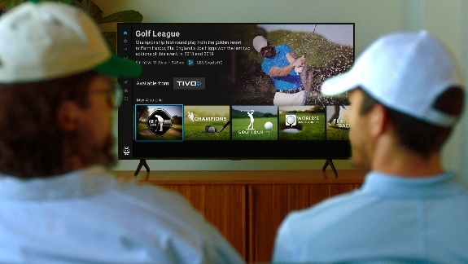

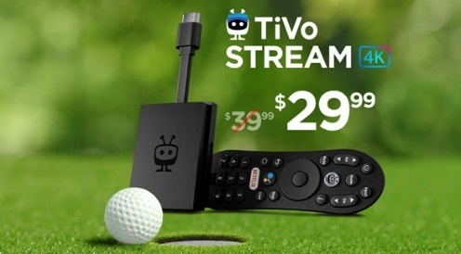

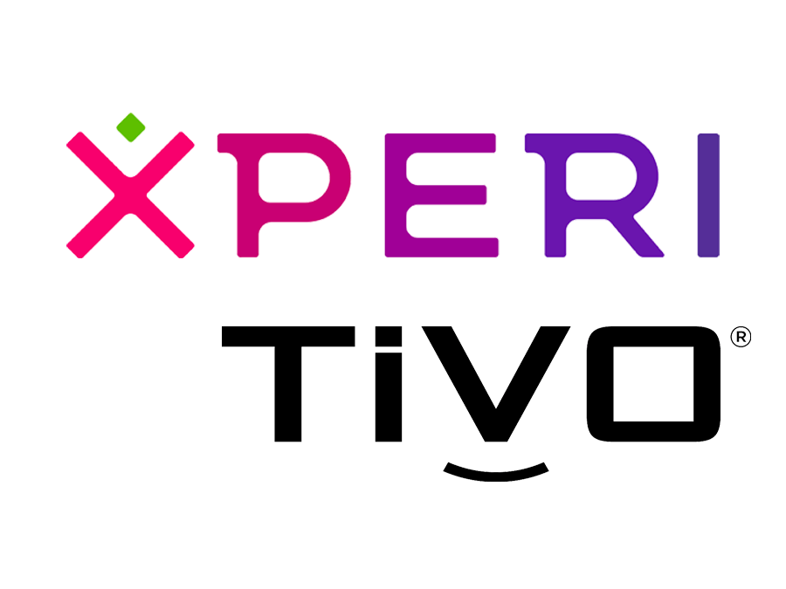
Category:
Consumer Technology
TiVo extended campaign reach through data-driven CTV advertising targeting sport enthusiasts, which drove a double-digit lift in device sales
Streaming only
Challenge
TiVo wanted to drive awareness for their new Stream 4K dongle and boost device sales
Solution
Launched campaign targeting households of sports enthusiasts during a premier golf tournament to promote their new Stream 4k product and inspire online conversion
  Content Affinity: Reach active sports fans by leveraging first-party, deterministic STB viewership data on CTV ad spots during the broadcast
  Sequential Targeting: Identify households exposed to the ad & extend campaign reach by digitally targeting them with secondary messages
  Conversion Attribution: By matching IP addresses to online sales during the campaign window, attributed sales lift from households exposed to the ad
Target Segment
Sports Enthusiasts
Results
CTV advertising generated a +25% lift in Stream 4K sales vs. households not exposed to the ad
Company / Platform / Media Type
TiVo, Xperi / Streaming Only / Connected TV (CTV)
+25%
Lift in Stream 4K Sales
Compared to households not exposed to ad
Source: TiVo & Xperi, Case study: TiVo Extends Campaign Reach and Lifts Device Sales with Data-Driven CTV Advertising. Campaign time period: flight date – 6/21/21-6/29/21; measurement period - 6/21/21 - 7/5/21, which was extended beyond the campaign window to capture Stream 4K purchases post-flight.
This information is exclusively provided to VAB members and qualified marketers. Further distribution is prohibited.
PAGE 11

Slide 12


Category:
Consumer Packaged Goods
A CPG brand implemented contextually relevant binge ads, leading to incremental sales growth
Streaming + Multiscreen TV
Challenge
A CPG brand sought to increase sales by creating real connections with engaged viewers across connected TV, desktop and mobile
Solution
Hulu’s in-house creative team, Greenhouse, worked with the brand to create sequential Binge Ads. The contextually and situationally-relevant messages appeared during viewers’ binge-watching session
Campaign delivered & measured in collaboration with Hulu, a CPG sales partner and a data connectivity platform
Target Segment
W25-49
Results
Those only exposed to the Binge Ad were highly responsive to the campaign but those exposed to both the Binge and Standard Ad drove the highest response rate, likely due to increased frequency
Company / Platform / Media Type
Hulu / Streaming + Multiscreen / Connected TV (CTV), Desktop, Mobile
Response Index
90 | 180 | 335
●/● Response Index (Campaign Response / Households)
Source: Hulu, Binge Ad Case Study, Q1 2020. Campaign length: 3 months; Binge Ad ran 1 month.
This information is exclusively provided to VAB members and qualified marketers. Further distribution is prohibited.
PAGE 12

Slide 13



Category:
B2B (Entertainment / TV)
Streaming only
A TV network leveraged a sell-side platform to ensure
brands across their portfolio would reach the right audiences, leading to programmatic growth and increased revenue
Challenge
AMC Networks sought to simplify their ad buying process and unlock inventory for more advertisers following an increase in programming development and implementation of a more aggressive distribution strategy
Solution
Magnite’s demand facilitation specialists worked with AMC Networks to grow revenue & generate new business by leveraging platform tools and educating advertisers about AMC’s premium inventory and improving overall campaign performance
Results
The Magnite CTV platform delivered triple digit YoY programmatic growth, as well as triple digit YoY revenue growth (+415%)
Company / Platform / Media Type
Magnite / Streaming Only / Magnite Connected TV (CTV) Platform
Programmatic Growth
Revenue growth
July 2020 - 2021
Q2 2020 – Q2 2021
2020 - 2021
+120%
+311%
+415%
Source: Magnite, Case study: Magnite Helps AMC Networks Monetize Premium Video Inventory. Campaign time period: Programmatic growth - July 2020 – July 2021, Q2 2020 – Q2 2021; Revenue growth – 2020-2021.
This information is exclusively provided to VAB members and qualified marketers. Further distribution is prohibited.
PAGE 13

Slide 14
What You’ll Learn…
1
2
3
4
How do I use streaming to extend the reach of my video campaign beyond linear TV?
How do I use video streaming to boost sales?
How do I use streaming to increase my share
of voice?
How do I use streaming
to reach new audiences?
5
6
7
8
How can I make an impact on a local level with streaming?
How can I use streaming to build brand love?
How can I drive in-store traffic with streaming?
How can I use interactive ad units to motivate consumer action?
This information is exclusively provided to VAB members and qualified marketers. Further distribution is prohibited.
PAGE 14

Slide 15

Category:
Healthcare
Streaming + Multiscreen (non-TV)
Healthcare brand achieved scale and drove incremental users within premium OTT inventory, leading to growth in share of voice
Challenge
A large healthcare brand wanted to optimize their cross-screen reach and increase share of voice (SOV) in the market with a focus on driving cost efficiencies
Solution
Build a custom data segment of consumers who were exposed to competitors’ ads on Linear TV
Reach exposed users across OTT, desktop, tablet, and mobile to ensure client was the second touchpoint across Digital screens
Measure success via a custom Competitive Insights report comparing competitors’ Linear reach, frequency, and SOV pre- and post- campaign activation
Target Segment
Custom target audience exposed to competitors' Linear TV ads on Digital
Results
VideoAmp measured +25% increase in video completion rate, a 33% larger share of voice than their competitors and +8MM incremental unique users reached
Company / Platform / Media Type
VideoAmp / Streaming + Multiscreen (non-linear) / OTT
+25%
+33%
8MM+
Video Completion Rate Increase
Larger Share of Voice vs. Competitors via Cross-Channel Unique Reach
Incremental Unique Users Reached
Source: VideoAmp, Case study: Healthcare Brand Captures Market Share with Conquesting Strategy Across Linear and Digital. Campaign time period: July 2020.
This information is exclusively provided to VAB members and qualified marketers. Further distribution is prohibited.
PAGE 15

Slide 16
What You’ll Learn…
1
2
3
4
How do I use streaming to extend the reach of my video campaign beyond linear TV?
How do I use video streaming to boost sales?
How do I use streaming to increase my share
of voice?
How do I use streaming
to reach new audiences?
5
6
7
8
How can I make an impact on a local level with streaming?
How can I use streaming to build brand love?
How can I drive in-store traffic with streaming?
How can I use interactive ad units to motivate consumer action?
This information is exclusively provided to VAB members and qualified marketers. Further distribution is prohibited.
PAGE 16

Slide 17






Category:
Home Appliances (Whirlpool)
Leading home appliance brand Whirlpool utilized CTV insights to identify optimal publishers to increase unique reach and cost efficiencies
Streaming only
Challenge
Looking to drive awareness, Whirlpool, utilized programmatic CTV to optimize reach, frequency and efficiencies across publishers
Solution
Whirlpool launched an awareness campaign across over 50 curated CTV publishers via custom PMPs*, utilizing Innovid as their video ad server and measurement provider
Target Segment
Third-party Homeowner Audience Segment
Results
Analysis found programmatic buys across multiple publishers (50+) can drive unique reach (87%) while maintaining low target average frequency (3.3X)
Demonstrated how programmatic CTV could drive cost savings while improving ROI; campaign had lower overall cost-per-unique-reach, outperforming ANA study benchmark** by 10%
Company / Platform / Media Type
Innovid / Streaming Only / Connected TV (CTV)
87%
~26%
+2.5%
3.3X
Unique Reach Percentage¹
Unique Reach Efficiency²
Benchmark Reach
of U.S. CTV Universe³
Average Campaign Frequency⁴
Source: Innovid, Case study: Innovid Insights Measures 87% Unique Reach Percentage for Whirlpool. Campaign time period: 4/1/2021 – 5/30/3021. 1. Unique Reach Percentage: The total number of unique or distinct households (only) reached during the campaign, displayed as a percentage. This included 3rd-party audience segments targeting homeowners. 2. Unique Reach Efficiency: A publisher overall efficiency in reaching unique households against delivered impressions. **3. Benchmark Reach of U.S. CTV Households: Benchmarks are Innovid-ANA’s State of Connected TV 2021 Report. 4. Average Campaign Frequency: The average number of times a single household was exposed during the campaign. *Private marketplace.
This information is exclusively provided to VAB members and qualified marketers. Further distribution is prohibited.
PAGE 17

Slide 18


Category:
Pharma (Dermatology)
A specialty dermatology drug brand used
machine learning optimizations to grow verified patient reach and improve cost efficiencies
Streaming + Multiscreen (non-TV)
Challenge
A specialty dermatology drug brand wanted to raise awareness by growing verified patient reach while quantifying the efficacy and efficiency of Connected TV (CTV) and online video (OLV) to inform ongoing media mix strategies
Solution
Targeted patient modeled audiences across CTV and OLV, and used DeepIntent Outcomes™ optimizations to increase verified patient reach while reducing cost-per-verified-patient (CPVP)
Target Segment
Cord cutters with a high likelihood to suffer from a specified skin condition
Results
Combined CTV and OLV campaigns achieved 4X reach among verified patients while reducing CPVP -35%
CTV-only campaign delivered 3X verified patient reach and reduced CPVP -37%
Company / Platform / Media Type
DeepIntent Outcomes™ / Streaming + Multiscreen (non-linear) / Connected TV (CTV), Online Video (OLV)
Cumulative Campaign Performance
Before & after algorithmic optimizations
CTV + OLV
CTV Only
4X
-37%
-35%
3X
Source: DeepIntent, Case study: DeepIntent Outcomes™ In-Flight Optimizations Grow Verified Patient Reach for Specialty Dermatology Drug. Campaign time period: February 2021 – May 2021.
This information is exclusively provided to VAB members and qualified marketers. Further distribution is prohibited.
PAGE 18

Slide 19





Category:
Retail (Balsam Brands)
Streaming only
Holiday décor brand Balsam Brands drove ROAS
among shoppers via a programmatic CTV campaign
and achieved incremental reach while driving responses
Challenge
Balsam Brands, a leading retailer of holiday décor, wanted to drive quality site traffic from holiday decoration shoppers and drive ROAS*
Solution
MediaMath & TVSquared partnered to measure the effectiveness of Balsam Brand’s reach and messaging across publisher partners, enabling optimizations to be made throughout the programmatic CTV campaign against high-performing publishers & devices
Target Segment
Custom Audience Target
Results
Balsam Brands was able to drive a ROAS by 150% vs. year prior, and achieved incremental unique reach over linear by 78%
Company / Platform / Media Type
TVSquared, MediaMath / Streaming Only / Connected TV (CTV)
CTV
LINEAR
3% overlap
78% of CTV reach was unique, tapping into a subset of users unreachable on linear
4.7M
households reached
35M
impressions
131K
responses from CTV
Source: TVSquared, Case study: Driving Performance with CTV: MediaMath partnered with TVSquared to measure the effectiveness of Balsam Brand’s reach and messaging across publisher partners. Campaign time period: Holiday Season 2019 vs. 2020 (mid-October – end November (peak holiday shopping season). *Return on ad spend.
This information is exclusively provided to VAB members and qualified marketers. Further distribution is prohibited.
PAGE 19

Slide 20

Category:
Pharma (Psoriasis)
A specialty pharmacy drug brand utilized
machine learning optimizations to grow verified patient reach and maximize cost efficiencies
Streaming + Multiscreen (non-TV)
Challenge
A specialty pharmacy drug used to treat moderate-to-severe plaque psoriasis wanted to raise awareness by accelerating verified patient reach while maximizing efficiencies
Solution
Targeted patient modeled audiences across Connected TV (CTV), online video (OLV), and display media using DeepIntent’s healthcare-specialized DSP and CTV Marketplace
Performance was optimized using DeepIntent Outcomes™ machine learning algorithms that automatically adjust campaign parameters
in-flight to maximize outcomes
Target Segment
Individuals with a high likelihood to have a specified diagnosis and have also been prescribed the brand or specified competitive brands
Results
Machine learning optimizations delivered 5.7X average weekly verified patient reach while reducing cost-per-verified-patient (CPVP) -83%
Company / Platform / Media Type
DeepIntent Outcomes™ / Streaming + Multiscreen (non-linear) / Connected TV (CTV), Online Video (OLV), Display media
Total Campaign Performance
Impact of machine learning optimizations
Algorithms auto-optimize all campaign parameters in-flight, including inventory
5.7X
Partner Spotlight
Impact of optimizations on CPVP
-83%
-66%
Source: DeepIntent, Case study: DeepIntent Outcomes™ Machine Learning Optimizations Maximize Verified Patient Reach and Efficiency for Plaque Psoriasis Drug. Campaign time period: December 2020 – June 2021. ‘CPVP’ = cost-per-verified-patient.
This information is exclusively provided to VAB members and qualified marketers. Further distribution is prohibited.
PAGE 20

Slide 21
What You’ll Learn…
1
2
3
4
How do I use streaming to extend the reach of my video campaign beyond linear TV?
How do I use video streaming to boost sales?
How do I use streaming to increase my share
of voice?
How do I use streaming
to reach new audiences?
5
6
7
8
How can I make an impact on a local level with streaming?
How can I use streaming to build brand love?
How can I drive in-store traffic with streaming?
How can I use interactive ad units to motivate consumer action?
This information is exclusively provided to VAB members and qualified marketers. Further distribution is prohibited.
PAGE 21

Slide 22


Category:
Financial
A financial advertiser extended reach beyond linear TV activity via a geo-targeted streaming campaign
Streaming + Multiscreen TV
Challenge
Financial brand wanted to extend reach beyond its traditional TV campaign while reinforcing its message among light TV viewers and maintaining its existing budget
Solution
A geo-targeted streaming campaign was added to the advertiser’s existing TV campaign, delivering its message within similar premium, long-form content
Bottom 1/3 of households based on total viewing were defined as “light TV” viewing households to measure success
Target Segment
A25-64
Results
Campaign delivered +10% more households and increased frequency +29% (4.0x to 5.2x) with even greater results seen among “light TV viewer” households
Company / Platform / Media Type
Effectv / ‘Effectv Streaming’* + Multiscreen TV / Linear TV, Connected TV (CTV), STB VOD, Mobile & Web
Incremental Benefits From Streaming
Total Campaign
More Reach
+10%
more households reached
by adding streaming
More Frequency
+29%
more frequency (4.0 to 5.2)
for the cross-platform campaign
“Light TV” Viewing Households
More Reach
+20%
more “light TV” households reached by adding streaming
More Frequency
+79%
more frequency (2.3 to 4.1)
for the cross-platform campaign
Source: Effectv, Automotive Case Study. Based on analysis of Effectv Streaming advertising campaigns (2021). Campaign time period: January 2021. This analysis is based upon aggregated ad exposure data of viewing by Comcast households. Comcast households with a pay TV service representing the bottom 1/3 of TV viewing were defined as “Light TV viewing households”. *’Effectv Streaming’ consists of premium, mostly long-form video across multiple devices including Connected TV (CTV), set-top-box VOD (STB VOD), mobile and web.
This information is exclusively provided to VAB members and qualified marketers. Further distribution is prohibited.
PAGE 22

Slide 23




Category:
Home Furnishings
Streaming + Multiscreen (non-TV)
A furniture brand used cross-channel insights
from a local streaming campaign to ensure incremental reach of the right audience at an optimal frequency
Challenge
A furniture brand wanted to increase unique reach in local markets within a 10-mile radius & extend their media investments by targeting advanced audiences on digital mediums
Solution
Measured to establish a baseline in the first 4 weeks of the campaign to understand audience composition per unique local market & tactic across channels
Activated custom suppression segments to remove households that were exposed to the brand’s linear campaign messages
Optimized campaign tactics and strategy in-flight, leveraging a combination of CTV and 3-screen activation to validate the use of suppression segments for driving incremental reach across the brand’s digital buy
Target Segment
Custom in-market target audience at local level
Results
VideoAmp measured 1.9MM incremental users and garnered a 1.94% click-through-rate (CTR) average per local market and a 93.96% video completion rate
Company / Platform / Media Type
VideoAmp / Streaming + Multiscreen (non-linear) / OTT
1.9MM
Incremental Users Reached
1.94%
Click-Through-Rate (CTR) Average Per Local Market
93.96%
Video Completion Rate
Source: VideoAmp, Case study: Furniture Brand Finds Comfort in Reaching Cross-Channel Local Audiences. Campaign time period: August 2020.
This information is exclusively provided to VAB members and qualified marketers. Further distribution is prohibited.
PAGE 23

Slide 24

Category:
Automotive
Streaming + Linear TV
A geo-targeted, audience-based campaign
drove website traffic for an automotive brand
Challenge
An auto brand sought to efficiently maximize reach and drive website traffic with an audience-based, cross-platform campaign
Solution
An audience-based TV campaign ran across 41 networks, with 70% of impressions running outside primetime
Enhanced with 20% of overall investment in a targeted streaming campaign to support and expand overall reach
Entire campaign was geographically targeted to the area where majority of sales originated
Target Segment
In-market for new vehicles
Results
Nearly half (43%) of households reached via streaming were incremental to TV. Campaign also generated a positive impact on website traffic, increasing immediate visitors to brand’s website +419 in one month
Company / Platform / Media Type
Effectv / ‘Effectv Streaming’* + Linear TV / Linear TV, Connected TV (CTV) STB VOD, Mobile & Web
AWARENESS*
CONSIDERATION**
TV Outcomes
Streaming Outcomes
Web Results
+13%
more likely for TV viewers
to be in the target audience
78%
of targeted impressions came from an audience-based campaign with the remainder from fixed programming
43%
of households reached with streaming were incremental to TV
21%
of streaming impressions delivered were to households with no TV service
81%
of streaming impressions were served via the TV screen
+419
Immediate visitors to their website within one month
2+
Visits within the month from these immediate visitors
Source: Effectv, Automotive Case Study. Based on analysis of Effectv Streaming advertising campaigns (2021); Web site results provided by TVSquared analysis. Time period: February 2021. *The “Awareness” portion of the analysis consisted of aggregated ad exposure data of viewing by Comcast households. **The “Consideration” portion of the analysis consisted of third-party web site evaluation by TVSquared; Immediate visitors are defined as additional (above pre-determined baseline) web site visitors occurring within 30 minutes of a cable TV ad airing. *’Effectv Streaming’ consists of premium, mostly long-form video across multiple devices including Connected TV (CTV), set-top-box VOD (STB VOD), mobile and web.
This information is exclusively provided to VAB members and qualified marketers. Further distribution is prohibited.
PAGE 24

Slide 25



Category:
Retail
A national retailer realized the impact of regional TV and streaming campaigns on driving website traffic and sales through cross-screen campaign insights
Streaming + Linear TV
Challenge
A national retailer’s holiday 2020 campaign goal required driving shopper behavior across the brand’s core brick & mortar footprint while monitoring ecommerce outcomes
Solution
Media agency Mediahub used an audience-first approach to target shoppers across live linear & streaming devices within a regionalized footprint while measuring website visits post ad-exposure
Ampersand’s Targeted TV solution delivered a geo-targeted, multiscreen campaign across premium live & on-demand platforms, which was measured in partnership with TVSquared to demonstrate how TV exposure drives web traffic*
Target Segment
A25-54
Results
Campaign insights revealed:
  Optimal linear TV dayparts and networks: daytime drove 33% of immediate site visitors
  Streaming TV insights demonstrated timely impact of campaign, with 30% of website visitors & order confirmations occurring within 2 days of ad exposure
Company / Platform / Media Type
Ampersand’s Targeted TV solution / Streaming + Linear TV / Local Linear TV, OTT, Connected TV (CTV), Desktop, Mobile, Tablet
Local Targeted TV
Impact on Outcomes
Streaming TV
9% Direct
(<10min)
Website Visits
Website Visits
320,994
Immediate visitors
30 minutes
Retailer Site
91% Drag
(10-30min)
99,242
Responses
6 days
435,038
Repeat Visitors
14 days
39,321
Within 14 days
Order Confirmations
7,580
Within 6 days
Linear Results
Streaming Results
Cable TV ad exposure insights identified areas to drive increased performance based on the following:
Diversify Dayparts: Daytime and Weekend Daytime drove 33% of immediate visitors
Heavy Up Networks: 3 networks drove 21% of immediate visitors
27% of website responses & 36% of on-site order confirmations occurred during the weeks of Thanksgiving & Cyber Monday (11/12-12/6)
30% of website visitors + order confirmations occurred within 2-days of ad exposure
26% of all visitors/responses were from Daytime whereas 22% were from Prime
Source: Ampersand, Case study: Targeted TV Effectiveness: Local multi-screen holiday TV campaign drives shopper engagement + sales. Campaign time period: flight date – 9/28/20-12/25/20; measurement period – 10/13/20-12/27/20. Campaign agency: Mediahub. Data partner: TVSquared. Geos: 19 total based on store proximity. Frequency: even weekly pacing + 95% video completion rate (VCR). Actions measured: retailer site visitation (any page), order confirmation page. Attribution based on website visitation following linear ad or digital ad exposure; Attribution windows: Local targeted TV – 30 minutes = immediate response, 14 days from Immediate Response = Return Response; Streaming – within 7 days Post Initiative Exposure. *Website visits measured by TVSquared pixels.
This information is exclusively provided to VAB members and qualified marketers. Further distribution is prohibited.
PAGE 25

Slide 26

Category:
Automotive (Ford)
A geo-targeted multiscreen campaign with tailored
creative had a direct impact on sales for a local Ford dealership
Streaming + Multiscreen TV
Challenge
A local Ford dealership was looking to expand their primary customer base and conquest sales from competitive dealerships in a geography 20+ miles south of their location
Solution
Spectrum Reach developed new creative with new relevant, targeted messaging to use in a multiscreen campaign aimed at Ford customers
In partnership with Experian and IHS Markit, Spectrum was able to isolate exposed / unexposed viewers to measure the direct impact of the campaign on business outcomes
Target Segment
Ford Car & Truck Buyers
Results
Reach: A total of 94,975 HHs were exposed to a Ford Dealer Commercial
Sales: Exposed homes bought a total of 185 cars – essentially, 1 car sold for every 500 homes exposed to an ad
Scale: Spectrum HHs accounted for 61% of all Palm Coast Ford sales for the 3-month time period. Among that group, 80% were exposed to the ad
Company / Platform / Media Type
Spectrum Reach / Streaming + Multiscreen / Linear TV, streaming TV and addressable online video, display and search
Overall Dealership Multiscreen Impact
+52%
+8%
+13%
Site Traffic
Leads
Sales
Overall Dealership Conversion Lift
Conquest Geography Sales Lift
121.25%
263%
The unique messaging and introduction of Multiscreen TV in the conquest geography drove sales up by 263%
Those exposed to the ad were more than 2X as likely to buy a new vehicle from Palm Coast Ford vs. unexposed
Source: Spectrum Reach, Custom Case study: How Campaign Attribution Made Palm Coast Ford, a Believer in Multiscreen Media. Data partners: Experian, IHS Markit. Campaign time period: Dec 14, 2020 – Feb 28, 2021. Traffic, Leads and Sales based on purchased made by exposed HH within 90 days of exposure. Conquest: sales during
Oct-Dec 2021 compared to Jan-Apr, 2021.
This information is exclusively provided to VAB members and qualified marketers. Further distribution is prohibited.
PAGE 26

Slide 27
What You’ll Learn…
1
2
3
4
How do I use streaming to extend the reach of my video campaign beyond linear TV?
How do I use video streaming to boost sales?
How do I use streaming to increase my share
of voice?
How do I use streaming
to reach new audiences?
5
6
7
8
How can I make an impact on a local level with streaming?
How can I use streaming to build brand love?
How can I drive in-store traffic with streaming?
How can I use interactive ad units to motivate consumer action?
This information is exclusively provided to VAB members and qualified marketers. Further distribution is prohibited.
PAGE 27

Slide 28







Category:
Beverages (Sparkling Water)
Using audience-based OTT targeting, a sparkling water brand boosted their consideration and overall image among consumers
Streaming only
Challenge
A disruptor in the flavored sparkling water category wanted to drive consideration for their brand and position themselves as an icon of “real”
Solution
Brand partnered with NBCU on a digital sponsorship of an NBC primetime scripted program that aligned thematically with the messaging and tone of brand’s creative
Amplified campaign with audience targeting against a sparkling water competitive set across NBCU’s O&O short-form and FEP content
Target Segment
Sparkling Water Custom Target
Results
Campaign generated +51% higher brand consideration and +42% higher purchase intent with an overall positive boost to brand perception
Company / Platform / Media Type
NBCU / Streaming Only / OTT (Desktop & Mobile)
Impact on brand KPIs
+51% higher brand consideration
+42% higher purchase intent
Impact on brand perception attributes
+31% higher agreement the brand “made with real squeezed fruit”
+32% higher agreement the brand “a premium beverage brand”
+32% higher agreement the brand “stands out from other beverage brands”
Source: NBCU, Beverages (Sparkling Water) Case Study. Campaign time period: Q2 2019.
This information is exclusively provided to VAB members and qualified marketers. Further distribution is prohibited.
PAGE 28

Slide 29

Category:
Fitness
An online fitness app leveraged an addressable audience-targeted streaming campaign to increase familiarity, consideration and website traffic
Streaming + Multiscreen TV
Challenge
A leading online cycling and running virtual training app wanted to drive brand impact and website traffic for their app on a global scale
Solution
Using addressable advertising, powered by AdSmart, an audience-targeted campaign was launched to reach cycling audiences refined for each market across NBCU + Sky
Targeted impressions were delivered dynamically through set-top boxes internationally and through NBCU’s FEP content across O&O CTV apps, STB VOD, and Hulu in the U.S.
Target Segment
Cycling Custom Target
Results
Campaign generated significant brand awareness, internationally and in the U.S., including lift in familiarity, visitation rates and consideration intent
Company / Platform / Media Type
NBCU + Sky / Streaming + Multiscreen / NBCU O&O apps on Connected Devices, NBCU on Hulu (CTV, Desktop, Mobile), NBCU STB VOD, Sky STB VOD
Global brand metrics across Germany, U.K. and & U.S.
+100%
lift in unaided ad recall
+39%
lift in brand familiarity
+24%
lift in brand favorability
+19%
lift in consideration intent
+14%
lift in recommendation intent
Global impact on website traffic U.S.
+141%
lift in site visitation rate
+113%
lift in click rate to account creation page
+146%
lift in click rate to subscription page
Source: NBCU, Fitness Case Study. Campaign time period: Q4 2020 - Q1 2021. FEP = full episode player.
This information is exclusively provided to VAB members and qualified marketers. Further distribution is prohibited.
PAGE 29

Slide 30
What You’ll Learn…
1
2
3
4
How do I use streaming to extend the reach of my video campaign beyond linear TV?
How do I use video streaming to boost sales?
How do I use streaming to increase my share
of voice?
How do I use streaming
to reach new audiences?
5
6
7
8
How can I make an impact on a local level with streaming?
How can I use streaming to build brand love?
How can I drive in-store traffic with streaming?
How can I use interactive ad units to motivate consumer action?
This information is exclusively provided to VAB members and qualified marketers. Further distribution is prohibited.
PAGE 30

Slide 31


Category:
QSR
A QSR brand drove incremental visitation through a convergent, audience-based campaign
Streaming + Multiscreen TV
Challenge
A QSR brand sought to bring awareness to a new product offering and drive in-store visits through a convergent, audience-based campaign
Solution
ViacomCBS’ as-run and impression-level delivery data, combined with Foursquare’s location data & attribution methodology, enabled measurement of incremental foot traffic compared to concurrent non-targeted inventory
Target Segment
High Value QSR Custom Target
Results*
Vantage-targeted inventory exceeded Foursquare’s performance benchmarks, driving greater reach and in-store visits, with 1:1 environments yielding the most significant impact
Company / Platform / Media Type
ViacomCBS Vantage, Foursquare / Streaming + Multiscreen / Linear TV, STB live linear addressable and VOD, EyeQ** [CTV/OTT (desktop, mobile)]
Vantage-targeted campaign drove…..
Target Segment Delivery:
Campaign achieved a 38% gain in impressions delivered in target segment vs. vs non-targeted concurrent buy
Incremental Visits:
Across all platforms, Vantage inventory drove a statistically significant lift of 4.3%
Increased Store Visitation:
Vantage cross-platform campaign outperformed non-targeted media by more than 7x
Better Performance Than Category Benchmarks:
Overall campaign performance exceeded Foursquare’s omnichannel campaign behavioral lift benchmark by +50%
1:1 exposure yielded most significant impact
1:1 environments*** delivered 24% lift in target segment reach
Vantage live linear addressable & targeted OTT media together drove 34% lift, a 10x increase over linear alone, and 3x over the non-targeted digital media campaign.
Source: ViacomCBS, Attribution case study: ViacomCBS and Foursquare show increased media impact by measuring multi channel campaign. Segmentation source: MRI-Simmons. Attribution partner: Foursquare. Optimizer: ViacomCBS’ Vantage (proprietary). Comparable benchmarks: non-targeted media on same platforms. Campaign time period: Q3 2020. *Total campaign delivered 87% cost efficiency on incremental visits, with streaming showing the greatest efficiency. **Encompasses Pluto TV and all ViacomCBS O&O apps including CBS All Access. ***1:1 environments: STB live linear addressable and VOD, CTV, OTT.
This information is exclusively provided to VAB members and qualified marketers. Further distribution is prohibited.
PAGE 31

Slide 32


Category:
Tax Services
Utilizing audience-based OTT strategies, a tax services provider drove tax filing conversion rates for both their online services and retail locations
Streaming + Multiscreen TV
Challenge
A leading tax services provider wanted to improve conversions for their services online and in their retail locations
Solution
Using addressable advertising, powered by AdSmart, an audience-targeted campaign launched aiming to reach a custom competitor target modeled from the client’s 1st-party data across NBCU
Targeted impressions were delivered dynamically as viewers watched NBCU’s FEP content across their O&O CTV apps, STB VOD, and Hulu
Target Segment*
Custom lookalike target modeled from client
1st party data made up of retail tax filers and online/DIY tax filers
Results
Campaign drove lift for tax filings overall, delivering lift in conversion rates and more efficient costs-per-conversion
Company / Platform / Media Type
NBCU / Streaming & Multiscreen / NBCU O&O apps on Connected Devices, NBCU on Hulu (CTV, Desktop, Mobile), NBCU STB VOD
Overall lift for tax filings
+10%
lift in tax filing conversion rate
+10%
lift in online/DIY tax filing conversion rate
+10%
lift in retail tax filing conversion rate
2020 campaign results vs. 2019 campaign results
+66%
more efficient cost per conversion
+2.5%
higher tax filings conversion rate
Source: NBCU, Financial (Tax Services) Case Study. Campaign time period: Q1 2020. *Based on TransUnion data.
This information is exclusively provided to VAB members and qualified marketers. Further distribution is prohibited.
PAGE 32

Slide 33
What You’ll Learn…
1
2
3
4
How do I use streaming to extend the reach of my video campaign beyond linear TV?
How do I use video streaming to boost sales?
How do I use streaming to increase my share
of voice?
How do I use streaming
to reach new audiences?
5
6
7
8
How can I make an impact on a local level with streaming?
How can I use streaming to build brand love?
How can I drive in-store traffic with streaming?
How can I use interactive ad units to motivate consumer action?
This information is exclusively provided to VAB members and qualified marketers. Further distribution is prohibited.
PAGE 33

Slide 34
Category:
QSR
Audiences exposed to interactive ad units saw
3x lift in purchase rate for a QSR brand’s
cross-screen campaign
Streaming + Multiscreen TV
Challenge
A QSR brand looked to drive sales through personalized messages prompting user engagement
Solution
Hulu delivered selected audiences GatewayGo ads. These interactive units allow viewers to engage through personalized message prompting users to open a push notification, email or scan
a QR code
Campaign was delivered & measured in collaboration with Hulu, a credit card transaction partner and a data connectivity platform
Target Segment
A18-49 across 5 DMAs
Results
Hulu viewers exposed to the GatewayGo unit showed heightened responsiveness to campaign and drove a 0.27% shop rate and a high average household spend of $0.13
Company / Platform / Media Type
Hulu / Streaming + Multiscreen / Connected TV (CTV), Desktop, Mobile
% of HHs Exposed | 79% | 28%
Source: Hulu, GatewayGo Case Study, Q2 2020. Campaign length: 2 months. *A slate is a branded title card that appears before video creative.
This information is exclusively provided to VAB members and qualified marketers. Further distribution is prohibited.
PAGE 34

Slide 35
Eight best practices marketers are using in their video streaming campaigns to drive brand success
Leverage data to create custom target(s) and discover new audiences
Implement an audience-based buying approach
Embrace OTT across platforms and devices to maximize reach
Tailor creative to deliver the right messaging to the
right audiences
Utilize geo-targeting to reach best prospects
Partner with trusted measurement companies to evaluate campaign performance
Understand which outcomes are most important to your objectives
Optimize to outcomes for your current & future TV buys
This information is exclusively provided to VAB members and qualified marketers. Further distribution is prohibited.
PAGE 35

Slide 36

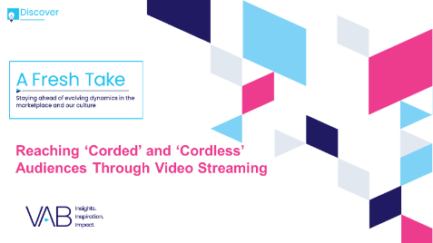
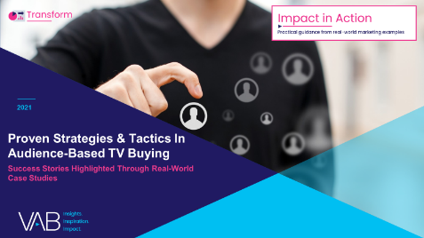
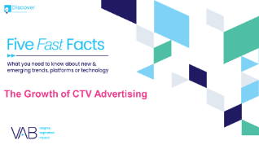
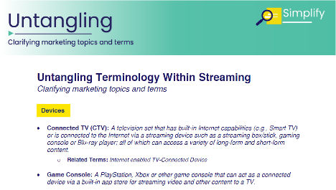
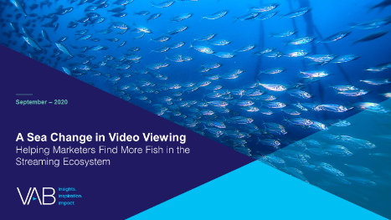







Creators
Jason Wiese
Leah Montner-Dixon
SVP, Director of Strategic Insights
jasonw@thevab.com
Associate Insights Director
leahm@thevab.com
Interested in learning more? Check out this related content:
VAB Members, brand marketers and agencies get free and immediate access to VAB’s content library. Get access at theVAB.com
A Fresh Take
Reaching ‘Corded’ and ‘Cordless’ Audiences Through Video Streaming
Proven Strategies & Tactics In Audience-Based TV Buying
Success Stories Highlighted Through Real-World Case Studies
Five Fast Facts
The Growth of CTV Advertising
Untangling Terminology
Within Streaming
A Sea Change in Video Viewing
Helping Marketers Find More Fish
in the Streaming Ecosystem
This information is exclusively provided to VAB members and qualified marketers. Further distribution is prohibited.
PAGE 36

Slide 37

About VAB
VAB is an insights-driven organization that inspires marketers to reimagine their media strategies resulting in fully informed decisions.
Drawing on our marketing expertise, we simplify the complexities in our industry and discover new insights that transform the way marketers look at their media strategy.
Transform
We help you build your brand by focusing on core marketing principles that will help drive tangible business outcomes.
Simplify
We save you time by bringing you the latest data & actionable takeaways you can use to inform your marketing plans.
Discover
We keep you one step ahead with the latest thinking so you can create innovative, forward-looking strategies.
We are committed to your business growth and proud to offer VAB members, brand marketers and agencies complimentary access to our continuously-growing Insights library. Get immediate access at theVAB.com.
This information is exclusively provided to VAB members and qualified marketers. Further distribution is prohibited.
PAGE 37

