Slide 1





Staying Current on Streaming
The Latest on Connected TV Consumer Behaviors
June 2024

Slide 2






Six Current Trends on Connected TV Consumer Behaviors
1
2
3
Many viewers are turning to streaming as their ‘go-to’ first platform for video consumption
The TV home screen is a growing source for content discovery
Consumers are more likely to adopt free streaming services & ad-supported tiers than ad-free options
4
5
6
As subscriber churn rises, more consumers are replacing subscriptions with ad-supported services
Bundling services together is aiding in acquiring and retaining streaming subscribers
Interactive CTV ads are creating significant engagement across categories
Click through a box above to be brought directly to the appropriate section
This information is exclusively provided to VAB members and qualified marketers. Further distribution is prohibited.
PAGE 2

Slide 3

1
Many viewers are turning to streaming as their ‘go-to’ first platform for video consumption

Slide 4

Streaming TV has now become the ‘default’ source for many viewers when they want to watch their favorite video content, even for older adults
% of adults who say streaming TV is their default source for viewing TV / video content
84%
A18-29
79%
A30-44
71%
A45-60
51%
A61+
Source: Variety VIP+. Adtaxi, Variety Intelligence Platform Analysis.
This information is exclusively provided to VAB members and qualified marketers.
PAGE 4

Slide 5



Video viewing is growing more on Connected TV than mobile or desktop, driven by a preference for larger screens and enhanced experiences
Average Time Spent per Day with Digital Video, by Device
Hrs:mins
2:07
1:22
0:22
Connected TV
(+140% vs. 2019)
Mobile Devices
(+82% vs. 2019)
Desktop / Laptop
(+22% vs. 2019)
Source: EMARKETER Forecast, February 2024. Note: Ages 18+; includes all time spent with online video activities; includes viewing via any device; includes time spent with video via social networks. Time spent with each medium includes multitasking; for example, 1 hour of multitasking on a mobile phone while watching TV is counted as 1 hour for mobile phone and 1 hour for TV. Figures are rounded to the nearest minute. Estimates of average time spent with media are based on the total US adult population according to the US Census Bureau 2010 release, not the number of users of each medium. Estimates are based on the analysis of estimates from other research firms, consumer media consumption trends, device adoption trends, company reports, primary research, and interviews.
This information is exclusively provided to VAB members and qualified marketers.
PAGE 5

Slide 6


The streaming experience fuels greater engagement as watching a single episode initially often leads to an extended viewing session
Time Spent Streaming in a Single Sitting
% of respondents
56%
1-3 Hours
40%
3+ Hours
Source: Tubi, The Stream 2024: Streaming Insights for Marketers. Based on a survey of 2,503 a18+ who stream video at least 1 hour a week, conducted by The Harris Poll on behalf of Tubi from 12/22/23 - 1/5/24.
This information is exclusively provided to VAB members and qualified marketers.
PAGE 6

Slide 7
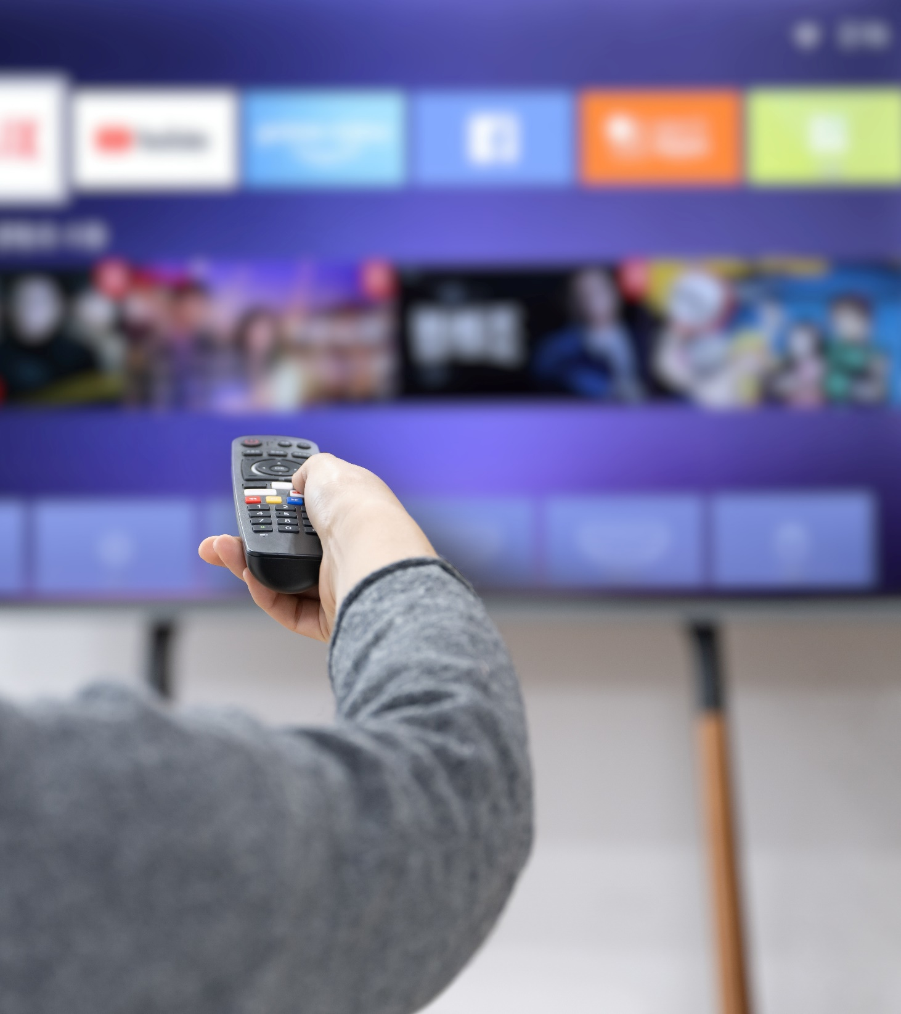

The number of connected TV apps used has doubled in the past two years, however app usage has plateaued recently signifying a limit to adoption
Average Number of Native Apps Used per Connected TV
Source: Inscape, TV Market Trends Report, Q4 2023. Inscape Panel, Base: Inscape TVs with at least one minute of app viewing. Streaming includes viewership on vMVPDs. Gaming console viewing is not included in these calculations.
This information is exclusively provided to VAB members and qualified marketers.
PAGE 7

Slide 8
2
The TV home screen is a growing source for content discovery

Slide 9

Viewers often spend over six minutes searching for new content on TV, indicating a significant time investment in the discovery process
When looking for something new to watch,
how long do you typically spend searching?
63%
of viewers are spending 6+ minutes searching
for new content
Source: Comcast, Content Discovery in a Multiscreen TV World, 2024. Comcast Advertising survey conducted through Cint in December 2023. U.S. N=1,500. Qualifying criteria: adults 18+ who searched for or watched something new in the past three months? Data refers to time spent searching for content on linear TV or streaming platforms.
This information is exclusively provided to VAB members and qualified marketers.
PAGE 9

Slide 10

With so many streaming offerings, viewers are often searching multiple apps or services to find content, highlighting a fragmented experience
Thinking about your experience when searching for something new to watch,
which statement most accurately describes your experience?
44%
‘I have to search multiple apps or services to find the content I want’
28%
‘I can easily search using my device and find what I want to watch’
22%
‘Everything I want to watch is in one place (e.g., a single app, device, service)’
6%
‘It’s hard to find the content I want so I opt to watch or do something else’
Source: Comcast, Content Discovery in a Multiscreen TV World, 2024. Comcast Advertising survey conducted through Cint in December 2023. U.S. N=1,500. Qualifying criteria: adults 18+ who searched for or watched something new in the past three months?
This information is exclusively provided to VAB members and qualified marketers.
PAGE 10

Slide 11

Viewers are using their TV's built-in home screens for content discovery, offering marketers the opportunity to connect within the native interface
Top Content Recommendation Sources*
2 in 5
CTV users rely on
the TV home screen
for content recommendations as the starting point for viewing
Source: LG Ad Solutions, The Big Shift: Wave III, 2024. *Note: Aided choices.
This information is exclusively provided to VAB members and qualified marketers.
PAGE 11

Slide 12
3
Consumers are now more likely to
adopt free streaming services &
ad-supported tiers than ad-free options

Slide 13
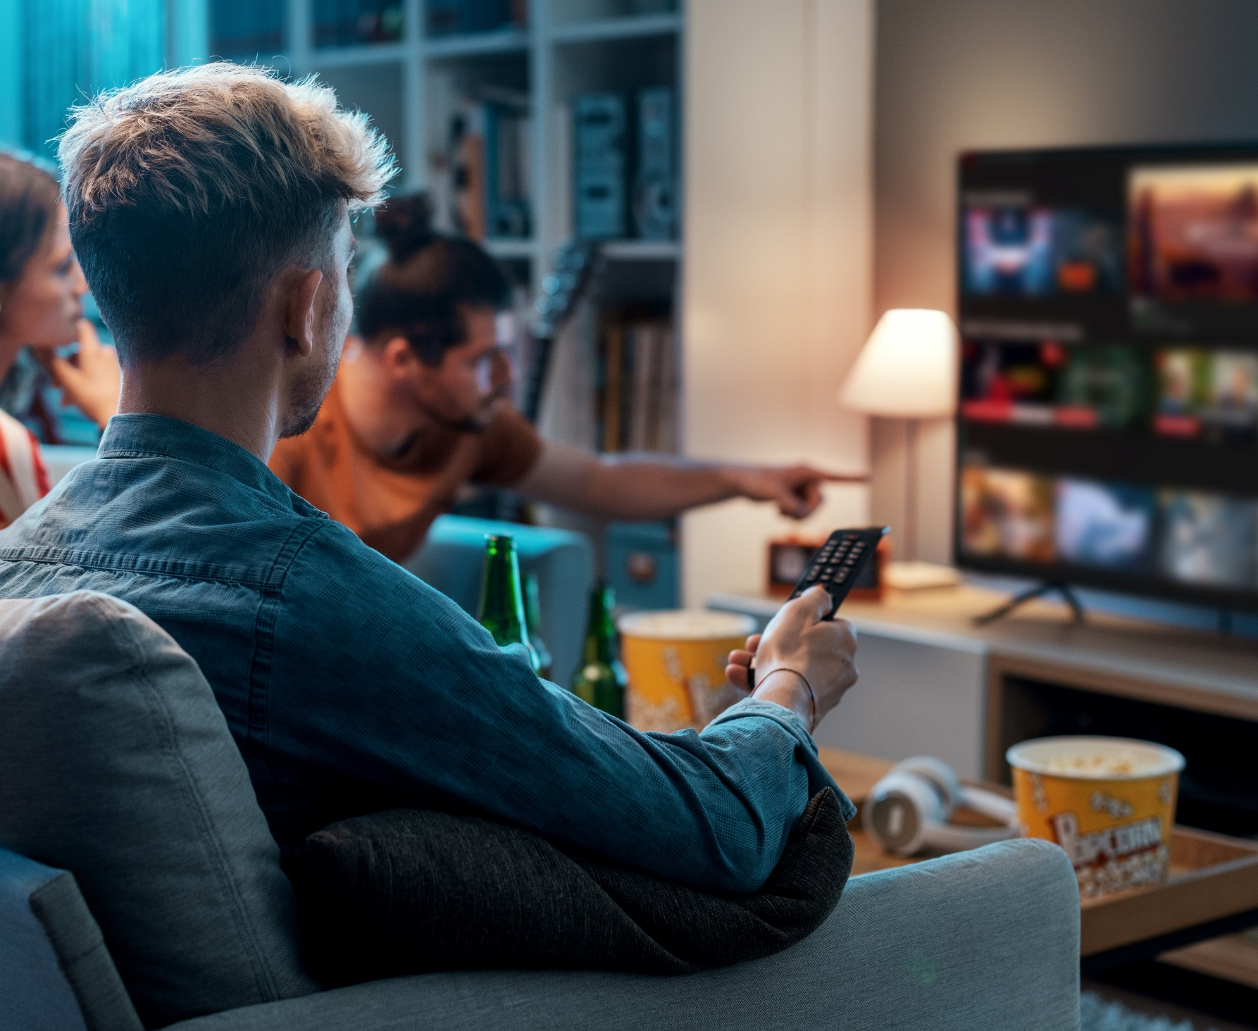

Two-thirds of audiences prefer ad-supported services and tiers due to the cost benefit and value exchange of ads in streaming
‘I prefer streaming free video content with ads / commercials instead of paying for a subscription without ads / commercials’
% of video streamers that agree
Source: VAB analysis of MRI-Simmons November 2022 & March 2024 Cord Evolution Study, A18+. ‘I prefer streaming free video content with ads/commercials instead of paying for a subscription without ads/commercials’ (strongly / somewhat agree). Base = ‘Streamed in the past 12 months’. Download VAB’s ‘Advertising Accelerated’ to learn more.
This information is exclusively provided to VAB members and qualified marketers.
PAGE 13

Slide 14
Most new subscriptions are for ad-supported tiers now, reflecting a shift in consumer preference towards cost-saving options with ads
Select SVOD Gross Adds
Ad-Free vs. Ad-Supported
Source: Antenna. U.S. only. Excludes free tiers, MVPD + Telco Distribution, and select Bundles. Services include AMC+, Apple TV+, BET+, Discovery+, Disney+, Hulu, Max, Netflix, Paramount+, Peacock and Starz. AMC+ does not include Direct distribution.
This information is exclusively provided to VAB members and qualified marketers.
PAGE 14

Slide 15


In addition to cost savings, consumers are OK with ad-supported tiers because they are used to seeing ads everywhere else online and offline
What are some reasons you would opt for a lower-cost ad-supported tier?
Source: DISQO, Ad-Supported Streaming TV: Optimizing brand experience in the fast-evolving streaming landscape, 2024. Based on survey of 17,788 U.S. adults from DISQO’s first-party audience, between 12/28/23 – 12/30/23. Q: What are some reasons you would opt for a lower-cost ad-supported tier?
This information is exclusively provided to VAB members and qualified marketers.
PAGE 15

Slide 16
4
As subscriber churn rises, more consumers are replacing subscriptions with ad-supported services

Slide 17

Churn is often driven by 'subscription cycling,' where viewers sign up for a specific show and cancel once it ends
% of U.S. adults planning to subscription cycle in the next 6 months
67%
76%
66%
45%
Source: Samba TV, The State of Viewership: H2 2023, U.S. ‘Subscription cycling’ refers to the trend of people signing up for a subscription video on demand (SVOD) service to watch a specific program, then canceling the subscription once the program ends and signing up for another.
This information is exclusively provided to VAB members and qualified marketers.
PAGE 17

Slide 18
Economic concerns have driven over half of viewers to cancel a streaming subscription in the past year, contributing to rising churn
SVOD Industry Average Churn YoY*
based on average service
52%
+10%
say that economic concerns have caused them to cancel a streaming subscription in the last 12 months
(+14% YoY)
Source: LG Ad Solutions, The Big Shift: Wave III, 2024. *Antenna. Chart by ESHAP.
This information is exclusively provided to VAB members and qualified marketers.
PAGE 18

Slide 19
More viewers are replacing paid subscriptions with free services, reflecting a growing preference for cost-effective options
Change in Subscription / Free Streaming Services
Past 12 Months
Next 12 Months
+2% pp YoY
+17% pp YoY
-6% pp YoY
+16% pp YoY
Source: LG Ad Solutions, The Big Shift: Wave III, 2024. PP = percentage point.
This information is exclusively provided to VAB members and qualified marketers.
PAGE 19

Slide 20
5
Bundling services together is aiding in acquiring and retaining streaming subscribers

Slide 21

Three-quarters of viewers watch streaming through bundles or packages, indicating a trend toward more selection and value
Source: DISQO, Ad-Supported Streaming TV: Optimizing brand experience in the fast-evolving streaming landscape, 2024. Based on survey of 17,788 U.S. adults from DISQO’s first-party audience, between 12/28/23 – 12/30/23.
This information is exclusively provided to VAB members and qualified marketers.
PAGE 21

Slide 22
Bundling multiple streaming services at a discount can entice most consumers to consider subscribing to that bundle
How much would each of the following impact the likelihood of you subscribing to a streaming service?
% of respondents, sorted by top 2 box
Major Impact | Moderate Impact
Exclusive original content
Access to other streaming services at a discount
Free trials
Older content that originally aired on other TV networks or streaming services
Ability to share passwords with friends / family
for no extra cost
Source: VAB custom research fielded by Hub Entertainment Research as part of the 2023 Best Bundle report. Data sourced from Hub’s survey of 1,603 TV consumers, ages 16-74 who meet the following criteria: watch at least one hour of TV / week, have broadband access. U.S. census balanced Data collected March 2023. Q: How much would each of the following items impact the likelihood of you subscribing to a streaming service? Respondents who answered ‘major impact’ or ‘moderate impact’. ‘Major impact’ and ‘moderate impact’ might not add up to top 2 box total due to rounding. Download VAB’s ‘Recipe for Success’ to learn more.
This information is exclusively provided to VAB members and qualified marketers.
PAGE 22

Slide 23





The introduction of non-TV elements, like retail benefits, into a bundle can also motivate users to continue subscribing to a streaming service
Which of the following incentives, if any, would motivate you to continue subscribing to a streaming service?
% of total respondents
Free access to other, non-TV benefits
(e.g., Walmart+, Amazon Prime)
Access to other streaming services
at a discount
Ability to switch to a lower-priced ad-supported tier or see even more ads for a lower cost
37%
33%
26%
Exclusive benefits for premium subscribers or frequent users of a service
Ability to watch live sporting events
25%
25%
Source: VAB custom research fielded by Hub Entertainment Research as part of the 2023 Best Bundle report. Data sourced from Hub’s survey of 1,603 TV consumers, ages 16-74 who meet the following criteria: watch at least one hour of TV / week, have broadband access. Data collected early February 2023. Q: Which of the following incentives, if any, would motivate you to continue subscribing to a streaming service? Download VAB’s ‘Recipe for Success’ to learn more.
This information is exclusively provided to VAB members and qualified marketers.
PAGE 23

Slide 24
6
Interactive CTV ads are creating significant engagement across categories

Slide 25




Consumers are inherently curious and motivated to act after engaging with an interactive ad
% of P16+ who have taken the following actions after seeing a specific type of interactive shoppable ad
% of respondents Total (rank 1-3)
Click to Receive Info to Your Email / Device
Explorable Ads*
‘Click to Buy’ Ads
QR Codes
67%
Have interacted
62%
Have interacted
58%
Have interacted
36%
Have interacted
27%
Used a search engine to look up more information
28%
Used a search engine to look up more information
18%
Used a search engine to look up more information
13%
Visited a website for a product/service to learn more
24%
Visited a website for a product/service to learn more
26%
Saved information for future reference
17%
Purchased a product they
saw advertised
13%
Downloaded an app they
saw on screen
23%
Used a coupon or offer they received from the ad
22%
Visited a website for a product/service to learn more
17%
Visited a brands social media page to learn more
12%
Used a search engine to look up more information
Source: VAB custom research fielded by Hub Entertainment Research as part of the 2023 Monetization of Video report. Data sourced from Hub’s survey of 1,602 TV consumers, ages 16-74 who meet the following criteria: watch at least one hour of TV / week, have broadband access. U.S. census balanced. Data collected June 2023. Q: Which of the following actions have you taken after seeing the following types of ads? *Ads that let you browse different video clips, product types, or information screens. Download VAB’s ‘Recipe for Success’ to learn more.
This information is exclusively provided to VAB members and qualified marketers.
PAGE 25

Slide 26



As viewers spend more time with ad-supported content, it is important for marketers to note the effectiveness and engagement of interactive ads
3.39%
92 seconds
Engagement Rate
Consumers spend an average of an additional 92 seconds engaging with interactive CTV ads vs. standard pre-roll
Interactive CTV ads deliver 7x the engagement of standard video ads
Source: Innovid, The CTV Advertising Insights Report 2024.
This information is exclusively provided to VAB members and qualified marketers.
PAGE 26

Slide 27





Interactive ads greatly enhance brand awareness, ad recall and purchase intent across various categories, especially among high-income viewers
Interactive Ad Viewer Impact, by Category
Category:
Outdoor Living
Category: Electronics
Category:
Pharma
Category:
Energy
Audience: A40+ HHs with an income of $75K+
Audience: Males 25-54
Audience: HHs with an income of $100K+
Audience: HHs with an income of $100K+
Brand Awareness
+38%
Brand Awareness
+18%
Brand Awareness
+23%
Brand Awareness
+11%
Purchase Intent
+48%
+135%
+46%
+182%
Ad Recall
Ad Recall
Ad Recall
Brand Consideration
+46%
Source: BrightLine, State of the TV Ad(Re)volution, 2023.
This information is exclusively provided to VAB members and qualified marketers.
PAGE 27

Slide 28

It is important for marketers to adopt appealing ad experiences, as people don't inherently mind ads - they mind bad ones
“There was always this notion that people don’t like ads. I don’t think that’s true. People don’t like bad advertising or a bad advertising experience.”
Rita Ferro, President of Global Advertising, The Walt Disney Company
(New York Times, 5/26/24)
This information is exclusively provided to VAB members and qualified marketers.
PAGE 28

Slide 29


Streaming TV has become the go-to choice for video consumption, with many preferring larger screens and enhanced viewing experiences via their CTV
Viewers are increasingly relying on their TV home screen to discover new content which creates additional opportunities for marketers to connect with consumers on the TV set, outside of programming
Consumers are now favoring free, ad-supported streaming services and tiers over fully paid subscriptions, driven by cost-saving benefits
and the widespread acceptance of ads
Interactive CTV ads create a more ‘lean-in’ experience which drives higher engagement,
brand awareness and purchase intent across categories
Key Marketer Takeaways
This information is exclusively provided to VAB members and qualified marketers.
PAGE 29

Slide 30




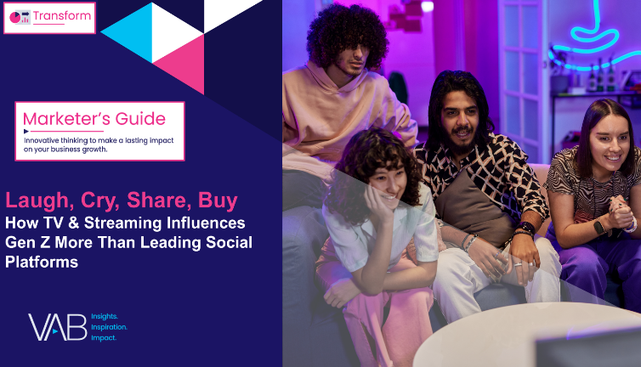
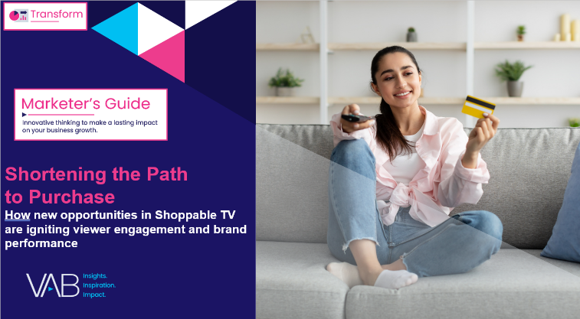
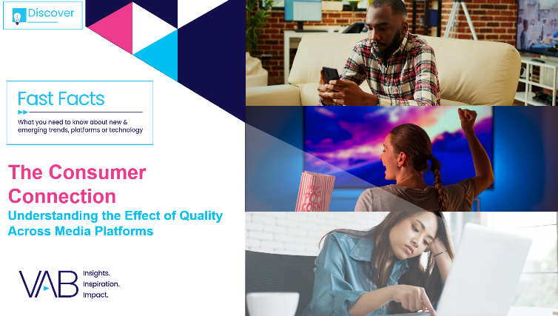

Creators
Jason Wiese
Leah Montner-Dixon
SVP, Director of Strategic Insights
jasonw@thevab.com
Director, Audience & Behavioral Insights
leahm@thevab.com
Recipe for Success
Six Key Ingredients for
Stirring Growth in Streaming
Advertising, Accelerated
An Update on 15 Streaming Trends That Are Impacting Marketing Plans
Discover more
Looking for more data, insights and takeaways? Check out this related VAB content
Left to Your Own Devices
The Latest on Multiplatform Video Consumption – June 2024
Laugh, Cry, Share, Buy
How TV & Streaming Influences Gen Z More Than Leading Social Platforms
Through Upfront season, marketers are making important decisions about their video investment strategy.
We’re here to help.
Visit our Upfront Planning Resource Center
for a curated a list of resources filled with the data, analysis and insights needed to make informed investment decisions.
Shortening the Path to Purchase
How New Opportunities in Shoppable TV are Igniting Viewer Engagement & Brand Performance
The Consumer Connection
Understanding the Effect of Quality
Across Media Platforms
VAB Members, brand marketers and agencies get free and immediate access to VAB’s content library. Get access at theVAB.com
This information is exclusively provided to VAB members and qualified marketers.
PAGE 30

Slide 31


About VAB
VAB plays a dual role in the video advertising industry. We are leading the change to bring about a more innovative and transparent marketplace. We also provide the insights and thought leadership that enables marketers to develop business-driving marketing strategies.
Drawing on our marketing expertise, we simplify the complexities in our industry and discover new insights that transform the way marketers look at their media strategy.
We are committed to your business growth and proud to offer VAB members, brand marketers and agencies complimentary access to our continuously-growing Insights library. Get immediate access at theVAB.com.
This information is exclusively provided to VAB members and qualified marketers.
PAGE 31

