Slide 1




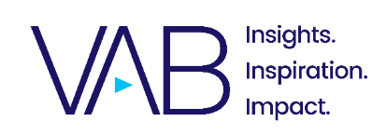
A Silver Lining
Understanding the Consumer Value of Adults 65+
September 2023
Part 1

Slide 2


The new age of adults 65+ -
active lifestyles with increased purchasing power
Older adults are evolving into a vibrant demographic.
As many postpone traditional retirement milestones and engage in a more fun and active lifestyle, they are also spending more in discretionary categories and have a much higher household net worth than younger consumers.
However, they are often an overlooked opportunity by marketers.
This piece explores how adults 65+ today defy preconceptions, how the recent pandemic and on-going economic uncertainty has affected their mindset and why they are an important segment for brands to engage with.
This information is exclusively provided to VAB members and qualified marketers.
PAGE 2

Slide 3

The mindset and lifestyle of adults 65+

Slide 4

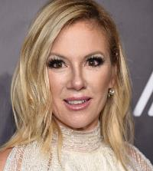

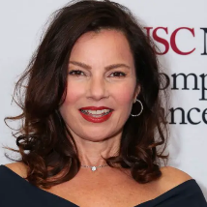


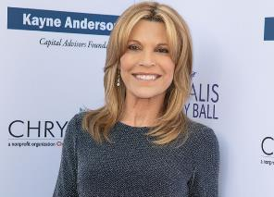

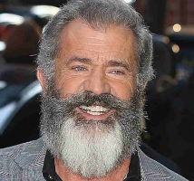

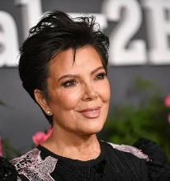
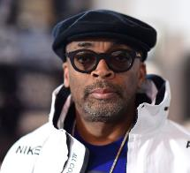
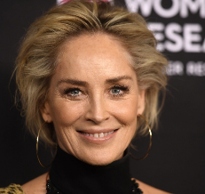
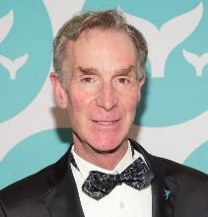

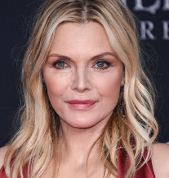

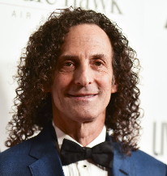
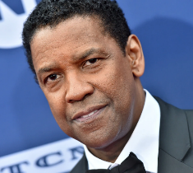
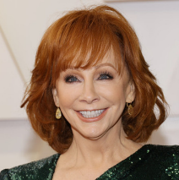
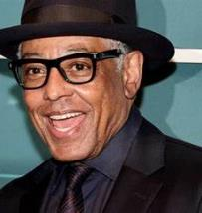
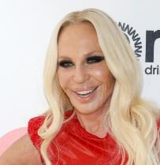
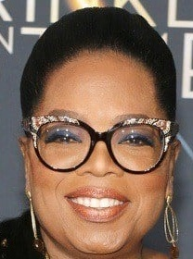

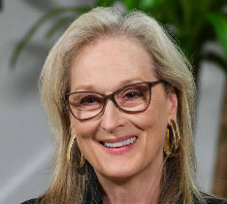
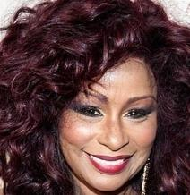
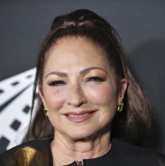

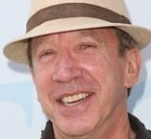


Adults 65+ today defy expectations from the past
They’re…
  Influencers
  Actors
  Entertainers
  Musicians
  Thinkers
  Artists
  Athletes
This information is exclusively provided to VAB members and qualified marketers.
PAGE 4

Slide 5
















They’re also…
  Carpenters
  Teachers
  Accountants
  Chefs
  Lawyers
  Doctors
  Architects
  And, of course,
  Active Retirees
This information is exclusively provided to VAB members and qualified marketers.
PAGE 5

Slide 6





There’s no doubt the pandemic took a toll on all age segments, however adults 65+ were more likely to fare better emotionally than younger people
Older adults tend to have much more stability in their personality, social support networks and day-to-day activities and were thus disrupted much less by the pandemic than younger people…this also shows just how important the perspective of age can be
The impact of the pandemic on older adults
Well-being
Relationships
Travel
Work
They were the least likely to report psychological stress / poor physical and mental health
(much less likely than people 16-24)
Almost 66% of adults 80+ say they are living their ‘best life possible’ or close to it
(vs. 20% of younger adults)
90% of adults 55+ were extremely or very satisfied with their relationships during
and after the pandemic
Three-quarters said their happiness levels stayed the same during Covid
Multigenerational travel is up 50%
Nearly 40% of adults 65+ are prioritizing traveling out of state with more than half visiting family or friends
Covid has prompted about one-third of adults to change the age they anticipate retiring
Nearly 40% of older adults are planning to work another 3-5 years before retiring
Source: AARP, Three Years In, How the Pandemic Has Changed Our Lives (and How It Hasn’t), March 7, 2023.
This information is exclusively provided to VAB members and qualified marketers.
PAGE 6

Slide 7
With greater stability, older adults are more likely to report better mental, and sometimes even physical, health compared to younger generations
% of respondents who report their mental vs. physical health as poor or very poor by generation
Source: eMarketer Insider Intelligence, U.S. Adults Who Report Their Mental vs. Physical Health as Poor or Very Poor, by Generation, November 2022.
This information is exclusively provided to VAB members and qualified marketers.
PAGE 7

Slide 8



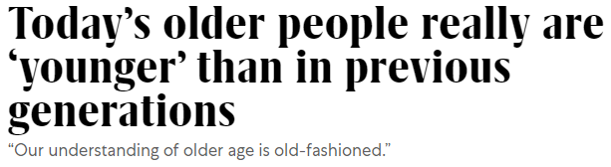
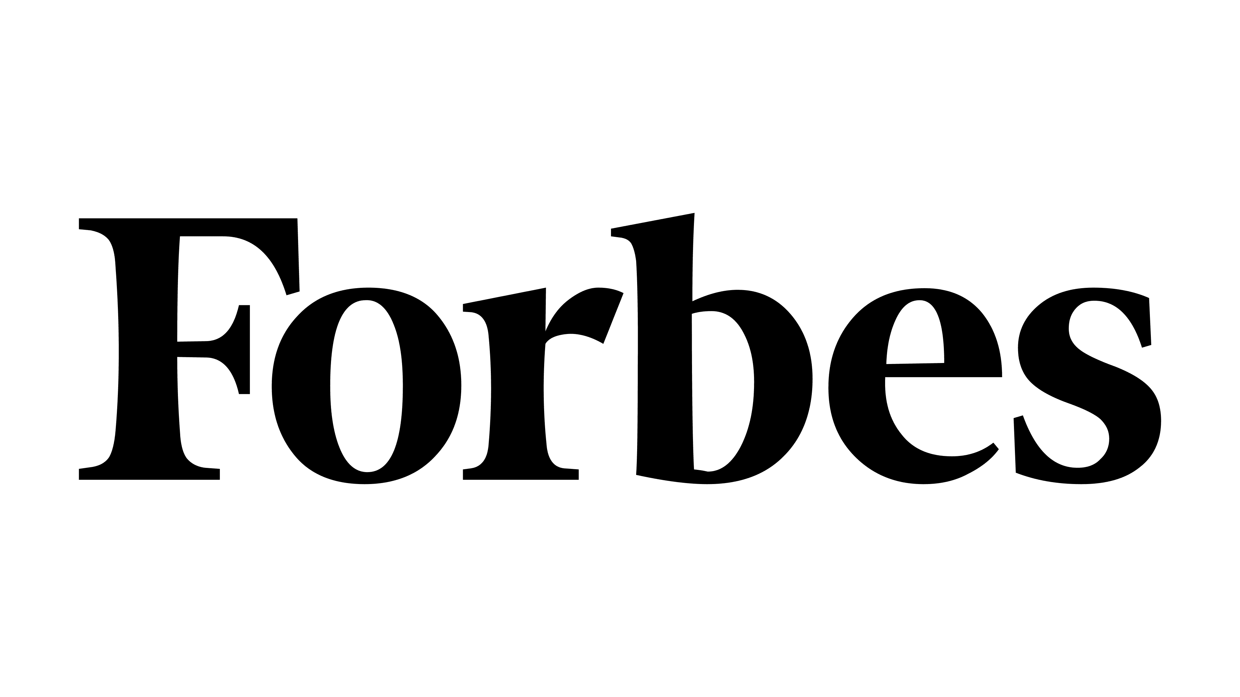

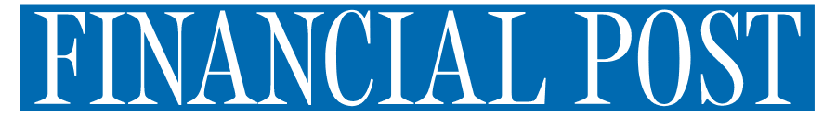

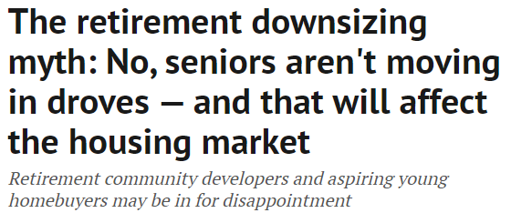
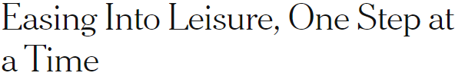
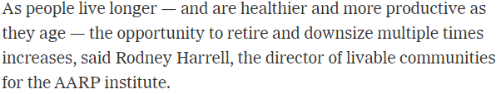
Older adults are embracing more active lifestyles while postponing ‘later’ life milestones like downsizing & retirement
This information is exclusively provided to VAB members and qualified marketers.
PAGE 8

Slide 9











They are spending more time staying active, participating in physical activities like hiking, bicycling and yoga for enjoyment and their health
Top 10 Sports Adults 65+ Personally Participated in the Last 12 months
Walking for Exercise
Swimming
Hiking
Weightlifting
Bicycling
A65+ spend 61% more time than A25-34 doing leisure activities & sports
73% of adults 65+ say they ‘exercise regularly’
Fishing
Golf
Yoga
Aerobics
Cornhole
59% of adults 65+ have participated in at least one of these sports in the last 12 months
Source: VAB analysis of U.S. Bureau of Labor Statistics data, American Time Use Survey, 2021; % Share based on Average Hours Per Day Spent in Primary Activities; Younger millennials = A25-34. VAB analysis of MRI-Simmons Winter 2023 USA Study.
This information is exclusively provided to VAB members and qualified marketers.
PAGE 9

Slide 10




Those who are retired are often financially stable and able to seek out colorful lives filled with travel and connectivity
Attitudes of Retirees 65+
% of respondents who agree
82%
68%
65%
46%
Feel financially secure
Agree that life should be as fun as possible
Would feel disconnected without internet
Agree that travel
is their passion
Source: VAB analysis of MRI-Simmons Spring 2023 USA Study. Base = Employment Status – Retired.
This information is exclusively provided to VAB members and qualified marketers.
PAGE 10

Slide 11
However, adults 65+ are also more likely to be active in the workforce today because they are choosing to work longer
% of U.S. A65+ who are employed
+28%
19%
15%
Source: VAB analysis of MRI-Simmons USA Study, Spring 2017 & Spring 2023. ‘Other’ includes individuals not in the workforce or not explicitly defined as ‘retired’.
This information is exclusively provided to VAB members and qualified marketers.
PAGE 11

Slide 12
With many working later into life, the growth in their average household income has outpaced younger demographics
Their household income has outpaced the national average increase over the past 20 years
+101%
2001 vs. 2021
A25-64 % Change:
+84%
Source: VAB analysis of Consumer Expenditure Survey, U.S. Bureau of Labor Statistics, 2001, 2011 & 2021; Reflects income before taxes.
This information is exclusively provided to VAB members and qualified marketers.
PAGE 12

Slide 13







With greater disposable income, adults 65+ are more likely to spend in discretionary categories like pets, entertainment, home and dining out
Older adults are living more active and social lives than previous generations, and as a result they are spending more on ‘fun’ categories, outpacing growth in spend among the average consumer
A65+ % Increase in Average Annual Expenditures by Category: 2011 vs. 2021
Household Furnishings & Equipment
Pets & Toys
Vehicle Purchases
+146%
+145%
+143%
vs. 2011
vs. 2011
vs. 2011
A25-64 % Increase: +84%
A25-64 % Increase: +53%
A25-64 % Increase: +95%
Alcoholic Beverages
Dining Out
Entertainment Fees & Admissions
+84%
+53%
+27%
vs. 2011
vs. 2011
vs. 2011
A25-64 % Increase: +27%
A25-64 % Increase: +23%
A25-64 % Increase: +19%
Source VAB analysis of Consumer Expenditure Survey data, U.S. Bureau of Labor Statistics, 2011 & 2021.
This information is exclusively provided to VAB members and qualified marketers.
PAGE 13

Slide 14








Although we’ve been in a period of economic uncertainty and inflation, most adults 65+ are not cutting back on their favorite activities because of it
% of adults 65+ who are not cutting back on the following in response to inflation
Exercise / gym memberships
Buying fresh produce
Making personal investments
(trading stocks, bonds, crypto, ETFs)
Their # of TV streaming services
95%
91%
90%
82%
Attending events
(concerts, sports games, etc.)
Travel
Buying name brand products
Eating out at restaurants
64%
55%
50%
36%
Source: VAB analysis of MRI-Simmons Trending Topics, 2Q 2023 USA Study.
This information is exclusively provided to VAB members and qualified marketers.
PAGE 14

Slide 15


With half of adults 65+ open to switching brands due to inflation, there’s opportunities for advertisers to create new loyalists among this segment
% of adults 65+ who agree with the following statements
“When I find a brand I like, I stick to it”
“If a product is made by a company I trust,
I'll buy it even if it is slightly more expensive”
90%
80%
vs. 46% of A18-34
vs. 71% of A18-34
Source: VAB analysis of MRI-Simmons Spring 2023 USA Study.
This information is exclusively provided to VAB members and qualified marketers.
PAGE 15

Slide 16


Brands can also create loyalists by being more inclusive with this lucrative segment through their product development, innovation and marketing
76% of adults 55+ are likely to decide against purchasing from a company whose advertising either ignores them or they find objectionable*, marketers should pay more mind to this valuable segment
% of A55+ Who Agree With the Following Statements
“Most new products are being created with my needs in mind”
“Most new products excite me”
19%
27%
vs. 41% of A18-34
vs. 52% of A18-34
Source: Ipsos, Why Brands Need to Innovate for Older Americans, May 2023. *CivicScience data via Marketing Charts, 6 in 10 Adults Ages 55+ Feel They’re Not Accurately Represented in Marketing and Advertising, August 2023. Based on respondents who answered, ‘very likely’ (50%) and ‘somewhat likely’ (26%).
This information is exclusively provided to VAB members and qualified marketers.
PAGE 16

Slide 17
Sizing the adult 65+ consumer marketplace

Slide 18
There are nearly 60 million adults 65+ in the U.S., a population that has more than doubled in size over the last 40 years
+17.0MM
+17.5MM
+3.8MM
+3.6MM
+5.6
MM
% of Total Population
11%
13%
12%
13%
17%
21%
1980
1990
2000
2010
2020
2030
Source: VAB analysis of U.S. Census Bureau data, Population Estimates for 1980, 1990, 2000, 2010; U.S. Census Bureau, Population Division: Washington, DC., Projected Age Groups and Sex Composition of the Population: Main Projections Series for the United States, 2017-2060.
This information is exclusively provided to VAB members and qualified marketers.
PAGE 18

Slide 19
In the last 10 years, over 16 million adults have aged into the adults 65+ demo, while younger populations are experiencing less growth
U.S. Population by Demo
Broadcast Years
’11 vs ’21
P65+: +16.3MM
P25-64 + 7.0MM
P25+: +23.3MM
225,050
Total P25+ U.S. Pop
201,800
(% of P25+ US Pop)
Source: VAB analysis of Nielsen Universe Estimates data, Total U.S., Base: P25+, years reflect that following: 8/29/11-8/26/12 & 8/30/21-8/28/22.
This information is exclusively provided to VAB members and qualified marketers.
PAGE 19

Slide 20
A good measure for financial stability and wealth, household net worth growth for adults 65+ has outpaced younger demographics
This is especially apparent when looking at the average home’s net worth
Household Net Worth by Demo
2017 vs. 2023
+80%
+50%
+7%
Source: VAB analysis of MRI-Simmons USA Study, Spring 2017 & Spring 2023. According to the U.S. Census Bureau, ‘net worth’ is the value of assets owned (cash in bank accounts, investments, retirement accounts, etc. as well as the value of any owned property) minus any liabilities owed (debt, including student loans, credit cards, mortgage, etc.).
This information is exclusively provided to VAB members and qualified marketers.
PAGE 20

Slide 21
With increased net worth, adults 65+ are active spenders, accounting for 21% of annual total U.S. expenditures, which translates to $1.9 trillion
A55+ account for 41% of annual U.S. expenditures
Source: VAB analysis of Consumer Expenditure Survey 2021 data, U.S. Bureau of Labor Statistics, reported as of September 2022, Data represents adults 65+ due to data age group breakouts.
This information is exclusively provided to VAB members and qualified marketers.
PAGE 21

Slide 22
They have become a powerful buying segment as their annual spending has increased by over $1 trillion in the last two decades
Growth in adult 65+ expenditures is outpacing younger demographics
+208%
2001 vs. 2021
A25-64 % Change: +91%
$1.9T
$1.0T
+85%
2011 vs. 2021
A25-64 % Change: +40%
Source: VAB analysis of Consumer Expenditure Survey data, U.S. Bureau of Labor Statistics, 2001, 2011 & 2021, Data represents adults 65+ due to data age group breakouts.
This information is exclusively provided to VAB members and qualified marketers.
PAGE 22

Slide 23

Adults 65+ are embracing active lifestyles and leveraging their increased disposable income to fund their interests, which translates to inclusive brand opportunities that are often overlooked by marketers today
The adult 65+ population has more than doubled in size and their spending has more than tripled, increasing by over $1 trillion annually, in the last 20 years which firmly establishes them as a very lucrative segment for brands to directly engage with
Key Marketer Takeaways
This information is exclusively provided to VAB members and qualified marketers.
PAGE 23

Slide 24
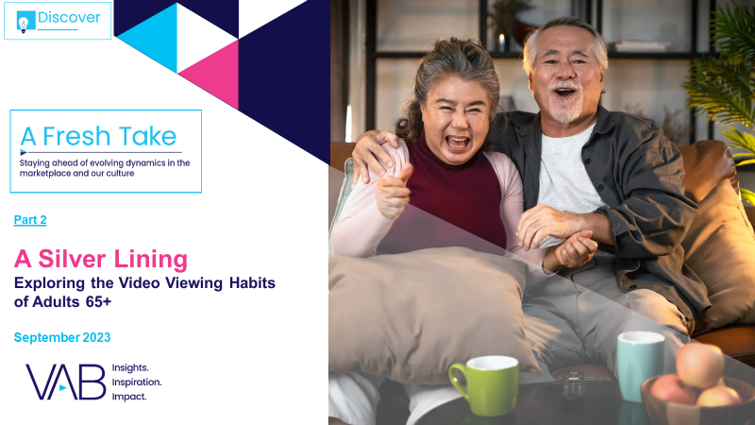


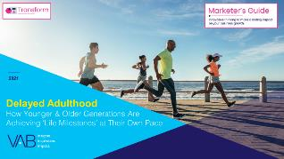

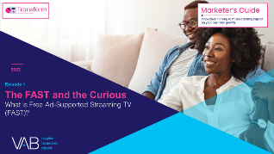

Creators
Jason Wiese
Leah Montner-Dixon
SVP, Director of Strategic Insights
jasonw@thevab.com
Director, Audience & Behavioral Insights
leahm@thevab.com
Karolina Guillen
Click here to download part 2 of this 2-part series
Insights Manager
karolinag@thevab.com
A Silver Lining
Exploring the Video Consumption Habits of Adults 65+
The Secret of My Success
Examining The Winning Marketing Strategy That’s Fueling High-Growth DTC Brands
Discover more
Looking for more data, insights and takeaways? Check out this related VAB content
Audience Migration in Context
Leveraging Population Shifts To Unlock $4 Trillion In Buying Power
Delayed Adulthood
How Younger & Older Generations Are Achieving ‘Life Milestones’ at Their Own Pace
We are committed to providing marketers with the data and insights they need to develop thoughtful, inclusive campaigns & strategies. To find out more on the unique media consumption behaviors and cultural trends of diverse consumers, visit the VAB’s DEIB Marketing Resources Center.
The FAST and the Curious
What is Free Ad-Supported Streaming TV (FAST)?
The Opportunities to Engage Adults 50+ in Streaming Video
VAB Members, brand marketers and agencies get free and immediate access to VAB’s content library. Get access at theVAB.com
This information is exclusively provided to VAB members and qualified marketers.
PAGE 24

Slide 25


About VAB
VAB is an insights-driven organization that inspires marketers to reimagine their media strategies resulting in fully informed decisions.
Drawing on our marketing expertise, we simplify the complexities in our industry and discover new insights that transform the way marketers look at their media strategy.
We are committed to your business growth and proud to offer VAB members, brand marketers and agencies complimentary access to our continuously-growing Insights library. Get immediate access at theVAB.com.
Curious to learn more about VAB? Check out this quick video to see what we do and how we can help you develop business-driving marketing strategies.
This information is exclusively provided to VAB members and qualified marketers.
PAGE 25

