Slide 1

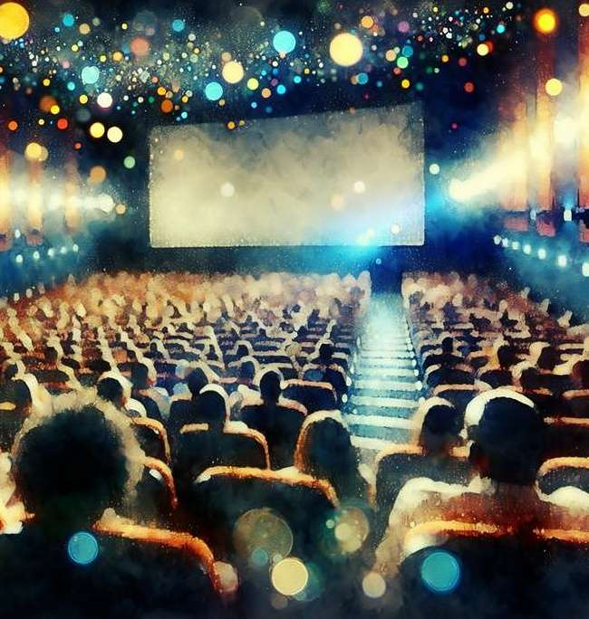



Show Me the Money
Highlighting the Value of Moviegoers Across 20 Major Categories

Slide 2


Moviegoers contribute outsized sales to brands across a variety of categories
Cinema captivates an attentive audience in a distraction-free setting, boosting brand favorability and purchase intent. Moviegoers themselves are desirable consumers who spend more across a range of categories including ecommerce, financial, health and beauty, home improvement, travel and more.
With the active lifestyles of adults 18-34 and the high disposable income of affluent consumers, moviegoers are a prime audience
for marketers seeking to drive purchases across these segments.
Their spending habits reflect consumers with a variety of interests and needs – which can also involve their family, their friends or just themselves.
For marketers, cinema advertising offers an opportunity to reach
an engaged audience with a proven propensity for purchase
in their category.
This information is exclusively provided to VAB members and qualified marketers.
PAGE 2

Slide 3


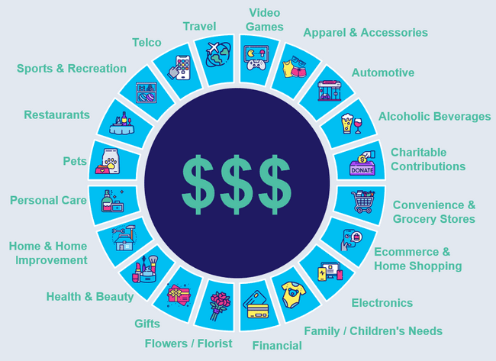
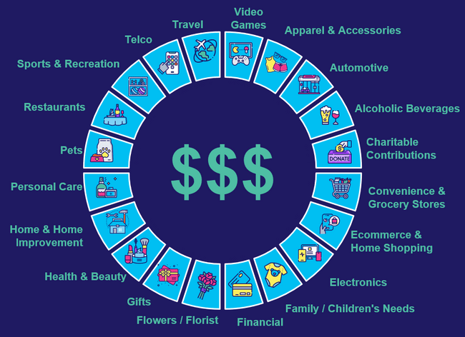
The Cinema Equation for Brand Success
Cinema:
Video Platform
Moviegoers:
Audience
Advertisers:
Incremental Sales
Highly attentive environment with emotionally engaging content that creates a positive mindset among moviegoers
Highly desirable consumers with a variety of interests and needs who drive outsized sales across
a wide range of major categories
This information is exclusively provided to VAB members and qualified marketers.
PAGE 3

Slide 4

Cinema is a highly attentive video platform with emotionally engaging content that delivers positive results for brands

Slide 5


Almost all moviegoers, including young adults, put their phones away once the lights go down, which creates a fully immersive atmosphere
% of moviegoers that…
P18+
P18-24
P18-34
$150K+ HHI
97% / 95% / 96% / 96%
put away their phones
once the lights go down in the movie theater
Besides sleep, what other activity can get Gen Z’ers to put their phones away for over two hours?!?*
Source: Screenvision, Screen Engine Data, March 2024. Base: P18+, P18-24 & P18-34, $150K+ HHI. ‘Once the lights in the theater go down, do you typically put your cell phone away?’ *Average length of a theatrical release is 2 hours, 6 minutes according to VAB’ At the Movies: 15 Reasons to Include Cinema Within a Video Ad Campaign.
This information is exclusively provided to VAB members and qualified marketers.
PAGE 5

Slide 6






The theatrical experience achieves much greater audience attention for cinema advertising in comparison to other digital and social channels
Average Seconds Viewed of Ads
:30 second ads
:15 second ads or less
Source: NCM & Lumen, Attention Study, October 8-12, 2023, n=364 A18+. Lumen/Holdco Proprietary Audio/Social/Digital 2023 Study.
This information is exclusively provided to VAB members and qualified marketers.
PAGE 6

Slide 7

Cinema fosters a sense of connection within the theater, which is crucial for people’s overall mood, well-being and sense of community with others
60%
of people always or often experience a sense of connection to others at the movies
Source: Digital Cinema Media (DCM), Maxmising Cultural Power with Cinema, 2024. DCM / Burst Your Bubble 2024. Base: Cinema goers last 4 weeks; P16-54 (n = 884).
This information is exclusively provided to VAB members and qualified marketers.
PAGE 7

Slide 8

People are in a good mood at the movies and those who are in a positive state of mind are more inclined to purchase products they see advertised
Impact of positive mindset on response to advertising
+18%
78%
of people who visit the cinema spend their time there in a good mood
Increase in brand favorability
+35%
Increase in purchase intent
Source: Digital Cinema Media (DCM), Cinema Effectiveness Roadmap, 2023. IPA Touch Points.
This information is exclusively provided to VAB members and qualified marketers.
PAGE 8

Slide 9
Moviegoers, including young and affluent audiences, are highly desirable consumers who drive outsized sales across a wide variety of major categories

Slide 10




















In this analysis, we examined the average moviegoer’s spending across twenty categories representing a wide variety of interests and needs
20 Categories Analyzed
Apparel & Accessories
Automotive
Alcoholic Beverages
Charitable Contributions
Convenience & Grocery Stores
Ecommerce & Home Shopping
Electronics
Family / Children's Needs
Financial
Flowers / Florist
Gifts
Health & Beauty
Home & Home Improvement
Personal
Care
Pets
Restaurants
Sports & Recreation
Telco
Travel
Video Games
click the appropriate box above if you would like to be brought directly to the corresponding category
Note: Total annual U.S. consumer expenditures across 19 categories, excluding ‘Financial’ = $4.4 trillion. ‘Financial’ category is excluded from the total since the category represents ‘credit card / debit card – total expenditures’ and therefore would inherently include some duplication of expenditures across the other 19 categories (based on the assumption that at least some spending across the other categories was done using a credit or debit card).
This information is exclusively provided to VAB members and qualified marketers.
PAGE 10

Slide 11
Moviegoers are highly desirable consumers who spend much more than non-moviegoers on average across all the categories we analyzed
19 Categories*: Aggregated Annual Expenditure Per Person
(% difference vs. Non-Moviegoers)
Demo | Non-Moviegoers | Moviegoers | ‘Frequent’ Moviegoers
A18+ | $16,241 | $19,233 | $19,677
A18-34 | $15,691 | $17,843 | $18,314
Affluent HHI $100K+ | $20,190 | $22,421 | $22,907
(+18% higher)
(+21% higher)
(+14% higher)
(+17% higher)
(+11% higher)
(+13% higher)
Source: VAB analysis of MRI-Simmons Spring 2024 Doublebase Study, A18+. ‘Non-Moviegoer’ = Has not gone to the movies in the last 12 months; ‘Moviegoer’ = Attended a movie in the last 12 months; ‘Frequent Moviegoer’ = Attend a movie at least once a month. *’Financial’ category is excluded from the total since the category represents ‘credit card / debit card – total expenditures’ and therefore would inherently include some duplication of expenditures across the other 19 categories (based on the assumption that at least some spending across the other categories was done using a credit or debit card).
This information is exclusively provided to VAB members and qualified marketers.
PAGE 11

Slide 12

Apparel & Accessories
The average moviegoer spends much more than non-moviegoers on apparel, revealing a valuable audience inclined to ‘look good, feel good’
Apparel & Accessories: Annual Expenditure Per Person
(% difference vs. Non-Moviegoers)
Demo | Non-Moviegoers | Moviegoers | ‘Frequent’ Moviegoers
A18+ | $534 | $719 | $817
A18-34 | $548 | $691 | $785
Affluent HHI $100K+ | $686 | $839 | $943
(+35% higher)
(+53% higher)
(+26% higher)
(+43% higher)
(+22% higher)
(+37% higher)
Source: VAB analysis of MRI-Simmons Spring 2024 Doublebase Study, A18+. ‘Non-Moviegoer’ = Has not gone to the movies in the last 12 months; ‘Moviegoer’ = Attended a movie in the last 12 months; ‘Frequent Moviegoer’ = Attend a movie at least once a month. ‘Apparel and accessories’ includes expenses on women’s clothing, men’s clothing, fine jewelry, athletic shoes, other shoes, watches, dry cleaning, laundry / laundromats, costume jewelry and nonprescription sunglasses.
This information is exclusively provided to VAB members and qualified marketers.
PAGE 12

Slide 13

Automotive
Moviegoers spend slightly more on their automotive needs to aid in their mobility and ability to conveniently get out of their house and drive
Automotive: Annual Expenditure Per Person
(% difference vs. Non-Moviegoers)
Demo | Non-Moviegoers | Moviegoers | ‘Frequent’ Moviegoers
A18+ | $1,517 | $1,614 | $1,594
A18-34 | $1,464 | $1,517 | $1,507
Affluent HHI $100K+ | $1,746 | $1,740 | $1,722
(+6% higher)
(+5% higher)
(+4% higher)
(+3% higher)
(Flat)
(-1% lower)
Source: VAB analysis of MRI-Simmons Spring 2024 Doublebase Study, A18+. ‘Non-Moviegoer’ = Has not gone to the movies in the last 12 months; ‘Moviegoer’ = Attended a movie in the last 12 months; ‘Frequent Moviegoer’ = Attend a movie at least once a month. ‘Automotive’ includes expenses on gasoline, automotive maintenance & repairs, tires and automotive parts & supplies.
This information is exclusively provided to VAB members and qualified marketers.
PAGE 13

Slide 14

Alcoholic Beverages
Alcohol brands can tap into moviegoers’ large appetite for social gatherings with friends or family, both in and out of the home
Alcoholic Beverages: Annual Expenditure Per Person
(% difference vs. Non-Moviegoers)
Demo | Non-Moviegoers | Moviegoers | ‘Frequent’ Moviegoers
A18+ | $228 | $309 | $326
A18-34 | $202 | $287 | $296
Affluent HHI $100K+ | $328 | $390 | $428
(+35% higher)
(+43% higher)
(+42% higher)
(+46% higher)
(+19% higher)
(+30% higher)
Source: VAB analysis of MRI-Simmons Spring 2024 Doublebase Study, A18+. ‘Non-Moviegoer’ = Has not gone to the movies in the last 12 months; ‘Moviegoer’ = Attended a movie in the last 12 months; ‘Frequent Moviegoer’ = Attend a movie at least once a month. ‘Alcoholic Beverages’ includes expenses on liquor, beer and wine.
This information is exclusively provided to VAB members and qualified marketers.
PAGE 14

Slide 15

Charitable Contributions
Moviegoers show a greater willingness to contribute to charitable causes, making them an ideal audience for purpose-driven brands
Charitable Contributions: Annual Expenditure Per Person
(% difference vs. Non-Moviegoers)
Demo | Non-Moviegoers | Moviegoers | ‘Frequent’ Moviegoers
A18+ | $148 | $183 | $160
A18-34 | $66 | $90 | $80
Affluent HHI $100K+ | $205 | $233 | $217
(+24% higher)
(+8% higher)
(+36% higher)
(+21% higher)
(+14% higher)
(+6% higher)
Source: VAB analysis of MRI-Simmons Spring 2024 Doublebase Study, A18+. ‘Non-Moviegoer’ = Has not gone to the movies in the last 12 months; ‘Moviegoer’ = Attended a movie in the last 12 months; ‘Frequent Moviegoer’ = Attend a movie at least once a month. ‘Charitable Contributions’ includes expenses on contributions to organizations like PBS, NPR, religious groups, animal rights / conservation, arts / cultural, children / youth, educational, environmental, health, military / veterans, political, private foundations, social services, other non-religious organizations, etc.
This information is exclusively provided to VAB members and qualified marketers.
PAGE 15

Slide 16

Convenience & Grocery Stores
Whether it’s to satisfy family needs or ‘hosting’ duties at home, moviegoers spend slightly more at convenience and grocery stores
Convenience & Grocery Stores: Annual Expenditure Per Person
(% difference vs. Non-Moviegoers)
Demo | Non-Moviegoers | Moviegoers | ‘Frequent’ Moviegoers
A18+ | $6,190 | $6,449 | $6,452
A18-34 | $6,351 | $6,462 | $6,458
Affluent HHI $100K+ | $6,728 | $6,753 | $6,690
(+4% higher)
(+4% higher)
(+2% higher)
(+2% higher)
(Flat)
(-1% lower)
Source: VAB analysis of MRI-Simmons Spring 2024 Doublebase Study, A18+. ‘Non-Moviegoer’ = Has not gone to the movies in the last 12 months; ‘Moviegoer’ = Attended a movie in the last 12 months; ‘Frequent Moviegoer’ = Attend a movie at least once a month. ‘Convenience & Grocery Stores’ includes expenses on food stores and convenience stores.
This information is exclusively provided to VAB members and qualified marketers.
PAGE 16

Slide 17

Ecommerce & Home Shopping
Moviegoers are much more likely to shop through the internet making them an attractive audience for ecommerce and online retail brands
Ecommerce & Home Shopping: Annual Expenditure Per Person
(% difference vs. Non-Moviegoers)
Demo | Non-Moviegoers | Moviegoers | ‘Frequent’ Moviegoers
A18+ | $871 | $1,092 | $1,098
A18-34 | $847 | $1,013 | $1,022
Affluent HHI $100K+ | $1,135 | $1,297 | $1,310
(+25% higher)
(+26% higher)
(+20% higher)
(+21% higher)
(+14% higher)
(+15% higher)
Source: VAB analysis of MRI-Simmons Spring 2024 Doublebase Study, A18+. ‘Non-Moviegoer’ = Has not gone to the movies in the last 12 months; ‘Moviegoer’ = Attended a movie in the last 12 months; ‘Frequent Moviegoer’ = Attend a movie at least once a month. ‘Ecommerce & Home Shopping’ includes expenses on internet, phone and mail shopping using the internet and in-home shopping.
This information is exclusively provided to VAB members and qualified marketers.
PAGE 17

Slide 18

Electronics
Moviegoers' higher electronics spending reflects an early-adopter audience ripe for brand engagement from technology brands
Electronics: Annual Expenditure Per Person
(% difference vs. Non-Moviegoers)
Demo | Non-Moviegoers | Moviegoers | ‘Frequent’ Moviegoers
A18+ | $48 | $64 | $73
A18-34 | $56 | $70 | $83
Affluent HHI $100K+ | $63 | $75 | $83
(+33% higher)
(+52% higher)
(+25% higher)
(+48% higher)
(+18% higher)
(+30% higher)
Source: VAB analysis of MRI-Simmons Spring 2024 Doublebase Study, A18+. ‘Non-Moviegoer’ = Has not gone to the movies in the last 12 months; ‘Moviegoer’ = Attended a movie in the last 12 months; ‘Frequent Moviegoer’ = Attend a movie at least once a month. ‘Electronics’ includes expenses on personal home computer software, headphones, cameras / camcorders and audio equipment & accessories.
This information is exclusively provided to VAB members and qualified marketers.
PAGE 18

Slide 19

Family / Children's Needs
Moviegoers spend more on children’s interests and needs, highlighting them as a prized audience for family-focused brands
Family / Children's Needs: Annual Expenditure Per Person
(% difference vs. Non-Moviegoers)
Demo | Non-Moviegoers | Moviegoers | ‘Frequent’ Moviegoers
A18+ | $214 | $269 | $272
A18-34 | $294 | $292 | $279
Affluent HHI $100K+ | $249 | $284 | $274
(+25% higher)
(+27% higher)
(-1% lower)
(-5% lower)
(+14% higher)
(+10% higher)
Source: VAB analysis of MRI-Simmons Spring 2024 Doublebase Study, A18+. ‘Non-Moviegoer’ = Has not gone to the movies in the last 12 months; ‘Moviegoer’ = Attended a movie in the last 12 months; ‘Frequent Moviegoer’ = Attend a movie at least once a month. ‘Family / Children's Needs’ includes expenses on children’s toys & games, children’s clothing, children’s shoes and baby furniture & equipment.
This information is exclusively provided to VAB members and qualified marketers.
PAGE 19

Slide 20

Financial
Aligning with their higher spending across categories, moviegoers buy many more products and services through their credit and debit cards
Financial: Annual Expenditure Per Person
(% difference vs. Non-Moviegoers)
Demo | Non-Moviegoers | Moviegoers | ‘Frequent’ Moviegoers
A18+ | $9,987 | $12,091 | $11,847
A18-34 | $8,658 | $10,125 | $10,028
Affluent HHI $100K+ | $13,273 | $14,658 | $14,396
(+21% higher)
(+19% higher)
(+17% higher)
(+16% higher)
(+10% higher)
(+8% higher)
Source: VAB analysis of MRI-Simmons Spring 2024 Doublebase Study, A18+. ‘Non-Moviegoer’ = Has not gone to the movies in the last 12 months; ‘Moviegoer’ = Attended a movie in the last 12 months; ‘Frequent Moviegoer’ = Attend a movie at least once a month. ‘Financial’ includes expenses on credit cards and debit cards.
This information is exclusively provided to VAB members and qualified marketers.
PAGE 20

Slide 21

Flowers / Florist
Spending on treats like flowers and other indulgences appeals
to moviegoers, revealing an interest in small and affordable luxuries
Flowers / Florist: Annual Expenditure Per Person
(% difference vs. Non-Moviegoers)
Demo | Non-Moviegoers | Moviegoers | ‘Frequent’ Moviegoers
A18+ | $12 | $19 | $19
A18-34 | $8 | $13 | $13
Affluent HHI $100K+ | $55 | $76 | $83
(+58% higher)
(+63% higher)
(+57% higher)
(+68% higher)
(+39% higher)
(+52% higher)
Source: VAB analysis of MRI-Simmons Spring 2024 Doublebase Study, A18+. ‘Non-Moviegoer’ = Has not gone to the movies in the last 12 months; ‘Moviegoer’ = Attended a movie in the last 12 months; ‘Frequent Moviegoer’ = Attend a movie at least once a month. ‘Flowers / Florist’ includes expenses on flowers by phone / Internet and flower shops.
This information is exclusively provided to VAB members and qualified marketers.
PAGE 21

Slide 22

Gifts
Higher spending on gifts among moviegoers reflects a penchant for shared experiences and thoughtful gestures with family and friends
Gifts: Annual Expenditure Per Person
(% difference vs. Non-Moviegoers)
Demo | Non-Moviegoers | Moviegoers | ‘Frequent’ Moviegoers
A18+ | $68 | $94 | $94
A18-34 | $47 | $64 | $71
Affluent HHI $100K+ | $92 | $114 | $111
(+38% higher)
(+37% higher)
(+36% higher)
(+52% higher)
(+24% higher)
(+21% higher)
Source: VAB analysis of MRI-Simmons Spring 2024 Doublebase Study, A18+. ‘Non-Moviegoer’ = Has not gone to the movies in the last 12 months; ‘Moviegoer’ = Attended a movie in the last 12 months; ‘Frequent Moviegoer’ = Attend a movie at least once a month. ‘Gifts’ includes expenses on gift cards and prepaid cards.
This information is exclusively provided to VAB members and qualified marketers.
PAGE 22

Slide 23

Health & Beauty
A focus on wellness is evident through higher health and beauty spending among moviegoers
Health & Beauty: Annual Expenditure Per Person
(% difference vs. Non-Moviegoers)
Demo | Non-Moviegoers | Moviegoers | ‘Frequent’ Moviegoers
A18+ | $216 | $271 | $277
A18-34 | $190 | $233 | $241
Affluent HHI $100K+ | $270 | $313 | $321
(+26% higher)
(+28% higher)
(+23% higher)
(+27% higher)
(+16% higher)
(+19% higher)
Source: VAB analysis of MRI-Simmons Spring 2024 Doublebase Study, A18+. ‘Non-Moviegoer’ = Has not gone to the movies in the last 12 months; ‘Moviegoer’ = Attended a movie in the last 12 months; ‘Frequent Moviegoer’ = Attend a movie at least once a month. ‘Health & Beauty’ includes expenses on women’s health & beauty aids, men’s health & beauty aids, beauty parlor, barber shop and personal health appliances.
This information is exclusively provided to VAB members and qualified marketers.
PAGE 23

Slide 24

Home & Home Improvement
As many moviegoers enter new lifestages they are also more likely to spend more on their home especially for ‘big ticket’ furnishings
Home & Home Improvement : Annual Expenditure Per Person
(% difference vs. Non-Moviegoers)
Demo | Non-Moviegoers | Moviegoers | ‘Frequent’ Moviegoers
A18+ | $1,386 | $1,626 | $1,558
A18-34 | $1,098 | $1,321 | $1,275
Affluent HHI $100K+ | $1,940 | $2,061 | $1,963
(+17% higher)
(+12% higher)
(+20% higher)
(+16% higher)
(+6% higher)
(+1% higher)
Source: VAB analysis of MRI-Simmons Spring 2024 Doublebase Study, A18+. ‘Non-Moviegoer’ = Has not gone to the movies in the last 12 months; ‘Moviegoer’ = Attended a movie in the last 12 months; ‘Frequent Moviegoer’ = Attend a movie at least once a month. ‘Home & Home Improvement ’ includes expenses on home remodeling, big-ticket and low-ticket household furnishing items, home improvements, property & garden maintenance, any climate control appliance, bedding & bath goods and table settings.
This information is exclusively provided to VAB members and qualified marketers.
PAGE 24

Slide 25

Personal Care
Spending on personal care items like fragrances and eyewear is noticeably higher among moviegoers, who prioritize self-presentation
Personal Care: Annual Expenditure Per Person
(% difference vs. Non-Moviegoers)
Demo | Non-Moviegoers | Moviegoers | ‘Frequent’ Moviegoers
A18+ | $127 | $154 | $183
A18-34 | $129 | $154 | $178
Affluent HHI $100K+ | $142 | $162 | $193
(+21% higher)
(+44% higher)
(+20% higher)
(+39% higher)
(+14% higher)
(+36% higher)
Source: VAB analysis of MRI-Simmons Spring 2024 Doublebase Study, A18+. ‘Non-Moviegoer’ = Has not gone to the movies in the last 12 months; ‘Moviegoer’ = Attended a movie in the last 12 months; ‘Frequent Moviegoer’ = Attend a movie at least once a month. ‘Personal Care’ includes expenses on eyeglasses, contact lenses, perfume / cologne for women (self / as a gift) and cologne for men (self / as a gift).
This information is exclusively provided to VAB members and qualified marketers.
PAGE 25

Slide 26

Pets
Moviegoers spend more on veterinarian care and pet food, reflecting the love they have for their pets and the companionship they bring
Pets: Annual Expenditure Per Person
(% difference vs. Non-Moviegoers)
Demo | Non-Moviegoers | Moviegoers | ‘Frequent’ Moviegoers
A18+ | $460 | $509 | $480
A18-34 | $456 | $507 | $485
Affluent HHI $100K+ | $619 | $639 | $622
(+11% higher)
(+4% higher)
(+11% higher)
(+6% higher)
(+3% higher)
(Flat)
Source: VAB analysis of MRI-Simmons Spring 2024 Doublebase Study, A18+. ‘Non-Moviegoer’ = Has not gone to the movies in the last 12 months; ‘Moviegoer’ = Attended a movie in the last 12 months; ‘Frequent Moviegoer’ = Attend a movie at least once a month. ‘Pets’ includes expenses on vet care and pet food.
This information is exclusively provided to VAB members and qualified marketers.
PAGE 26

Slide 27

Restaurants
Moviegoers are inherently social beings who spend much more money out at QSRs, family restaurants and fine dining establishments
Restaurants: Annual Expenditure Per Person
(% difference vs. Non-Moviegoers)
Demo | Non-Moviegoers | Moviegoers | ‘Frequent’ Moviegoers
A18+ | $1,413 | $1,964 | $2,275
A18-34 | $1,383 | $1,785 | $2,045
Affluent HHI $100K+ | $1,821 | $2,331 | $2,732
(+39% higher)
(+61% higher)
(+29% higher)
(+48% higher)
(+28% higher)
(+50% higher)
Source: VAB analysis of MRI-Simmons Spring 2024 Doublebase Study, A18+. ‘Non-Moviegoer’ = Has not gone to the movies in the last 12 months; ‘Moviegoer’ = Attended a movie in the last 12 months; ‘Frequent Moviegoer’ = Attend a movie at least once a month. ‘Restaurants’ includes expenses on fast food & drive-in restaurants, family restaurants & steak houses, fine dining restaurants and other restaurants.
This information is exclusively provided to VAB members and qualified marketers.
PAGE 27

Slide 28

Sports & Recreation
A strong commitment to active lifestyles is reflected by higher sports
and recreation spending among moviegoers
Sports & Recreation: Annual Expenditure Per Person
(% difference vs. Non-Moviegoers)
Demo | Non-Moviegoers | Moviegoers | ‘Frequent’ Moviegoers
A18+ | $161 | $249 | $252
A18-34 | $174 | $259 | $258
Affluent HHI $100K+ | $236 | $310 | $313
(+55% higher)
(+57% higher)
(+49% higher)
(+48% higher)
(+31% higher)
(+33% higher)
Source: VAB analysis of MRI-Simmons Spring 2024 Doublebase Study, A18+. ‘Non-Moviegoer’ = Has not gone to the movies in the last 12 months; ‘Moviegoer’ = Attended a movie in the last 12 months; ‘Frequent Moviegoer’ = Attend a movie at least once a month. ‘Sports & Recreation’ includes expenses on camping equipment, sport / recreation equipment and sports clothing.
This information is exclusively provided to VAB members and qualified marketers.
PAGE 28

Slide 29

Telco
Higher telco spending among moviegoers underscores their connectivity needs and early-adopter nature
Telco: Annual Expenditure Per Person
(% difference vs. Non-Moviegoers)
Demo | Non-Moviegoers | Moviegoers | ‘Frequent’ Moviegoers
A18+ | $1,279 | $1,405 | $1,413
A18-34 | $1,274 | $1,321 | $1,332
Affluent HHI $100K+ | $1,503 | $1,574 | $1,561
(+10% higher)
(+10% higher)
(+4% higher)
(+5% higher)
(+5% higher)
(+4% higher)
Source: VAB analysis of MRI-Simmons Spring 2024 Doublebase Study, A18+. ‘Non-Moviegoer’ = Has not gone to the movies in the last 12 months; ‘Moviegoer’ = Attended a movie in the last 12 months; ‘Frequent Moviegoer’ = Attend a movie at least once a month. ‘Telco’ includes expenses on cellular / mobile phones / smartphones and mobile phone & tablet apps.
This information is exclusively provided to VAB members and qualified marketers.
PAGE 29

Slide 30

Travel
Their strong eagerness for experiences and adventures shines through, with moviegoers spending much more on vacations and travel essentials
Travel: Annual Expenditure Per Person
(% difference vs. Non-Moviegoers)
Demo | Non-Moviegoers | Moviegoers | ‘Frequent’ Moviegoers
A18+ | $1,324 | $2,184 | $2,263
A18-34 | $1,025 | $1,675 | $1,810
Affluent HHI $100K+ | $2,319 | $3,166 | $3,265
(+65% higher)
(+71% higher)
(+63% higher)
(+77% higher)
(+36% higher)
(+41% higher)
Source: VAB analysis of MRI-Simmons Spring 2024 Doublebase Study, A18+. ‘Non-Moviegoer’ = Has not gone to the movies in the last 12 months; ‘Moviegoer’ = Attended a movie in the last 12 months; ‘Frequent Moviegoer’ = Attend a movie at least once a month. ‘Travel’ includes expenses on domestic vacations, foreign vacations and luggage.
This information is exclusively provided to VAB members and qualified marketers.
PAGE 30

Slide 31

Video Games / Gaming
An enthusiasm for immersive experiences is evident, as moviegoers channel their love for captivating worlds into higher gaming spending
Video Games / Gaming: Annual Expenditure Per Person
(% difference vs. Non-Moviegoers)
Demo | Non-Moviegoers | Moviegoers | ‘Frequent’ Moviegoers
A18+ | $45 | $61 | $73
A18-34 | $80 | $91 | $97
Affluent HHI $100K+ | $51 | $65 | $77
(+36% higher)
(+64% higher)
(+14% higher)
(+22% higher)
(+27% higher)
(+51% higher)
Source: VAB analysis of MRI-Simmons Spring 2024 Doublebase Study, A18+. ‘Non-Moviegoer’ = Has not gone to the movies in the last 12 months; ‘Moviegoer’ = Attended a movie in the last 12 months; ‘Frequent Moviegoer’ = Attend a movie at least once a month. ‘Video Games / Gaming’ includes expenses on video games and hardware.
This information is exclusively provided to VAB members and qualified marketers.
PAGE 31

Slide 32
The Review: How moviegoers’ spending compares to non-moviegoers across the 20 categories analyzed
Moviegoers’ (A18+) Annual Expenditures by Category: % Difference vs. Non-moviegoers
Category | Moviegoers | ‘Frequent’ Moviegoers
Apparel & Accessories | +35% | +53%
Automotive | +6% | +5%
Alcoholic Beverages | +35% | +43%
Charitable Contributions | +24% | +8%
Convenience & Grocery Stores | +4% | +4%
Ecommerce & Home Shopping | +25% | +26%
Electronics | +33% | +52%
Family / Children’s Needs | +25% | +27%
Financial | +21% | +19%
Flowers / Florist | +58% | +63%
Category | Moviegoers | ‘Frequent’ Moviegoers
Gifts | +38% | +37%
Health & Beauty | +26% | +28%
Home & Home Improvement | +17% | +12%
Personal Care | +21% | +44%
Pets | +11% | +4%
Restaurants | +39% | +61%
Sports & Recreation | +55% | +57%
Telco | +10% | +10%
Travel | +65% | +71%
Video Games | +36% | +64%
Source: VAB analysis of MRI-Simmons Spring 2024 Doublebase Study, A18+. ‘Non-Moviegoer’ = Has not gone to the movies in the last 12 months; ‘Moviegoer’ = Attended a movie in the last 12 months; ‘Frequent Moviegoer’ = Attend a movie at least once a month.
This information is exclusively provided to VAB members and qualified marketers.
PAGE 32

Slide 33




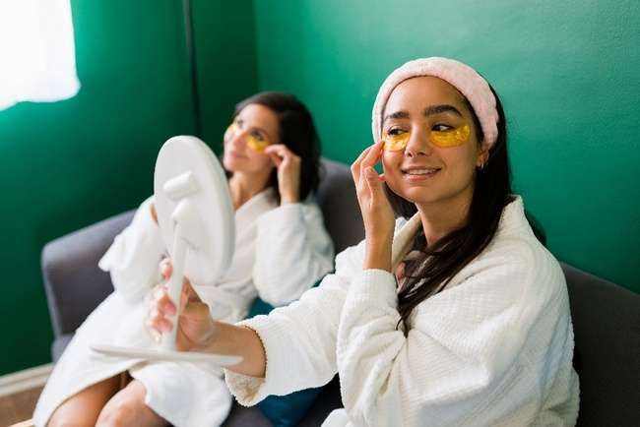
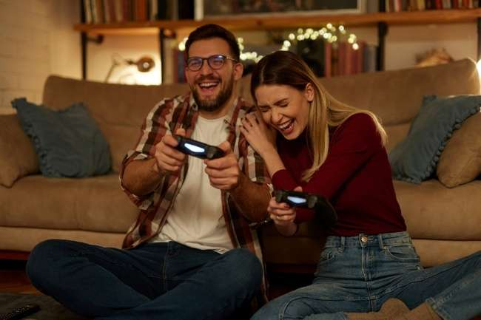






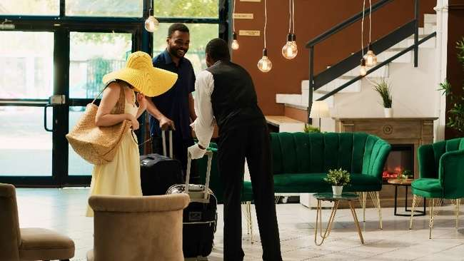


Moviegoers are multifaceted in their interests and behaviors, making them highly valuable to brands
They’re Shoppers and Spenders
They’re Givers and Gifters
They’re Socializers
They’re Travelers
They’re Foodies
They’re Recreationalists
They’re Early Adopters
They’re DIYers
They’re Gamers
They’re Enthusiasts
This information is exclusively provided to VAB members and qualified marketers.
PAGE 33

Slide 34
Brands can meet these highly desirable consumers in the moments before upcoming releases at a movie theater near you

Slide 35







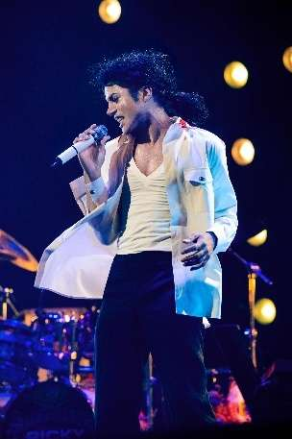








The theatrical pipeline is filled with high-profile movies and specialty film releases throughout 2025
12/20/24
12/25/24
1/17/25
1/24/25
2/14/25
2/28/25
4/4/25
4/18/25
4/18/25
5/23/25
5/30/25
6/13/25
6/20/25
6/27/25
7/2/25
7/11/25
Source: IMDb, Upcoming Releases, 2024/2025. Note: Release dates planned as of 11/8/24 and subject to change.
This information is exclusively provided to VAB members and qualified marketers.
PAGE 35

Slide 36
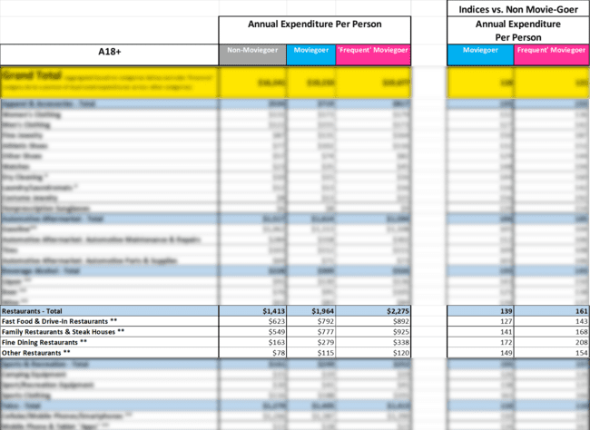
Interested in getting more granular moviegoer spending data across 70 subcategories in total?
Example:
Restaurant Category
Click this button to download the excel!
Subcategories:
Fast Food & Drive-Ins
Family Restaurants & Steakhouses
Fine Dining
Other
This information is exclusively provided to VAB members and qualified marketers.
PAGE 36

Slide 37
The cinema experience delivers brand success – through a video platform that creates a highly attentive environment with emotionally engaging content to the audience who drives outsized sales compared to non-moviegoers
Moviegoers, with their variety of interests and needs, have proven to be highly desirable consumers for brands across a wide range of categories including ecommerce, financial, health and beauty, home improvement and travel
With pandemic-related lockdowns and Hollywood strikes well in the past, the theatrical release pipeline will be strong in 2025 giving marketers consistent opportunities to reach these highly desirable moviegoing consumers throughout the year
Key Marketer Takeaways
This information is exclusively provided to VAB members and qualified marketers.
PAGE 37

Slide 38


Download our supplemental report to access additional age breaks (A25-44 & A25-54) on moviegoer category expenditures
Click report cover below to download
This information is exclusively provided to VAB members and qualified marketers.
PAGE 38

Slide 39

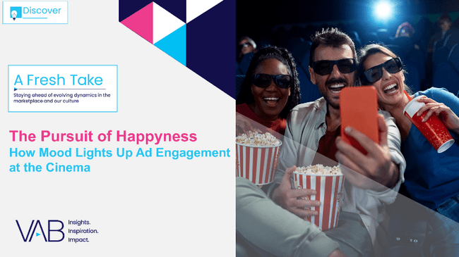
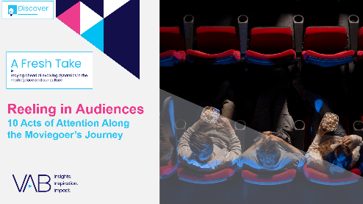

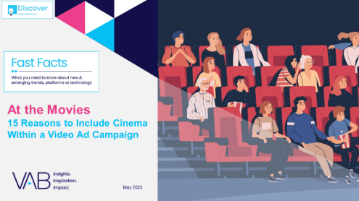


Creators
Jason Wiese
Leah Montner Dixon
SVP, Director of Strategic Insights
jasonw@thevab.com
Director, Audience & Behavioral Insights
leahm@thevab.com
The Pursuit of Happyness
How Mood Lights Up
Ad Engagement at the Cinema
Reeling in Audiences
10 Acts of Attention Along
the Moviegoer’s Journey
Karolina Guillen
Kaileen Cain
Associate Director, Insights, Strategy & Analytics
karolinag@thevab.com
Senior Insights Analyst
kaileenc@thevab.com
Discover more
Looking for more data, insights and takeaways? Check out this related VAB content
The Passion of the Cinema
Tapping into people’s excitement
for quality, premium video content
At the Movies
15 Reasons to Include Cinema Within
a Video Campaign
Disconnect to Reconnect
How Real-Life Shared Experiences Are the Antidote for Social Media Isolation Among Gen Z
How can cinema deliver desirable audiences for my brand?
VAB Members, brand marketers and agencies get free and immediate access to VAB’s content library. Get access at theVAB.com
This information is exclusively provided to VAB members and qualified marketers.
PAGE 39

Slide 40


About VAB
VAB is an insights-driven organization that inspires marketers to reimagine their media strategies resulting in fully informed decisions.
Drawing on our marketing expertise, we simplify the complexities in our industry and discover new insights that transform the way marketers look at their media strategy.
We are committed to your business growth and proud to offer VAB members, brand marketers and agencies complimentary access to our continuously-growing Insights library. Get immediate access at theVAB.com.
This information is exclusively provided to VAB members and qualified marketers.
PAGE 40

