Slide 1





Shortening the Path
to Purchase
How new opportunities in Shoppable TV are igniting viewer engagement and brand performance

Slide 2


Shoppable ads can shorten consumers’ path to purchase and further strengthen
TV as a high-performance channel
As advertisers look for new and innovative ways to engage their target audiences, more TV platforms are introducing modern ad formats featuring shoppable experiences to connect consumers directly to brands and stimulate conversions and sales.
These interactive, shoppable ad formats further enhance TV as a high-performance channel that ignites full-funnel outcomes while also providing marketers with innovative ways to increase engagement with customer prospects.
This guide explores the different shoppable TV ad formats that are gaining greater traction, the current levels of awareness and engagement among viewers and the brand outcomes that are being achieved.
This information is exclusively provided to VAB members and qualified marketers. Further distribution is prohibited.
PAGE 2

Slide 3
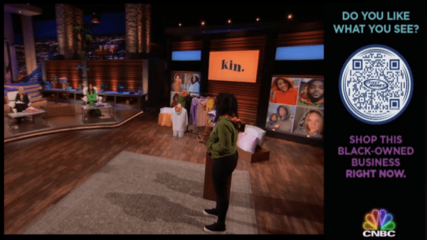
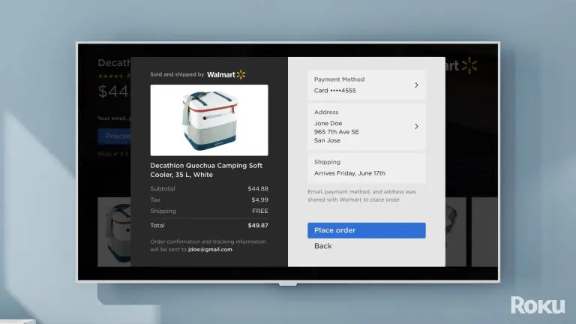
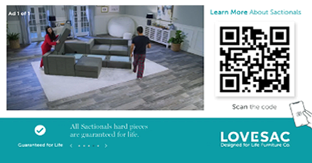
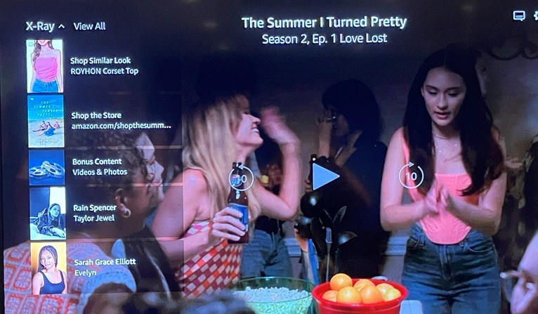
What are ‘shoppable’ TV ads?
Visual examples of shoppable TV ads
Shoppable TV ads are interactive ad formats that are designed to inspire viewers to engage directly using elements like scannable QR codes, ‘send to phone’ notifications, tune-in reminders for programs, and more. They can also allow viewers to make a purchase directly from an ad on their TV.
These ads can appear during regularly scheduled ad breaks or can be overlaid in a program as it airs or is paused.
Viewers can engage with these types of ads on their
TV set using their remote or internet-connected device.*
A shoppable TV moment enabled by QR code on NBCU’s Shark Tank**
The checkout “page” in Walmart’s Roku integration*
Innovid QR code ad viewers can scan to learn more about a product***
Amazon pause ad that allows viewers to buy products seen in the show
See pages 15-17 for more examples of shoppable TV ads
Source: *Internet-connected device includes smartphones, tablets, smart speakers, etc. **Retail TouchPoints, Has the Age of Shoppable TV Finally Arrived? NBCU is Banking on it, 7/6/2023. ***Innovid, Interactive CTV Drives QR Code Engagements for LOVESAC, 11/5/20.
This information is exclusively provided to VAB members and qualified marketers. Further distribution is prohibited.
PAGE 3

Slide 4


How can shoppable ads simplify both the viewing experience and purchase journey?
Value for Viewers
Value for Marketers
Shoppable ads allow viewers to easily access more information about a product or service, get a coupon for a discounted offer or even make a purchase using their remote or internet-connected device.
Viewers can also benefit from a more immersive and engaging viewing experience that can be tailored to their preferences and needs.
Shoppable TV ad formats have the power to revolutionize the way brands engage with consumers by speeding up the path to purchase with the click of a button.
This convenience eliminates barriers to the purchase journey and can encourage deeper engagement with brands beyond the ad itself.
This information is exclusively provided to VAB members and qualified marketers. Further distribution is prohibited.
PAGE 4

Slide 5




To assess the opportunity of shoppable TV ads, it is important to first understand how related consumer behaviors have shaped the marketplace
Factors like more widespread internet usage, increased adoption of digital wallets and growing interest in shoppable videos have created a nurturing environment in which consumers are comfortable with, and even enthusiastic about, the idea of making purchases through TV ads
Ubiquitous Internet Connectivity
Ecommerce and Growing Use of Digital Wallets
Rising Interest in Shopping Videos
Almost all people in the U.S.
use the internet today*
(92%)
Over half of the U.S. population will use a digital wallet in 2023**
(53%)
Nearly half of U.S. adults have used livestreamed / video ecommerce or are interested in using it***
(46%)
Source: Retail TouchPoints, Has the Age of Shoppable TV Finally Arrived? NBCU is Banking on it, 7/6/2023. *Statista, United States Internet Penetration 2000-2023, January 2023.**eMarketer Insider Intelligence, Apple may create the first US super app and other predictions about mobile wallet use, 5/24/23. ***eMarketer Insider Intelligence, The Insider Intelligence Ecommerce Survey, conducted by Bizrate Insights in October 2022. Note: Livestreamed / video ecommerce refers to buying a product by clicking on a link directly within or next to a video.
This information is exclusively provided to VAB members and qualified marketers. Further distribution is prohibited.
PAGE 5

Slide 6

Why the Time is Here for Shoppable TV Ads
Increased comfortability with ecommerce and growth of ad-supported streaming

Slide 7

“Now is the time, and this time is actually different…Almost 40 years after the first shoppable television system was introduced, this is the moment when it is going to become a reality. Huge leaps in innovation are rarely the result of a single new technology being developed. Think of things like the car or the smartphone —
there is a convergence of multiple technology innovations, of market forces
and changing consumer behaviors and expectations.”
Evan Moore, SVP of Commerce Partnerships, NBCUniversal
Retail Innovation Conference and Expo, June 2023
This information is exclusively provided to VAB members and qualified marketers. Further distribution is prohibited.
PAGE 7

Slide 8
Consumers have grown increasingly comfortable with online purchases, signaling a willingness to buy products through new digital technologies
By 2027, ecommerce will account for over 20% of total retail sales, nearly doubling it’s share over just eight years
U.S. Retail Ecommerce Sales
2019-2027
(in billions)
+11%
YoY
+11%
YoY
+11%
YoY
+9%
YoY
+11%
YoY
+17%
YoY
+9%
YoY
+37%
YoY
+15%
YoY
% of Total Retail Sales
11%
15%
15%
15%
16%
17%
18%
19%
21%
Source: eMarketer Insider Intelligence, U.S. Retail Ecommerce Sales and Percentage of Total Retail Sales, 2018-2027, June 2023.
This information is exclusively provided to VAB members and qualified marketers. Further distribution is prohibited.
PAGE 8

Slide 9

Growing adoption of digital payment methods has made it even easier for consumers to buy products using mobile devices like their smartphone
Over half
of the U.S. population will use
a digital wallet in 2023 (53%)
By 2027, over 187 million people
will use a digital wallet in the U.S.,
or 65% of the population
Source: eMarketer Insider Intelligence, Apple may create the first US super app and other predictions about mobile wallet use, 5/24/23.
This information is exclusively provided to VAB members and qualified marketers. Further distribution is prohibited.
PAGE 9

Slide 10
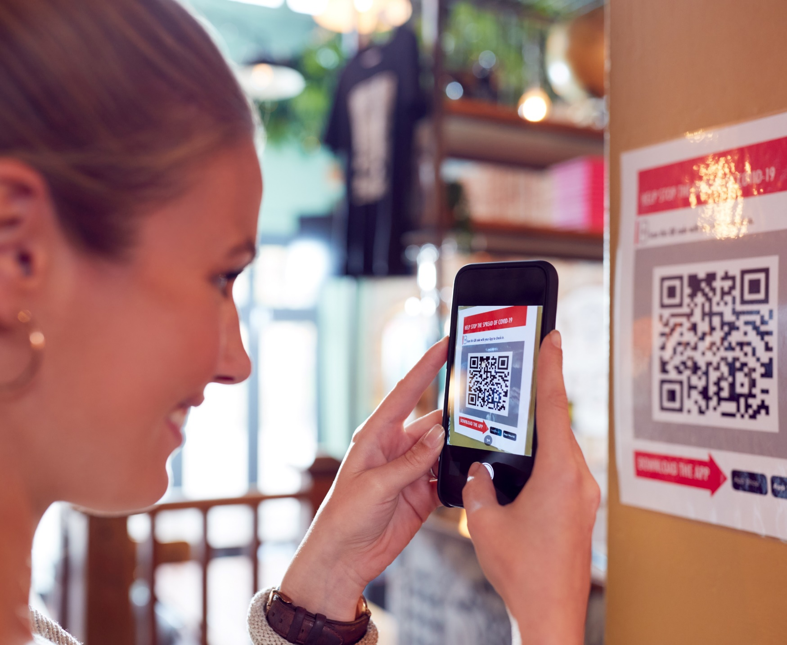
Usage of QR code scanners has seen a significant increase, aided by the surge in contactless solutions that became popular during the pandemic
Leveraging this familiarity, QR codes are often a popular choice by brands making forays into shoppable ads
U.S. Smartphone QR Code Scanners
in millions
+6%
YoY
+5%
YoY
+7%
YoY
+10%
YoY
+15%
YoY
+25%
YoY
+13%
YoY
Source: eMarketer Insider Intelligence, QR Codes Forecast & Trends 2022. Note: ages 18+; smartphone users who scan a QR code at least once during the calendar year.
This information is exclusively provided to VAB members and qualified marketers. Further distribution is prohibited.
PAGE 10

Slide 11
More consumers are streaming video through ad-supported services, which has expanded how and where brands can reach them online
U.S. Ad-Supported Video-on-Demand (AVOD) Viewers
in millions
+6%
YoY
+3%
YoY
+9%
YoY
+9%
YoY
+20%
YoY
+31%
YoY
+39%
YoY
Source: eMarketer Insider Intelligence, U.S. AVOD Viewers and Penetration, February 2023.
This information is exclusively provided to VAB members and qualified marketers. Further distribution is prohibited.
PAGE 11

Slide 12
Connected TV is achieving similar growth to ecommerce as audience scale and engagement continues to increase
Connected TV Ad Spending
in billions
+13%
YoY
+17%
YoY
+21%
YoY
+20%
YoY
+58%
YoY
+57%
YoY
+51%
YoY
Average Daily Time Spent with Connected TV*
in minutes
59.0
82.0
94.0
105.0
115.0
123.0
131.0
Source: eMarketer Insider Intelligence, Connected TV Ad Spending, 2019-2027, April 2023. *eMarketer Insider Intelligence, Average Time Spent per Day with Connected TV, A18+, June 2023.
This information is exclusively provided to VAB members and qualified marketers. Further distribution is prohibited.
PAGE 12

Slide 13


Most viewers are already ‘second screening’ while watching TV, which enables people to use either their remote or connected device for purchases
U.S. Simultaneous Internet and TV Users
201.3 MM
Users
76%
of population
Source: eMarketer Insider Intelligence, Simultaneous Internet and TV Users, January 2023.
This information is exclusively provided to VAB members and qualified marketers. Further distribution is prohibited.
PAGE 13

Slide 14
Examples of Shoppable TV Ads
Getting to know the ad formats available to marketers

Slide 15
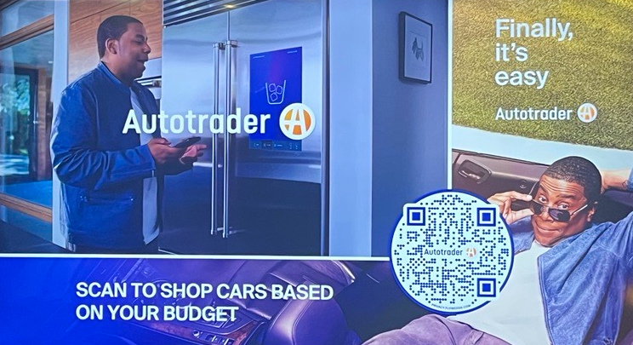

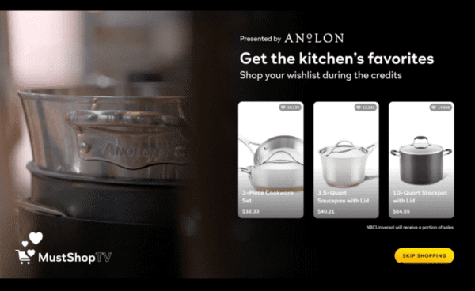
The emergence of shoppable TV ads can shorten the path to purchase by putting a brand’s digital platform directly in front of viewers
Three different categories of shoppable ad experiences
Shoppable commercials
Direct-selling segments
Shoppable television shows
Video ads that air during traditional
ad breaks which include a method, such as a scannable QR code, for viewers to engage with to get more information or to purchase a product
Interactive ads that are integrated into traditional programming to direct viewers towards specific products, such as cookware being promoted during a cooking segment
The ability to purchase is seamlessly woven into programming by integrating products into shows and then letting viewers know how they can purchase them
Source: Retail TouchPoints, Has the Age of Shoppable TV Finally Arrived? NBCU is Banking on it, 7/6/2023.
This information is exclusively provided to VAB members and qualified marketers. Further distribution is prohibited.
PAGE 15

Slide 16




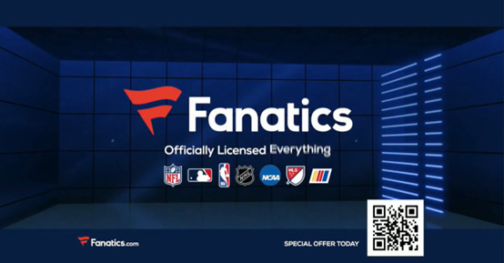
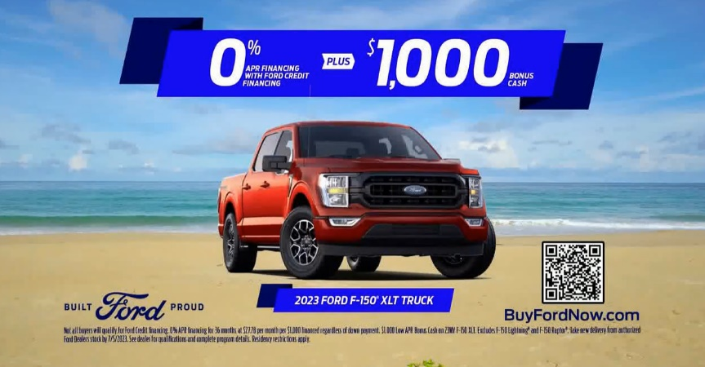
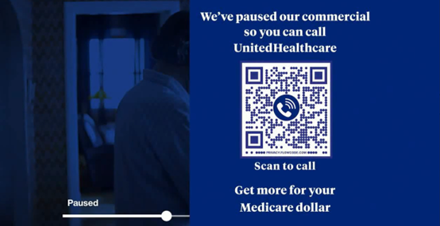






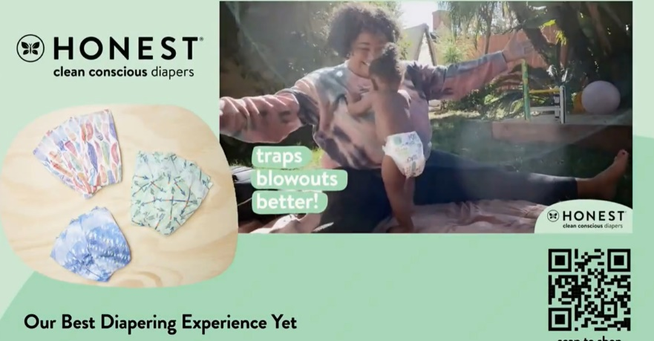
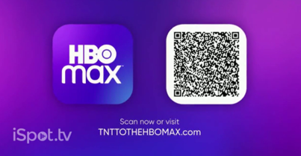
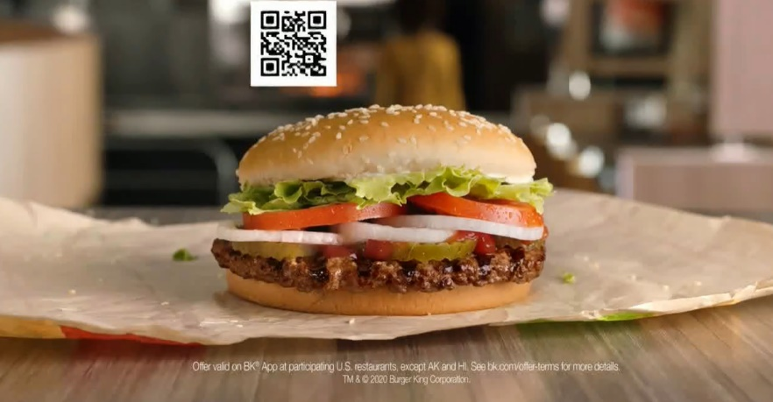
QR codes are currently a popular choice among brands across a range of categories that are adopting shoppable ad creative
Ads using QR codes to entice viewers to engage directly with brands have proven to be attention-grabbling, like Coinbase’s stripped-down campaign which immediately gained viral popularity when it aired during Super Bowl LVI in 2022
Examples of Ads Using QR Codes
Apparel, Footwear & Accessories
(TV spot first aired: 6/21/2023)
Automotive
(TV spot first aired: 6/8/2023)
Insurance
(TV spot first aired: 10/17/2022)
Investment Services
(TV spot first aired: 2/13/2022
during Super Bowl LVI)
Food & Beverage
(TV spot first aired: 2/8/2022)
Health & Beauty
(TV spot first aired: 1/18/2021)
Streaming Services
(TV spot first aired: 12/30/2020)
Quick Serve Restaurants
(TV spot first aired: 4/23/2020)
Source: Creative from iSpot.tv, time period of airing 4/23/20 – 6/21/23. Click above images to watch TV spots.
This information is exclusively provided to VAB members and qualified marketers. Further distribution is prohibited.
PAGE 16

Slide 17
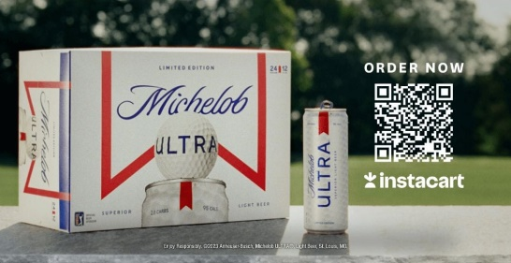
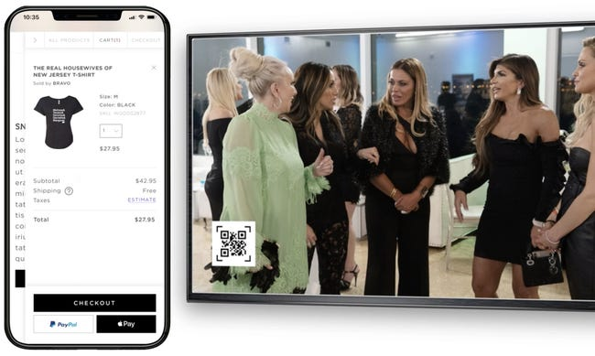
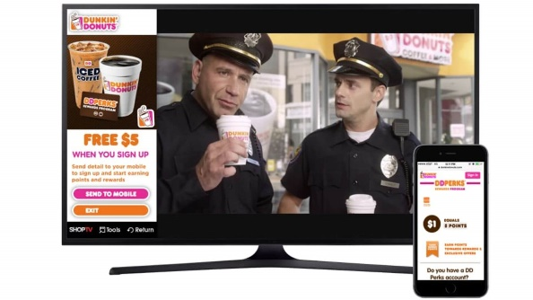
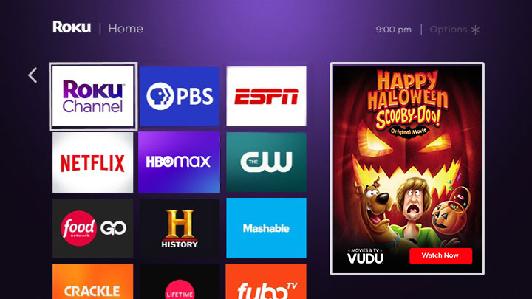
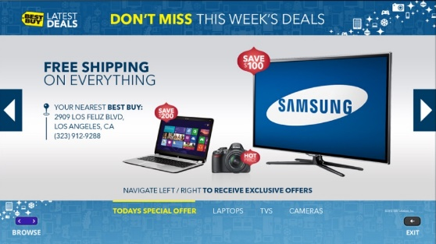
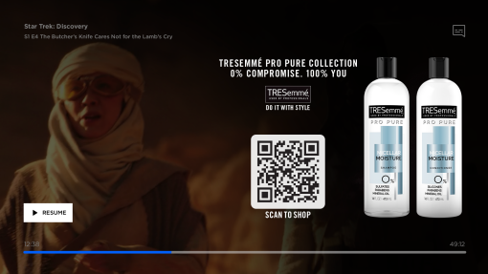
As technology evolves and more brands pursue new ad formats,
other types of interactive shoppable ads are becoming more common
Examples of different types of interactive shoppable ads
Ads with a scannable QR code
‘Click to buy’ ads
(via methods like NBCU Checkout, Roku Pay, etc.)
Click to receive information to email / device
Allows viewer to scan a QR code on the screen in order to learn more about a product or service, or to visit a brand’s website
Ability to make a purchase directly from an ad on a TV set using already-enabled digital payment methods
Button on screen can be clicked using remote to have information or a coupon sent directly to the viewers email or mobile device
Promos with a tune-in reminder or 'add to watch list’ button
Explorable ads with option to browse video clips, product types, or other info
Pause Ads
Button on screen can be clicked using remote to watch a program, or branded content, being advertised or save it to a watchlist for later
Viewers can toggle through different related video clips, product offerings or deals using their remote
Ads that appear overlayed over the content while a program is paused
Source: Retail TouchPoints, Has the Age of Shoppable TV Finally Arrived? NBCU is Banking on it, 7/6/2023. Paramount Pause Ad Spec Sheet. Advanced Television, Report: Open programmatic ad spend up 41% YoY, 3/8/2023. Business Insider, NBCUniversal expanded its shoppable ad offerings with Checkout, 4/24/20.
This information is exclusively provided to VAB members and qualified marketers. Further distribution is prohibited.
PAGE 17

Slide 18
Viewers’ Familiarity with Shoppable TV Ads
Understanding audiences’ knowledge
of interactive ad formats

Slide 19
“Today’s consumers demand innovative and interactive experiences to engage with. In fact, a third of U.S. adults would like to click an ad on TV to make a purchase. This is even more prevalent with Gen Z and Millennials, who have almost $3 trillion in buying power combined. Advertisers, take note. It’s imperative to invest in and deploy creative that offer interactive and shoppable experiences to truly engage these audiences. If you don’t, your competitors will.”
Meredith Brace, CMO, Samba TV
This information is exclusively provided to VAB members and qualified marketers. Further distribution is prohibited.
PAGE 19

Slide 20
Younger audiences are more likely to recall seeing shoppable ads, which provides marketers an opportunity to connect with this valuable segment
% of A16+ who recall seeing different types of interactive ad formats when watching TV
% of total respondents
Source: VAB custom research fielded by Hub Entertainment Research as part of the 2023 Monetization of Video report. Data sourced from Hub’s survey of 1,602 TV consumers, ages 16-74 who meet the following criteria: watch at least one hour of TV / week, have broadband access. Data collected June 2023. Q2: Which of the following types of ad formats do you recall seeing when watching TV (including: TV and streaming)?
This information is exclusively provided to VAB members and qualified marketers. Further distribution is prohibited.
PAGE 20

Slide 21
Additionally, HHs with teens are more likely to recall seeing shoppable ads, which highlights the opportunity for marketers to engage families as well
% of A16+ who recall seeing different types of interactive ad formats when watching TV
% of total respondents
Source: VAB custom research fielded by Hub Entertainment Research as part of the 2023 Monetization of Video report. Data sourced from Hub’s survey of 1,602 TV consumers, ages 16-74 who meet the following criteria: watch at least one hour of TV / week, have broadband access. Data collected June 2023. Q2: Which of the following types of ad formats do you recall seeing when watching TV (including: TV and streaming)?
This information is exclusively provided to VAB members and qualified marketers. Further distribution is prohibited.
PAGE 21

Slide 22


Interactive ads are the preferred ad format for a sizeable segment of video streamers
Preferred Ad Formats Among AVOD & SVOD Streamers
30%
24%
of AVOD & SVOD streamers
prefer watching interactive ad formats
of AVOD & SVOD streamers prefer watching ads that include QR codes
Source: Tubi + FOX, 2023 Audience Insights for Brands, 2/14/23.
This information is exclusively provided to VAB members and qualified marketers. Further distribution is prohibited.
PAGE 22

Slide 23



Consumers show a clear interest in making purchases through shoppable ads on their TV set, indicating a ripe opportunity for brands
1 in 5
58%
Over 1 in 3
Adults has made a purchase through a QR code shown on a TV ad
of Millennials say they would be more likely to purchase a product if they saw a TV ad with a QR code offering a discount on a product
U.S. adults say they would be likely to use a function on their TV where they could easily click on an ad to make a direct purchase
Source: Samba TV and HarrisX data.
This information is exclusively provided to VAB members and qualified marketers. Further distribution is prohibited.
PAGE 23

Slide 24


As of now, more consumers prefer to use their mobile device over a TV remote to interact with shoppable ads
46%
26%
of consumers prefer to use their mobile device to transact while they’re watching TV
of consumers want to use their remote to interact on screen
Source: Aluma Insights, Aluma: 70% of Online Adults Who Have Engaged Shoppable TV Ads Purchased a Featured Product, 1/3/22.
This information is exclusively provided to VAB members and qualified marketers. Further distribution is prohibited.
PAGE 24

Slide 25
Brand Impact of Shoppable TV Ads
Exploring how interactive formats ignite outcomes for advertisers

Slide 26
The time viewers spend with interactive shoppable ads extends the average brand engagement by two to three times the length of the ad itself
Ad Length Plus Additional Time Gained During Interaction
in minutes and seconds
1:04
+113%
time spent with ad
:43
+187%
time spent with ad
Source: Magna Global, Media Economy Report, Vol. 15 - The Medium is the Message: How Data and Technology Are Informing The Creative Process, June 2019.
This information is exclusively provided to VAB members and qualified marketers. Further distribution is prohibited.
PAGE 26

Slide 27
Due to their increased level of engagement, interactive shoppable ads are more likely to drive greater brand health KPIs across the purchase funnel
Lift in Brand KPIs by Ad Type
Source: Magna Global, Media Economy Report, Vol. 15, The Medium is the Message: How Data and Technology Are Informing the Creative Process, June 2019.
This information is exclusively provided to VAB members and qualified marketers. Further distribution is prohibited.
PAGE 27

Slide 28


Viewers who interact with a shoppable ad are inherently more likely to then make a purchase
39%
70%
of U.S. adults who have viewed shoppable ads have engaged directly with them
of that group have made a purchase
Source: Aluma Insights, Aluma: 70% of Online Adults Who Have Engaged Shoppable TV Ads Purchased a Featured Product, 1/3/22.
This information is exclusively provided to VAB members and qualified marketers. Further distribution is prohibited.
PAGE 28

Slide 29






Outside of purchases, viewers interact with different shoppable ad formats in various ways to further engage with, or learn about, brands and products
% of P16+ who have taken the following actions after seeing a specific type of interactive shoppable ad
% of respondents Total (rank 1-3)
Click to Receive Info to Your Email / Device
Explorable Ads*
‘Click to Buy’ Ads
Pause Ads
Promos with an ‘add to watch list’ Button
QR Codes
67%
Have interacted
62%
Have interacted
58%
Have interacted
51%
Have interacted
58%
Have interacted
36%
Have interacted
27%
Used a search engine to look up more information
28%
Used a search engine to look up more information
18%
Used a search engine to look up more information
22%
Used a search engine to look up more information
21%
Saved information for future reference
13%
Visited a website for a product/service to learn more
24%
Visited a website for a product/service to learn more
26%
Saved information for future reference
17%
Purchased a product they saw advertised
19%
Visited a website for a product/service to learn more
20%
Used a search engine to look up more information
13%
Downloaded an app they saw on screen
23%
Used a coupon or offer they received from the ad
22%
Visited a website for a product/service to learn more
17%
Visited a brands social media page to learn more
18%
Talked to friends/family about the product/service
18%
Talked to friends/family about the product/service
12%
Used a search engine to look up more information
Source: VAB custom research fielded by Hub Entertainment Research as part of the 2023 Monetization of Video report. Data sourced from Hub’s survey of 1,602 TV consumers, ages 16-74 who meet the following criteria: watch at least one hour of TV / week, have broadband access. Data collected June 2023. Q3: Which of the following actions have you taken after seeing the following types of ads? *Ads that let you browse different video clips, product types, or information screens.
This information is exclusively provided to VAB members and qualified marketers. Further distribution is prohibited.
PAGE 29

Slide 30
Younger audiences show even stronger levels of interest, with over half having interacted with a shoppable ad in some way
% of P16-34 who have taken the following actions after seeing a specific type of interactive shoppable ad
% of respondents (rank 1-3)
Explorable Ads*
Click to Receive Info to Your Email / Device
‘Click to Buy’ Ads
Pause Ads
Promos with an ‘add to watch list’ Button
QR Codes
65%
Have interacted
63%
Have interacted
56%
Have interacted
60%
Have interacted
59%
Have interacted
51%
Have interacted
28%
Saved information for future reference
24%
Downloaded an app they saw on screen
20%
Purchased a product they saw advertised
22%
Used a search engine to look up more information
26%
Saved information for future reference
20%
Downloaded an app they saw on screen
25%
Used a search engine to look up more information
24%
Used a search engine to look up more information
18%
Saved information for future reference
21%
Talked to friends/family about the product/service
25%
Used a search engine to look up more information
19%
Talked to friends/family about the product/service
21%
Used a coupon or offer they received from the ad
24%
Visited a website for a product/service to learn more
18%
Used a search engine to look up more information
19%
Saved information for future reference
19%
Talked to friends/family about the product/service
18%
Used a search engine to look up more information
Source: VAB custom research fielded by Hub Entertainment Research as part of the 2023 Monetization of Video report. Data sourced from Hub’s survey of 1,602 TV consumers, ages 16-74 who meet the following criteria: watch at least one hour of TV / week, have broadband access. Data collected June 2023. Q3: Which of the following actions have you taken after seeing the following types of ads? *Ads that let you browse different video clips, product types, or information screens.
This information is exclusively provided to VAB members and qualified marketers. Further distribution is prohibited.
PAGE 30

Slide 31
“[Brightline] data shows interactive ads drive greater lifts
in brand metrics than a traditional, passive 30-second spot.
This means more value for viewers and more meaningful engagements for advertisers.”
Adam Bergman, Group VP of Advertising & Data Sales, Vizio
Fierce Video, 12/21/2022
This information is exclusively provided to VAB members and qualified marketers. Further distribution is prohibited.
PAGE 31

Slide 32

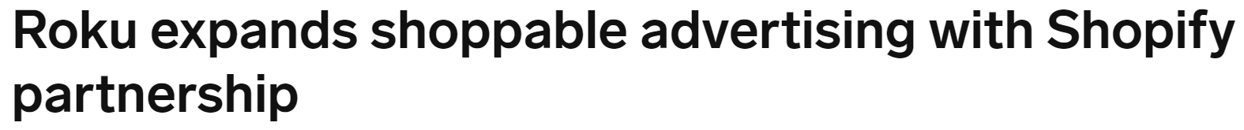






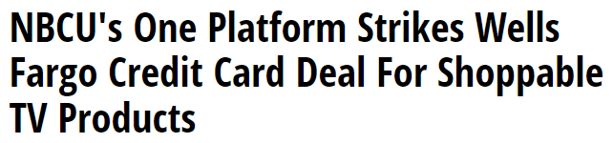
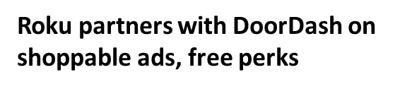






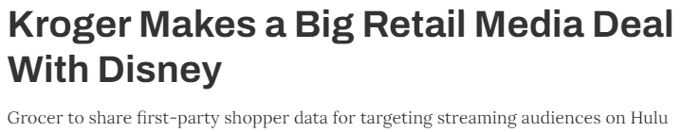








Marketer opportunities are growing as more media publishers and brands are partnering to introduce shoppable TV ads across platforms
Examples of video platforms using interactive ad products
7/12/23
6/14/23
2/27/23
Examples of measurement vendors that monitor interactive ad campaigns
6/15/23
4/19/23
3/21/23
Click through the logos above to be brought directly to the corresponding company’s website
This information is exclusively provided to VAB members and qualified marketers. Further distribution is prohibited.
PAGE 32

Slide 33
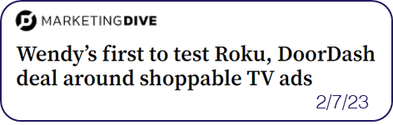
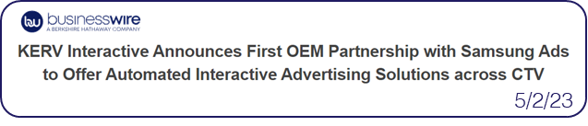

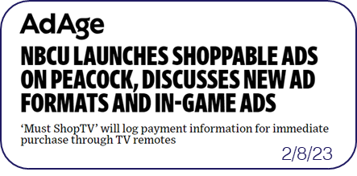

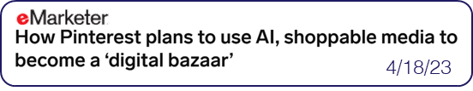
What’s next for the future of shoppable TV advertising?
Will ‘shoppable’ ad opportunity spread to more platforms?
Are advertisers prioritizing adopting shoppable ad formats?*
What kind of impact will AI have on shoppable advertising?
Shoppable ads are being adopted by top streaming platforms.
There is significant interest in ad formats that enable brands to directly engage with consumers and shorten the path to purchase.
AI could enable an even more seamless purchase experience.
“As the media economy shifts, everyone is looking for new paths to monetization. Being able to buy directly from a TV commercial is a great way to enable this.”
– Alan Wolk, TVREV Week in Review, 7/14/2023
Nearly half of media buyers plan to focus more on shoppable ads in 2023 (43%)
Shoppable ads ranked higher than areas like attention metrics (36%), retail media network ads (30%), data clean rooms (29%) and augmented reality ads (18%) in terms of their focus
Disney Ad Sales President Rita Ferro has said
AI could remove the need for QR codes by scanning visuals for products and offering ways
to buy them directly from the streaming interface
Ad Age’s 2023 State of TV Advertising Conference
(eMarketer, 5/31/23)
Source: Interactive Advertising Bureau via eMarketer Insider Intelligence, 2023 Outlook Survey, 11/17/22. Q: Do you expect to focus more, less, or the same amount of time and/or resources in 2023 (vs. 2022) on the following? Based on respondents who answered ‘focus significantly more’ or ‘focus somewhat more’.
This information is exclusively provided to VAB members and qualified marketers. Further distribution is prohibited.
PAGE 33

Slide 34
Shoppable TV Ad Case Studies
Real-world examples of how brands are achieving results through the purchase funnel

Slide 35




Category:
Financial
A campaign featuring scannable QR codes drove an 8.9x lift in awareness and an 8.8x lift
in conversions
Upper / Lower Funnel
Awareness, Conversions
Challenge
The agency of a mobile-first financial platform wanted to drive awareness and acquire new customers
Solution
Roku’s scannable videos were used to generate top-of-funnel awareness and drive new account creation
OneView, Roku’s streaming ad buying platform was leveraged to re-engage streamers across devices and optimize the campaign in-flight
Target Segment
Middle bracket earners
Adults 25-44
Results
The financial platform saw increased brand awareness and a lift in new account creation with the help of scannable videos and machine learning capabilities
Company / Interactive Ad Type
Roku / Scannable videos on Roku, display ads
Campaign Results
Brand Awareness
New Accounts
Cross-Device
8.9x
Lift in aided brand awareness
51%
Conversion lift in new account creation
8.8x
Conversion lift across all devices*
Source: Roku Advertising case study, Q1 2022. Peasant Media Inc. cashes in on TV streaming ads and a cross-device strategy with Roku, 8/18/2022. Note: Brand awareness and new account lift compared to control group, cross-device lift from a direct comparison to conversion rates. *Across both site visits and account creation events.
This information is exclusively provided to VAB members and qualified marketers. Further distribution is prohibited.
PAGE 35

Slide 36


Category:
QSR
Audiences exposed to interactive ad units saw 3x lift in purchase rate for a QSR brand’s cross-screen campaign
Lower Funnel
Sales
Challenge
A QSR brand looked to drive sales through personalized messages prompting user engagement
Solution
Hulu delivered selected audiences GatewayGo ads. These interactive units allow viewers to engage through personalized message prompting users to open a push notification, email or scan a QR code
Campaign was delivered & measured in collaboration with Hulu, a credit card transaction partner and a data connectivity platform
Target Segment
Adults 18-49 across 5 DMAs
Results
Hulu viewers exposed to the GatewayGo unit showed heightened responsiveness to campaign and drove a 0.27% shop rate and a high average household spend of $0.13
Company / Interactive Ad Type
Hulu / Personalized Messaging, QR Code
% of HHs Exposed | 79% | 28%
Source: Hulu, GatewayGo Case Study, Q2 2020. Campaign length: 2 months. *A slate is a branded title card that appears before video creative.
This information is exclusively provided to VAB members and qualified marketers. Further distribution is prohibited.
PAGE 36

Slide 37






Key Takeaways For Marketers on Shoppable TV Advertising
Consumer behaviors like increased comfortability with both online shopping and technology like QR codes, combined with growing usage of ad-based streaming platforms, is priming the industry for wider adoption of shoppable TV ad formats
Audiences today are looking for a more engaging ad experience that better meets their needs while removing barriers to purchase – shoppable TV ads can ignite consumer action whether they’re using their mobile device or TV remote
Interactive shoppable TV ads boost brand health metrics like awareness, recall and consideration while shortening the consumer path to purchase by delivering a brand’s digital platform directly to the viewer
The shoppable TV ad opportunity continues to grow as more video platforms enter the space and develop interactive
ad formats as well as innovative retail partnership and solutions to create seamless shopping experiences
This information is exclusively provided to VAB members and qualified marketers. Further distribution is prohibited.
PAGE 37

Slide 38



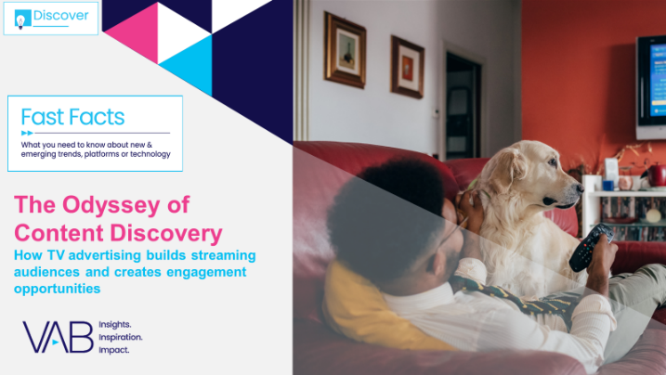





Creators
Jason Wiese
Leah Montner-Dixon
SVP, Director of Strategic Insights
jasonw@thevab.com
Associate Insights Director
leahm@thevab.com
Reed Kiely
Karolina Guillen
Staying Current on Streaming
The Latest on Connected TV
Consumer Behaviors
Setting the Stage
15 Streaming Trends That Will Impact Marketing Plans in 2023
Associate Insights Director
reedk@thevab.com
Insights Manager
karolinag@thevab.com
Discover more
Looking for more data, insights and takeaways? Check out this related VAB content
The Odyssey of Content Discovery
How TV Advertising Builds Streaming Audiences
and Creates Engagement Opportunities
How can I drive in-store traffic with streaming?
What is TV?
A Modern Look At How Consumers Define TV
What’s the Deal with Engagement?
VAB Members, brand marketers and agencies get free and immediate access to VAB’s content library. Get access at theVAB.com
This information is exclusively provided to VAB members and qualified marketers. Further distribution is prohibited.
PAGE 38

Slide 39


About VAB
VAB is an insights-driven organization that inspires marketers to reimagine their media strategies resulting in fully informed decisions.
Drawing on our marketing expertise, we simplify the complexities in our industry and discover new insights that transform the way marketers look at their media strategy.
We are committed to your business growth and proud to offer VAB members, brand marketers and agencies complimentary access to our continuously-growing Insights library. Get immediate access at theVAB.com.
Curious to learn more about VAB? Check out this quick video to see what we do and how we can help you develop business-driving marketing strategies.
This information is exclusively provided to VAB members and qualified marketers. Further distribution is prohibited.
PAGE 39

