Slide 1





The Rise of Shoppable TV
Bringing Commerce and Premium Video Content Together

Slide 2


Understanding TV’s evolving ability as a shopping platform
As the video ecosystem continues to evolve, marketers are increasingly leaning into shoppable TV ads to meet consumers where they are, drive brand engagement and ultimately shorten their path to purchase.
Shoppable TV’s use and acceptance by audiences is growing rapidly, driven by an increase in consumer readiness and their desire for convenient shopping experiences.
Enhancements in data and technology are also fueling the rise of Shoppable TV, which enables brands to create innovative and interactive ads that not only engage audiences but are fully measurable as well.
With consumer behavior and technology converging, shoppable TV is a powerful way for marketers to unite the power of premium video content and direct commerce.
This information is exclusively provided to VAB members and qualified marketers.
PAGE 2

Slide 3



















Brand opportunities are growing as more media publishers and brands are partnering to introduce shoppable TV ads across platforms
10/16/24
10/17/23
3/11/24
12/16/24
2/3/25
7/8/24
6/17/24
12/22/24
Watch & Shop: How Shoppable CTV Ads are Transforming Viewer Engagement
2/20/25
9/19/24
Shoppable Ads: Transforming the Customer Experience
1/26/25
This information is exclusively provided to VAB members and qualified marketers
PAGE 3

Slide 4
10 Things You Need To Know About The Rise of Shoppable TV
1
2
3
4
Shoppable media is now a mainstream consumer activity
Brands are aligning with consumers by increasing their focus on shoppable ads
Shoppable TV inspires consumers to buy directly on the biggest screen
Consumers are open to innovative shopping methods enabled by their TV
5
6
7
Shoppable TV ignites consumer curiosity and consideration
Shoppable TV ads drive full-funnel conversion opportunities
Relevant and engaging ads drive more outcomes for advertisers using shoppable TV
8
9
10
Publishers, platforms and technology partners are creating more shoppable TV opportunities
Enhancements in data and technology are unlocking new shoppable TV capabilities for marketers
AI, CTV and frictionless UX are critical to the
future of shoppable TV
This information is exclusively provided to VAB members and qualified marketers
PAGE 4

Slide 5

1
With 88 million buyers projected by 2028, shoppable media represents a growing opportunity for brands to directly engage with consumers
U.S. Shoppable Media Universe: Consumer Purchasers
In Millions
+15%
vs 2024
% of internet users
29.1%
29.9%
30.8%
31.4%
32.1%
Source: eMarketer, Shoppable Media Buyers, October 2024; ages 14+ digital buyers who have made at least one purchase during the calendar year after consuming online media content (including video, text and images) with an immediate purchase option embedded in or adjacent to the content; excludes search ads and product listings).
This information is exclusively provided to VAB members and qualified marketers
PAGE 5

Slide 6



2
Brand adoption is increasing as more than one-third of all advertisers are planning to increase their focus on shoppable ads this year
1 4
advertisers are already
using shoppable ads
38%
of advertisers are planning to increase
their focus on shoppable ads in 2025
nearly
in
Source: eMarketer, Shoppable Media Buyers, October 2024
Source: eMarketer, Shoppable Media 2025, February 2025
This information is exclusively provided to VAB members and qualified marketers
PAGE 6

Slide 7
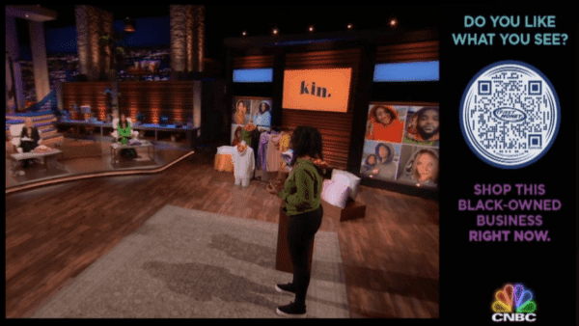
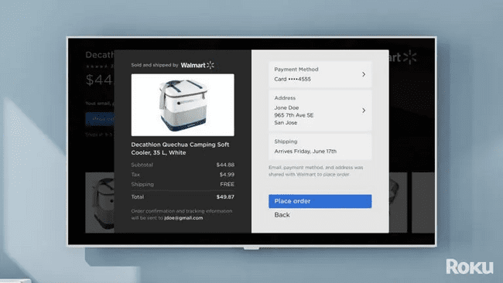
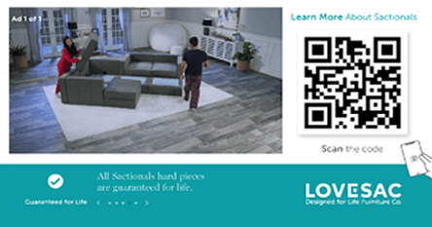
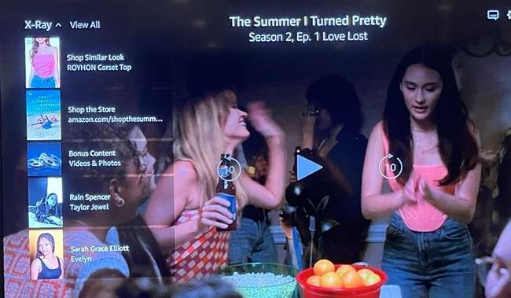
3
Shoppable TV, a form of shoppable media, inspires consumers to buy directly from an ad on the biggest screen at home
Shoppable TV ads are interactive ad formats that are designed to inspire viewers to engage directly with a brand using elements like scannable QR codes, ‘send to phone’ notifications, ‘click for more information’ CTAs and more. They can also allow viewers to make a purchase directly from an ad on their TV.
These ads can appear during regularly scheduled ad breaks or can be overlaid in a program as it airs or is paused.
Viewers can engage with these types of ads on their TV set using their remote or internet-connected device.*
Examples of Shoppable TV ads
A shoppable TV moment enabled by QR code on NBCU’s Shark Tank**
The checkout “page” in
Walmart’s Roku integration*
Innovid QR code ad viewers can scan to learn more about a product***
Amazon pause ad that allows viewers to buy products seen in the show
Source: *Internet-connected device includes smartphones, tablets, smart speakers, etc. **Retail TouchPoints, Has the Age of Shoppable TV Finally Arrived? NBCU is Banking on it, 7/6/2023. ***Innovid, Interactive CTV Drives QR Code Engagements for LOVESAC, 11/5/20.
This information is exclusively provided to VAB members and qualified marketers
PAGE 7

Slide 8






4
Consumers are open to interacting with brands on TV through multiple devices including their remotes, phones and smart speakers
% of viewers who are open to using the following methods for purchasing products or services via TV
70%
Saving products to a wish list directly on the TV
67%
Sending a text for more information or discount code
62%
Scanning a QR code to checkout on a mobile device
62%
Using a voice to add to cart
via home smart speaker or TV
60%
Saving shipping / payment details for quick checkout on TV
54%
AI assistant contacting them via email, text or social media
Source: LG Ad Solutions, ‘Shoppable TV Report 2025’, March 2025.
This information is exclusively provided to VAB members and qualified marketers
PAGE 8

Slide 9
5
Shoppable TV ignites consumer curiosity, with roughly half of viewers wanting to see a variety of buying options offered within programming
Value for Viewers
Shoppable ads allow viewers to easily access more information about a product or service, redeem a special offer or even make a purchase using their remote or internet-connected device.
Viewers can also benefit from a more immersive and engaging viewing experience that can be tailored to their preferences and needs.
Consumer Perception of Shoppable TV
56%
wish they could see
store / brand inventory on their TV
45%
wish all TV ads had a quick option to buy
the product
43%
wish they could
shop online directly
through their TV
Source: LG Ad Solutions, ‘Shoppable TV Report 2025’, March 2025.
This information is exclusively provided to VAB members and qualified marketers
PAGE 9

Slide 10




6
Shoppable TV ads provide marketers with full funnel conversion opportunities, creating a seamless and user-friendly path to purchase
How Shoppable TV Impacts the Purchase Funnel
C
C
C
C
Awareness
Intent
Purchase
Loyalty
63%
often discover new brands and products through TV ads*
79%
are influenced
by TV ads in
their shopping decisions*
47%
Have made a purchase after seeing a TV ad
(last 3 months)*
40%
Will spend more on shoppable TV products over the next 12 months than the currently do**
Source: *LG Ad Solutions, ‘Shoppable TV Report 2025’, March 2025. **eMarketer | Shopsense, ‘Turning TV into a Retail Powerhouse’, Sept 2024 (33% will spend the same amount over the next 12 months).
This information is exclusively provided to VAB members and qualified marketers
PAGE 10

Slide 11
7
Relevant ads highlighting special offers and ‘learn more’ extensions can enhance a brand’s ability to drive greater attention and engagement
Discounts & Promotions
Click to Learn
Relevancy
57%
of viewers are
most influenced by TV ads that offer discounts and promotions
1 in 4
of viewers are
influenced by the
ability to click to a
page to learn more
76%
of viewers chose not to scan a QR code due to disinterest, underscoring the importance of relevant messaging
Source: LG Ad Solutions, ‘Shoppable TV Report 2025’, March 2025
This information is exclusively provided to VAB members and qualified marketers
PAGE 11

Slide 12

























8
The shoppable TV ecosystem continues to expand across an
ever-growing set of publishers, platforms and technology partners
Publishers & Platforms
Technology Partners
Role in the Ecosystem
Role in the Ecosystem
Produce and publish shoppable video content as well as shoppable
ad formats
Partner with retailers and media platforms on ecommerce integration
and media products
Source: eMarketer Shoppable Media Explainer 2024: Will the Success of Social Commerce Spread to Other Channels? February 2024. The above represents a sampling of publishers, platforms and tech partners within the shoppable TV ecosystem.
This information is exclusively provided to VAB members and qualified marketers
PAGE 12

Slide 13



9
CTV enhancements in data and technology are unlocking new capabilities for marketers to target and measure consumers
Three Ways Data & Technology are Enhancing Shoppable TV
First Party Collaboration
Increased partnerships between Retail Media Networks, publishers and
ad tech creates opportunities
for powerful audience targeting through the sharing and alignment of first party data.
AI Enabled Creative
Emerging versions of shoppable TV use AI to match in-show items with similar or exact products that are available from sponsors, retail partners or a store nearby a viewer’s location.
Closed Loop Measurement
Shoppable TV can deliver closed loop measurement enabling marketers to understand audience behaviors from ad exposure to purchase allowing for more informed campaign decisions and optimizations.
Source: eMarketer “Retailers experiment with shoppable TV as consumers warm to the format”; November 2024
This information is exclusively provided to VAB members and qualified marketers
PAGE 13

Slide 14



10
AI integration, the strength of CTV and a frictionless consumer experience are critical to the present and future of Shoppable TV
Influence of AI
Power of CTV
Consumer Experience
“We’re seeing AI influence some of the shoppable formats that are out there. When you think about the intersection of commerce and streaming TV, there’s really an opportunity to build brands and drive frictionless commerce. We’re now in some ways one engagement away from a direct add to cart option.”
-Aaron Sobol, Head of Media Investment & Partnerships, Unilever
“Shoppable ads aren’t just going mainstream – they’re already here. As CTV, social, and digital video continue to converge, the gap between creativity and commerce is disappearing…engaging with interactive video on the biggest screen in the house is normalizing more and more each day.”
-Dan Mouradian, SVP, Global Client Solutions, Innovid
“While secondary screens like mobile devices remain integral to shopping and the broader advertising ecosystem, its clear consumers want more when it comes to TV. Emerging technologies are set to drive this next wave of innovation – eliminating friction and paving the way for a more seamless, intuitive shoppable TV experience.”
-Monica Longoria, Head of Marketing Insights,
LG Ad Solutions
Source: Beet.TV, Unilever’s Sobol Switches On To AI-Driven TV Ads, Shoppable TV, 2/15/24; TVREV, Hot Takes: the Future of Shoppable TV, 3/3/25; Business Wire, The Shoppable TV Report: 2025 and Beyond – How Consumers Are Driving the Next Wave of Shoppable TV Innovation, 3/11/25.
This information is exclusively provided to VAB members and qualified marketers
PAGE 14

Slide 15

As shoppable TV ads become more common, audiences will grow more accustomed to engaging and purchasing through interactive and innovative ad formats
Advertiser adoption of shoppable TV is poised for further growth as the evolution of technology continues to reduce friction around the consumer experience while it enhances targeting and measurement capabilities
From branding to performance, shoppable TV ads create full funnel opportunities for brands to grow their businesses by combining premium video’s ability to engage audiences with seamless and direct buying experiences
Key Marketer Takeaways
PAGE 15
This information is exclusively provided to VAB members and qualified marketers.

Slide 16


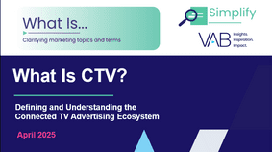
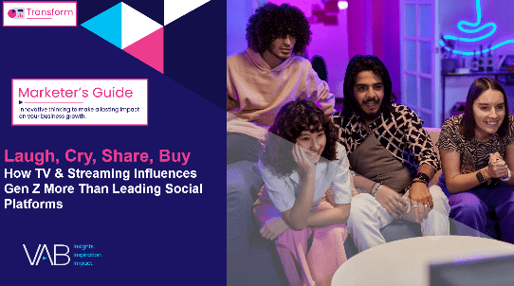
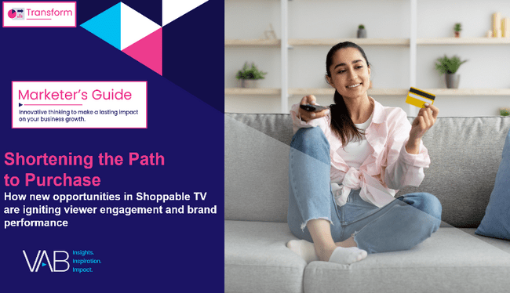
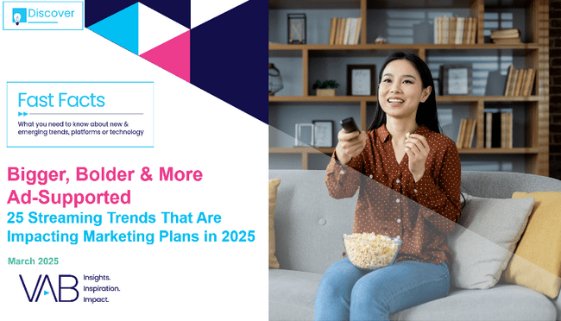


Creators
Jason Wiese
Benjamin Vandegrift
EVP, Strategic Insights & Measurement
jasonw@thevab.com
VP, Measurement Solutions & Innovations benjaminv@thevab.com
Reed Kiely
The Power of Premium Video
What It Means for Multiscreen TV
and Why It Matters to Marketers
What Is CTV?
Defining and Understanding the Connected TV Advertising Ecosystem
Director, Data Insights & Trends
reedk@thevab.com
Laugh, Cry, Share, Buy
How TV & Streaming Influences Gen Z
More Than Leading Social Platforms
Shortening the Path to Purchase
How New Opportunities in Shoppable TV Are Igniting Viewer Engagement and Brand Performance
Discover more
Looking for more data, insights and takeaways? Check out this related VAB content
Bigger, Bolder, More Ad-Supported
25 Streaming Trends That Are Impacting
Marketing Plans in 2025
Breaking Through
How New Advertisers Are Using TV to Ignite Interest & Turn Consumers Into Customers
VAB Members, brand marketers and agencies get free and immediate access to VAB’s content library. Get access at theVAB.com
This information is exclusively provided to VAB members and qualified marketers.
PAGE 16

Slide 17


About VAB
VAB plays a dual role in the video advertising industry. We are leading the change to bring about a more innovative and transparent marketplace. We also provide the insights and thought leadership that enables marketers to develop business-driving marketing strategies.
Drawing on our marketing expertise, we simplify the complexities in our industry and discover new insights that transform the way marketers look at their media strategy.
We are committed to your business growth and proud to offer VAB members, brand marketers and agencies complimentary access to our continuously-growing Insights library. Get immediate access at theVAB.com.
This information is exclusively provided to VAB members and qualified marketers.
PAGE 17

