Slide 1

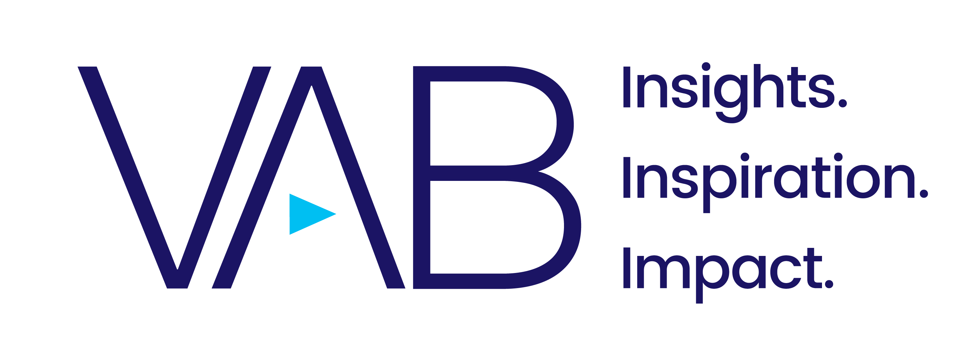
April 2021

Slide 2


As an industry we will look back at 2020 and remember it as a transformative time for streaming with accelerated consumer adoption and usage and the introduction of several new platforms.
These Five Fast Facts explore the growing opportunities for marketers to reach and engage their audiences across streaming platforms and devices.
This information is exclusively provided to VAB members and qualified marketers. Further distribution is prohibited.
PAGE 2

Slide 3
1
Share of Streaming by Platform Type
Among Streaming Capable Homes
Ad-supported services now collectively account for over one-third of all video streaming time, providing greater opportunities for brands to expand their video campaigns cross-platform for incremental reach.
K2-11: 35%
T12-17: 32%
P18-34: 29%
P35-54: 32%
P55+: 40%
The collective ad-supported share is even greater in Black homes (45%)
while Asian-American homes had the highest percentage specifically among AVOD services (34%).
Jan ‘20
Jan ‘21
*As of December 2020, streaming accounted for 23% of total TV usage among streaming capable homes (vs. 21% in Dec ‘19)
Source: Nielsen Streaming Meter Homes, January 2020 & January 2021, P2+, Total Day. Linear TV streaming reflects TVE / network / cable provider apps. ‘Other Streaming’ primarily reflects SVOD platforms and includes social, gaming and other uncategorized platforms.
This information is exclusively provided to VAB members and qualified marketers. Further distribution is prohibited.
PAGE 3

Slide 4
2
Screen On Which Viewers Watch Most Often
TV is the most preferred device for viewing content, but as we enter a post-pandemic world and can resume more active, ‘on-the-go’ lifestyles, it will be important for marketers to consider a variety screens and platforms in their video campaigns
Source: TiVo, Video Trends Report Q4 2020. Percentages are based on respondents who view each type of content.
This information is exclusively provided to VAB members and qualified marketers. Further distribution is prohibited.
PAGE 4

Slide 5
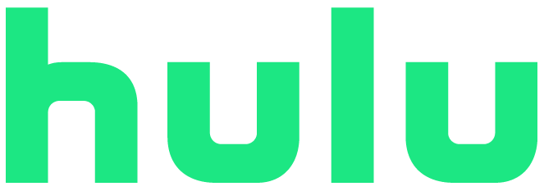




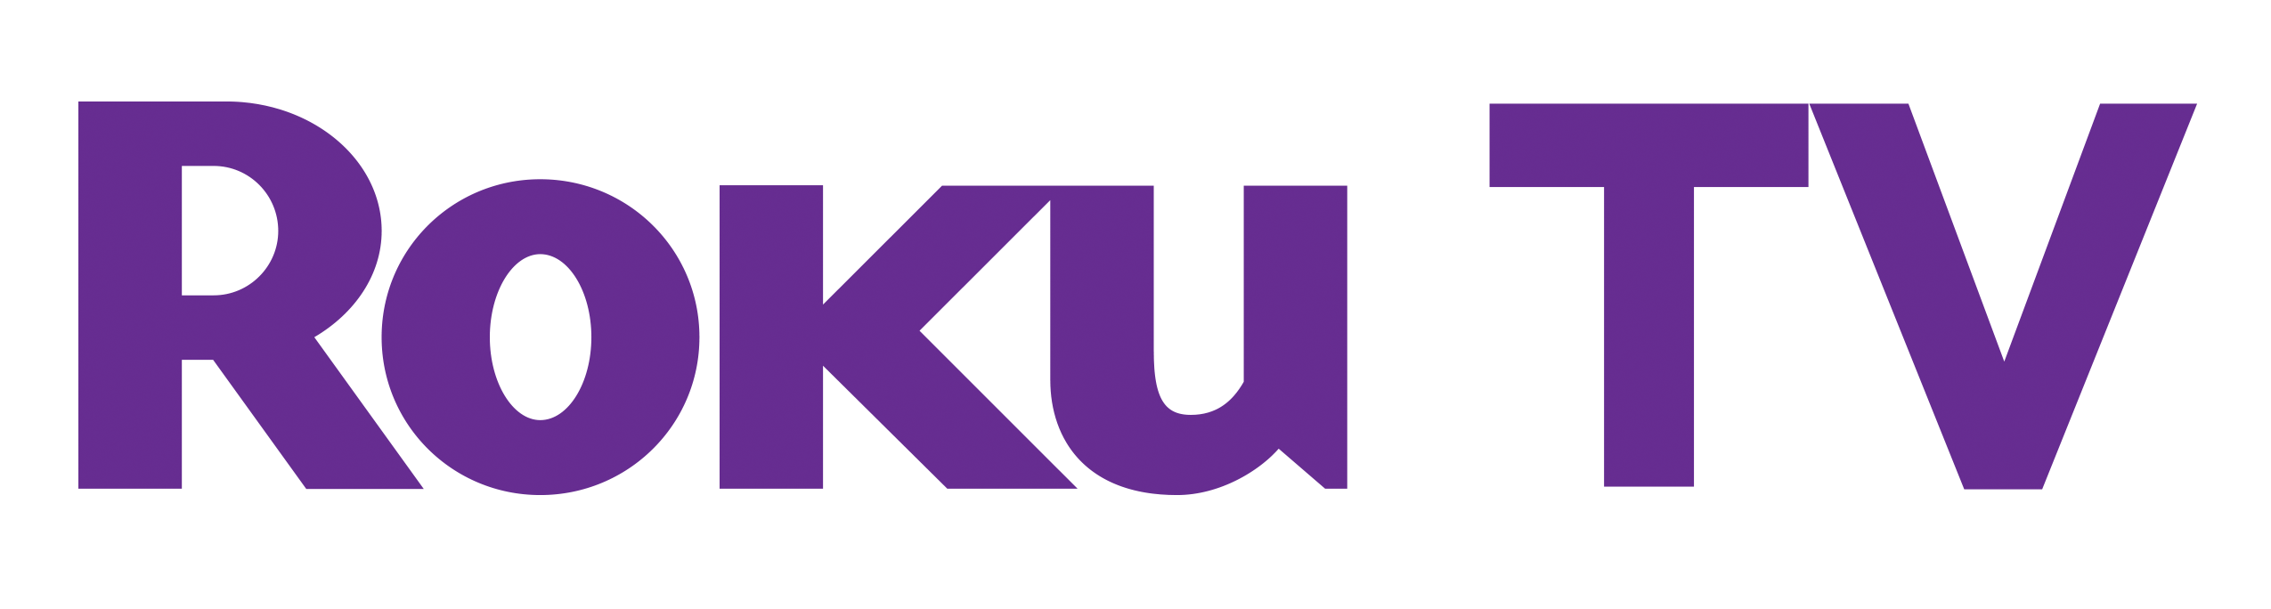


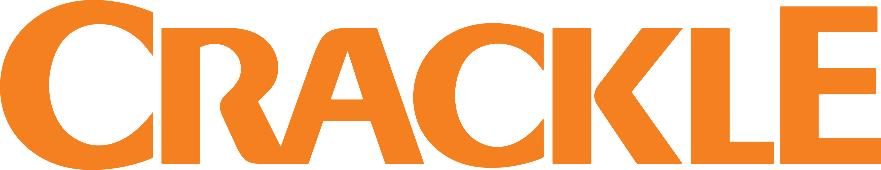

3
While many consumers are aware of the major ad-supported streaming services, increased competition means consumers need a compelling reason to
try out a new platform.
70% of P16-34 are more interested in watching a show when it’s labeled as an ‘original,’ this type of content can drive trial and convert people from awareness to engagement with a service.
Awareness & Familiarity of AVOD & Hybrid AVOD/SVOD Streaming Services
Awareness: % have heard of, Familiarity: % that could explain what the brand is and offers
Source: Hub Research, Evolution of Video Branding, Feb 2021, Note: only AVOD & Hybrid AVOD/SVOD streaming services shown. *HBO Max ad-supported tier coming in June 2021. **Data reflects CBS All Access which now has been rebranded to Paramount+.
This information is exclusively provided to VAB members and qualified marketers. Further distribution is prohibited.
PAGE 5

Slide 6
4
In the past year, consumers were motivated to add streaming services due to free time, deals and desire while money and the lack of use were the main reasons for canceling a service.
As the economy rebounds and disposable income increases, consumers will be less motivated to cancel services, leading to larger viewer bases and higher reach for marketers.
Why Consumers Added Subscriptions During COVID-19
(25% added at least one new streaming subscription due to the pandemic)
Why Consumers Canceled Subscriptions During COVID-19
(15% canceled at least one video subscription due to the pandemic)
63%
We’re at home and have more time to watch
45%
Our household income has been affected by coronavirus
38%
Deal or special offer
(free trial, etc.)
39%
We are tightening our budget just in case
36%
Specific show or movie
we wanted to see
35%
We realized we weren’t watching them enough
26%
We need to entertain our kids
28%
We don’t have enough time to watch them right now
19%
We ran out of things to watch on our other services
26%
We watched everything we wanted to watch on that service
11%
Need new ways to keep up with the news
17%
We wanted to switch to a different video service instead
Source: TiVo, Video Trends Report Q4 2020
This information is exclusively provided to VAB members and qualified marketers. Further distribution is prohibited.
PAGE 6

Slide 7




5
With many already subscribing to several paid services, consumers are welcoming of free, ad-supported streaming options and would even like
to see their favorite SVOD platforms create an ad-supported tier.
Marketers can capitalize on greater incremental reach opportunities within streaming
as more streamers gravitate towards AVOD services.
83%
81%
Say that canceling paid streaming services and using free, ad-supported services is a good way to save money
Wish that paid streaming services like Netflix or Prime Video offered a free, ad-supported option
79%
57%
Say they would rather use free, ad-supported service than subscribe to another paid service
of consumers are happy to watch some ads in OTT in exchange for free content
Source: TiVo, Video Trends Report Q4 2020; Conviva, State of Streaming Advertising, March 2021 (top two box agreement).
This information is exclusively provided to VAB members and qualified marketers. Further distribution is prohibited.
PAGE 7

Slide 8
As consumer behaviors have evolved during the pandemic, so too has video streaming.
Ad-supported services are growing – the launch of more platforms has led to the exponential availability of more free, premium content which has increased total time spent viewing and share of overall streaming
Marketers can leverage the growing advertising opportunities across platforms and devices by utilizing advanced data to build incremental reach and engage their target audiences within premium content
What does this mean for marketers?
This information is exclusively provided to VAB members and qualified marketers. Further distribution is prohibited.
PAGE 8

Slide 9
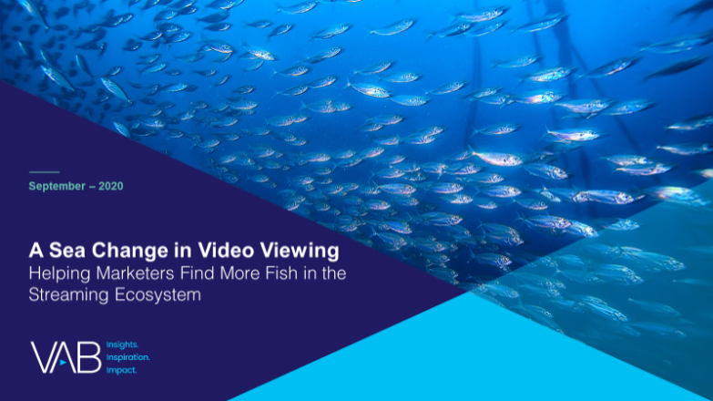
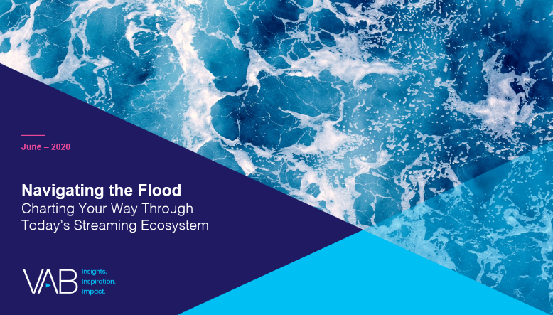

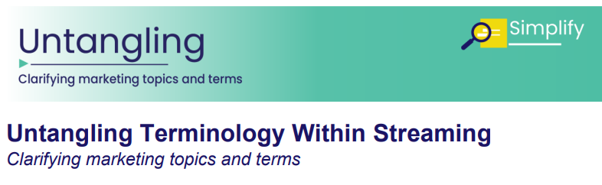

Discover more
Looking for more data, insights and takeaways? Check out this related VAB content
A Sea Change in Video Viewing
Helping Marketers Find More Fish in the Streaming Ecosystem
Navigating the Flood
Charting Your Way Through
Today’s Streaming Ecosystem
Five Fast Facts on Paramount+
Untangling Terminology Within Streaming
Clarifying Marketing Topics and Terms
VAB Members, brand marketers and agencies get free and immediate access to VAB’s content library. Get access at theVAB.com
This information is exclusively provided to VAB members and qualified marketers. Further distribution is prohibited.
PAGE 9

Slide 10

About VAB
VAB is an insights-driven organization that inspires marketers to reimagine their media strategies resulting in fully informed decisions.
Drawing on our marketing expertise, we simplify the complexities in our industry and discover new insights that transform the way marketers look at their media strategy.
Discover
We keep you one step ahead with the latest thinking so you can create innovative, forward-looking strategies.
Simplify
We save you time by bringing you the latest data & actionable takeaways you can use to inform your marketing plans.
Transform
We help you build your brand by focusing on core marketing principles that will help drive tangible business outcomes.
We are committed to your business growth and proud to offer VAB members, brand marketers and agencies complimentary access to our continuously-growing Insights library. Get immediate access at theVAB.com.
This information is exclusively provided to VAB members and qualified marketers. Further distribution is prohibited.
PAGE 10

