Slide 1


April 2021

Slide 2


As marketers battle for viewer attention, it’s important to understand how best to engage with consumers across platforms and devices.
These Five Fast Facts explore the relative ad views and engagement across platforms and devices, with a particular focus on connected TV, to help marketers boost the impact of their campaigns.
This information is exclusively provided to VAB members and qualified marketers. Further distribution is prohibited.
PAGE 2

Slide 3
1
Share of Ad Views By Distribution Platform
2H 2020
As consumers straddle both content worlds, many marketers are utilizing a combination of streaming and cable / satellite apps (TVE) to achieve their desired scale
Source: Freewheel, Video Monetization Report 2H 2020: A Decade of TV Evolution.
This information is exclusively provided to VAB members and qualified marketers. Further distribution is prohibited.
PAGE 3

Slide 4

2
Understanding the importance
of precisely reaching the right audience with their message, marketers have doubled their number of impressions in audience-based buying
Audience Share of Targeted Campaigns
2H 2020
+91%
growth in audience targeted ad views since 2018
Source: Freewheel, U.S. Video Monetization Report H2 2020: A Decade of TV Evolution; ‘Demo’ audience segment types are those that target based on age and gender, ‘Behavioral’ audience segment types are those that target more advanced segments such as auto intenders, sports enthusiasts etc.
This information is exclusively provided to VAB members and qualified marketers. Further distribution is prohibited.
PAGE 4

Slide 5
3
Although people’s comfort level with viewing content on various platforms has increased, their attention to ads directly corresponds to screen size, making it a critical factor for marketers
Completion Rate by Device and Ad Format
N/A
0.6%
N/A
0.3%
1.4%
0.5%
0.4%
0.8%
0.2%
Ad Engagement Rate
Source: Innovid, U.S. Video Benchmarks Fall 2020, DCO is ‘Dynamic Creative Optimization’ which is a platform for advertisers to engage consumers with personalized relevant messaging across platforms, *Standard Pre-Roll Video running across CTV devices does not allow for click-throughs and therefore does not have engagement opportunities, no engagement data available for Connected TV DCO Video. Examples of Interactive Ads: Expand, TV-2-Mobile and Choice Based.
This information is exclusively provided to VAB members and qualified marketers. Further distribution is prohibited.
PAGE 5

Slide 6
4
Recognizing the superior ad environment available in CTV, marketers are increasingly shifting impressions from other video options
Ad Impressions by Device
Source: Freewheel, Video Monetization Report, 1H 2020 & 2H 2020, Note: Starting in 2H 2020, FreeWheel categorizes impressions from IP apps on MVPD set top
boxes as ‘CTV.’
This information is exclusively provided to VAB members and qualified marketers. Further distribution is prohibited.
PAGE 6

Slide 7


5
When considering ad format in CTV, consumers reward marketers who provide choice and value by enhancing their overall viewing experience
Connected TV Engagement Rate by Interactive Ad Format
Overlay
Canvas
0.4%
0.4%
Logo
Bug
CTA
Expand
Choice-Based*
TV-2-Mobile
0.7%
20.3%
0.8%
Standard
Commercial Breaks
- or -
Engage For No Ads
Source: Innovid, U.S. Video Benchmarks Fall 2020, *Choice-Based: by interacting with an Engagement Ad, viewers are given the ability to watch their content with significantly reduced ad loads while guaranteeing the full attention of the viewer with a marketing message.
This information is exclusively provided to VAB members and qualified marketers. Further distribution is prohibited.
PAGE 7

Slide 8
As marketers develop cross-screen campaigns to add reach, it’s also important to consider how viewer engagement plays a role in overall campaign effectiveness.
Beyond understanding how screen size, content length and context may affect viewer engagement with their brand messaging, marketers should also consider going beyond the creation of standard ads to cultivate further interactivity with consumers
What does this mean for marketers?
This information is exclusively provided to VAB members and qualified marketers. Further distribution is prohibited.
PAGE 8

Slide 9
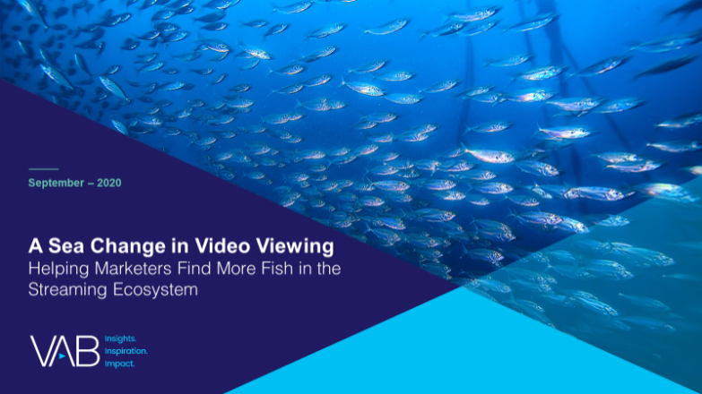

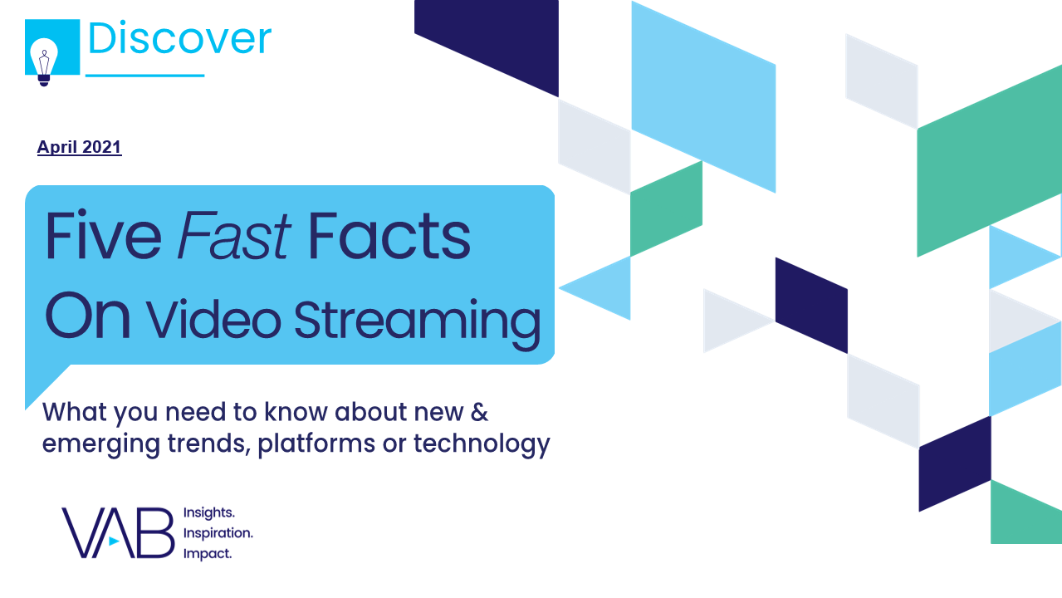

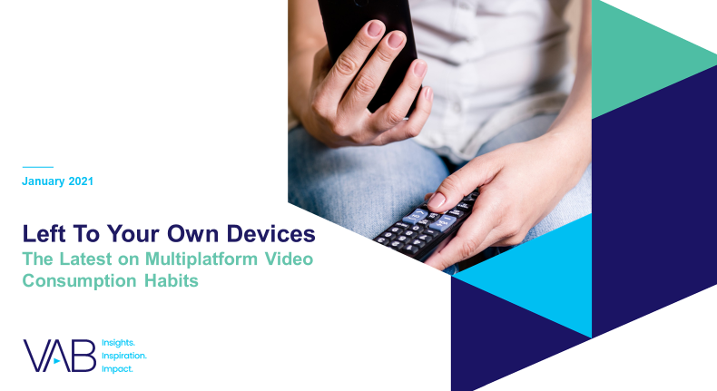
Discover more
Looking for more data, insights and takeaways? Check out this related VAB content
A Sea Change in Video Viewing
Helping Marketers Find More Fish in the Streaming Ecosystem
Navigating the Flood
Charting Your Way Through
Today’s Streaming Ecosystem
Five Fast Facts On Video Streaming
Five Fast Facts On Content Engagement
VAB Members, brand marketers and agencies get free and immediate access to VAB’s content library. Get access at theVAB.com
This information is exclusively provided to VAB members and qualified marketers. Further distribution is prohibited.
PAGE 9

Slide 10

About VAB
VAB is an insights-driven organization that inspires marketers to reimagine their media strategies resulting in fully informed decisions.
Drawing on our marketing expertise, we simplify the complexities in our industry and discover new insights that transform the way marketers look at their media strategy.
Discover
We keep you one step ahead with the latest thinking so you can create innovative, forward-looking strategies.
Simplify
We save you time by bringing you the latest data & actionable takeaways you can use to inform your marketing plans.
Transform
We help you build your brand by focusing on core marketing principles that will help drive tangible business outcomes.
We are committed to your business growth and proud to offer VAB members, brand marketers and agencies complimentary access to our continuously-growing Insights library. Get immediate access at theVAB.com.
This information is exclusively provided to VAB members and qualified marketers. Further distribution is prohibited.
PAGE 10

