Slide 1

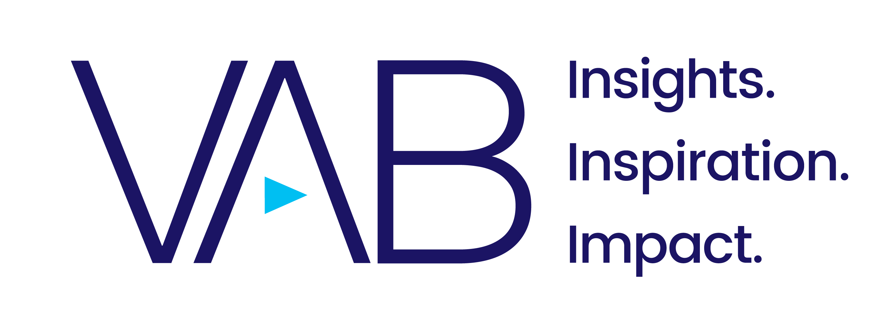
April 2021

Slide 2


With the proliferation of platforms and increased time at home during the pandemic, consumers now have a bevy of choices – across both linear TV and streaming – and a variety of ways to discover new content.
In this highly competitive environment, these Five Fast Facts explore the how, what and why of content engagement and the implications for marketers around viewer behaviors and video services’ content libraries.
This information is exclusively provided to VAB members and qualified marketers. Further distribution is prohibited.
PAGE 2

Slide 3
1
Prior to the pandemic, broadband-only homes cherry-picked their video services and added two more on average during the pandemic as they searched for more content.
Pay-TV subscribers’ thirst for content was satisfied by the existing strong base of content available through their MVPD, they kept their total services constant through the pandemic by potentially shifting between secondary streaming services.
Number of Video Services Per Person
Average Across Respondent Types
+37%
Q4 vs Q1
Source: VAB analysis of TiVo Video Trends Report, Q1 2020 & Q4 2020, P18+. *Pay-TV = Cable, Satellite or Telco TV subscribers.
This information is exclusively provided to VAB members and qualified marketers. Further distribution is prohibited.
PAGE 3

Slide 4
2
Even as platforms proliferate, viewership fragments and the ways to gather information accelerates, TV’s ability to enable viewers to discover new content through advertising and promos
that run during other TV shows
is higher than any other form
of communication
How Viewers Discover New Movies/TV Shows to Watch
Percentage of total respondents, respondents could choose more than one answer
Source: TiVo Video Trends Report Q4 2020, P18+. *Social Media not available for 2019.
This information is exclusively provided to VAB members and qualified marketers. Further distribution is prohibited.
PAGE 4

Slide 5













3
35%
57%
of viewers have signed up for a provider just to get access to one show
of P16-24 have signed up for a provider just to get access to one show
Many streamers have signed up for a service just to watch a specific show, however subscriptions driven from these shows can also lead to higher churn if a service lacks a deep library.
When selecting advertising partners, marketers should consider the full breadth of their content library and be sure to re-evaluate platforms on a regular basis to assess the audiences across services.
Which Show Did You Sign Up to Watch?
Most Mentioned Titles
1
2
3
4
5
6
7
8
9
Source: Hub Research, Evolution of Video Branding, Feb 2021, Survey Base: P16-74, watch at least one hour of TV weekly & have broadband access, Survey Fielded February 2021
This information is exclusively provided to VAB members and qualified marketers. Further distribution is prohibited.
PAGE 5

Slide 6
















4
Netflix’s Most Watched Shows
Week of 3/24/21
On Netflix, while their original series releases garner the most headlines and buzz, at least half of the most watched shows on the service tend to be acquired programming from TV networks.
It’s imperative for marketers to understand what content is
on each platform as TV network groups build up their own DTC streaming services and look
to retain, or take back, the streaming rights to their shows.
1
2
3
4
5
6
7
8
9
10
Source: ReelGood via PCMag ‘The Most Watched Shows on Netflix This Week’, updated on 4/1/21, ‘Most Viewed Shows’ reflects ReelGood platform data of 4MM monthly users stream usage.
This information is exclusively provided to VAB members and qualified marketers. Further distribution is prohibited.
PAGE 6

Slide 7




5
While COVID-19 closed most cinemas for an extended period, the pent-up desire to see movies on the big screen has meant that most people are eager to go back to theaters as soon as local restrictions are lifted.
Although some studios will continue to release new movies on streaming post-pandemic, questions remain regarding interest from viewers.
63%
21%
Are eager to go to a movie theater 0-3 months of covid restrictions being lifted
Plan to go to the movies even more post-pandemic
29%
31%
Are interested in paying to view a new movie release at home
Are interested in viewing new movie releases at home even after pandemic is over
Source: Nielsen Total Audience Report, March 2021, based on a special COVID-related advertising survey fielded in February 2021, (Top 2 Box – very eager / somewhat eager). TiVo Video Trends Report Q4 2020;
This information is exclusively provided to VAB members and qualified marketers. Further distribution is prohibited.
PAGE 7

Slide 8
Many consumers have built a large video service stack as platforms have proliferated, therefore it’s important for marketers to re-evaluate platforms regularly as evolving content offerings can affect new subscribers or retention rates
As the video service landscape becomes even more competitive inside the home and more pandemic-related local restrictions are lifted outside the home, it’s important to follow consumer behavior to understand how video content consumption will be affected moving forward
What does this mean for marketers?
This information is exclusively provided to VAB members and qualified marketers. Further distribution is prohibited.
PAGE 8

Slide 9


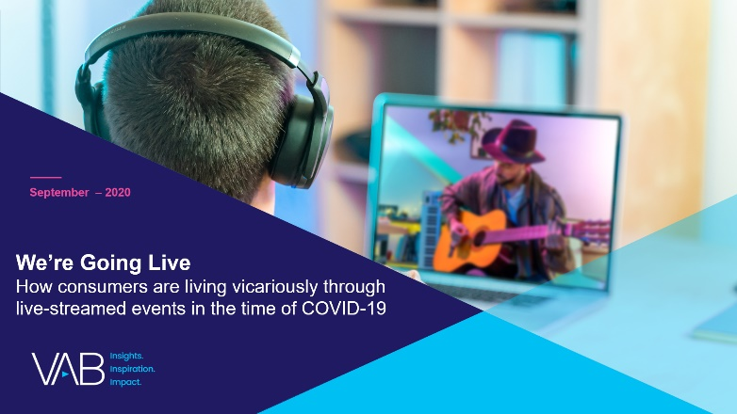


Discover more
Looking for more data, insights and takeaways? Check out this related VAB content
A Sea Change in Video Viewing
Helping Marketers Find More Fish in the Streaming Ecosystem
Navigating the Flood
Charting Your Way Through
Today’s Streaming Ecosystem
We’re Going Live
How Consumers are Living Vicariously Through Live-Streamed Events in the Time of COVID-19
Five Fast Facts On Video Streaming
VAB Members, brand marketers and agencies get free and immediate access to VAB’s content library. Get access at theVAB.com
This information is exclusively provided to VAB members and qualified marketers. Further distribution is prohibited.
PAGE 9

Slide 10

About VAB
VAB is an insights-driven organization that inspires marketers to reimagine their media strategies resulting in fully informed decisions.
Drawing on our marketing expertise, we simplify the complexities in our industry and discover new insights that transform the way marketers look at their media strategy.
Discover
We keep you one step ahead with the latest thinking so you can create innovative, forward-looking strategies.
Simplify
We save you time by bringing you the latest data & actionable takeaways you can use to inform your marketing plans.
Transform
We help you build your brand by focusing on core marketing principles that will help drive tangible business outcomes.
We are committed to your business growth and proud to offer VAB members, brand marketers and agencies complimentary access to our continuously-growing Insights library. Get immediate access at theVAB.com.
This information is exclusively provided to VAB members and qualified marketers. Further distribution is prohibited.
PAGE 10

