Slide 1
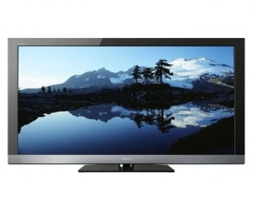
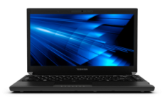
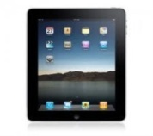
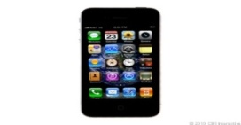

As Seen On TV:
A Direct Response To What Drives DR
Notes:
1
1

Slide 2
The Quick Pitch: Television Represents A Proven Path To Success Within The Direct Response Category
In a fast-moving category predicated on the direct selling of high volume products, TV advertising is consistently the main driver of brand success through its ability to deliver mass reach and scale quickly
Perfected by the iconic DR products of the early 2000’s, the most successful brands enacted a multi-pronged, TV-centric media strategy of buying wide and deep:
  “Top Dollar” – Brands invested significantly to ensure heavy TV exposure
  “Dominant Share” - TV was the leading medium by far within the media mix
  “Continuity” – Weekly TV presence existed throughout the entire ad campaign
  “Around-The-Clock Coverage” - Brand presence in all TV dayparts
                Heavy focus on prime & daytime
  “Wide Net” – Deep network list across various demographics and multiple genres
This proven formula is in effect now more than ever with dozens of current DR products employing similar “TV-centric” media strategies to build their brand and strengthen sales
Notes:
2
2

Slide 3
The Quick Pitch: Television Builds Iconic Brands & Delivers Incredible Results
  Popular Culture
  Parody
  Community
Ingrained in the consumer consciousness:
-Products
-Pitchmen
-Celebrities & entertainers on popular TV programs
-Thousands of YouTube videos uploaded by the average user
    -Bloggers incessantly blog about them
-Facebook fan clubs have launched around them and members share content
    -Product Twitter mentions are everywhere
Television, and the mass reach strategies of buying deep and maintaining a continuous presence, has enabled many DR brands to take on “larger than life” personas through:
While most importantly not only achieving, but exceeding, desired business outcomes:
  Website Traffic
  Sales (“Cee, TV works!”)
-TV spending , traffic
-TV Spending , traffic
-Consumer Acceptance
-Explosive Growth
-Extensive Back Orders
Notes:
3
3

Slide 4
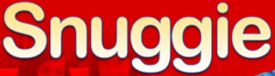

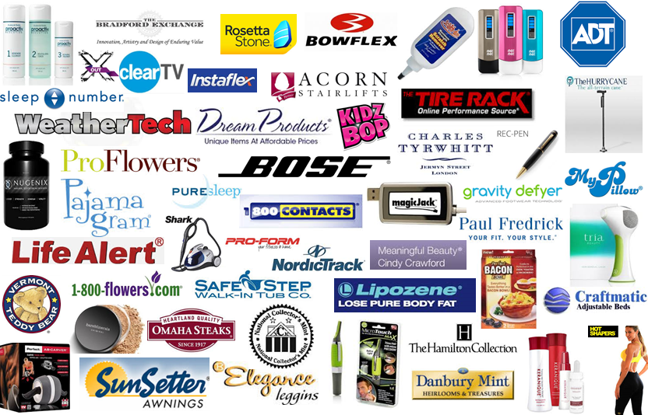
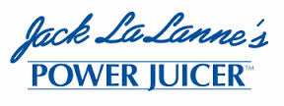


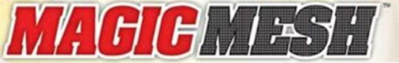
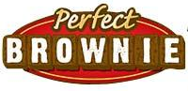
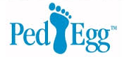

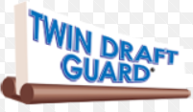
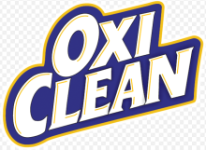
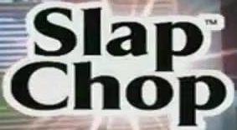
DR Category Segment Analysis: “Iconic” & “Active” Brands
“Iconic” Brands
“Active” Brands
To understand how TV drives their business, we analyzed the media activity of two segments within the DR category representing “iconic” brands of the recent past and products that are currently active in the marketplace
Notes:
4
4

Slide 5
Several Of The Successful Media Strategies Employed By Iconic DR Brands Of The Recent Past Continue Today With Similar Eye-Popping Results
“Iconic” Brands
“Active” Brands
Notes:
5
5

Slide 6
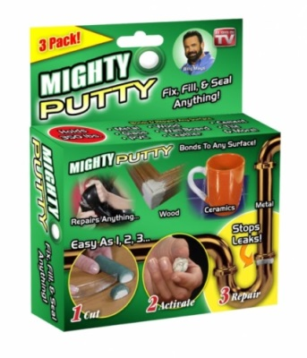
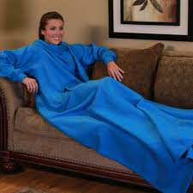
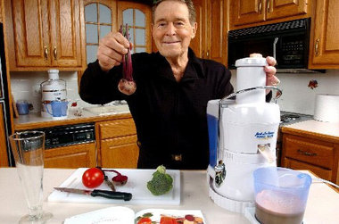
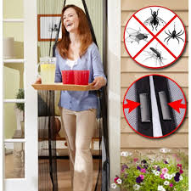
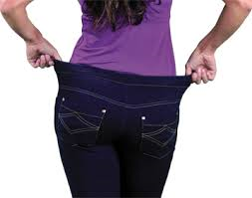
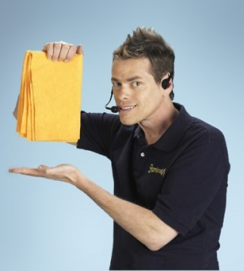

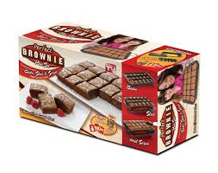

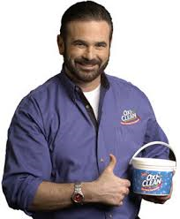
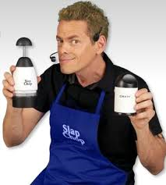
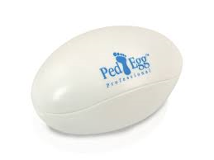
What Do These 12 Iconic Direct Response Brands From The 2000’s Have in Common?
Snuggie
Mighty Putty
Jack LaLanne’s Power Juicer
Magic Mesh
Pajama Jeans
ShamWow
“The blanket with sleeves!”
“Before buying new, let Mighty Putty fix it for you!”
“Change your life, save your life!”
“Keep fresh air in and bugs out!”
“Pajamas you live in. Jeans you sleep in!”
“Say WOW every time!”
Shake Weight
Perfect Brownie
Twin Draft Guard
OxiClean
Ped Egg
Slap Chop
“This is not a workout. This is a revolution.”
“Go from flabby to fabulous!” (women)
“Bake, Slice and Serve!”
“The double-sided insulating miracle”
“The stain specialist!”
“Treat your feet to a foot makeover!”
“You’re going to love my nuts!”
Notes:
6
6

Slide 7
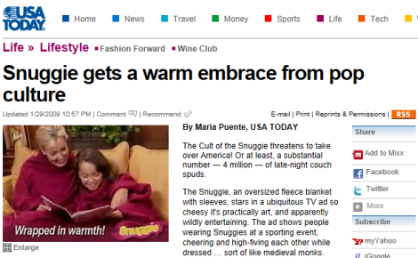
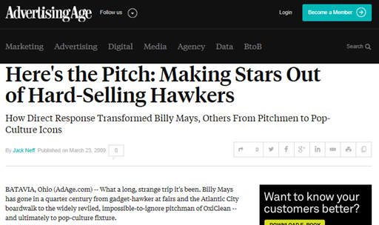
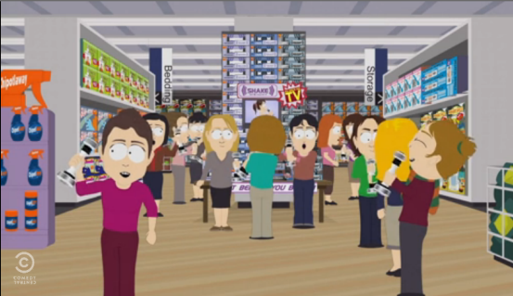
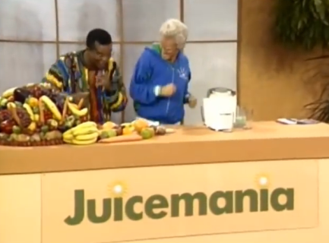
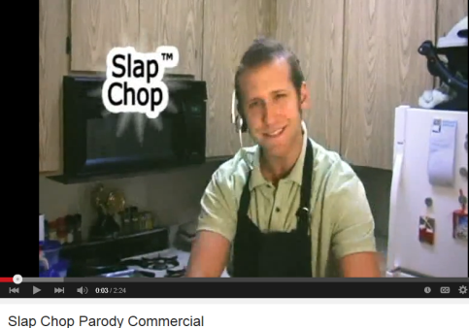
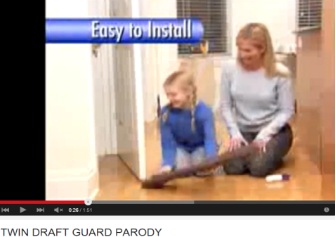
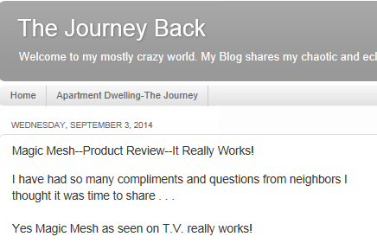
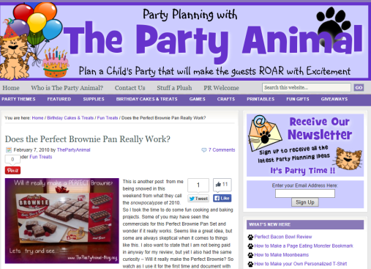
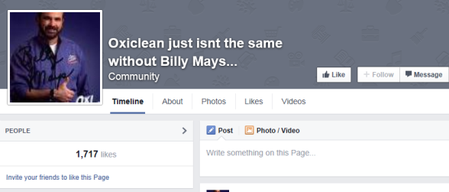
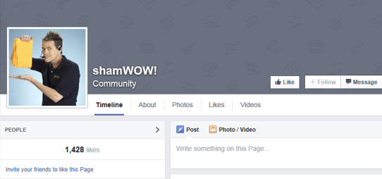

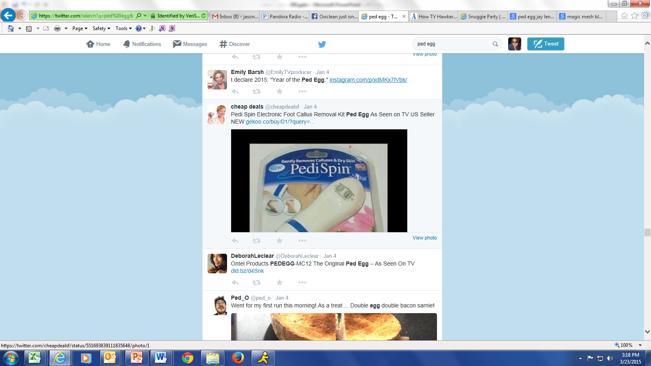
They All Entered The Mainstream Lexicon Of The American Consumer And Became A Cultural Phenomenon
The products and pitchmen are ingrained in pop culture
They’ve been parodied on Television…
…And by the average person on YouTube
Users have incessantly blogged about them…
…Facebook fan clubs have launched…
…And Twitter mentions are everywhere
Notes:
7
7

Slide 8
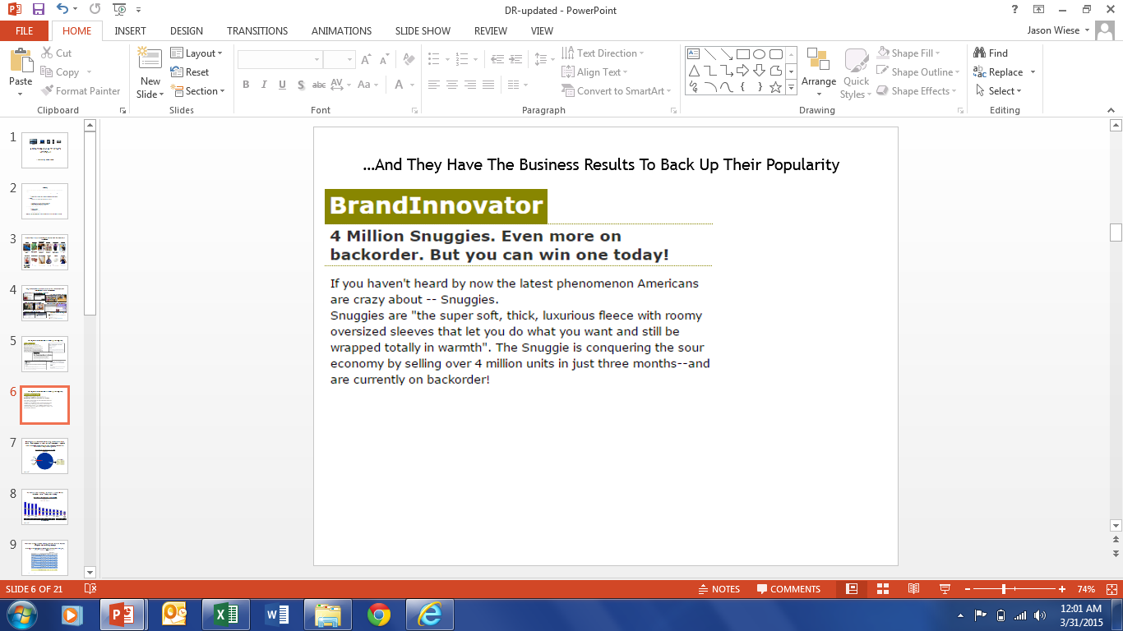
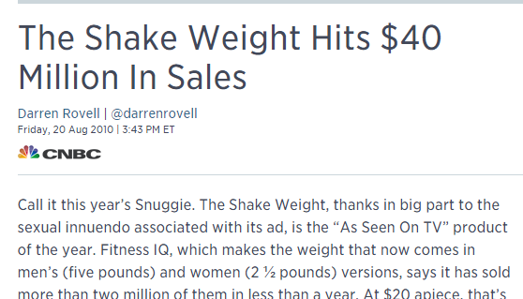
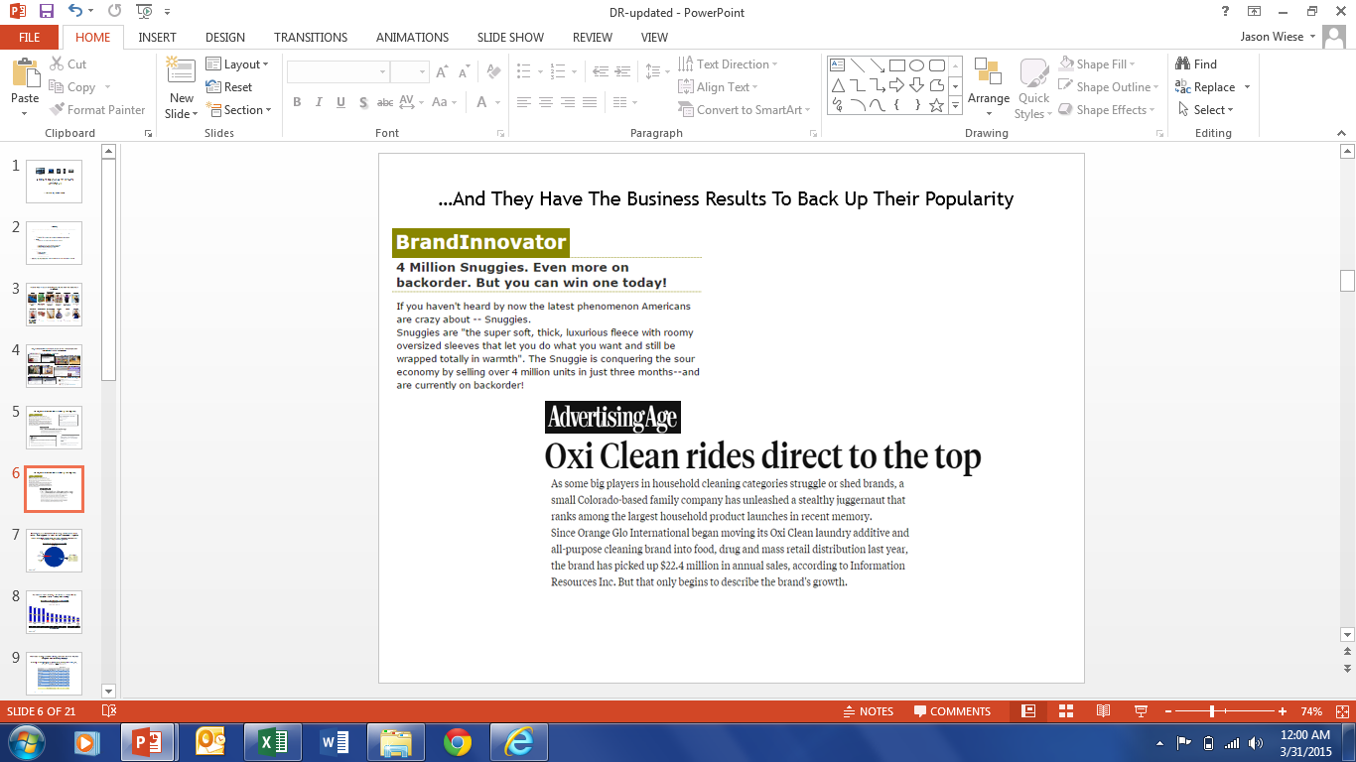
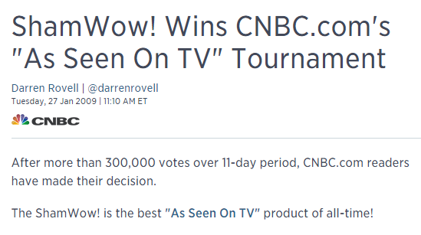
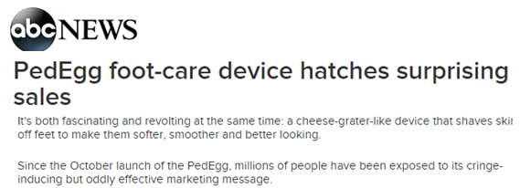
…And They Have The Business Results To Back Up Their Popularity
Notes:
8
8

Slide 9
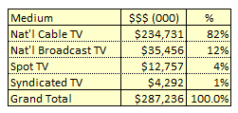
But Becoming A Cultural Phenomenon & Delivering “Off The Charts” Sales Wouldn’t Have Happened If It Wasn’t For Their Tremendous TV Exposure
These 12 iconic direct response brands were almost all exclusively advertised on TV, both infomercials & heavy commercial placements
12 “Iconic” Brands: Collective Media Mix ($000)
CY 2004-2014
Cable drove the
TV investment
TV reflects commercial spend only and excludes infomercials
Source: Nielsen Ad*Views; Print includes newspapers, magazines and Sunday supplements. TV includes national, syndication, spot & Hispanic.
Notes:
9
9

Slide 10
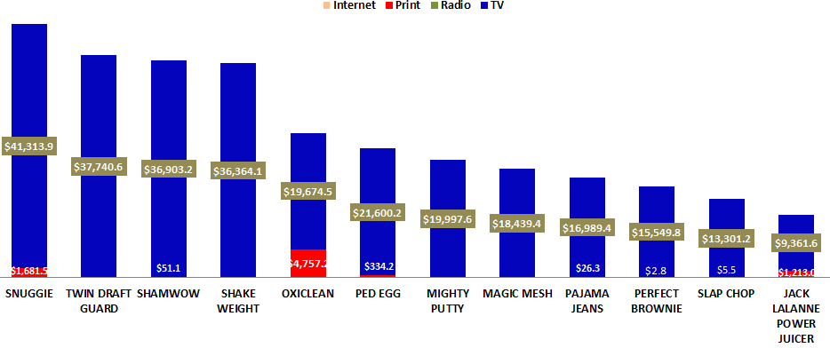
The Media Mix Wasn’t Driven By A Few Either, All “Iconic” Brands Employed A Similar TV-Heavy Media Strategy
“Iconic” Brands: Total Campaign Media Spend ($000)
CY 2004-2014
$42,996.0
$37,740.6
$36,954.4
$36,364.1
$24,515.6
$21,934.6
$19,997.8
$18,441.2
$17,048.5
$15,552.6
$13,306.7
$10,589.2
2008-2011
2007-2012
2007-2013
2009-2012
2004-2007
2007-2014
2007-2009
2011-2014
2010-2013
2009-2010
2008-2013
2004-2013
Active Campaign Years
Source: Nielsen Ad*Views; Print includes newspapers, magazines and Sunday supplements. TV includes national, syndication, spot & Hispanic.
Excludes infomercials spend
Notes:
10
10

Slide 11
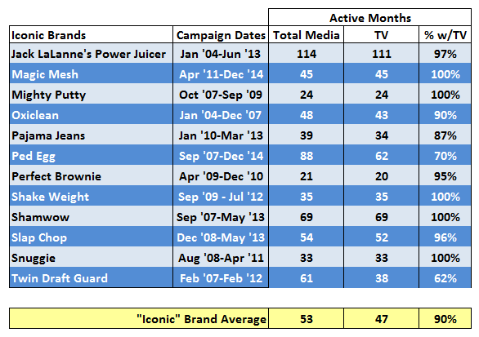
To Maintain “Top-of-Mind” Awareness, They Employed A Strong, Continuous Television Presence Throughout Their Advertising Campaign
The average advertising campaign for “Iconic” Brands lasted almost four and ½ years, of which TV was active in 90% of the months
Source: Nielsen Ad*Views; Time Period – CY 2004-2014
Notes:
11
11

Slide 12
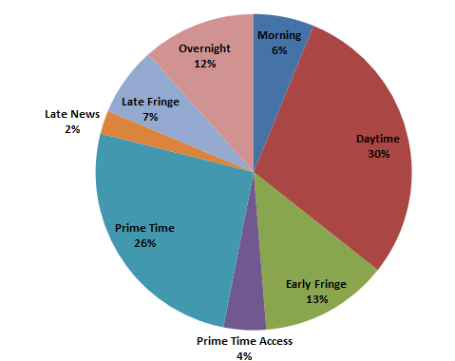
24-Hour A Day Advertising! Direct Response Brands Weren’t Just Relegated To Post-1AM Overnight Placements Either
In an effort to maximize reach, “Iconic” brands employed a balanced daypart mix strategy targeting consumers throughout the day including primetime
12 “Iconic” Brands: Collective TV Daypart Mix (based on $$$)
CY 2004-2014
Source: Nielsen Ad*Views. TV includes national, spot & Hispanic; syndication is excluded due to inability to define dayparts.
Excludes infomercials spend
Notes:
12
12

Slide 13
Casting A Wide Net, Direct Response Brands Bought Deep To Create A Robust Television Network Mix
In another “maximizing reach” strategy, “Iconic” brands bought across multiple genres, interests and demographic targets to incorporate a deep network list into their TV buy
“Iconic” Brands: Total # of TV Networks Utilized During Campaign
CY 2004-2014
Campaign Years
2009-2012
52 nets avg/year (74 nets in highest year - 2011)
2007-2013
35 nets avg/year (74 nets in highest year - 2009)
2008-2011
61 nets avg/year (82 nets in highest year - 2009)
2007-2012
51 nets avg/year (70 nets in highest year - 2009)
2008-2013
28 nets avg/year (69 nets in highest year - 2009)
2007-2014
26 nets avg/year (54 nets in highest year - 2008)
40 nets avg/year (60 nets avg in highest year)
2007-2009
45 nets avg/year (63 nets in highest year - 2008)
2010-2013
43 nets avg/year (62 nets in highest year - 2011)
2009-2010
53 nets avg/year (54 nets in highest year - 2009)
2011-2014
39 nets avg/year (53 nets in highest year - 2011)
2004-2007
39 nets avg/year (53 nets in highest year - 2011)
2004-2013
5 nets avg/year (12 nets in highest year - 2007)
Source: Nielsen Ad*Views. TV includes national & Hispanic; syndication & spot is excluded. Excludes infomercials data.
Notes:
13
13

Slide 14
Similar TV-Centric Media Strategies Developed By These Iconic Brands Continue To Be Utilized By The Most Popular DR Brands Advertising Today
“Iconic” Brands
“Active” Brands
Notes:
14
14

Slide 15
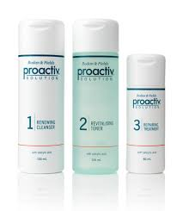
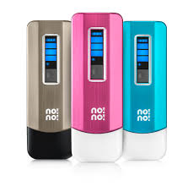
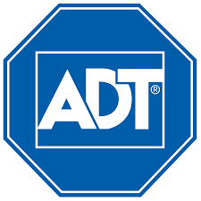
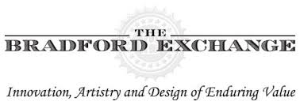
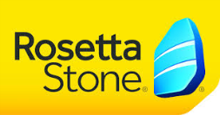
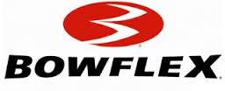
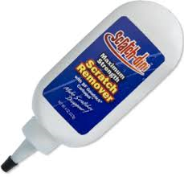













































These Diverse Brands Represent 50 Of The Most Popular Direct Response Advertisers That Were Active In 2014
*Major advertisers representing a cross-section of various DR categories and active for multiple years including 2014
Notes:
15
15

Slide 16
Television Is The Primary Driver For The Most Popular DR Brands Currently Being Advertised
90% of the popular Direct Response brands we analyzed over the last 10-years advertise on TV, while almost 70% utilize it as the dominant media in their mix
50 “Active” DR Brands: TV Spend as a % of Their Media Mix
10-Year Total: CY 2004-2014
45 brands
34 brands
30 brands
20 brands
14 brands
Source: Nielsen Ad*Views, includes TV, Internet, Radio, Outdoor & Print and all their measured subcategories
Notes:
16
16

Slide 17
In 2014, Even More Top DR Brands Relied on TV Advertising, Almost Exclusively, To Drive Sales
Almost half of the active DR brands used TV nearly exclusively within their media mix,
a testament to the continued power of the medium
50 “Active” DR Brands: TV Spend as a % of Their Media Mix
CY 2014
45 brands
42 brands
34 brands
35 brands
30 brands
29 brands
20 brands
23 brands
14 brands
17 brands
Source: Nielsen Ad*Views, includes TV, Internet, Radio, Outdoor & Print and all their measured subcategories
Notes:
17
17

Slide 18


Television Spending By Popular DR Brands Has Continued To Increase Along With Their Overall Media Budgets
The 50 active popular Direct Response brands spent almost $700 million on TV in 2014
50 “Active” DR Brands: Total Media Spend (000)
CY 2012 - 2014
$1,150,348
$1,076,736
$944,045
Cable drives the
TV investment
Source: Nielsen Ad*Views - TV includes national, spot & syndication TV; Other includes Internet, Radio, Outdoor & Print and all their measured subcategories
Notes:
18
18

Slide 19

Most Active DR Brands Call For A Strong, Continuous Television Presence Throughout Their Advertising Campaign
Over the last three years, current DR brands have been active on TV for an average of 86% of the months, with over half of the brands (58%) active on TV every month
“Active” DR TV Brands: Active TV Months Within Ad Campaign
CY 2012 - 2014
Source: Nielsen Ad*Views; Time Period – CY 2012-2014
Notes:
19
19

Slide 20

Primetime Is The Leading Daypart For Direct Response Brands’ Around-The-Clock Messaging
Much like the “iconic” DR brands, current advertisers have consistently employed a balanced daypart mix targeting consumers through the day to maximize reach
“Active” DR TV Brands: Collective TV Daypart Mix (based on $$$)
CY 2012-2014
Source: Nielsen Ad*Views. TV includes national, spot & Hispanic; syndication is excluded due to inability to define dayparts.
Notes:
20
20

Slide 21
Direct Response Brands Are Buying Deeper To Build An Even More Robust Television Network Mix
Current advertisers, who already buy deep, are going even deeper on their network buy list to capture consumers and maximize their reach
“Active” DR Brands: Average # of TV Networks Utilized Each Year
CY 2009-2014
Network Avg For Any Brand*
32
34
36
36
38
38
*Based on brands in any category that spent $10MM+ in national TV each year (equivalent average TV spend of the “current” DR brands)
Source: Nielsen Ad*Views. TV includes national, spot & Hispanic; syndication is excluded due to inability to define dayparts. Network average based on “when-on” for consistently active TV brands between 2009-2014
Reflects 30 TV brands that have been active each year from 2009-2014 = 1-800 contacts, Acorn Stairlifts, ADT, Bare Minerals, Bose, Bowflex, Bradford Exchange, Craftmatic, Danbury Mint, Euro-Pro Shark, Keranique, Kidz Bop, Life Alert, Lipozene, Magic Jack, Meaningful Beauty, Micro Touch, National Collectors Mint, Nordic Track, Omaha Steaks, Pajamagram, ProActiv, Pro Flowers, Pure Sleep, Rosetta Stone, Safe Step Walk in Tub, Sleep Number, Sunsetter, Vermont Teddy Bear, WeatherTech
Notes:
21
21

Slide 22




TV Advertising Drives Consumers To Direct Response Brands’ Websites
13 out of 15 Direct Response brands (87%) showed a direct correlation between their TV spend / network depth and their website traffic
Average Monthly Unique Visitors (000) Vs. Average Monthly TV Spend (000) / Network Depth Comparison
Oct ‘13 – Apr ’14 vs. May ‘14 – Dec ‘14
TV Spend Up, Traffic Up
Seven-Brand Average
# of TV Networks Bought:
+7
+27
+7
+1
flat
TV Spend (000):
+57%
+79%
+41%
+13%
+3%
Unique Visitors (000):
+44%
+53%
+81%
+26%
+3%
TV Spend Down, Traffic Down
Six-Brand Average
# of TV Networks Bought:
-5
-10
-1
-3
-8
TV Spend (000):
-23%
-48%
-23%
-88%
-4%
Unique Visitors (000):
-25%
-38%
-18%
-13%
-9%
Selected brands based on comScore measured direct response brands with 100K+ average website monthly uniques & $1MM+ TV total spend
Source: Nielsen AdViews; National, Spot & Syndication TV spend Oct 2013-Dec 2014; comScore unique visitors P2+. Spend & unique visitors based on Oct ‘13-Apr ‘14 vs. May ‘14-Dec ’14 monthly averages
15 brands: X-Out, Rosetta Stone, MagicJack, Bose, KidzBop, 1800contacts, ADT, ProFlowers, Bare Escentuals, WeatherTech, Pajamagram, Sleep Number, Nordic Track, ViVint, Proform
Notes:
22
22

Slide 23












Today’s Direct Response Brands Continue To Enter The Mainstream Lexicon Of The American Consumer
The products, their spokesmen and the slogans are ingrained in pop culture
They’re parodied on Television…
…And by the average person on YouTube
Users incessantly blog about them…
…People post & share content on Facebook…
…And Twitter mentions are everywhere
Notes:
23
23

Slide 24







…And They Also Have The Business Results To Back Up Their Popularity
TV launched in 2008
Notes:
24
24

Slide 25




















































For Direct Response, TV Delivers Reach On A Massive Scale Enabling Millions To Engage With And Socialize Their Products
DR Brands have been able to effectively drive engagement and sales through their collective $20 billion TV advertising investment over the last 10 years
“Iconic” Brands
“Active” Brands
Media Strategy
Media Strategy
Mass Reach
Heavy TV Continuity In All Dayparts Across Many Networks
Mass Reach
Heavy TV Continuity In All Dayparts Across Many Networks
Engagement
Engagement
Sales
Sales
Investment figure based on total DR category TV spend as reported by Nielsen Ad*Views, excluding infomercials
Notes:
25
25

Slide 26

Notes:
26
26

