Slide 1





2021
The Secret of My Success
Examining The Winning Marketing Strategy
That’s Fueling High-Growth DTC Brands

Slide 2
What You’ll Learn…
How a total audience marketing strategy is igniting the business outcomes of fast-growing ‘direct-to-consumer’ brands
How embracing an audience-first TV buying strategy delivers new consumers to these brands, in particular the lucrative group of adults over 50
Real-world examples and inspiration from 30 of the most innovative brands showing how an audience-first TV buying strategy broadened their consumer base, driving significant business outcomes from engagement to action
This information is exclusively provided to VAB members and qualified marketers. Further distribution is prohibited.
PAGE 2

Slide 3

‘Direct-to-consumer’ are among the fastest-growing brands, driven by their innovative approach to consumers

Slide 4






DTC brands build themselves around the needs of the modern consumer
How Are DTC Brands Attracting Consumers?
Deliver On A Specific Consumer Need
Ensure That Their Products Are Designed & Executed Well
Offer Their Product At A Fair Price
Take Pride In Excellent Customer Service / Experience
Simplify The Buying / Returning / Exchanging Process
This information is exclusively provided to VAB members and qualified marketers. Further distribution is prohibited.
PAGE 4

Slide 5
Boosted by the pandemic, digital-native DTC brands’ e-commerce sales increased 40% during 2020 and have more than doubled over the last few years
Digital-Native ‘Direct-to-Consumer’ Brand E-commerce Sales
(in billions)
+17%
+18%
+20%
+40%
+37%
Source: Insider Intelligence / eMarketer, D2C Marketing Trends Roundup, August 2021. Includes products sold by consumer brand manufacturers that sell their products directly to consumers digitally via their owned and operated sites, bypassing standard distribution channels through a retailer, wholesaler or third-party platform such as a marketplace. Excludes travel and event tickets and food or drink services, also excludes ecommerce sales from ‘established’ brands with an ecommerce business like adidas, Apple, Gap, Nike, etc.
This information is exclusively provided to VAB members and qualified marketers. Further distribution is prohibited.
PAGE 5

Slide 6







Successful DTC brands adhere to a core set of principles that are shaped to fit today’s consumer behaviors, lifestyles and values
E-commerce
Data-
Obsessed
Socially-
Interactive
Design-
Focused
Consumer-
Centric
Customer-
Led
Mission-
Driven
For more information on DTC brands’ core principles, download Deciphering Direct-to-Consumer: An Insider's Guide to America's Fastest Growing Brands
This information is exclusively provided to VAB members and qualified marketers. Further distribution is prohibited.
PAGE 6

Slide 7
The secret to their success?
Embracing all audiences as potential customers through their integrated marketing strategies

Slide 8
DTC brands are evolving their video creative by employing six key strategies to engage a broader audience
Embracing older consumers
Engaging multigenerational families
Incorporating diversity & inclusion
Developing Spanish-language creative
Injecting ‘lifestyle’
into a brand’s product
Leveraging ‘everyday’ celebrities with wide appeal
This information is exclusively provided to VAB members and qualified marketers. Further distribution is prohibited.
PAGE 8

Slide 9





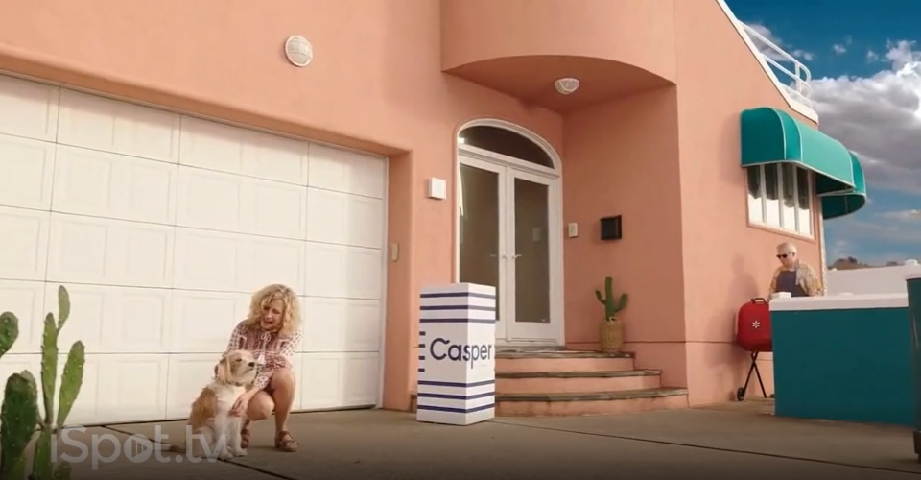



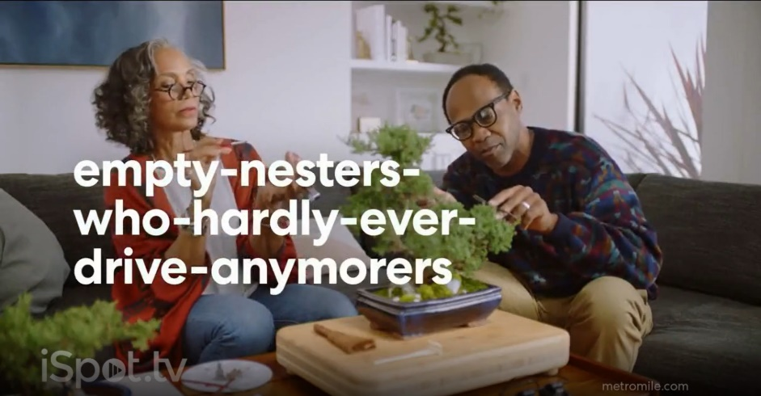


Many DTC brands are evolving their TV messaging by shifting from primarily millennial-focused to integrating people of all ages and life stages
(TV spot first aired: 6/18/2018)
(TV spot first aired: 8/25/2019)
(TV spot first aired: 2/24/2017)
(TV spot first aired: 2/5/2021)
(TV spot first aired: 7/24/2017)
(TV spot first aired: 10/14/2019)
(TV spot first aired: 8/6/2018)
(TV spot first aired: 10/17/2020)
Source: creative from iSpot.tv, time period of airing 1/1/17 – 3/31/21, note: each creative execution had to launch before 3/31/21 so some may still be actively airing on TV. Click above images to watch TV spots.
This information is exclusively provided to VAB members and qualified marketers. Further distribution is prohibited.
PAGE 9

Slide 10
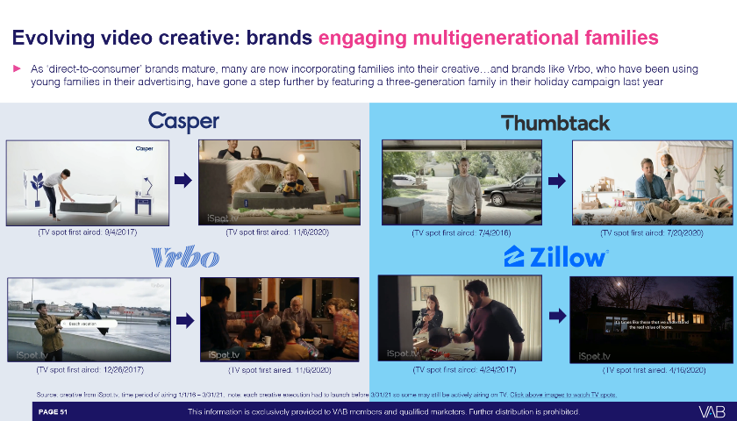
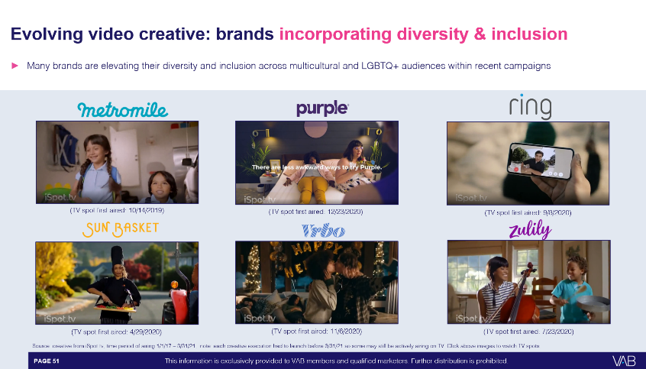
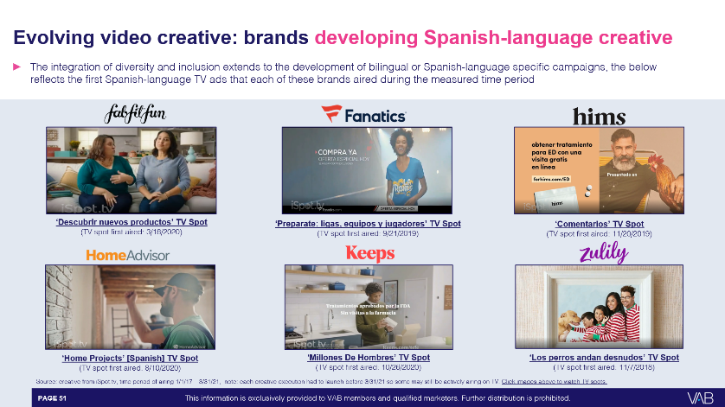
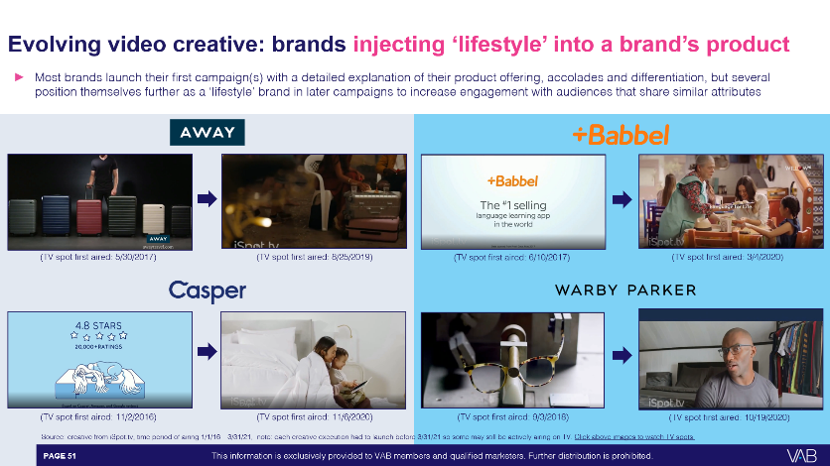
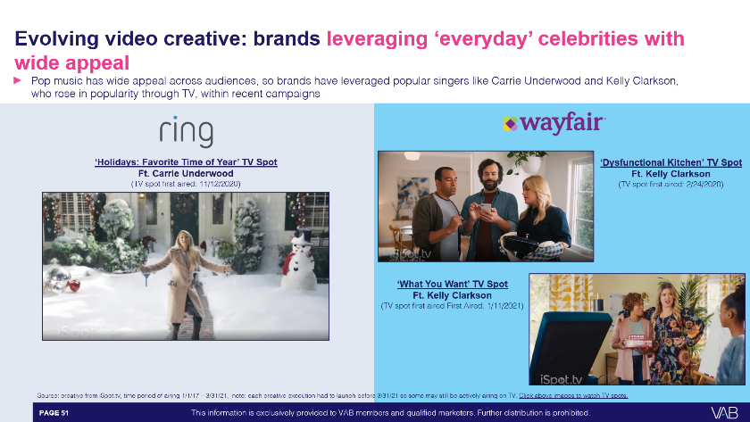
Click on the appropriate imagery below to explore in more detail the other five key strategies being employed to engage a broader audience
Engaging multigenerational families
Incorporating diversity & inclusion
Developing Spanish-language creative
Injecting ‘lifestyle’
into a brand’s product
Leveraging ‘everyday’ celebrities with wide appeal
Click on thumbnails above (in ‘slide show’) to see full slide, and view creative executions, in appendix
This information is exclusively provided to VAB members and qualified marketers. Further distribution is prohibited.
PAGE 10

Slide 11


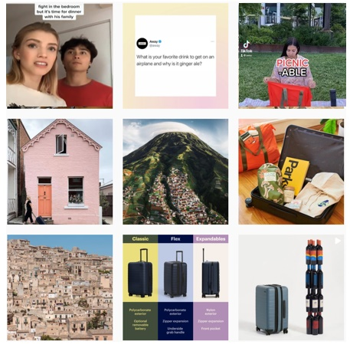

Brand communications through their social channels are tailored towards younger people to ensure they are reaching all audiences
From a total audience integrated marketing approach, while many direct-to-consumer brands are evolving their TV creative to engage broader audiences, their social media pages continue to be largely millennial and young adult-focused
Source: recent social media images from each brand’s Instagram page as of September 2021.
This information is exclusively provided to VAB members and qualified marketers. Further distribution is prohibited.
PAGE 11

Slide 12


















From a media strategy perspective, DTC brands typically establish themselves through social media and then add media platforms to
broaden their audience in order to continually fuel their customer funnel
Typical Direct-to-Consumer Brand Advertising Evolution
Social Media
Sampling of brands that are primarily advertising in this channel
Podcasts, Out-of-Home, Satellite Radio
Sampling of brands that have added these channels to their media mix
Multiscreen TV
Sampling of brands that have added TV
to their media mix
(establish their customer base)
(broaden their audience beyond loyalists)
(make the ‘big bet’ on scale & growth)
DTC Brand Maturity
This information is exclusively provided to VAB members and qualified marketers. Further distribution is prohibited.
PAGE 12

Slide 13
Multiscreen TV is a key driver of growth for ‘direct-to-consumer’ brands as the category has invested over $20 billion in the platform since 2013
Digital-Native ‘Direct-to-Consumer’ Annual TV Spend
(in billions)
+19%
+2%
+46%
+44%
+31%
+30%
+59%
Cume TV Spend
$0.7 B
$1.8 B
$3.2 B
$5.1B
$7.8 B
$11.7 B
$16.4 B
$21.2 B
Source: VAB analysis of Nielsen Ad Intel, calendar year 2013 – 2020, based on a custom created category for ‘direct-to-consumer’ which includes travel, event tickets, and food / drink services. TV spend includes cable TV, broadcast TV, Spanish language cable TV, Spanish language broadcast TV, spot TV, and syndicated TV.
This information is exclusively provided to VAB members and qualified marketers. Further distribution is prohibited.
PAGE 13

Slide 14
DTC brands’ customer-centric approach fosters their ‘total audience’ mindset when it comes to planning and buying their TV campaigns

Slide 15












DTC brands embrace a total audience mindset by optimizing TV buys against best customer prospects to drive outcomes rather than limiting themselves to age and gender buying demos
Marketers can buy TV on buying habits, characteristics or viewing behaviors (programs, genres watched)
which is a more accurate surrogate for their customer than a prescribed age bucket
Buying Habits
Personal Characteristics
Potential New Homeowners
New Gym Members
Dining Out Regulars
Executives
Expectant Mothers
Gamers
In-Market Vehicle Buyers
Resort Travelers
Movie Goers
Newlyweds
College Graduates
Health-Conscious Adults
This information is exclusively provided to VAB members and qualified marketers. Further distribution is prohibited.
PAGE 15
This information is exclusively provided to VAB members and qualified marketers. Further distribution is prohibited.

Slide 16

They are also eager to talk about the successes they achieve through TV’s ability to reach new audiences and drive brand health metrics
“We have a product that has a utility for a wide swath of people. How do we start to think about the full marketing funnel in order to grow our reach and have a conversation with these people and at the same time think about how that impacts and actually makes our bottom of the funnel more efficient?
We think about what other roles can TV play, it’s not just reach but driving culture, emotional resonance and return on brand equity through the different kinds of premium programming you align to. There is customer alignment, there's emotional alignment, there’s value alignment, it creates mental availability and they’ll be reminded when they’re in the market from that availability.
“As we think about brand health metrics - awareness, consideration and market penetration - we think about how are we moving those metrics through the stories that we tell on television, through the stories that we tell through upper funnel and as your awareness and your consideration moves, your penetration will move too and that’s your bottom funnel.”
“We spent the first four years of the business focused on digital growth and understanding our core audience. We decided to take what we learned and apply it toward traditional avenues like TV. This new touchpoint has added depth to our 360- degree marketing efforts and has helped MVMT reach new audiences that aren’t glued to their smartphones.
We saw great results with our first series of commercials. Three variations were initially tested, and we soon discovered our “Founder” narrative resonates best with viewers. To date, MVMT has aired on 124 different television networks and continues to show on TV.”
Jake Kassan, co-founder & CEO, MVMT
(Glossy, ‘Why Fashion Brands Are Advertising on TV,’ 7/18)
Selena Kalvaria, VP of Brand Marketing, Away
(Beet.TV interview, 1/22/19)
This information is exclusively provided to VAB members and qualified marketers. Further distribution is prohibited.
PAGE 16

Slide 17

With data science as a core competency, most DTC companies rely on data & analytics for their media decision-making
Performance is their currency and DTC companies know exactly what media works for growing and perhaps, more importantly, retaining their customer base
DTC’s top KPIs are focused on growth metrics like sales, customer acquisition, conversion rates and website traffic
Through their own analytics, these brands can quickly
‘test & learn’ how their media placements (and creative content) are performing and their agility allows them to react / optimize swiftly and scale up when necessary
This information is exclusively provided to VAB members and qualified marketers. Further distribution is prohibited.
PAGE 17

Slide 18
By not limiting themselves to an age demographic, advertisers have access to more than seven trillion adult 18+ national TV impressions each year
Adult 50+ national TV impressions have increased from 5.1 trillion in 2018 to 5.3 trillion in 2020
Total National TV P18+ IMPs Share (equivalized) by Demo
2018
2019
2020
Source: VAB analysis of Nielsen Ad Intel data. National TV (broadcast TV, cable TV, Spanish language broadcast TV, Spanish language cable TV), total day, all genres, Live + 7, calendar year, base: P18+, excludes promos and PSAs.
Impressions are equivalized (:30s).
This information is exclusively provided to VAB members and qualified marketers. Further distribution is prohibited.
PAGE 18

Slide 19
A total audience approach gives brands access to more potential customers who account for 41% of total annual U.S. expenditures,
or $3.3 trillion in yearly spend
% Share of Annual Aggregate Expenditures by Age Demo
2020
Source: VAB analysis of 2020 Consumer Expenditure Survey data, U.S. Bureau of Labor Statistics, reported as of September 2021.
This information is exclusively provided to VAB members and qualified marketers. Further distribution is prohibited.
PAGE 19

Slide 20







Opportunities through a total audience approach increased due to Covid as older adults accelerated their use of online shopping and services
With more disposable income and now easier ways to shop, adults 55+ spend 46% more time shopping than younger millennials
August 5, 2021
In the next 90 days, baby boomers are more likely to….
% more likely than the average consumer
190%
‘start a food delivery service subscription than the average American consumer’
9%
‘increase online grocery orders’
73%
‘start a new virtual gym subscription’
14%
‘increase their likelihood to purchase products online’
40%
‘decrease their likelihood to visit a grocery store or pharmacy in-person’
Source: VAB analysis of U.S. Bureau of Labor Statistics data, American Time Use Survey, 2019; % Share based on Average Hours Per Day Spent in Primary Activities; Younger millennials = A25-34. Insider Intelligence / eMarketer, The Pandemic Has Driven Boomers to Increase their Digital Shopping, 8/5/21. Resonate, Who Are the Baby Boomer Online Shoppers Driving Up E-Commerce?, 4/1/21.
This information is exclusively provided to VAB members and qualified marketers. Further distribution is prohibited.
PAGE 20

Slide 21
The goods and services purchased by this broader consumer base mirrors those purchased by millennials, making it a natural extension for DTC or younger skewing brands
Adults 25-34
Adults 55+
Source: VAB analysis of Consumer Expenditure Survey 2020 data, U.S. Bureau of Labor Statistics, reported as of September 2021, Adults 55+ calculated based on a weighted average for Adults 55-64 and Adults 65 and older; data represents adults 55+ due to data age group breakouts and excludes ‘miscellaneous’ categories.
This information is exclusively provided to VAB members and qualified marketers. Further distribution is prohibited.
PAGE 21

Slide 22
To get a deeper understanding of how this ‘total audience’ mindset is fueling business outcomes, we analyzed 30 of the fastest growing DTC brands

Slide 23



























The selection set reflects high-growth DTC brands from a diverse mix
of categories and life stages across both public & private companies
(Travel / Luggage)
(Language Learning)
(Flower Delivery)
(eRetailer)
(Apparel & Accessories)
(Mattresses & Bedding)
(Women’s Lifestyle)
(Apparel & Accessories)
(Beauty)
(eRetailer)
(Men’s Health)
(Home Services)
(Hair Loss)
(Meal Kit Delivery)
(Auto Insurance)
(Watches)
(Real Estate)
(Men’s Clothing)
(Mattresses & Bedding)
(Real Estate)
(Home Security)
(Meal Kit Delivery)
(Home Services)
(Apparel & Accessories)
(Men’s Lifestyle)
(Vacation Rentals)
(Eyewear)
(Home Goods)
(Real Estate)
(eRetailer)
This information is exclusively provided to VAB members and qualified marketers. Further distribution is prohibited.
PAGE 23

Slide 24








Many of the founders and C-suite executives credit TV advertising
for driving key brand metrics and delivering business outcomes
“We have seen our TV advertising drive a new level of website and customer activity through its broad reach but also precision of finding our target audience.”
“TV has been a staple for Valentine’s Day and Mother’s Day because you’re looking for that big reach for
the big holidays.”
“We see the benefits of using it (TV) early. It’s not a small investment in terms of developing the creative and media costs, but it’s a channel that enables you to tell a story.”
Rachael Tann, Head of Acquisition Marketing, FabFitFun
(Effectv & VAB ‘The Halo Effect of TV’, 11/16/20)
John Tabis, Founder & CEO, The Bouqs Co.
(2x eCommerce Podcast, episode 252)
Steven Gutentag, Co-Founder, Keeps
(Digiday, 1/22/19)
“(Speaking about launching a linear TV / online video ad campaign during the pandemic) Our brand is about giving people information. It felt more appropriate to lean in than to go silent, even though everyone is in a challenging situation”
“When we started with television, it was just an experiment, we always have a part of our budget that’s set aside to try new things and we didn’t know how big it could be. Very quickly it actually ended up being the biggest portion of our marketing spend.”
Tom also pointed to the importance of “a diversified marketing strategy comprised of TV, radio, direct mail, social, digital, even out of home marketing at times. For us, the key is to have multiple touch-points to spread awareness and tell our brand story,”
Aimee Johnson, Chief Marketing Officer, Zillow
(AdExchanger, 4/22/20)
Jerry Hum, Co-Founder & CEO, Touch of Modern
(VAB ‘Founders Campaign’ TV Spot, May 2019)
Tom Patterson, CEO, Tommy John
(Modern Fellows, 7/4/20)
“(Speaking about their new TV spots) Over the past few months, we’ve seen a steady and sustained increase in our organic traffic. It’s reflected not only in brand awareness, but in sales figures: we’re growing faster than before.”
“The Wayfair brand is only a little over six years old and we’ve been able to build it as a household brand very quickly over just the last few years. Without using television, I don’t think we would be where we are today.”
“I have worked for 20 years in marketing and have not seen a company as broad in appeal and user base as Zulily, we think about our customer more in how she shops and why she shops than by age or income band. Zulily is unique in that we approach her mindset more than her wallet size or age.”
Arne Schepker, Chief Marketing Officer (now CEO), Babbel
(Little Black Book online (UK), May 2017)
Niraj Shah, Co-Founder, Wayfair
(VAB ‘Founders Campaign’ TV Spot, May 2018)
Naama Bloom, VP of Marketing, Zulily
(Forbes, 3/26/19)
This information is exclusively provided to VAB members and qualified marketers. Further distribution is prohibited.
PAGE 24

Slide 25
Since 2017, the 30 DTC brands analyzed have invested over $3 billion in TV advertising, significantly increasing their presence on the platform
It’s important to recognize that the full impact of advertising’s effect is not seen immediately – 18% of sales derived from advertising occurs within hours/days of exposure, 42% within weeks/months after exposure; therefore 100% of impact isn’t achieved until months/years after exposure
30 ‘Direct-to-Consumer’ Brands: Total Rolling Cume TV Spend
(spending aggregated across years within time period)
in millions
Annual TV Spend (MM):
$28
$36
$158
$337
$395
$554
$495
$803
$1,040
$811
$141
Sources: VAB analysis of Nielsen Ad Intel data, CY 2010 – Q1 2021. TV spend includes national broadcast TV, cable TV, Spanish language broadcast TV, Spanish language cable TV, spot TV, syndication TV. Reflects the total annual TV spend across the 30 brands analyzed. Cume TV spend = the rolling totals aggregated across each year. Recent TV spend reflects a 31% compound annual growth rate (CAGR) of cume TV spend between calendar years 2016 – 2020 (i.e., mean annual growth of TV spend across the time period). Impact on advertising figures based on data from Ebiquity, ‘Advertising Through a Recession,’ April 2020.
This information is exclusively provided to VAB members and qualified marketers. Further distribution is prohibited.
PAGE 25

Slide 26
This equates to over 600 billion national TV impressions over the time period for these 30 brands, with 70% of the delivery towards adults 50+
Due to their total audience buying mindset, their buys were unencumbered by any artificial age caps as they targeted their best prospects
30 ‘Direct-to-Consumer’ Brands: Total Rolling Cume National TV P18+ IMPs
(impressions aggregated across years within time period)
in billions
590.0
618.3
435.5
242.1
96.5
Annual
Total IMPs:
96.5 B
145.6 B
193.4 B
154.5 B
28.3 B
% of P50+ IMPs:
67.5%
68.6%
70.2%
72.3%
72.4%
Source: VAB analysis of Nielsen Ad Intel data. National TV (broadcast TV, cable TV, Spanish language broadcast TV, Spanish language cable TV), total day, all genres, Live + 7, Base: P18+, calendar year / quarter (2017 – 1Q 2021).
Impressions are unequivalized. Rolling Cume IMPs = the aggregated total impressions across each year during the time period. 70% of the 600 billion national TV impressions equates to 433 billion impressions delivered towards adults 50+.
This information is exclusively provided to VAB members and qualified marketers. Further distribution is prohibited.
PAGE 26

Slide 27


The exposure to this adult 50+ audience resulted in the influx of new consumers through the ‘digital storefronts’ of the 30 brands
Through a buying strategy that is not limited to an age demographic, DTC brands are able to engage best prospects across all audiences
Unique Website Visitors: 30 Brand Average
1Q ‘17*
(Monthly Avg)
1Q ‘21
(Monthly Avg)
1Q ‘21 vs. 1Q ‘17
(Monthly Avg)
Median Age
30 Brand Avg
43.2
49.9
+6.7
years
Total U.S. Internet Avg
44.3
45.2
+0.9
years
P50+ Comp %
30 Brand Avg
37.6%
51.7%
+14.1%
percentage points
Total U.S. Internet Avg
39.7%
42.2%
+2.5
percentage points
Source: VAB analysis of Comscore mediametrix multiplatform media trend data, P18+. 1Q ’17: January – March ‘17, 1Q ‘21: January – March ‘21 (calendar months), monthly average within each quarter, P50+ comp% is based on monthly unique visitors; figures are based on monthly averages for each 3-month time period across the 30 brands analyzed. *1Q ‘17 (Jan-Mar ‘ 17) is reflective of the first 3-month measurement period available and is inclusive of a few brands that were first measured after this time period, based on their first 3-month measurement period. Note: Comscore did not begin measuring ‘median age’ as a reported metric until February ‘17, therefore the first time period reflects Feb-Apr ‘17.
This information is exclusively provided to VAB members and qualified marketers. Further distribution is prohibited.
PAGE 27

Slide 28



This drove clear business results with exponential growth in consumer action and digital engagement
Key Website Metrics: 30 Brand Average
1Q ‘21 vs. 1Q ‘17*: Monthly Avg Comparison
Unique Visitors (000)
Total Visits (000)
Total Minutes (MM)
# Difference
+3,156
+22,184
+95
% Difference
+63%
+135%
+89%
Total U.S. Internet Avg
% Difference
+10%
+26%
+34%
Source: VAB analysis of Comscore mediametrix multiplatform media trend data, P18+. 1Q ’17: January – March ’17, 1Q ’21: January – March ‘21 (calendar months), figures are based on monthly averages for each 3-month time period across the 30 brands analyzed. *1Q ’17 (Jan-Mar ’17) is reflective of the first 3-month measurement period available and is inclusive of a few brands that were first measured after this time period, based on their first 3-month measurement period.
This information is exclusively provided to VAB members and qualified marketers. Further distribution is prohibited.
PAGE 28

Slide 29



Not only is a total audience TV strategy driving greater consumer action and engagement, but it’s also delivering substantial revenue growth for public companies
Time Period
CAGR*
Brand
2017
2020
U.S. Revenue (000)
$230,106
$485,028
+28%
Rolling Cume TV Spend (000)
$18,777
$119,923
+86%
U.S. Revenue (000)
€18,838
€127,220
+89%
Rolling Cume TV Spend (000)
$364
$2,937
+101%
U.S. Revenue (000)
$370,036
$886,093
+34%
Rolling Cume TV Spend (000)
$10,080
$72,878
+93%
U.S. Revenue (000)
$4,153,057
$11,900,658
+42%
Rolling Cume TV Spend (000)
$105,794
$450,889
+62%
U.S. Revenue (000)
$1,076,794
$3,339,817
+46%
Rolling Cume TV Spend (000)
$44,180
$155,449
+52%
Sources: Revenues are based on company filings (10-K) via sources such as SEC.gov (EDGAR) and S&P Global Market Intelligence. TV spend based on VAB analysis of Nielsen Ad Intel data (national cable TV, national broadcast TV, Spanish language broadcast TV, Spanish language cable TV, spot TV, syndication TV). For comparison purposes, rolling cume TV spend based only on the time period between CY 2017-2020, with 2020 cume TV spend based on aggregated spending across the time period beginning in CY 2017. Casper revenues are based on North America. Marley Spoon U.S. revenues were reported in euros. *CAGR = compound annual growth rate (i.e., mean annual growth across the time period).
This information is exclusively provided to VAB members and qualified marketers. Further distribution is prohibited.
PAGE 29

Slide 30

Public companies that added TV to their media mix more recently have also seen immediate, and significant, sales growth in line with their investment as they seek to build their presence among new audiences
‘New’ TV Advertisers Who Launched Their First Campaign in 2018
Time Period CAGR*
Time Period CAGR*
2018
2020
2018
2020
U.S. Revenue
(000)
$26,679
$148,757
+136%
U.S. Revenue
(000)
$285,791
$648,471
+51%
Rolling Cume
TV Spend (000)
$18,192
$89,899
+122%
Rolling Cume
TV Spend (000)
$140,422
$289,878
+44%
Sources: Revenues are based on company filings (S-1 & 10-K) via sources such as SEC.gov (EDGAR) and S&P Global Market Intelligence. TV spend based on VAB analysis of Nielsen Ad Intel data (national cable TV, national broadcast TV, Spanish language broadcast TV, Spanish language cable TV, spot TV, syndication TV). Rolling cume TV spend based on the time period between CY 2018-2020, with 2020 cume TV spend based on aggregated spending across the time period beginning in CY 2018 when their first measured TV campaign launched. *CAGR = compound annual growth rate (i.e., mean annual growth across the time period).
This information is exclusively provided to VAB members and qualified marketers. Further distribution is prohibited.
PAGE 30

Slide 31






Nine private company ‘unicorns’ have collectively spent almost $1.1 billion on TV advertising since 2017 as they further build their brands through a total audience strategy
‘Unicorn’ Brands
$1+ Billion Valuations
(Apparel & Accessories)
(Home Services)
(Eyewear)
$12.8 B
$3.2 B
$3.0 B
(Real Estate)
(Beauty)
(Travel / Luggage)
$3.0 B
$1.8 B
$1.54 B
(Auto Insurance)
(Language Learning)
(Hair Loss)
$1.3 B
$1.19 B
$1.0+ B
Sources: based on latest funding and valuation data publicly available through sources including TechCrunch, PitchBook, Bloomberg, Wall Street Journal, Fortune, CNN Money. “Unicorn” = private companies valued at $1 billion+. Keeps valuation is based on parent company, Thirty Madison. “B” = billions. TV spend based on VAB analysis of Nielsen Ad Intel data (national cable TV, national broadcast TV, Spanish language broadcast TV, Spanish language cable TV, spot TV, syndication TV), CY 2017 - 1Q 2021.
This information is exclusively provided to VAB members and qualified marketers. Further distribution is prohibited.
PAGE 31

Slide 32





Most of the investor funding across 10 private companies - 72% of the overall $5 billion raised – occurred during a time when these brands were ramping up their TV investments to broaden their customer base
Brand
Year Founded
Total Funding
$$$
Funding %
(btwn 2017 – Present)
Cume TV Spend
$$$
TV Spend %
(btwn 2017 – 1Q 2021)
1995
$2.7 B
74%
$826.4 MM
54%
2008
$698.2 MM
61%
$126.3 MM
58%
2010
$535.5 MM
60%
$298.0 MM
95%
2010
$266.4 MM
87%
$846.0 K
100%
2013
$245.9 MM
45%
$36.2 MM
25%
2015
$155.0 MM
100%
$37.9 MM
100%
2015
$181.0 MM
94%
$40.3 MM
100%
2012
$88.1 MM
78%
$9.1 MM
62%
2010
$83.5 MM
96%
$14.4 MM
100%
2017
$69.8 MM
100%
$72.9 MM
100%
Sources: Funding figures based on VAB analysis of crunchbase.com, as of August 2021. TV spend based on VAB analysis of Nielsen Ad Intel data (national cable TV, national broadcast TV, Spanish language broadcast TV, Spanish language cable TV, spot TV, syndication TV), CY 2010-1Q 2021. Cume TV spend reflects the aggregated spending between CY 2010 – 1Q 2021. Collectively across the 10 private companies, 67% of the cume TV spend was invested between 2017 – 1Q 2021.
This information is exclusively provided to VAB members and qualified marketers. Further distribution is prohibited.
PAGE 32

Slide 33
Increased TV investment coupled with a total audience approach broadened brands’ customer base, driving significantly higher engagement across categories

Slide 34






For every category within our analysis, when TV spend increased, their customer base widened which positively impacted their business outcomes
E-commerce & Online Delivery
Real Estate
Home
Travel
Personal Care
Apparel & Accessories
Lifestyle
This information is exclusively provided to VAB members and qualified marketers. Further distribution is prohibited.
PAGE 34

Slide 35
E-commerce & Online Delivery: TV aided in driving older consumers, who were getting more comfortable with digital services before the pandemic, to fully embrace online services during Covid
TV Spend → Outcomes Correlation: 6 Brands
1Q ‘21 vs. 1Q ‘17*: Monthly Avg Website Metrics Comparison
Increased TV Investment
Website: Age Evolution
Outcomes: Increased Consumer Action
Total Cume
TV Spend (MM)
Median Age**
6 Brand Average
Difference
6 Brand Average
# Diff
% Diff
+7.7
years
(40.8 vs 48.5)
+55%
+7.7
years
Unique Visitors (000):
+554
+25%
% Diff:
Median Age:
P50+ Comp %
($331.7 vs. $213.4)
(48.5 vs. 40.8)
+18%
percentage points
(30.1% vs. 48.5%)
Reflects total difference between cume TV spend through 1Q ’21 vs. cume TV spend through 1Q ‘17
Sources: VAB analysis of Nielsen Ad Intel data, CY 2013 – Q1 2021. TV spend includes national broadcast TV, cable TV, Spanish language broadcast TV, Spanish language cable TV, spot TV, syndication TV. Reflects the total cume TV spend across the 6 brands analyzed. Cume TV spend = the rolling totals aggregated across years beginning in 2013, the first year of measured brand TV spend. VAB analysis of Comscore mediametrix multiplatform media trend data, P18+. 1Q ’17: January – March ‘17, 1Q ’21: January – March ‘21 (calendar months). Median age and unique visitor figures are based on monthly averages for each 3-month time period across the 6 brands analyzed within the custom created ‘E-commerce & Online Delivery’ category. *1Q ‘17 (Jan-Mar ‘17) is reflective of the first 3-month measurement period available and is inclusive of some brands that were first measured after this time period, based on their first 3-month measurement period. Note: Comscore did not begin measuring ‘median age’ as a reported metric until February ‘17, therefore this metric is reflective of Feb-Apr ‘17.
This information is exclusively provided to VAB members and qualified marketers. Further distribution is prohibited.
PAGE 35

Slide 36

Real Estate: Brands increased their TV spend and reached older consumers who have been driving the real estate market as people buy homes - particularly their second home - later in life
TV Spend → Outcomes Correlation: 3 Brands
1Q ‘21 vs. 1Q ‘17*: Monthly Avg Website Metrics Comparison
Increased TV Investment
Website: Age Evolution
Outcomes: Increased Consumer Action
Total Cume
TV Spend (MM)
Median Age**
3 Brand Average
Difference
3 Brand Average
# Diff
% Diff
+7.7
years
(40.8 vs 48.5)
+171%
+3.6
years
Unique Visitors (000):
+12,079
+41%
% Diff:
Median Age:
P50+ Comp %
($406.9 vs. $150.2)
(49.1 vs. 45.4)
+18%
percentage points
(30.1% vs. 48.5%)
Reflects total difference between cume TV spend through 1Q ’21 vs. cume TV spend through 1Q ‘17
Sources: VAB analysis of Nielsen Ad Intel data, CY 2012 – Q1 2021. TV spend includes national broadcast TV, cable TV, Spanish language broadcast TV, Spanish language cable TV, spot TV, syndication TV. Reflects the total cume TV spend across the 3 brands analyzed. Cume TV spend = the rolling totals aggregated across years beginning in 2012, the first year of measured brand TV spend. VAB analysis of Comscore mediametrix multiplatform media trend data, P18+. 1Q ‘17: January – March ‘17, 1Q ‘21: January – March ‘21 (calendar months). Median age and unique visitor figures are based on monthly averages for each 3-month time period across the 3 brands analyzed within the custom created ‘Real Estate’ category. *1Q ‘17 (Jan-Mar ‘17) is reflective of the first 3-month measurement period available and is inclusive of some brands that were first measured after this time period, based on their first 3-month measurement period. Note: Comscore did not begin measuring ‘median age’ as a reported metric until February ‘17, therefore this metric is reflective of Feb-Apr ‘17.
This information is exclusively provided to VAB members and qualified marketers. Further distribution is prohibited.
PAGE 36

Slide 37


Home: With over $2 billion in total TV investment across these brands, older consumers have driven website traffic in line with the growth in
TV spend as ‘home upkeep’ has taken on more importance to them
TV Spend → Outcomes Correlation: 6 Brands
1Q ‘21 vs. 1Q ‘17*: Monthly Avg Website Metrics Comparison
Increased TV Investment
Website: Age Evolution
Outcomes: Increased Consumer Action
Total Cume
TV Spend (MM)
Median Age**
6 Brand Average
Difference
6 Brand Average
# Diff
% Diff
+7.7
years
(40.8 vs 48.5)
+158%
+5.9
years
Unique Visitors (000):
+7,542
+160%
% Diff:
Median Age:
P50+ Comp %
($2,332.3 vs. $902.5)
(52.1 vs. 46.1)
+18%
percentage points
(30.1% vs. 48.5%)
Reflects total difference between cume TV spend through 1Q ’21 vs. cume TV spend through 1Q ‘17
Sources: VAB analysis of Nielsen Ad Intel data, CY 2002 – Q1 2021. TV spend includes national broadcast TV, cable TV, Spanish language broadcast TV, Spanish language cable TV, spot TV, syndication TV. Reflects the total cume TV spend across the 6 brands analyzed. Cume TV spend = the rolling totals aggregated across years beginning in 2002, the first year of measured brand TV spend. VAB analysis of Comscore mediametrix multiplatform media trend data, P18+. 1Q ‘17: January – March ‘17, 1Q ‘21: January – March ‘21 (calendar months). Median age and unique visitor figures are based on monthly averages for each 3-month time period across the 6 brands analyzed within the custom created ‘Home’ category. *1Q ‘17 (Jan-Mar ‘17) is reflective of the first 3-month measurement period available and is inclusive of some brands that were first measured after this time period, based on their first 3-month measurement period. Note: Comscore did not begin measuring ‘median age’ as a reported metric until February ‘17, therefore this metric is reflective of Feb-Apr ‘17.
This information is exclusively provided to VAB members and qualified marketers. Further distribution is prohibited.
PAGE 37

Slide 38
Travel: Although this category took a substantial hit during the first year
of the pandemic, the longer-term trends have been positive as active,
older consumers are being driven to these ‘travel lifestyle’ brands
TV Spend → Outcomes Correlation: 2 Brands
1Q ‘21 vs. 1Q ‘17*: Monthly Avg Website Metrics Comparison
Increased TV Investment
Website: Age Evolution
Outcomes: Increased Consumer Action
Total Cume
TV Spend (MM)
Median Age**
2 Brand Average
Difference
2 Brand Average
# Diff
% Diff
+7.7
years
(40.8 vs 48.5)
+N/A
+6.4
years
Unique Visitors (000):
+1,413
+24%
% Diff:
Median Age:
P50+ Comp %
($117.5 vs. $0)
(51.5 vs. 45.0)
+18%
percentage points
(30.1% vs. 48.5%)
Reflects total difference between cume TV spend through 1Q ’21 vs. cume TV spend through 1Q ‘17
Sources: VAB analysis of Nielsen Ad Intel data, CY 2017 – Q1 2021. TV spend includes national broadcast TV, cable TV, Spanish language broadcast TV, Spanish language cable TV, spot TV, syndication TV. Reflects the total cume TV spend across the 2 brands analyzed. Cume TV spend = the rolling totals aggregated across years beginning in 2017, the first year of measured brand TV spend. VAB analysis of Comscore mediametrix multiplatform media trend data, P18+. 1Q ‘17: January – March ‘17, 1Q ‘21: January – March ‘21 (calendar months). Median age and unique visitor figures are based on monthly averages for each 3-month time period across the 2 brands analyzed within the custom created ‘Travel’ category. *1Q ‘17 (Jan-Mar ‘17) is reflective of the first 3-month measurement period available and is inclusive of some brands that were first measured after this time period, based on their first 3-month measurement period. Note: Comscore did not begin measuring ‘median age’ as a reported metric until February ‘17, therefore this metric is reflective of Feb-Apr ‘17.
This information is exclusively provided to VAB members and qualified marketers. Further distribution is prohibited.
PAGE 38

Slide 39

Personal Care: Because ‘looking and feeling good’ is important to the ‘new age’ older consumer, this segment saw the largest shift in customer age as TV brand spend exploded and many new customers enter their digital storefronts
TV Spend → Outcomes Correlation: 4 Brands
1Q ‘21 vs. 1Q ‘17*: Monthly Avg Website Metrics Comparison
Increased TV Investment
Website: Age Evolution
Outcomes: Increased Consumer Action
Total Cume
TV Spend (MM)
Median Age**
4 Brand Average
Difference
4 Brand Average
# Diff
% Diff
+7.7
years
(40.8 vs 48.5)
+2,958%
+10.2
years
Unique Visitors (000):
+338
+62%
% Diff:
Median Age:
P50+ Comp %
($407.4 vs. $15.4)
(46.6 vs. 36.4)
+18%
percentage points
(30.1% vs. 48.5%)
Reflects total difference between cume TV spend through 1Q ’21 vs. cume TV spend through 1Q ‘17
Sources: VAB analysis of Nielsen Ad Intel data, CY 2013 – Q1 2021. TV spend includes national broadcast TV, cable TV, Spanish language broadcast TV, Spanish language cable TV, spot TV, syndication TV. Reflects the total cume TV spend across the 4 brands analyzed. Cume TV spend = the rolling totals aggregated across years beginning in 2013, the first year of measured brand TV spend. VAB analysis of Comscore mediametrix multiplatform media trend data, P18+. 1Q ‘17: January – March ‘17, 1Q ‘21: January – March ‘21 (calendar months). Median age and unique visitor figures are based on monthly averages for each 3-month time period across the 4 brands analyzed within the custom created ‘Personal Care’ category. *1Q ‘17 (Jan-Mar ‘17) is reflective of the first 3-month measurement period available and is inclusive of some brands that were first measured after this time period, based on their first 3-month measurement period. Note: Comscore did not begin measuring ‘median age’ as a reported metric until February ‘17, therefore this metric is reflective of Feb-Apr ‘17.
This information is exclusively provided to VAB members and qualified marketers. Further distribution is prohibited.
PAGE 39

Slide 40

Apparel & Accessories: The idea of ‘looking good, feeling good’ for older consumers extends to apparel as well and this is another category with a tight correlation between the increase in TV spend and influx of new customers
TV Spend → Outcomes Correlation: 5 Brands
1Q ‘21 vs. 1Q ’17*: Monthly Avg Website Metrics Comparison
Increased TV Investment
Website: Age Evolution
Outcomes: Increased Consumer Action
Total Cume
TV Spend (MM)
Median Age**
5 Brand Average
Difference
5 Brand Average
# Diff
% Diff
+7.7
years
(40.8 vs 48.5)
+102%
+6.5
years
Unique Visitors (000):
+482
+74%
% Diff:
Median Age:
P50+ Comp %
($1,017.0 vs. $503.3)
(53.2 vs. 46.7)
+18%
percentage points
(30.1% vs. 48.5%)
Reflects total difference between cume TV spend through 1Q ’21 vs. cume TV spend through 1Q ‘17
Sources: VAB analysis of Nielsen Ad Intel data, CY 2000 – Q1 2021. TV spend includes national broadcast TV, cable TV, Spanish language broadcast TV, Spanish language cable TV, spot TV, syndication TV. Reflects the total cume TV spend across the 5 brands analyzed. Cume TV spend = the rolling totals aggregated across years beginning in 2000, the first year of measured brand TV spend. VAB analysis of Comscore mediametrix multiplatform media trend data, P18+. 1Q ‘17: January – March ‘17, 1Q ‘21: January – March ‘21 (calendar months). Median age and unique visitor figures are based on monthly averages for each 3-month time period across the 5 brands analyzed within the custom created ‘Apparel & Accessories’ category. *1Q ‘17 (Jan-Mar ‘17) is reflective of the first 3-month measurement period available and is inclusive of some brands that were first measured after this time period, based on their first 3-month measurement period. Note: Comscore did not begin measuring ‘median age’ as a reported metric until February ’17, therefore this metric is reflective of Feb-Apr ‘17.
This information is exclusively provided to VAB members and qualified marketers. Further distribution is prohibited.
PAGE 40

Slide 41

Lifestyle: Older adults are more active, curious and tech-savvy than past generations which, driven by a major increase in TV spend, is helping to grow educational and multi-interest ‘lifestyle’ brands
TV Spend → Outcomes Correlation: 3 Brands
1Q ‘21 vs. 1Q ’17*: Monthly Avg Website Metrics Comparison
Increased TV Investment
Website: Age Evolution
Outcomes: Increased Consumer Action
Total Cume
TV Spend (MM)
Median Age**
3 Brand Average
Difference
3 Brand Average
# Diff
% Diff
+7.7
years
(40.8 vs 48.5)
+2,336%
+4.6
years
Unique Visitors (000):
+1,130
+134%
% Diff:
Median Age:
P50+ Comp %
($261.3 vs. $10.7)
(48.1 vs. 43.6)
+18%
percentage points
(30.1% vs. 48.5%)
Reflects total difference between cume TV spend through 1Q ’21 vs. cume TV spend through 1Q ‘17
Sources: VAB analysis of Nielsen Ad Intel data, CY 2013 – Q1 2021. TV spend includes national broadcast TV, cable TV, Spanish language broadcast TV, Spanish language cable TV, spot TV, syndication TV. Reflects the total cume TV spend across the 3 brands analyzed. Cume TV spend = the rolling totals aggregated across years beginning in 2013, the first year of measured brand TV spend. VAB analysis of Comscore mediametrix multiplatform media trend data, P18+. 1Q ‘17: January – March ‘17, 1Q ‘21: January – March ‘21 (calendar months). Median age and unique visitor figures are based on monthly averages for each 3-month time period across the 3 brands analyzed within the custom created ‘Lifestyle’ category. *1Q ‘17 (Jan-Mar ‘17) is reflective of the first 3-month measurement period available at the time of this analysis. Note: Comscore did not begin measuring ‘median age’ as a reported metric until February ‘17, therefore this metric is reflective of Feb-Apr ‘17.
This information is exclusively provided to VAB members and qualified marketers. Further distribution is prohibited.
PAGE 41

Slide 42




Key Takeaways For Marketing Plans
Don’t limit your brand – either through media buying or creative messaging – by narrowly focusing on traditional
age / gender definitions
Don’t make assumptions
as to who your purchasers are, employ an audience-first mindset to reach the best potential customers and optimize on outcomes
Ensure your touchpoints – both media and creative – are engaging the lucrative group of adults over 50
Use multiscreen TV to engage viewers, inspire action and drive revenues
This information is exclusively provided to VAB members and qualified marketers. Further distribution is prohibited.
PAGE 42

Slide 43



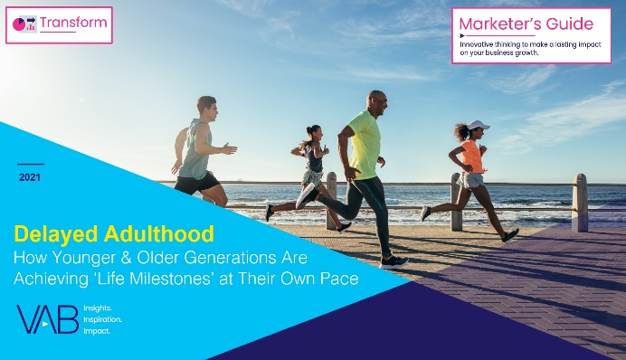









Creators
Jason Wiese
Reed Kiely
Karolina Guillen
SVP, Director of Strategic Insights
jasonw@thevab.com
Associate Insights Director
reedk@thevab.com
Insights Manager
karolinag@thevab.com
Interested in learning more? Check out this related content:
VAB Members, brand marketers and agencies get free and immediate access to VAB’s content library. Get access at theVAB.com
The Halo Effect
TV as a growth engine
Deciphering Direct-to-Consumer
An insider’s guide to America’s
fastest growing brands
Delayed Adulthood
How younger & older generations are achieving ‘life milestones’ at their own pace
Audience Migration In Context
Leveraging Population Shifts to Unlock $4 Trillion in Buying Power
An Insider’s Look
Why agencies and brands are shifting to audience-based TV buying
The VAB Top 10
A top-line view of how the industry is adopting audience-based buying
Meeting Industry Challenges
Guidance and inspiration to embracing an audience-first TV buying approach
Proven Strategies & Tactics In Audience-Based TV Buying
Success stories highlighted through real-world case studies
This information is exclusively provided to VAB members and qualified marketers. Further distribution is prohibited.
PAGE 43

Slide 44

About VAB
VAB is an insights-driven organization that inspires marketers to reimagine their media strategies resulting in fully informed decisions.
Drawing on our marketing expertise, we simplify the complexities in our industry and discover new insights that transform the way marketers look at their media strategy.
Transform
We help you build your brand by focusing on core marketing principles that will help drive tangible business outcomes.
Simplify
We save you time by bringing you the latest data & actionable takeaways you can use to inform your marketing plans.
Discover
We keep you one step ahead with the latest thinking so you can create innovative, forward-looking strategies.
We are committed to your business growth and proud to offer VAB members, brand marketers and agencies complimentary access to our continuously-growing Insights library. Get immediate access at theVAB.com.
This information is exclusively provided to VAB members and qualified marketers. Further distribution is prohibited.
PAGE 44

Slide 45
Appendix: Evolving video creative
to embrace all audiences

Slide 46


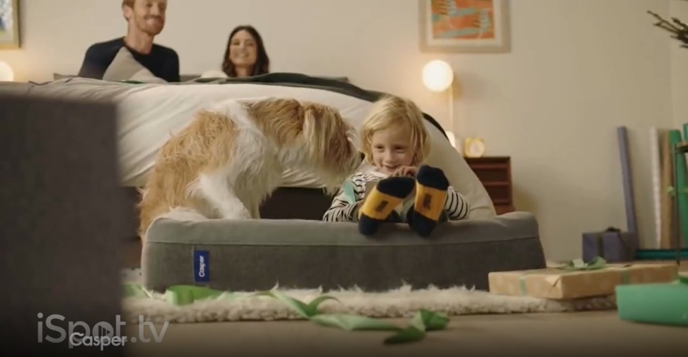







Evolving video creative: brands engaging multigenerational families
Click to return to slide 10
As ‘direct-to-consumer’ brands mature, many are now incorporating families into their creative…and brands like Vrbo, who have been using young families in their advertising, have gone a step further by featuring a three-generation family in their holiday campaign last year
(TV spot first aired: 9/4/2017)
(TV spot first aired: 11/6/2020)
(TV spot first aired: 7/4/2016)
(TV spot first aired: 7/20/2020)
(TV spot first aired: 12/26/2017)
(TV spot first aired: 11/6/2020)
(TV spot first aired: 4/24/2017)
(TV spot first aired: 4/16/2020)
Source: creative from iSpot.tv, time period of airing 1/1/16 – 3/31/21, note: each creative execution had to launch before 3/31/21 so some may still be actively airing on TV. Click above images to watch TV spots.
This information is exclusively provided to VAB members and qualified marketers. Further distribution is prohibited.
PAGE 46

Slide 47


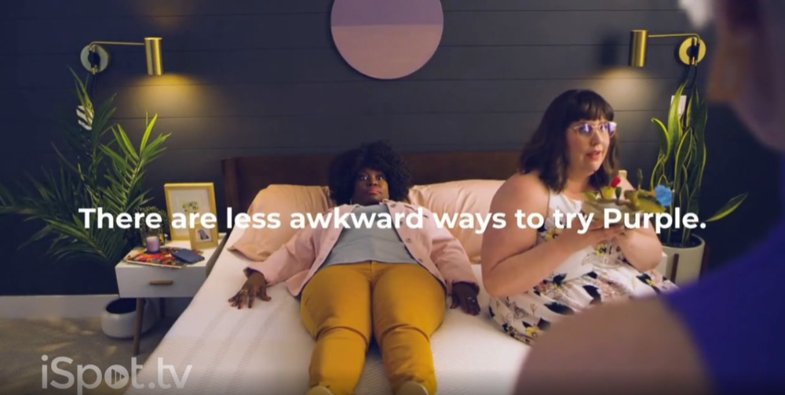
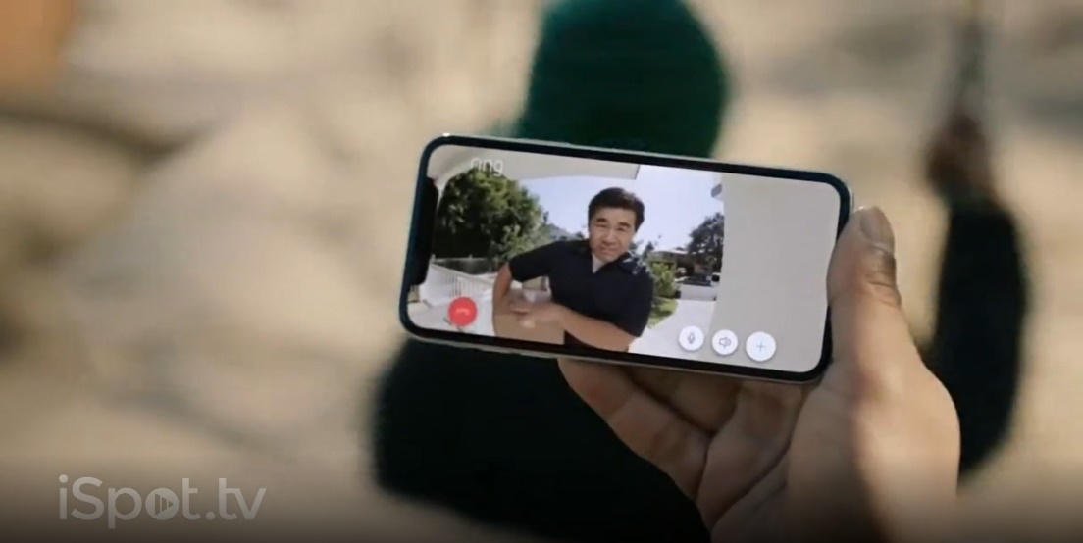





Evolving video creative: brands incorporating diversity & inclusion
Click to return to slide 10
Many brands are elevating their diversity and inclusion across multicultural and LGBTQ+ audiences within recent campaigns
(TV spot first aired: 10/14/2019)
(TV spot first aired: 12/23/2020)
(TV spot first aired: 9/8/2020)
(TV spot first aired: 4/29/2020)
(TV spot first aired: 11/6/2020)
(TV spot first aired: 7/23/2020)
Source: creative from iSpot.tv, time period of airing 1/1/17 – 3/31/21, note: each creative execution had to launch before 3/31/21 so some may still be actively airing on TV. Click above images to watch TV spots.
This information is exclusively provided to VAB members and qualified marketers. Further distribution is prohibited.
PAGE 47

Slide 48









Evolving video creative: brands developing Spanish-language creative
Click to return to slide 10
The integration of diversity and inclusion extends to the development of bilingual or Spanish-language specific campaigns, the below reflects the first Spanish-language TV ads that each of these brands aired during the measured time period
‘Descubrir nuevos productos’ TV Spot
(TV spot first aired: 3/18/2020)
‘Preparate: ligas, equipos y jugadores’ TV Spot
(TV spot first aired: 9/21/2019)
‘Comentarios’ TV Spot
(TV spot first aired: 11/20/2019)
‘Home Projects’ [Spanish] TV Spot
(TV spot first aired: 8/10/2020)
‘Millones De Hombres’ TV Spot
(TV spot first aired: 10/26/2020)
‘Los perros andan desnudos’ TV Spot
(TV spot first aired: 11/7/2018)
Source: creative from iSpot.tv, time period of airing 1/1/17 – 3/31/21, note: each creative execution had to launch before 3/31/21 so some may still be actively airing on TV. Click images above to watch TV spots.
This information is exclusively provided to VAB members and qualified marketers. Further distribution is prohibited.
PAGE 48

Slide 49



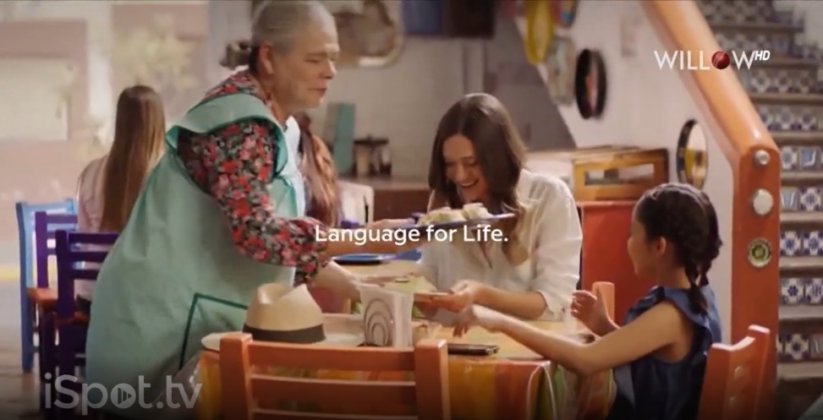




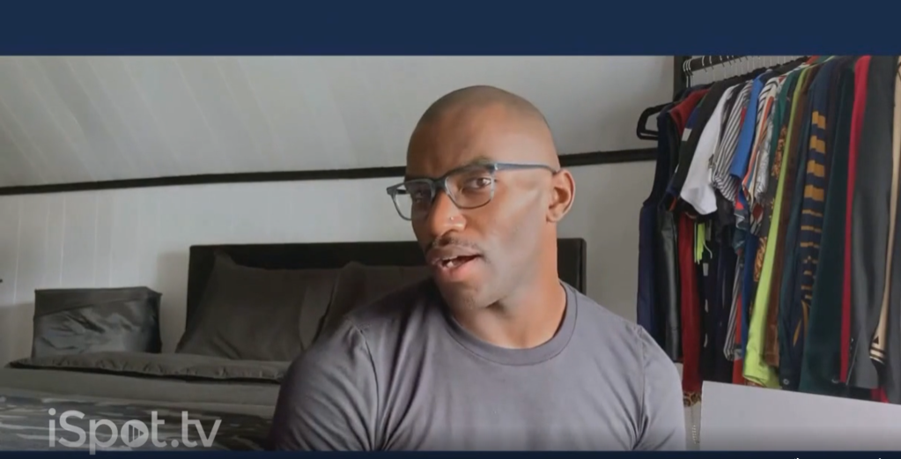
Evolving video creative: brands injecting ‘lifestyle’ into a brand’s product
Click to return to slide 10
Most brands launch their first campaign(s) with a detailed explanation of their product offering, accolades and differentiation, but several position themselves further as a ‘lifestyle’ brand in later campaigns to increase engagement with audiences that share similar attributes
(TV spot first aired: 5/30/2017)
(TV spot first aired: 8/25/2019)
(TV spot first aired: 6/10/2017)
(TV spot first aired: 3/4/2020)
(TV spot first aired: 11/2/2016)
(TV spot first aired: 11/6/2020)
(TV spot first aired: 9/3/2018)
(TV spot first aired: 10/19/2020)
Source: creative from iSpot.tv, time period of airing 1/1/16 – 3/31/21, note: each creative execution had to launch before 3/31/21 so some may still be actively airing on TV. Click above images to watch TV spots.
This information is exclusively provided to VAB members and qualified marketers. Further distribution is prohibited.
PAGE 49

Slide 50

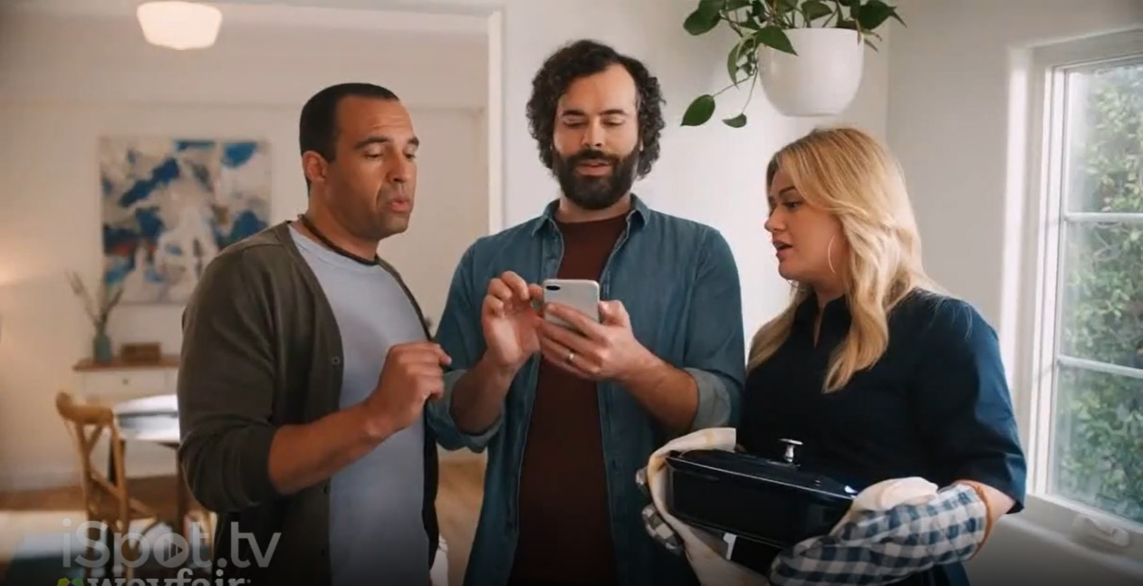

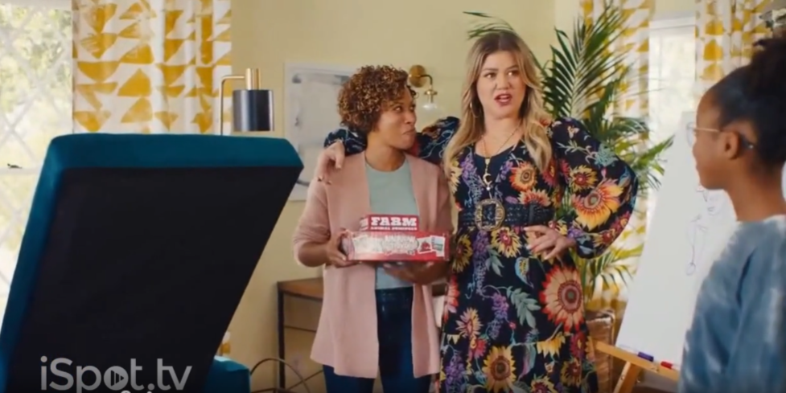
Evolving video creative: brands leveraging ‘everyday’ celebrities with wide appeal
Click to return to slide 10
Pop music has wide appeal across audiences, so brands have leveraged popular singers like Carrie Underwood and Kelly Clarkson,
who rose in popularity through TV, within recent campaigns
‘Holidays: Favorite Time of Year’ TV Spot
Ft. Carrie Underwood
(TV spot first aired: 11/12/2020)
‘Dysfunctional Kitchen’ TV Spot
Ft. Kelly Clarkson
(TV spot first aired: 2/24/2020)
‘What You Want’ TV Spot
Ft. Kelly Clarkson
(TV spot first aired First Aired: 1/11/2021)
Source: creative from iSpot.tv, time period of airing 1/1/17 – 3/31/21, note: each creative execution had to launch before 3/31/21 so some may still be actively airing on TV. Click above images to watch TV spots.
This information is exclusively provided to VAB members and qualified marketers. Further distribution is prohibited.
PAGE 50

