Slide 1



2020 – Volume VI
A Second Look
10 Slides To Help Marketers Adapt Their Plans In Today’s Landscape

Slide 2


About VAB
VAB is an insights-driven organization that inspires marketers to reimagine their media strategies resulting in fully informed decisions.
Drawing on our marketing expertise, we simplify the complexities in our industry and discover new insights that transform the way marketers look at their media strategy.
Simplify
We save you time by bringing you the latest data & actionable takeaways you can use to inform your marketing plans.
Discover
We keep you one step ahead with the latest thinking so you can create innovative, forward-looking strategies.
Transform
We help you build your brand by focusing on core marketing principles that will help drive tangible business outcomes.
This information is exclusively provided to VAB members and qualified marketers. Further distribution is prohibited.
PAGE 2

Slide 3

‘WFH’ Creates More Opportunities To Reach Consumers:
A majority of people that are working from home through the pandemic watch TV or stream content during working hours
Click here for the full report
What Are You Doing During Work Hours?
65%
56%
50%
Source: Nielsen Total Audience Report, August 2020, ‘The Nielsen Remote Workers Consumer Survey,’ a survey of 1,000 adults who worked from home prior to and during the novel coronavirus outbreak.
This information is exclusively provided to VAB members and qualified marketers. Further distribution is prohibited.
PAGE 3

Slide 4


Sports Are Back!: Most fans, especially multicultural fans, have bought a bigger TV screen at some point just so they can enjoy a better viewing experience for watching sports at home
Click here for the full report
% of Sports Fans Who Agree
All
Avid
Male
Female
Black
Hispanic
I bought a bigger TV screen just so I could have a better viewing experience for sports
63%
76%
66%
59%
68%
76%
Click here to view this session and more
For more information on sports viewer preferences, view Session 3 in our
VAB INSPIRE summer series
I watch sports on a high definition TV so I can see the action clearer
60%
66%
60%
61%
52%
61%
Whenever possible I watch sports on the largest screen available in my home
48%
54%
49%
47%
41%
46%
Source: VAB / Dynata ‘Sports Viewing Experience Survey,’ September 2019. Survey base = self-identified sports fans, P18+. Q17: Please rate how much you agree or disagree with the following statement (Top 2 Box: Somewhat Agree & Strongly Agree), Q20: Which of the following statements do you believe are true for you? Avid Fans Respondents (habitually watch sports on TV, intensely follow teams / players, etc), All Sports Fans based on P18+.
This information is exclusively provided to VAB members and qualified marketers. Further distribution is prohibited.
PAGE 4

Slide 5
OOH Viewing Extends Reach For Live Sports: People gather with their close circle since they enjoy the communal aspect of sports
More than half of fans (54%) primarily watch sports out-of-home with three or less people, which is considered ‘safe’ by pandemic guidelines for gatherings at other people’s homes and socially-distanced set-ups at restaurants and bars
Click here for the full report
What are Reasons for Viewing Sports Out-Of-Home?
Adults 18+
Click here to view this session and more
For more information on sports viewer preferences, view Session 3 in our
VAB INSPIRE summer series
Source: VAB analysis of Nielsen Fall Sports, Game On: Driving Brand Engagement and Co-Viewing On Linear TV With Out-Of-Home Audiences; 2019. Reflects multiple responses chosen from respondents in Nielsen’s Out-of-Home Fall Sports Location Survey, General Population (10/29/18-10/31/18). Survey participants were able to select responses for each viewing event, leading to a distribution of over 100%.
This information is exclusively provided to VAB members and qualified marketers. Further distribution is prohibited.
PAGE 5

Slide 6


Programming Relevant To Cultural Identity Drives Greater Engagement: People crave familiarity and, for multicultural viewers, that plays a big role in the content they connect with
Click here for the full report
% vs. Non-Hispanic White 18+
Black A18+
Hispanic A18+
Asian A18+
‘I’m more likely to watch a TV show if it is relevant to my own cultural identity’
+68%
+40%
+20%
31%
26%
22%
XX%
= % of Respondents
Source: VAB’s ‘Discover the Difference: How Culturally Relevant Video Content Drives Action By Multicultural Audiences’. VAB / Dynata ‘Multicultural Video Engagement Survey,’ August 2019. Q7: What qualities make you more likely to watch a TV program? Select any or all that apply . African American/Black/Caribbean American = 302 Respondents, Hispanic = 300 Respondents, Asian American/Pacific Islander = 100 Respondents, Non-Hispanic White = 300 Respondents.
This information is exclusively provided to VAB members and qualified marketers. Further distribution is prohibited.
PAGE 6

Slide 7





Diversity & Inclusion Ad Campaigns Increase Digital Engagement: Johnnie Walker’s inclusive campaign drove two-thirds of the brand’s total digital interactions over the last five years
Click here for the full report
On election day in 2016, Johnnie Walker released an ad entitled ‘This Land’ as part of their ‘Keep America Walking’ campaign. The spot quotes Woody Guthrie’s song ‘This Land is Your Land,’ in both English and Spanish, to spread a message of unity and inclusion. The ad offers distinct visualizations and provides an authentic representation of America’s rich cultural diversity.
Results: Viewer sentiment was overwhelmingly positive for the ad, especially considering the divisiveness of the times during the 2016 Presidential election, which helped spur high digital interactions (mainly social mentions and online video views) relative to brand spend.
Business Outcomes
Positive Sentiment: 90%
Average positive sentiment for all other Johnnie Walker ads: 80%
Digital Engagement Impact:
Although only 16% of TV spend, it resulted in 65% of total earned online activity
‘This Land’ TV spot - $5.7 MM
Airings Throughout 18 Weeks: 11/8/16 – 3/14/17
446 Airings / 222.0 MM HH IMPs
click banner above images to watch spot
Source: VAB analysis of iSpot.tv TV occurrence data and engagement analytics, time period: 1/1/16 – 6/30/20, estimated media spend. Impressions represent US TV HHs and include activity within measured national broadcast and cable TV linear, national time-shifted, local, VOD and OTT. ‘Digital Engagement Impact’ figures are based on all measured TV activity between 1/1/16 – 6/30/20. ‘Total Earned Online Activity’ = TV-driven searches, TV-driven social actions, TV-driven earned online video views.
This information is exclusively provided to VAB members and qualified marketers. Further distribution is prohibited.
PAGE 7

Slide 8


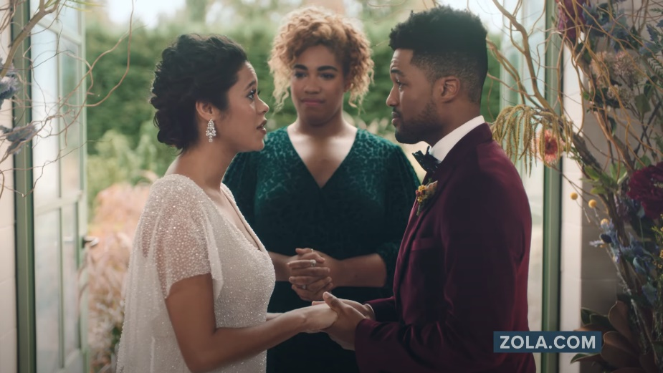
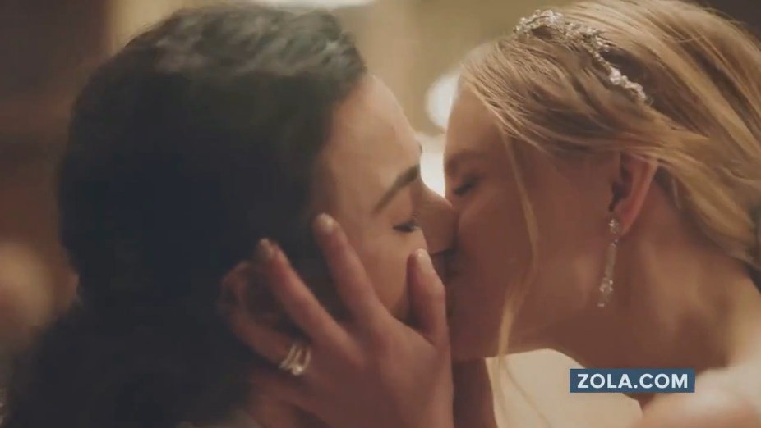
Diversity & Inclusion Ad Campaigns Drive Website Traffic:
Zola’s launch of their diversity and LGBTQ+ inclusion campaign
led to the brand’s most trafficked month ever on their website
Click here for the full report
In December 2019, Zola debuted their ‘No Regrets’ campaign which included six different spots focused specifically on diversity and LGBTQ+ inclusion. The ads show three couples who all appear to be reciting their vows but instead are stating regrets from their wedding planning, which highlights just how much people have lost touch with what matters – the couple.
Results: Zola saw their highest total monthly unique website traffic ever in January 2020, two months into the campaign launch, with 345K more digital visitors than their second highest trafficked month (January 2019). Zola was continuing their upward momentum through first quarter 2020 until COVID-19 hit.
Business Outcomes
Persons 18+ Website Traffic: +15% increase
in Zola’s two-month average unique P18+ website visitors towards the end of the campaign between Feb-Mar ‘20 (YoY comparison).
Black 18+ Website Traffic: +70% increase
in Zola’s two-month average unique Black 18+ website visitors during the same time frame period comparison
as above for P18+.
‘No Regrets’ TV spot (six creatives) - $2.7 MM
16-Week Campaign: 12/2/19 – 3/24/20
3,852 Airings / 698.1 MM HH IMPs
click image above to watch spot
click image above to watch spot
click image above to watch spot
Source: VAB analysis of iSpot.tv TV occurrence data, time period: 1/1/19 – 6/30/20, estimated media spend. Impressions represent US TV HHs and include activity within measured national broadcast and cable TV linear, national time-shifted, local, VOD and OTT. VAB analysis of Comscore mediametrix multiplatform media trend data (desktop and mobile), P18+, Black 18+, January ‘19 – March ‘20. Comparisons reflect January ‘20 vs. January ‘19 and February-March ‘20 vs. February-March ‘19.
This information is exclusively provided to VAB members and qualified marketers. Further distribution is prohibited.
PAGE 8

Slide 9

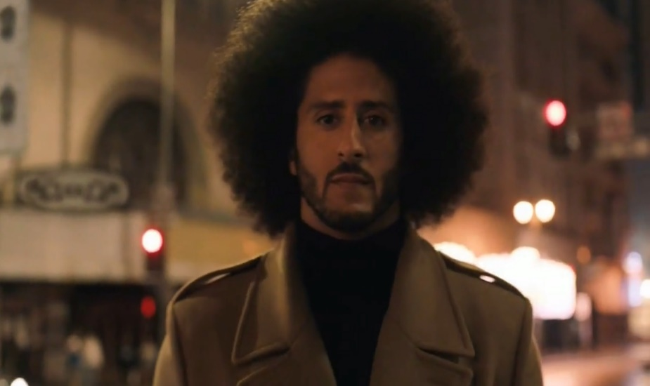
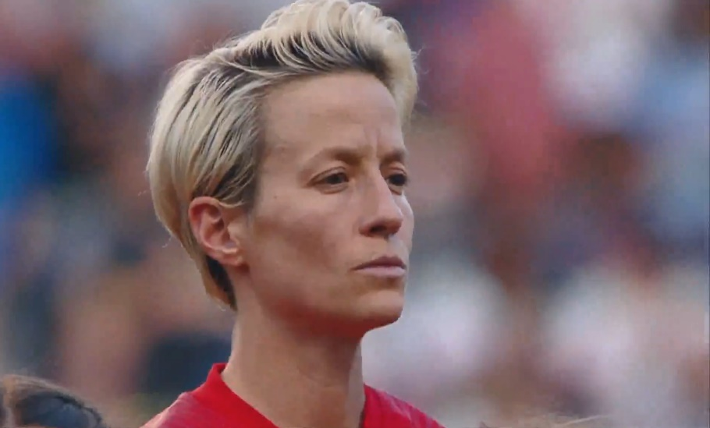
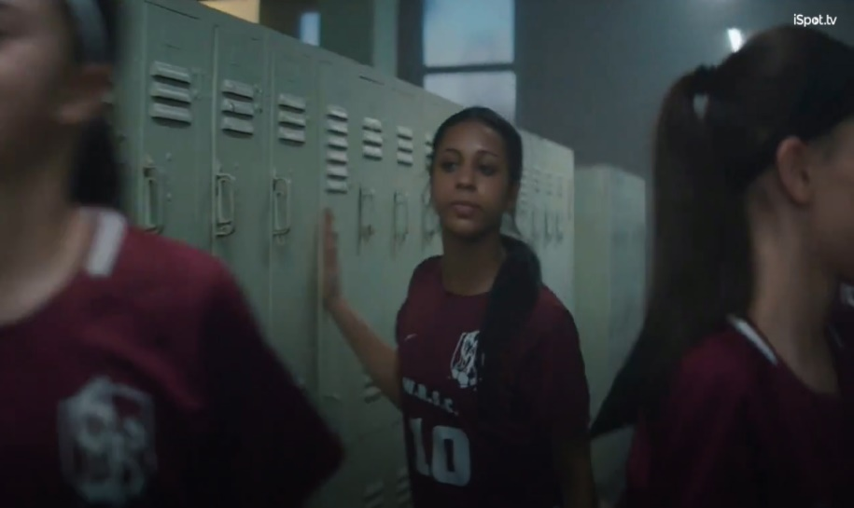
Diversity & Inclusion Ad Campaigns Deliver Sales Growth:
Nike saw record-breaking sales each quarter since the launch of their ‘Dream Crazy’ campaign featuring Colin Kaepernick
Click here for the full report
In September 2018, Nike released their first in a series of ‘Dream’ spots for their on-going ‘Just Do It’ campaign. The first ad (‘Dream Crazy’) featured controversial NFL star turned social activist, Colin Kaepernick, who remarked ‘believe in something, even if it means sacrificing everything.’ The ads celebrate the rich diversity found in sports through the collection of stories that represent athletes who are household names and those that should be (including 29-year old basketball wheelchair athlete Megan Blunk and Isaish Bird, a 10-year old wrestler born without legs).
Results: Nike launched the ‘Dream Crazy’ ad at the beginning of their 3rd quarter and proceeded to see their highest 3Q revenues ever at that point and their highest year-over-year growth in any quarter in over two and a half years. Record-breaking quarterly sales have continued in each successive quarter through our evaluation period (ending Feb ‘20).
Business Outcomes
North America Quarterly Revenue Comparison:
Sep-Nov ‘18 (‘Dream Crazy’ launch) vs. PY: +9%
Dec ‘18-Feb ‘19 vs. PY:+7%
Mar-May ‘19 (‘Dream Crazier’ active) vs. PY: +7%
Jun-Aug ‘19 (‘Dream Us’ active) vs. PY: +4%
Sep-Nov ‘19 vs. PY: +5%
‘Dream Crazy / Dream Crazier / Dream With Us’ TV spots (five creatives) - $21.7 MM
14-Month Campaign: 9/6/18 – 10/23/19
683 Airings / 371.1 MM HH IMPs
click image above to watch spot
click image above to watch spot
click image above to watch spot
PY = Previous Year (same quarter)
Source: VAB analysis of iSpot.tv TV occurrence data, time period: 1/1/18 – 6/30/20, estimated media spend. Impressions represent US TV HHs and include activity within measured national broadcast and cable TV linear, national time-shifted, local, VOD and OTT. Revenues are based on quarterly company filings (10-Q) for North American revenue (Nike does not report at the United States geographical level) via SEC.gov (EDGAR), revenues reflect Nike brands and excludes Converse.
This information is exclusively provided to VAB members and qualified marketers. Further distribution is prohibited.
PAGE 9

Slide 10
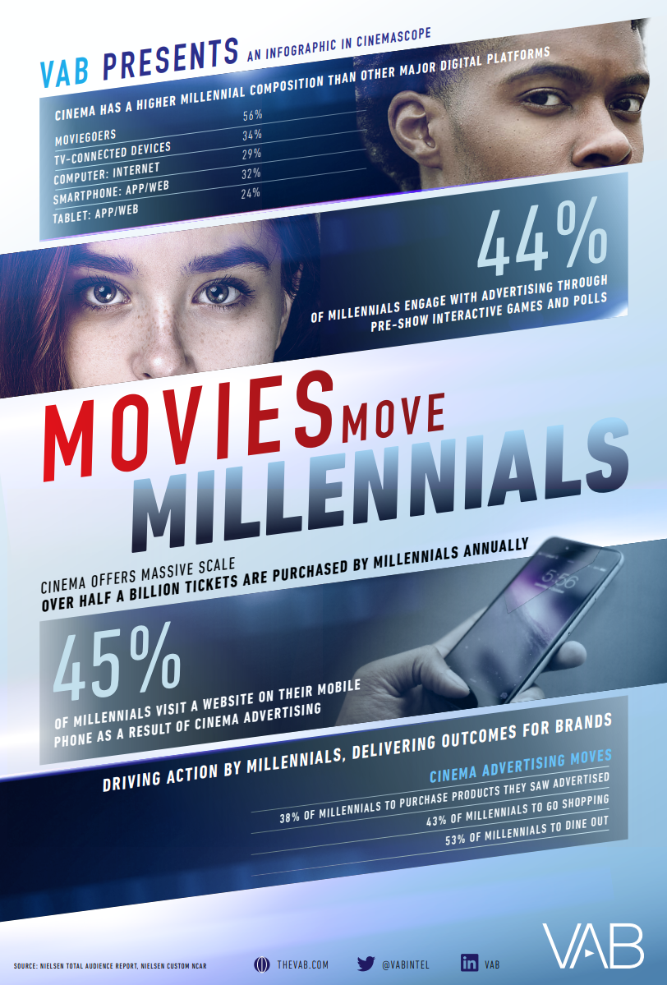
Movie Theaters Are
Re-Opening Across
The Country:
Cinema advertising drives meaningful action by millennials which delivers outcomes for brands
Click here to download infographic
This information is exclusively provided to VAB members and qualified marketers. Further distribution is prohibited.
PAGE 10

Slide 11







The Pandemic Has Accelerated Growth In Smart TV and Streaming Devices: Consumers’ in-home data usage has increased by double-digits as cross-platform viewing expands across devices
Click here for the full report
Percent Change in Average Monthly In-Home Data Usage by Device
2019 vs 2020 – Gigabytes Received
Click here to view this session and more
Streaming Box / Stick
Gaming Console
For more information on video streaming trends, view
Session 1 in our
VAB INSPIRE summer series
Phone
Smart TV
Tablet
January
+21%
+26%
+24%
+18%
+6%
February
+27%
+22%
+21%
+15%
+12%
March
+43%
+41%
+36%
+24%
+15%
Source: Parks Associates via Advanced Television, May 20, 2020. Comscore, April 2020. Comscore Total Home Panel Custom Reporting, March 2019 – March 2020.
This information is exclusively provided to VAB members and qualified marketers. Further distribution is prohibited.
PAGE 11

Slide 12


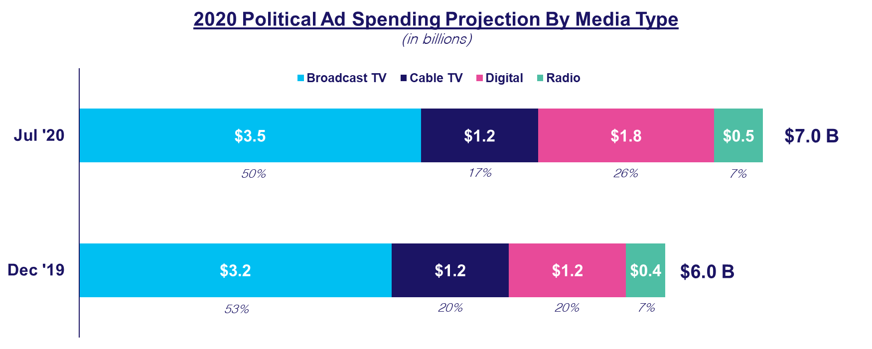
Connected TV & OTT Is Seeing Significant Spend From Political: While TV is forecast to account for two-thirds of spend, much of the digital growth is projected to come from Connected TV / OTT
Click here for the full report
Click here to view this session and more
For more information on how ‘Share Of Voice’ impacts election outcomes, view Session 2 in our
VAB INSPIRE summer series
Dec ‘19 & Jul ‘20 represents the time period of spending forecasts released by Kantar Media
Source: VAB analysis of Kantar Media projections including ‘Political Advertising Trends: What To Expect In 2020’ (Kantar, Dec ‘19) and ‘How Many Political Ads Does $7 Billion Buy? We’re About To Find Out’ (Wall Street Journal, 7/10/20, based on Kantar data).
This information is exclusively provided to VAB members and qualified marketers. Further distribution is prohibited.
PAGE 12

Slide 13
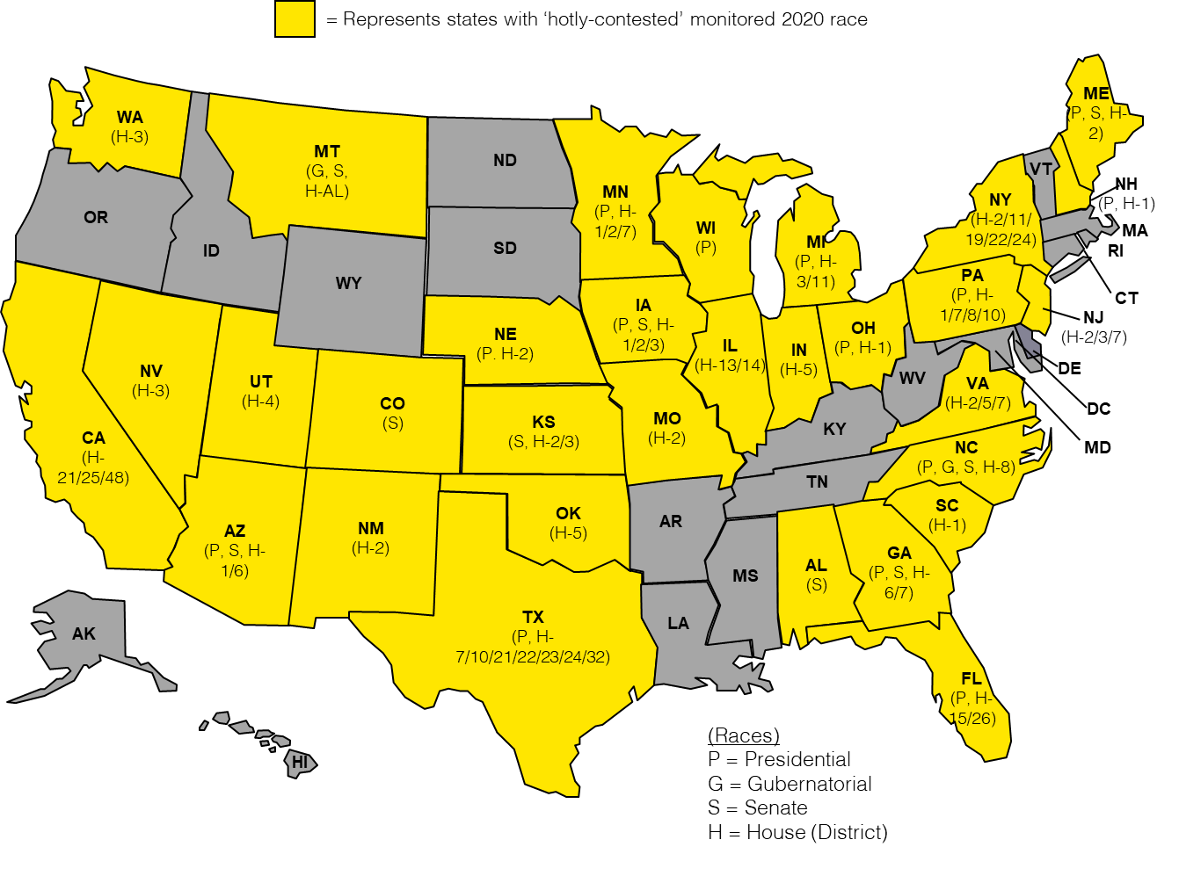
In Addition To The Presidential Race, The Election Cycle Features 70 ‘Hotly Contested’ Races Across 30 States: Heavy political spending by candidates and PACs is anticipated in these markets
Click here for the full report
Bonus Slide!
Click here to view this session and more
For more information on how ‘Share Of Voice’ impacts election outcomes, view Session 2 in our
VAB INSPIRE summer series
Presidential = ‘toss up’ and ‘lean’ states
70 Non-Presidential ‘Hotly Contested 2020 Races:
Gubernatorial: two races
Senate: 10 races
House of Representatives: 58 races
Source: VAB analysis of Cook Political 2020 ratings, ‘Hotly-Contested’ races are ‘Toss-Up’ or ‘Lean’ ratings based on the latest available ratings date for the 2020 elections: Presidential (7/13/20), Gubernatorial (4/3/20), US Senate (6/18/20) and US House of Representatives (7/16/20).
This information is exclusively provided to VAB members and qualified marketers. Further distribution is prohibited.
PAGE 13

Slide 14





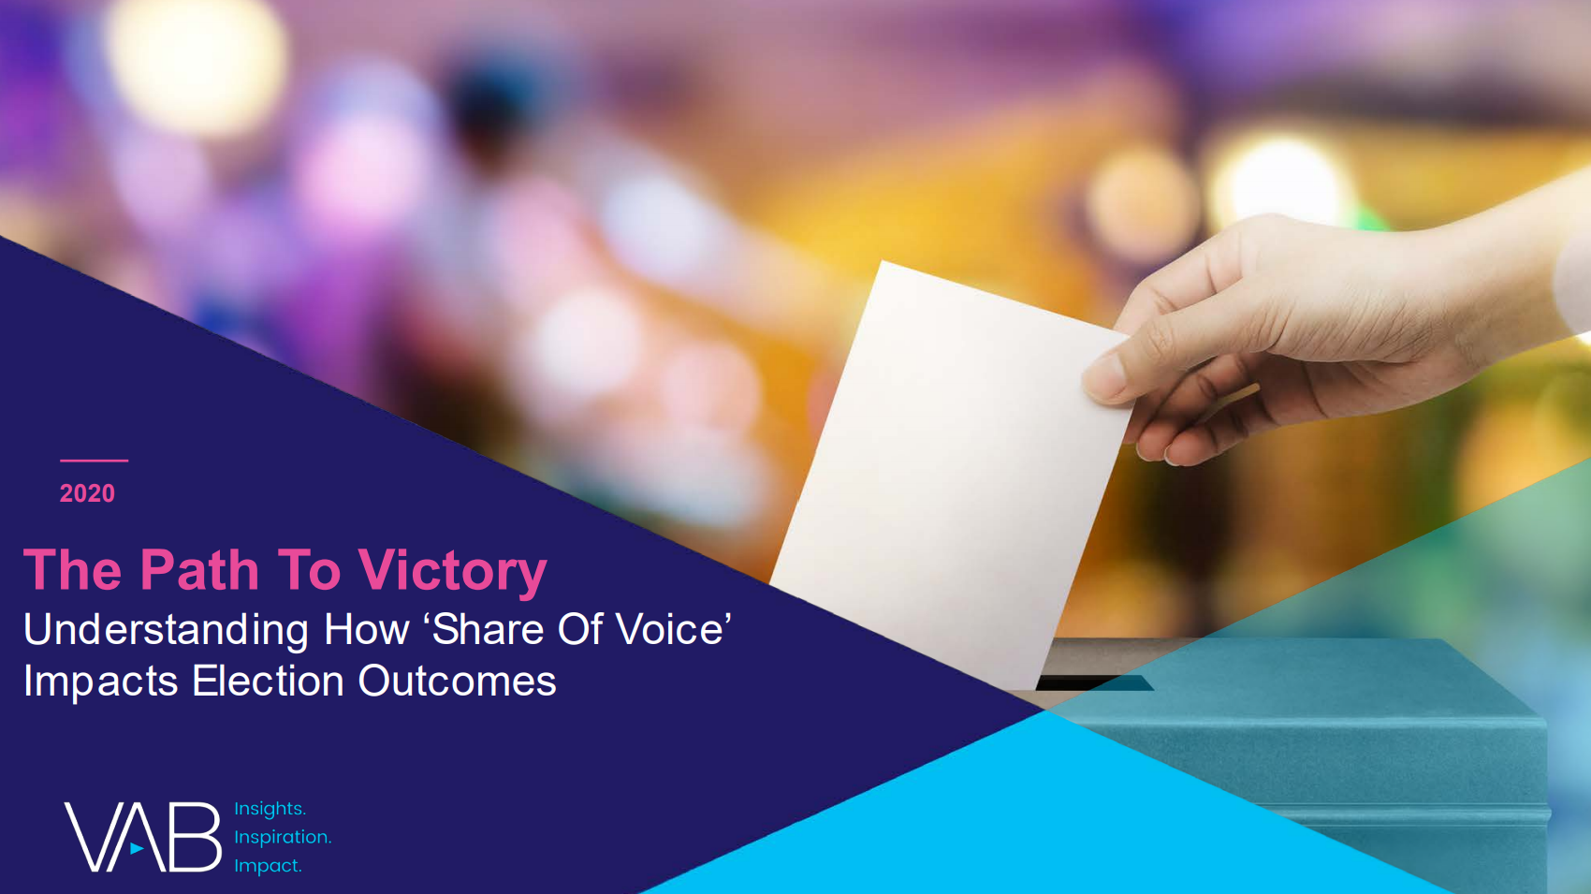

Thank You
Creators
Leah Montner-Dixon
Reed Kiely
Karolina Guillen
Insights Manager
leahm@thevab.com
Insights Manager
reedk@thevab.com
Senior Insights Analyst
karolinag@thevab.com
Interested in learning more? Check out this related content:
Left To Your Own Devices
- Q1 2020
Understanding Consumption In Today’s Connected World
The Best Seats In The House
Recreating The Gameday Sports Experience At Home
A Matter of Principle
Reassessing Your Strategy in Today’s Environment
Do The Right Thing
How Diversity & Inclusion Drives Brand Outcomes
Movies Move Millennials
Cinema Ads Inspire Millennial Action
Navigating the Flood
Charting Your Way Through Today’s Streaming Ecosystem
The Path To Victory
Understanding How ‘Share Of Voice’ Impacts Election Outcomes
This information is exclusively provided to VAB members and qualified marketers. Further distribution is prohibited.
PAGE 14

Slide 15

Get immediate access to the VAB Insights library
We’ve answered hundreds of marketers’ questions.
Our guides, reports, webinars and videos provide actionable insights to help marketers navigate today’s video landscape and think differently about their strategy.
We are committed to your business growth and proud to offer brand marketers and agencies complimentary access to our continuously-growing Insights library.
Get Access at theVAB.com or visit us here
This information is exclusively provided to VAB members and qualified marketers. Further distribution is prohibited.
PAGE 15

