Slide 1


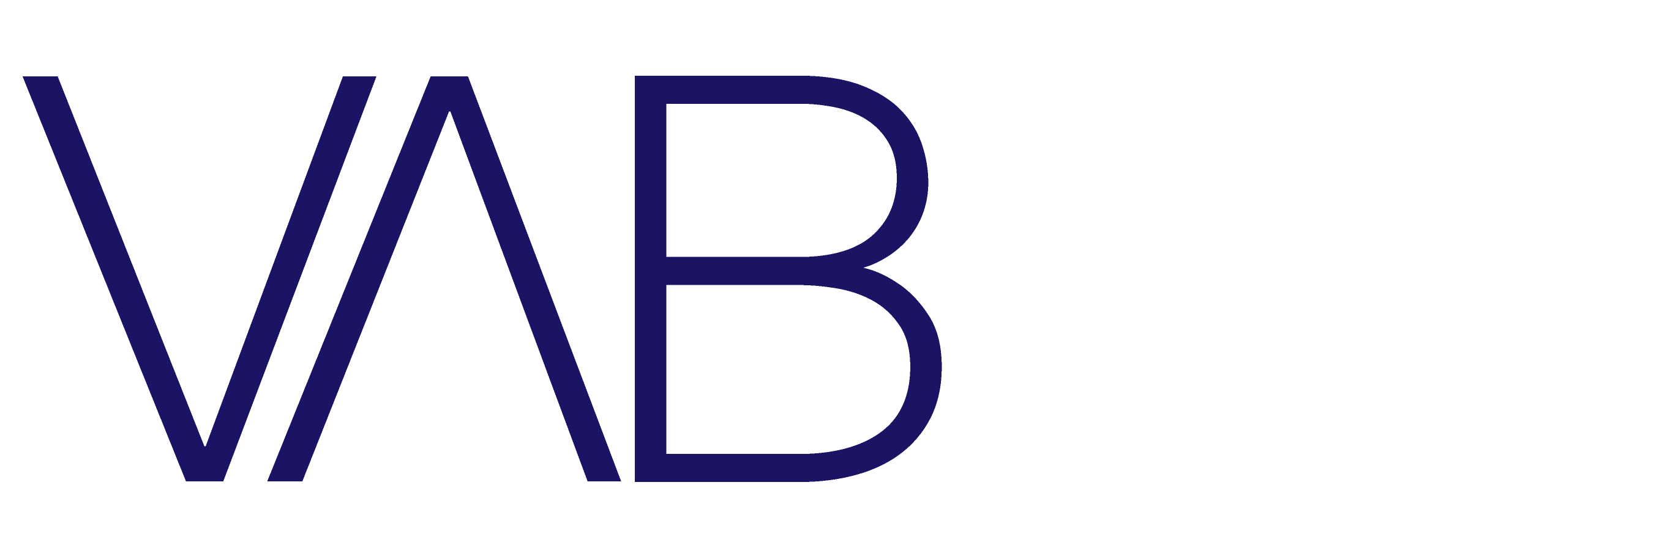
2020 – Volume VII
A Second Look
10 Slides to Help Marketers Extend Reach Through Video Streaming

Slide 2


About VAB
VAB is an insights-driven organization that inspires marketers to reimagine their media strategies resulting in fully informed decisions.
Drawing on our marketing expertise, we simplify the complexities in our industry and discover new insights that transform the way marketers look at their media strategy.
Simplify
We save you time by bringing you the latest data & actionable takeaways you can use to inform your marketing plans.
Discover
We keep you one step ahead with the latest thinking so you can create innovative, forward-looking strategies.
Transform
We help you build your brand by focusing on core marketing principles that will help drive tangible business outcomes.
This information is exclusively provided to VAB members and qualified marketers. Further distribution is prohibited.
PAGE 2

Slide 3

Even before the pandemic, rising interest in TV-related tech attributed to the growth in video streaming services, with household reach increasing 11% from January to March 2020
Click here for the full report
+11%
+11%
Source: Comscore, April 2020.
This information is exclusively provided to VAB members and qualified marketers. Further distribution is prohibited.
PAGE 3

Slide 4
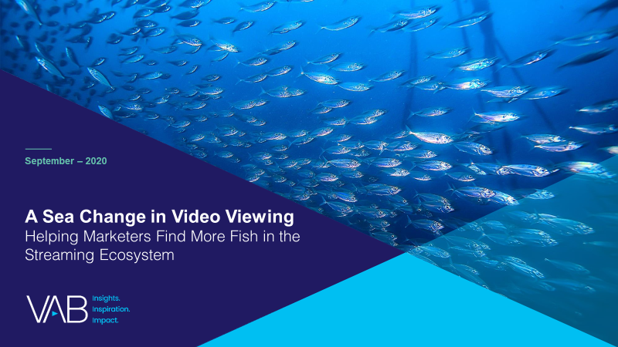

With more ‘free’ time during the pandemic, video streaming has become a habitual, daily activity for over half of adults 18-44
and households with children
Click here for the full report
On average, how many times per week do you watch a video streaming service?
Source: VAB / Lucid ‘COVID-19 Streaming Behavior Survey,’ June 2020. Survey base: A18+ in households with access to streaming services and have viewed content on streaming services (n=1,000). S3. On average, how many times per week do you watch a video streaming service? (e.g., Netflix, Disney +, Tubi, Hulu, CBS All Access, etc.)
This information is exclusively provided to VAB members and qualified marketers. Further distribution is prohibited.
PAGE 4
PAGE 1

Slide 5
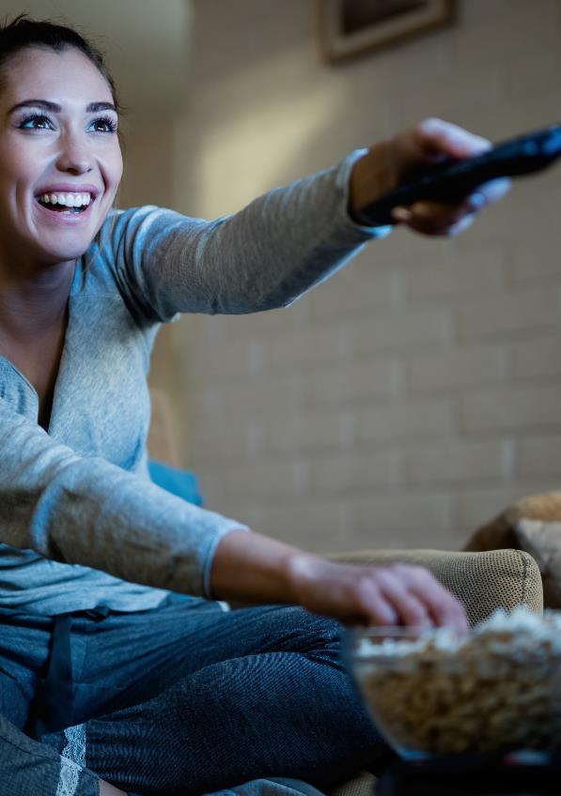
Viewers’ access to more services has risen as streaming usage increases – over one-third of AVOD users now have access to
4 or more services
Click here for the full report
How many streaming services does your household currently have access to?
Source: VAB / Lucid ‘COVID-19 Streaming Behavior Survey,’ June 2020. Survey base: A18+ in households with access to streaming services and have viewed content on streaming services (n=1,000). Q2. How many streaming services does your household currently have access to? AVOD Users = respondents who regularly watch free subscription streaming services with commercials (e.g., Crackle, Pluto TV, Tubi TV) (n= 298).
This information is exclusively provided to VAB members and qualified marketers. Further distribution is prohibited.
PAGE 5
PAGE 1

Slide 6
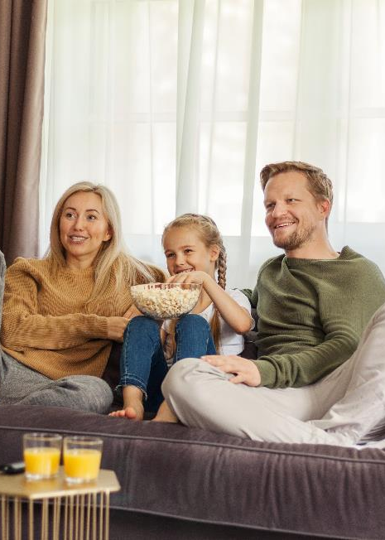
Due to heightened interest and attention during COVID-19, trial and adoption of AVOD services accelerated, with 1 in 4 viewers stacking AVOD subscriptions on top of paid
Click here for the full report
27%
of SVOD users also subscribe to AVOD services
75%
of AVOD users also access SVOD services
Source: VAB / Lucid ‘COVID-19 Streaming Behavior Survey,’ June 2020. Survey base: A18+ in households with access to streaming services and have viewed content on streaming services (n=1,000). Q5. Which of the following streaming service types do you watch regularly? Does not equal 100% due to the ability to choose multiple responses. AVOD Users = respondents who regularly watch free subscription streaming services with commercials (e.g., Crackle, Pluto TV, Tubi TV) (n= 298). SVOD Users = respondents who regularly watch paid subscription streaming services with no commercials (e.g., Netflix, Disney+) (n= 817).
This information is exclusively provided to VAB members and qualified marketers. Further distribution is prohibited.
PAGE 6

Slide 7



Nearly 4 in 10 AVOD users wish there were more free streaming video services because of their desire for even more premium original and library content on demand
Click here for the full report
Which of the following statements about streaming video content do you agree with?
% of respondents who agree completely
AVOD Users
72%
“I like the large selection of TV shows and movies they offer”
67%
“I like having access to every show, past or present”
58%
“I enjoy the original content the service offers”
Source: VAB / Lucid ‘COVID-19 Streaming Behavior Survey,’ June 2020. Survey base: A18+ in households with access to streaming services and have viewed content on streaming services (n=1,000). Q3. When thinking about streaming video services, how much do you agree with the following statements? Does not equal 100% due to the ability to choose multiple responses. AVOD Users = respondents who regularly watch free subscription streaming services with commercials (e.g., Crackle, Pluto TV, Tubi TV) (n= 298). Q10.Which of the following statements describe your views on free streaming services? (e.g., Tubi, Pluto, Crackle , etc.)
This information is exclusively provided to VAB members and qualified marketers. Further distribution is prohibited.
PAGE 7

Slide 8
AVOD users are not deterred by advertising, in fact they acknowledge that ads make their viewing experience more affordable
Click here for the full report
Which of the following statements about streaming video content do you agree with?
% of respondents who agree completely
“I appreciate the fact that ads are making this service cheaper for me”
“I don’t mind seeing ads in free streaming programming”
AVOD Users
AVOD Users
53%
35%
A18-34
A35-54
A18-34
A35-44
41%
35%
25%
30%
Source: VAB / Lucid ‘COVID-19 Streaming Behavior Survey,’ June 2020. Survey base: A18+ in households with access to streaming services and have viewed content on streaming services (n=1,000). Q10. Which of the following statements describe your views on free streaming services? Q12. Which of the following statements about advertisements that appear in streaming services that have ads do you agree with? Does not equal 100% due to the ability to choose multiple responses. AVOD Users = respondents who regularly watch free subscription streaming services with commercials (e.g., Crackle, Pluto TV, Tubi TV) (n= 298).
This information is exclusively provided to VAB members and qualified marketers. Further distribution is prohibited.
PAGE 8

Slide 9
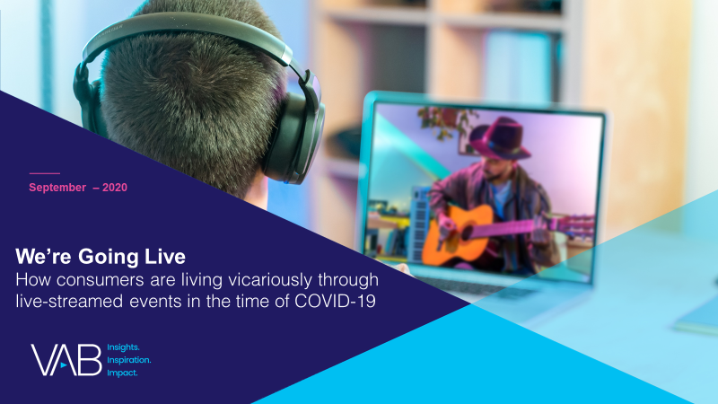


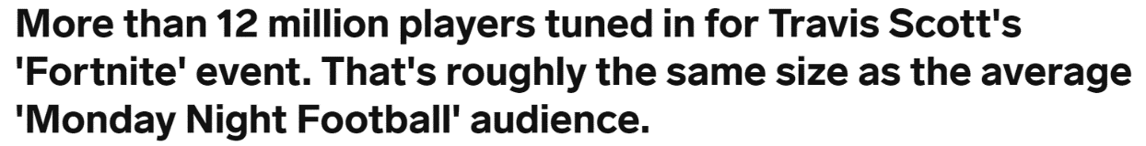

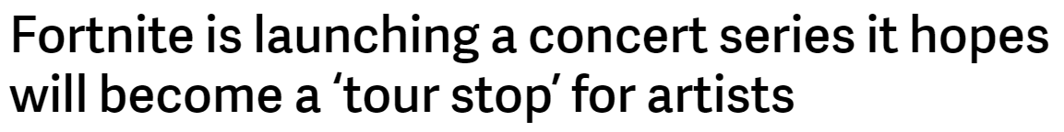
Due to restrictions around large gatherings, livestreaming has grown in popularity and is creating more ad opportunities
Nearly one-third of all adults are tuning in and enjoying the livestream of events like Travis Scott’s ‘Fortnite’ concert
Click here for the full report
“I have livestreamed concerts and / or events
while in quarantine”
% who agree
April 24th, 2020
September 8th, 2020
Source: VAB / Lucid ‘COVID-19 Streaming Behavior Survey,’ June 2020. Survey base: P18+ in households with access to streaming services and have viewed content on streaming services within the past seven days (n=1,000). Q14.When thinking about livestreaming, by which we mean: streaming a program online live as it happens (e.g., Concert - One World: Together at Home, Sporting Event – Virtual NFL Draft) - which of the following statements do you feel apply to you?
This information is exclusively provided to VAB members and qualified marketers. Further distribution is prohibited.
PAGE 9
Notes:
Actual reach

Slide 10



Livestreaming as a format is poised for even greater growth as more events become virtual and, in a post-pandemic world, more virtual experiences are created as a complement to live, in-person events
Click here for the full report
“I haven’t livestreamed an event or concert, but would consider if there was something that interested me”
% who agree
37%
42%
29%
P18+
P18-24
Single
Source: VAB / Lucid ‘COVID-19 Streaming Behavior Survey,’ June 2020. Survey base: P18+ in households with access to streaming services and have viewed content on streaming services within the past seven days (n=1,000). Q14.When thinking about livestreaming, by which we mean: streaming a program online live as it happens (e.g., Concert - One World: Together at Home, Sporting Event – Virtual NFL Draft) - which of the following statements do you feel apply to you?
This information is exclusively provided to VAB members and qualified marketers. Further distribution is prohibited.
PAGE 10
Notes:
Potential reach

Slide 11
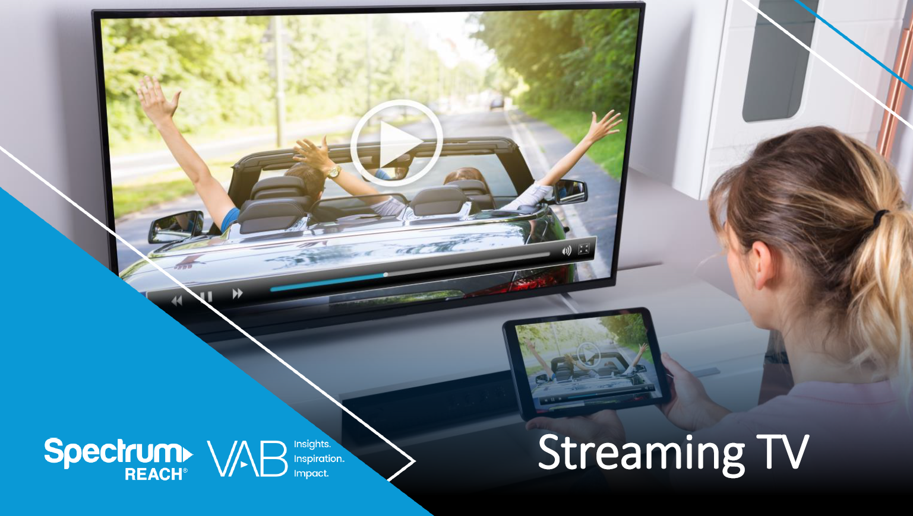
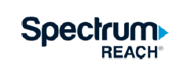
Combining streaming and linear TV within an ad campaign can drive double-digit increases in incremental reach and frequency for advertisers
Click here for the full report
+17%
STV
TV
On average, adding Streaming TV to a Linear campaign will deliver an incremental 17% lift in Reach*
The average Frequency of a Multiscreen campaign is 14, compared to an 8 with TV only, and a 5 with Streaming TV only*
Source: Spectrum Reach, Streaming TV, 2020. Spectrum Reach AM Campaign Data. Date – 1st & 2nd Quarter 2020. O&O Only. *Includes all campaigns with Streaming TV & Linear. N = Total Campaigns – 1,202. Linear = 85% Reach / Streaming TV = 20% Reach. Duplication = 6%. Streaming TV Life - % of new HHs reached.
This information is exclusively provided to VAB members and qualified marketers. Further distribution is prohibited.
PAGE 11

Slide 12
With the significant growth in ad-supported streaming creating more available inventory, revenues are projected to more than double over the next five years
Click here for the full report
+120%
Source: Digital TV Research via Cynopsis Media (North American AVOD Revenues), May 19, 2020.
This information is exclusively provided to VAB members and qualified marketers. Further distribution is prohibited.
PAGE 12

Slide 13

Creators
Leah Montner-Dixon
Reed Kiely
Karolina Guillen
Insights Manager
leahm@thevab.com
Insights Manager
reedk@thevab.com
Senior Insights Analyst
karolinag@thevab.com
Interested in learning more? Check out this related content:
Navigating the Flood
Charting Your Way Through Today’s Streaming Ecosystem
A Sea Change in Video Viewing
Helping Marketers Find More Fish in the Streaming Ecosystem
We’re Going Live
How Consumers Are Living Vicariously Through Live-Streamed Events in the Time of COVID-19
Multiscreen TV and Local Advertising
Spectrum Reach
This information is exclusively provided to VAB members and qualified marketers. Further distribution is prohibited.
PAGE 13

Slide 14
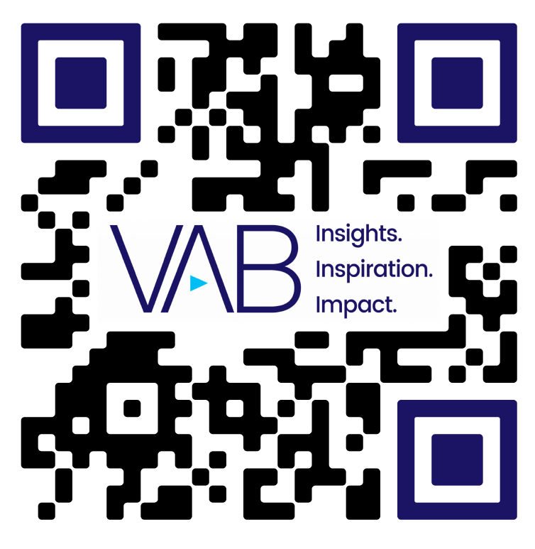
Get immediate access to the VAB Insights library
We’ve answered hundreds of marketers’ questions.
Our guides, reports, webinars and videos provide actionable insights to help marketers navigate today’s video landscape and think differently about their strategy.
We are committed to your business growth and proud to offer brand marketers and agencies complimentary access to our continuously-growing Insights library.
Get Access at theVAB.com or visit us here
This information is exclusively provided to VAB members and qualified marketers. Further distribution is prohibited.
PAGE 14

